Slide 1
Gestational Hyperandrogenism
Dr. Zahra Ghasemzade
Endocrine Fellow
Research Institute Of Endocrine Sciences
Shahid Beheshti University Of Medical Science
Tir 1394 – July 2015

Slide 2
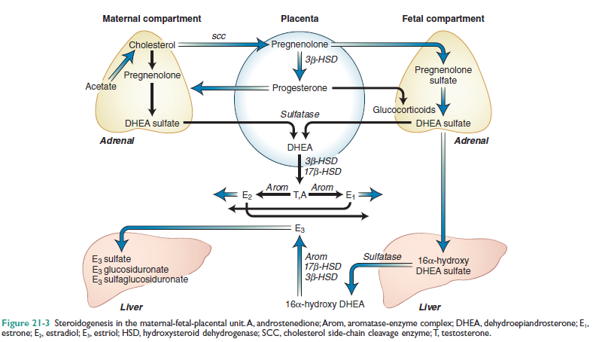

Slide 3
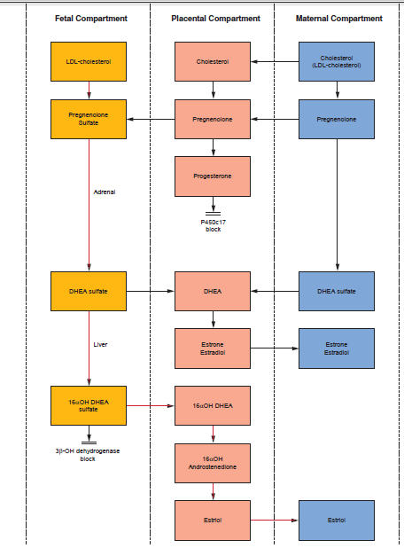

Slide 4
Maternal Compartment | Change
Free testosterone | Modest increase until the third trimester when the level doubles
Total testosterone | Increases progressively throughout pregnancy
Androstenedione | Increases primarily in late pregnancy
Dihydrotestosterone | Increases progressively throughout pregnancy
Sex hormone binding globulin | Increases markedly by the second trimester and remains elevated through term
Dehydroepiandrosterone | Modest increase in early pregnancy and then remains stable through term
Dehydroepiandrosterone sulfate | Marked decrease in second trimester and continues to fall until delivery
3alpha17beta androstanediol glucuronide | Increased in pregnancy

Slide 5
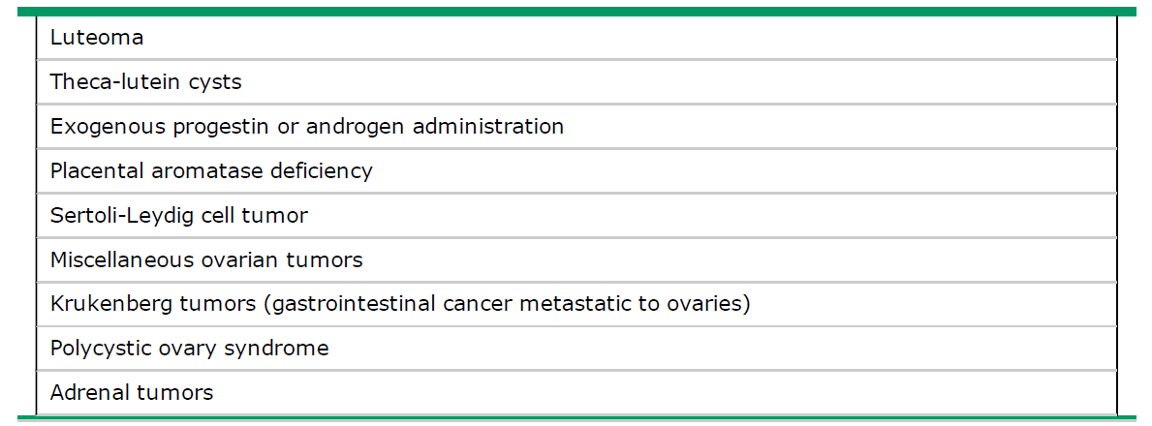
Causes of gestational hyperandrogenism

Slide 6
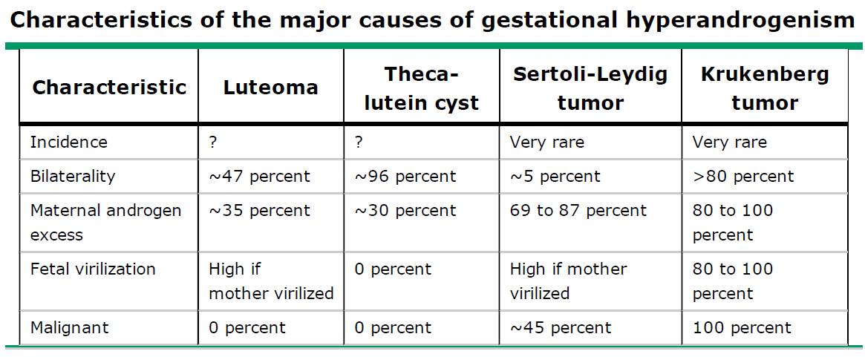
Characteristics of the major causes of gestational hyperandrogenism

Slide 7
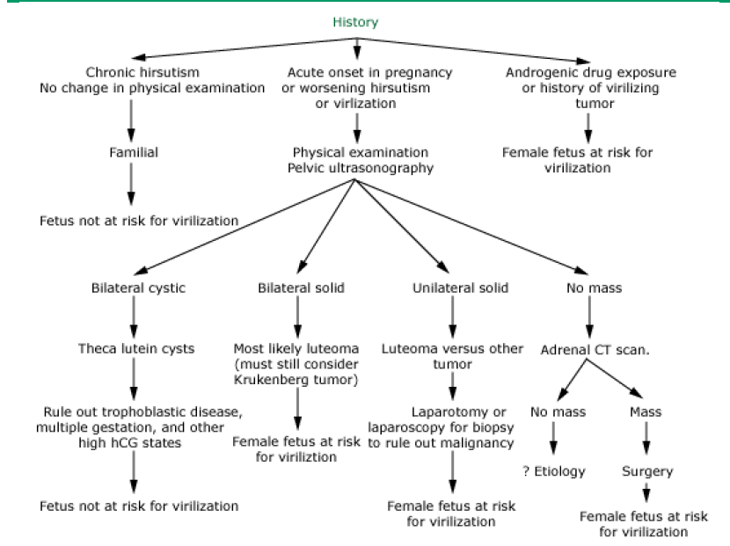
Diagnosis and management of hirsutism or virilization in pregnancy

Slide 8
Theca lutein cyst
Theca lutein cysts (TLC), also known as hyperreactio luteinalis (HL), are a type of functional ovarian cyst. They are typically multiple and bilateral
The cysts are usually large (2-3 cm) and have a typical multilocular cystic appearance across all imaging techniques.
Ultrasound
Bilateral enlarged, multicystic ovaries. The cysts are classically thin walled and have clear contents. There is large amount of solid component which is possibly the residual ovarian stroma.

Slide 9
gestational trohpoblastic disease
hydatidiform mole
invasive mole
Choriocarcinoma
placental site trophoblastic tumour
epithelioid trophoblastic tumour
multifetal pregnancy
diabetes mellitus
Theca lutein cysts (TLC)
ovulation induction
normal uncomplicated pregnancy
Chronic renal failure
polycystic ovarian syndrome
clomiphene intake

Slide 10
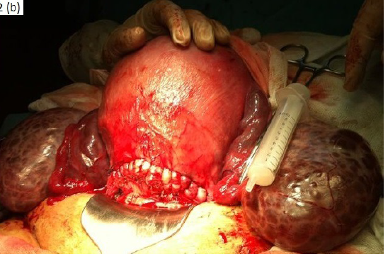
Gestational hyperandrogenism:
A case report
A 34 weeks pregnant applied for generalized itching and rashes. Her examination was detected common acneiform eruptions, temporal alopecia, hirsuitism and deepening of the voice.
Modified Ferriman-Gallwey hirsutism score was found as 20. Her serum total testosterone level was 3162.87 ng/dl (14.2-73.1) and β-HCG was 461928.1 nU/ml.
Her ultrasound was demonstrated bilateral ovarian multicystic appearance and she was diagnosed as gestational bilateral ovarian theca-lutein cysts .

Slide 11

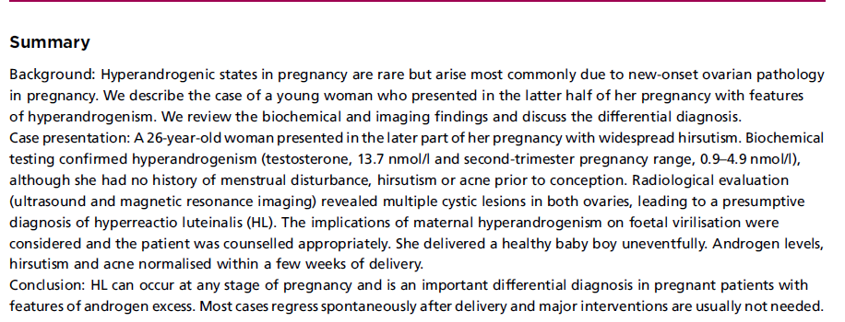
Late presentation of hyperandrogenism in pregnancy: clinical features and differential diagnosis

Slide 12
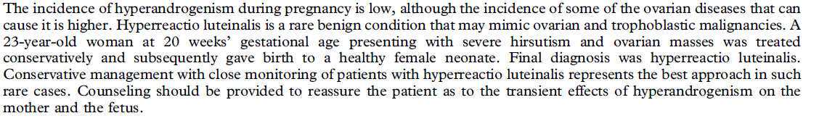
Hirsutism and hyperandrogenism associated with hyperreactio luteinalis in a singleton pregnancy:
A case report

Slide 13
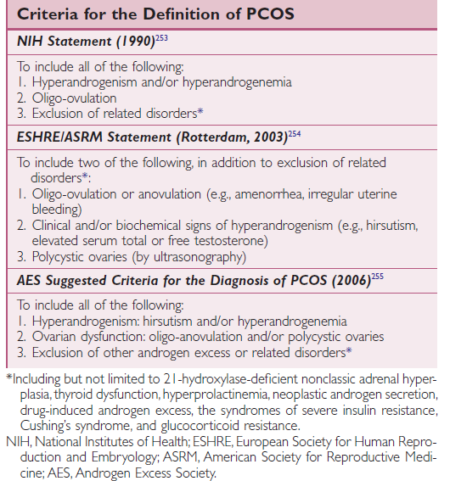
*Including but not limited to 21-hydroxylase-deficient nonclassic adrenal hyperplasia,
thyroid dysfunction, hyperprolactinemia, neoplastic androgen secretion,
drug-induced androgen excess, the syndromes of severe insulin resistance,
Cushing’s syndrome, and glucocorticoid resistance.
NIH, National Institutes of Health; ESHRE, European Society for Human Reproduction
and Embryology; ASRM, American Society for Reproductive Medicine;
AES, Androgen Excess Society.

Slide 14
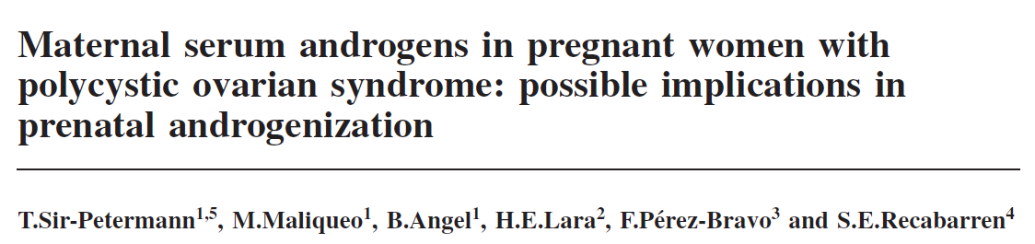
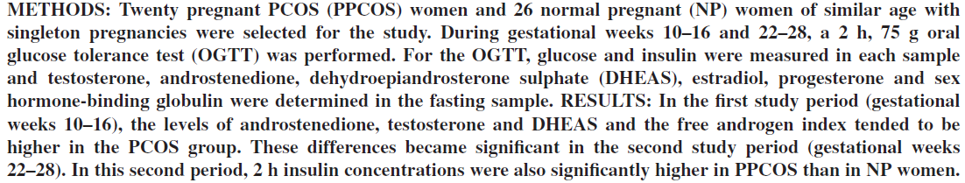

Slide 15
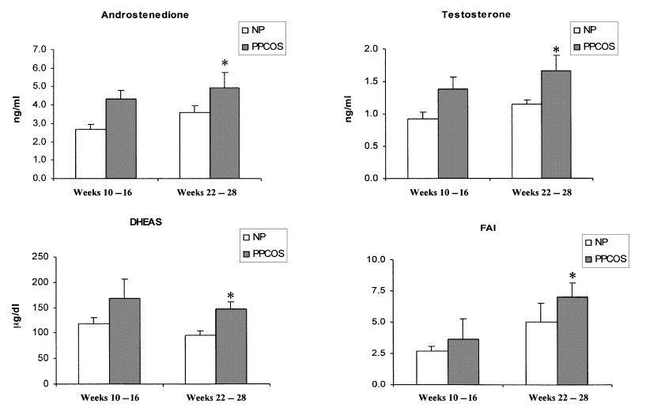
CONCLUSIONS:
The present study demonstrates a significant increase in androgen concentrations during pregnancy in PCOS women. We propose that these androgen concentrations could provide a potential source of
androgen excess for the fetus, without leading to fetal virilization.

Slide 16
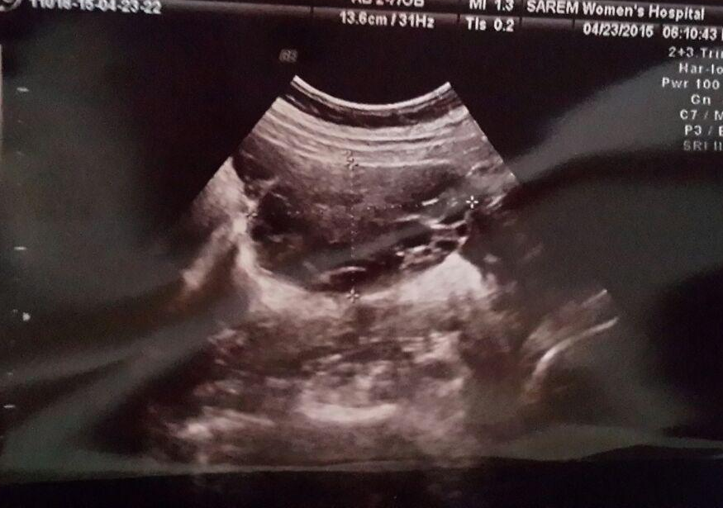
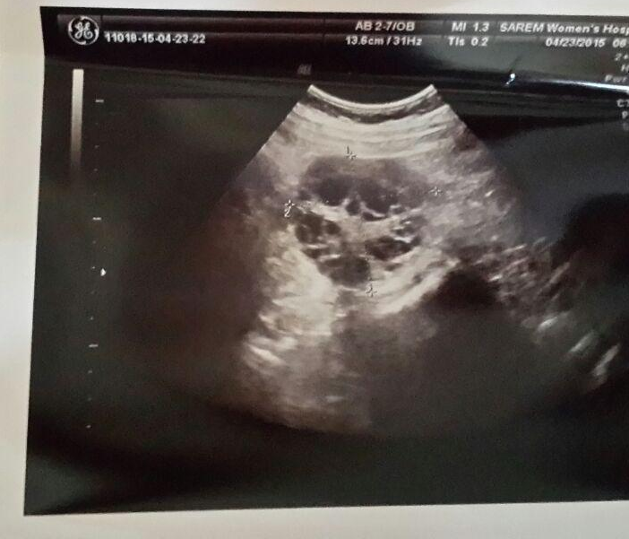
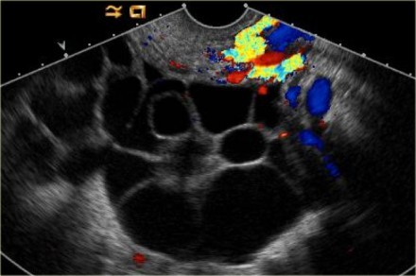
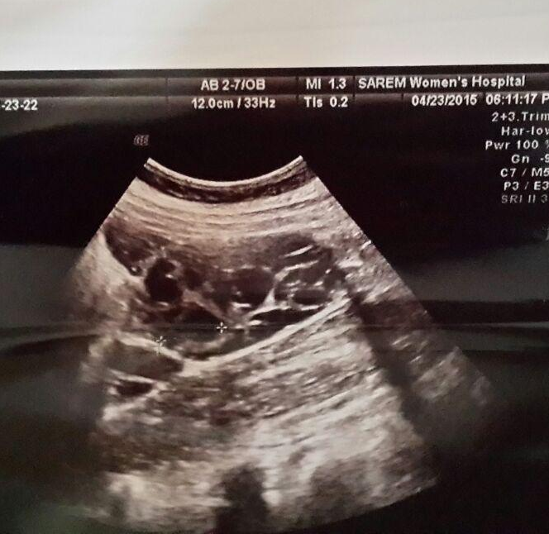
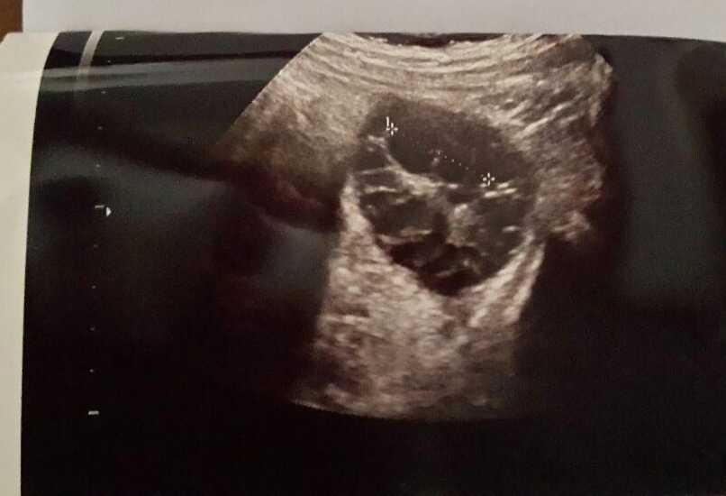
www.radiologyassistant.nl

Slide 17
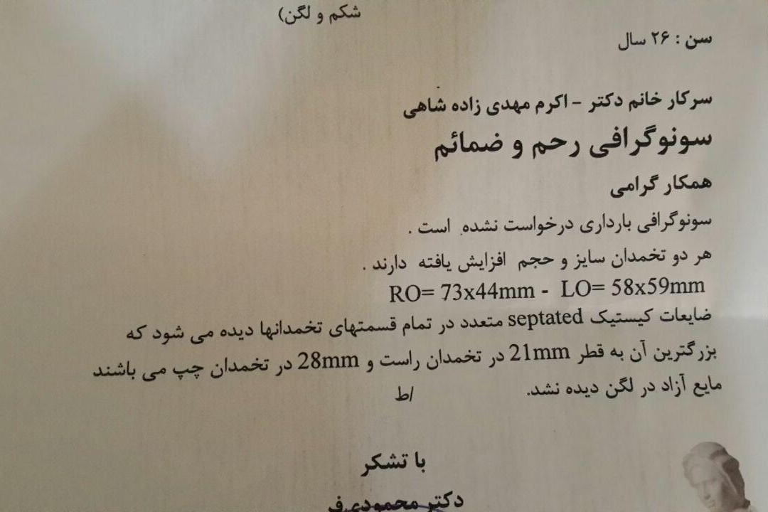

Slide 18
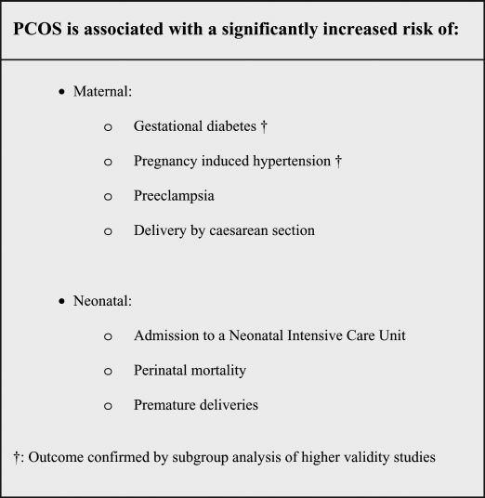

Slide 19
THANK YOU

