Slide 1
IN THE NAME OF GOD
Clinical Guidelines and PTH Measurement
Does Assay Generation Matter?
Presentation By Dr. Ali Golshaian
Day 13th 1400

Slide 2
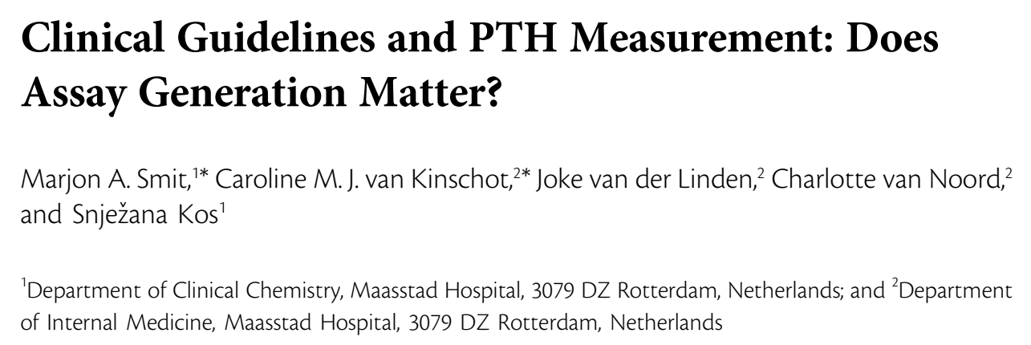
(2019) Smit MA, van Kinschot CMJ, van der Linden J, van Noord C, Kos S. Clinical Guidelines and PTH Measurement: Does Assay Generation Matter? Endocr Rev. 2019 Dec 1;40(6):1468-1480. doi: 10.1210/er.2018-00220. Erratum in: Endocr Rev. 2020 Dec 1;41(6): PMID: 31081903.

Slide 3
Agenda
Introduction
PTH fragments and post translationally modified forms
Measurement of PTH: Current Assays and Pitfalls
Immunoassays
Liquid chromatography tandem mass spectrometry (LC-MS/MS)
Analytical aspects of PTH measurements and reference values
Patent Groups and Applicable Guidelines
Primary hyperparathyroidism
Chronic kidney disease
Bariatric patients
Perioperative use of PTH measurements
Conclusion

Slide 4
Agenda
Introduction
PTH fragments and post translationally modified forms
Measurement of PTH: Current Assays and Pitfalls
Immunoassays
Liquid chromatography tandem mass spectrometry (LC-MS/MS)
Analytical aspects of PTH measurements and reference values
Patent Groups and Applicable Guidelines
Primary hyperparathyroidism
Chronic kidney disease
Bariatric patients
Perioperative use of PTH measurements
Conclusion

Slide 5
Introduction
PTH is an important regulator of calcium and phosphate homeostasis and bone remodeling.
Three different purposes:
Hypercalcemia
Secondary hyperparathyroidism:
Vitamin D deficiency, CKD, Post bariatric surgery
The best available hormonal parameter to detect metabolic bone disease is PTH.
During and after parathyroid and thyroid surgery

Slide 6
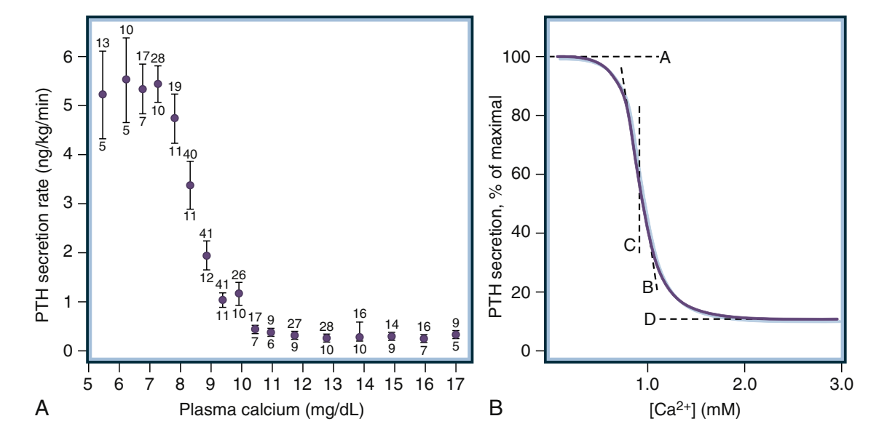
Introduction
(2020) Williams Textbook of Endocrinology, 14th edition

Slide 7
Introduction
The hypothalamic-pituitary-target organ axes of all vertebrates are similar.
The hypothalamus is one of the most evolutionarily conserved and essential regions of the mammalian brain.
Parathyroid glands first appeared in evolutionary history with the exit of amphibians from the sea and a switch from dependence on gills to sole dependence on bone, intestine, and kidney to maintain extracellular calcium homeostasis.
(2020) Williams Textbook of Endocrinology, 14th edition

Slide 8
Introduction
PTH shares homology with PTH‐related protein (PTHrP), a polypeptide of 141 amino acids that is genetically and functionally distinct from PTH.
The shared amino acid sequence homology between PTH and PTHrP is strongest in the N‐terminal portions of the ligands.
A functionally distinct peptide that shares weak but detectable homology with the N‐terminal regions of PTH and PTHrP is TIP39 (tuberoinfundibular peptide of 39 amino acids)
(2019) Primer on the Metabolic Bone Diseases and Disorders of Mineral Metabolism Ninth Edition, 205-206

Slide 9
Introduction
The PTH(1‐84) molecule is subject to two alternative fates, likely depending in part on the prevailing blood calcium concentrations.
The mature hormone may be secreted into the circulation through a classical exocytotic mechanism, or it may be cleaved by calcium‐sensitive proteases present within the secretory vesicles.
This cleavage can result in the accumulation of carboxyl‐terminal PTH fragments that lack the amino‐terminal residues.
Cleavage can also occur in peripheral tissues, such as the liver and kidney.
(2019) Primer on the Metabolic Bone Diseases and Disorders of Mineral Metabolism Ninth Edition, 206

Slide 10
Introduction
PTH is currently measured by automated sandwich type immunoassay methods of different generations.
These assays use different antibodies against PTH and recognize not only biologically active full-length PTH but also PTH fragments.
The lack of standardization contributes to differences in PTH concentrations between laboratories even when the same assay generation is used.
The aim of this review is to discuss different methods of PTH measurement, and associated pitfalls, in the context of clinical guidelines, and to increase awareness among clinicians and laboratory specialists of the complexity of PTH measurements in clinical care.

Slide 11
Agenda
Introduction
PTH fragments and post translationally modified forms
Measurement of PTH: Current Assays and Pitfalls
Immunoassays
Liquid chromatography tandem mass spectrometry (LC-MS/MS)
Analytical aspects of PTH measurements and reference values
Patent Groups and Applicable Guidelines
Primary hyperparathyroidism
Chronic kidney disease
Bariatric patients
Perioperative use of PTH measurements
Conclusion

Slide 12
PTH fragments and post translationally modified forms
The PTH is synthesized in the chief cells of the parathyroid glands as a 115–amino acid peptide precursor, preproPTH.
Cleavage of preproPTH results in proPTH, which is cleaved into the 84–amino acid peptide PTH, the biologically active form.
The first 34 amino acids and the formation of an alpha helix are crucial for its biological activity.

Slide 13
PTH fragments and post translationally modified forms
(2018) Kakuta, et all. Critical Governance Issue of Parathyroid Hormone Assays and its Selection in the Management of Chronic Kidney Disease Mineral and Bone Disorders: PTH Assay and its Selection. Therapeutic Apheresis and Dialysis. 22

Slide 14
PTH fragments and post translationally modified forms
PTH circulates not only in the form of the full-length 84–amino acid peptide but also as multiple fragments, called C-terminal fragments.
These C-terminal fragments arise mainly from metabolism by the liver but also from direct secretion.
The plasma half-life of full-length PTH is very short (2 to 4 minutes), but the half-life of C-terminal fragment is five to ten times longer with normal kidney function and even longer in the presence of kidney disease.

Slide 15
PTH fragments and post translationally modified forms
The ratio of C-terminal fragments to full-length PTH:
Higher in kidney disease
Decreases in response to hypocalcemia
In hypercalcemia adaptation of the parathyroid gland leads to a larger decline in the secretion of full-length PTH compared with PTH fragments.

Slide 16
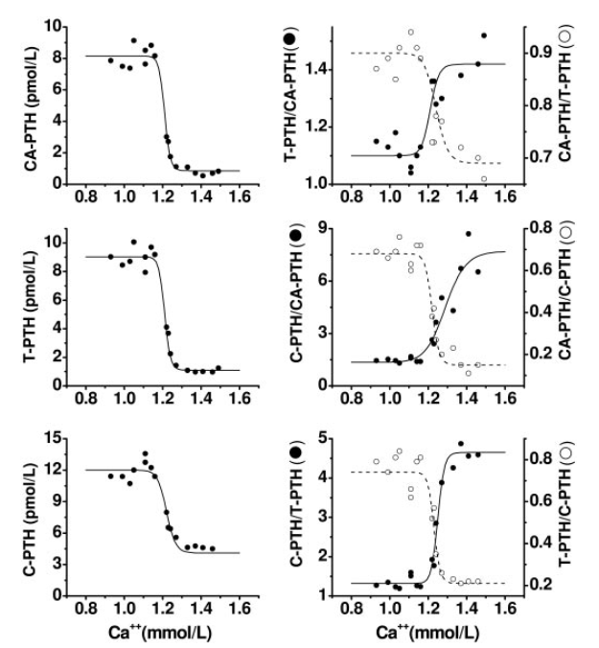
whole PTH, cyclase-activating (CA) PTH, bio intact PTH
Total (T) PTH, is a second-generation PTH assay from the same company
(2006) D’Amour P, et al. Acute regulation of circulating parathyroid hormone (PTH) molecular forms by calcium: utility of PTH fragments/PTH(1-84) ratios derived from three generations of PTH assays. J Clin Endocrinol Metab. 2006; 91(1):283–289

Slide 17
PTH fragments and post translationally modified forms
The exact lengths of the different fragments of PTH have been identified by mass spectrometry analysis.
Other C-terminal fragments were identified by HPLC analysis and subsequent radioactive protein sequencing.

Slide 18
PTH fragments and post translationally modified forms
The PTH fragments do not activate the PTH1R receptor; however, there is some evidence that these fragments have some biological activity through binding a distinct class of receptor.
In contrast to the PTH1R receptor, which has been well characterized, receptors for PTH fragments have not yet been cloned.

Slide 19
PTH fragments and post translationally modified forms
Every protein can undergo posttranslational modifications.
For PTH it has been shown that it can be phosphorylated and oxidized.
Phosphorylation of several serine residues results in phosphorylated PTH that is unable to activate the PTH receptor in vitro.
Oxidation of PTH occurs in methionine at positions 8 and 18 and is particularly found in patients with kidney disease, Because of the altered structure, this oxidized PTH cannot activate the PTH receptor.

Slide 20
PTH fragments and post translationally modified forms
In parathyroid carcinoma a posttranslational modified form of PTH is overproduced; is referred as amino-PTH and modified in the amino acid region 12–18.
However, this modified form is not specific for parathyroid carcinoma because it has been identified in healthy people as well as in patients with primary hyperparathyroidism (PHPT) and in patients with kidney disease.

Slide 21
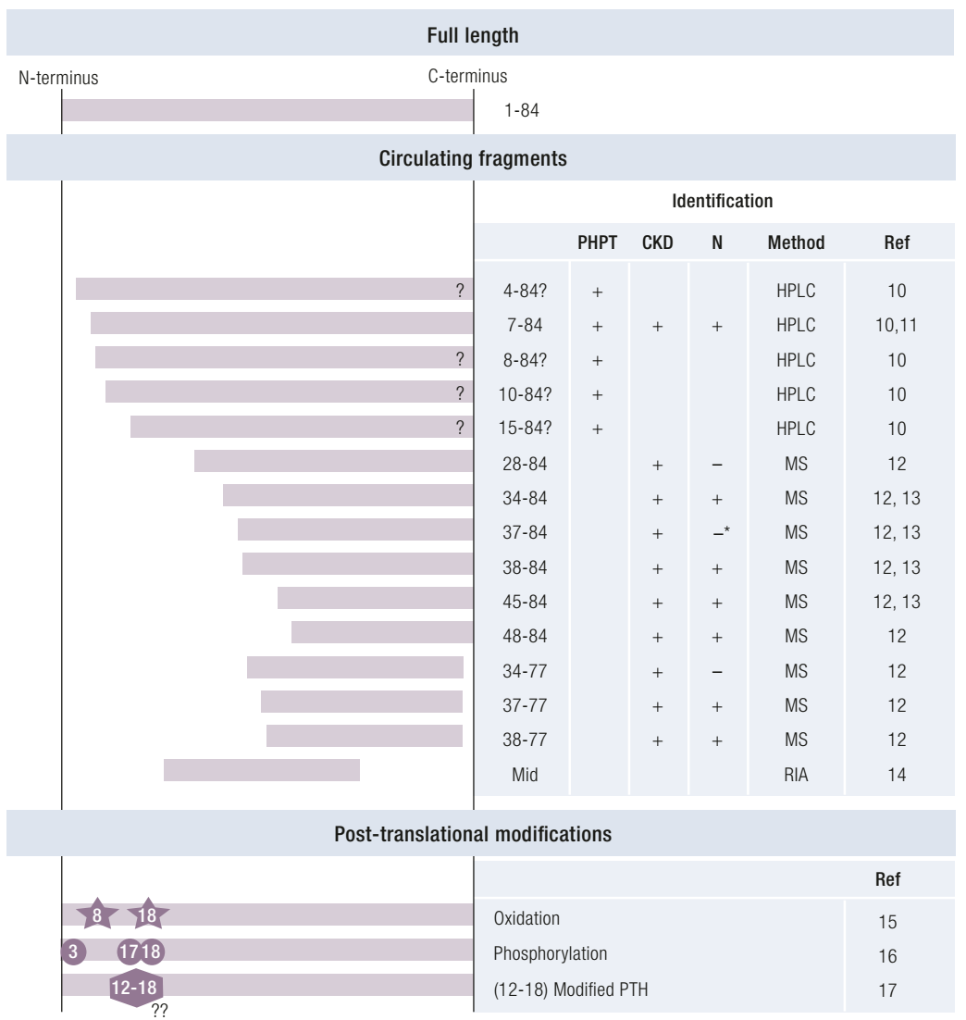
The different forms of PTH.
Numbers indicate affected amino acids.
Detected after
SC injection or
IV infusion of recombinant human PTH.

Slide 22
Agenda
Introduction
PTH fragments and post translationally modified forms
Measurement of PTH: Current Assays and Pitfalls
Immunoassays
Liquid chromatography tandem mass spectrometry (LC-MS/MS)
Analytical aspects of PTH measurements and reference values
Patent Groups and Applicable Guidelines
Primary hyperparathyroidism
Chronic kidney disease
Bariatric patients
Perioperative use of PTH measurements
Conclusion

Slide 23
Measurement of PTH: Current Assays and Pitfalls
Immunoassays
First-generation PTH assays
Second-generation PTH assays
Third-generation PTH assays
Liquid chromatography coupled with tandem mass spectrometry (LC-MS/MS)

Slide 24
Measurement of PTH: Current Assays and Pitfalls
First-generation PTH assays: a single polyclonal antibody directed against the C-terminal part.
Second-generation assays are called intact PTH : first-generation assays + Use of an extra antibody (against the N-terminal*) >> Sandwich immunoassay
This way, the assay was supposed to measure only full-length PTH.
However, because the N-terminal antibody is not directed at the first four amino acids, this assay was discovered to measure also C-terminal fragments, mainly the PTH fragment 7-84.
The antibody can be directed to the amino acids 12-24 or the amino acids 26-32

Slide 25
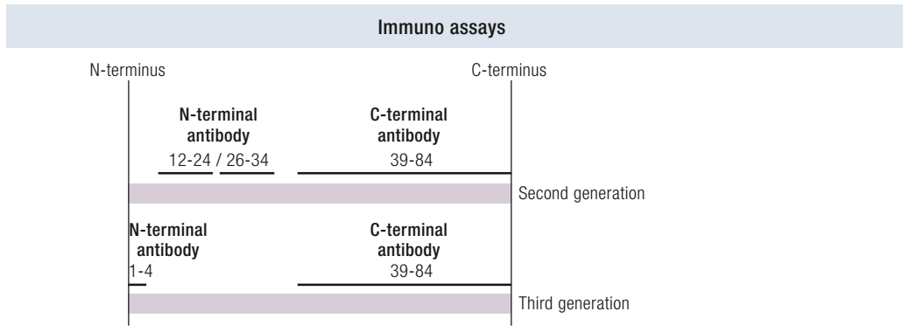
Measurement of PTH: Current Assays and Pitfalls
Third-generation PTH assays are called whole or bio-intact PTH assays.
The sandwich-type immunoassay: an N-terminal antibody directed against the first four amino acids + C-terminal antibody similar to second-generation assays

Slide 26
Measurement of PTH: Current Assays and Pitfalls
Although third-generation assays seem more specific than second-generation assays, these assays can detect PTH forms that are post-translationally modified, like the form found overproduced in parathyroid carcinoma.
PTH measurements by second- and third-generation assays can vary up to 47%
Standardization is defined as the achievement of equivalent results by different clinical laboratory tests. It is a complex and time-consuming procedure, International Federation of Clinical Chemistry and Laboratory Medicine (IFCC) has formed a working group.
1= (1988) Raymond Lepage, et all. A non-(1–84) circulating parathyroid hormone (PTH) fragment interferes significantly with intact PTH commercial assay measurements in uremic samples. Clinical Chemistry, Volume 44, Issue 4, 1 April 1998, Pages 805–809

Slide 27
Measurement of PTH: Current Assays and Pitfalls
(2014) Couchman L, et al. LC-MS candidate reference methods for the harmonisation of parathyroid hormone (PTH) measurement: a review of recent developments and future considerations. Clin Chem Lab Med. 2014; 52(9):1251–1263

Slide 28
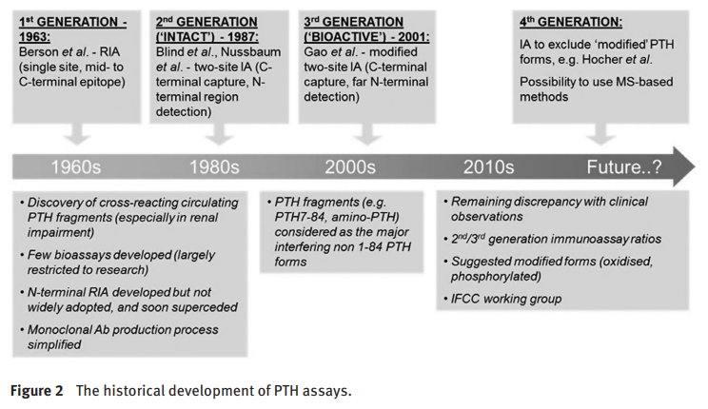
Measurement of PTH: Current Assays and Pitfalls
(2014) Couchman L, et al. LC-MS candidate reference methods for the harmonisation of parathyroid hormone (PTH) measurement: a review of recent developments and future considerations. Clin Chem Lab Med. 2014; 52(9):1251–1263

Slide 29
Measurement of PTH: Current Assays and Pitfalls
The most abundant fragment observed was the 7–24 PTH fragment.
In HPLC experiments, this fragment was found to comigrate with a synthetic 7–84 PTH fragment and is also called non–(1–84) PTH.
Of note, this specific fragment was not detected by mass spectrometry analysis.
(1988) Lepage R, et al. A non-(1-84) circulating parathyroid hormone (PTH) fragment interferes significantly with intact PTH commercial assay measurements in uremic samples. Clin Chem. 1998; 44(4):805–809

Slide 30
Measurement of PTH: Current Assays and Pitfalls
Liquid chromatography coupled with tandem mass spectrometry (LC-MS/MS) is a promising candidate as a reference measurement method.
The combination of chromatography with detection based on mass/charge ratio is far more specific than immunoassays.
High-performance liquid chromatography (HPLC) is a technique in analytical chemistry used to separate, identify, and quantify each component in a mixture.
It relies on pumps to pass a pressurized liquid solvent containing the sample mixture through a column filled with a solid adsorbent material. Each component in the sample interacts slightly differently with the adsorbent material, causing different flow rates for the different components and leading to the separation of the components as they flow out of the column.

Slide 31
Measurement of PTH: Current Assays and Pitfalls
Mass spectrometry (MS) is an analytical technique that is used to measure the mass-to-charge ratio of ions.
In a typical MS procedure, a sample, which may be solid, liquid, or gaseous, is ionized, for example by bombarding it with a beam of electrons.
These ions (fragments) are then separated according to their mass-to-charge ratio.
Ions of the same mass-to-charge ratio will undergo the same amount of deflection.
The first instrument is used to select ions of a particular m/z, called precursor ions or parent ions. The precursor ion is directed into the collision cell, where ions collide with background gas molecules and are broken into smaller ions, called product ions or daughter ions.
(2015) Tietz Fundamentals of Clinical Chemistry and Molecular Dagnostics, 7th edition

Slide 32
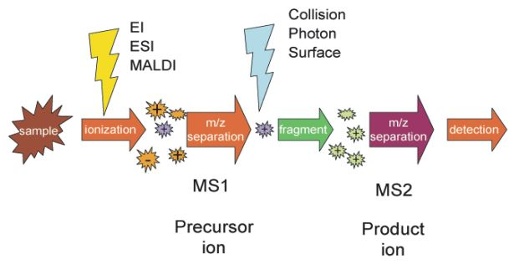
Measurement of PTH: Current Assays and Pitfalls
(2011) Yan, Yan & Zhang, Shenggui & Wu, Fang-Xiang. (2011). Applications of graph theory in protein structure identification. Proteome science. 9 Suppl 1. S17. 10.1186/1477-5956-9-S1-S17.

Slide 33
Measurement of PTH: Current Assays and Pitfalls
Mass spectrometry–based assays for PTH involve sample preparation before LC-MS/MS analysis.
Step 1: Enrichment step
Current enrichment methods use immune affinity extraction with a C-terminal PTH antibody.
Disadvantage: The outcome depends on the choice of the antibody.
Step 2: Cleavage step
Mass spectrometry analysis is currently possible only with small proteins.
The enrichment step is followed by protein digestion via trypsin.
Trypsin cleaves peptides after an arginine or lysine amino acid, generating, among other peptides, the 1–13 tryptic peptide

Slide 34
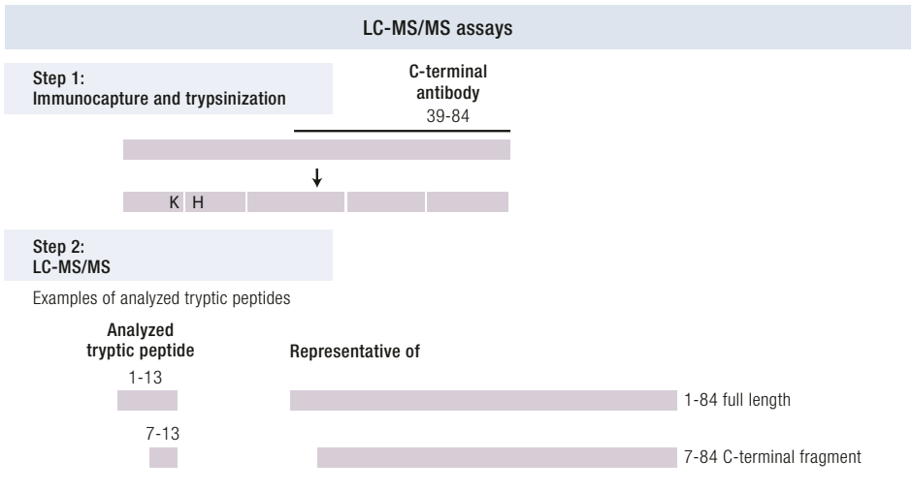
LC-MS/MS
Most methods use this 1-13 fragment as representative of full-length PTH.
Any (posttranslational) modification after amino acid 1-13 is measured as full-length unmodified PTH.

Slide 35
Measurement of PTH: Current Assays and Pitfalls
The 7–13 PTH fragment has not been detected yet by mass spectrometry analysis.
Either a modification in the 7–13 region that alters the mass/charge ratio of this tryptic peptide or a modification that influences the ability of trypsin to cut after position 13 could possibly lead to a lack of detection of this 7–84 PTH fragment.
Optimization of the mass spectrometry method is needed as well, before it can serve as a reliable reference method.

Slide 36
Agenda
Introduction
PTH fragments and post translationally modified forms
Measurement of PTH: Current Assays and Pitfalls
Immunoassays
Liquid chromatography tandem mass spectrometry (LC-MS/MS)
Analytical aspects of PTH measurements and reference values
Patent Groups and Applicable Guidelines
Primary hyperparathyroidism
Chronic kidney disease
Bariatric patients
Perioperative use of PTH measurements
Conclusion

Slide 37
Analytical aspects of PTH measurements and reference values
Preanalytical conditions are important and may influence PTH measurement.
Measurement of PTH in serum vs plasma results in different PTH concentrations
The IFCC working group recommends measurement of PTH in EDTA plasma and not in serum, because PTH is most stable in EDTA plasma. ¹
Also, PTH assays can be influenced by biotin supplements (vitamin H, also known as vitamin B7 or B8). ²
1 = (2017) Sturgeon CM, et al. Perspective and priorities for improvement of parathyroid hormone (PTH) measurement: a view from the IFCC Working Group for PTH. Clin Chim Acta. 2017;467:42–47
2 = (2017) Piketty ML, et al. False biochemical diagnosis of hyperthyroidism in streptavidin-biotin-based immunoassays: the problem of biotin intake and related interferences. Clin Chem Lab Med. 2017; 55(6):780–788

Slide 38
Analytical aspects of PTH measurements and reference values
The biological variation of PTH is substantial.
The within-subject variation of PTH is ~20% in healthy people and up to 30% in patients on hemodialysis.
This implies that the difference in PTH concentration must exceed 54% in healthy people and 72% in patients on hemodialysis to state that the concentration of PTH has decreased or increased. ¹ (Base on Intraindividual coefficients of variance (CVI))
The determination of PTH reference values is challenging because many factors influence PTH concentrations, as summarized in Table 2.
1 = (2017) Gardham C, Stevens PE, Delaney MP, LeRoux M, Coleman A, Lamb EJ. Variability of parathyroid hormone and other markers of bone mineral metabolism in patients receiving hemodialysis. Clin J Am Soc Nephrol. 2010;5(7):1261–1267

Slide 39
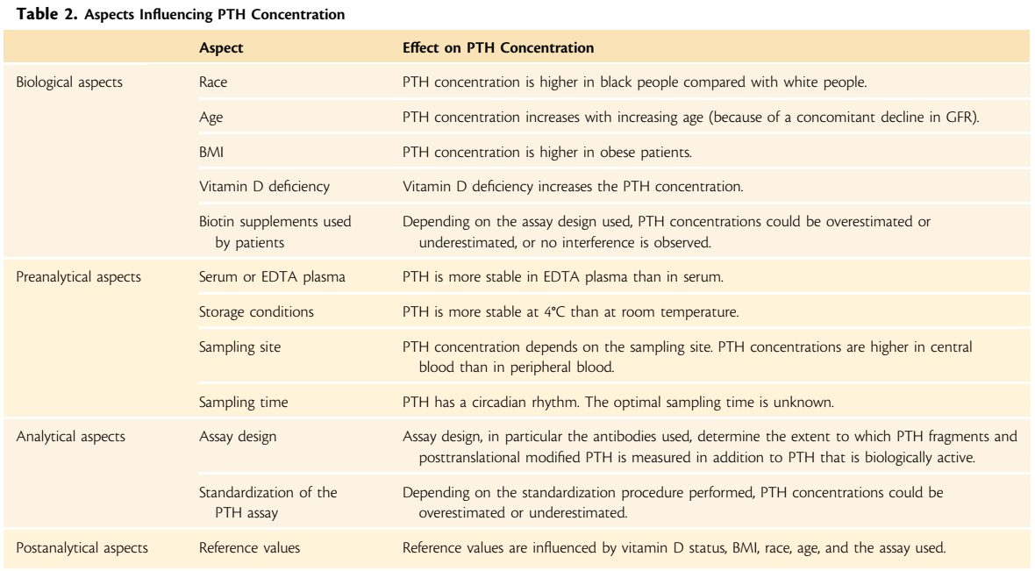

Slide 40
Summary
Assay
1st Generation | single polyclonal AB against the C-terminal |  | all C-fragments detect
2nd Generation | Sandwich type + against the N-terminal amino acids 12-24 or 26-32 | Intact PTH | some inactive C-fragments detect (7-84 PTH)
3th Generation | Sandwich type + against the N-terminal first four amino acids | (Whole) Bio-Intact PTH | Inactive post-translationally modified 1-84 PTH
HPLC |  | Detect 7-84 PTH | Can detect 7-84 PTH
MS-MS |  | Can not detect 7-84 PTH Can not detect Inactive post-translationally modifications | Can detect 7-84 PTH

Slide 41
Agenda
Introduction
PTH fragments and post translationally modified forms
Measurement of PTH: Current Assays and Pitfalls
Immunoassays
Liquid chromatography tandem mass spectrometry (LC-MS/MS)
Analytical aspects of PTH measurements and reference values
Patent Groups and Applicable Guidelines
Primary hyperparathyroidism
Chronic kidney disease
Bariatric patients
Perioperative use of PTH measurements
Conclusion

Slide 42
Patient Groups and Applicable Guidelines
Primary hyperparathyroidism
PHPT is defined as hypercalcemia and an elevated or inappropriately normal concentration of PTH.
The only curative treatment of PHPT is parathyroidectomy, which is indicated for symptomatic patients and patients with osteoporosis, impaired kidney function, kidney stones, hypercalciuria, and patients <50 years of age or when calcium has increased to more than 0.25 mmol/L above the upper limit of normal.

Slide 43
Patient Groups and Applicable Guidelines
Primary hyperparathyroidism
Because PTH concentration is not included in the decision criteria for performing surgery, differences in PTH measurements are not an issue in this respect.
However, PTH measurement is important to set the diagnosis PHPT.
The American Association of Endocrine Surgeons guideline for management of PHPT does not mention differences in PTH assays and does not give recommendations on this issue. ¹
1 = (2016) Wilhelm SM, et al. The American Association of Endocrine Surgeons guidelines for definitive management of primary hyperparathyroidism. JAMA Surg. 2016;151(10): 959–968

Slide 44
Patient Groups and Applicable Guidelines
Primary hyperparathyroidism
The international workshop on diagnosing asymptomatic PHPT does consider differences in PTH assay measurements and recommends using assay-specific reference values.
The international workshop on diagnosing asymptomatic PHPT states that PTH measurement can be performed with second and third-generation PTH assays because both assay generations have similar diagnostic sensitivity for PHPT. (based on four clinical studies)
One study by Gao et al. recommended measuring PTH with third-generation assays.

Slide 45
Patient Groups and Applicable Guidelines
Primary hyperparathyroidism
This recommendation was based on their HPLC experiments, which showed a higher percentage of PTH fragments in patients with PHPT compared with normal subjects. The percentage can vary from to 20% to 90%. ¹
Overestimation of PTH by second-generation assays would be of minor consequence hypercalcemic PHPT because in these patients the distinction between hypercalcemia due to PTH overproduction and PTH-independent causes of hypercalcemia is clear cut.
1 = (2001) Gao P, et al. Development of a novel immunoradiometric assay exclusively for biologically active whole parathyroid hormone 1-84: implications for improvement of accurate assessment of parathyroid function. J Bone Miner Res. 2001;16(4):605–614

Slide 46
Patient Groups and Applicable Guidelines
Primary hyperparathyroidism
Accurate measurement of PTH is important in identifying patients with normocalcemic primary hyperparathyroidism.
Even though the calcium concentration is within the reference range, these patients are still at risk for developing complications associated with classic PHPT.
Because PTH elevation is crucial for establishing this diagnosis, accurate measurement is essential.

Slide 47
Patient Groups and Applicable Guidelines
Primary hyperparathyroidism
Another proposed use of PTH measurement is the distinction between parathyroid carcinoma and benign disease.
Third-generation assays measure a post translationally modified form (in the 12–18 amino acid region) overproduced in parathyroid carcinoma.
Because third-generation assays usually give lower PTH values than second-generation assays, a ratio of third to second-generation assay PTH measurements >1 could indicate presence of this modified form and may point toward parathyroid carcinoma.
Several limitations:
Different assays of the same generation, influencing the ratio
Most laboratories do not offer both generation assays
Also present in healthy people and patients with PHPT or CKD

Slide 48
Patient Groups and Applicable Guidelines
Chronic kidney disease
PTH increases in response to hyperphosphatemia, hypocalcemia, lowered 1,25-dihydroxyvitamin D and elevated FGF23.
SHPT requires treatment because abnormal bone turnover can result in skeletal and mineral disorders.
The gold standard to diagnose renal osteodystrophy is bone biopsy. Because this is an invasive and costly procedure, PTH is used as a first screening test.
C-terminal PTH fragments accumulate in the circulation with increasing stages of kidney disease.

Slide 49
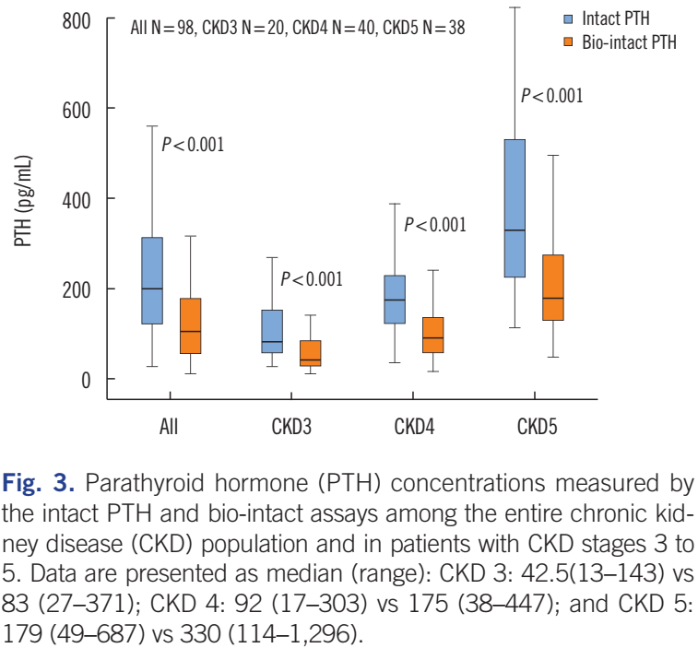
Patient Groups and Applicable Guidelines
Chronic kidney disease
In patients with CKD, a third-generation assay demonstrates ~50% (43% to 47%) lower PTH concentrations compared with a second-generation assay. ¹
Several studies comparing 15 different commercially available PTH assays (both second and third generation) showed more than twofold differences between the lowest and the highest value of PTH within the same patient. (Even a 4.2-fold )
1 & figure = (2017) Einbinder Y, et all. Comparison of intact PTH and bio-intact PTH assays among non-dialysis dependent chronic kidney disease patients. Ann Lab Med. 2017;37(5):381–387

Slide 50
Patient Groups and Applicable Guidelines
Chronic kidney disease
The Kidney Disease Improving Global Outcomes guideline:
For patients on dialysis, it recommends maintaining PTH concentration in the range of 2 to 9 times the upper normal limit for the specific assay.
The guideline states that in patients with moderate to end-stage CKD who are not on dialysis, the optimal PTH concentration is unknown.
The Kidney Disease: Improving Global Outcomes guideline recommends following trends of PTH concentrations to determine the optimal treatment.
(2009) Kidney Disease: Improving Global Outcomes (KDIGO) CKD-MBD Work Group. KDIGO clinical practice guideline for the diagnosis, evaluation, prevention, and treatment of chronic kidney disease-mineral and bone disorder (CKD-MBD). Kidney Int Suppl. 2009:S1–130

Slide 51
Patient Groups and Applicable Guidelines
Chronic kidney disease
It recommends using second-generation assays because of the widespread availability of these assays. ¹
Third-generation assays, do not recognize C-terminal fragments.
Most clinical studies have not convincingly shown an advantage of third-generation assays compared with second-generation assays in the diagnosis of low, normal, and high bone turnover.
One possible explanation is co-measurement of an oxidized form of PTH that is not biologically active. ²
1= (2009) Kidney Disease: Improving Global Outcomes (KDIGO) CKD-MBD Work Group. KDIGO clinical practice guideline for the diagnosis, evaluation, prevention, and treatment of chronic kidney disease-mineral and bone disorder (CKD-MBD). Kidney Int Suppl. 2009:S1–130
2= (2013) Hocher B, et all. Modeling of oxidized PTH (oxPTH) and non-oxidized PTH (noxPTH) receptor binding and relationship of oxidized to non-oxidized PTH in children with chronic renal failure, adult patients on hemodialysis and kidney transplant recipients. Kidney Blood Press Res. 2013; 37(4-5):240–251

Slide 52
Patient Groups and Applicable Guidelines
Chronic kidney disease
Oxidized PTH (oxPTH) loses its PTH receptor-stimulating properties.
This was described in more than 20 well published studies in the 1970(s) and 80(s).
PTH oxidation hence alters PTH-PTH receptor interaction via oxidation induced three-dimensional structure alteration of PTH.
Non-oxidized PTH concentrations are 1.5 - 2.25 fold higher in patients with renal failure as compared to health controls.
A huge proportion of circulating PTH is oxidized and thus not biologically active.
Patients with renal failure have increased oxidative stress.
(2013) Hocher B, et all. Modeling of oxidized PTH (oxPTH) and non-oxidized PTH (noxPTH) receptor binding and relationship of oxidized to non-oxidized PTH in children with chronic renal failure, adult patients on hemodialysis and kidney transplant recipients. Kidney Blood Press Res. 2013; 37(4-5):240–251

Slide 53
Patient Groups and Applicable Guidelines
Chronic kidney disease
Preclinical studies in cell culture systems in CKD models showed that parathyroid hormone (PTH), oxidized at the 2 methionine residues (positions 8 and 18), caused a loss of function.
In patients with CKD, a considerable but variable fraction (about 70 to 90%) of measured PTH appears to be oxidized.
Currently used PTH assays detect both oxidized and non-oxPTH.
In patients with renal failure was shown that measuring nonoxidized PTH correlated better with clinical outcomes, including mortality due to cardiovascular complications, than measuring both oxidized and nonoxidized PTH.
(2017) Hocher B, Yin L. Why current PTH assays mislead clinical decision making in patients with secondary hyperparathyroidism. Nephron. 2017;136(2):137–142

Slide 54
Patient Groups and Applicable Guidelines
Chronic kidney disease
The standard treatment of SHPT includes dietary modification to reduce phosphate intake, use of phosphate binders, vitamin D supplementation, and adjustment of the dialysis regimen.
The National Institute for Health and Care Excellence guideline recommends starting cinacalcet treatment when PTH reaches 85 pmol/L (corresponding to 802 pg/mL, ~10x the upper reference limit) and when SHPT is refractory to other treatments and surgery is contraindicated. ¹
Given the aforementioned challenges in PTH measurement, stating absolute cut off values in guidelines should be avoided.
1 = (2018) National Institute for Health and Care Excellence. Cinacalcet for the treatment of secondary hyperparathyroidism in patients with end-stage renal disease on maintenance dialysis therapy. Accessed 17 December 2018

Slide 55
Patient Groups and Applicable Guidelines
Bariatric patients
After partial bypass of the small intestine (e.g., gastric bypass surgery), absorption of calcium and vitamin D is decreased, which may result in secondary hyperparathyroidism.
The prevalence of SHPT 5 years after bariatric surgery is reported to be as high as 63%, depending on the type of surgery performed.
Guidelines recommend monitoring PTH after bariatric surgery on a regular basis to evaluate for calcium and vitamin D deficiency and starting supplementation to prevent metabolic bone disease.
Even if calcium intake or absorption is inadequate, normal calcium concentration can be maintained as a result of compensatory mechanisms such as bone resorption and decreased calcium excretion.
PTH may be more sensitive in detecting clinically relevant calcium deficiency.

Slide 56
Patient Groups and Applicable Guidelines
Bariatric patients
1470 obese subjects undergoing bariatric/metabolic surgery
322 patients undergoing Roux-en-Y gastric bypass (RYGB)
695 undergoing single anastomosis (mini-)gastric bypass (SAGB)
93 undergoing laparoscopic adjustable gastric banding (LAGB)
360 undergoing sleeve gastrectomy (SG)
The prevalence of SHPT increased to 35.4% at 1 year after surgery and 63.3% at 5 years after surgery.
SAGB had the highest prevalence of SHPT (50.6%) followed by RYGB (33.2%), LAGB (25.8%), and SG (17.8%) at 1 year after surgery. At 5 years after surgery, SAGB still had the highest prevalence of SHPT (73.6%), followed by RYGB (56.6%), LAGB (38.5%), and SG (41.7%).
(2018) Wei JH, Lee WJ, Chong K, Lee YC, Chen SC, Huang PH, Lin SJ. High incidence of secondary hyperparathyroidism in bariatric patients: comparing different procedures. Obes Surg. 2018;28(3):798–804

Slide 57
Patient Groups and Applicable Guidelines
Bariatric patients
According to the guideline of the American Society for Metabolic and Bariatric Surgery, PTH concentration >6.9 pmol/L (65 pg/mL) indicates calcium or vitamin D deficiency. (PTH assay didn`t mention) ¹
Although several studies have shown progressive deterioration in bone quality and elevated fracture risk after bariatric surgery, the pathologic mechanism is not clear.
PTH does not seem to be a reliable marker of bone disease in bariatric patients because changes in bone mineral density occur independently of changes in PTH.
1 = (2017) Parrott J, et all. American society for metabolic and bariatric surgery integrated health nutritional guidelines for the surgical weight loss patient 2016 update: micronutrients. Surg Obes Relat Dis. 2017;13(5):727–741

Slide 58
Patient Groups and Applicable Guidelines
Bariatric patients
38,971 obese patients undergoing gastric bypass were identified, 7758 with diabetes and 31,213 without.
The mechanisms behind the gastric bypass-induced fracture risk are still unknown.
Greater weight loss was not associated with greater increase in risk of any fracture.
Inadequate calcium and vitamin D intake and absorption may not explain the increased fracture risk.
Some studies reporting bone loss and increased bone turnover after gastric bypass without signs of SHPT.
(2018) Axelsson KF, et all. Fracture risk after gastric bypass surgery: a retrospective cohort study. J Bone Miner Res. 2018;33(12):2122–2131

Slide 59
Patient Groups and Applicable Guidelines
Bariatric patients
After gastric bypass, the level of physical activity is increased, which is likely to higher risk of falls.
Our results indicate that the increased fracture risk following gastric bypass surgery could be, at least to some extent, due to increased susceptibility to falls or is dependent on other mechanism (than weight loss and SHPT) affecting skeletal metabolism, perhaps including:
Alterations in adipokines
Gonadal steroids
Gut-derived hormones
(2018) Axelsson KF, et all. Fracture risk after gastric bypass surgery: a retrospective cohort study. J Bone Miner Res. 2018;33(12):2122–2131

Slide 60
Patient Groups and Applicable Guidelines
Bariatric patients
In general, for patients after bariatric surgery it is unknown what the appropriate cutoff values of PTH are.
Because no comparison of second- and third-generation assays has been performed in bariatric patients, the clinical implication of the differences is unknown.
Because of the differences between assays, absolute cutoff values should be avoided in guidelines.
Because PTH is measured regularly, clinical decisions are based on PTH changes over time.
For an adequate evaluation of the trend of PTH, subsequent measurements should be performed with the same PTH assay.

Slide 61
Patient Groups and Applicable Guidelines
Perioperative use of PTH measurements
During parathyroidectomy, measuring PTH concentrations provides surgeons with information about whether the parathyroid tissue causing the elevated PTH has been removed.
Because second-generation assays recognize C-terminal fragments that have a longer half-life, third-generation assays seem more useful for this purpose.
The difference is more pronounced in patients with SHPT (due to kidney disease) compared with patients with PHPT.
With third-generation assays, 50% drop in PTH can be observed after 10 minutes, whereas it takes an additional 5 minutes if a second-generation assay is used

Slide 62
Patient Groups and Applicable Guidelines
Perioperative use of PTH measurements
After thyroid surgery, PTH measurement is used as a predictor of postoperative hypoparathyroidism.
The Australian Endocrine Surgeons guidelines advise measurement of PTH 4 hours after surgery. (Only second-generation assays were used) ¹
According to the American Thyroid Association Surgical Affairs Committee, there is no need for intensive calcium monitoring when the PTH concentration is >1.6 pmol/L (15 pg/mL) measured ≥20 minutes after surgery. In this guideline, PTH measurements are referred to as intact PTH. ²
1 = (2007) AES Guidelines 06/01 Group. Australian Endocrine Surgeons Guidelines AES06/01. Postoperative parathyroid hormone measurement and early discharge after total thyroidectomy: analysis of Australian data and management recommendations. ANZ J Surg. 2007;77(4):199–202
2 = (2018) Orloff LA, et al. American thyroid association statement on postoperative hypoparathyroidism: diagnosis, prevention, and management in adults. Thyroid. 2018;28(7):830–841

Slide 63
Patient Groups and Applicable Guidelines
Perioperative use of PTH measurements
To use follow-up PTH measurements during and after surgery, it is most important to use the same assay to allow proper comparison.
3rd generation assay reflects parathyroid function in the first postoperative hours and is more reliable in predicting postoperative hypocalcemia. However, studies comparing different generation PTH assays in patients undergoing thyroid surgery have not been performed.

Slide 64
Agenda
Introduction
PTH fragments and post translationally modified forms
Measurement of PTH: Current Assays and Pitfalls
Immunoassays
Liquid chromatography tandem mass spectrometry (LC-MS/MS)
Analytical aspects of PTH measurements and reference values
Patent Groups and Applicable Guidelines
Primary hyperparathyroidism
Chronic kidney disease
Bariatric patients
Perioperative use of PTH measurements
Conclusion

Slide 65
Conclusions
For a correct interpretation of the PTH trend over time, the measurements should be performed with the same assay in the same laboratory with assay-specific reference values.
Regardless of which assay is the most accurate to use, clinicians and laboratory specialists should be aware of the differences between second- and third-generation PTH assays stated in this review, to correctly interpret PTH measurement results, apply the various guidelines, and improve patient care.

Slide 66
Thanks for your attention

