Slide 1
Functional Menstrual Disorders in Systemic Diseases
Hengameh Abdi
Endocrine Research Center
Research Institute for Endocrine sciences
Shahid Beheshti University of Medical Sciences
1396.11.26
15 Feb 2018

Slide 2
Outlines
Background
Thyroid diseases and menstrual disturbances
  Thyrotoxicosis
  Hypothyroidism
Diabetes mellitus and menstrual disturbances
Chronic kidney disease and menstrual disturbances
Chronic liver disease and menstrual disturbances
Lupus and menstrual disturbances
Conclusions

Slide 3
Outlines
Background
Thyroid diseases and menstrual disturbances
  Thyrotoxicosis
  Hypothyroidism
Diabetes mellitus and menstrual disturbances
Chronic kidney disease and menstrual disturbances
Chronic liver disease and menstrual disturbances
Lupus and menstrual disturbances
Conclusions

Slide 4
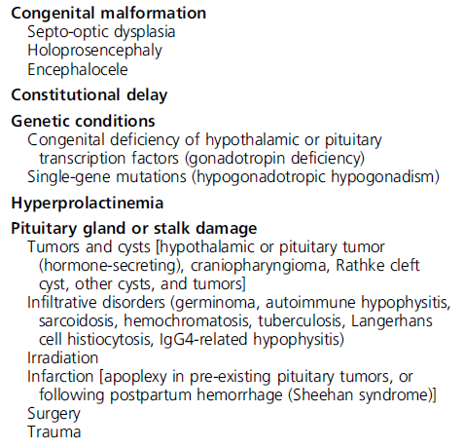
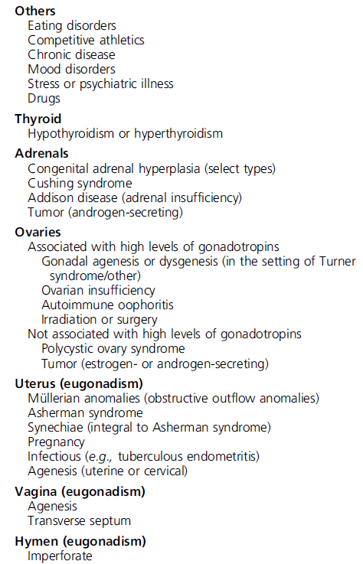
Potential etiologies of amenorrhea
Chronic disease
Thyroid disease
Gordon CM, et al. J Clin Endocrinol Metab 2017;102:1413-1439.

Slide 5
Evaluation of patients with suspected functional hypothalamic amenorrhea (FHA): Endocrine society recommendations
In adolescents and women with suspected FHA, we recommend obtaining the following screening laboratory tests:
  β-hCG, CBC, electrolytes, glucose, bicarbonate, blood urea nitrogen, creatinine, liver panel, and (when appropriate) ESR/CRP.
As part of an initial endocrine evaluation for patients with FHA, we recommend obtaining the following laboratory tests:
  TSH, free T4, prolactin, LH, FSH, estradiol (E2), and AMH.
Clinicians should obtain total testosterone and dehydroepiandrosterone sulfate (DHEA-S) levels in patients with clinical hyperandrogenism and 8 AM 17-hydroxyprogesterone levels if clinicians suspect late-onset congenital adrenal hyperplasia (CAH).
Gordon CM, et al. J Clin Endocrinol Metab 2017;102:1413-1439.

Slide 6
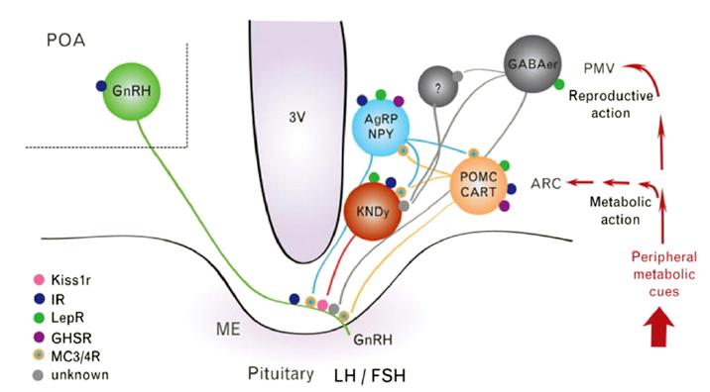
Neural interactions between metabolic and reproductive functions
Secretion of kisspeptin
IR, insulin receptor; Kiss1r, kisspeptin receptor; LepR, leptin receptor.
POA, preoptic area; ARC, arcuate nucleus.
KNDy, kisspeptin/neurokinin B/dynorphin.
Navarro VM, Kaiser UB. Curr Opin Endocrinol Diabetes Obes. 2013;20(4):335-341.
Notes:
Activation of HPA axis and reduction in GnRH drive in FHA.
Kisspeptin/neurokinin B/dynorphin neurons may be the final common pathway that integrates the other neuromodulatory signaling systems that are linked to reduced GnRH pulsatility.
3V, third ventricle; AgRP, agouti-related peptide; CART, cocaine- and amphetamine-regulated transcript; GABA, g-aminobutyric acid; GHSR, GH secretagogue receptor; IR, insulin receptor; Kiss1r, kisspeptin receptor; KNDy, kisspeptin/neurokinin B/dynorphin; LepR, leptin receptor; MC3r, melanocortin receptor 3; MC4r, melanocortin receptor 4; ME, median eminence; NPY, neuropeptide Y; PMV, ventral premammillary nucleus; POA, preoptic area; POMC, pro-opiomelanocortin.

Slide 7
Outlines
Background
Thyroid diseases and menstrual disturbances
  Thyrotoxicosis
  Hypothyroidism
Diabetes mellitus and menstrual disturbances
Chronic kidney disease and menstrual disturbances
Chronic liver disease and menstrual disturbances
Lupus and menstrual disturbances
Conclusions

Slide 8
Thyrotoxicosis
Hormonal changes in female thyrotoxicosis
Sex hormone-binding globulin (SHBG)
Production rate of estrogens
Metabolic clearance rate of estrogens or androgens
Estradiol (E2)
Free Estradiol
Testosterone, Androstendione, DHEA
Progesterone
LH
FSH
Krassas GE, et al. Endocrine Reviews 2010;31:702–755.
Krassas GE, et al. Werner & Ingbar's The Thyroid 10th ed 2013;457-467.

Slide 9
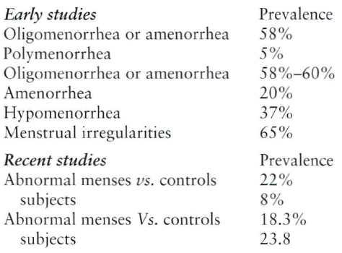
Menstrual disturbances associated with thyrotoxicosis
Lower prevalence of menstrual disturbances in recent studies; due to better medical care and public awareness, thyroid disturbances are diagnosed much earlier when the symptoms are still mild.
Positive correlations between smoking and thyroid hormone levels with menstrual irregularities.
Krassas GE, et al. Werner & Ingbar's The Thyroid 10th ed 2013;457-467.

Slide 10
Hypothyroidism
Hormonal changes in female hypothyroidism
Sex hormone-binding globulin (SHBG)
Production rate of estrogens
Metabolic clearance rate of estrogens or androgens
Estradiol (E2)
Free Estradiol | Normal
Testosterone, Androstendione
Progesterone
LH | Normal
FSH | Normal
Krassas GE, et al. Endocrine Reviews 2010;31:702–755.
Krassas GE, et al. Werner & Ingbar's The Thyroid 10th ed 2013;582-589.

Slide 11
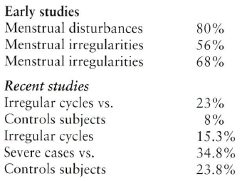
Menstrual disturbances associated with hypothyroidism
The frequency of menstrual disturbances (oligomenorrhea and amenorrhea, polymenorrhea, and menorrhagia) in hypothyroidism is approximately three times greater than in the normal population.
Polymenorrhea and menorrhagia due to estrogen breakthrough bleeding secondary to anovulation and/or defects in hemostasis factors.
Krassas GE, et al. Werner & Ingbar's The Thyroid 10th ed 2013;457-467.

Slide 12
Outlines
Background
Thyroid diseases and menstrual disturbances
  Thyrotoxicosis
  Hypothyroidism
Diabetes mellitus and menstrual disturbances
Chronic kidney disease and menstrual disturbances
Chronic liver disease and menstrual disturbances
Lupus and menstrual disturbances
Conclusions

Slide 13
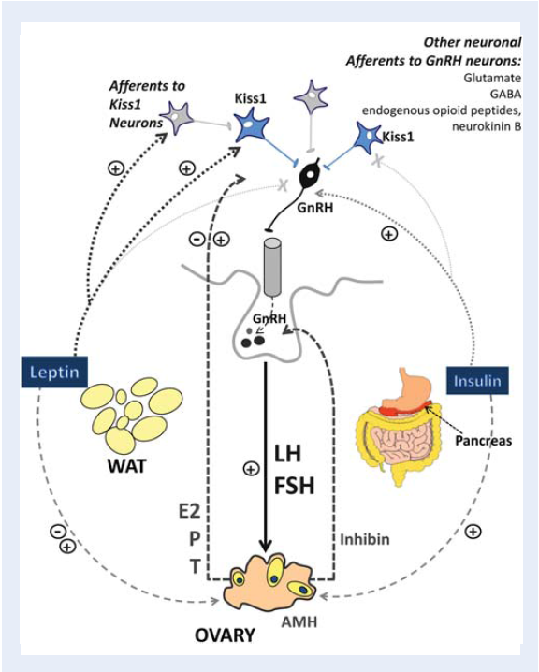
Neuroendocrine regulation of the HPG axis
T1DM
T1DM
Codner E, et al. Human Reproduction Update 2012;18(5):568-585.

Slide 14
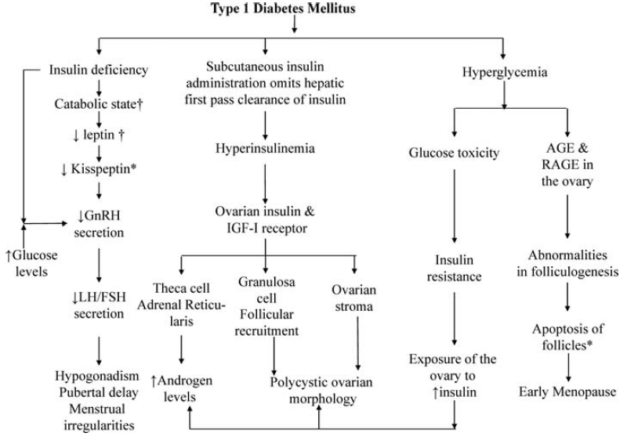
Pathophysiology of the reproductive axis in type 1 DM
1
2
3
4
Codner E, et al. Human Reproduction Update 2012;18(5):568-585.
Notes:
†Catabolism and leptin deficiency secondary to severe insulin deficiency has been observed in patients with ketoacidosis (Fluck et al., 1999; Soliman et al., 2002).
*Findings that have been demonstrated in animals.

Slide 15
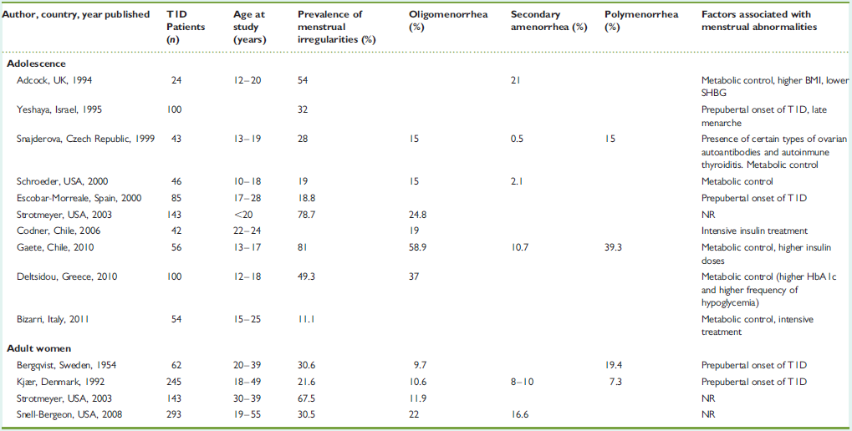
Menstrual irregularities in type 1 DM
Metabolic control
Codner E, et al. Human Reproduction Update 2012;18(5):568-585.

Slide 16

Nine primary studies involving 475 adolescent or adult women with type 1 diabetes were included.
The prevalence of PCOS and associated traits:
  PCOS: 24% (95% CI 15-34)
  Hyperandrogenemia: 25% (95% CI 17-33)
  Hirsutism: 25% (95% CI 16-36)
  Menstrual dysfunction: 24% (95% CI 17-32)
  PCOM: 33% (95% CI 24-44)
These figures are considerably higher than those reported earlier in the general population without diabetes.

Slide 17
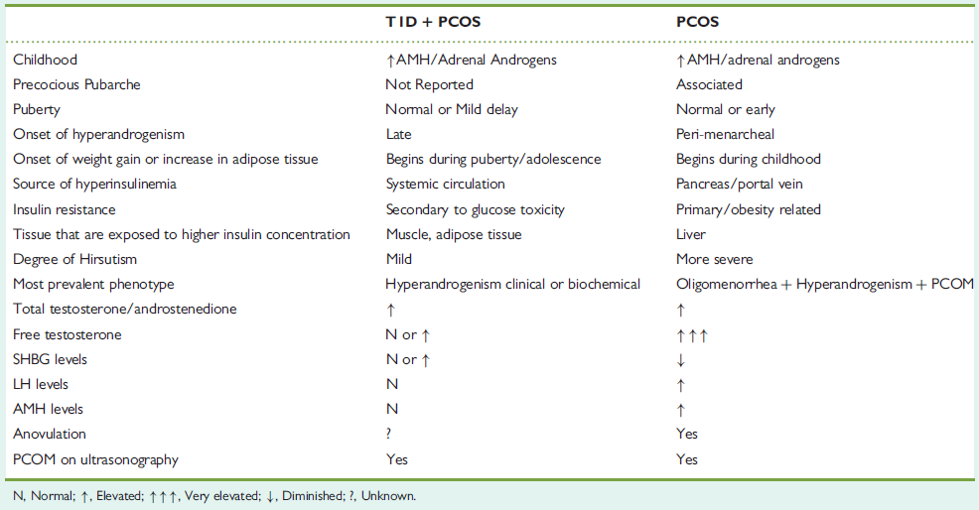
Comparison of PCOS characteristics in women with T1DM and PCOS vs. patients with PCOS without T1DM
Codner E, et al. Human Reproduction Update 2012;18(5):568-585.

Slide 18
Type 2 diabetes
  Insulin resistance, hyperglycemia and anovulatory cycles.
  In type 2 diabetes mellitus, it is difficult to dissect how much the confounding obesity or insulin resistance contributes to development of oligomenorrhea.

Slide 19
Outlines
Background
Thyroid diseases and menstrual disturbances
  Thyrotoxicosis
  Hypothyroidism
Diabetes mellitus and menstrual disturbances
Chronic kidney disease and menstrual disturbances
Chronic liver disease and menstrual disturbances
Lupus and menstrual disturbances
Conclusions

Slide 20
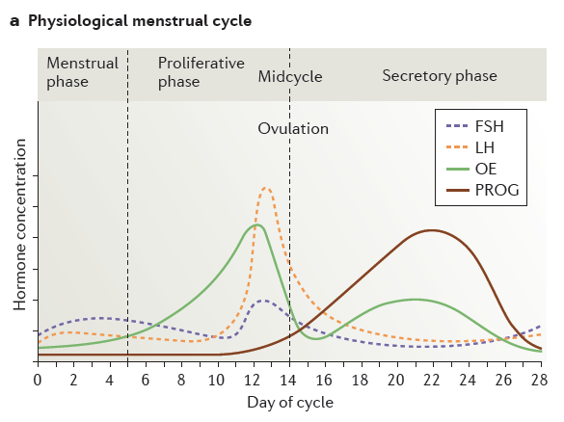
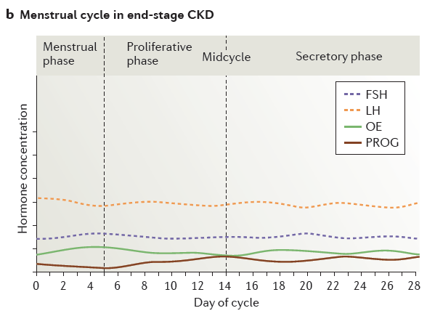
Wiles KS, et al. Nat Rev Nephrol 2018 Jan;1-20.

Slide 21
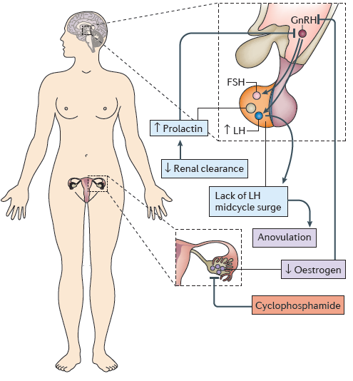
Endocrine effects of chronic kidney disease on the hypothalamic-pituitary-ovarian axis
Wiles KS, et al. Nat Rev Nephrol 2018 Jan;1-20.

Slide 22
Chronic kidney disease
  In women with CKD, oligomenorrhea progresses to amenorrhea as glomerular filtration rate (GFR) declines. However, the threshold GFR at which this progression becomes clinically significant for reproductive health is unknown owing to a lack of data.
  In a cohort of 76 women on dialysis aged ≤ 55 years, 42% reported a regular menstrual cycle compared with 75% before the start of dialysis.
Wiles KS, et al. Nat Rev Nephrol 2018 Jan;1-20.
Holley JL, et al. Am. J. Kidney Dis 1997;29:685-690.

Slide 23
Outlines
Background
Thyroid diseases and menstrual disturbances
  Thyrotoxicosis
  Hypothyroidism
Diabetes mellitus and menstrual disturbances
Chronic kidney disease and menstrual disturbances
Chronic liver disease and menstrual disturbances
Lupus and menstrual disturbances
Conclusions

Slide 24
Chronic liver disease/cirrhosis
Scarce data in women.
Pathophysiology: Hypothalamic-pituitary-gonadal axis dysfunction and the origin of liver disease itself.
Alcoholic and nonalcoholic chronic liver disease.
Increased SHBG and prolactin levels.
Chronic anovulation, secondary amenorrhea, oligomenorrhea, or irregular episodes of metrorrhagia.
Burra P, et al. Transplantation 2010;89:1425-1429.
Burra P. Best Pract Res Clin Gastroenterol 2013;27:553-563.

Slide 25
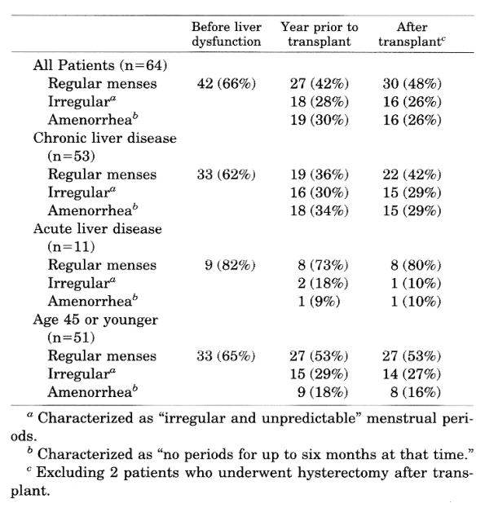
Menstrual patterns of 64 recipients of liver transplantation
Mass K, et al. Transplantation 1996;62(4):476-479.

Slide 26
Outlines
Background
Thyroid diseases and menstrual disturbances
  Thyrotoxicosis
  Hypothyroidism
Diabetes mellitus and menstrual disturbances
Chronic kidney disease and menstrual disturbances
Chronic liver disease and menstrual disturbances
Lupus and menstrual disturbances
Conclusions

Slide 27
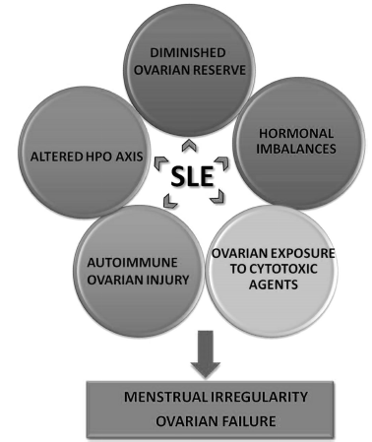
Contributory factors causing menstrual irregularity, ovarian failure, and infertility in women with systemic lupus erythematosus
Oktem O, et al. Obstet Gynecol Surv 2015;70(3):196-210.

Slide 28
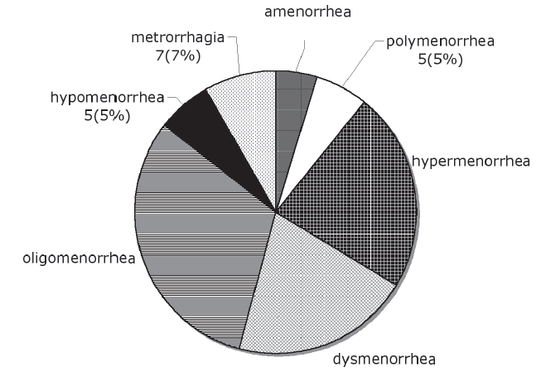
Frequency of menstrual disturbances in 94 SLE patients
(54%)
Shabanova SS, et al. Clin Exp Rheumatol 2008;26:436-441.

Slide 29
Outlines
Background
Thyroid diseases and menstrual disturbances
  Thyrotoxicosis
  Hypothyroidism
Diabetes mellitus and menstrual disturbances
Chronic kidney disease and menstrual disturbances
Chronic liver disease and menstrual disturbances
Lupus and menstrual disturbances
Conclusions

Slide 30
Concluding remarks
  Functional menstrual abnormalities are prevalent in various systemic diseases.
  Despite discovery of several pathophysiologic mechanisms at different levels of the hypothalamic-pituitary-ovarian axis in systemic diseases, there are still many unresolved problems in this topic.
  In patients with menstrual disturbances, especially those with oligo-amenorrhea, clinicians should consider evaluation for systemic diseases focusing on history and physical examinations and an initial laboratory work-up.

Slide 31
Concluding remarks
  In several circumstances, recovery or improvement of the underlying systemic disease results in improvement of the menstrual disturbances; however, in other conditions, type of the treatment itself and some other factors related to the underlying inflammation would result in persistent menstrual abnormalities.

Slide 32

Thanks for your patience!

