Slide 1
Prevention and Treatment of Glucocorticoid-Induced Osteoporosis
Dr.Marjan Khayamzadeh

Slide 2
AGENDA
GIO pathogenesise
fracture risk assessment
fracture risk reassessment
Treatment
Follow up

Slide 3
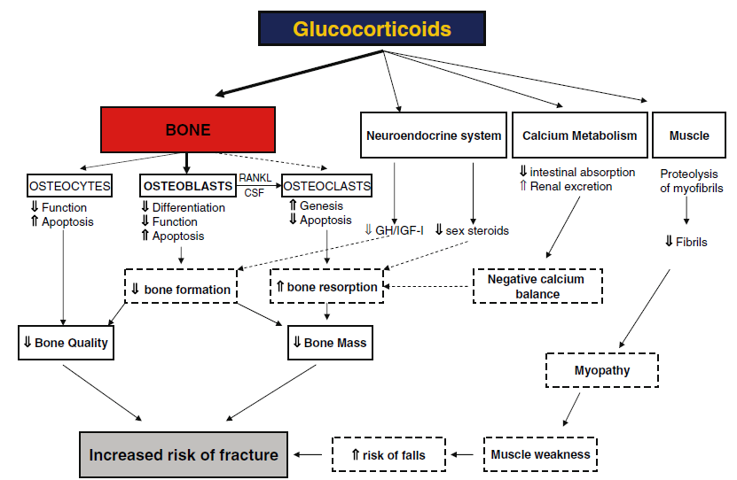

Slide 4
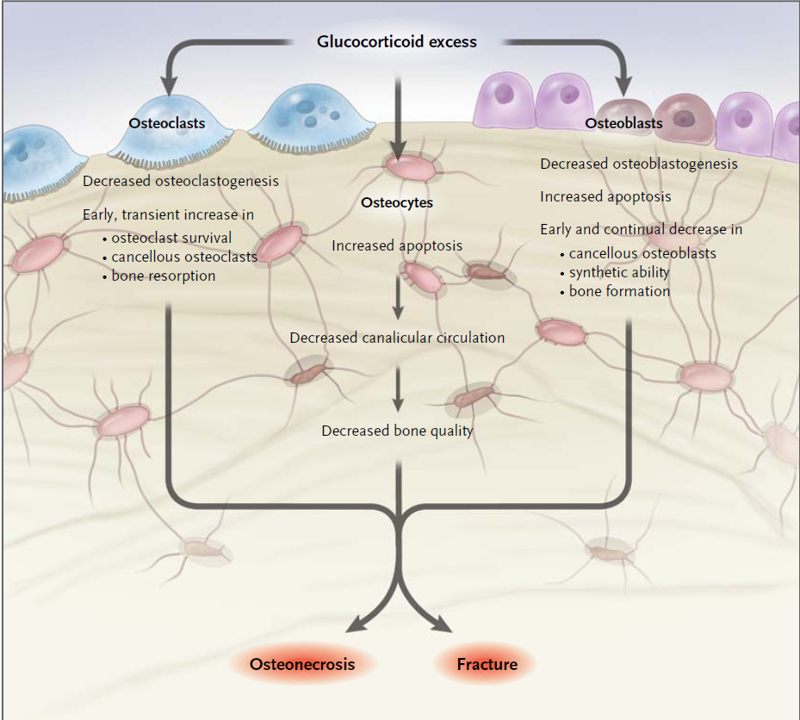

Slide 5
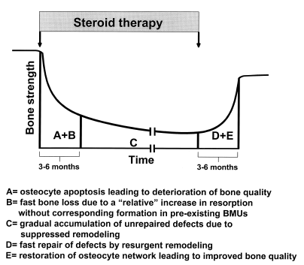

Slide 6
GC treatment is a potentially reversible risk factor for glucocorticoid-induced osteoporosis
if GC treatment is terminated, BMD increases and fracture risk declines.
In addition, the absolute risk of future fracture
in an individual is substantially influenced by demographic and other characteristics

Slide 7
(age, race, sex, and concomitant OP risk factors).
For these reasons, it is important to identify those patients taking GCs for whom the benefits of preventive therapy sufficiently outweigh potential harms.

Slide 8
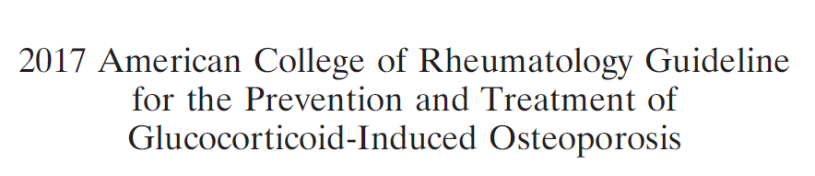

Slide 9
Recommendations

Slide 10
A strong recommendation means that the Panel was confident that the desirable effects of following the recommendation outweigh the undesirable effects(or vice versa), so the course of action would apply to all or almost all patients, and only a small proportion would not want to follow the recommendation.

Slide 11
A conditional recommendation means that the
Panel believed the desirable effects of following
the recommendation probably outweigh the undesirable effects, so the course of action would
apply to the majority of the patients, but some
may not want to follow the recommendation.

Slide 12
A good practice recommendation means that although the Panel believed the benefits of proceeding according to the guidance far outweigh the harms, the supporting evidence is indirect, and the Panel did not formally assess the relevant evidence.

Slide 13
More than 10% of patients who receive long-term GC treatment are diagnosed with a fracture.
30–40% have radiographic
evidence of vertebral fractures.

Slide 14
Recommendations for fracture risk assessment and reassessment

Slide 15
All of the fracture risk assessment and reassessment recommendations are made as good practice recommendations.

Slide 16
In all adults and children, an initial clinical fracture risk assessment should be performed as soon as possible, but at least within 6 months of the initiation of long-term GC treatment.

Slide 17
This assessment should include a history with the details of GC use (dose, duration, pattern
of use), an evaluation for falls, fractures, frailty, and other risk factors for fracture (malnutrition, significant weight loss or low body weight, hypogonadism, secondary hyperparathyroidism, thyroid disease, family history of hip fracture, history of alcohol use

Slide 18
[at >3 units/day] or smoking) and other clinical comorbidities, and a physical examination including measurement of weight and height (without shoes), testing of muscle strength, and assessment for other clinical findings of undiagnosed fracture (i.e., spinal tenderness, deformity, and reduced space between lower ribs and upper pelvis) as appropriate given the patient’s age.

Slide 19
In addition, for adults >40 years of age, the initial absolute fracture risk should be estimated using FRAX with the adjustment for GC dose and BMD testing (if available, or without BMD if it is not available) as soon as possible, but at least within 6 months of the initiation of GC treatment.

Slide 20
For adults <40 years of age, BMD testing
should be done as soon as possible but at least within 6 months of the initiation of GC treatment if the patient is at high fracture risk because of a history of previous OP fracture(s) or if the patient has other significant OP risk factors (malnutrition, significant weight loss

Slide 21
or low body weight, hypogonadism, secondary hyperparathyroidism, thyroid disease, family history of hip fracture, smoking, alcohol use at >3 units/day).

Slide 22
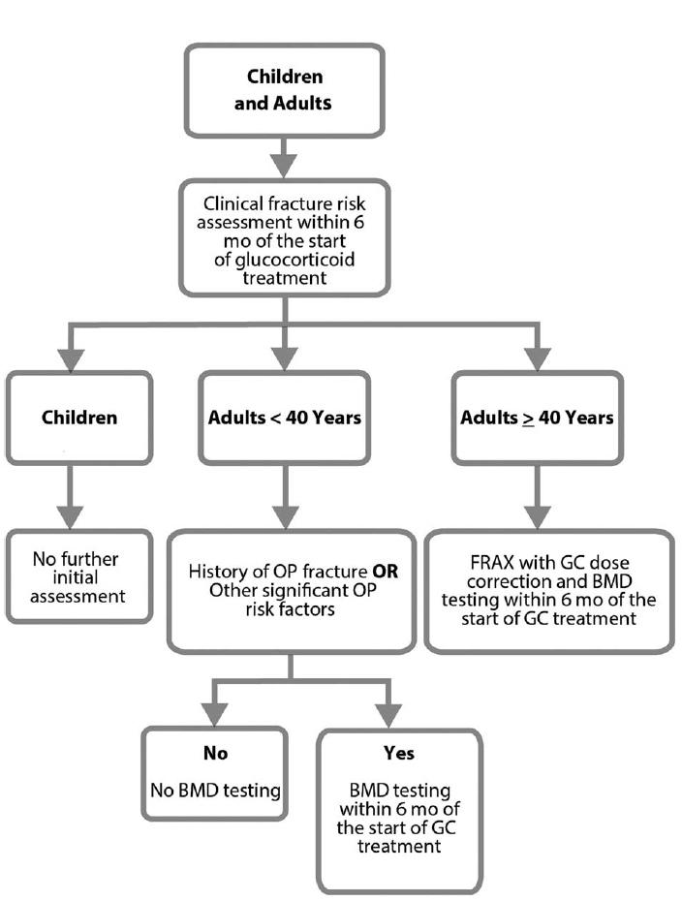

Slide 23
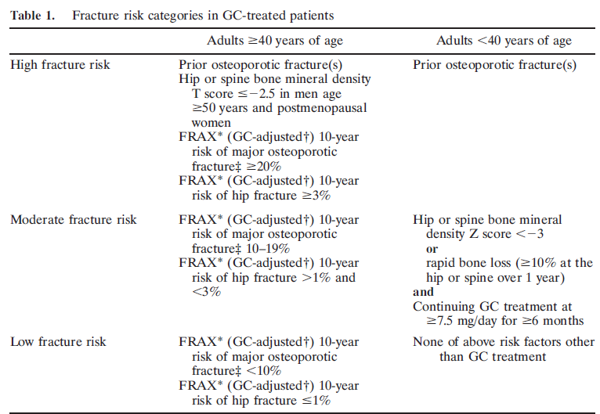

Slide 24
Increase the risk generated with FRAX by 1.15 for major osteoporotic fracture and 1.2 for hip fracture
if glucocorticoid (GC) treatment is >7.5 mg/day (e.g., if hip fracture risk is 2.0%, increase to 2.4%).
Major osteoporotic fracture includes fractures of the spine (clinical), hip, wrist, or humerus.

Slide 25
Reassessment of fracture risk:
In all adults and children who continue GC treatment, a clinical fracture risk reassessment should be performed every 12 months

Slide 26
For adults >40 years of age who continue GC treatment and are not treated with an OP medication beyond calcium and vitamin D, reassessment with FRAX, with BMD testing if available, should be completed every 1–3 years. This reassessment should be performed earlier within this 1–3-year time range for adults age >40 years who are receiving very high doses of GCs.

Slide 27
(initial prednisone dose >30 mg/day,
cumulative dose >5 gm in the previous year) or those with a history of OP fracture(s).
Later or less frequent testing within this range can be done for adults age >40 years who are taking lower doses of GCs with no other OP risk factors.

Slide 28
For adults >40 years old who continue GC treatment and are currently treated with an OP medication in addition to calcium and vitamin D, BMD testing should be completed every 2–3 years during treatment in highrisk patients such as those receiving very high-dose GCs(initial prednisolone dose>=30mg/dl,

Slide 29
cumulative dose 5 gm in the previous year), a history of OP fracture occurring after >18 months of treatment with antifracture medication (other than calcium and vitamin D),risks for poor medication adherence or absorption, or other significant OP risk factors.

Slide 30
For adults >40 years old who received an OP treatment in the past but are no longer being treated with an OP medication other than calcium and vitamin D, BMD testing should be done every 2–3 years.

Slide 31
Within this range, reassessment should be conducted earlier in patients receiving higher doses of GCs and those with a history of fracture or low BMD, and later in those receiving lower doses of GCs, with higher BMD and no other OP risk factors.

Slide 32
Adults <40 years of age. For all adults <40
years of age who continue GC treatment and are at moderate-to-high fracture risk (history of previous fracture, BMD Z score < -3, received very high-dose prednisone
[>=30 mg/day and cumulative dose >5 gm] in

Slide 33
the previous year, risks for poor medication adherence or absorption, or multiple OP risk factors), BMD testing should be done every 2–3 years.

Slide 34
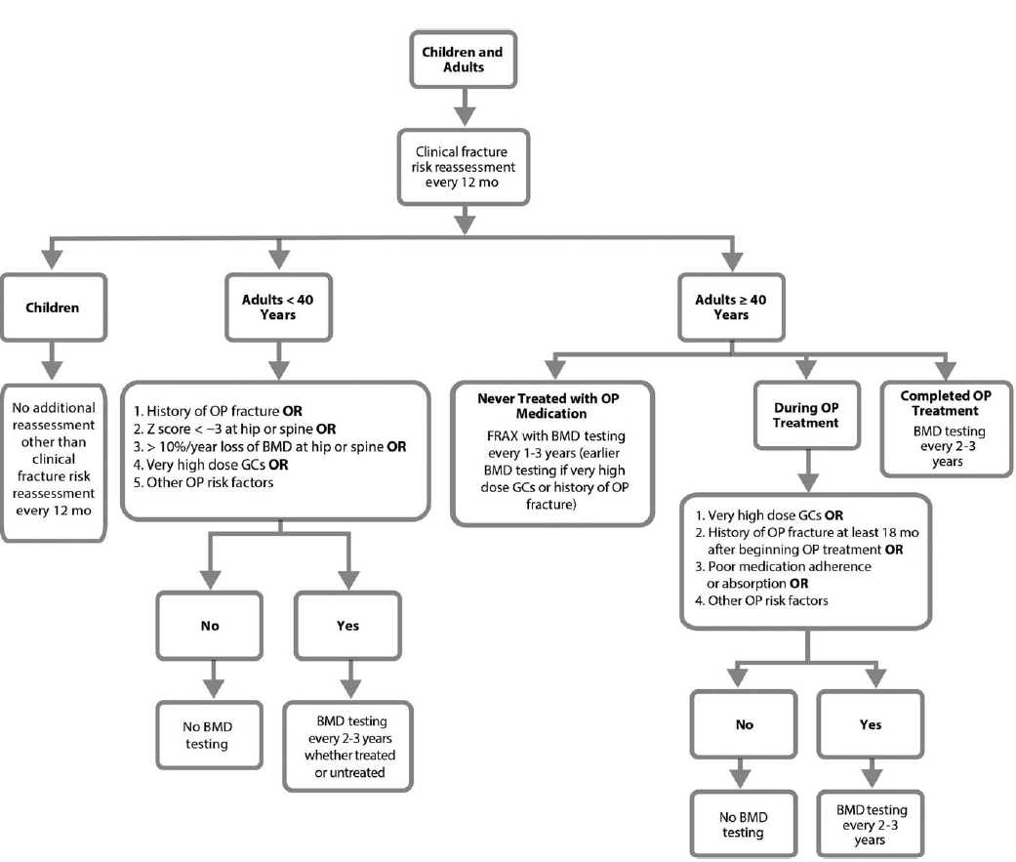

Slide 35
Recommendations for treatment

Slide 36
Calcium and vitamin D intake and lifestyle
modifications:
Optimizing calcium intake (1,000–1,200 mg/day) and vitamin D intake (600–800 IU/day; serum level >=20 ng/ml)

Slide 37
lifestyle modifications (a balanced diet, maintaining weight in the recommended range, smoking cessation, regular weightbearing or resistance training exercise, limiting alcohol intake to 1–2 alcoholic beverages/day)
(conditionally recommended for all patients receiving GC treatment)

Slide 38
Initial pharmacologic treatment.
Adults >=40 years of age. Women>=40 years of age and not of childbearing potential and men >=40 years of age who are at moderate-to-high risk of fracture should be treated with an oral bisphosphonate
(strong recommendation for those at high risk; conditional recommendation for those at moderate risk).

Slide 39
For patients in whom oral bisphosphonates are not appropriate (for example, due to comorbidities, patient preference, or concerns about adherence with an oral medication regimen), IV bisphosphonates should be used rather than the patient receiving no additional treatment beyond
calcium and vitamin D.

Slide 40
If bisphosphonate treatment is not appropriate, teriparatide should be used rather than the patient receiving no additional treatment beyond calcium and vitamin D.
If neither oral nor IV bisphosphonates nor teriparatide treatment is appropriate,
denosumab should be used.

Slide 41
For postmenopausal women in whom none of these medications is appropriate, raloxifene should be used rather than the patient receiving no additional treatment beyond calcium and vitamin D.
The order of the preferred treatments was determined based on a comparison of efficacy (fracture reduction), toxicity, and cost.
( These are conditional recommendations)

Slide 42
For adults <40 years of age (women not of childbearing potential and men) with a history of OP fracture, or those continuing GC treatment (>=6 months at a dose of >=7.5 mg/day) who have either a hip or spine BMD Z score<-3 or bone loss of>=10%/year at the hip or spine as assessed by DXA, an oral bisphosphonate

Slide 43
be used rather than the patient receiving no additional treatment beyond calcium and vitamin D. If treatment with an oral bisphosphonate is not appropriate, the same alternative medications listed for adults >=40 years of age are recommended with the exception of raloxifene, which is not used in men and premenopausal women.
(These are conditional recommendations)

Slide 44
Special populations:
For women who meet criteria for moderate-to-high risk of fracture and are of childbearing potential , but do not plan to become pregnant within the period of OP treatment and are using effective birth control or are not sexually active, an oral bisphosphonate should

Slide 45
be used rather than the patient receiving no additional treatment beyond calcium and vitamin D.
If oral bisphosphonate treatment is not appropriate, teriparatide should be used rather than the patient receiving no additional
treatment beyond calcium and vitamin D.

Slide 46
Because of the lack of safety data and the potential fetal harm associated with denosumab in animal studies and with high-dose IV bisphosphonates , these therapies should be used only in women who are at high risk of fracture in whom treatment with an oral bisphosphonate and teriparatide

Slide 47
is not appropriate. Denosumab or IV bisphosphonate treatment should be initiated only after a discussion with the patient about the very low quality of evidence about fetal harms in the event of an unplanned pregnancy.
(These are conditional recommendations)

Slide 48
There is a lack of data on the safety of currently available OP treatments during pregnancy. Therefore, these guidelines do not include recommendations about OP prevention or treatment, other than calcium and vitamin D intake and lifestyle modification, in women who are pregnant.

Slide 49
For adults 30 years of age who are receiving very
high-dose GC treatment (initial prednisone dose of >=30 mg/day [or equivalent GC exposure] and a cumulative annual dose of >5 gm) , oral bisphosphonate treatment should be initiated. If treatment with an oral bisphosphonate is not appropriate, the age-related recommendations for second-line therapy should be followed
(These are conditional recommendations)

Slide 50
For adults who have received an organ transplant and who are continuing treatment with GCs , the age-related treatment recommendations outlined in these guidelines for men and women who do not have transplants should be followed if the glomerular filtration rate is >=30 ml/minute and there is no evidence of metabolic bone disease.

Slide 51
An evaluation by an expert in metabolic bone disease is recommended before initiating pharmacologic treatment in adults with a renal transplant .
The Panel made a recommendation against the use of denosumab because of lack of safety data in this population of patients who are treated with multiple immunosuppressive agents.
(These are conditional recommendations)

Slide 52
For GC-treated children 4–17 years of age, a calcium intake of 1,000 mg/day and vitamin D intake of 600 IU/day is recommended. For children who have had an OP fracture who continue GC treatment at a dose of >=0.1 mg/kg/day for >=3 months, treatment with an oral bisphosphonate (or an IV bisphosphonate if oral treatment is not appropriate) is recommended .
(These are conditional recommendations)

Slide 53
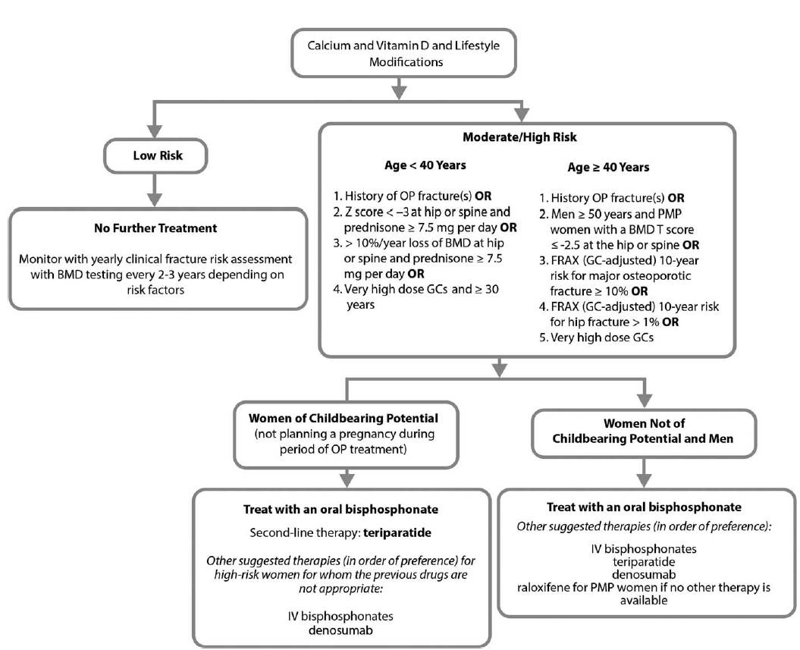

Slide 54
Follow-up treatment recommendations

Slide 55
Initial treatment failure
Treatment if moderate-to-high fracture risk persists after bisphosphonate therapy
Treatment if GCs are discontinued

Slide 56
Initial treatment failure
Adults age >=40 years continuing GC treatment who have had a fracture that occurred after >=18 months of treatment with an oral bisphosphonate or who have had a significant loss of bone mineral density (>=10%/year):

Slide 57
Treat with another class of OP medication (teriparatide or denosumab; or, consider IV bisphosphonate if treatment failure is judged to be due to poor absorption or poor medication adherence) recommended rather than the patient receiving no additional treatment beyond calcium and vitamin D alone or continuing oral bisphosphonate treatment.
(conditional recommendation)

Slide 58
Treatment if moderate-to-high fracture risk persists after bisphosphonate therapy
For adults >=40 years of age who have completed 5 years of oral bisphosphonate treatment who are continuing GC treatment and are assessed to be at moderate-to-high risk of fracture, continuation of active OP treatment (in addition to calcium and vitamin D) is recommended rather than the patient receiving no additional treatment beyond calcium and vitamin D.

Slide 59
Suggested treatment options include continuing the oral bisphosphonate for 7–10 years, switching to an IV bisphosphonate if absorption or adherence is a problem, or treatment with another class of OP medication (teriparatide or denosumab),
depending on the response to the initial

Slide 60
Bisphosphonate treatment (change in BMD, new fractures) and with consideration of rare risks, including jaw necrosis and atypical
femur fractures, which might increase with the
duration of antiresorptive therapy.
(conditional recommendations)

Slide 61
Treatment if GCs are discontinued
Adults age >=40 years taking an OP medication in addition to calcium and vitamin D who discontinue GC treatment and are assessed to be at low risk of fracture:
Discontinue the OP medication but continue calcium and vitamin D over continuing the OP medication.
(Conditional recommendation)

Slide 62
Adults age >=40 years taking an OP medication in addition to calcium and vitamin D who discontinue GC treatment and are assessed to be at moderate-to-high risk of fracture:
Complete the treatment with the OP medication over discontinuing the OP medication.
(strong recommendation for high risk and conditional recommendation for moderate risk)

Slide 63
Alendronate
48 week ,randomized,placebo-controlled study,two doses of alendronate
477 men and women,17 to 83 years of age
Primary end point:change in lumbar BMD
Result:the mean lumbar BMD increased by 2.1+/- 0.3 % and 2.9+/- 0.3 %.in 5 and 10 mg per day of alendronate and decreased by 0.4+/-0.3% in placebo group.

Slide 64
Risedronate
12 months double-blind placebo controlled study
290 men and women
Primary end point:lumbar BMD
Result:increased BMD by a mean of 2.9% at lumbar spine,BMD was maintained only in the control group

Slide 65
Risedronate &Zolendronate
12 months double blind study,5mg IV zolendronic acid versus 5 mg oral residronate
833 men and women randomised 1:1
Primary end point:lumbar BMD
Result:zolendronic acid was non inferior and superior to residronate for increase of lumbar BMD in treatment and prevention

Slide 66
Teriparatide & Alendronate
18 month randomized double-blind controlled trial
428 women and men ,22 to 89 years
Primary out come:lumbar BMD
Result:increased BMD in teriparatide 7.2+/-0.7% more than alendronate group 3.4+/-0.7%

Slide 67
Teriparatide & Risedronate
18 months randomized open labled trial ,20 micg/d teriparatide versus 35 mg/week risedronate
92 men,mean age 56.3 y,Tscore <-1.5
Primary out come:lumbar BMD
Results:increased trabecular BMD significantly greater with teriparatide 16.3% versus 3.8%

