Slide 1
In the Name of God

Slide 2
Case Presentation
By:Dr Rezvankhah.B
Dr Riahi.R
March, 2017

Slide 3
ID: A 24 year old man,single,born in Tehran,Living in Tehran,worker,elementary education,has 4 siblings(2 brothers & 2 sisters)
CC:Lack of facial hair

Slide 4
PI: A 24 y-o ♂ came to our clinic with CC of lack of facial hair.
He claimed his bear had been growing in puberty until he had a genitourinary operation;after that his fascial hair regressed.
He also was concerned about his phallus size,he said he had hetero sexual desire and intercourse but he did not have ejaculation.

Slide 5
He stated in newborn he had been discovered to have abnormalities in external genitalia in the form of hypospadias and bilateral undescended testes,at the age 4 his parents were advised to accept a feminizing operation but they refused.
As he told,puberty started at the age of 13 like his older brother,he gained weight and had height spurt plus fascial hair growth at that age. Pubic & axillary hair had appeared 1 or 2 years before that.
No cyclic menstruation

Slide 6
In 1387 he had an operation to fix his testes and repair hypospadias;
Surgery Report:Bilateral Abdominal Gonads + Uterus+ Hypospadias
Retroperitoneal region was expelored,there were no testes found.In intraperitoneal region,there were a uterus midline and bilateral gonads;Rt sided gonad was removed because of sever adhesion and cord shortness,the uterus was expelled too and Lt gonad was pulled down and fixed in high scrotal region.

Slide 8
PMH: cryptorchidism and hypospadias surgery in 1378,hypospadias surgery in 1389 & 1395(before surgery meatus was near to penoscrotal junction), Thyroid disease(-) Renal disease(-)
FH: father’s height:167
mother’s height:162
both brothers are approximately as tall as the patient and have bear & body hair.
his older brother is married and has children.

Slide 9
Ph/Ex
BP:110/80 | BW: 90 Kg
PR: 88/min | Height:162 Cm
RR: 17/min | BMI:34.2
T: 36.5 ◦C | Arm span:168 Cm

Slide 10
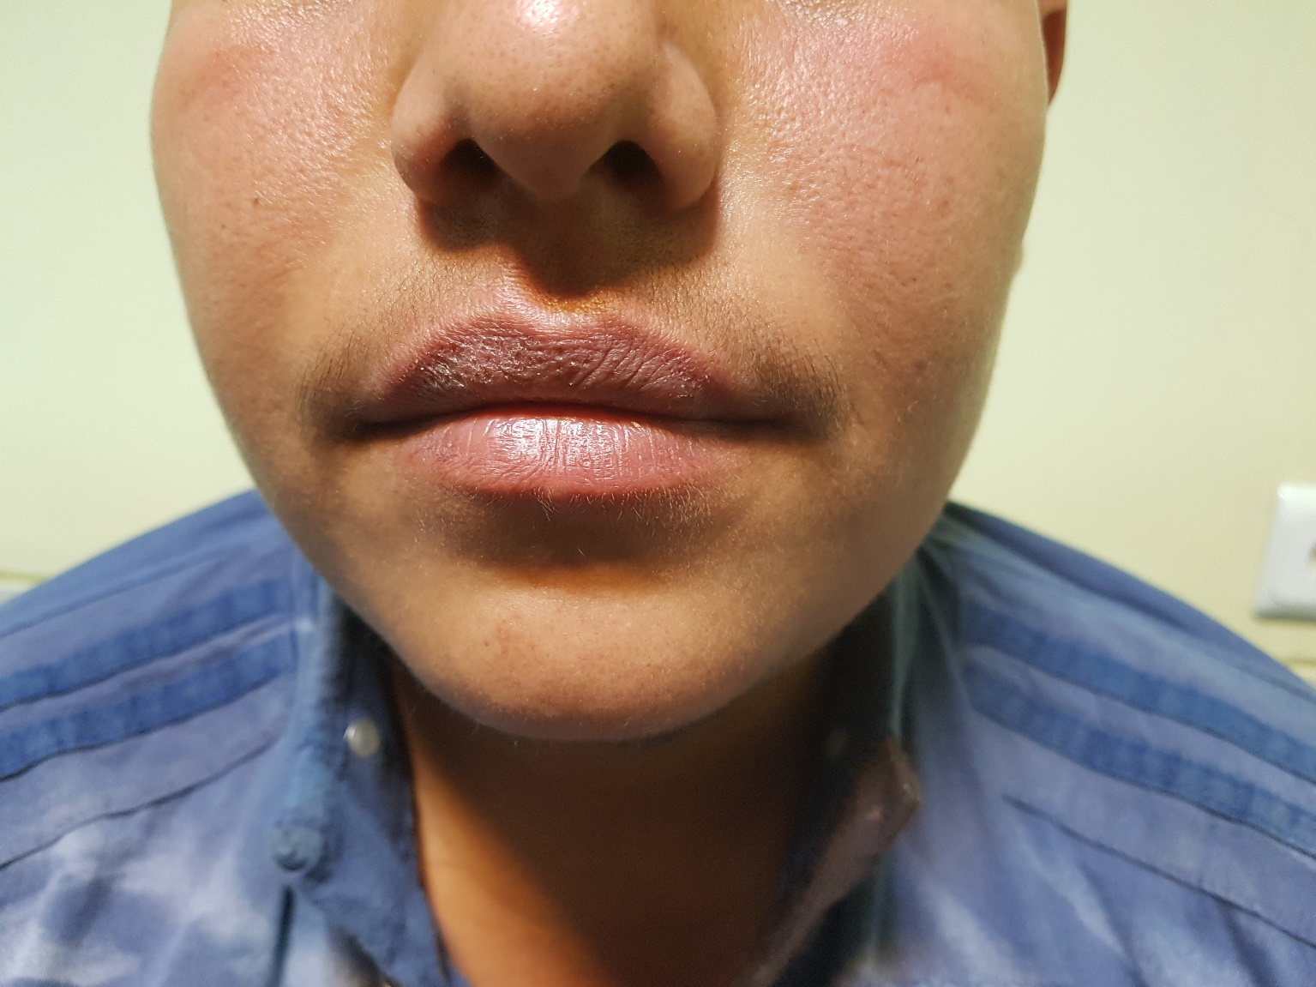

Slide 11
H&N: fascial deformity(-) vellus hair on the chin(+) low-set hair line(-) webbed neck(-)
Thyroid examination→ NL
Chest: shield chest(-) lipomastia(+)
Abdomen: mid line surgery scar(+) abdominal obesity
Ext: bone deformity(?)
Genitalia: Pigmented scrotolabial fold,partially fused,no labia minor,no other meatus.
An unstretched 3-cm phallus
Lf gonad was palpated as a soft & oval mass measured 1.5*0.5cm in high scrotal region
EMS:4

Slide 12
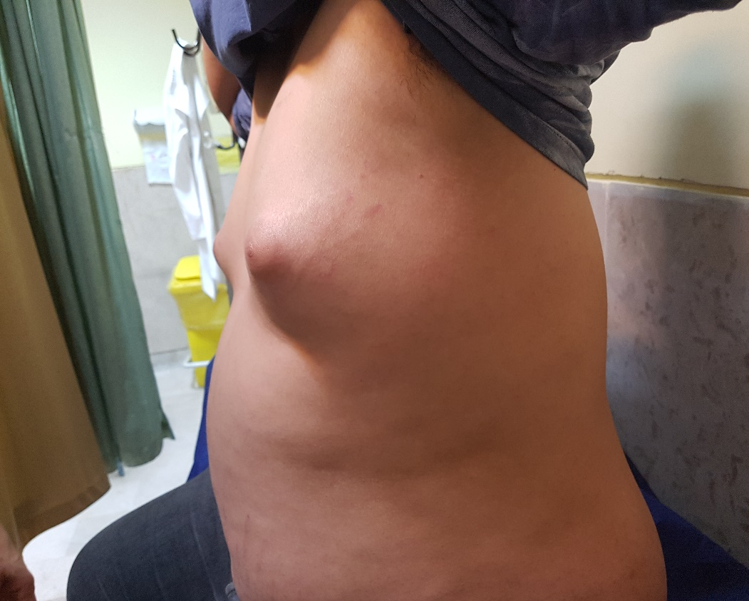

Slide 15
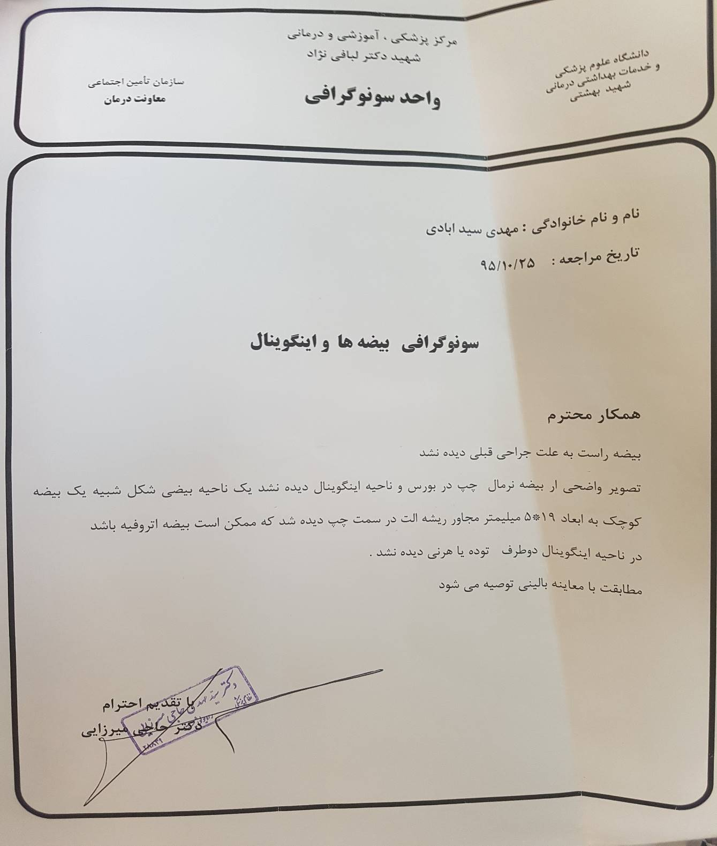

Slide 16
Lab data:
FSH | 56 miu/l | 1.5-12.4
LH | 31 miu/ml | 1.7-8.6
Prolactin | 14.3 ng/ml | 4-15.2
Testosterone | 0.1ng/ml | 2-9.8

Slide 17
Problem List:
A young man with ambiguous genitalia(hypospadias and bilateral UDT)
Hx of unilateral gonadectomy & hysterectomy
EMS:4

