Slide 2
Adolescent Bariatric surgery
KHALAJ A.R. M.D
Obesity Clinic
Mostafa Khomini Hospital
Shahed University
Tehran
www.iranobesity .com

Slide 3
زيان چاقي زياد
روي هم رفته چاق بيش از حد كه به سن رشد رسيده باشد براي مرگ نابهنگام آماده تر از غير خودشانند.بويژه اگر هم از اوايل زندگي چاق پرورده شده باشند و به جواني و سن رشد برسند مرگ در انتظارشان است ... رگهايشان نازك و باريك و زير فشار واقع شده اند. بسا آسان سكته، فلج، خفقان، فساد معده و روده، سوء تنفس، غش كردن و تبهاي بغرنج و شديد مهمان اين بدن چاق مي شوند.
شيخ الرئيس ابوعلي سينا، قانون در طب، كتاب اول، ترجمه عبدالرحمن شرفكندي Medicine Avicenna (980-1037 AD), The Canon of

Slide 4
EFFECTIVENESS OF BARIATRICSURGERY
Reduction of comorbidities
Reduction in mortality
Surgery compared to medical treatment
Treatment for type 2 diabetes

Slide 5
Reduction of comorbidities
Meta-analysis: surgical treatment of obesity.
Ann Intern Med 2005 Apr 5;142(7):547-59.
Maggard MA; et al
147 studies
Bariatric surgery: a systematic review and meta-analysis.
AU Buchwald H; Avidor Y; Braunwald E; Jensen MD; Pories W; Fahrbach K; Schoelles K
SO JAMA 2004 Oct 13;292(14):1724-37
136 fully extracted studies,

Slide 6
• Diabetes completely resolved in 77 percent and resolved or improved in 86 percent.
• Hyperlipidemia improved in 70 percent or more of patients.
• Hypertension resolved in 62 percent and resolved or improved in 79 percent.

Slide 7
• Obstructive sleep apnea resolved in 86 percent and resolved or improved in 84 percent.
• Gastroesophageal reflux symptoms improve and complete or partial regression of Barrett's esophagus has been demonstrated.

Slide 8
Reduction in mortality
Long-term mortality after gastric bypass surgery.
Adams TD; et al
N Engl J Med. 2007 Aug 23;357(8):753-61.
cohort study
from 1984 to 2002
9949 patients who had undergone gastric bypass surgery
9628 severely obese in control group

Slide 9
Effects of bariatric surgery on mortality in Swedish obese subjects.
AU Sjostrom L; Narbro K; Sjostrom CD; Karason K; Larsson B; Wedel H; Lystig T; Sullivan M; Bouchard C; Carlsson B; Bengtsson C; Dahlgren S; Gummesson A; Jacobson P; Karlsson J; Lindroos AK; Lonroth H; Naslund I; Olbers T; Stenlof K; Torgerson J; Agren G; Carlsson LM
SO N Engl J Med. 2007 Aug 23;357(8):741-52.

Slide 10
. Deaths from all causes were reduced by 40 percent,
from diabetes by 92 percent,
from coronary disease by 56 percent,
and from cancers by 60 percent.
Although the majority of mortality data for bariatric surgery comes from patients under age 65, a retrospective cohort analysis suggests that survival is improved, even in patients over age 65

Slide 11
Surgery compared to medical treatment
The Swedish Obese Subjects (SOS) study--rationale and results.
Swedish obese subjects (SOS)--an intervention study of obesity. Two-year follow-up of health-related quality of life (HRQL) and eating behavior after gastric surgery for severe obesity.
Effects of bariatric surgery on mortality in Swedish obese subjects.

Slide 12
Weight decreased by 23 percent after two years in the surgery group while it increased in the control group by 0.1 percent [35].
After 10 years, weight had decreased by 16 percent in the surgery group and increased in the control group by 1.6 percent
The surgery group had better two and 10-year incidence rates of diabetes, hypertriglyceridemia, lowered HDL levels, improved hypertension and hyperuricemia rates.

Slide 13
Treatment for type 2 diabetes
Adjustable gastric banding and conventional therapy for type 2 diabetes: a randomized controlled trial.
Improvement in glucose metabolism after bariatric surgery: comparison of laparoscopic Roux-en-Y gastric bypass and laparoscopic sleeve gastrectomy: a prospective randomized trial.
Cost-efficacy of surgically induced weight loss for the management of type 2 diabetes: a randomized controlled trial.

Slide 14
Participants randomized to surgical therapy were more likely to achieve remission of type 2 diabetes through greater weight loss.
Both procedures markedly improved glucose homeostasis.
Surgical therapy appears to be a cost-effective option for managing type 2 diabetes in class I and II obese patients.

Slide 15
History of weight loss surgery In Adolescents
Weight loss surgery has been performed in small groups of adolescents since the late 1970s
between 1996 and 2000, the annual number of surgical weight loss procedures in adolescents remained stable
between 2000 and 2003, the rate of surgical weight loss procedures in adolescents tripled to an estimated 771 procedures nationwide

Slide 16
In a survey of bariatric surgeons in the United States in 2005, 75 percent indicated they were planning to perform an adolescent procedure in the upcoming year.
Nonetheless, weight loss surgery for adolescents remains a small percentage of overall annual weight loss surgery procedures in the United States (0.7 percent)

Slide 17
Defining severe obesity
BMI ≥120 percent of the 95th percentile, or ≥35 kg/m2
This threshold corresponds to approximately the 99th percentile (z-score 2.33),
For boys, the 99th percentile for BMI is approximately 32 kg/m2 at 13 years of age and rises to 34 at 16 years of age.
For girls, the 99th percentile for BMI is approximately 34 at 13 years of age, and rises to 36 kg/m2 at age 15, and 38 by age 16.

Slide 18
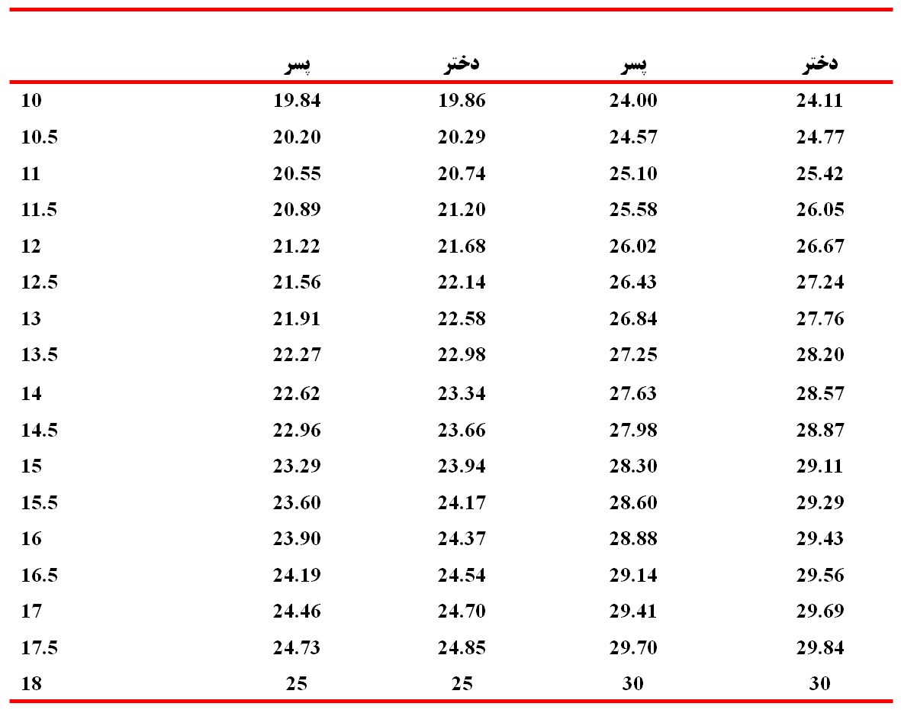
جدول رابطه BMI و اضافه وزن و چاقی در افراد بین 10 تا 18 سال
سن ( سال)
اضافه وزن
چاقی
منبع: Cole et al. BMJ 2000; 320: 1240

Slide 19
OUTCOMES
Despite these limitations, the existing retrospective data clearly demonstrate that both gastric bypass and banding in adolescents lead to clinically important and durable decreases in weight and BMI in the majority of patients
The largest retrospective series of adolescents after gastric bypass reported a 37 percent overall reduction in BMI at one year postoperatively
Lawson ML, Kirk S, Mitchell T, et al. One-year outcomes of Roux-en-Y gastric bypass for morbidly obese adolescents: a multicenter study from the Pediatric Bariatric Study Group. J Pediatr Surg 2006; 41:137.

Slide 20
Weight loss outcomes are often reported as percentage of excess weight loss (EWL). Several series have reported 56 to 62 percent EWL after roux-en-Y gastric bypass
Strauss RS, Bradley LJ, Brolin RE. Gastric bypass surgery in adolescents with morbid obesity. J Pediatr 2001; 138:499.
Sugerman HJ, Sugerman EL, DeMaria EJ, et al. Bariatric surgery for severely obese adolescents. J Gastrointest Surg 2003; 7:102.

Slide 21
In two studies of adolescents undergoing AGB, mean weight loss after ranged from 52 to 60 percent EWL at one- and two-years follow-up
One study reported 70 percent EWL (range 37 to 101 percent) in 18 patients followed for three years after AGB Al-Qahtani AR. Laparoscopic adjustable gastric banding in adolescent: safety and efficacy. J Pediatr Surg 2007; 42:894.Dillard BE 3rd, Gorodner V, Galvani C, et al. Initial experience with the adjustable gastric band in morbidly obese US adolescents and recommendations for further investigation. J Pediatr Gastroenterol Nutr 2007; 45:240.

Slide 22
A prospective series reported somewhat less weight loss (34 percent EWL at 12 months and 41 percent EWL at 18 months. This study was limited by a 20 percent dropout rate (5 of 25 patients were unavailable for data collection). Holterman AX, Browne A, Tussing L, et al. A prospective trial for laparoscopic adjustable gastric banding in morbidly obese adolescents: an interim report of weight loss, metabolic and quality of life outcomes. J Pediatr Surg 2010; 45:74.

Slide 23
A randomized trial of 50 adolescents compared AGB to a supervised lifestyle intervention, with two-year follow-up [39]. The patients in the AGB group lost an average of 34.6 kg or 79 percent EWL, as compared with 3.0 kg or 13 percent EWL in the lifestyle group. O'Brien PE, Sawyer SM, Laurie C, et al. Laparoscopic adjustable gastric banding in severely obese adolescents: a randomized trial. JAMA 2010; 303:519.

Slide 24
At study entry, 36% of band patients and 40% of lifestylepatients had metabolic syndrome, and at 24 months no band patients had metabolicsyndrome compared with 44% of the lifestyle modification patients.
Notably, the bandgroup had a 33% reoperative rate at 2 years because of band slippage, pouch dilation,and injury to port site tubing

Slide 25
obesity-related diseases usually improve or resolve after surgically induced weight loss in adolescents. The most dramatic improvements have been seen in insulin resistance, triglyceride levels, diabetes, obstructive sleep apnea, as well as depression and quality of life [4,21,37,41,42].

Slide 26
Two studies with 4 to 10 years of follow-up suggest that 10 to 15 percent of patients regain significant weight after gastric bypass procedures Strauss RS, Bradley LJ, Brolin RE. Gastric bypass surgery in adolescents with morbid obesity. J Pediatr 2001; 138:499.
Rand CS, Macgregor AM. Adolescents having obesity surgery: a 6-year follow-up. South Med J 1994; 87:1208.

Slide 27
In one retrospective series of 24 adolescents, maximal EWL (52 percent) occurred at one year after adjustable gastric banding with a regression to 42 percent EWL at two and three years [35]. Dillard BE 3rd, Gorodner V, Galvani C, et al. Initial experience with the adjustable gastric band in morbidly obese US adolescents and recommendations for further investigation. J Pediatr Gastroenterol Nutr 2007; 45:240.

Slide 28
Till and colleaguespublished a series of four children aged 8 to 17 years with obesity and serious medicalcomorbidities who underwent sleeve gastrectomy.
No postoperative complications
occurred,
and at mean follow-up of 12 months, mean BMI had decreased from 48.4
to 37.2 kg/m2.

Slide 29
Recommended evaluation of an adolescent considering bariatric surgery
Anthropometrics
Systolic and diastolic blood pressure
Waist circumference
Weight Height
Tanner Stage ≥4

Slide 30
Laboratory testing
Fasting lipid profile
Fasting insulin and glucose
Oral glucose tolerance test
Hemoglobin A1C
Liver profile
TSH

Slide 31
Diagnostic evaluations
Polysomnography
Echocardiogram
Electrocardiogram
Urea breath test or endoscopy to exclude helicobacter pylori infection
Bone age if needed to assess skeletal maturity (attainment of ≥95 percent of predicted adult height

Slide 32
Comprehensive psychological evaluation
Evaluation by pediatric psychologist or psychiatrist to screen for cognitive and psychiatric disorders, assess emotional maturity, decisional capacity and family support

Slide 33
Patient selection
A multidisciplinary approach is recommended
At a minimum, the team evaluating and caring for the candidate should include an experienced bariatric surgeon, pediatric obesity specialist, nurse, dietician, and pediatric psychologist or psychiatrist.

Slide 34
IPEG guidelines for adolescent bariatric surgery
Be very severely obese (BMI 35 kg/m2) with serious obesity-related comorbidities
OR
Be morbidly obese (BMI 40 kg/m2) with less-serious obesity-related comorbidities
AND
Have attained or, depending on the severity of comorbidity, nearly attained adult stature
Have at least 6 months of failed organized conventional attempts at weight management

Slide 35
Shown commitment to comprehensive pediatric psychological evaluation both before and
after surgery and agree to avoid pregnancy for at least 1-year postoperatively
Be capable of and willing to adhere to nutritional guidelines postoperatively
Have decisional capacity and provide informed assent for surgical management

Slide 36
Serious comorbid conditions
Type 2 DM
OSA (apnea-hypopnea index [AHI] >5 events per hour)
Pseudotumor cerebri

Slide 37
Less-serious comorbidities:
Weight-related arthropathy
OSA (AHI>5 events per hour)
Hypertension
Dyslipidemia
Venous stasis disease
Panniculitis
Urinary Incontinence
Significant impairment in activity of daily living
NAFLD (includes steatohepatitis)
Gastroesophageal reflux
Severe psychosocial distress
Significantly impaired quality of life

Slide 38
Contraindications
Medically correctable cause of obesity
An ongoing substance abuse problem (within the preceding year)
A medical, psychiatric, psychosocial, or cognitive condition that prevents adherence to post-operative dietary and medication regimens or impairs decisional capacity
Current or planned pregnancy within 12 to 18 months of the procedure
Inability on the part of the patient or parent to comprehend the risks and benefits of the surgical procedure

Slide 39
Types of bariatric procedures
Restrictive
Vertical banded gastroplasty
Laparoscopic adjustable gastric band
Sleeve gastrectomy
Malabsorptive
Jejunoileal bypass
Biliopancreatic diversion
Biliopancreatic diversion with duodenal switch
Combination of restrictive and malabsorptive
Roux-en-Y gastric bypass

Slide 40
Roux en Y gastric bypass

Slide 41
Lap adjustable gastric band

Slide 42
Sleeve gastrectomy

Slide 43
با سپاس از توجه شما

