Slide 1

BMD Interpretation and Its Pitfalls: How to Follow the Patients Accordingly?
Mohammad Hossein Dabbaghmanesh, M.D.
Internist, Professor of Endocrinology ,Director of Internal Medicine Sciences Institute, Deputy Director of Endocrinology and Metabolism Research Center
Shiraz University of Sciences, Shiraz, Iran

Slide 2
DEXA
Dual-energy x-ray absorptiometry (DEXA) is the technique of choice in the assessment of bone mineral density (BMD)
Dual-energy X-ray absorptiometry (DXA) is used for diagnosis of osteoporosis, and for monitoring changes in BMD over time.
Bordbar MR, Haghpanah S, Dabbaghmanesh MH, Omrani GR, Saki F. Bone mineral density in children with acute leukemia and its associated factors in Iran: a case-control study.Arch Osteoporos. 2016 Dec;11(1):36.

Slide 3
DEXA
DEXA is a quick method that is:
Accurate (exact measurement of BMD)
Precise (reproducible),
Flexible (different regions can be scanned)
Performed with a low radiation dose
Vaziri F, Dabbaghmanesh MH, Samsami A, Nasiri S, Shirazi PT. Vitamin D supplementation during pregnancy on infant anthropometric measurements and bone mass of mother-infant pairs: A randomized placebo clinical trial.Early Hum Dev. 2016 Dec;103:61-68.
Noorafshan A, Dabbaghmanesh MH, Tanideh N, Koohpeyma F, Rasooli R, Hajihoseini M, Bakhshayeshkaram M, Hosseinabadi OK. Stereological study of the effect of black olive hydroalcoholic extract on osteoporosis in vertebra and tibia in ovariectomized rats.Osteoporos Int. 2015 Sep;26(9):2299-307.

Slide 4
Procedural steps in DEXA
Procedural steps in DEXA scanning can be broken down into:
Scan acquisition
Analysis
Interpretation
Reporting
Zarei T, Haghpanah S, Parand S, Moravej H, Dabbaghmanesh MH, Omrani GR, Karimi M. Evaluation of bone mineral density in patients with hemoglobin H disease. Ann Hematol. 2016 Aug;95(8):1329-32

Slide 5
Image Acquisition
Areas Scanned
Lumbar spine(vertebral bodies L1–L4)
Proximal femur
Forearm(the distal one third ,33% radius)
Roshanzamir S, Dabbaghmanesh MH, Dabbaghmanesh A, Nejati S. Autonomic dysfunction and osteoporosis after electrical burn.Burns. 2016 May;42(3):583-8.

Slide 6
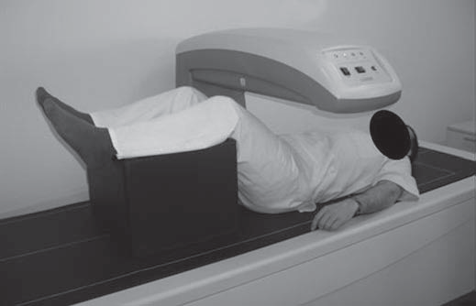
Appropriate Patient Positioning
Photograph shows position for posteroanterior imaging of lumbar spine: supine with hips and knees flexed over support to reduce lordosis
Jeddi M, Dabbaghmanesh MH, Ranjbar Omrani G, Ayatollahi SM, Bagheri Z, Bakhshayeshkaram M. Relative Importance of Lean and Fat Mass on Bone Mineral Density in Iranian Children and Adolescents.Int J Endocrinol Metab. 2015 Jul 1;13(3):

Slide 7
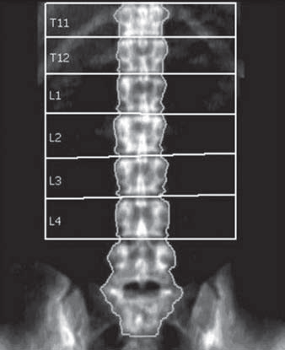
Numbering of vertebral bodies
The ribs appear at T12
The largest transverse processes are L3
The vertebral area values increase from L1 to L4
BMD increases from L1 to L3, and the BMD of L4 is similar to or slightly less than that of L3
Helpful markers are the iliac crest, usually at the L4–L5 interspace, and lowest set of ribs, usually at T12
Hamedani S, Dabbaghmanesh MH, Zare Z, Hasani M, Torabi Ardakani M, Hasani M, Shahidi S. Relationship of elongated styloid process in digital panoramic radiography with carotid intima thickness and carotid atheroma in Doppler ultrasonography in osteoporotic females. J Dent (Shiraz). 2015 Jun;16(2):93-9

Slide 8
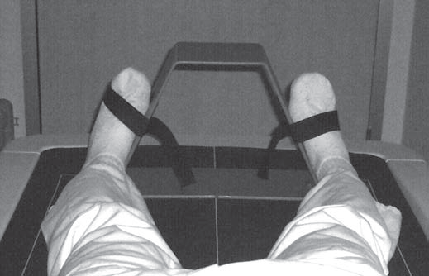
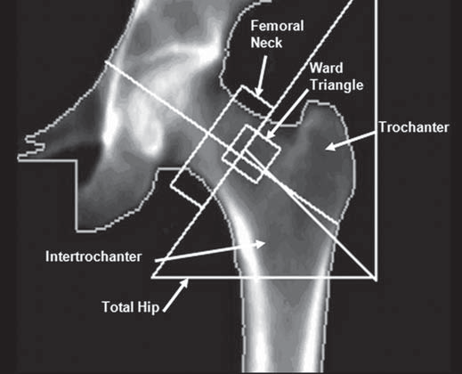
Photograph shows position for imaging of proximal femur: supine with lower extremity internally rotated 15°–30° and slightly abducted to keep femoral axis straight.
Ashouri E, Meimandi EM, Saki F, Dabbaghmanesh MH, Omrani GR, Bakhshayeshkaram M. The impact of LRP5 polymorphism (rs556442) on calcium homeostasis, bone mineral density, and body composition in Iranian children.J Bone Miner Metab. 2015 Nov;33(6):651-7

Slide 9
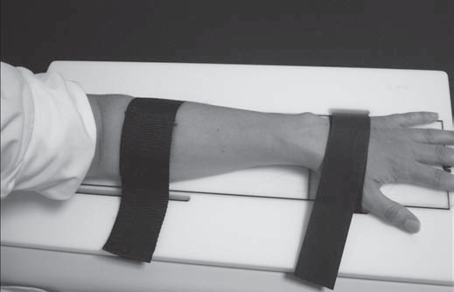
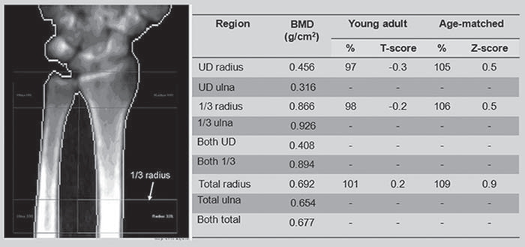
Sitting beside table with forearm resting on table, hand pronated and held by straps.
Khojastehpour L, Mogharrabi S, Dabbaghmanesh MH, Iraji Nasrabadi N. Comparison of the mandibular bone densitometry measurement between normal, osteopenic and osteoporotic postmenopausal women.J Dent (Tehran). 2013 May;10(3):203-9.

Slide 10
Common mistakes in BMD testing.
Indication
Quality control
Acquisition
Analysis
Interpretation
Messina C, Bandirali M, Sconfienza LM, D'Alonzo NK, Di Leo G, Papini GD, Ulivieri FM, Sardanelli F. Prevalence and type of errors in dual-energy x-ray absorptiometry. Eur Radiol. 2015 May;25(5):1504-11.

Slide 11
Who Should Have a Bone Density Test?
^{Indication}
Women age 65 and older Men age 70 and older
Postmenopausal women and men ages 50–69 with clinical risk factors
Adults who have a fracture after age 50
Adults with a condition (e.g., rheumatoid arthritis) or taking a medication (e.g., glucocorticoids) associated with low bone mass or bone loss
NOF: National Osteoporosis Foundation. Clinician’s Guide to Prevention and Treatment of Osteoporosis. www.nof.org. Accessed August 2014.
Notes:
http://nof.org/hcp/clinicians-guide
Conditions, Diseases and Medications That Cause or Contribute to Osteoporosis and Fractures
Lifestyle factors
Alcohol Abuse High salt intake Falling
Low calcium intake Inadequate physical activity Excessive thinness
Vitamin D insufficiency Immobilization
Excess vitamin A Smoking (active or passive)
Genetic factors
Cystic fibrosis Homocystinuria Osteogenesis imperfecta
Ehlers-Danlos Hypophosphatasia Parental history of hip fracture
Gaucher’s disease Idiopathic hypercalciuria Porphyria
Glycogen storage diseases Marfan syndrome Riley-Day syndrome
Hemochromatosis Menkes steely hair syndrome
Hypogonadal states
Androgen insensitivity Hyperprolactinemia Premature ovarian failure
Anorexia nervosa and bulimia Premature menopause Athletic amenorrhea
Turner’s & Klinefelter’s syndromes Panhypopituitarism
Endocrine disorders
Adrenal insufficiency Cushing’s syndrome Central Adiposity
Diabetes mellitus (Types 1 & 2) Hyperparathyroidism Thyrotoxicosis
Gastrointestinal disorders
Celiac disease Inflammatory bowel disease Primary biliary cirrhosis
Gastric bypass Malabsorption
GI surgery Pancreatic disease
Hematologic disorders
Multiple myeloma Monoclonal gammopathies Sickle cell disease
Hemophilia Leukemia and lymphomas Systemic mastocytosis
Thalassemia
Rheumatologic and autoimmune diseases
Ankylosing spondylitis Lupus Rheumatoid arthritis
Other rheumatic and autoimmune diseases
Central nervous system disorders
Epilepsy Parkinson’s disease Stroke
Multiple sclerosis Spinal cord injury
Miscellaneous conditions and diseases
AIDS/HIV Congestive heart failure Muscular dystrophy
Alcoholism Depression Post-transplant bone disease
Amyloidosis End stage renal disease Sarcoidosis
Chronic metabolic acidosis Hypercalciuria Weight loss
Chronic obstructive lung disease Idiopathic scoliosis
Medications
Aluminum (in antacids) Cyclosporine A and tacrolimus Proton pump inhibitors
Anticoagulants (heparin) Depo-medroxyprogesterone (premenopausal contraception) Selective serotonin reuptake inhibitors
Anticonvulsants Glucocorticoids (≥ 5 mg/d prednisone or equivalent for ≥ 3 months) Tamoxifen® (premenopausal use)
Aromatase inhibitors GnRH (Gonadotropin releasing hormone) antagonists and agonists Thiazolidinediones (such as Actos® and Avandia®)
Barbiturates Lithium Thyroid hormones (in excess)
Cancer chemotherapeutic drugs Methotrexate Parenteral nutrition

Slide 12
Quality control
It has been determined that the errors introduced by operator and subject variability are generally greater than errors related to machine performance.
Morgan SL, Prater GL. Quality in dual-energy X-ray absorptiometry scans. Bone. 2017 Jan 31.

Slide 13
Acquisition Pitfall
Incorrect demographic information
External artifacts
Improper patient positioning
Internal artifacts

Slide 14
Incorrect Demographic Information
Morgan SL, Prater GL. Quality in dual-energy X-ray absorptiometry scans. Bone. 2017 Jan 31.

Slide 15
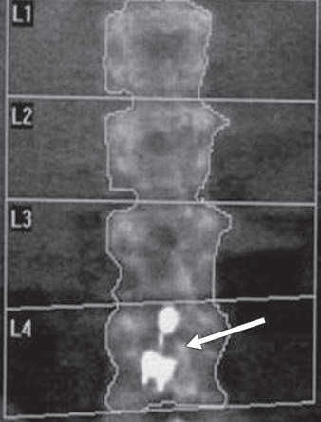
External Artifacts not removed from scanned area
18-year-old girl with anorexia nervosa. Dual energy x-ray absorptiometric (DEXA) image shows density superimposed on L4 (arrow) found to be metallic removable piercing not noticed by technologist.
Examination was repeated after removal of object, and L4 Z-score decreased from 1.6 to –3 and L1–L4 Z-score from –1.7 to –3.
Lorente-Ramos R, Azpeitia-Armán J, Muñoz-Hernández A, García-Gómez JM, Díez-Martínez P, Grande-Bárez M. Dual-energy x-ray absorptiometry in the diagnosis of osteoporosis: a practical guide. AJR Am J Roentgenol. 2011 Apr;196(4):897-904.

Slide 16
Calcium Tablet and Radio contrast
Refrain from taking any calcium containing tables for at least 24 h before the exam, as these tablets can overly the spine and cause false BMD elevations.
Not have undergone within the last 10–14 days any examinations where they received radiocontrast media orally or intravenously (such as barium or iodine based compounds during a contrast CT)
Heilmeier U, Youm J, Torabi S, Link TM. Osteoporosis Imaging in the Geriatric Patient. Curr Radiol Rep. 2016 Apr;4(4).

Slide 17
Artifacts
Two Calcium tablets and one multiple vitamin
External artifacts seen on a right hip DXA scan

Slide 18
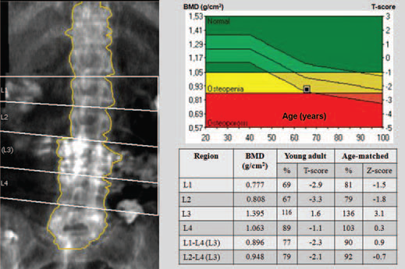
Artifacts caused by contrast material

Slide 19
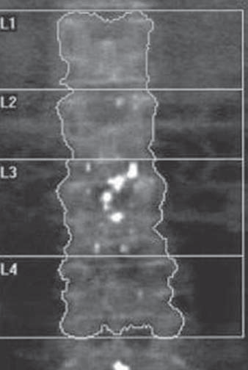
Artifacts caused by contrast material
72-year-old woman with remote history of myelography. DEXA image shows densities overlying L3 and L5 caused by retained myelographic contrast medium from examination performed 25 years ago. Area should be excluded from analysis. With exclusion of L3, L1–L4 T-score changes from –2.1 to –2.5.

Slide 20
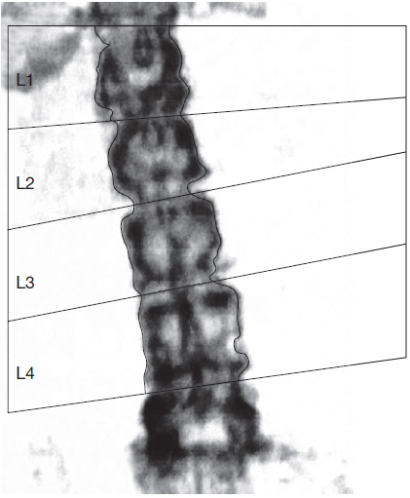
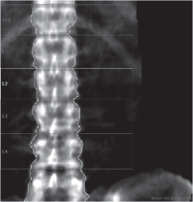
Acquisition pitfall
Improper patient positioning
DXA of the lumbar spine with poor
positioning.
The spine is too close to the right side of the image

Slide 21
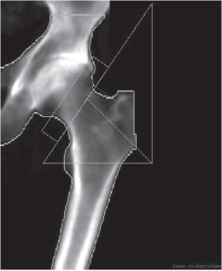
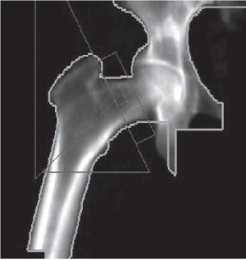
Acquisition pitfall
Improper patient positioning
The femur is adducted
The femur is abducted

Slide 22
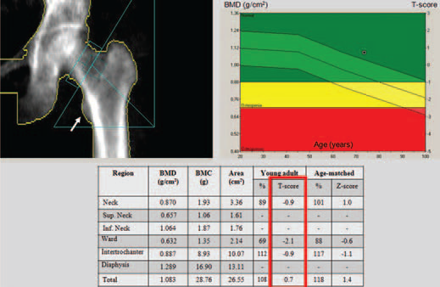
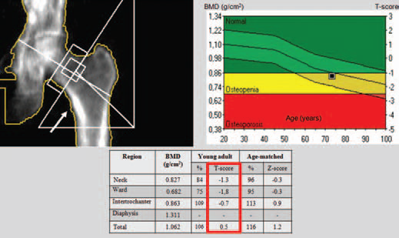
Acquisition
Improper patient positioning
Lorente-Ramos R, Azpeitia-Armán J, Muñoz-Hernández A, García-Gómez JM, Díez-Martínez P, Grande-Bárez M. Dual-energy x-ray absorptiometry in the diagnosis of osteoporosis: a practical guide. AJR Am J Roentgenol. 2011 Apr;196(4):897-904.

Slide 23
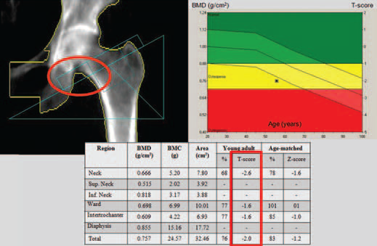
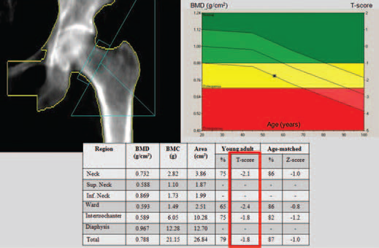
Analysis
Placement of Region of Interest
Lorente-Ramos R, Azpeitia-Armán J, Muñoz-Hernández A, García-Gómez JM, Díez-Martínez P, Grande-Bárez M. Dual-energy x-ray absorptiometry in the diagnosis of osteoporosis: a practical guide. AJR Am J Roentgenol. 2011 Apr;196(4):897-904.

Slide 24
Disorders in analysis

Slide 25
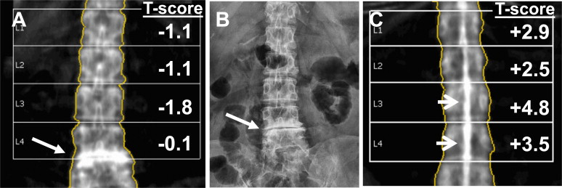
Analysis
Degenerative changes are an extremely common finding in patients undergoing DEXA. The patient in (A ,B) shows severe end-plate sclerosis of the L4/L5 disc space (arrow) with a significantly increased BMD value at L4 compared with L1-L3.
C,In adifferent patient with ankylosing spondylitis,the classic finding of “dagger spine,” caused by calcification of theinterspinousligament,isapparent(arrows).

Slide 26
In analysis of the lumbar spine, a greater than 1 point difference in T-score between two adjacent vertebrae indicates a vertebra is abnormal, and radiography is mandatory for diagnosis

Slide 27
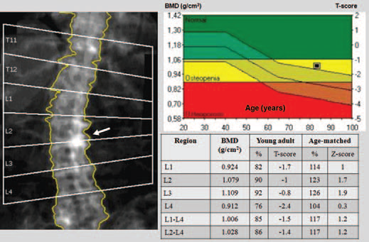
Analysis
72-year-old woman with osteoarthrosis. Dual-energy x-ray absorptiometric image shows artifactual increase in bone mineral density (arrow) in affected vertebrae due to osteophytes and vertebral endplate reaction to degenerative disk.
Affected vertebrae have higher bone mineral density and T-score (L2, –1.0; L3, –0.8) than adjacent vertebral bodies (L1, –1.7; L4, –2.4).

Slide 28
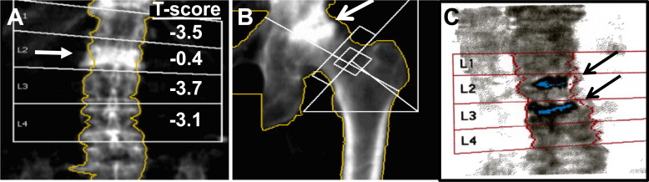
Analysis
(A) An 88-year-old woman with fracture of the L2 vertebral body (arrow) demonstrates diffusely decreased BMD with exception of the level of the compression fracture.
(B) A patient with avascular necrosis of the left femoral head (arrow). The femoral head appears dense and is associated with flattening and deformity.
(C)DEXA image in a patient status post vertebroplasty of L2 and L3 with introduction of radiopaque cement preparation(arrows).

Slide 29
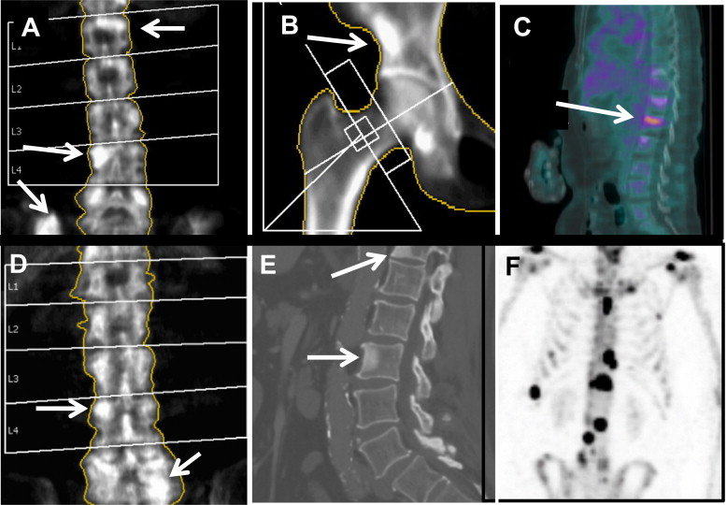
Analysis
Sclerotic metastases on DEXA (arrows). A 65-year-old woman, with known breast cancer (A-C), for evaluation of BMD before therapy.
DEXA images of the spine (A) and hip (B) demonstrate sclerotic boney metastases, corroborated on sagittal FDG-PET/CT image (C).
A 67-year-old man with Gleason 7 prostate cancer (D-F).Metastases to the spine are noted on DEXA (D), CT (E), and radionuclide bone scan (F).

Slide 30
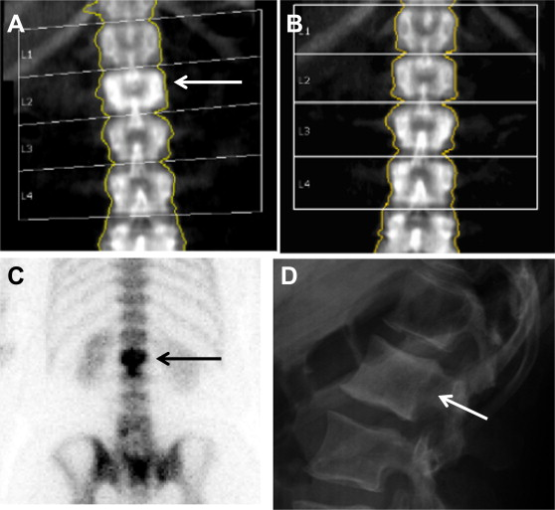
A 50-year-old woman with a sclerotic L2 vertebral body, typical of Paget disease (arrow). Prior study from 5 years earlier (B) does not evidence these findings. Recent 99mTc-MDPbonescan(C) and lateral view of the lumbar spine (D) confirm presence of a pagetoid vertebral body(arrows).

Slide 31
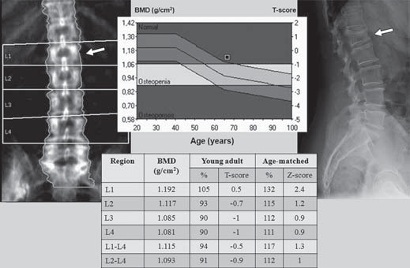
66-year-old woman with vertebral fracture. Dual-energy x-ray absorptiometric image shows high-density L1 vertebral body of reduced size consistent with vertebral fracture (arrow).
Lateral radiograph of lumbar spine confirms presence of fracture (arrow).

Slide 32
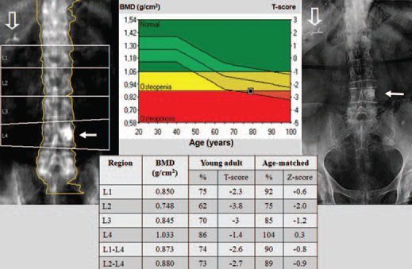
79-year-old woman with sclerotic vertebral pedicle. Dual-energy x-ray absorptiometric image and radiograph show dense round area overlyingL4 vertebral body (solid arrows) that turned out to be left L4 sclerotic pedicle.
Cholecystectomy clips (open arrows) are evident.

Slide 33
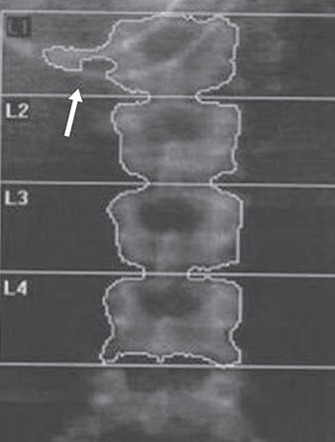
65-year-old woman with enteric tube. DEXA image shows dense structure (arrow) superimposed over L1 vertebral body. Exclusion of L1 from analysis changed T-score from –1 for L1–L4 to –1.2 for L2–L4.

Slide 34
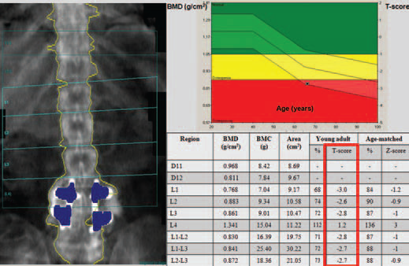
68-year-old woman with spinal fixation. DEXA image shows presence of surgical material over L4–L5 increases bone mineral density values (L3 T-score,–2.8; L4, 1.2).
Exclusion of L4 changes T-score from–1.8 for L1–L4 to –2.7 for L1–L3.

Slide 35
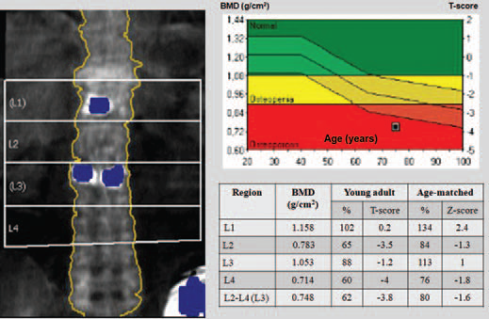
75-year-old woman with osteoporotic L1 and L3 fractures sustained 1 year ago and managed with vertebroplasty. DEXA image shows T-scores are higher than for adjacent vertebrae (L1, 0.2; L2, –3.5; L3, –1.2; L4, –4). Excluding L1 and L3 from analysis changes L1–L4 T-score from –2.1 to –3.8.

Slide 36
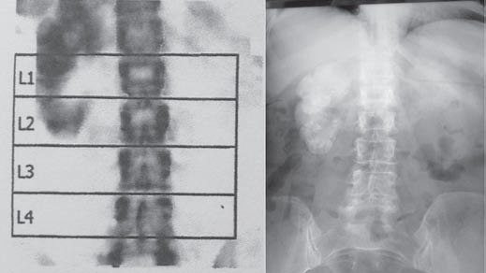
67-year-old-woman with calcified kidney. Dual-energy x-ray absorptiometric (DEXA) image shows previously unknown calcified nonfunctioning kidney. Radiograph confirms finding

Slide 37
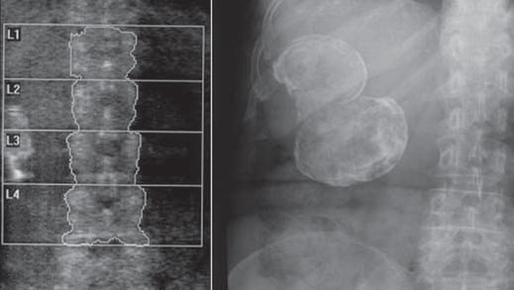
54-year-old woman with calcified hydatid cyst. DEXA image and radiograph show calcification that proved to be hepatic hydatid cyst.

Slide 38
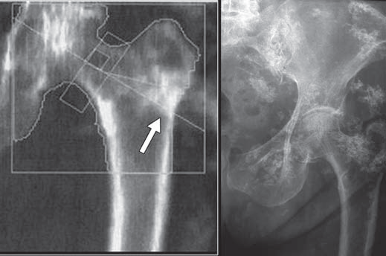
70-year-old woman with dermatomyositis. Dual-energy x-ray absorptiometric image and radiograph show multiple seeming calcifications superimposed on left hip. Erroneous increase in bone mineral density (arrow) precludes analysis.

Slide 39
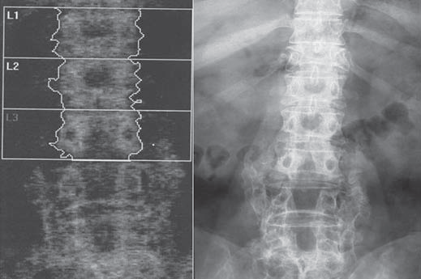
67-year-old woman with bone graft. Dual-energy x-ray absorptiometric image and radiograph show area of laminectomy and calcified bone graft over L4–L5 vertebral bodies. Exclusion of L3 and L4 changes L1–L4 T-score of –1.8 to L1–L2 T-score of –1.6.

Slide 40
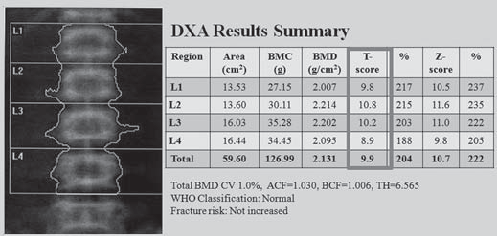
50-year-old woman with osteopetrosis.Posteroanterior dual-energy x-ray absorptiometric (DXA) image of lumbar spine shows dense vertebrae with high T-score at all levels

Slide 41
Interpretation

Slide 42
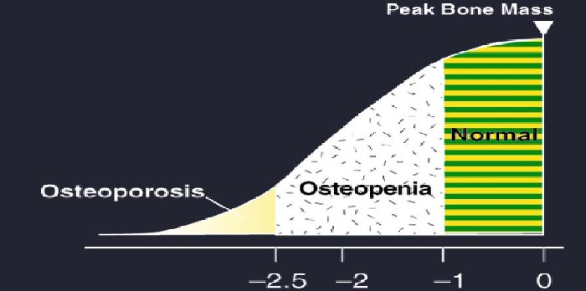
World Health Organization (WHO) Osteoporosis Guidelines(T Score vs Z score)
T Score
World Health Organization. Guidelines for Preclinical Evaluation and Clinical Trials in Osteoporosis. Geneva, Switzerland: World Health Organization; 1998.
Jeddi M, Roosta MJ, Dabbaghmanesh MH, Omrani GR, Ayatollahi SM, Bagheri Z, Showraki AR, Bakhshayeshkaram M. Normative data and percentile curves of bone mineral density in healthy Iranian children aged 9-18 years.Arch Osteoporos. 2013;8:114

Slide 43
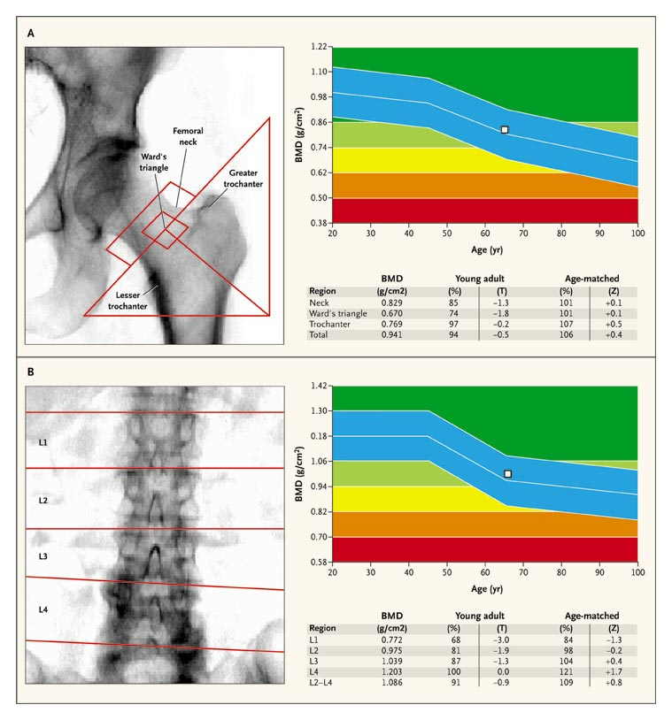
Dabbaghmanesh MH, Yousefipour GABone loss with multiple sclerosis: effect of glucocorticoid use and functional status..Iran Red Crescent Med J. 2011 Jan;13(1):9-14.

Slide 44
A Z-score less than –2 indicates the diagnosis is below low bone density for chronologic age (children).
Jeddi M, Roosta MJ, Dabbaghmanesh MH, Omrani GR, Ayatollahi SM, Bagheri Z, Showraki AR, Bakhshayeshkaram M. Normative data and percentile curves of bone mineral density in healthy Iranian children aged 9-18 years.Arch Osteoporos. 2013;8:114

Slide 45
Serial BMD Measurements
When reporting differences in BMD with serial measurements, only those changes that meet or exceed the Less Significant Change(LSC) are reported as a change.
When 30 patients (60 scans) have been obtained, the LSC can be calculated using the root mean square standard deviation.
Lewiecki EM, Binkley N, Morgan SL, Shuhart CR, Camargos BM, Carey JJ, Gordon CM, Jankowski LG, Lee JK, Leslie WD; International Society for Clinical Densitometry.. Best Practices for Dual-Energy X-ray Absorptiometry Measurement and Reporting: International Society for Clinical Densitometry Guidance. J Clin Densitom. 2016 Apr-Jun;19(2):127-40

Slide 46
precision analysis
To perform a precision analysis:
Measure 15 patients 3 times, or 30 patients 2 times, repositioning the patient after each scan,
Calculate the root mean square standard deviation for the group
The ISCD and others have developed online calculators to facilitate this process
International Society for Clinical Densitometry. 2015 ISCD Calculators. Available at: http://www.iscd.org/resources/calculators/. Accessed March 15, 2016.

Slide 47
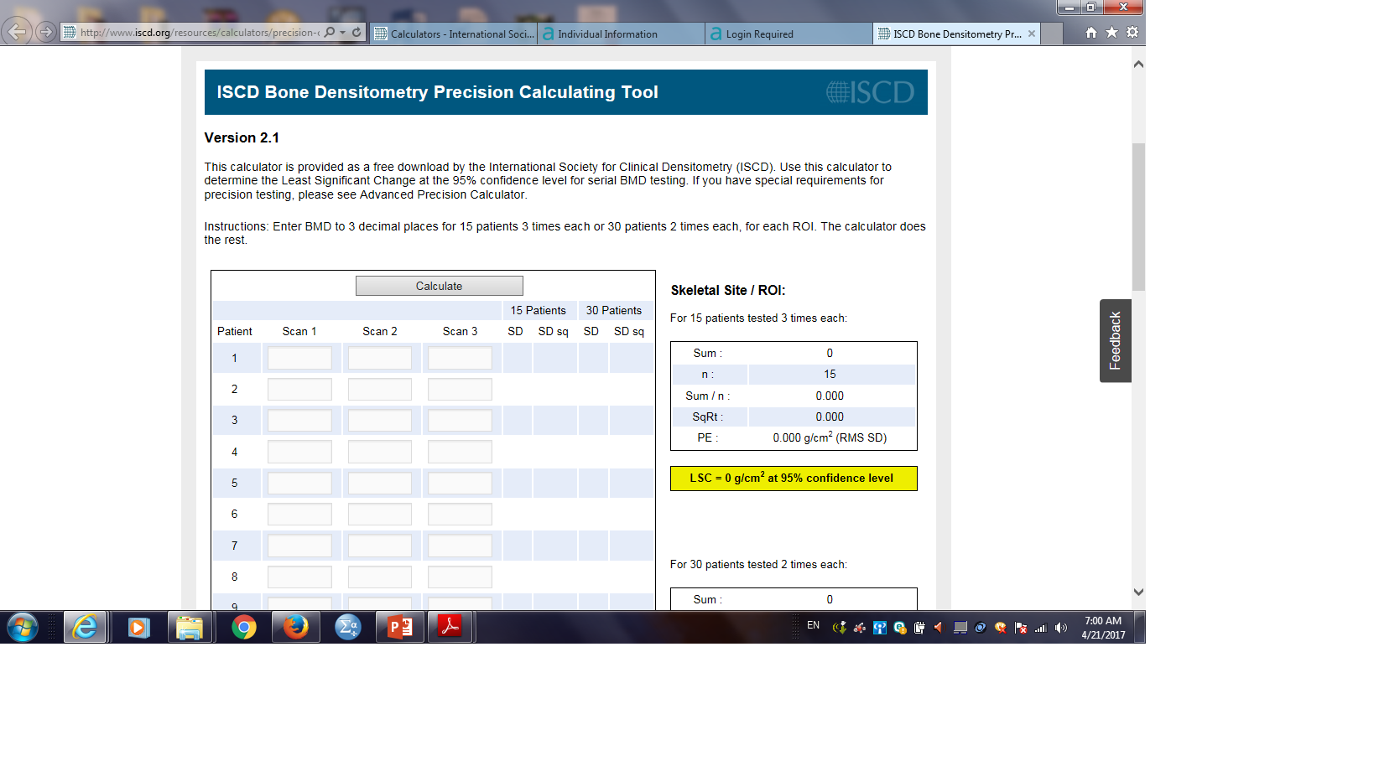
Determination of LSC
Calculate LSC for the group at 95% confidence interval.
LSC is calculated by multiplying 2.77 to precision error
The minimum acceptable precision for an individual technologist is:
Lumbar spine: 1.9% (LSC = 5.3%),
Total hip: 1.8% (LSC = 5.0%),
Femoral neck: 2.5% (LSC= 6.9%),
Retraining is required if a technologist’s precision is worse than these values.
Shepherd JA, Schousboe JT, Broy SB, Engelke K, Leslie WD. Executive Summary of the 2015 ISCD Position Development Conference on Advanced Measures From DXA and QCT: Fracture Prediction Beyond BMD. J Clin Densitom. 2015 Jul-Sep;18(3):274-86

Slide 48


