Slide 1
In the name of God

Slide 2
There are 2 questions about the first case:
1.What is diagnosis?
2.When is gonadectomy ideal?
3.Does it need hormone therapy?

Slide 3
And about the second case:
1.What is the diagnosis?
2.What is the differential diagnosis?

Slide 6
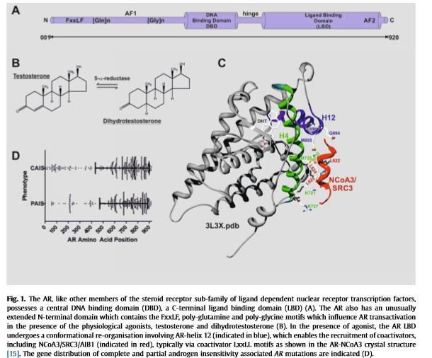

Slide 8
Complete androgen insensitivity syndrome

Slide 10
No precise figures are available for the prevalence of complete androgen insensitivity syndrome, but estimates range from one in 20 400 to one in 99 100 genetic males on the basis of a proven molecular diagnosis.

Slide 11
Bilateral inguinal herniae are rare in female infants—the incidence of complete androgen insensitivity syndrome in such patients is 1–2% during infancy. Clinicians recommend that karyotyping or a biopsy of a gonad within the hernial sac is done after the parents give consent.

Slide 12
Alternatively, vaginal length can be measured in prepubertal girls undergoing inguinal hernia repair to screen for complete androgen insensitivity syndrome; a shortened vagina and the absence of ovaries or fallopian tubes suggests the need for karyotyping.

Slide 13
Diagnosis of complete androgen insensitivity syndrome can happen by chance. The sex of a fetus is now increasingly known before birth through analysis of karyotypes, chorionic villi, amniotic fluid samples, or maternal circulating free fetal DNA,¹¹ and use of three-dimensional ultrasonography. .¹² Other modes of presentation include a known family history of X-linked complete androgen insensitivity syndrome and, occasionally, the discovery of a pelvic mass arising from a gonadal tumour.¹³

Slide 14
Partial androgen insensitivity syndrome

Slide 17
The clinical presentation of partial androgen insensitivity syndrome depends on the degree of responsiveness of the external genitalia to androgens. Occasionally, the appearance of the genitalia is more consistent with complete androgen insensitivity syndrome, apart from the degree of clitoromegaly.

Slide 19
Steroid 5α-Reductase Type 2 Deficiency.
is also characterized by a 46,XY karyotype, normally differentiated testes, and male internal ducts but a striking degree of virilization at puberty in patients reared as female with gonads retained.

Slide 20
The description of a genetic variant in SRD5A2 in the Dominican Republic and Mexico and analysis of molecular features underline the importance of DHT in the development of the male phenotype.

Slide 22
The type 3 isoenzyme is expressed primarily in the testes, where it favors the conversion of the weak androgen substrate, androstenedione, to the more biologically active testosterone. the family of 17β-HSDs comprises at least 14 isoenzymes that have physiologic relevance to a range of human tissues and disorders such as breast cancer, prostate cancer, and endometriosis.

Slide 23
A deficiency of HSD17B3, which is also called 17- ketosteroid reductase, was first reported as a cause of 46,XY DSD by Saez and colleagues . Most affected children (46,XY) have female-typical external genitalia at birth, although a few infants present with clitoromegaly or ambiguous genitalia. The testes are usually located in the inguinal canal and there is a blind vaginal pouch. Affected infants are usually assigned a female sex and may mistakenly be assumed to have CAIS.

Slide 24
Molecular pathogenesis
In complete and partial androgen insensitivity syndrome, mis-sense mutations are distributed throughout the eight exons of the androgen receptor gene, but localised mainly in exons that encode the DNA-binding and ligand-binding domains where their functional effect is great .
Genital skin fibroblasts express androgen receptors in high concentrations and can be used to measure androgen binding when a skin biopsy is taken at surgery.Typically, binding is absent in complete androgen insensitivity syndrome and binding affinity is altered in partial androgen insensitivity syndrome.

Slide 27
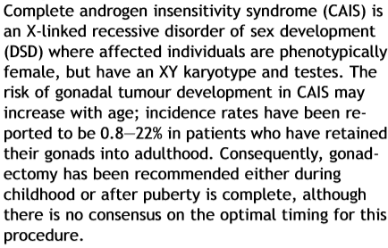

Slide 36
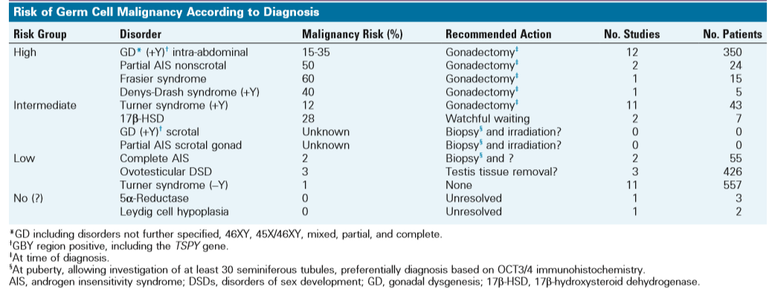

Slide 37
ex Dev 2017;11:171–174 D OI: 10.1159/000478082
Gonadectomy in Complete Androgen Insensitivity Syndrome: Why and When?

Slide 38
Proposal for a Screening
At this time, it is mostly agreed that gonadectomy in CAIS children prior to puberty is not warranted on a prophylactic basis. These children should undergo their usual pubertal development with endogenous hormone synthesis.

Slide 39
For women who wish to keep their gonads, we propose a regular (bi-)annual screening program comprising gonadal imaging by US or MRT, depending on the size and localisation of the gonad, determination of tumor markers (alpha-fetoprotein, betaHCG, LDH, and optionally PLAP in non-smokers), and endocrine evaluation (LH, FSH, testosterone, and inhibin B).

Slide 40
The pattern of gonadotropin and testosterone concentrations is less suggestive of hormone resistance when complete androgen insensitivity syndrome presents in infancy. Usually, LH-induced serum testosterone concentrations surge during the ﬁrst few months of life—a so-called mini-puberty. This proﬁ le, however, cannot be used to diagnose complete androgen insensitivity syndrome in many infants, although serum testosterone concentrations do increase appropriately after stimulation with human chorionic gonadotropin.

Slide 41
Automated DNA sequencing of the coding region and splice sites of the androgen receptor gene is now routinely available in the UK. A mutation is identiﬁ ed in more than 95% of patients with complete androgen insensitivity syndrome.

Slide 42
The transcriptional activity of new mutant androgen receptors might need to be assessed, especially in patients with a phenotype for partial or mild disease.

Slide 43
The spontaneous mutation rate in complete androgen insensitivity syndrome is about 30%—a ﬁnding consistent with other X-linked recessive disorders such as haemophilia and Duchenne muscular dystrophy. mutations are postzygotic and somatic mosaicism for the mutant androgen receptor can occur.

Slide 44
More than 800 mutations in diﬀerent patients are entered in the Cambridge database of androgen receptor genes as of September, 2011.

Slide 45
Most mutations of the ligand-binding domain are situated between aminoacid residues 688 and 712, 739 and 784, and 827 and 870.

Slide 46
General management
Management of androgen insensitivity syndrome should address functional, sexual, and psychological issues such as disclosure, gonadectomy and subsequent hormone replacement, creation of a functional vagina, and genetic advice. Care needs to be individualised, flexible, and holistic. Management is dependent multidisciplinary team include (paediatric or adult), urology, gynaecology, and clinical psychology.

Slide 47
Patient advocacy groups (eg, the Androgen Insensitivity Syndrome Support Group and dsdFamilies in the UK) should have a close supportive role. Support groups related to androgen insensitivity syndrome are well represented in several countries.

Slide 50
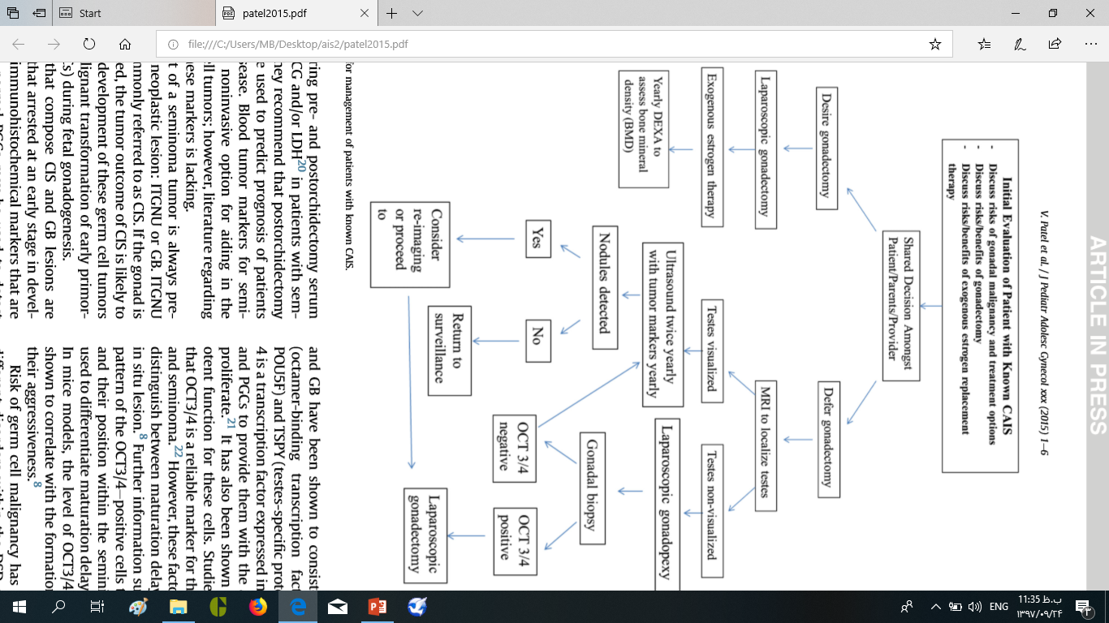

Slide 52
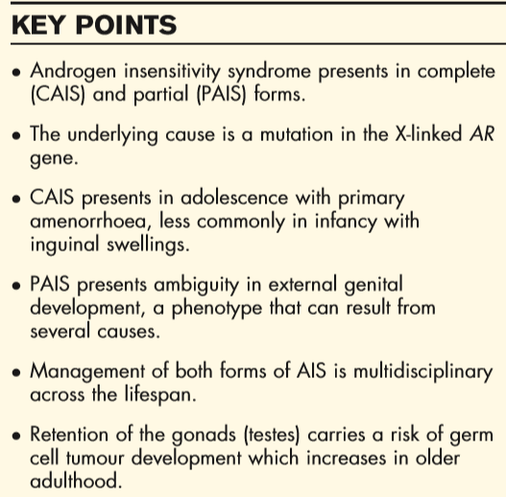

Slide 54
hohhhh
Hormone therapy:

Slide 59
Thank you

