Slide 1
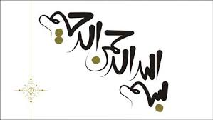

Slide 2
Herbal therapy for Abnormal uterine bleeding
Mina Amiri, PhD of Reproductive health
Reproductive Endocrinology Research Center, Shahid Beheshti University of Medical Sciences
Email: m-amiri@sbmu.ac.ir

Slide 3
Outlines
Introduction
Medicinal plants used for treatment of AUB
Mechanisms Herbal medicine for managing AUB
Types of herbal medicines in AUB
Review of literature
Key points and precautions
Conclusion

Slide 4
Introduction
Improving reproductive health of women requires access to safe and effective medication
Hormonal drugs or NSAIDs are considered as the first-line pharmacological treatments in the management of AUB
For many women in low-income countries, these treatments are unavailable or unaffordable
WHO suggested that in countries where access to modern healthcare facilities is limited or where traditional therapies are generally considered more culturally appropriate, research on the efficacy and safety of herbal therapies for menstrual disorders should be encouraged as an acceptable alternative

Slide 5
Introduction…
Modern oral contraceptives can cause symptoms such as fertility loss, `amenorrhea or mid-cycle breakthrough bleeding
In addition, risk of cardiovascular disorders increases during hormone therapy specially in postmenopausal women
Therefore, it seems logical to investigate other available sources to discover more effective and safe drugs
One of the most common options to achieve this goal is herbal therapy
Many plant species are used worldwide for reproductive health issues, but very few species have been examined for AUB
Limited number of clinical trials have demonstrated the beneficial effects of medicinal plants on AUB

Slide 7
Medicinal plants used for treatment of AUB mentioned in ‘‘Canon of Medicine’’…
Mobli et al. 2015. Scientific evaluation of medicinal plants used for the treatment of abnormal uterine bleeding by Avicenna

Slide 8
Medicinal plants used for treatment of AUB mentioned in ‘‘Canon of Medicine’’
Mobli et al. 2015. Scientific evaluation of medicinal plants used for the treatment of abnormal uterine bleeding by Avicenna

Slide 9
Mechanisms of medical plants for AUB
Management of
AUB
Anti proliferative activities on human cervical cancer cells
Estrogenic activities
Inhibitory activity on production of PGs
Inhibition of the inflammatory process
Mobli et al. 2015. Scientific evaluation of medicinal plants used for the treatment of abnormal uterine bleeding by Avicenna

Slide 11
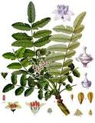
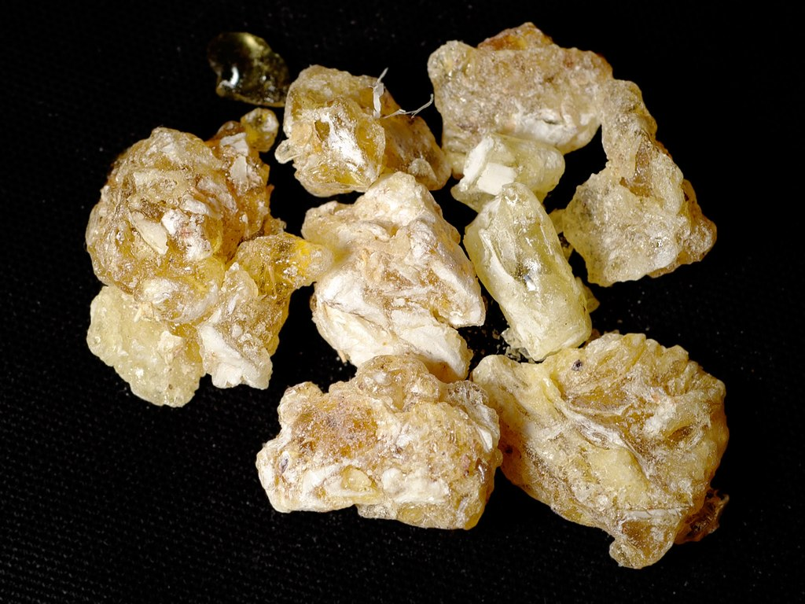
Boswellia species (Kondur) (کندر)
No clinical trial have assessed the efficacy of this plant on AUB
There is evidence that showed that this plan has anti-tumor effects on human cells especially breast and bladder cancer
Side effects: nausea, digestive disorders
Part/extract
Gum resin/ water extract
Resin/Methanol extract
Active constituent
Triterpene acids
Species
Mouse
Mechanism
Anti-inflammatory activity/analgesic activity.
This plant showed significant anti-inflammatory and analgesic activities and also exhibited remarkable inhibitory activity on production of Prostaglandin (PG) E2
C(28)- hydroxylated lupeolic acid from the gum resin of B. carteri suppressed eicosanoid biosynthesis in intact cells
Su et al (2012) J Ethnopharmacol 139:649–656; Banno et al. J Ethnopharmacol 107:249–253 ; Suhail et al. (2011). BMC Complementary and Alternative Medicine

Slide 12
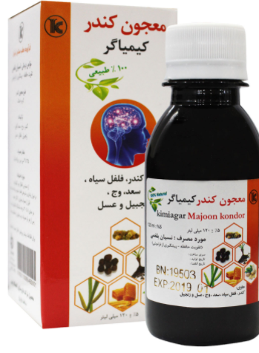
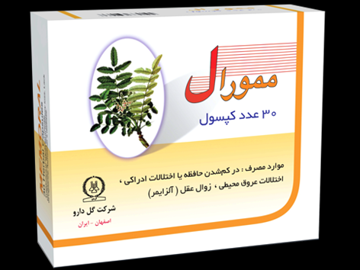
Boswellia species (Kondur)
Usage methods: oral, local, inhaler
Traditional treatment: A teaspoon of powder or chew a few pieces
In Iran: Capsule memoral (containing 360 mg kondur and 36 mg ginger)3-6 capsule daily
Syrup120 ml (3.5-4 cc daily)
Singh GB et al. Pharmacology of an extract of salai guggal ex-Boswellia serrata. Agents Actions 1986; 18: 407 - 12.

Slide 13
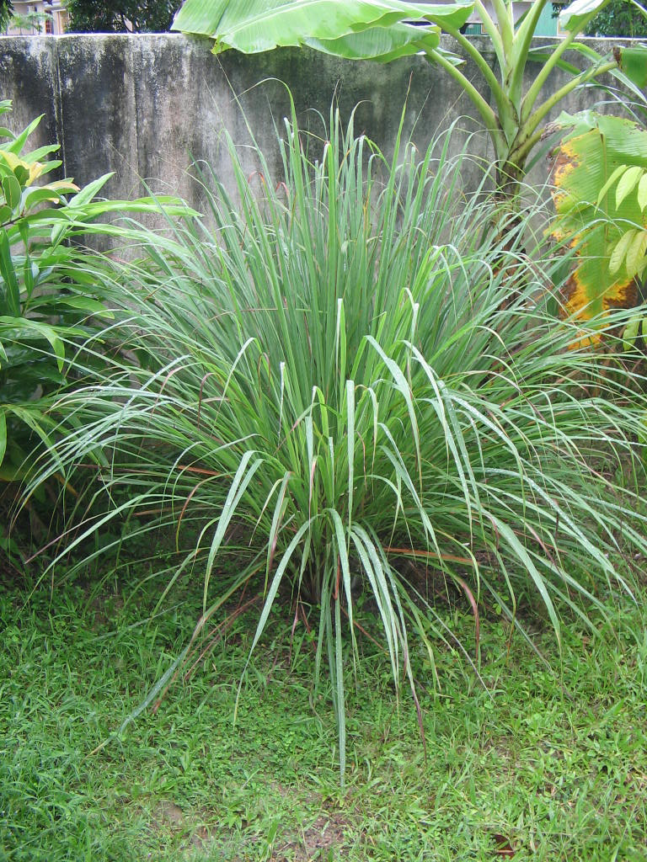
Cymbopogon flexuosus (Izkher) (علف لیمو)
Essential oil from this plant showed anti-inflammatory activity by reducing pro-inflammatory cytokines
Reducing rheumatism pain
No clinical trial on its effects on AUB in human
Toxicity: skin, respiratory, digestive, ocular and renal effects
Limited studies have assessed its effects on cancers
However, this herb could be considered as potent candidates for anticancer agents
Anticancer effects on Colon, cervix, oral, prostate, and leukemia cancer
Part/extract
Leaves
Species
Rat
Mechanism
Anti-inflammatory activity/analgesic activity
Active constituent
Essential oil
Chandrashekar et al (2010). Pharmacogn J 2:23–25; Ghosh et al. (2013). Pharmacognosy Communications; Chanda et al. (2013). Journal of Pharmacognosy and Phytochemistry. Vol. 2 No. 2

Slide 14
Cymbopogon flexuosus (Izkher)
Ghosh et al. (2013). Pharmacognosy Communications Volume 3 | Issue 4
Chanda et al. (2013). Journal of Pharmacognosy and Phytochemistry. Vol. 2 No. 2

Slide 15
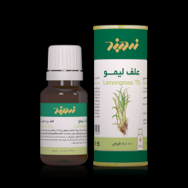
Cymbopogon flexuosus (Izkher)
Usage methods: Oral (drop, syrup, herbal tea)and local (oil)
In Iran: 3-5 drop with liquid daily

Slide 16
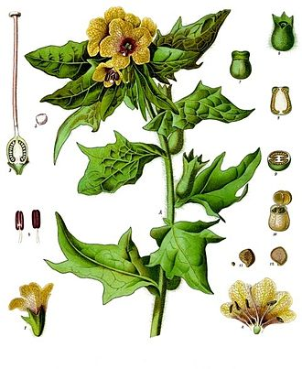
Hyoscyamus niger L.(Banj) (بنگ دانه)
Part/extract
Seed/methanol extract
Alcoholic extract
Species
Mouse/Rat
Mechanism
Antinociceptive activity/anti-inflammatory activity
Active constituent
Coumarinolignan
Banj tea was also used to decrease FBS, antispasmodic, anti-flatulent, hypnotic, opiate, analgesic
It contains hyoscine and a lower amount of hyoscyamine alkaloids
Atropine and hyoscine are taken from this plant.
This herb may be strongly toxic; it should use cautiously (CNS)
Its effects on cancer ??
Begum et al (2010). Fitoterapia 81:178–184

Slide 18
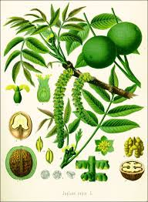
Juglans regia L.(Juz) (گردوی ایرانی)
Part/extract
Leaves/ ethanol and aqueous extract
Species
Mouse
Mechanism
Antinociceptive (analgesic) activity
Active constituent
??
Anti-inflammatory and antinociceptive activities of different parts of J. regia have been demonstrated in different studies
No clinical trial have assessed the efficacy of this herb on AUB
Some studies reported that this plant can prevent some cancer such as breast cancer
Side- effects: allergy and anaphylaxic reactions in some people
Erdemoglu et al (2003.) J Ethnopharmacol 89:123–129

Slide 19
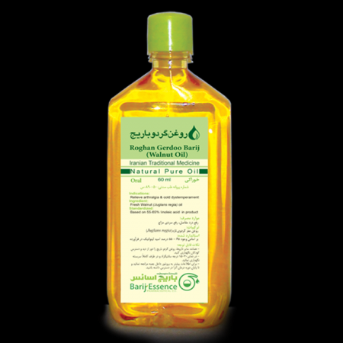
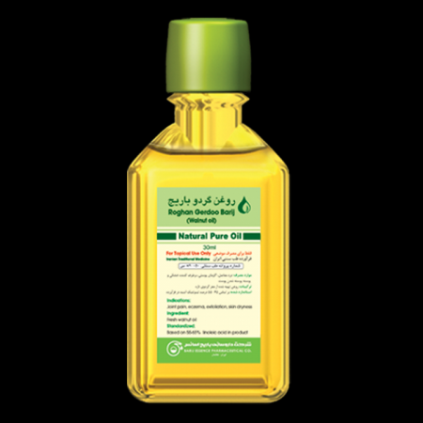
Juglans regia L.(Juz)
Usage methods: oral (oil 60 ml, 5 ml, BID), local (oil 20 ml, 5 times a day )

Slide 20
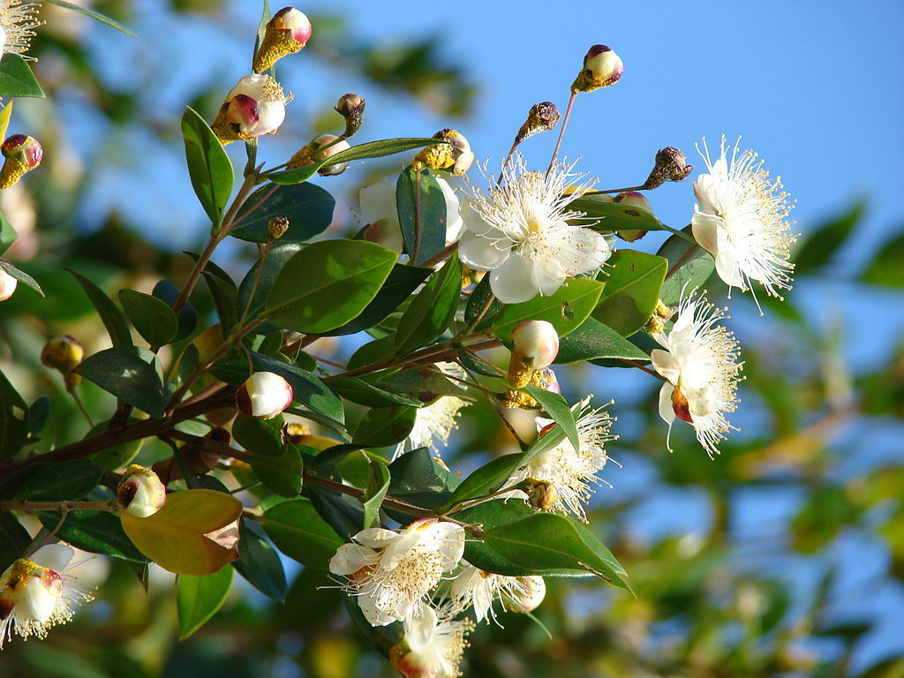
Myrtus communis L.(Aas) (آس یا مورد)
Part/extract
Leaves/Aerial parts/aqueous and ethanol extracts
Species
Mouse
Mechanism
Antinociceptive activity/anti-inflammatory activity
Active constituent
Tannins, alkaloids, and flavonoids
This plant grows in the Mediterranean and the Middle East, and is consisted of phytochemical components such as flavonoids, tannins, terpenoids, …
Leaves of this plant potently suppresses the biosynthesis of eicosanoids (PG E2 and Leukotrienes) by inhibition of COX-1 and 5-lipoxygenase
Clinical studies suggest that it has antioxidative, antidiabetic, anticancer, antibacterial, antiviral
The efficacy of this herb in improving AUB has been also confirmed during a number of clinical trials
Hosseinzadeh et al (2011). J Acupunct Meridian Stud 4:242–247

Slide 21
Myrtus communis L.(Aas)
Inhibition of cancer cells proliferation particularly in breast
Side-effects: Hypoglycemis, allergic reaction, nausea, vomiting, diarrhea, larynospasm
Interaction with hypoglycemic drugs
Javan et al. 2016. Herbal Medicines in Idiopathic Heavy Menstrual Bleeding: A Systematic Review

Slide 22
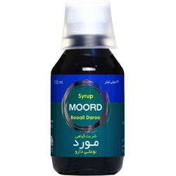
Myrtus communis L.(Aas)
Dose of syrup for decreasing AUB: 5 mg TID for 7 day (with the beginning of mens

Slide 23
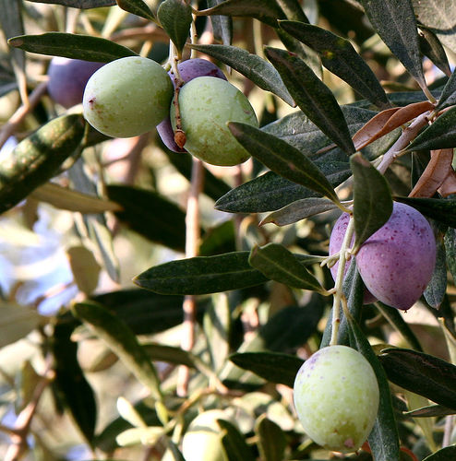
Olea uropaea L. (Zeitun)
Phenolic compounds of this plant found in olive leaves exhibiting marked anti-inflammatory and analgesic activities in animal models
No clinical trial have assessed the efficacy of this herb on AUB
Inhibition of cancer cells proliferation such as in breast
Part/extract
Fruits/n-hexanane extract/leaves/chloroform and methanol extracts/oil
Species
Rat/Mouse
Mechanism
Anti-inflammatory activity/ analgesic activity
Active constituent
Hydroxytyrosol and
oleuropein
Suntar et al (2010). J Med Food 13:352–356; Chebbi et al (2011). ISRN Pharmacol 2011:1–5; Eidi et al (2012). Pharm Biol 50:332–337

Slide 24
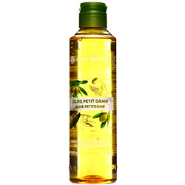
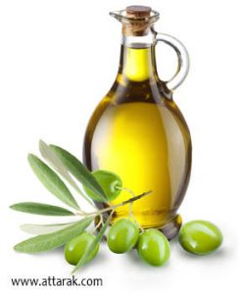
Olea uropaea L. (Zeitun) (زیتون)

Slide 25
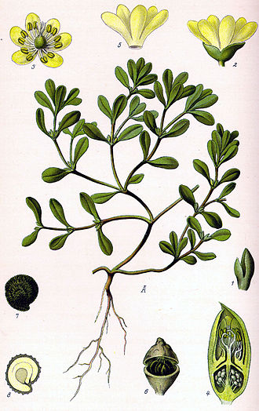
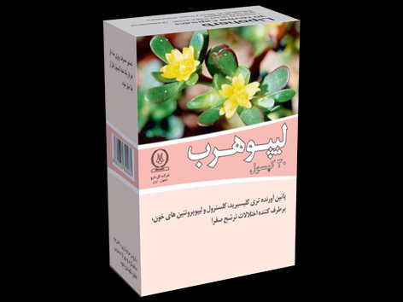
Portulaca oleracea L. (Boghla-al-homgha) (تخم خرفه)
Part/extract
Aerial parts/ethanol extract
Species
Rat/Mouse
Mechanism
Estrogenic activity/ Anti-inflammatory activity/ analgesic activity/ Antitumor activity against
cervical carcinoma/ Accelerating wound healing
process
Active constituent
Polysaccharides??
In a pilot clinical trial, the effectiveness of P. oleracea seeds on AUB was studied.
The seeds powder was packaged in sachets each containing 5 g of the powder in a glass of hot water sweetened with sugar
This herb is one of the components of Lipoherb in Iran (640 mg portulaca TID)
The aerial parts of this herb exhibited estrogenic activity in ovariectomized rats
Water-soluble polysaccharide from P. oleracea inhibited cervical cancer cell proliferation and significantly inhibited tumor growth in mice
No serious adverse events are reported with use of this herb.
Shobeiri et al. (2009). Phytother. Res. 23, 1411–1414

Slide 26
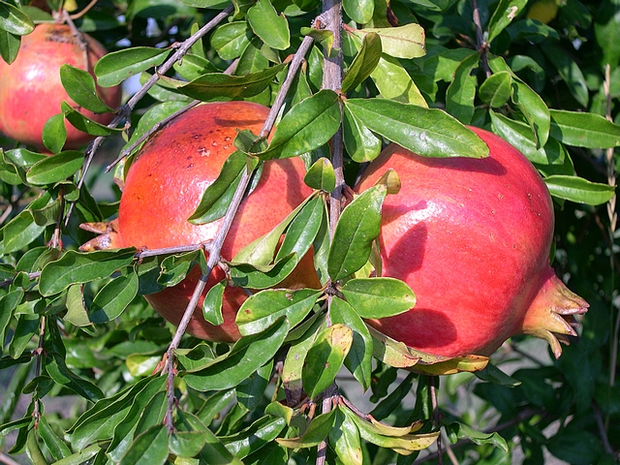
Punica granatum L. (golnar)
Part/extract
Fruit peel/methanol extract/Flower/ Fruit rind, flower and leaves
Species
Rat/Mouse
Mechanism
Anti-inflammatory activity/ analgesic activity
Active constituent
??
Golnar is one plant with an effect on AUB.
This plant contains unique phenols (tannins and flavonoids).
Polyphenol-rich extract of fruit exerted an anti-inflammatory effect in animal model by inhibiting the production of PGE2 and NO
Extracts of P. granatum flower exhibited antispasmodic effect on the uterus of non-pregnant rats and diminished contraction of uterus
Some studies suggest the Antioxidant Potency of Punica granatum L. Fruit peel reduces cell proliferation and Induces apoptosis on Breast Cancer
Ouachrif et al (2012). Pharm Biol 50:429–438; Sarker et al (2012). J Appl Pharmaceut Sci 2:133–136; Bagri et al (2010). Int J Drug Dev Res 2:698–702

Slide 27
Punica granatum L. (golnar)
Prasad et al (2014) showed a reduction in gingival bleeding after using toothpaste containing Persian Golnar
Memarzadeh et al. (2016) also reported a significant decrease in blood loss after 3 months of treatment with Persian Golnar syrup in premenopausal women with menorrhagia related to uterine leiomyoma.
Prasad et al. (2014). J Indian Soc Periodontol. 2014 Jul-Aug; 18(4): 428–432
Javan et al. (2016). Phytotherapy Research

Slide 28
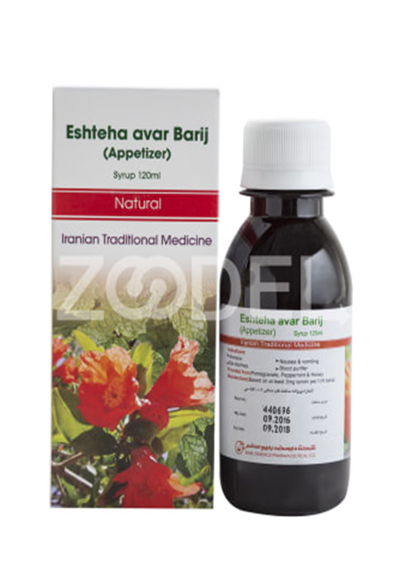
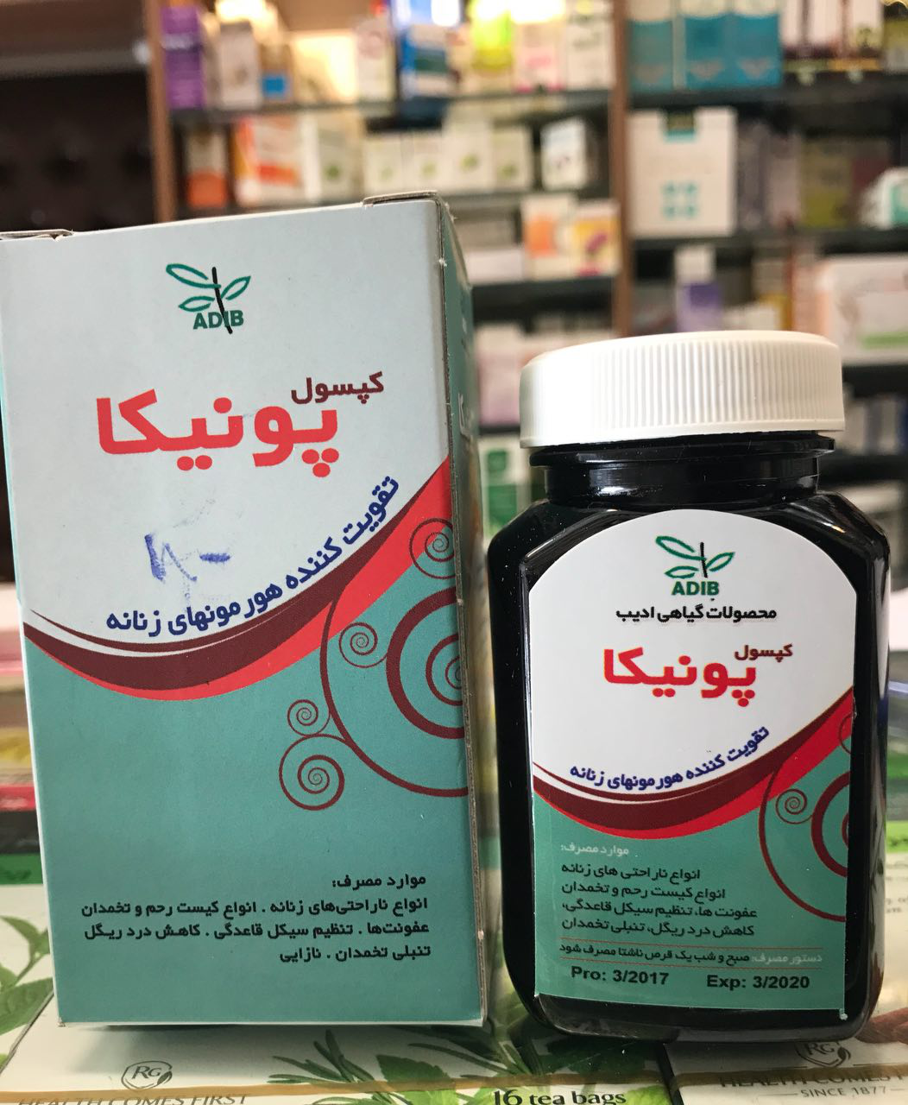
Punica granatum L. (golnar)
Syrup 120 ml (5 ml TID for 7 day from onset of bleeding)
Capsule 500 mg (BID)

Slide 29
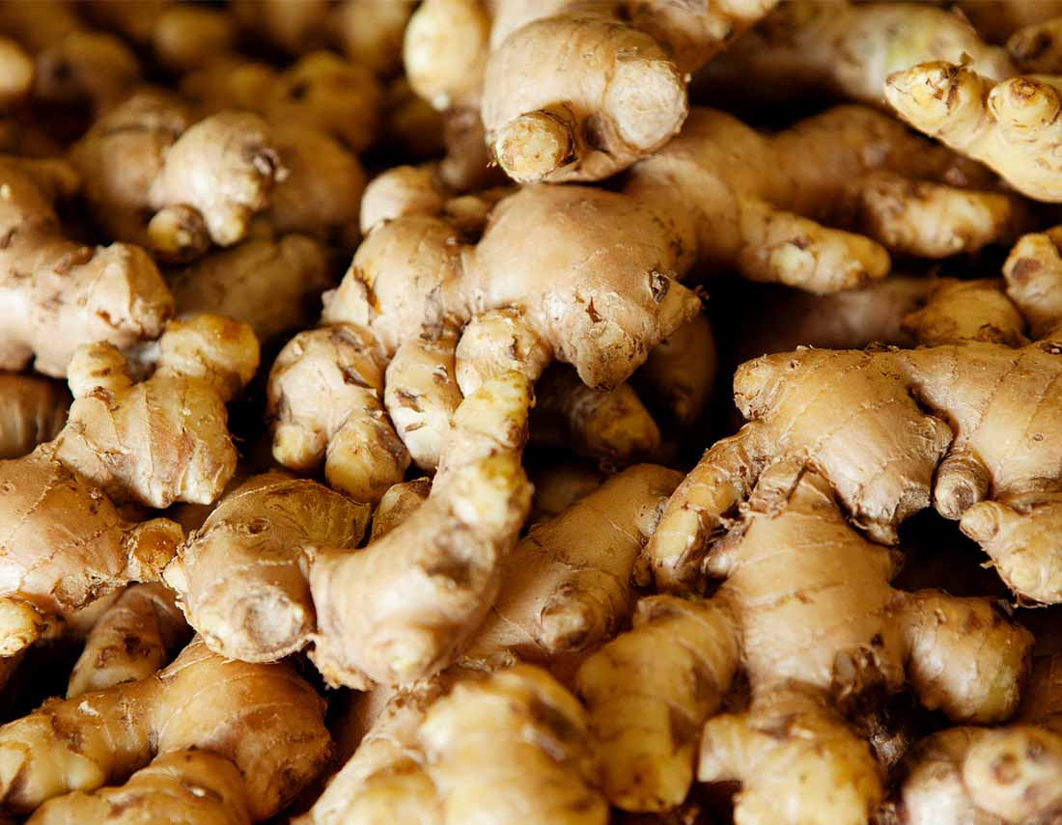
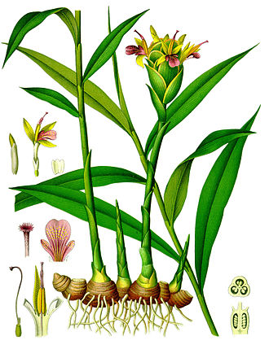
Ginger rhizome (Z. officinale Roscoe) (زنجبیل)
In a clinical trial by Shirvani et al. (2015), the effect of ginger on dysmenorrhea was demonstrated
Ginger relieves dysmenorrhea by inhibiting thromboxane and prostaglandin activities
Ginger can also be used for the treatment of inflammatory chronic diseases as a result of its anti-inflammatory and antioxidative properties
Traditional use of this herb for AUB may be a result of its anti-inflammatory effect
Side-effects: ↓ FBS, a strong anticoagulation effect, allergy, mouth inflammation
Part/extract
Root/stalk
Species
Rat/Mouse
Mechanism
antinausea, antiinflammatory, carminative, and antiemetic activities, anti-cancer, antioxidant
Active constituent
Gingerol/gingerdion
Ghasemzadeh et al., 2015; Shirvani et al. (2015), (Aryaeian and Tavakkoli, 2015). ; Avicenna (Ibn Sina) AH. 2005; Pizzorno and Murray, 2013

Slide 30
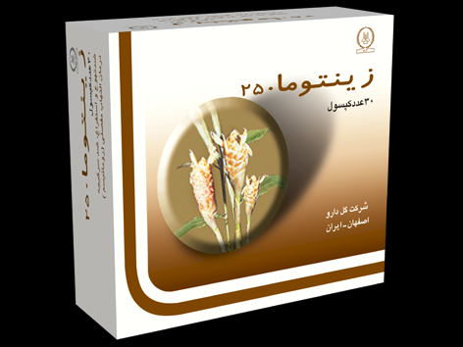
Ginger rhizome (Z. officinale Roscoe)
In Iran: Capsule 250 mg/ 3-4 capsule daily

Slide 31
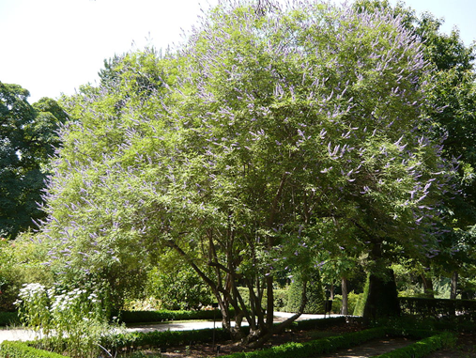
Vitex angnus –castus (chastetree)
Vitex agnus-castus, commonly called “chasteberry”, a small deciduous tree that grows in Asia, Mediterranean Europe and North America.
It is popularly used in folk medicine to treat ovarian insufficiency, uterine bleeding, premenstrual syndrome, and infertility.
It includes glycosides; flavonoids; progestins; alkaloids; and essential fatty acids
Effects on breast: ↓ prolactin by blocking Dopamine-2 receptor, Cytotoxicity effects and apoptotic Inducing apopetosis of vitex agnus on Normal and cancer Cells
Side-effects: nausea, headache, gastrointestinal discomfort, fatigue, allergic reactions, and heavy menstrual bleeding
Part/extract
fruits /leaves
Species
Rat/Mouse
Mechanism
Estrogenic activity (↑LH, ↓FSH)
Active constituent
Flavonoids (vitexin, casticin)
Arokiyaraj et al. (2009). International Journal of Green Pharmacy

Slide 32
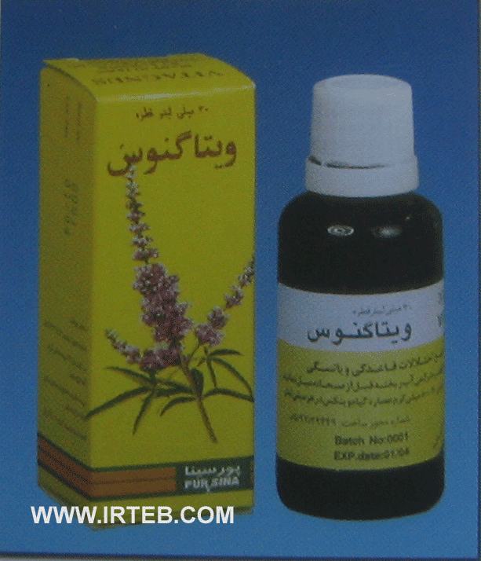
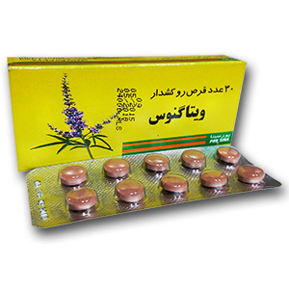
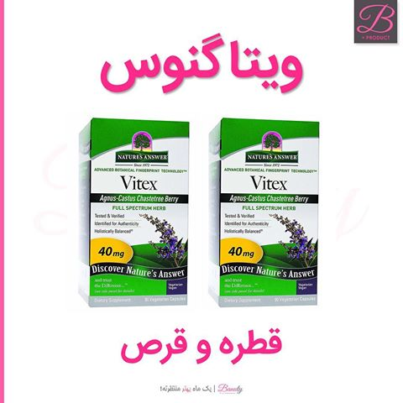
Vitex angnus –castus (5 انگشت)
In Iran: Tablet 3.3 mg BID; Drop 30 ml (40 drop daily)

Slide 33
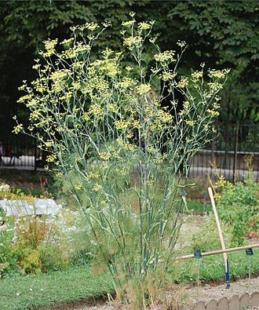
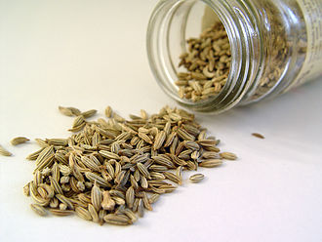
Fennel (رازیانه)
Fennel had mild estrogen-like activity
It inhibits spasms in smooth muscles; its efficacy is comparable with NSAIDs
It also contains natural estrogenic substances like flavonoids, a kind of phytoestrogens
Moreover, the seeds of fennel is traditionally known to be able to induce menstruation, are used to induce menstrual bleeding in women who have menstrual cessation
One of the mechanisms is direct effect of Fennel on uterine muscle rather than its effect on the released mediators
This herb has antioxidant effects; animal studies showed protective effect on prostate and cervix cells
Side effects: no serous side effects are reported
Part/extract
bulb, foliage, and seeds
Species
Rat/Mouse
Mechanism
Estrogenic activity/ analgesic/ anti-inflammatory effects
Active constituent
Essential oil
Mohebbi-kian et al. (2014). Contraception; Khorshidi et al. (2003). Iranian Journal of Pharmaceutical

Slide 34
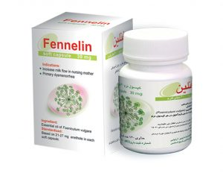
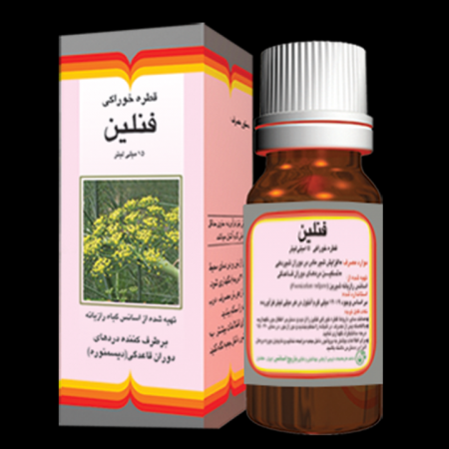
Fennel (رازیانه)
Capsule 30 mg (every 4 h)
Drop 18 ml (every 4 h 30 drop with fluids)

Slide 36
Mohebbi-kian et al. (2014). Contraception

Slide 37
Participants: 90 patients less than 45 with menorrhagia
Intervention: 45 patient Vitagnus group (30-40 mg or 40 drop daily( Vs. 45 patients )500 mg mefenamic acid group tid( from beginning menstrual bleeding to end of bleeding for 4 months
Outcomes: Hb content, estimation of menstrual blood loss by Higham table
Results:
both groups ↑Hb, ↓menstrual blood loss
No significant difference between two groups
Mefenamic acid had more complications in comparison with vitex
زمانی و همگاران (1386). مجله زنان مامايي و نازايي ايران:دوره 10 , شماره 1

Slide 38
Participants: 105 reproductive ages patients with menorrhagia
Intervention: Group 1: 30 patients (250 mg mefenamic acid tid); Group 2: 25 patients Vitagnus drop 30-40 mg or 40 drop daily( Group 3: 25 patients Fennelin drop (30 drop, every 4 h) and Group 4: 25 patients placebo before starting bleeding to 3 days after mens for 3 months
Outcomes: estimation of menstrual blood loss by Higham table
Results:
3 groups (mefenamic acid, Fennelin and Vitagnus): ↓menstrual blood loss
No significant difference between 3 groups
In this study, side effects did not assess.
شبیری و همگاران (1393). مجله علوم پزشکی همدان، دوره 21، شماره 3.

Slide 39
Clinical studies on plants used for treatment of AUB mentioned in ‘‘Canon of Medicine’’
Mobli et al (2015). Scientific evaluation of medicinal plants used for the treatment of abnormal uterine bleeding by Avicenna. Arch Gynecol Obstet 31

Slide 44
Key points and precautions
Medicinal plants used in traditional medicine may be valuable sources for discovering new drugs
Some of herbal compounds have nutritional value and are routinely used in human diets
Major mechanisms of action these medical herbs is inhibition of the inflammatory process and PG production
Many plants had phytochemical components that can exert special effects; conclusive confirmation of the efficacy and safety of these treatments needs more evaluations

Slide 45
Key points and precautions…
A belief held by many is that herbs are not drugs and are therefore safe
Limited randomized clinical trials have assessed the efficacy of herbal medicines on AUB; often these studies had no high quality
Most studies have not investigated side-effects of these herbs; therefore, safety of them is a concerning issue
Standard dose of these medical herbs is not often determined

Slide 46
Conclusion
Therefore, it is essential to investigate more about the pharmacological properties, possible benefits and adverse effects of traditional remedies before they recommend routinely as a standard treatment

Slide 47
Thank you for your attentions

