Slide 1
IN THE NAME OF GOD

Slide 2
Thyroid Disease Screening And Pregnancy
MS, Hosseini,associate professor of endocrinology,Baqiatallah university of medical science

Slide 3
Agenda
Introduction
Universal thyroid screening
Against universal thyroid screening
Screening recommendations for thyroid disorders in pregnancy
Conclusion

Slide 4
Introduction
For more than a decade, endocrinologists and obstetricians have been debating whether screening for thyroid disorders during pregnancy should be routine or should continue to be based on symptoms and risk factors
The primary impetus behind this debate was the publication of 2 observational studies in 1999
Both demonstrated that offspring of women with asymptomatic thyroid dysfunction were at increased risk for impaired neurodevelopment
N Engl J Med 1999;341:549-55
Clin Endocrinol (Oxf) 1999;50: 149-55

Slide 5
Universal thyroid screening
Efficacy of Case Finding
Targeted thyroid screening in the Endocrine Society Practice Guidelines is very comprehensive
In many clinical practices, few patients would escape screening if mentioned criteria for screening during pregnancy were followed
It has been estimated that only 30-80% of women with hypothyroidism
would be identified through screening based on symptoms/risk factors
Thus, it appears that case-finding guidelines are inadequate for the identification of all women with thyroid dysfunction
Endocrinol Nutr . 2012;59:547-60
J Endocrinol Metab 2007;92:203-7
Eur J Endocrinol 2010;163:645-50
J Clin Endocrinol Metab 2011;96:E1452-6

Slide 8
Universal thyroid screening
If a disease is frequent enough and interventions can improve perinatal outcome, then screening usually is justified and will likely be cost-effective
Thyroid dysfunction is the second most common endocrine disorder to affect women of reproductive age
Obstet Gynecol 2005;105:239-45
Obstet Gynecol 2002;100:387-96
.

Slide 9
Universal thyroid screening
Cost-Effectiveness
published cost-effectiveness studies include theoretic models based on the observational study by Haddow et al in1999
Assuming a two-thirds reduction in offspring with an IQ <85 through identification and treatment, this model predicted routine screening would
result in fewer children born with low IQ and save 8.3 million dollars per 100,000 women screened
Similar findings were noted in a Markov model constructed by Dosiou et al
Am J Obstet Gynecol 2009;200:267.e1-7
Eur J Endocrinol 2008;158:841-51
.

Slide 10
Universal thyroid screening
perinatal outcome
There are conflicting data about thyroid replacement benefits in pregnant women and their offspring who are identified with milder thyroid dysfunction
Several observational studies have suggested a benefit to screening and treatment
Thyroid. 2011;21:1053-5
Clin Endocrinol 2010;72:825-9
J Clin Endocrinol Metab 2006;91:2587-91

Slide 13
Universal thyroid screening
Missing oF overt hypothyroid pregnant women
Incidence of overt hypothyroidism in the United States are on the order of 2 in 1000
A substantial proportion of these women will not exhibit symptoms of hypothyroidism in the early stages of disease
If we were to assume that 50% of these patients might be identified through a case-finding approach, then 1 in 1000 pregnant women would remain undiagnosed
Pregnant women and neonate are screened for conditions with lower incidence rates
Therefore it is difficult to justify missing this important diagnosis, given the beneficial effects treatment may have on both maternal and neonatal outcome
Obstet Gynecol 2006;108:1283-92.
Obstet Gynecol 2009;113:1372

Slide 14
Against universal thyroid screening
According the US Preventative Services Task Force , new population
screening tests criteria are included:
(1) The diagnosis for which you are screening should be prevalent or important
enough to warrant population screening
(2) Clear evidence of bad outcomes associated with the diagnosis
(3) An intervention that shows improvements in the outcome
(4) The screen should be cost-effective
Agency for Healthcare Research and Quality. US preventative services
task force procedure manual. AHRQ Publication no. 08-05118-EF.
US Preventive Task Force Reference; July 2008;93

Slide 15
Against universal thyroid screening
The prevalence of overt thyroid disease is estimated to be 1-3 per 1000 pregnancies (not enough high)
TSH thresholds >2.5 mU/L for the diagnosis of hypothyroidism have been promoted and women with subclinical thyroid dysfunction commonly are included in estimates of thyroid disease during pregnancy
Additionally, based largely on the findings from 1 study of euthyroid pregnant women with TPO ab, routine assessment of thyroid autoimmunity has also been suggested the prevalence of disease in the United States might exceed 5%
Although this exaggerated prevalence rate alone would seem to justify screening, it includes a majority of women without clear evidence of associated poor outcomes
J Clin Endocrinol Metab 2006;91:2587-91

Slide 16
Against universal thyroid screening
Impaired neurodevelopment in offspring is commonly linked to pregnant women with subclinical thyroid disease
Assessment of this evidence is hampered by the fact that 2 distinct laboratory entities (isolated elevated TSH and isolated low fT4) are often erroneously considered together as subclinical hypothyroidism
The most compelling current evidence on this issue is the recently completed Controlled Antenatal Thyroid Screening Trial
N Engl J Med 1999;341:549-55
Clin Endocrinol (Oxf) 1999;50:149-55

Slide 17
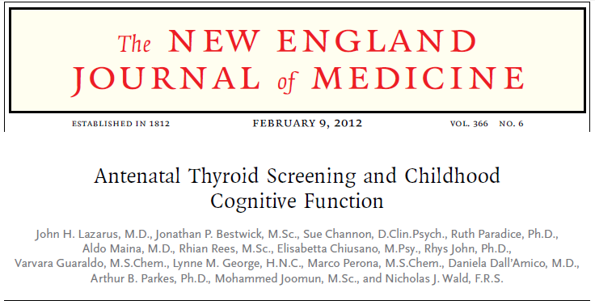
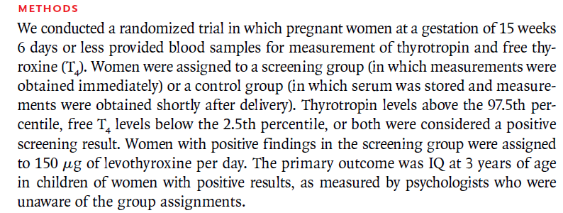
.

Slide 19
Treatment had no effect on mean offspring IQ at age 3 years or the number of children with an IQ <85
CONCLUSION
Antenatal screening and maternal treatment for women with subclinical thyroid dysfunction did not result in improved cognitive function in children at 3 years old

Slide 20
Against universal thyroid screening
Dta that link subclinical thyroid dysfunction to poor pregnancy outcomes are also not consistent
Obstet Gynecol 2005;105:239-45
Obstet Gynecol2008;112:85-92

Slide 21
Journal of Thyroid Research.2013

Slide 22
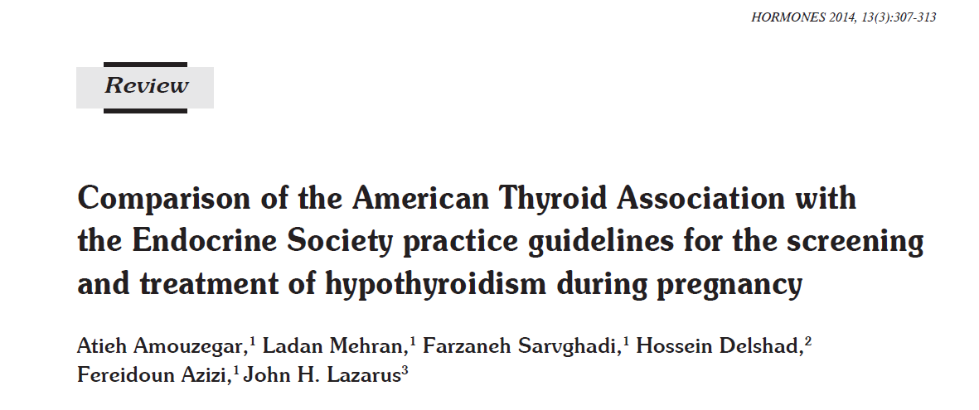

Slide 23
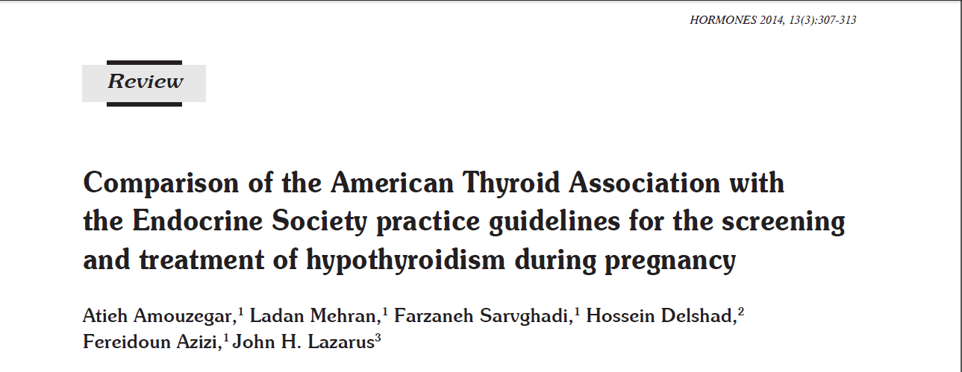

Slide 24
Conclusion
The issue of universal screening for thyroid dysfunction and thyroid autoimmune disease in pregnancy remains controversial
To date, there is limited evidence to demonstrate that LT4 treatment can improve outcomes
More RCTs are urgently needed, primarily to confirm the beneficial effects of universal screening as well as of treatment of pregnant women with subclinical hypothyroidism

Slide 25
Thanks For Attention

