Slide 2
Problem List:
HTN
Hypokalemia
High ARR
Bilateral Adrenal masses(3cm)
High cortisol level (positive overnight dexamethasone suppression test )
Suppressed ACTH

Slide 3
questions
When hyperaldosteronism should be considered?
How hyperaldosteronism should be evaluated?
How AVS procedure is done?
What are the limitations of AVS?
How is the prevalence of PA & sub clinical hypercortisolism coincidence?
What are the SCS complications?
How should our patient be managed?
How should our patient be followed?

Slide 4
When hyperaldosteronism should be considered?
Patients with sustained blood pressure (BP) above
150/100 mm Hg on each of three measurements
obtained on different days
hypertension resistant to three conventional
antihypertensive drugs (including a diuretic)
Controlled BP on four or more antihypertensive drugs
J Clin Endocrinol Metab, 2016

Slide 5
When hyperaldosteronism should be considered?
Hypertension and spontaneous or diuretic-induced hypokalemia
Hypertension and adrenal incidentaloma
Hypertension and sleep apnea
Hypertension and a family history of early onset hypertension or cerebrovascular accident at a young age (40 years)
All hypertensive first-degree relatives of patients with PA
J Clin Endocrinol Metab, 2016

Slide 6
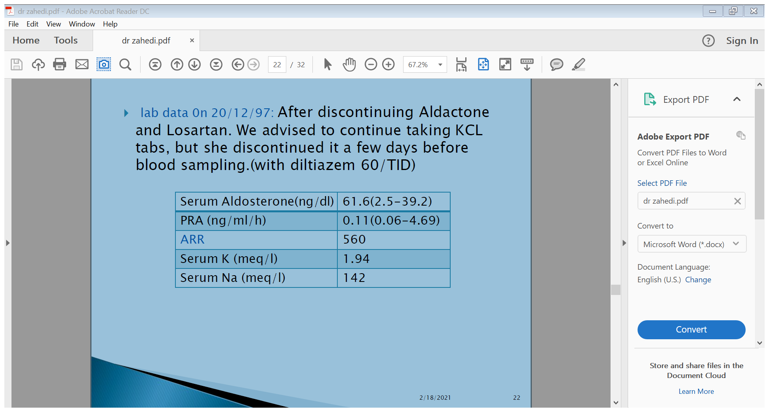

Slide 7
questions
When hyperaldosteronism should be considered?
How hyperaldosteronism should be evaluated?
How AVS procedure is done?
What are the limitations of AVS?
How is the Prevalence of PA & sub clinical hypercortisolism coincidence?
What are the SCS complications?
How should our patient be managed?
How should our patient be followed?

Slide 8
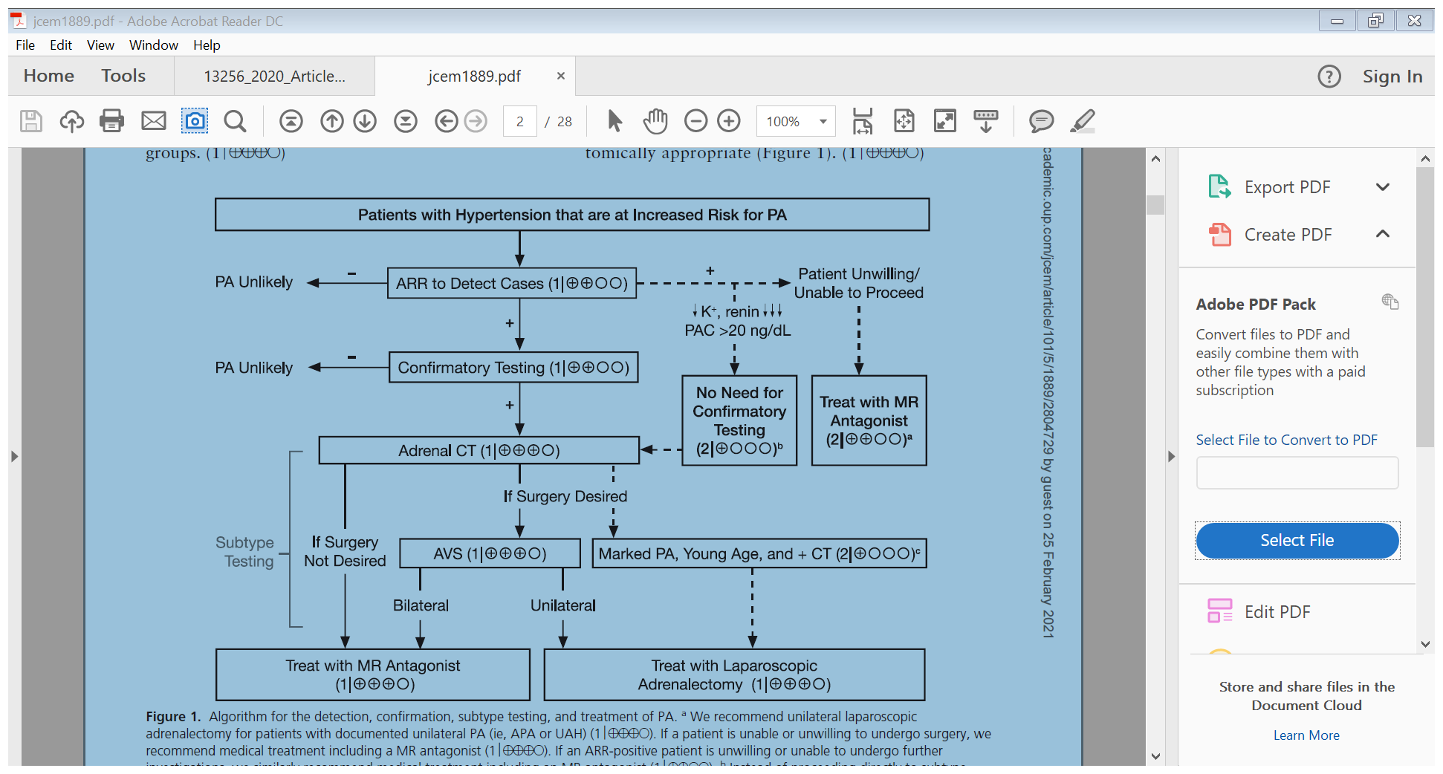
How should hyperaldosteronism be evaluated?
J Clin Endocrinol Metab, 2016

Slide 9
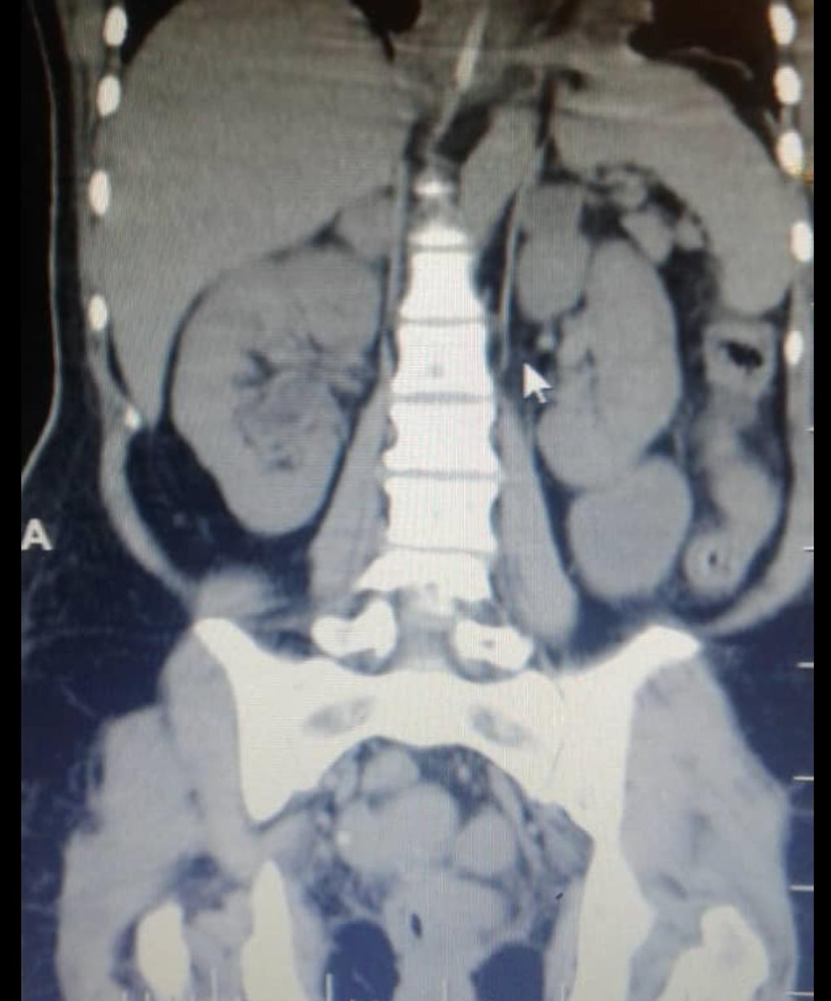
Our patients CT scan
Bilateral lesions

Slide 10
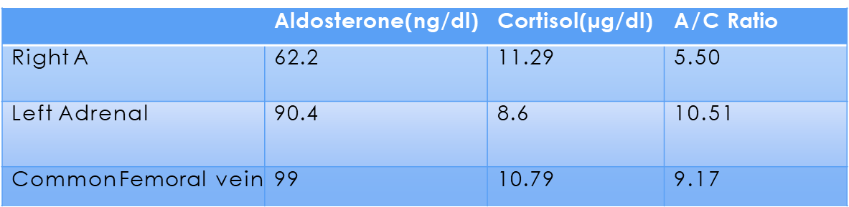
Our patients AVS
Cortisol of Rt Adrenal Vein/peripheral: 11.29/10.79= 1.04
Cortisol of Lt Adrenal Vein/peripheral: 8.6/10.79= 0.797
A/C of Rt Adrenal V.: 62.2/11.29= 5.50
A/C of lt Adrenal V.: 90.4/8.6= 10.5
A/C of Peripheral V.= 99/10.79= 9.17
A/C of Rt Adrenal V./peripheral V.= 5.50/9.17= 0.599
A/C of Lt Adrenal V./peripheral V.=10.5/9.17= 1.14

Slide 11
questions
When hyperaldosteronism should be considered?
How hyperaldosteronism should be evaluated?
How AVS procedure is done?
What are the limitations of AVS?
How is the Prevalence of PA & sub clinical hypercortisolism coincidence?
What are the SCS complications?
How should our patient be managed?
How should our patient be followed?

Slide 12
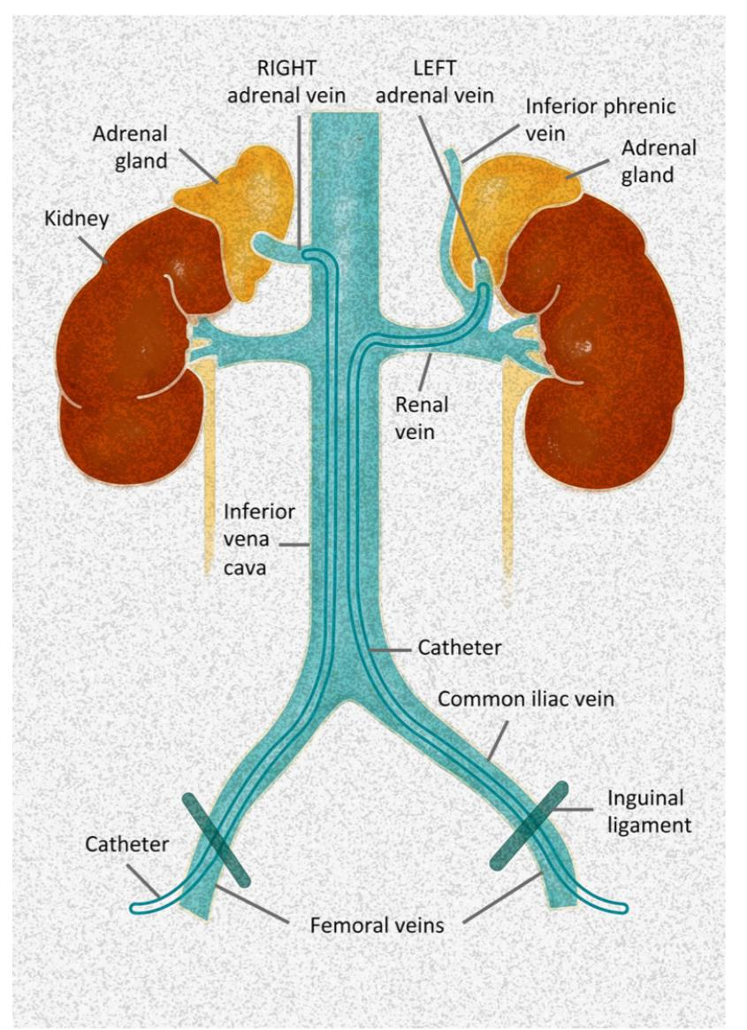
AVS procedure & pitfalls
Sampling from each AV & IVC sequentially/ simultaneously.
Simultaneously: eliminate temporal fluctuations but needs bilateral common femoral venous access,thecnical challenge.
Technical challenge can be minimized by sequential sampling during cosyntropin infusion.(increase sensitivity & specificity)
European Journal of Endocrinology (2018)

Slide 13
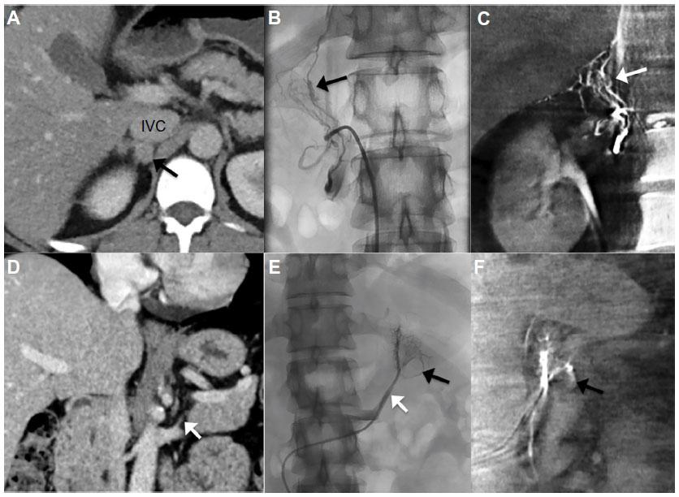
Right adrenal vein contrast injection
Right adrenal adenoma
Left adrenal vein origin
European Journal of Endocrinology (2018)

Slide 14
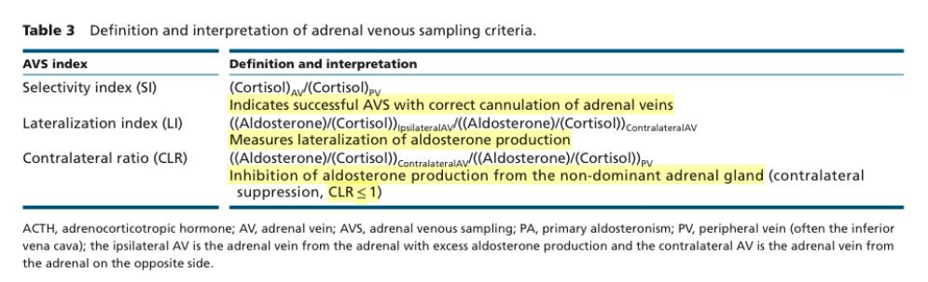
AVS
European Journal of Endocrinology (2018)

Slide 15
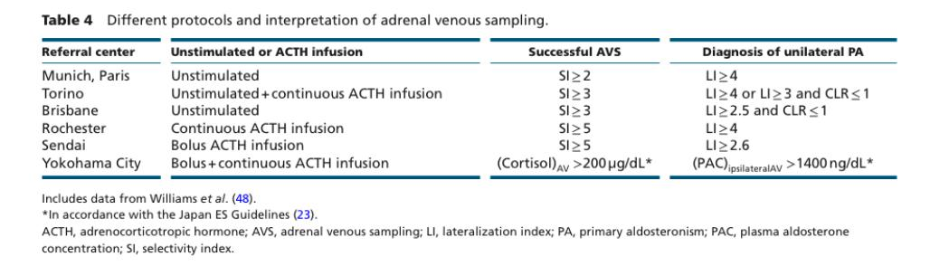
AVS
European Journal of Endocrinology (2018

Slide 16
Confirming successful catheterization
With cosyntropin infusion, AV to IVC cortisol ratio is typically more than 10:1
a ratio of at least 5:1 is required to be confident that the adrenal veins were successfully catheterized .
The adrenal/peripheral vein cortisol ratio is typically more than 5:1 with the
continuous cosyntropin infusion protocol and more than 2:1 without cosyntropin use
Cortisol-corrected ratios —cutoff for the cortisol-corrected aldosterone ratio from high-side to low-
side of more than 4:1
jClin Endocrinol Metab, May 2016, 101(5):1889–1916

Slide 17
questions
When hyperaldosteronism should be considered?
How hyperaldosteronism should be evaluated?
How AVS procedure is done?
What are the limitations of AVS?
How is the Prevalence of PA & sub clinical hypercortisolism coincidence?
What are the SCS complications?
How should our patient be managed?
How should our patient be followed?

Slide 18
AVS pitfalls
Difficulty in selecting right AV which originate directly from IVC.
Using venography landmarks before procedure , rapid cortisol testing.
Aberrant venous anatomy of left adrenal vein.
Glucocorticoid co-secretion in hyperaldosteronism.
Adrenal Vein Sampling, Radio Graphics, Australia 2005

Slide 19
questions
When hyperaldosteronism should be considered?
How hyperaldosteronism should be evaluated?
How AVS procedure is done?
What are the limitations of AVS?
How is the Prevalence of PA & sub clinical hypercortisolism coincidence?
What are the SCS complications?
How should our patient be managed?
How should our patient be followed?

Slide 20
PA & SCS
Prevalence:10-20%
Diagnosis SCS in PA can help:
  decrease false negative AVS( PAC should be used)
  Hormones like metanephrine in adrenal vein sample can be used
  Can prevent adrenal crisis after PA surgery (preoperative glucocorticoid use in PA & SCS)
  Can decrease hypercortisolism complication.(Follow up)
  J. Endocrinol. Invest. 36: 564-567, 2013

Slide 21
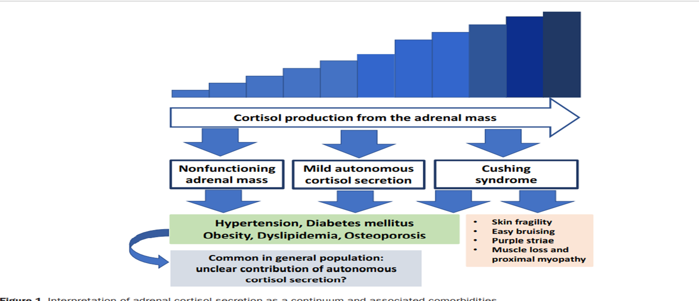

Slide 22
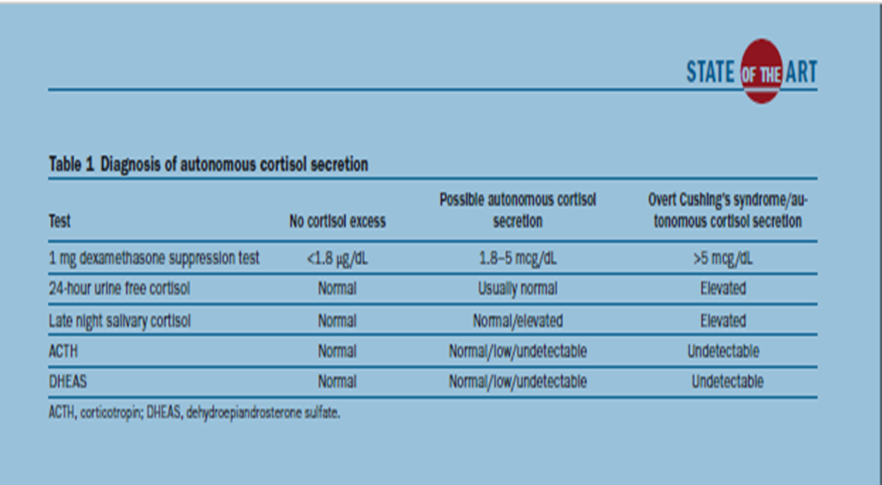

Slide 23
Our patients labs
21/12/97 | 8/1/98 | 12/3/98 | 21/3/98
ODST:8/8 micgr/dl | ODST:13/2 micgr/dl | ODST:12/3 micgr/dl | ODST:20/9 micgr/dl
24 hr urine: Volume:1800 cr:1 gr/24 hr UFC:227 micg/24 hr(50-190) | 24 hr urine: volume:1900 cr:1300 UFC:131 micg/24 hr |  | 24 hr urine: Volume :1000 cr:1/3 gr/24 hr UFC: 360 micgr/24 hr
 | ACTH:0/4 pmol/l (1-3/5)
 |  | DHEAS:83(35-430)

Slide 24
questions
When hyperaldosteronism should be considered?
How hyperaldosteronism should be evaluated?
How AVS procedure is done?
What are the limitations of AVS?
How is the Prevalence of PA & sub clinical hypercortisolism coincidence?
What are the SCS complications?
How should our patient be managed?
How should our patient be followed?

Slide 25
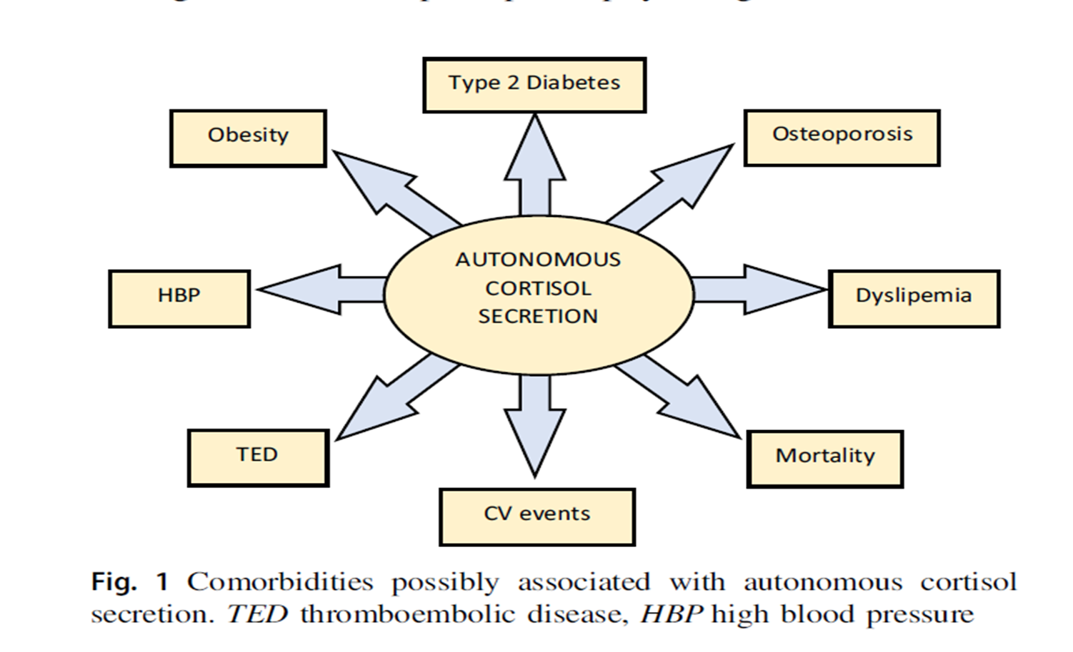

Slide 26
questions
When hyperaldosteronism should be considered?
How hyperaldosteronism should be evaluated?
How AVS procedure is done?
What are the limitations of AVS?
How is the Prevalence of PA & sub clinical hypercortisolism coincidence?
What are the SCS complications?
How should our patient be managed?
How should our patient be followed?

Slide 27
If both adrenal veins are not successfully catheterized, the decision may be to:
1) repeat AVS;
2) treat the patient medically; or
3) consider surgery based on the findings of other diagnostic tests, as previously noted.
jClin Endocrinol Metab, May 2016, 101(5):1889–1916

Slide 28
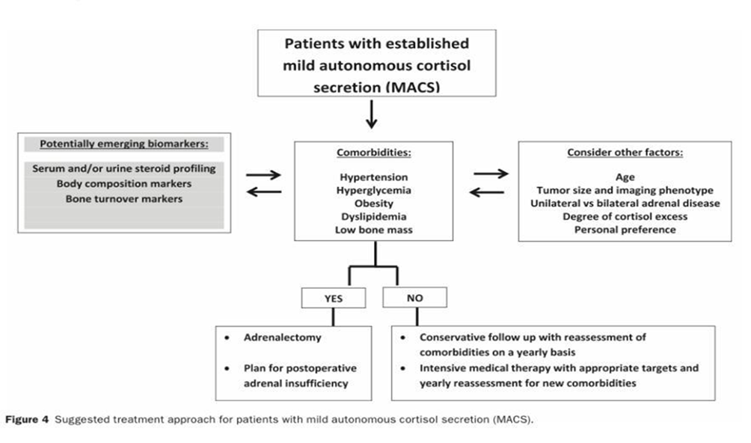


Slide 29
questions
When hyperaldosteronism should be considered?
How hyperaldosteronism should be evaluated?
How AVS procedure is done?
What are the limitations of AVS?
How is the Prevalence of PA & sub clinical hypercortisolism coincidence?
What are the SCS complications?
How should our patient be managed?
How should our patient be followed?

Slide 30
Follow up
BP & electrolyte monitoring
Abdominal CT scan
Monitoring hypercortisolism metabolic complication like osteoporosis (BMD)

Slide 31
Malignancy feature
size (≥4 cm)
HU ≥10 HU
Absolute washout <60%, relative washout <40%
Irregular margin
non homogeneous, non-uniform enhancement, surrounding tissue invasion or metastasis
increase in metabolites of steroids, such as dehydroepiandrosterone sulfate (DHEA-S)
Eur Radiol (2004) 14:1787–1792

Slide 32


