Slide 2
Non-Communicable Disease in the Islamic Republic of Iran
Fereidoun Azizi
Research Institute for Endocrine Sciences, SBUMS
Tehran, I.R. Iran
بيماريهاي عمده غير واگير در جمهوري اسلامي ايران
دکتر فريدون عزيزي
پژوهشکده علوم غدد درون ريز و متابوليسم
دانشگاه علوم پزشکي شهيد بهشتي
سومين كنگره پيشگيري و درمان چاقي ايران
27-25 آبان 1390

Slide 3
Effects of a sedentary lifestyle

Slide 4
Prevalence of diabetes and impaired fasting glucose in the adult (20-64 years) urban population of Iran
Esteghamati AR, et al. Diabetes Care 2008, 31:96-8

Slide 5
High prevalence of diabetes and abnormal glucose tolerance in adult population (≥20 years) of Tehran
Hadaegh F. at al. BMC Public Health 2008. 8:176

Slide 6
Age- and gender-wise prevalence of different glucose intolerance categories among Tehranian adults
%
Hadaegh F. at al. BMC Public Health 2008. 8:176

Slide 7
Estimation of the Prevalence of glucose intolerance in Iran
Azizi,2009*
Esteghamati,2008†
 | Urban | Rural | All
IGT | 3.2* | 0.9 | 4.1 | -
DM | 2.6 | 1.0 | 3.6 | 2.0
IFG |  |  |  | 4.4
Total | 5.8 | 1.9 | 7.7 | 6.4
*Estimation by studies using GTI ( Epidemiology of Common diseases in Iran
† National survey using FPG (Diabetes Care)

Slide 8
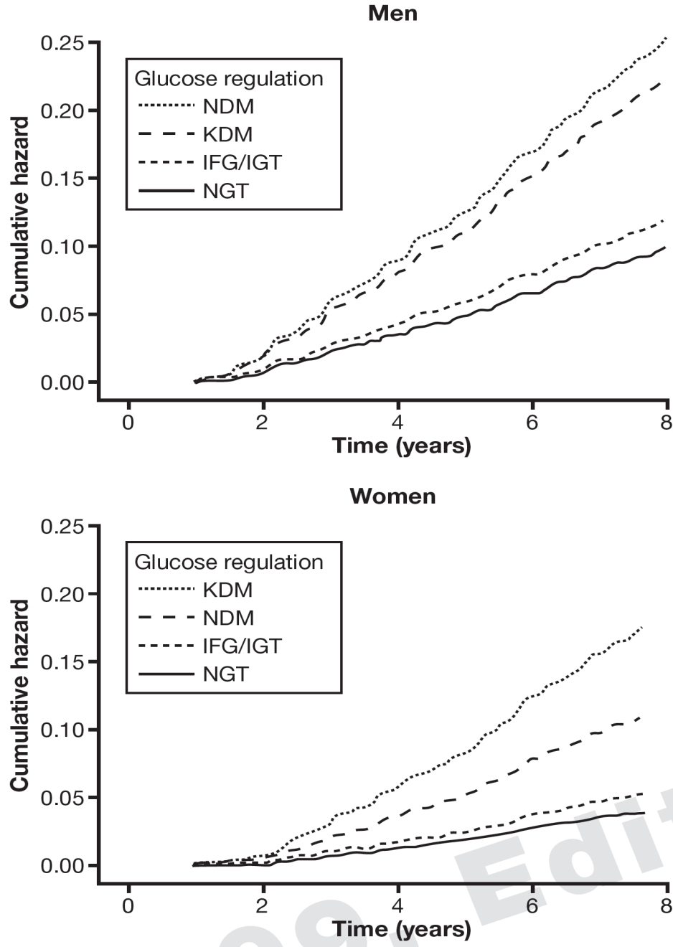
Age-adjusted cumulative hazard of cardiovascular disease
for glucose regulation categories .
In both genders NGT and IFG/IGT categories had relatively the same cumulative hazards. In the male population, there was no difference between NDM and KDM categories regarding the cumulative hazards of CVD; however, in women the KDM category had higher cumulative hazard than the NDM category.
NGT: normal glucose tolerance
IFG/IGT: impaired fasting glucose or impaired glucose tolerance
NDM: newly diagnosed diabetes mellitus
KDM: known diabetes mellitus
Hadaegh et al. J Endocrinol Invest 2009; 9: 724

Slide 9
Prevalence of overweight and obesity in Tehranian adults (TLGS)
2004
N = 8647 ( aged 20-70 years )
F.Azizi et al, East Mediter Health 2004;10:887

Slide 10
Prevalence of different categories of body mass index (BMI) and of abdominal obesity (Ab) by gender
Kelishadi R et al. Public Health Nutr 2007; 11: 246

Slide 11
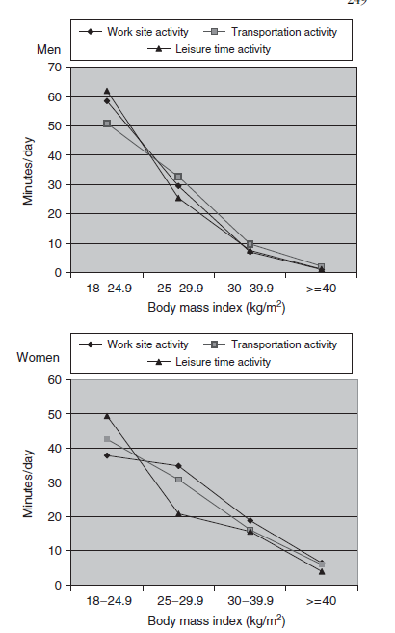
Daily time (min) spent on physical activity in men and women with different categories of BMI (BMI-body mass index)
Kelishadi R et al. Public Health Nutr 2007; 11: 246

Slide 12
تعداد افراد 20 ≥ ساله با اضافه وزن و چاقي در ايران
كل | روستا | شهر
4/16 | 2/5 | *2/11 | اضافه وزن
1/8 | 2/2 | 9/5 | چاق
5/24 | 4/7 | 1/17 | جمع
* ميليون نفر( کل جمعيت 72 ميليون و 65%، 20 سال و بالاتر)

Slide 13
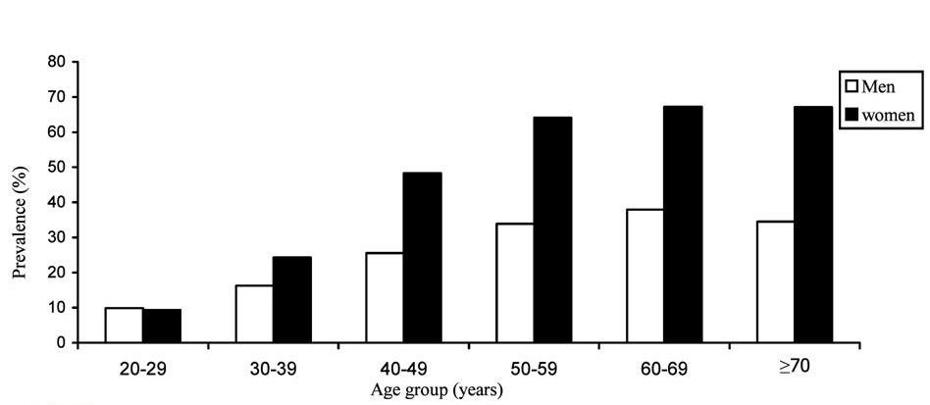
Age- specefic prevalence of metabolic syndrome by sex in Tehran’s adult population
The unadjusted prevalence of the metabolic syndrome in the study population was 30.1% (CI_{95%} : 29.2-31.0)
F. Azizi et al. Diabet Res Clin Prac 2003;61(1):29 -37

Slide 14
Waist circumference cut off in various metabolic syndrome and population/country-specific definitions
Definition | Cut-off (cm)
 | Women | Men
IGR (1999) | ≥ 80 | ≥ 94
NCEP/ATP III (2001) | ≥ 88 | ≥ 102
EUROPID IDF (2005) | ≥ 80 | ≥ 94
Asian IDF (2005) | ≥ 80 | ≥ 90
Japanese IDF (2005) | ≥ 90 | ≥ 85
Iranian (cross-sectional 2009) | ≥ 91 | ≥ 89
Iranian (outcome 2009) | ≥ 94.5 | ≥ 94.5

Slide 15
Appropriate Iranian Waist Circumference Cut-off Points: The First Report of the Iranian National Committee on Obesity
For both women and men ≥ 30 years:
Stage 1; preventive measures:
90 cm
Stage 2; serious management:
95 cm
Azizi F, et al. Arch Iran Med 2010; 13: 243-4.

Slide 16
Criteria for Clinical Diagnosis of the Metabolic Syndrome in the I. R. Iran
Measure | Categorical Cut Points
Elevated waist circumference* | ≥95 cm for both men & women
Elevated triglycerides (drug treatment for elevated triglycerides is an alternate indicator†) | 150 mg/dL (1.7 mmol/L)
Reduced HDL-C (drug treatment for reduced HDL-C is an alternate indicator†) | 40 mg/dL (1.0 mmol/L) in males; 50 mg/dL (1.3 mmol/L) in Females
Elevated blood pressure (antihypertensive drug treatment in a patient with a history of hypertension is an alternate indicator) | Systolic 130 and/or diastolic 85 mm Hg
Elevated fasting glucose‡ (drug treatment of elevated glucose is an alternate indicator) | 100 mg/dL
HDL-C indicates high-density lipoprotein cholesterol. *It is recommended that the IDF cut points be used for non-Europeans and either the IDF or AHA/NHLBI cut points used for people of European origin until more data are available. †The most commonly used drugs for elevated triglycerides and reduced HDL-C are fibrates and nicotinic acid. A patient taking 1 of these drugs can be presumed to have high triglycerides and low HDL-C. High-dose -3 fatty acids presumes high triglycerides. ‡Most patients with type 2 diabetes mellitus will have the metabolic syndrome by the proposed criteria.
Azizi F et al. Arch Iran Med 2010; 13: 243-4

Slide 21
Mean age-standardized SBP, TC, and FPG in relation to mean age-standardized BMI
Danaei G, et al. (Global Burden of Metabolic Risk Factors of Chronic Diseases Collaborating Group), In press.

Slide 22
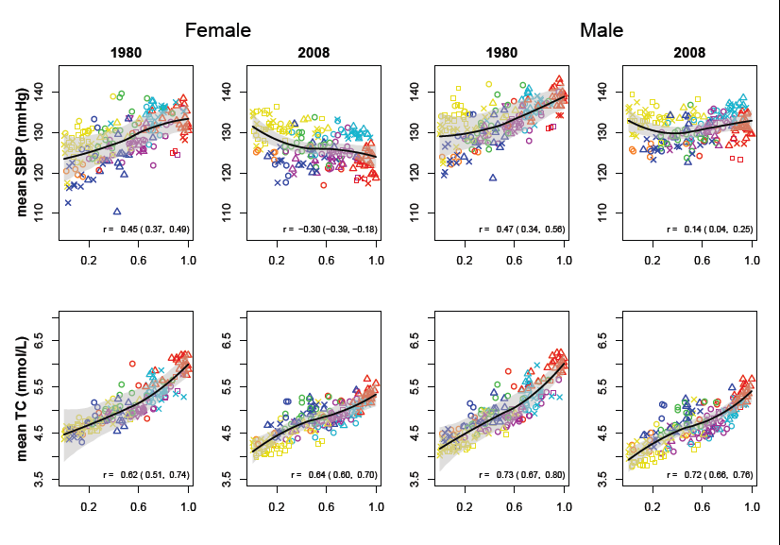
Mean age-standardized levels of metabolic risk factors in relation to western diet
Danaei G, et al. (Global Burden of Metabolic Risk Factors of Chronic Diseases Collaborating Group), In press.

Slide 23
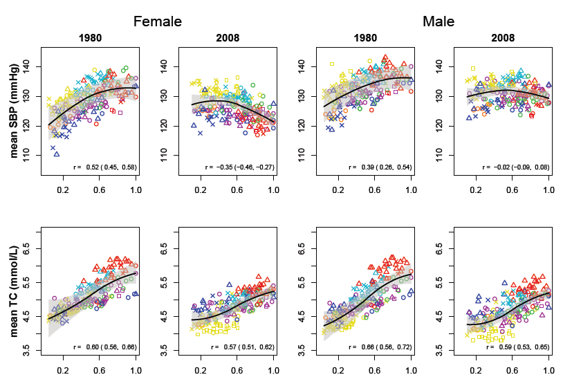
Mean age-standardized levels of metabolic risk factors in relation to the proportion of a country’s population that lived in urban areas
Danaei G, et al. (Global Burden of Metabolic Risk Factors of Chronic Diseases Collaborating Group), In press.

Slide 24
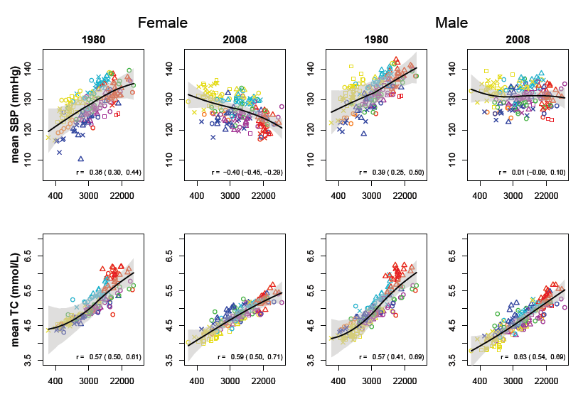
Mean age-standardized levels of metabolic risk factors in relation to per-capita gross domestic product (GDP)
Danaei G, et al. (Global Burden of Metabolic Risk Factors of Chronic Diseases Collaborating Group), In press.

Slide 25
Intervention Lifestyle intervention towards changes: in nutritional habits, increase in physical activities, decrease in cigarette smoking, and better management of stress

Slide 26
Results
The change in the prevalence of metabolic syndrome components
Over the time in cases and controls
Prevalence (%)
Cases
Controls

Slide 27
نتيجه گيري
در جمهوري اسلامي ايران برنامه هاي موثر براي شناخت، عوامل خطر بيماريهاي غيرواگير وجود دارد.
شيوع بالاي اين بيماري ها در كشور ما كه در گذار تغذيه اي است، لزوم مداخلات كشوري را در ابعاد مختلف عوامل محيطي به ويژه تغذيه سالم و پرتحركي تاكيد مي كند.
حمايت تحقيقات در زمينه هاي مختلف به ويژه روش هاي اصلاح شيوه زندگي و مطالعات ميداني و سلولي ملكولي ميتواند خصوصيات خاص بيماريهاي غيرواگير در ايران (مانند شيوع بالاي HDL-C پايين) و نحوه كنترل آنها را آشكار نمايد.
كنترل بيماري هاي غيرواگير و عوامل خطر آنها نياز به يك عزم ملي دارد.

