Slide 4
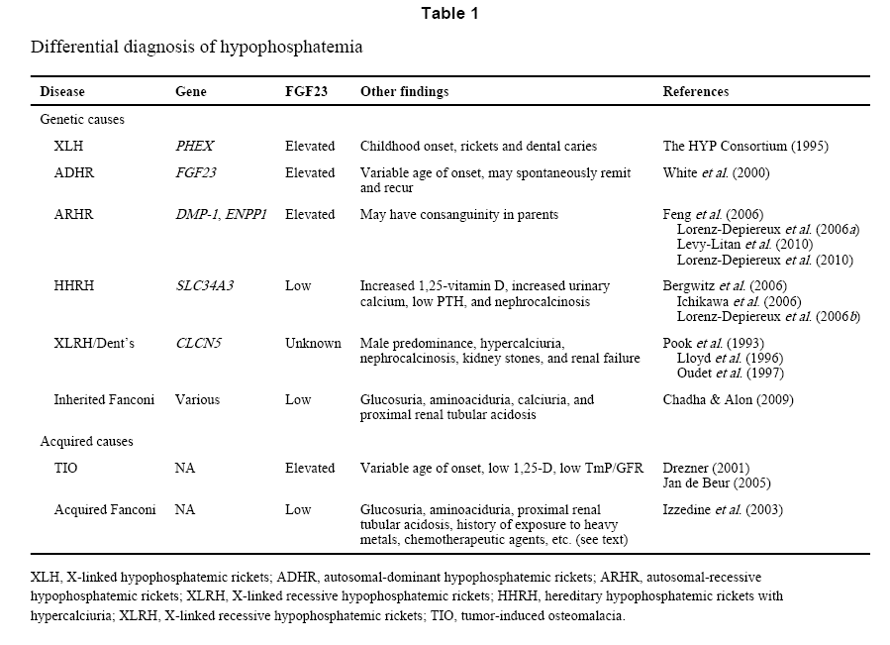

Slide 5
2012
The 39 patients described here were combined with the 269 cases reviewed in the literature
The general characteristics of TIO patients
The gender distribution was even (M:F 19:20) with an average age of 42 (20–69 years).
Their course of disease was 6.7 ± 5.3 years (1.5–28 years).
Their symptoms included muscle weakness/fatigue (100%), bone pain (100%), trouble walking(100%), reduced height (64.1%), and pathological fractures (84.6%), primarily in the ribs, vertebral bodies, and femoral neck.

Slide 6
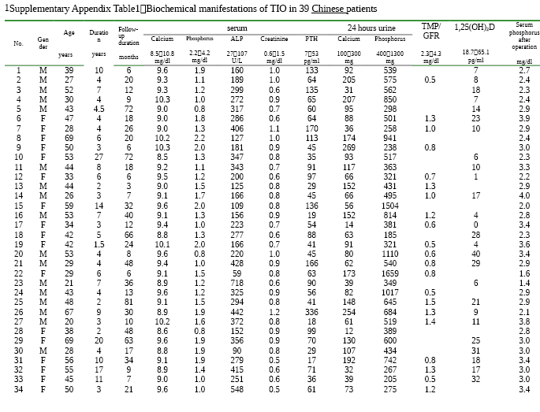

Slide 7
By radiograph:
Vertebral compression fractures were verified in 29 of 39 (74.4%)
Pelvis deformities in 15 of 39 (38.5%)
Pseudo fractures in 12 of 39 (30.8%)
Blurred pubic symphyses in 4 of 39 (10.3%)
Laboratory tests :
Serum calcium : 9.3 ± 0.5 mg/dL
Phosphorus : 1.4 ± 0.4 mg/dL
ALP : 270 ± 133 U/L
24-hour urine calcium : 104 ± 64 mg
24-hour urine phosphate : 720 ± 416 mg

Slide 8
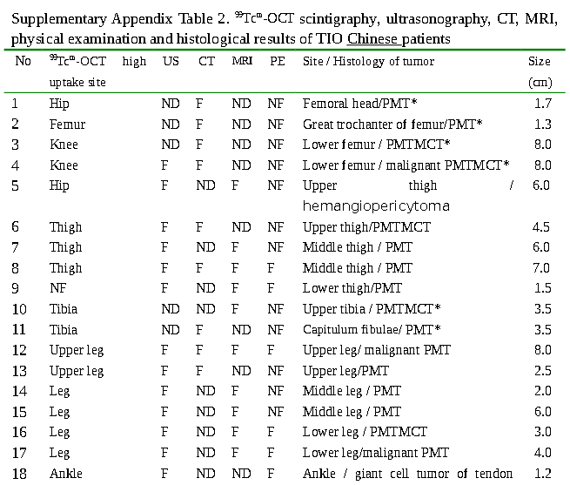
Lower extremities : 56%
Upper extremities : 5%
Hip : 3%
Thorax : 5%
Head : 31%
Mandible
Maxilla
Nasal sinus
Soft tissues : 67%
Skeletal sites : 33%
Size ranged from 1.0 to 7.0 cm

Slide 9
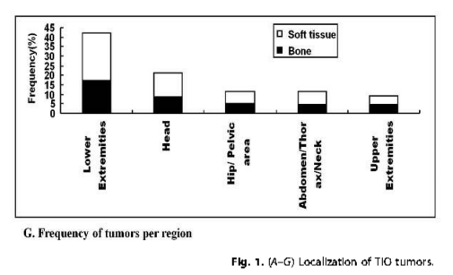

Slide 10
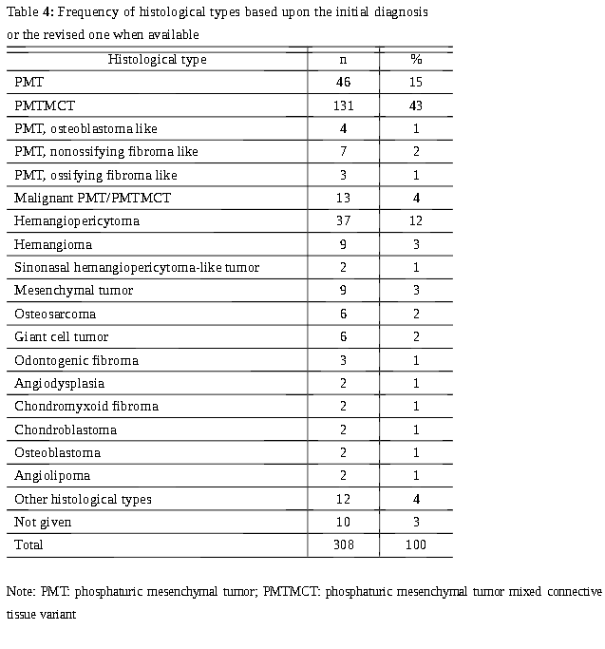

Slide 11
Hemangiopericytoma ( CNS )
Definition / general
< 1% of all primary CNS tumors
60% men, mean age 45 years
Usually single mass attached to meninges of brain or spinal cord (resembles meningioma radiographically)
overall survival : 84 months, 5 year survival 94% and 10 year survival 72%
41% recur, 12 - 20% metastasize to extra or intracranial sites
May invade through neighboring bone
Sites
Dural based
Often supratentorial
10% spinal
Radiology description
Often homogenously enhancing and well demarcated from adjacent brain - resembles meningioma
Revised: 6 September 2017, last major update August 2014

Slide 12
A retrospective evaluation of 1799 surgical specimens of meningiomas from 1582 patients was made (1964 – 1990)
Papillary Meningiomas and Hemangiopericytoma are known to show a significantly higher tendency to recur in comparison with classic meningioma;

Slide 13
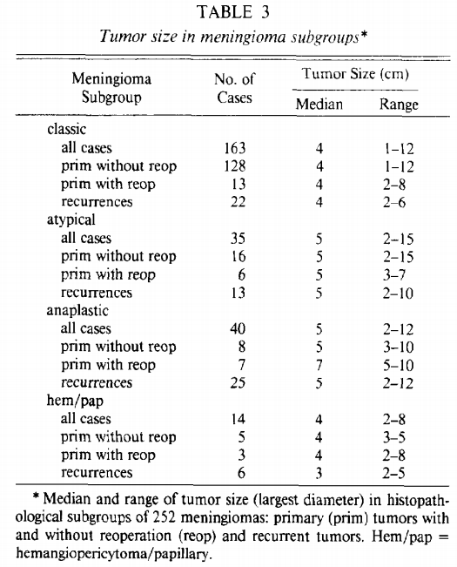
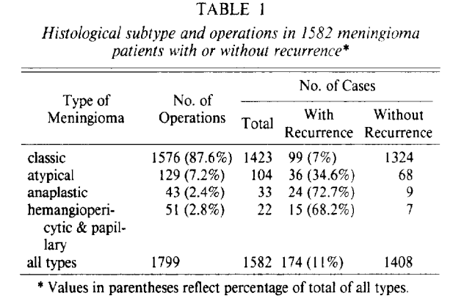

Slide 14
Solitary fibrous tumor / Hemangiopericytoma
Over the past decade, soft tissue pathologists have moved away from the designation Hemangiopericytoma, diagnosing such tumors within the spectrum of solitary
fibrous tumors, whereas neuropathologists have retained the term Hemangiopericytoma given its historical understanding and distinct clinicopathologic correlations, such as high recurrence rates and long-term risk of systemic metastasis.

Slide 15
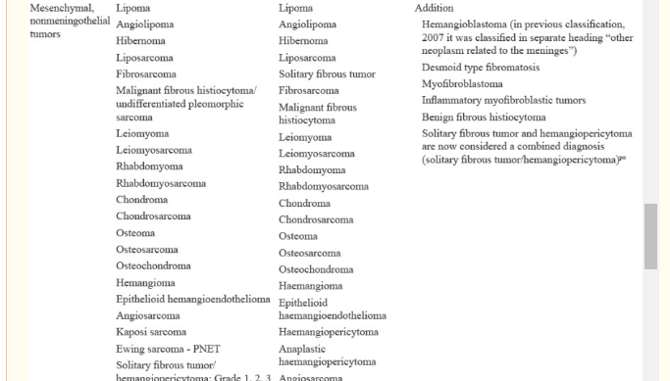

Slide 16
The index patient was a 44 year-old woman who had surgery and post-operative radiation for an meningeal malignant SFT in 2002.
In 2009, magnetic resonance imaging (MRI) showed a new brain mass and also a para spinal mass.(metastatic SFT)
In 2011: progression of sarcoma on chemotherapy( Liver metastases).
The specimen showed the typical morphologic features of SFT with HPC-like vessels.

Slide 17
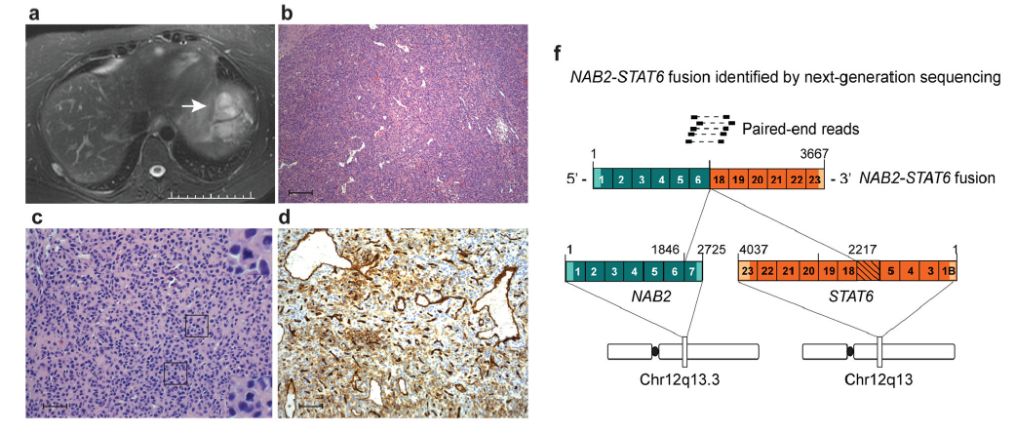

Slide 18
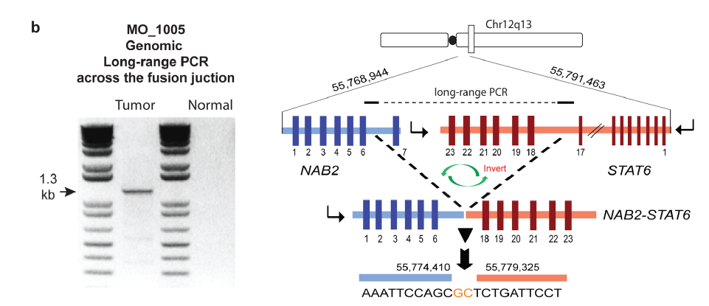

Slide 19
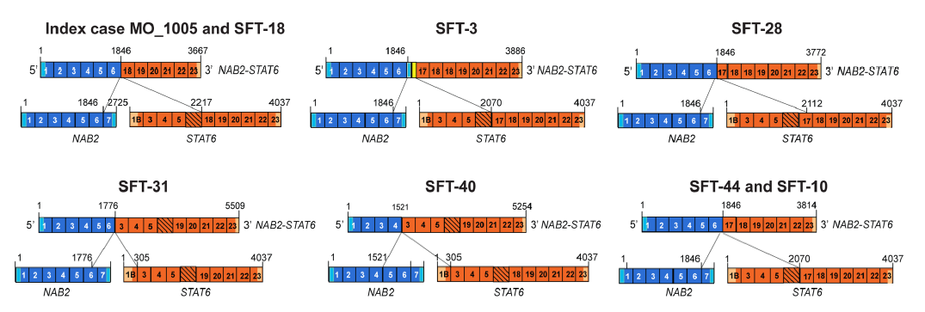
Overexpression of the NAB2-STAT6 gene fusion induced proliferation in cultured cells and activated EGR-responsive genes.
These studies establish NAB2-STAT6 as the defining driver mutation of SFT and provide an example of how neoplasia can be initiated by converting a transcriptional repressor of mitogenic pathways into a transcriptional activator.

Slide 20
World Neurosurg. (2014) 81, 3/4:552-556.
A total of 43 patients with intracranial HPC were treated from 1980 to 2010.
Treatment and follow-up information was available for analysis on 36 patients.
Eighteen patients (41.86%) had HPC recurrence. The median time until recurrence was 72.24 months ( 6 years )
Five patients (11.62%) developed extracranial metastasis.
Patients undergoing any form of adjuvant radiation treatment did have a significantly improved recurrence-free interval (108 vs. 64 months; P [ .04) compared with patients who did not undergo radiation treatment.
Tumor characteristics associated with earlier recurrence included size >7 cm and sinus invasion.

Slide 21
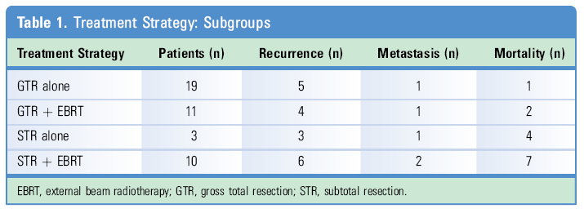
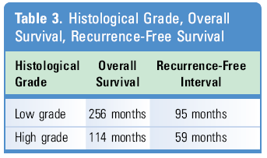

Slide 22
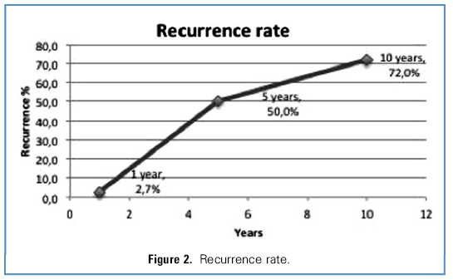
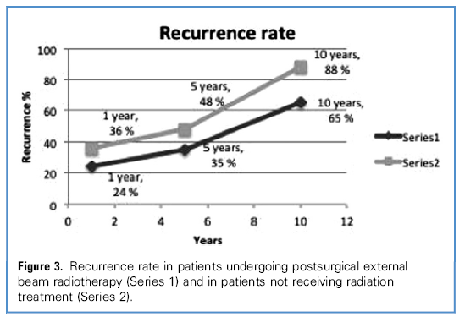

Slide 23
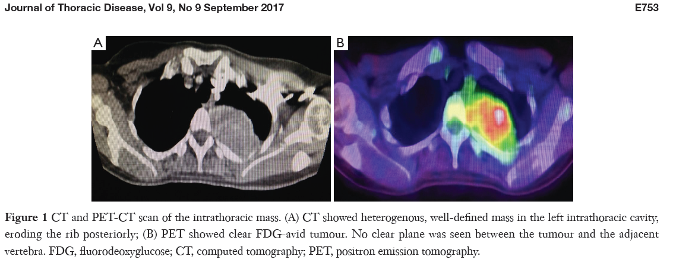
A 41-year-old female with two previous resections for intracranial meningeal HPC in 2004 and 2008, as well as adjuvant radiotherapy, presented in 2015 with left intrathoracic and left hip recurrence confirmed by positron emission tomography/computed tomography (PET/CT).

Slide 24
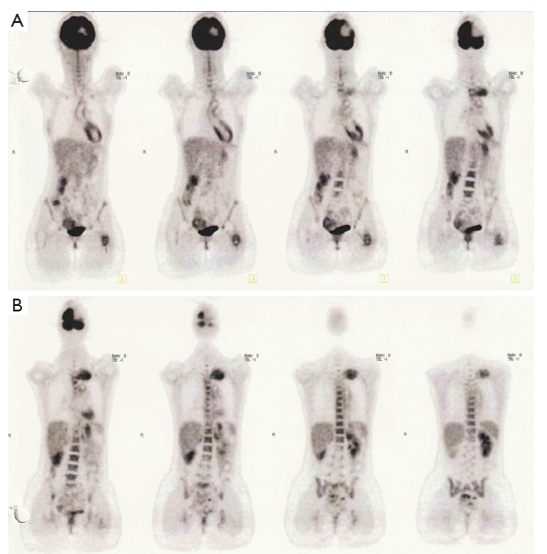

Slide 25
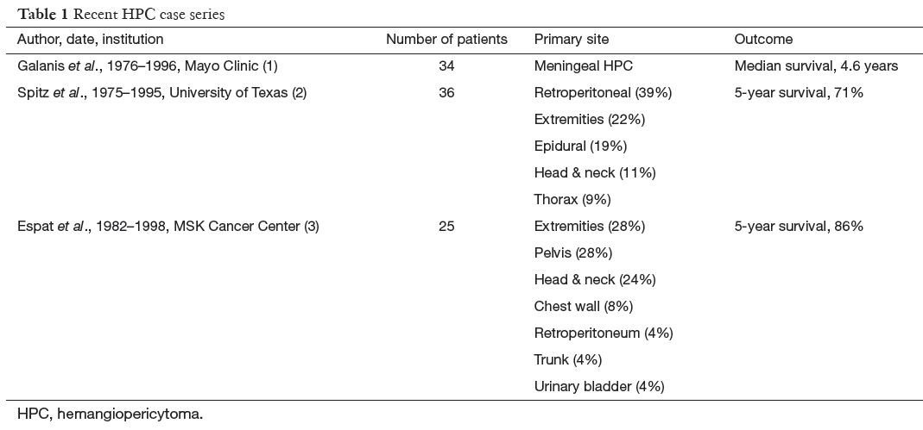

Slide 26
60 patients (27 men and 33 women, median age 42.5 years, range 13-69 years) treated between 1981 and 2016
SFT/HPC grade I : 4
SFT/HPC grade II : 40
SFT/HPC grade III : 16
Results
Six patients (10%) showed extracranial metastasis during a median period of 103.7 months (range 31.9-182.3 months).
Nineteen patients (31.7%) presented with tumor recurrences.
Conclusions
The long-term follow-up and periodic systemic evaluation are mandatory to detect systemic metastasis.

Slide 27
The records of 47 patients-10 with SFT, 33 with HPC, and 4 with anaplastic HPC-were reviewed(1996-2014)
Mean follow-ups : 114 months
Results
Extracranial metastases to the liver, bone, lung, spine, and kidney occurred in 10 patients (21.3%).
Grade III SFT/HPC was strongly correlated with the development of extracranial metastases (p = 0.031).
Conclusions
Gross-total resection should be the primary treatment goal in patients with SFT/HPC, regardless of the pathological grade.
Radiation can be administered as adjuvant therapy for patients with SFT/HPC that shows an aggressive phenotype or that is not treated with GTR.

Slide 28
31 subjects with TIO that All had failed either initial, or re-localization.
Functional imaging with
111Indium-octreotide with computed tomography (Octreo-SPECT or SPECT/CT) 18fluorodeoxyglucose positron emission tomography/CT (FDG-PET/CT)
were performed, followed by anatomic imaging (CT,MRI).
Selective venous sampling (VS) was performed when multiple suspicious lesions were identified or high surgical risk was a concern.

Slide 29
Results
Tumors localization : 20/31 subjects (64.5%).
18 of 19 (95%) were positive on Octreo-SPECT.
14 of 16 (88%) were positive on FDG-PET/CT.
10 of 12 (83%) were positive on Selective venous sampling .
15 subjects had their tumor resected at our institution, and were disease-free at last follow-up.
Serum phosphorus returned to normal in all subjects within 1-5 days.
In 10 subjects who were followed for at least 7 days postoperatively, intact FGF23 (iFGF23) decreased to near undetectable within hours and returned to the normal range within 5 days
Serum 1,25-dihydroxyvitamin D3 (1,25D) rose and exceeded the normal range.

Slide 30
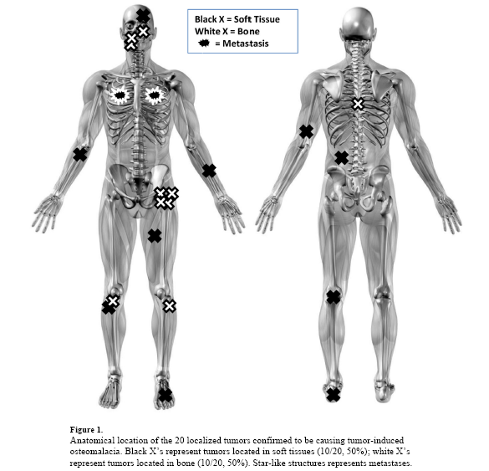

Slide 31
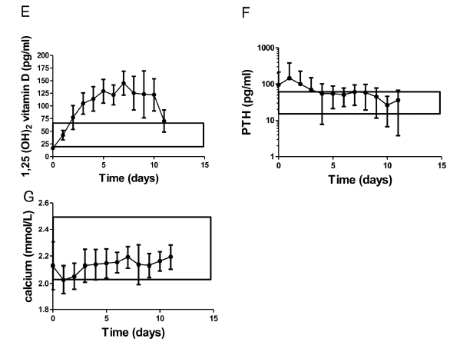

Slide 32
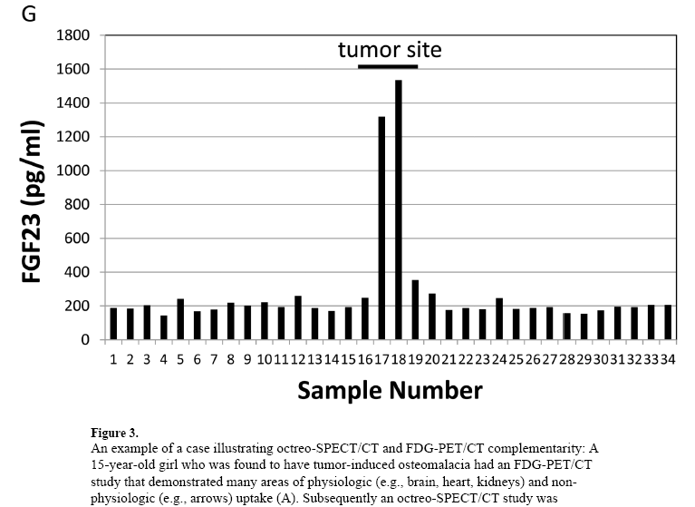

Slide 33
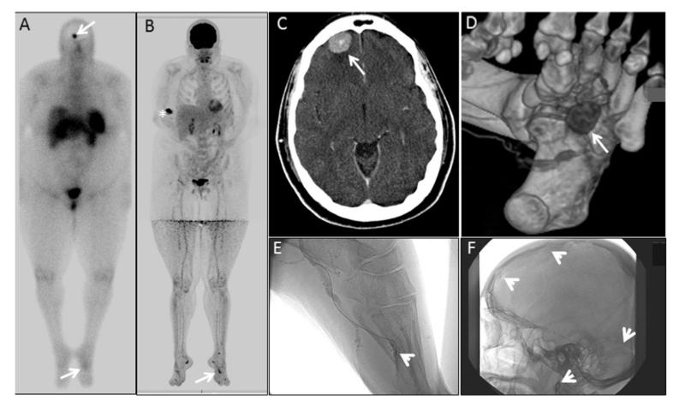
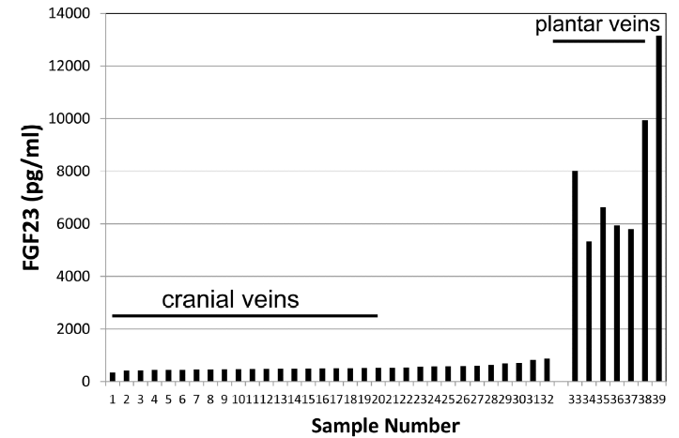

Slide 34
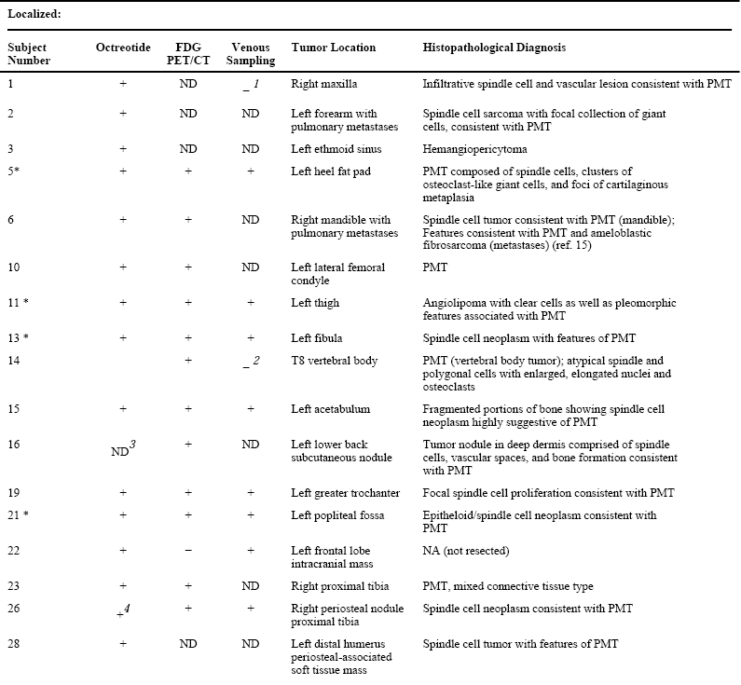

Slide 35
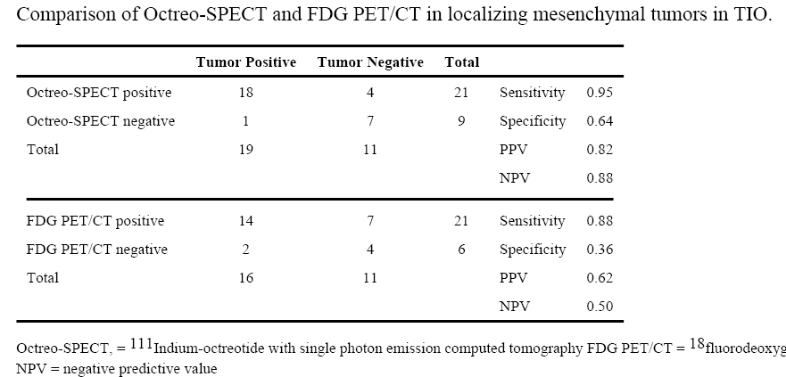

Slide 36
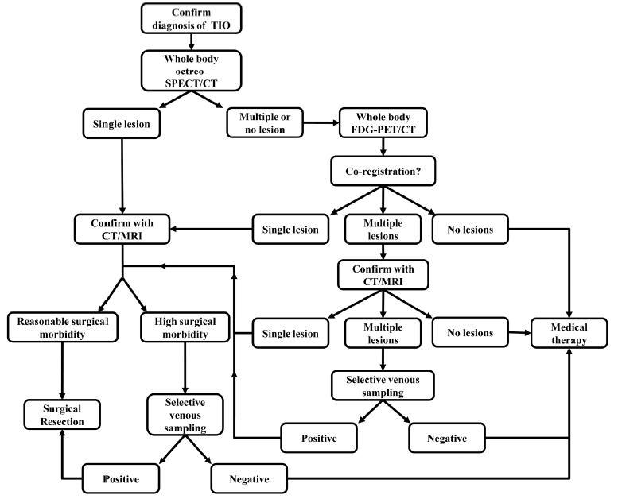

Slide 37
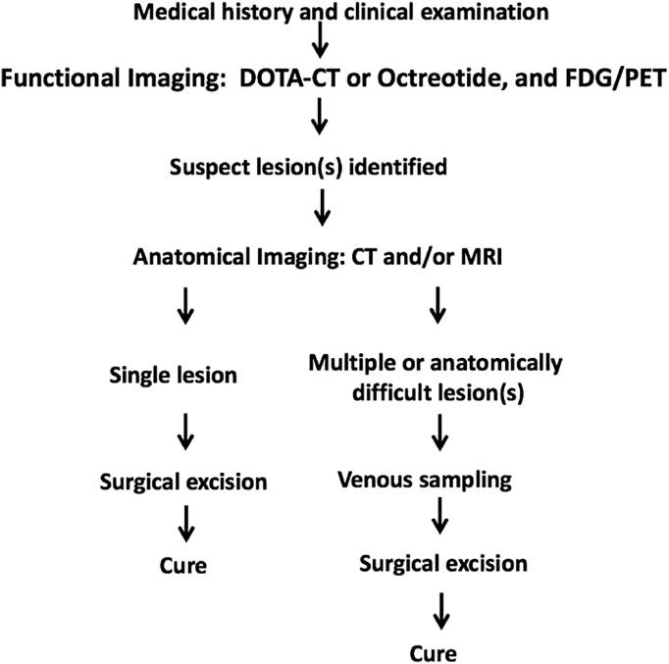

Slide 38
Using ⁶⁸Gallium (⁶⁸Ga)-conjugated somatostatin peptide analogues, such as 1,4,7,10-tetraazacyclododecane-1,4,7,10-tetraacetic acid (DOTA)TATE, which enables somatostatin receptor imaging with positron emission tomography (PET), may be useful at identifying these tumors.
11 subjects (6females, 5males) with TIO were included(2014-2015)
Intervention
⁶⁸Ga-DOTATATE PET/CT
¹¹¹In-pentetreotide single-photon emission CT (Octreoscan- SPECT/CT)
Fluorodeoxyglucose-PET/CT (18F FDG-PET/CT) scan.

Slide 39
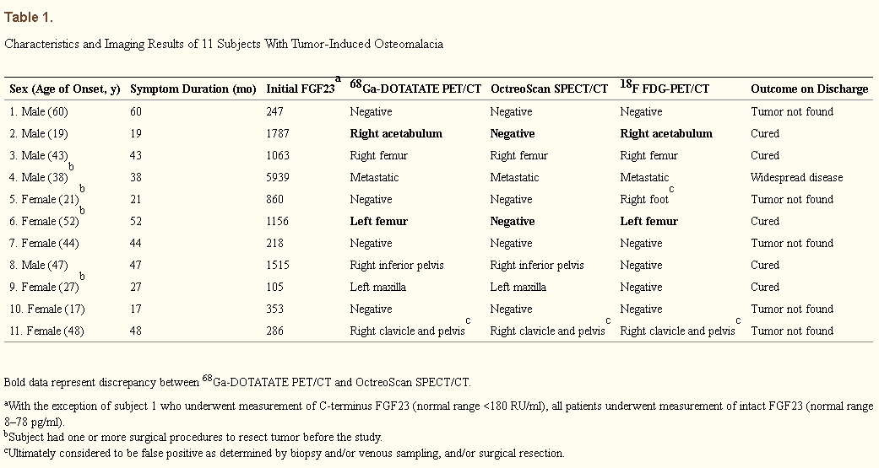
4
6
5

Slide 40
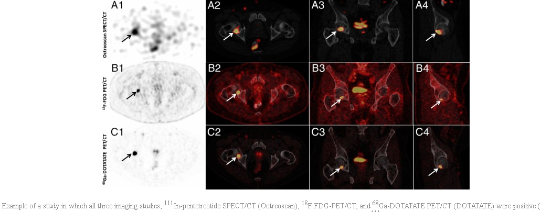

Slide 41
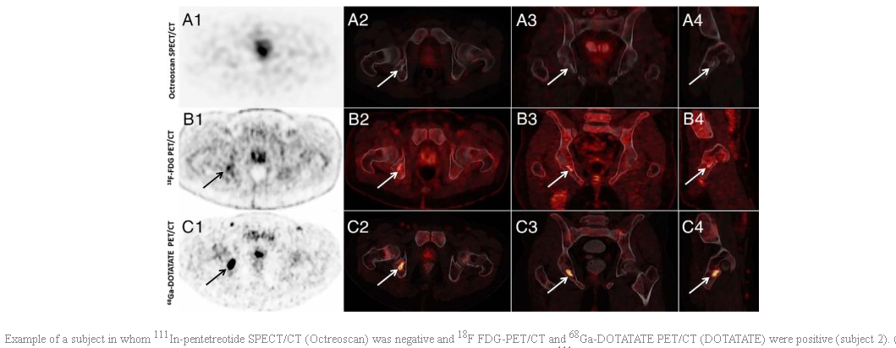

Slide 42
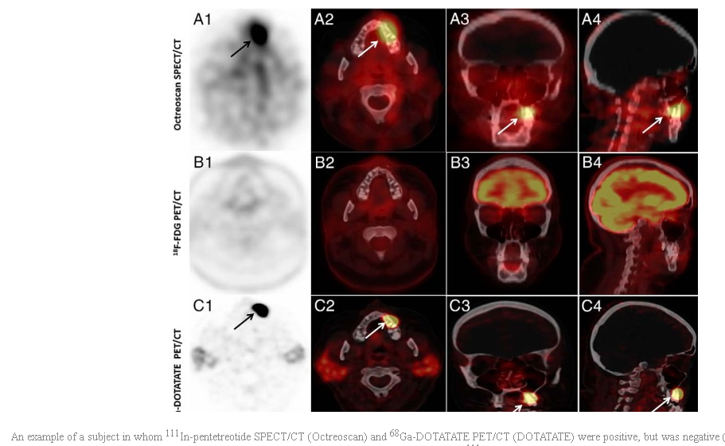

Slide 43
Patients:
All patients had a biochemical profile consistent with TIO, including low serum phosphorus and 1,25-dihdroxyvitamin D, low tubular reabsorption of phosphorus, and an elevated blood FGF23.
All subjects had failed tumor localization at least once before referral.
Results:
The tumor was successfully localized in 6/11 (54.5%) subjects (one was metastatic).
The tumor was identified by 68Ga-DOTATATE in all six cases.
Both Octreoscan-SPECT/CT and 18F FDG-PET each identified the tumor in 4/6.
In no cases was 68Ga-DOTATATE the only imaging study to identify the tumor.
Conclusions:
In this first prospective study comparing ⁶⁸Ga-DOTATATE PET/CT to Octreoscan-SPECT/CT and 18F FDG-PET in TIO localization, ⁶⁸Ga-DOTATATE PET/CT demonstrated the greatest sensitivity and specificity, suggesting that it may be the best single study for localization of PMTs in TIO.

Slide 44
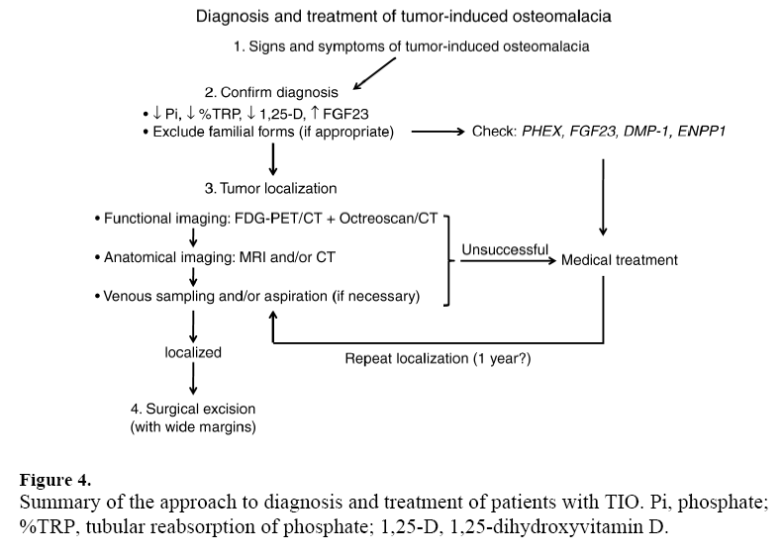

Slide 46
Summary
Diagnosis (1st Step)
Octreoscan
FDG-PET/CT Scan
Selective venous sampling/⁶⁸Ga-DOTATATE PET/CT ( ? )
Treatment
Gross Resection with Adjuvant radiotherapy
Phosphate supplement & Calcitriol (Appropriate dose)
Follow-up
Accurate & regular F/U (Clinical & laboratory)

