Slide 1
Pathophysiology of Diabetes
Farhad Hosseinpanah
Obesity Research Center
Research Institute for Endocrine sciences
Shahid Beheshti University of medical sciences
Jan 11, 2014
Tehran

Slide 2
Agenda
Overview of classification
Physiology of insulin
Pathophysiology of Type 1
Pathophysiology of Type 2

Slide 3
Classification
Type 1
Type 2

Slide 4
Type 1A DM
Autoimmune beta cell destruction
Usually leads to insulin deficiency

Slide 5
Type 1B DM
Insulin deficiency
Tendency to develop ketosis
Lack immunologic markers of an autoimmune destructive process of the beta cells
The mechanisms leading to beta cell destruction are unknown

Slide 6
Type 2 DM
Heterogeneous group of disorders usually characterized by variable degrees of Insulin resistance , impaired insulin secretion, increased glucose production

Slide 7
The 3 main pathophysiological defects of Type 2 diabetes
β-cell dysfunction
Insulin-resistance
Increased hepatic glucose production

Slide 8
Excessive hepatic glucose production in Type 2 diabetes
Insulin; IR
Hepatic
glucose
output
Glucagon
Fasting & postprandial hyperglycaemia
Plasma glucose concentration
IR=insulin resistance
Notes:
Excessive hepatic glucose production in Type 2 diabetes
In addition to lost β-cell function and mass, Type 2 diabetes is also characterised by excessive hepatic glucose production.
This slide shows that excessive hepatic glucose production, which is mediated by glucagon, contributes to both fasting and postprandial hyperglycaemia. Increased insulin resistance reduces glucose uptake by peripheral tissues and further exacerbates hyperglycaemia.
REFERENCE
Toft-Nielsen M, Damholt M, Madsbad S, et al. J Clin Endocrinol Metab. 2001;86:3717-3723.

Slide 9
Other specific types of diabetes
Genetic defects of b-cell function characterized by mutations in:
1. Hepatocyte nuclear transcription factor (HNF) 4a ,(MODY 1)
2. Glucokinase ( MODY 2)
3. HNF-1a (MODY 3)
4. Insulin promoter factor (IPF) 1 (MODY 4)
5. HNF-1b (MODY 5)
6-NeuroD1 (MODY 6)
7- Mitochondrial DNA
8- Proinsulin or insulin conversion

Slide 10
Maturity onset diabetes of the young (MODY)
Autosomal dominant inheritance
Early onset of hyperglycemia
Impairment in insulin secretion

Slide 11
Genetic defects in insulin action
Mutations in the insulin receptor cause a group of rare disorders characterized by severe insulin resistance
1. Type A insulin resistance
2. Leprechaunism
3. Rabson-Mendenhall syndrome
4. Lipoatrophic diabetes

Slide 12
OTHER TYPES OF DM
DM can result from pancreatic exocrine disease when the majority of pancreatic islets (>80%) are destroyed.
Several endocrinopathies can lead to DM as a result of excessive secretion of hormones that antagonize the action of insulin.
C. Diseases of exocrine pancreas pancreatitis, pancreatectomy, neoplasia, cystic fibrosis, hemochromatosis, fibrocalculous pancreatopathy
D. Endocrinopathies
acromegaly, Cushing's syndrome, glucagonoma, pheochromocytoma, hyperthyroidism, somatostatinoma, aldosteronoma

Slide 13
OTHER TYPES OF DM
E. Drug- or chemical-induced
Vacor
pentamidine
nicotinic acid
glucocorticoids
thyroid hormone
diazoxide, thiazides
b-adrenergic agonists
phenytoin
a-interferon
protease inhibitors
clozapine
F. Infections
congenital rubella, cytomegalovirus, coxsackie
G. Uncommon forms of immune-mediated diabetes
"stiff-man" syndrome
anti-insulin receptor antibodies

Slide 14
Other genetic syndromes sometimes associated with diabetes
Down's syndrome
Klinefelter's syndrome
Turner's syndrome
Wolfram's syndrome
Friedreich's ataxia
Huntington's chorea
Laurence-Moon-Biedl syndrome
myotonic dystrophy
porphyria, Prader-Willi syndrome

Slide 15
INSULIN BIOSYNTHESIS
Insulin is produced in the beta cells of the pancreatic islets
It is synthesized as a single-chain 86-aa precursor polypeptide, preproinsulin
Cleavage of an internal 31-residue fragment from proinsulin generates the C peptide , A (21 aa) ,B (30 aa) chains of insulin, are connected by disulfide bonds

Slide 16
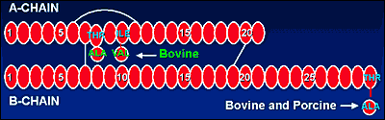

Slide 17
INSULIN SECRETION
The insulin and C peptide are stored together and cosecreted from secretory granules in the beta cells
Because the C peptide is less susceptible than insulin to hepatic degradation, it is a useful a marker of insulin secretion and allows discrimination of endogenous and exogenous sources of insulin in the evaluation of hypoglycemia.

Slide 18
SECRETION
Glucose is the key regulator of insulin secretion by the pancreatic beta cell
Amino acids
Ketones
Various nutrients
GI peptides
Neurotransmitters
Glucose levels >70 mg/dL stimulate insulin synthesis
By enhancing protein translation
Processing inducing insulin secretion

Slide 19
SECRETION
Glucose stimulates insulin secretion through transport into the beta cell by the GLUT2
Glucose phosphorylation by glucokinase is the rate-limiting step that controls glucose-regulated insulin secretion

Slide 20
SECRETION
Metabolism of glucose-6-phosphate via glycolysis generates ATP, which inhibits the activity of an ATP-sensitive K⁺ channel
This channel is a complex of two separate proteins, one is the receptor for certain OAH ( SUD, meglitinides) the other subunit is an inwardly rectifying K⁺ channel protein

Slide 21
SECRETION
Inhibition of this K⁺ channel induces:
beta cell membrane depolarization
Opening of voltage-dependent calcium channels leading to an influx of calcium stimulation of insulin secretion.

Slide 22
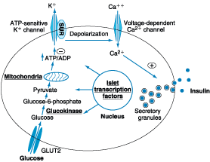

Slide 23
SECRETION
Insulin secretory profiles reveal pulsatile pattern of hormone release with small secretory bursts about every 10 min superimposed upon greater amplitude oscillations of about 80 to 150 min.
Meals or other major stimuli of insulin secretion induce large (four- to fivefold increase versus baseline) bursts of insulin secretion that usually last for 2 to 3 h before returning to baseline

Slide 24
Physiological Serum Insulin Secretion Profile
75
Breakfast
Lunch
Dinner
50
Plasma
Insulin
(μU/mL)
25
4:00
8:00
12:00
16:00
20:00
24:00
4:00
8:00
Time (h)
Adapted from White JR, et al. Postgrad Med. 2003;113:30–36.
Notes:
Physiological Serum Insulin Secretion Profile
Physiologic serum insulin secretion has two components: basal insulin + bolus insulin to cover postprandial glucose (PPG) excursions. Basal or bolus insulin alone is not physiologic therapy.
Looking at the physiologic serum insulin secretion profile, there is a basal level of insulin secretion, and then a surge of insulin secretion (bolus) to cover mealtime needs. This is what occurs in people without diabetes.
Ideally, every patient with diabetes would be managed with a therapy that would mimic the normal physiologic profile as closely as possible. This typically requires what is called “intensive insulin therapy” or multiple daily injections (MDI).
Adapted from White JR, et al. Novel insulins and strict glycemic control. Postgrad Med. 2003;113:30–36.

Slide 25
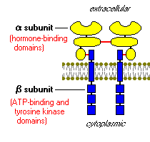
The insulin receptor is a dimeric tyrosine kinase embedded in the plasma membrane.
    Two alpha subunits-extracellular, have insulin binding domains.
    Two beta subunits linked by disulfide bonds-within and on cytosolic side of membrane.

Slide 26
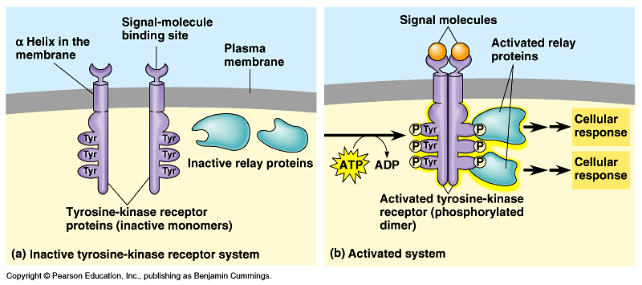
Binding of insulin to the alpha subunits causes the beta subunits to phosphorylate themselves (autophosphorylation), thus activating the catalytic activity of the receptor.

Slide 27
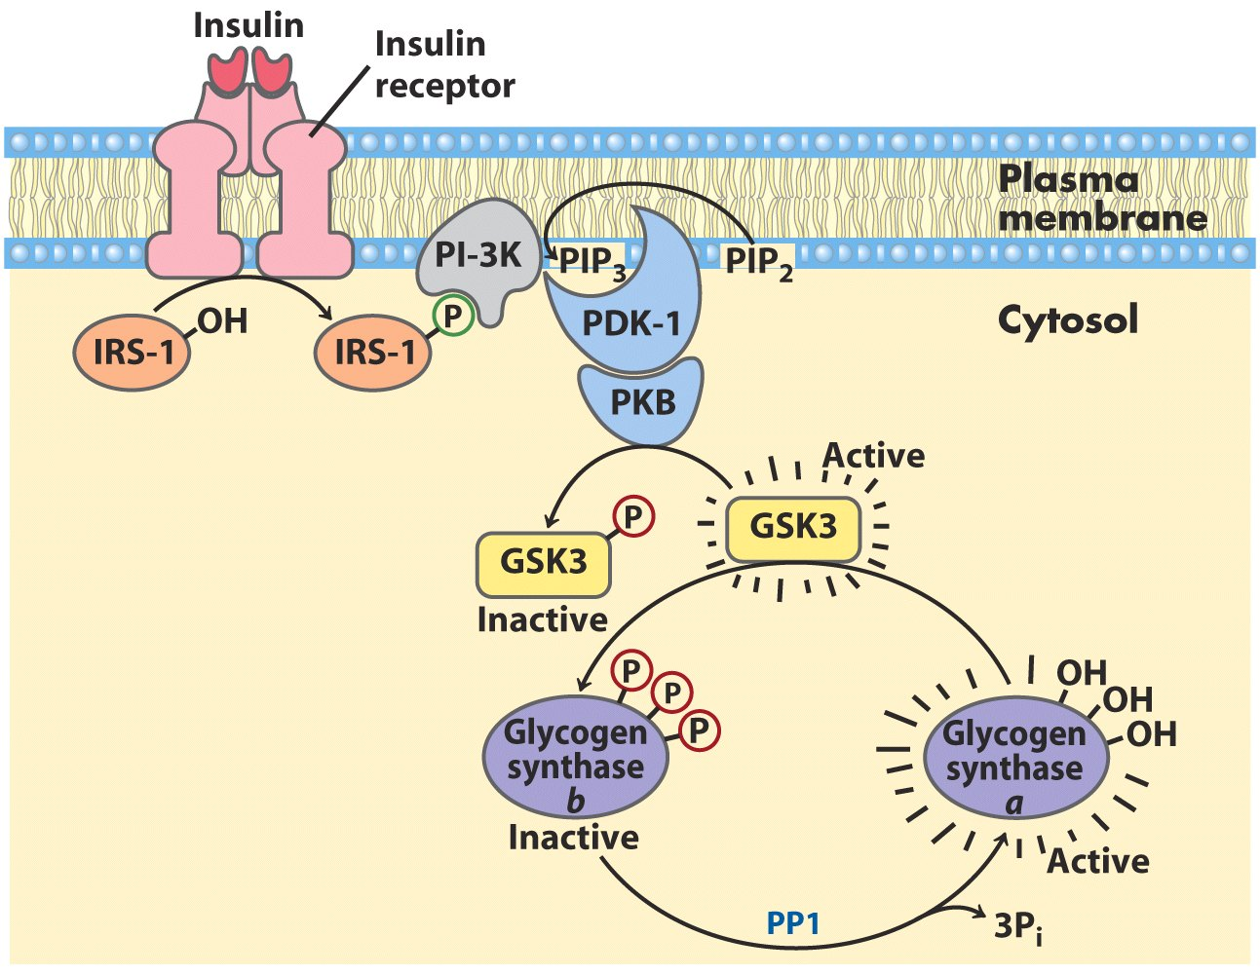
Several intracellular proteins have been identified as phosphorylation substrates for the insulin receptor, the best-studied of which is insulin receptor substrate 1 or IRS-1.
  When IRS-1 is activated by phosphorylation, is serves as a type of docking center for recruitment and activation of other enzymes.

Slide 28
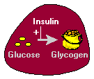
Activation of the insulin receptor will lead to the activation of the phosphatidylinositol-3 kinase (PI-3K) pathway.
  This pathway will activate protein kinase B (PKB).
  PKB will inactivate glycogen synthetase 3 (GSK3) which normally inhibits glycogen synthase.
  When glycogen synthase is active, glucose monomers are synthesized into long chains of glycogen (liver and muscle).

Slide 29
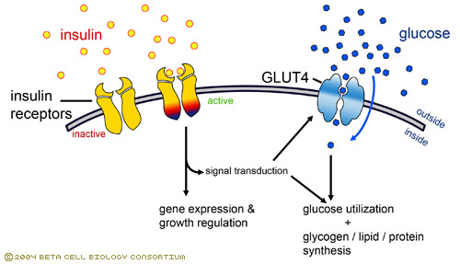
Protein kinase B causes movement of the GLUT4 glucose transporter from intracellular membranes to the cell surface.
  The influx of glucose will lower blood glucose levels.
  When blood glucose levels return to normal, the GLUT4 transporters will be taken back into the cell by endocytosis.
PKB

Slide 30
ACTION
Once insulin is secreted into the portal vein, ~50% is removed and degraded by the liver
Unextracted insulin enters the systemic circulation and binds to its receptor in target sites

Slide 31
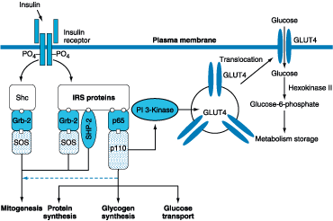

Slide 32
Glucose homeostasis
1- Hepatic glucose production
2- Peripheral glucose uptake and utilization.

Slide 33
ACTION
In the fasting state, low insulin level promote
Hepatic gluconeogenesis
Glycogenolysis to prevent hypoglycemia.

Slide 34
Low insulin
Decrease glycogen synthesis
Reduce glucose uptake in insulin-sensitive tissues
promote mobilization of stored precursors.

Slide 35
Pathogenesis of Type 1 DM
Type 1A DM develops as a result of the synergistic effects of :
Genetic
environmental
immunologic factors

Slide 36
Pathogenesis of Type 1

Slide 37
Pathogenesis of Type I DM
Genetic
HLA-DR3/DR4
Environment ?
Viral infe..??
Autoimmune Insulitis
ß cell Destruction
Severe Insulin deficiency
Type I DM

Slide 38
Features of Type 1 Diabetes
80% occur before age 20
May occur at any age
Insulin deficient
  autoimmune pathogenesis, HLA linked
  less commonly non-immune mediated
Ketosis prone
Normal insulin sensitivity

Slide 39
Pathogenesis of Type 1 DM
Individuals with a genetic susceptibility have normal beta cell mass at birth but begin to lose beta cells secondary to autoimmune destruction that occurs over months to years
This autoimmune process is triggered by an infectious or environmental stimulus sustained by a beta cell-specific molecule.

Slide 40
Pathogenesis of Type1DM
The rate of decline in beta cell mass varies widely among individuals some patients progressing rapidly to clinical diabetes others evolving more slowly
Features of diabetes do not become evident until a majority of beta cells are destroyed (~80%).
At this point, residual functional beta cells still exist but are insufficient in number to maintain glucose tolerance

Slide 41
Natural History of Type 1 Diabetes
Putative
trigger
β-Cell
mass 100%
Cellular autoimmunity
Circulating autoantibodies (ICA, GAD65, ICA512A, IAA)
Loss of first-phase
insulin response (IVGTT)
Abnormal glucose
tolerance (OGTT)
Clinical
onset
Genetic
predisposition
Insulitis
β-Cell injury
β-Cell insufficiency
Diabetes
Time
Eisenbarth GS. N Engl J Med. 1986;314:1360-1368

Slide 42
GENETIC CONSIDERATIONS
The genetic contributions to type 1A DM involve multiple genes
The concordance of type 1A DM in identical twins ranges between 40 and 60%
Additional factors must be involved in diabetes development

Slide 43
GENETIC CONSIDERATIONS
The major susceptibility gene for type 1A DM is located in the HLA region on ch 6
Polymorphisms in the HLA account for 40 to 50% of the genetic risk of type 1A DM
This region contains genes that encode the class II MHC molecules, which present antigen to helper T cells and thus are involved in initiating the immune response .

Slide 44
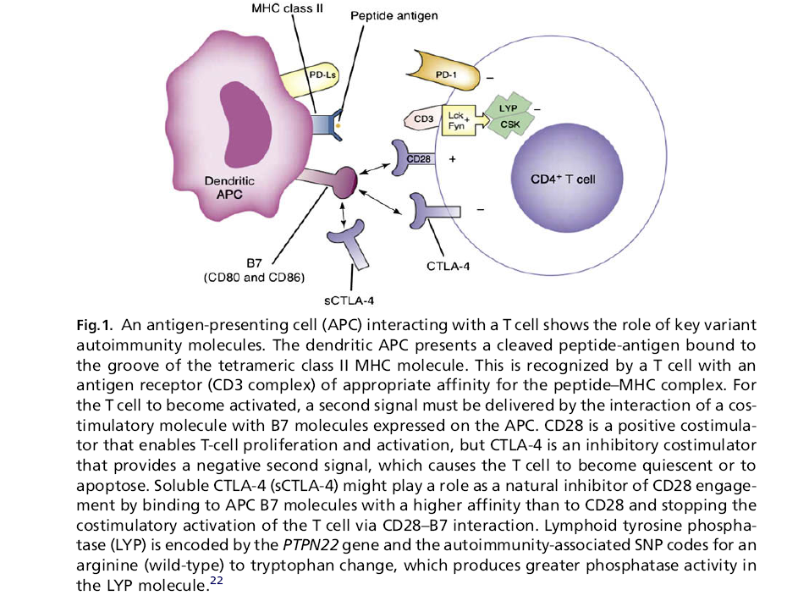

Slide 45
Genetic Susceptibility
Polymorphisms of multiple genes are reported to influence the risk of type 1A diabetes including:
HLA-DQ alpha beta
HLA-DR
preproinsulin
PTPN22 gene
CTLA-4
interferon-induced helicase
IL2 receptor (CD25)
lectin-like gene (KIA0035)
ERBB3e
undefined gene at 12q

Slide 46
Genetic Susceptibility
Only HLA alleles have a large effect
Followed by : insulin gene polymorphisms and PTPN22

Slide 47
MHC genes
More than 90 % of patients with type 1 diabetes carry HLA-DR3,DQB1*0201 or -DR4,DQB1*0302 versus 40 % of controls with either haplotype
30 % of patients have both haplotypes (DR3/4 heterozygotes) which confers the greatest susceptibility

Slide 48
GENETIC CONSIDERATIONS
Genes that confer protection against the development of the disease also exist.
The haplotype
DQA1*0102,
DQB1*0602
is extremely rare in type 1A DM (<1%)

Slide 49
Non-MHC genes
Amino acid change of a lymphocyte-specific tyrosine phosphatase (termed lyp, PTPN22)
polymorphisms of a promoter of the insulin gene

Slide 50
Non-MHC genes
CTLA-4
In a meta-analysis of 33 studies involving over 5000 patients
Polymorphism in cytotoxic T-lymphocyte-associated antigen-4 gene was shown to be associated with the risk of type 1 diabetes

Slide 51
APC and T cell Interactions
B7 (CD80/86)
CTLA-4
↓Activation
B7 (CD80/86)
CD28
↑Activation
CD4⁺ T Cell
MHC II
TCR
Recognition
APC
CD58 (LFA-3)
CD2
Adhesion
↑Activation
CD154
(CD40L)
CD40

Slide 52
GENETIC CONSIDERATIONS
Risk of developing type 1 DM is increased tenfold in relatives of individuals with the disease
Risk (is relatively low) 3–4% if the parent has type 1 diabetes
5–15% in a sibling (depending on which HLA haplotypes are shared)
Most individuals with type 1 DM do not have a first-degree relative with this disorder.

Slide 53
lifelong risk of type 1 diabetes
About 6 % in offspring ( children)
5 % in siblings ( brothers and sisters)
50 % in identical twins
versus 0.4 % in subjects with no family history

Slide 54
Autoimmune Factors
Pathologically, the pancreatic islets are infiltrated with lymphocytes ( insulitis).
After all beta cells are destroyed
the inflammatory process abates
the islets become atrophic
immunologic markers disappear

Slide 55
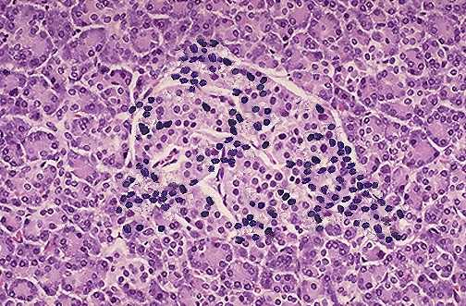
Insulitis – Type I
Insulinitis

Slide 56
Autoimmune Factors
Studies of the insulitis and autoimmune process in type 1A DM identified abnormalities in both humoral and cellular arms of the immune system:
Evidence:
1- Islet cell autoantibodies
2 -Activated lymphocytes in the islets, peripancreatic lymph nodes, and systemic circulation;

Slide 57
Autoimmune Factors
The precise mechanisms of beta cell death are not known but may involve formation of
Nitric oxide metabolites
apoptosis
Direct CD8+ T cell cytotoxicity.

Slide 58
Autoimmune Factors
Islet autoantibodies are not involved in the destructive process
These antibodies do not generally react with the cell surface of islet cells

Slide 59
Confirmed targets of autoantibodies in type 1 diabetes of man
Insulin
GAD
Insulinoma associated protein 2 (IA-2)
ZnT8 (zinc transporter)

Slide 60
Immunologic Markers
1-Classifying the type of DM as type IA
2- Identifying non diabetic individuals at risk for developing type 1A DM.

Slide 61
ICAs
Majority of (>75%) new-onset type 1A
Significant minority (5-10%)of individuals with newly diagnosed type 2 DM
GDM (<5%)

Slide 62
Immunologic Markers
ICAs are present in 3 to 4% of first-degree relatives of individuals with type 1A DM.

Slide 63
Immunologic Markers
In conjunction with impaired IV GTT, they predict a >50% risk of developing type 1A DM within 5 years.
Without this impairment in insulin secretion, the presence of ICAs predicts a 5-year risk of <25%.

Slide 64
Immunologic Markers
Risk of a first-degree relative developing type 1A DM is relatively low, and even ICA-positive individuals are not destined to develop diabetes.
At present, the ICAs are used predominantly as a research tool

Slide 65
Environmental Factors
Perinatal factors
Role of viruses
Childhood immunization
Role of diet (cow milk, cereals, omega 3, nitrates , vitamin d supplement)

Slide 66
Pathogenesis of Type 2

Slide 67
TYPE 2 DM
Central to the development of type 2 DM are:
Insulin resistance
Abnormal insulin secretion
Although controversy remains, most studies support the view that insulin resistance precedes insulin secretory defects

Slide 68
Type 2 Diabetes: A Dual Defect Disease
Genes
Genes
Impaired Insulin
Secretion
Insulin
Resistance
± Environment
IGT
IGT
Type 2 Diabetes
IGT = Impaired Glucose Tolerance
Notes:
Developed by Derek Le Roith, M.D., Ph.D.
Aventis Dinner 2000
Slide 3
Type 2 Diabetes:
Two Defects
The pathophysiology of type 2 diabetes mellitus is related to two defects. The clinical expression of this disease usually requires the presence of both impaired insulin secretion and insulin resistance. These traits are thought to be genetically determined although the genes have not yet been identified. Environmental factors, such as obesity, a high-fat diet, physical inactivity, or some medications, usually participate in the expression of these traits. Individuals with one genetic defect, with or without an environmental trigger, may demonstrate impaired glucose tolerance or impaired fasting glucose but do not typically develop frank diabetes. In most instances, both β-cell dysfunction and insulin resistance are required for the development of the hyperglycemia of type 2 diabetes.

Slide 69
GENETIC CONSIDERATIONS
Type 2 DM has a strong genetic component
Disease is polygenic and multifactorial.

Slide 70
GENETIC CONSIDERATIONS
The concordance of type 2 DM in identical twins is between 70 and 90%.
Individuals with a parent with type 2 DM have an increased risk of diabetes
If both parents have type 2 DM, the risk in offspring may reach 40%.

Slide 71
GENETIC CONSIDERATIONS
Genes that predispose to type 2 DM are incompletely identified
Most prominent is a variant of the transcription factor 7-like 2 gene that has been associated with type 2 diabetes
In addition to genetic susceptibility, environmental factors (such as obesity, nutrition, and physical activity) modulate the phenotype.

Slide 72
GENETIC CONSIDERATIONS
Genetic polymorphisms associated with type 2 diabetes found in the genes encoding:
Peroxisome proliferators-activated receptor-gamma
K channel in beta cells
Zinc transporter in beta cells
IRS
Calpain 10

Slide 73

~90% of people with type 2 diabetes are overweight or obese
World Health Organization, 2005. http://www.who.int/dietphysicalactivity/publications/facts/obesity
Notes:
The World Health Organization reports that around 90% of individuals with type 2 diabetes are overweight or obese.¹
Fat distribution in the body may be either abdominal (android or central obesity – often referred to as ‘apple-shaped’) or affect the lower body (mainly thighs and buttocks; gynoid obesity – often referred to as ‘pear-shaped’).²
Central obesity (indicated by, for example, high waist:hip ratio; that is waist:hip ratio > 0.90 for men, > 0.85 for women) is a strong risk factor for insulin resistance.³
¹ World Health Organization, 2005. http://www.who.int/dietphysicalactivity/publications/facts/obesity
²Basdevant A, et al. Presse Med 1987; 16:167–170.
³Ascaso JF, et al. Eur J Intern Med 2003; 14:101–106.

Slide 74
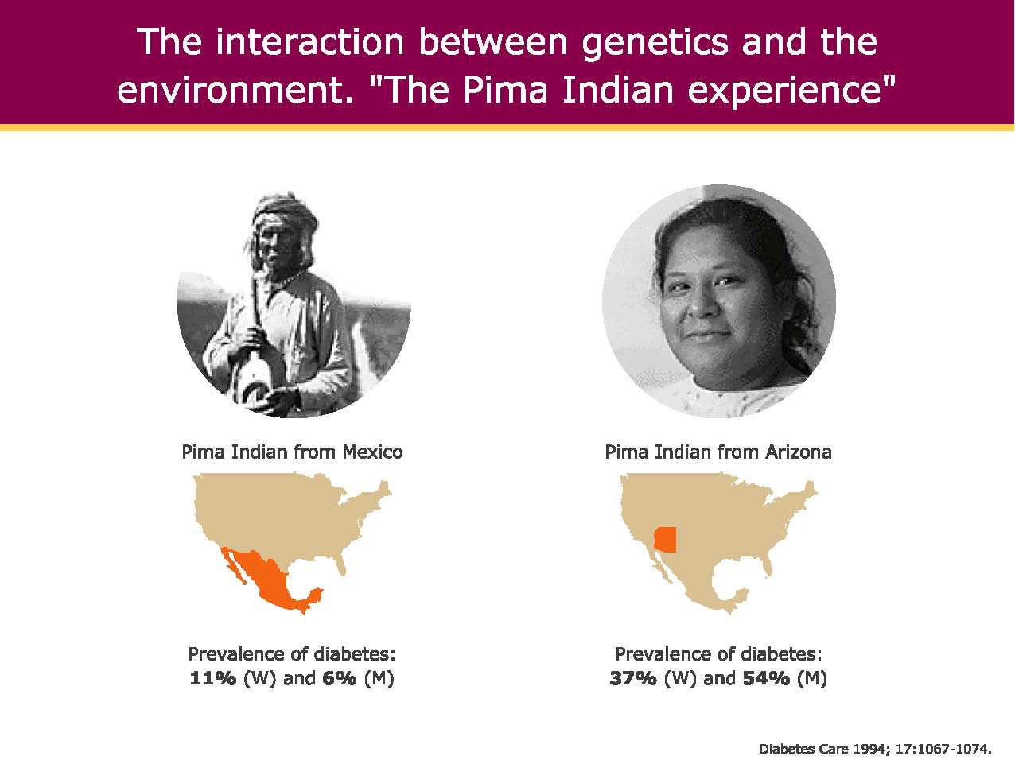
The interaction between genetics and the environment. “The Pima Indian experience”

Slide 75
Pathophysiology
Type 2 DM is characterized by
Impaired insulin secretion
Peripheral insulin resistance
Excessive hepatic glucose production
Abnormal fat metabolism
Obesity, particularly visceral or central (as evidenced by the hip-waist ratio), is very common in type 2 DM

Slide 76
Pathogenesis of Type II DM
ß cell defect
Genetic
Environment
Obesity ???
Abnormal Secretion
Insulin resistance
Relative Insulin Def.
ß cell
exhaustion
IDDM
Type II DM

Slide 77

Type 2 Diabetes: Insulin Resistance
Plus Impaired β-Cell Function
Both insulin resistance and β-cell dysfunction are present
at the time of diagnosis of type 2 diabetes
Insulin
resistance
Normal
β-cell function
Abnormal
β-cell function
Compensatory
hyperinsulinemia
Relative insulin deficiency
Hyperglycemia
Normoglycemia
(Metabolic syndrome)
Type 2 diabetes
Notes:
Insulin resistance and β-cell dysfunction are key pathophysiologic triggers in the development of type 2 diabetes; both of these deficits tend to be present at the time of diagnosis.
In individuals with normal β-cell function, insulin resistance leads to compensatory hyperinsulinemia and the development of metabolic syndrome, but glucose levels will remain normal.
However, in individuals with impaired β-cell function, insulin resistance gives rise to relative insulin deficiency, hyperglycemia, and type 2 diabetes.
Gerich JE. Contributions of insulin-resistance and insulin-secretory defects to the pathogenesis of type 2 diabetes mellitus. Mayo Clin Proc. 2003;78:447-456.
77

Slide 78

Etiology of β-Cell Dysfunction in Type 2 Diabetes
Age
Genetics
(TCF 7L2)
↓ Incretin
Effect
Amyloid (Islet Amyloid
Polypeptide)
Deposition
β-Cell
Dysfunction
Insulin Resistance
Glucose
Toxicity
Lipotoxicity
↑ Free Fatty Acids
Notes:
78
78
β-Cell failure in type 2 diabetes has a number of potential causes.
First, studies have shown a progressive age-related decline in β-cell function.
In addition, research has led to the identification of specific genes, such as transcription factor TCF 7L2, that are linked to β-cell dysfunction in patients with type 2 diabetes.
Insulin resistance plays a major role in progressive β-cell failure by creating an ongoing demand for insulin hypersecretion.
Evidence indicates that lipotoxicity, defined as an increase in plasma free fatty acid (FFA) concentrations, can impair β-cell function in genetically predisposed subjects.
Research has shown that glucose toxicity, which refers to chronically elevated plasma glucose levels, also leads to reduced insulin secretion.
Deposition of amyloid and islet amyloid-like polypeptide may play a role in progressive β-cell failure in type 2 diabetes as well.
Finally, decreases in the incretin effect have been shown to be a major contributor to β-cell dysfunction.
DeFronzo RA. Banting Lecture. From the triumvirate to the ominous octet: a new paradigm for the treatment of type 2 diabetes. Diabetes. 2009;58:773-795.

Slide 79
Pathophysiology
In the early stages, glucose tolerance remains normal, despite IR, because the pancreas compensate by increasing insulin .
As IR and compensatory hyperinsulinemia progress, the pancreatic islets become unable to sustain hyperinsulinemic state.

Slide 80
Metabolic Abnormalities
Insulin Resistance
This is caused by the decreased ability of insulin to act on target tissues (especially muscle and liver and fat) and is a prominent feature of type 2 DM.
This resistance is relative, since supernormal levels of insulin will normalize glucose.

Slide 81
Metabolic Abnormalities
Insulin Resistance
1-impairs glucose utilization by insulin-sensitive tissues and
2-Increases hepatic glucose output
both effects contribute to the hyperglycemia.

Slide 82
Metabolic Abnormalities
A current focus for the pathogenesis of insulin resistance focuses on a PI-3 kinase signaling defect, which causes reduced translocation of GLUT4 to the plasma membrane.

Slide 83
Metabolic Abnormalities
Increased HGP predominantly accounts for increased FPG levels
Decreased peripheral glucose usage results in PP hyperglycemia.
Glucose usage in insulin-independent tissues is not decreased in type 2 DM.

Slide 84
Metabolic Abnormalities
Not all insulin signal transduction pathways are resistant to the effects of insulin (those controlling cell growth and differentiation).

Slide 85
Pathophysiology of Type 2 Diabetes
Other Factors
Historically, hyperglycemia in diabetes has been viewed as a:
Failure of insulin-mediated glucose disposal into muscle and adipose tissue.
This looks to be an over simplification of a more complicated issue.

Slide 86
Incretin
Incretins are released from neuroendocrine cells of gastrointestinal tract following food ingestion and amplify glucose-stimulated insulin secretion and suppress glucagon secretion.
Glucagon-like peptide 1 (GLP-1), the most potent incretin, is released from L cells in the small intestine and stimulates insulin secretion only when blood glucose is above fasting

Slide 87
The incretin effect
i.v.
pr. OS
Up to 70% of post-glucose insulin secretion is due to the effects of incretins
The incretin effect is
due to gut hormones –
the incretin hormones
Glucose
10
Glucose (mmol/l)
5
Time (min)
1000
Incretin
Insulin (pmol/l)
500
0
Time (min)

Slide 88
Pathophysiology of Type 2 Diabetes
The Glucagon Factor
In response to a carbohydrate-containing meal, individuals without diabetes increase insulin secretion simultaneously decrease pancreatic glucagon secretion.
The decrease in glucagon is associated with a decrease in HGP , and along with the insulin response, results in a very modest increase in postprandial glucose.

Slide 89
Pathophysiology of Type 2 Diabetes
The Glucagon Factor
In contrast, the glucagon secretion in type 2 diabetics is not decreased, and may even be paradoxically increased.
These insulin and glucagon abnormalities produce an excessive postprandial glucose excursion.

Slide 90
Pathophysiology of Type 2 Diabetes
The Gastric Emptying Factor
Many factors can affect the rate of gastric emptying.
Most people with type 1 and type 2 diabetes have accelerated gastric emptying compared to those without diabetes.
Gastroenterology. 1990;98:A378.

Slide 91
Diabetes is a Multi-System Disorder:
“The Incretin Effect”
Liver
Pancreas
GLP-1 and other gut hormones released in response to food:
“entero-insular axis”
This ability is reduced or lost in type 2 diabetes
Suppressed post-prandial glucagon Decreased Glucose Output
Enhanced Insulin secretion
GLP-1
release
Food
Slowed gastric emptying
Increased Satiety

Slide 92
Weight gain
Each unit increase in BMI (about 2.7 - 3.6 kg) increases Type 2 diabetes risk by 12.1 percent !
68 - 72 % of diabetes risk in the U.S. is attributable to or associated with excess weight
For every kilogram increase in weight over 10 years, Type 2 diabetes risk increases 4.5 %
Ford et al. Amer J Epidemiol 146:214,1997

Slide 93
Pathophysiology
Adipocytes secrete biologic products :
Leptin
Tumor necrosis factor α
Free fatty acids
These factors can modulate processes such as insulin secretion, insulin action, and body weight and may contribute to the insulin resistance

Slide 94
Metabolic Abnormalities
Another emerging theory proposes that elevated levels of free fatty acids, a common feature of obesity, may contribute to the type 2 DM in several different ways.
Free fatty acids can
impair glucose utilization in skeletal muscle
promote glucose production by the liver
impair beta cell function

Slide 95
Metabolic Abnormalities
Adiponectin
Adiponectin (an insulin-sensitizing peptide) production by adipocytes
Reduced in obesity and this may contribute to hepatic insulin resistance

Slide 96
Metabolic Abnormalities
The accumulation of lipid within skeletal myocytes
which impair mitochondrial oxidative phosphorylation
reduce insulin-stimulated mitochondrial ATP production.
Impaired fatty acid oxidation and lipid accumulation within skeletal myocytes may generate reactive oxygen species such as lipid peroxides

Slide 97
Obesity & Low grade inflammation
Adipocyte products and adipokines also produce an inflammatory state and may explain why markers of inflammation such as IL-6 C-reactive protein are often elevated in type 2 DM

Slide 98
Metabolic Abnormalities
Impaired Insulin Secretion
In type 2 DM, insulin secretion initially increases in response to insulin resistance in order to maintain normal glucose tolerance.
Initially, the insulin secretory defect is mild and selectively involves glucose-stimulated insulin secretion.

Slide 99
Metabolic Abnormalities
Chronic hyperglycemia paradoxically impairs islet function ("glucose toxicity") and leads to a worsening of hyperglycemia.
Improvement in glycemic control is often associated with improved islet function.
In addition, elevation of free fatty acid levels ("lipotoxicity") also worsens islet function.
.

Slide 100
Metabolic Abnormalities
Increased Hepatic Glucose and lipid Production
In type 2 DM, insulin resistance in the liver reflects the failure of hyperinsulinemia to suppress gluconeogenesis which results in fasting hyperglycemia decreased glycogen storage by the liver in the postprandial state.

Slide 101
Metabolic Abnormalities
Increased Hepatic Glucose and lipid Production
Increased hepatic glucose production occurs early in the course of diabetes, though likely after the onset of insulin secretory abnormalities and insulin resistance in skeletal muscle.

Slide 102
Metabolic Abnormalities
As a result of insulin resistance in adipose tissue and obesity:
FFA flux from adipocytes is increased
leading to increased lipid [VLDL and triglyceride] synthesis in hepatocytes.

Slide 103
Metabolic Abnormalities
NAFLD
This lipid storage or steatosis in the liver may lead to nonalcoholic fatty liver disease and abnormal liver function tests.

Slide 104
Metabolic Abnormalities
This is also responsible for dyslipidemia found in type 2 DM :
elevated triglycerides
reduced HDL
increased small dense LDL particles

Slide 105
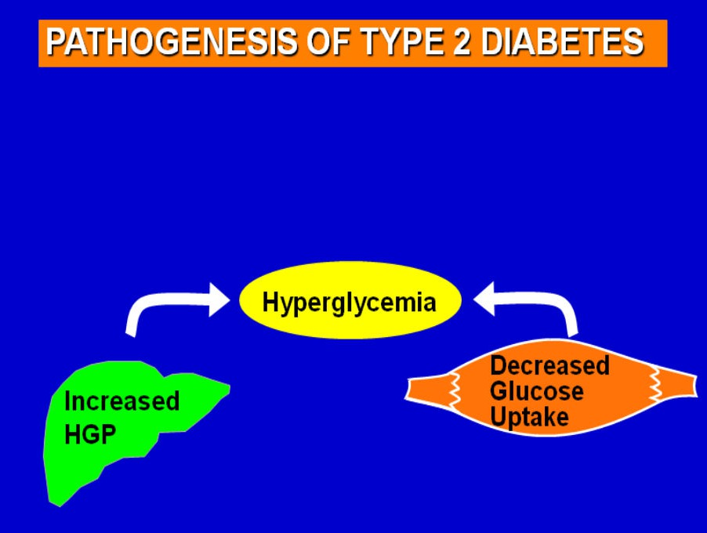

Slide 106
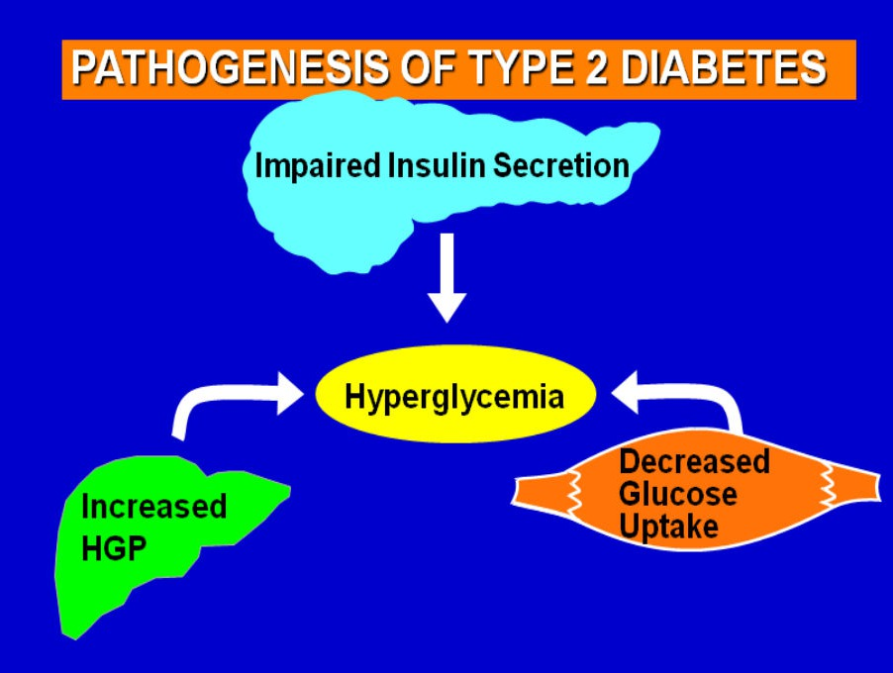

Slide 107
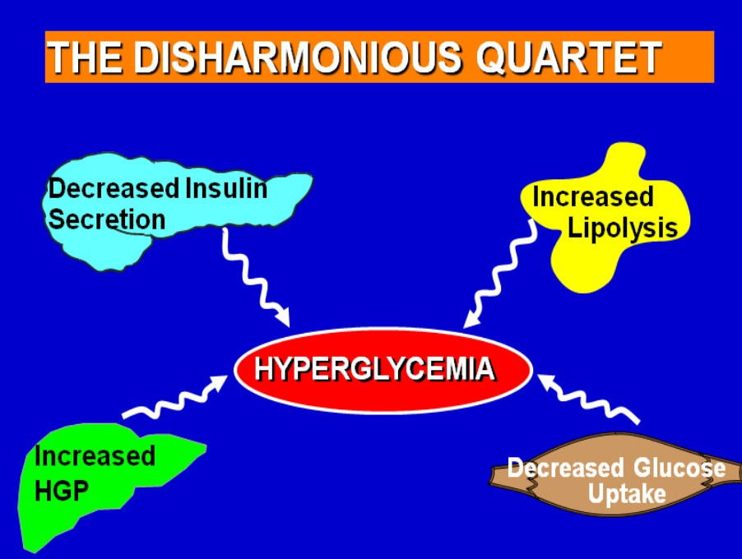

Slide 108
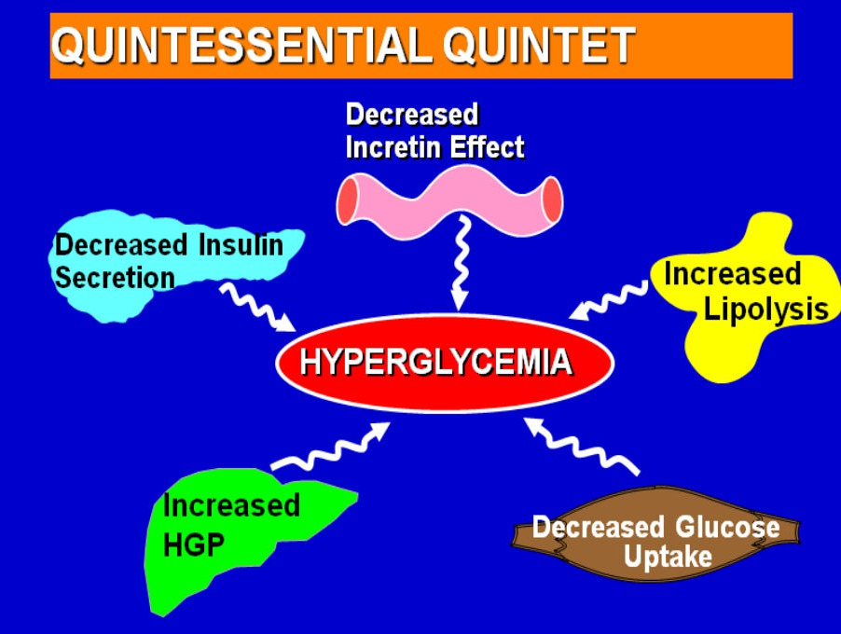

Slide 109
