Slide 1
Abnormal Uterine Bleeding During The Reproductive Years
Fahimeh Ramezani Tehrani
Professor
Reproductive Endocrinology Research Center
Research Institute for Endocrine Sciences
Shahid Beheshti University of Medical Sciences
ramezani@endocrine.ac.ir
framezan@post.harvard.edu

Slide 2
Regular menstrual cycles; the main component of “female sensuality”

Slide 3
Prevalence
Most common problem for gynecologic consultation(>20%) (Obstet Gynecol 2001)
12% women overall, 24% women aged 36-40 y, up to 50% of perimenopausal women (J Clin Epidemiology 2005)
25% of gynecologic surgeries is related to AUB
>50% hysterectomies performed
Iron deficiency anemia develops in 21-67% of cases (Annal Hematol 1997)
40-80% of women treated for AUB have no anatomical pathology (Cochrane Database Syst Rev 2008)
53% of women used medical treatment had undergone surgery during follow up (Olave 2007)

Slide 4
Impact
Significant decrease in overall quality of life, HRQoL of women with AUB is less than 25th percentile of national norm
(Value health 2007)
Sexual function score of women with AUB is 55-69 as compared to 100(optimal functioning) (Value health 2007)

Slide 5
Health services utilization & costs
AUB contributed to
more than 5 million hospitalizations
2 million hysterectomies
20 million hospital days
Total direct cost $1 billion annually
Total indirect cost $12 billion
Work loss from increased blood flow $1692 annually per women
Heavy bleeders worked 3.6 weeks fewer than non heavy bleeders
(Health Econ 2011)

Slide 6
Definition
Abnormal Uterine Bleeding is defined as bleeding that is abnormal in duration, volume or interval.
A wide variety of labels and terms with no consistency was applied
These include menorrhagia, metrorrhagia, hypermenorrhea, hypomenorrhea, oligomenorrhea, polymenorrhea,….
The comparability of available evidences is impossible

Slide 7
Women’s perceptions of heavy menstrual bleeding

Slide 8
New Definition
Sem Rep Med 2011

Slide 9
Normal limits for menstrual cycle during reproductive years

Slide 14
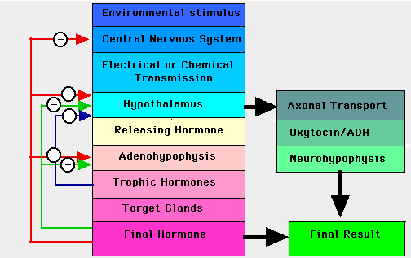
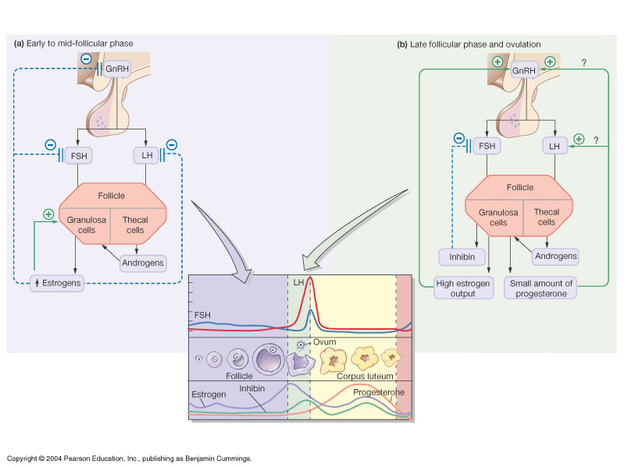
Normal physiology
Normal menses requires pulsatile secretion of GnRH
in appropriate time intervals &amount
FSH & LH secreted by pituitary in response to GnRH
FSH bind to receptors on granulosa cells and stimulate
Aromatization of the theca-derived androgens
Sex steroid and inhibin feedback at the
pituitary and hypothalamus

Slide 15
Early follicular estrogen
Healing &regeneration of the endometrium
Follicular development
Selection of dominant follicle
Final maturation
Ovulation
Corpus luteum
Progesterone production
Endometrial decidualization
Corpus luteum involution
Decline in progesterone &estrogen

Slide 17
Progesterone withdrawal leads to:
↓ Expression of tissue factor (TF)
↓ Plasminogen activator inhibitor 1
Less homeostasis
↑ prostaglandins
Vasoconstrictions, tissues hypoxia
↓ matrix metalloproteinase 1,3,9
↑ tissue degradatins
↑chemokines
↑leukocytes infiltration

Slide 19
FIGO’s PALM-COIN system for classification of HMB
Polyp
Adenomyosis
Leiomyoma
Malignancy &hyperplasia
Coagulopathy
Ovulatory disorders
Endometrium
Iatrogenic
Not classified
Munro 2011

Slide 20
HMB treatment
Pharmacologic
OCPs
Tranexamic acid
NSAIDs
Levonorgestrel-IUD
Medroxyprogesterone acetate
Oral progestins
Danazol
Surgical
Endometrial ablation
Hysteroscopic polyp excision
Myomectomy
hysterectomy

Slide 21
Selection of treatment’s options
Etiology
Severity
Associated symptoms
Contraceptive needs, Desire for further fertility
Contraindications to hormonal or other medication
Medical co morbidities
Patients preferences regarding medical vs. surgical and long term vs. short term therapy

Slide 22
NSAIDs
Reduce the rate of PGE2 & PGF2α, leading to vasoconstriction &reduced blood loss
Prostanoids promote angiogenesis and may have a role in aberrant neovascularization leading to DUB (Hickey 2006)
Effective in reducing blood loss (Lethaby 2007)
Ibuprofen 400-800 mg/3x
Mefenamic acid 500 mg/3x
Naproxen sodium 550mg/2x
No differences in effectiveness of various NSAIDs (Pinkerton 2010)
Can be combined with OCPs
Can be used while attempting pregnancy

Slide 23
Tranexamic Acid
Binds to lysine binding site on tissue plasminogen activator
Reduce plasmin lysis of fibrin
Decrease the uterine bleeding by half with/without fibroma (Lukes 2010, Muse 2011)
2 Cap.3-4 times a day up to 5 days
Only given during menses
Patient can self-adjust the dose downward
Can be used while attempting pregnancy

Slide 24
Tranexamic Acid
Reduced dosage in women with decreased renal function
Theoretical concern for increasing thromboembolic risk
Case report of thrombotic episodes in patients on the drug (Linkus 2011)
No concomitant with hormone therapy
Not been used in women with active thromboembolic disorders or its history, or at increased risk of it or with past retinal vein or artery occlusion
Review of 238,000 Scandinavian women on T for HMB not increased thrombotic problems (Preston 1995)

Slide 25
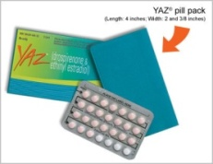
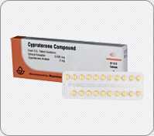
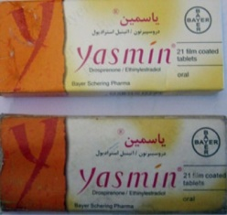
Combined OCPs
Traditional :21 active pills
Decrease blood loss by 50%
Provide reversible contraception &preserve fertility
Improve dysmenorrhea
Risk of VTE is greatest in the 1st year and related to both dose EE &type Progesterone
3.6 fold LNG (LD)
5.6 fold for gestodene
7.3 fold for desogestrel
6.8 fold for cyproterone acetate
6.3 fold for drospirenone
2 times for transdermal patch compare to norgestimate OCPs

Slide 26
OCPs for heavy bleeding
More frequently for a short period of time
four times per day dosing for 5 to 7 days,
twice per day for 3 to 5 days,
then reduced to daily dosing for 3 weeks,
usually followed by a withdrawal bleed.

Slide 27
Parenteral estrogen for AUB
Parenteral conjugated estrogens ,IV , 25mg doses every 6 hours,
Followed by oral estrogen or
estrogen/progesterone therapy.
preventive measures such as the concomitant use of low-molecular-weight heparin may be considered

Slide 28
Oral progestins for HMB
Luteal phase therapy for 1-2 weeks is not effective (Cook,2005)
Not be used in ovulatory women (Lethaby 2008)
3 weeks dosing each week
May be effective
Not advantage to other treatment
May be used if E is contraindicated
Less effective than other methods

Slide 30
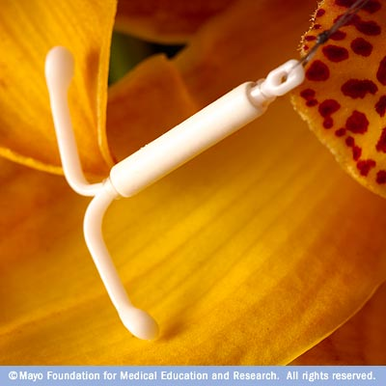
Levonorgestrel-releasing IUD(Mirena)
Release 20 mcg daily of Levonorgestrel
Reduction in bleeding may not be apparent until after 3 months of treatment
Many patients amenorrheic
80% ↓ blood loss at 1 year
Superior to NSAIDs & Tranexamic acid (Milsom 1991)
Superior to MPA (Kaunitz 2010)
Superior to combined OCPs (Shabaan 2011)
Effective in women with Coagolopathy (Chi 2011)
Effective in fibroid associated HMB, reduce uterus volume but not fibroid size (Magalhaes 2007)
Good long term acceptance, 88% use 2nd IUD ( Late 2011)
Equally as effective as endometrial ablation, review of 6 randomized clinical trial (Kaunitz 2009)

Slide 31
Levonorgestrel-releasing IUD vs. hysterectomy and endometrial ablation
Similar in both cost-effectiveness and improvements in HQL (Pulmenthal 2011)
QALY of hysterectomy is superior (Robert 2011)

Slide 32
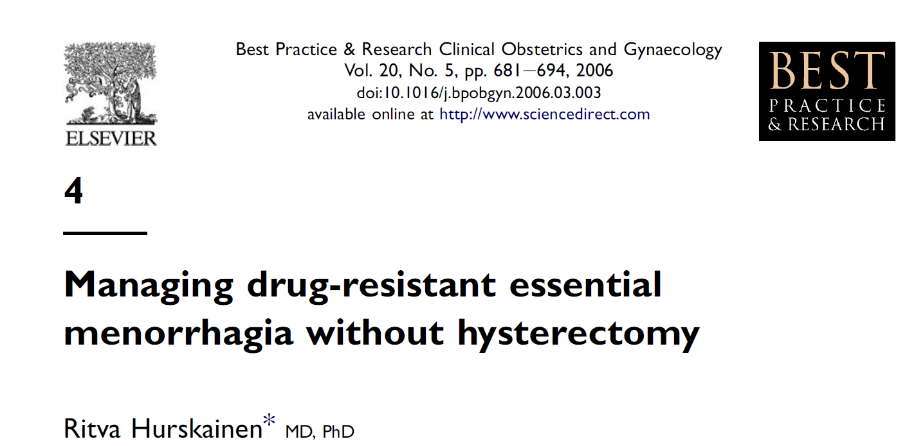
Levonorgestrel-releasing IUD
Endometrial ablation

Slide 33
GnRH agonists
Down regulate gonadotropin secretion
Not well studied as single agent in HMB
High rate of side effect
Have been used in combination with OCP, with beneficial effect on blood loss and side effect

Slide 34
Danazol
Synthetic steroid with mild androgenic and minimal/no estrogenic/progestin activity
Very effective in reducing blood loss (Luisi 2009)
Androgenic side effect
Not be used while attempting pregnancy

Slide 35
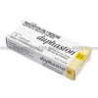
Anovulatory uterine bleeding
Cyclic oral progesterone:
Options for women who do not want to use OCP
Hyperplasia without atypia
Progesterone 5-10 mg for 10-14 days each month.
It can be taken for longer periods if there is overgrowth of the uterine lining
Bleeding will begin before the 7 day of progestin if the uterine lining is overgrown; otherwise it may not be seen until several days after the last progesterone pill
It is not a contraceptive

Slide 36
Hyperplasia with atypia
Megestrol 40-50 mg/daily for 3-6 months
Repeated biopsies to document resolution
75-90% respond to therapy

Slide 37
Mechanism of unscheduled bleeding in women using contraception
Upon initiation method a thick endometrium to a relatively thin endometrium
Continues use produce a dense network of small thin-walled, dilated superficial veins and capillaries that prone to bleeding
Change in endometrial local vascular homeostasis, matrix metalloproteinase activity, pro and antioxidant process.

Slide 38
Bleeding pattern in combined OCPs
It occurs in up to 30% at initiating OCPs, decrease to less than 10%
It is higher with the lowest dose of OCP
Intermenstrual bleeding is more common with those containing lower progestin levels relative to EE (Saleh 1997).
Continues use associates with ↓ no.scheduled bleeding days but ↑unscheduled bleeding &spotting (Sharder 2008)

Slide 39
Management
Reinforcing consistence use, taking the pill at the same time each day
Reassurance , it will cease by 3rd cycle
Smoker are more likely to have AUB
Short course of 1.25 Conjugated Estrogen for 7 days at any time during the pill cycle
Monophasic is better than biphasic?
Triphasic may better than Monophasic (Fert Steril 2009)
Change to pill products by different manufactures or different formulations of E or P improved bleeding pattern? (Am J Obs Gyn 1999)
Switching is unlikely to worsen AUB but can improve satisfaction
21-day E-P pill has less AUB in comparison to 24-day pill (Obstet Gynecol 2009)
Doubling or tripling the daily dose of OCPs will not decrease AUB

Slide 40
Continues or extended pill regimens
It will decrease over time
E dose or P type is important
30 mcg of EE has less AUB compare to 20
Norehinoderone acetate has less AUB compare to Levonorgestrel
Dose of Levonorgestrel is not important
If it happen for 21st day of use, stop it for 3 days and then start it again, it can be repeat several times.
Doxycycline inhibit metalloproteinase, if given with continues OCPs can reduce the length of time needed to achieve amenorrhea.

Slide 41
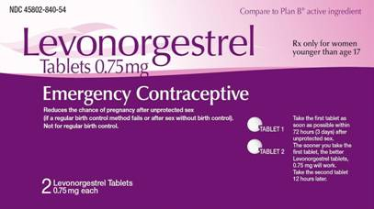
Treatment in the 1st 3 weeks of menstrual cycle shortened that cycle
The magnitude of this is greater with earlier the pills was taken
Duration of 1st cycle after treatment increased
IMB occurred in only 5% of women in 1st cycle after treatment

Slide 42
DMPA
Amenorrhea occurs in 12% after 3 months and it increase to 46% after 1 year.
AUB is because of atrophy and chronic endometritis (Speroff 2011)
Reassurance, Usually medication is not helpful.
E supplement? (Contraception 2010) 1.25 mg Conjugated E for 7-14), but recur after discontinuation
Prophylactic use of E? (Contraception 2002)
Mefenamic acid (500 mg/BD/5days), 1st week not 4th week
Tranexamic acid (250 mg/QID/ 5 days), 1st week & 4th week
Mifepristone (50 mg/once every 2 weeks), three months
Shortening of the interval between DMPA injections?

Slide 43
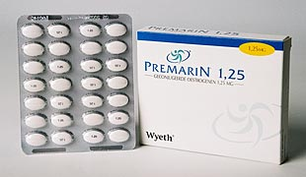
Contraceptive Implants
Expectant management is best for Progesterone implant’s users
Supplement E, 1.25 mg for 7 days
E-P OCPs for 21 days, then 7 days break for 3 months
Progestin ?
Doxycycline 100mg/BD/10 days

Slide 44
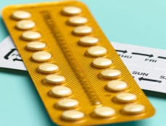
Progestin pills
40% have normal cycles, 40%AUB,10% amenorrhea
Taking pill at the same time each day
Conjugated E ,1.25 for 7 days

Slide 45
Levonorgestrel-releasing IUD
A systematic review of 15 trials involving 2702 women, demonstrated that NSAIDS reduce the amount of bleeding. Unscheduled bleeding? (Cochrane 2006)
500 mg Naproxen/BD/for 5 days every 4 weeks for 12 weeks reduce AUB in LNG-IUD’s users (Am J Obstet Gynecol 2012)
Doxycycline, 100 mg/BD/for 7-14 days (Hum Rep 2006)

Slide 46
Take Home Messages
AUB management is an easy but difficult task.
There is not an universal treatment protocol for all women with AUB.
Its treatment depends on its etiology, severity, associated symptoms, contraceptive need, desire for further fertility, contraindications to hormonal or other medication, medical co morbidities, patient preference.
Consider minimum possible intervention.

Slide 47
Thank you

