Slide 1

In the name of GOD
1
1

Slide 2
Gestational Diabetes Mellitus
Pathogenesis and Epidemiology
F.Sarvghadi M.D
Associate prof. Research institute for endocrine sciences. Shahid Beheshti University of Medical Sciences.

Slide 3
Outline
Normal physiology of pregnancy.
Review of pathophysiology of GDM.
Risk factors of GDM.
Reported prevalence in Iran.
Impact of new criteria on prevalence of GDM
Conclusion

Slide 4
Introduction
Metabolism comes from the Greek word meaning
“ to change ”
Pregnancy is associated with major changes in metabolic processes and endocrine function.

Slide 5
Maternal physiologic adaptations
Growth and development of the fetus.
Providing the fetus with adequate stores of energy and substrates needed for transition to extra uterine life.
Maternal needs for increased physiologic demands of pregnancy.
Providing energy and substrate stores for pregnancy , labor and lactation.

Slide 6
Physiology of pregnancy
Pregnancy is primary an anabolic state:
1- Increase food intake and appetite.
2- Around 3.5 kg of fat is deposited.
3- New protein synthesis is about 900 g.
4- The energy cost of reproduction is estimated at 75000- 85000 Kcal.

Slide 7
Utilization of maternal fuels by fetus
Glucose and 3.C intermediates ( 6 mg/kg/min )
Nitrogen and amino acids ( 54 mmol/D )
Triglycerides and cholestrol ( poorly transferring )
Ketone bodies ( transfer freely).

Slide 8
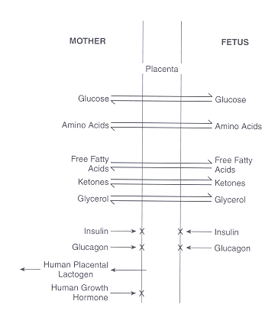
Maternal – fetal substrate, hormone relationship
Mother
Placenta
Fetus
Glucose
Glucose
Amino acids
Amino acids
FFA
FFA
Ketones
Ketones
Glycerol
Glycerol
Insulin
×
×
Insulin
Glucagon
×
×
Glucagon
HPL
Human GH
×
Homko CJ et al. Semin Reprod Endocrinol 1999 ; 17 : 119 – 125 .

Slide 9
Physiologic adaptation

Slide 10
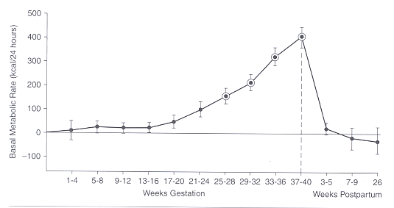
1-Basal Metabolic Rate during pregnancy

Slide 11
2-Insulin metabolism during pregnancy
Insulin degradation is increased by liver and placenta
Insulin secretion is increased ( beta cell hypertrophy ) due to insulin resistance.

Slide 12
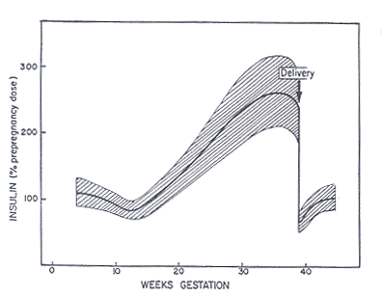
Insulin requirement during pregnancy
Metzger BE , Freinkel N. Biol Neonate 1987 ; 51 : 78 – 85 .

Slide 13
3- Hepatic glucose production
a) Early pregnancy:
Insulin sensitivity
Glucose production
Lipogenesis
Anabolic state for mother and fetus

Slide 14
b) Late pregnancy:
Anti-insulin hormones
Increase insulin resistance
Beta cell hypertrophy
Hyperinsulinemia
Increase insulin degradition
Lipolysis
Accelarated starvation ( hyperketonemia )
Hypoaminoacidemia ( fetus storage )
Anabolic state ( fetus ) Catabolic state in mother

Slide 15
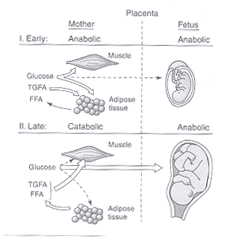
Fuel disposition in pregnancy ( overnight fast )
Mother
Anabolic
Placenta
Fetus
Anabolic
I) Early
II)Late
Catabolic
Anabolic

Slide 16
Anti-insulin hormones of pregnancy
HCS ( hpl ): The strogest hormone
GH like effect
Lipolysis - Liopogenesis
Insulin resistance
Progestrone - Estrogen
Insulin resistance – beta cell hypertrophy – cortisol secretion
Cortisol ( free and total )
Insulin resistance, IRS-1

Slide 17
Prolactin -Placenta GHv.
GH like effect
beta cell hypertrophy and insulin secretion.
Leptin – Adipokines
Insulin resistance
TNF α - INL6 …( ? )
Mills JL, et al. Metabolism 1998 ; 47 : 1140 – 1144

Slide 18
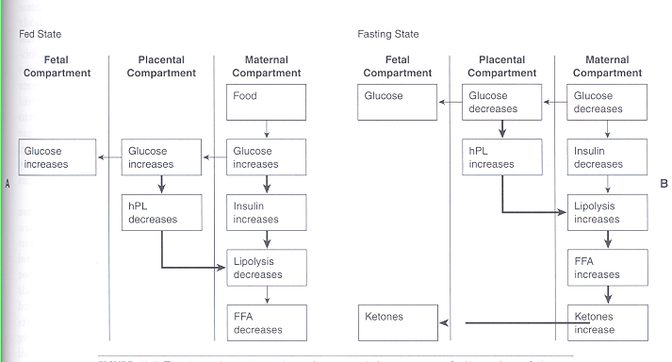
Absorptive and postabsorptive state during pregnancy
Fed state
Fasting state

Slide 19
Maternal adaptation
The maternal response is characterized by a switch from carbohydrate to fat utilization that is facilitated by both insulin resistance and increased plasma concentrations of lipolytic hormones
After an overnight fast the maternal fasting capillary whole blood glucose concentration falls , while plasma ketone and free fatty acid concentrations rise
Mother preferentially use fat (eg, free fatty acids, triglycerides, ketone bodies)
Preserve much of the available glucose and amino acids (especially alanine) for the fetus

Slide 20
Gestational Diabetes Mellitus
Glucose intolerance of variable degree with onset or first recognition during pregnancy.
WHO Consultation Group.. Geneva:1999:1-59

Slide 21
Factors mediating predisposition to G.D.M
I ) Precursors of T2DM:
Weight – age – ethnicity – family history – PCOD
II) Specific genetic status:
TIDM ( HLA DR3-4 – GAD ab. )
MODY
Mutation of mitochondrial DNA
etc…

Slide 22
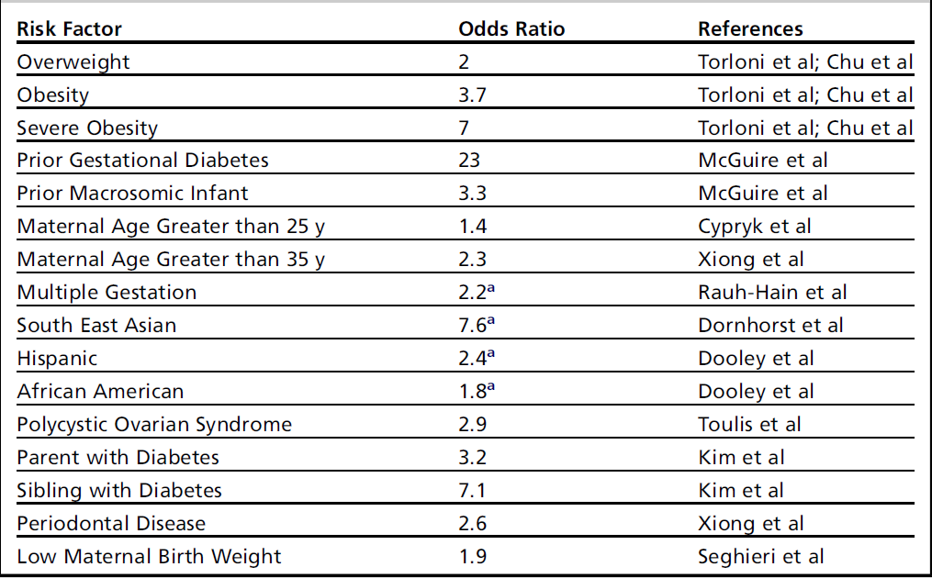
Risk factors
Obstet Gynecol Clin N Am 37 (2010) 255–267

Slide 23
Maternal-Fetal metabolism
Anabolic phase:
- Normal or increased sensitivity to insulin
- lower plasma glucose level
- lipogeneses, glycogen stores increases
Catabolic phase (Accelerated starvation):
- Maternal insuln resistance
- Increased transport of nutritients trough placental membrane
- lipolysis
Cousins L. Diabetes 1991 ; 40 ( Suppl-2 ): 39 – 43 .

Slide 24
Circulating concentration of nutrient fuels
In normal pregnancy:
Accelerated starvation FPG
Lipolysis and insulin resistance TG
Cholesterol
FFAs
Glycerol
Shift to fetus Amino acids
In GDM:
Basal and postprandial concentration of glucose, FFAs,
amino acids, TG.

Slide 25
Pathophysiology of GDM
The development of gestational diabetes is associated with a much greater severity of insulin resistance than normal pregnant women.
The degree of insulin resistance seems to be influenced by obesity & inheritance.
Gestational diabetes mellitus occurs when a woman's pancreatic function is not sufficient to overcome the insulin resistance.
GDM occurs as a result of a combination of insulin resistance and decreased insulin secretion.
Barbour LA et al. Diabetes Care 2007 ; 30 ( Suppl 2 ): 112 – 119 .

Slide 26
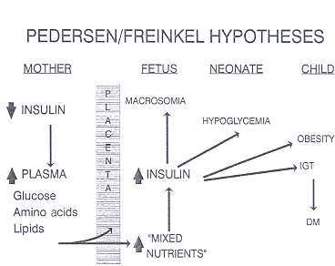
Fuel mediated teratogenesis
Silverman BL . Diabetes Rev 4:21-35 1996
Pedersen – Freinkel Hypothesis
P
L
A
C
E
N
A

Slide 27
GDM outcomes
Polyhydramnios
Vaginal candidosis.
Hypertension.
UTI
Macrosomia
Birth trauma – dystocia
Neonatal hypoglycemia- hypocalcemia – hypokalemia- hyperbilirubinemia
Nature ( genetic )
Obesity, IGT& DM
Nurture (intrauterine environment ) in childhood

Slide 28
Clinical implications.
Pregnancy as a state of facilitated anabolism.
Pregnancy as a state of accelerated starvation.
Pregnancy as a state of diabetogenic state.

Slide 29
Prevalence
GDM complicates approximately 1% to 14% of all pregnancies.
( 5% - 6% )
In low-risk populations, such as those found in Sweden, the prevalence in population-based studies is lower than 2%.
In high-risk populations, such as the Native American Cree, Northern Californian Hispanics and Northern Californian Asians, reported prevalence rates ranging from 4.9% to 12.8%.
Curr Diab Rep (2010) 10:224–228

Slide 30
Reasons for differences in reported prevalence
Different diagnostic criteria
Different screening policies
Different definitions, screening strategies and awareness of type 2 diabetes
Maternal age
Racial/ethnic composition of population
Obstet Gynecol Clin North Am. 2007 June ; 34(2):

Slide 31
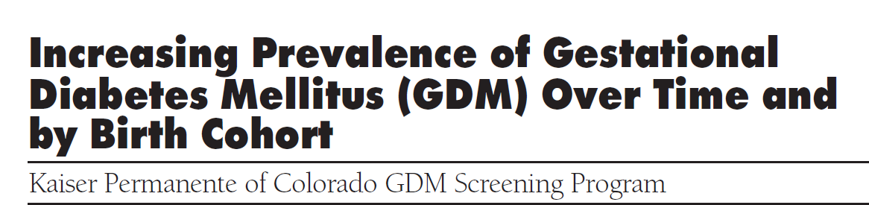
This report is based on 36,403 KPCO singleton pregnancies occurring between 1994 and 2002 and examines trends in GDM prevalence among women with diverse ethnic backgrounds
Diabetes Care 28:579–584, 2005

Slide 32
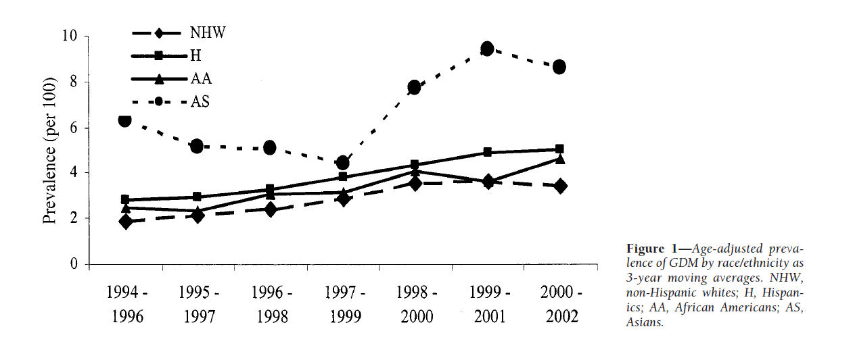
The prevalence of GDM among KPCO members doubled from 1994 to 2002
(2.1– 4.1%, P 0.001)
Prevalence of GDM is increasing in a universally screened multiethnic population
Given the etiology of type 2 diabetes , the observed increase probably reflects the well-documented obesity epidemic

Slide 33
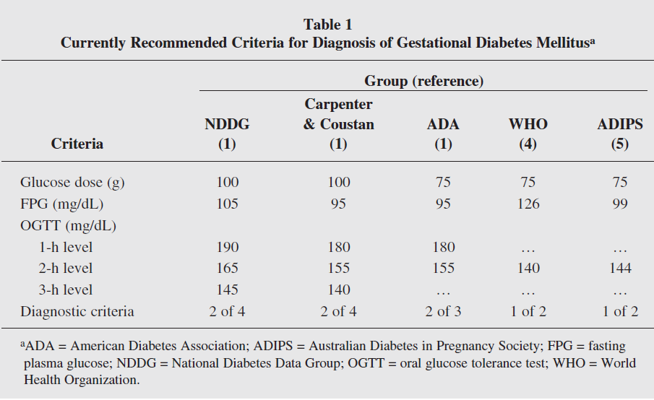
92
153
1
Different protocol for diagnosis

Slide 34

Aim: Impact of new IADPSG criteria on diagnosis of GDM compared with ADA criteria
Diabetes Care 2010 33:2018–2020,

Slide 35
Results
ADA criteria identified 12.9%women with GDM
ADPSG criteria identified 37.7% women with GDM
The IADPSG criteria increased GDM prevalence nearly threefold

Slide 36
Epidemiological studies in Iran
Larijani B, et al. Cost analysis of different screening strategies for gestational diabetes mellitus. Endocr Pract 2003;9:504–509.
Keshavarz M, et al. Gestational diabetes in Iran: incidence, risk factors and pregnancy outcomes. Diabetes Res Clin Pract 2005;69:279–286.
Hadaegh F , et al. Prevalence of gestational diabetes mellitus in southern Iran (Bandar Abbas City). Endocr Pract 2005;11:313–318.
Hossein-Nezhad A et al , Prevalence of gestational diabetes mellitus and pregnancy outcomes in Iranian women.Taiwan J Obstet Gynecol. 2007 Sep;46(3):236-41
Maghbooli Z et al ,Relationship between leptin concentration and insulin resistance .Horm Metab Res. 2007 Dec;39(12):903-7
Shirazian N et al, Comparison of different diagnostic criteria for gestational diabetes mellitus based on the 75-g oral glucose tolerance test: a cohort study . Endocr Pract 2008 Apr;14(3):312-7
Shirazian N et al , Screening for gestational diabetes: usefulness of clinical risk factors .Arch Gynecol Obstet. 2009 Dec;280(6):933-7

Slide 37
Prevalence% | Sample size | Diagnostic method | Year | Author
4.7 | 2416 | 50&100g GTT | 2003 | Tehran | Larijani
8.9 | 800 | 50&100g GTT | 2005 | Bandar-abbas | Hadaegh
4.8 | 1310 | 50&100g GTT | 2005 | Shahrood | Keshavarz
4.7 | 2416 | 50&100g GTT | 2003 | Tehran | Hosseinnezad
7 | 741 | 50&100g GTT | 2007 | Tehran | Maghbooli
6.1 | 670 | 75g GTT | 2008 | Tehran | Shirazian
7.4 | 924 | 75gGTT | 2009 | Tehran | Shirazian

Slide 38
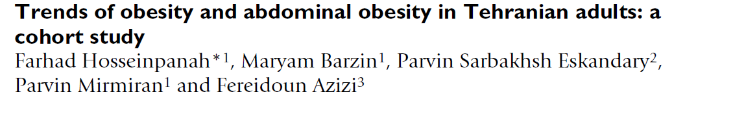
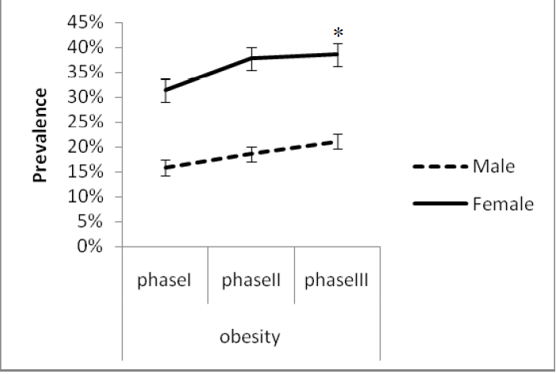
To examine trends of obesity and abdominal obesity among Tehranian adults during a median follow-up of 6.6 years.
BMC Public Health 2009, 9:426

Slide 39
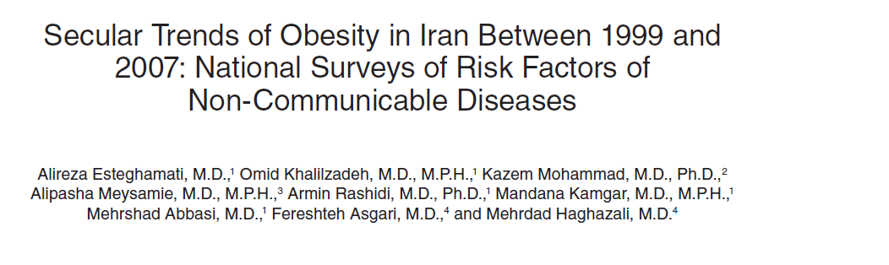
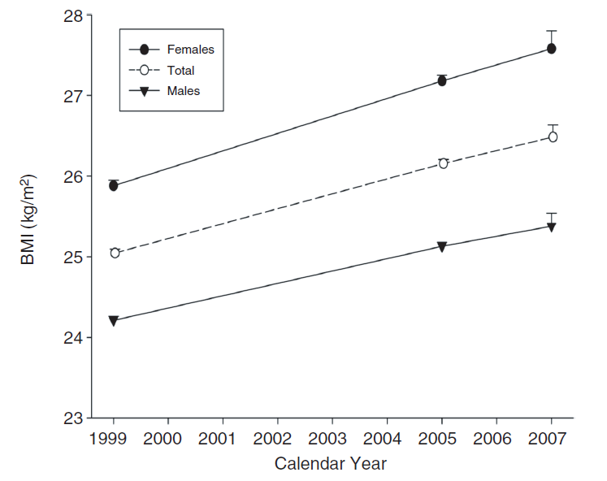
To determine secular trends of overweight and obesity among Iranian adults (25–64 years old) within an 8-year period (1999–2007)
Estaghamati AR et al. Diabetes Care 2008 ;31- 96-98

Slide 40
 | 0verweight | Obesity
1999 | 32.2% | 13.6%
2005 | 35.8% | 19.6%
2007 | 36.3% | 22.3%
Estaghamati AR et al. Diabetes Care 2008 ;31- 96-98

Slide 41
Conclusion
Pregnancy is characterized by insulin resistance and hyperinsulinemia, thus it may predispose some women to develop diabetes.
Gestational diabetes occurs when pancreatic function is not sufficient to overcome the insulin resistance created by changes in diabetogenic hormones during pregnancy .
Prevalence of GDM in a population is reflective of the prevalence of type 2 diabetes in that population.
The prevalence of GDM in Iran varies between 4.7% and 8.9% ,which represents a moderate prevalence rate.
Based on increasing trend of obesity in Iran, it seems that the prevalence of GDM is also increasing .
Practical bulletin , ACOG 2013 :137; 406- 416

Slide 42

Thank you

Slide 43
Hormones associated with modifications in insulin secretion and action
Estrogens ↑ Insulin concentration
↑ Insulin binding
Progesterone ↓ Glucose transport
↓ Insulin binding
↓ Insulin-induced hepatic
Gluconeogenesis

Slide 44
Hormones associated with modifications in insulin secretion and action….
Cortisol ↑ Insulin resistance
↓ Phosphorylation of insulin receptor
↓IRS-1
hPL, GH ↓ Insulin sensitivity
↑ Insulin secretion
↑ Insulin synthesis
↑ Utilization and glucose oxidation
↑ cAMP metabolism
↑ β-cell number
↑ β-cell mass
Leptin ↑ Insulin resistance
Glucagon ↑ Insulin resistance

Slide 45
Early pregnancy
Increased glucose-stimulated insulin secretion
Unchanged or enhanced peripheral (muscle) insulin sensitivity
Unchanged basal hepatic glucose production
Normal or slightly improved glucose tolerance
Normal sensitivity to the blood glucose–lowering effect of exogenously administered insulin.
Late pregnancy
Rising concentrations of several diabetogenic hormones
Increased peripheral insulin resistance
Progressive increase in basal & postprandial insulin (up to 2 fold in third trimester)
lower insulin action in late normal pregnancy than in non pregnant women (50-70%)
Basal endogenous hepatic glucose production increases by 16–30%

