Slide 1
Medical nutrition therapy Diabetes (2)
Presented by:
Baran Hashemi
PhD Candidate (Shiraz
University of Medical Sciences)

Slide 2
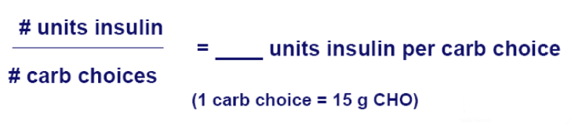

Insulin to carbohydrate ratio
(ICR)
?

Slide 3


روشهاي محاسبه نسبت انسولين به کربوهیدرات
روش اول : استفاده از فرم ثبت غذاها و تعيين بهترين نسبت ممکن براي هر وعدۀ غذا
= تعداد واحد انسولين براي هر واحد کربوهيدرات | تعداد واحد انسولين رگولار در هر وعده
 | تعداد واحد کربوهيدرات در آن وعده

Slide 4
روشهاي محاسبه نسبت انسولين به کربوهیدرات
روش دوم: استفاده از مقدار انسولين رگولار روزانه
= تعداد واحد انسولين براي هر واحد کربوهيدرات | کل واحدهاي روزانه انسولين رگولار
 | متوسط واحد کربوهيدرات مصرفي در طول روز

Slide 5

روشهاي محاسبه نسبت انسولين به کربوهیدرات
روش سوم : استفاده از قانون 30
  کل مقدار انسولين روزانه تقسيم بر 30

Slide 6


Case Study
Ali is a pleasant 30 year old male who has had type 1 diabetes for 20 years.
He has been carbohydrate counting and trying to follow a consistent carbohydrate meal plan.
He is coming to learn advanced carbohydrate counting skills because he wants to improve his glycemic control and have a more flexible lifestyle.

Slide 7
Other information about him
Ht =183 cm
Wt = 83 kg
BMI = 24.8
Ali’s insulin:
  12 u intermediate-acting insulin bid
  8 u rapid-acting insulin with meals
  Total daily dose = 48 u/day
HbA1C = 7.9
Total CHO per day = 17

Slide 8
Calculate Ali’s ICR
Insulin:Carb Ratio
24 / 17 = 1.4
48 / 30 = 1.6
1.5

Slide 9

For example:
Blood sugar before lunch : 200
His target : 100
He want to eat 4 exchange CHO
Regular before lunch

Slide 10
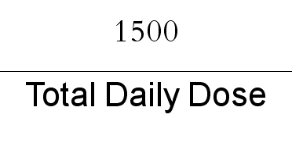
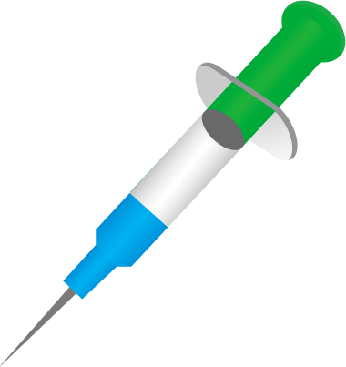
Insulin Sensitivity Factor (ISF)
1700-1800

Slide 11
Calculate Ali’s ICR & ISF
Insulin:Carb Ratio
24 / 17 = 1.4
48 / 30 = 1.6
1.5
Insulin Sensitivity Factor
1500 / 48 = 30

Slide 12

Regular
+
9
3
6
ISF
ICR
30
1.5
BG before meal
CHO
200
(target:100)
4

Slide 13
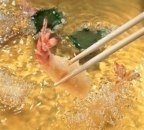

Special Considerations : Fat
Strategies to use if effect is noted:
  – MDI: inject post-meal or split dose: 50%
  initially, remaining 50% 1-2 hours after meal
  – Pump: use “dual wave” type bolus with 50% initial and remainder over 2-5 hours
• SMBG and Pattern Management will help
determine correct distribution
Strategies

Slide 14
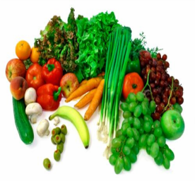
Special Considerations : Fiber & GI
Fiber is a carbohydrate that is only digested by ruminants, i.e. will not raise BG in humans!
• Fiber content must be subtracted from total CHO of portion eaten.
• Low GI carbs (legumes, oats, etc) may require insulin administration strategies similar to high fat carbs due to slower rate of digestion.

Slide 15
Special Considerations : Fiber
100 g French fries = 28 g carbohydrate
175 g cooked lentils = 28 g carbohydrate
128 g sweet potato = 28 g carbohydrate
58 g white bread = 28 g carbohydrate
Which carb portion will be digested most slowly?
May require different timing of insulin administration

Slide 16
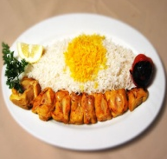
Special Considerations : Protein
No immediate effect on BG: should not be calculated in Bolus.
Certain amino acids stimulate both insulin and glucagon. Results in late BG rise in individuals with type 1 DM due to a lack of endogenous insulin.
May require additional insulin 2-4 hours after meal to cover protein in excess of usual consumption.

Slide 17

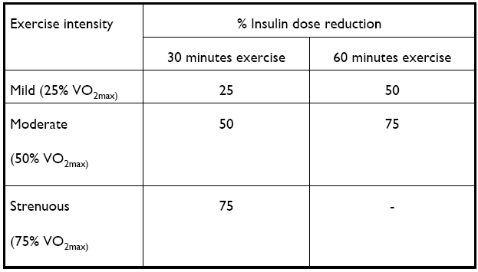
Insulin dose reduction guidelines
for planned postprandial exercise

Slide 18
Exercise: General Recommendations
Bolus insulin:
– ↓ pre-exercise bolus insulin by 10-80% according to
duration and intensity, when activity follows a meal
– Following prolonged exercise, subsequent meal boluses
may need to be ↓‘d by 25-50%
• Basal insulin:
– Injected morning basal insulin may need to be ↓‘d by 10-
50% for planned or continuing activity in the afternoon
– Injected bedtime basal insulin may need to be ↓‘d by 10-
30% following prolonged endurance exercise
– Pump basal rates should be decreased by an appropriate
amount prior to the start of activity (30 - 60 min.) and may
need to be continued for several hours after

Slide 19
Non-food Factors
Changes in body weight, Sick days, stress, medications that increase insulin resistance (e.g. steroids); Often increase insulin requirements, therefore insulin:carb ratio may be inadequate.
• Frequent testing will assess need for
supplemental doses

Slide 20

So :
Skills needed for successful Advanced CHO
counting:
1. Motivation to make efforts and take time required to
record, calculate, test, reflect/analyze, adjust,
re-test, etc.
2. Ability to count CHO in foods/portions to be eaten
3. Ability to calculate bolus insulin dose using
insulin:carb ratios and supplemental insulin dose
using ISF, and to understand insulin action

Slide 21

So :
Ability to assess foods of differing nutrient composition (high fat, etc) and/or without nutritional label (i.e. educated guesstimates)
Ability to adjust for activity, illness
Ability to problem-solve
Ability to accept that mistakes happen…
No one is perfect!

Slide 22
The ability to think like a pancreas!

Slide 23
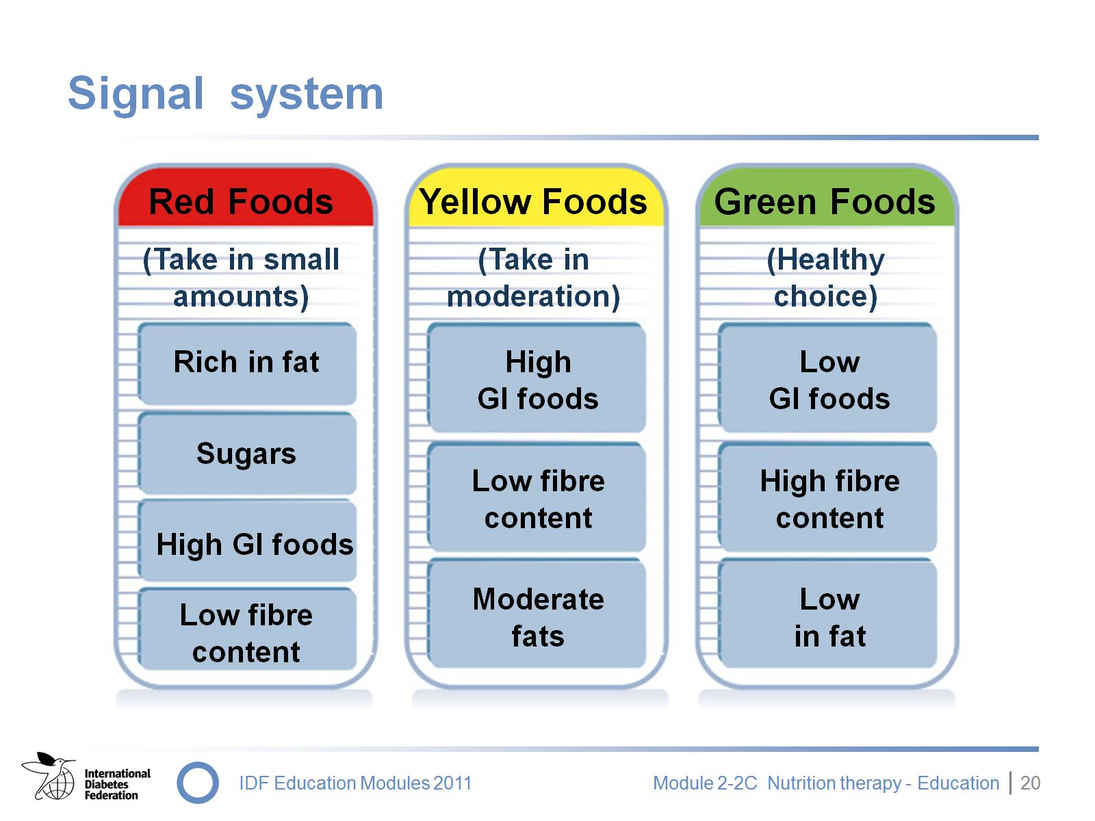
Signal system
Notes:
In India a simple system called the “Signal System’’ is used.
This is a useful aid to mass communication of dietary education and it encourages less motivated people to learn about healthy eating choices. It has been presented at various events all over India.
Red zone: these foods are rich in fat and in refined carbohydrates/sugars; they have a high glycaemic index or are low in fibre. They should be eaten in very limited quantities.
Yellow zone: these foods should be eaten in moderation since they may have a high glycaemic index, be low in fibre content, or have moderate amounts of fat.
Green zone: these foods are healthy choices because they have a low glycaemic index, are high in fibre, and low in fat. However, foods in the green zone should still only be eaten in the recommended amounts.

Slide 24
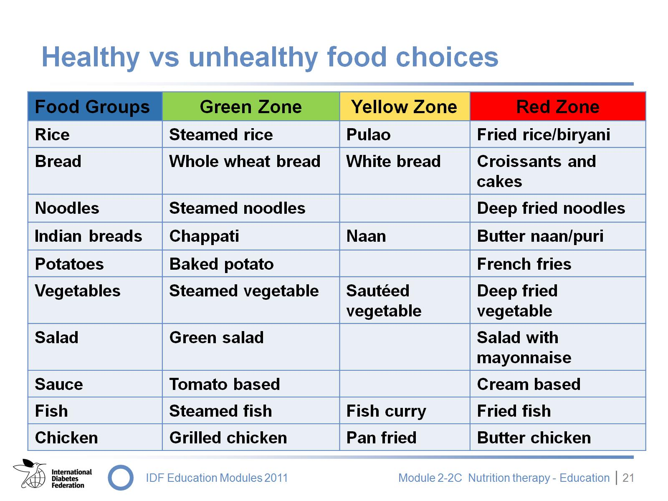
Healthy vs unhealthy food choices
Notes:
This slide shows how food can move from the green to the red zone depending on the method of processing and cooking. The following example takes the same serving of rice and describes its fat content according to the cooking method used:
Steamed long grain or parboiled rice is a healthy option since it is low in fat and has a low glycaemic index
The same serving prepared as pulao rice would have a moderate amount of fat (around 10-15 g)
Fried or biryani rice is a very rich and unhealthy choice since it would have a fat content of 60-80 g per serving
Other examples include:
Whole-grain or multi-grain bread is healthy since it has a low glycaemic index and is rich in fibre, while croissants made from refined wheat flour with added fats are richer in calories
Roti is healthy while naan would fall into the yellow zone as it is low in fibre and has a high glycaemic index (a butter naan or puri with added fat would be in the red zone)
Baked potatoes are healthier than chips/french fries
Salad changes from being a green zone, healthy food option to a red, unhealthy choice when mayonnaise is added to it
Steamed or stir-fried vegetables (in minimal amounts of oil) are healthy when compared to fried vegetables
Steamed, poached or grilled fish is a healthy choice as is grilled, tandoori or roasted chicken; however, if a high fat, butter sauce is added – rather than, for example, a low fat, mustard sauce – then the fat content of the dish would change from less than 5 g to more than 40 g of fat in the case of the fish; Similarly, butter chicken would move the healthy chicken from the green zone to the red zone
The signal system can be tailored for each type of cuisine and food. It is a useful tool for teaching the importance of healthy cooking and processing of food.

Slide 25
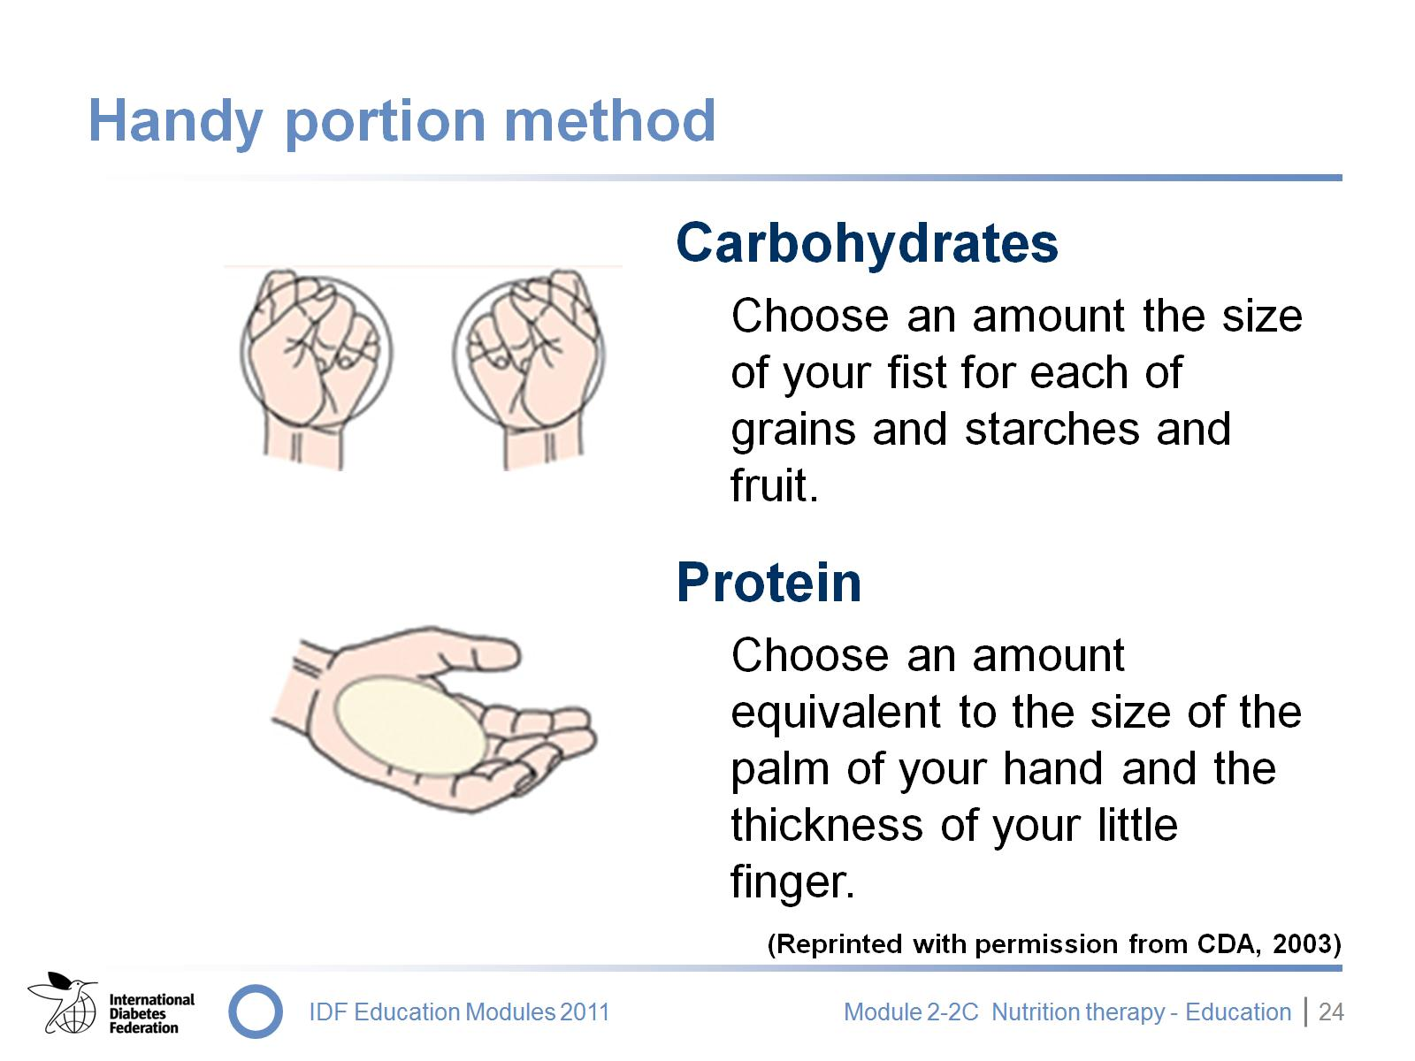
Handy portion method
Notes:
The hand portion method was first used in Africa to teach people how much they should eat by using their hands as a measure. It has now been adapted by the Canadian Diabetes Association.
Hands can be very useful in estimating portion sizes – they are always available and are always the same size!
When planning a meal, these portion sizes are used as a guide.
Canadian Diabetes Association Clinical Practice Guidelines Expert Committee. (2003). Canadian Diabetes Association 2003 Clinical Practice Guidelines for the prevention and management of diabetes in Canada. Can J Diab, 27(suppl 2).

Slide 26
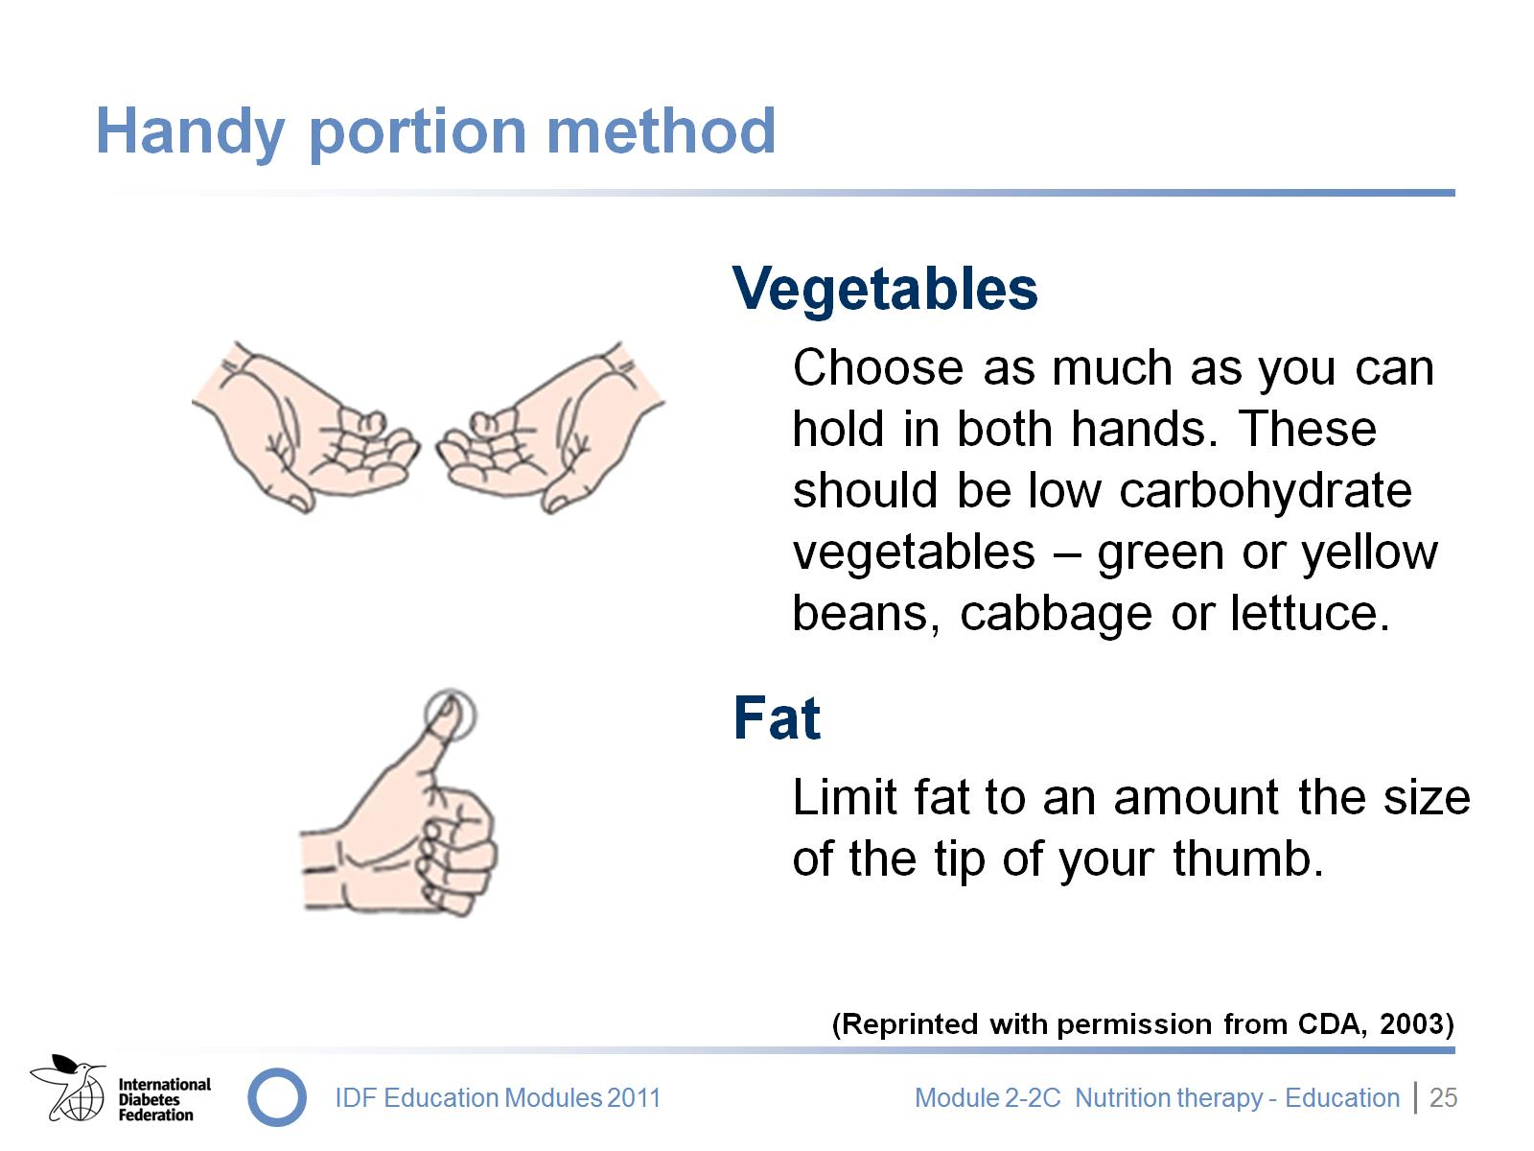
Handy portion method
Notes:
Drink no more than 250 ml low fat milk at a meal.
Canadian Diabetes Association Clinical Practice Guidelines Expert Committee. (2003). Canadian Diabetes Association 2003 Clinical Practice Guidelines for the prevention and management of diabetes in Canada. Can J Diab, 27(suppl 2).

Slide 27
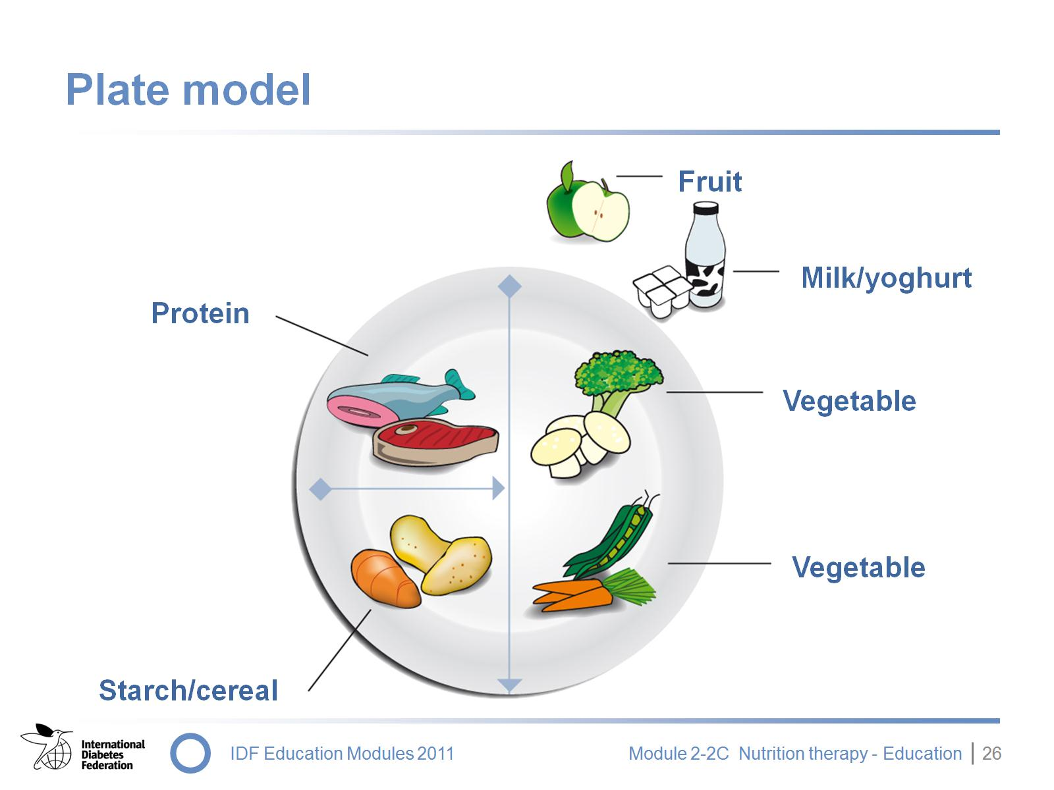
Plate model
Notes:
The plate model is a simple way to planning a balanced diet through appropriate portion sizes.
Foods are divided into five basic groups:
Starch/cereals
Vegetables
Fruit
Milk
Protein/meat
The plate model recommends:
One fourth starch (potato, colocassia, yam, sweet potato, peas, etc.)
One fourth protein (meat, fish, poultry, pulses, tofu, beans, etc.)
Half of the plate should consist of vegetables (preferably non starchy, low carbohydrate vegetables such as cabbage, broccoli, green beans, carrots, mushrooms, tomatoes, cauliflower, spinach, peppers or salad greens)
One cup of low-fat milk or yoghurt/curd
One piece of fruit
A “meal plan’’ exercise using the plate model can be carried out in a variety of ways:
A paper plate can be used with basic drawings showing the amount of space which should be taken up by each food group; this technique helps to reinforce consistency and prevent large amounts of carbohydrate foods being eaten on any one day
Remind people to do a “Handy Meal Plan” on their hand: hold up your hand (palm facing forward), point to your four fingers and show that most adults can have about four carbohydrates per meal, a serving of meat/meat substitute the size of the palm (about 110 g) and just a “thumb tip’’ of fat

Slide 28


Any Question ?
f.amiri@gabric.ir

Slide 29
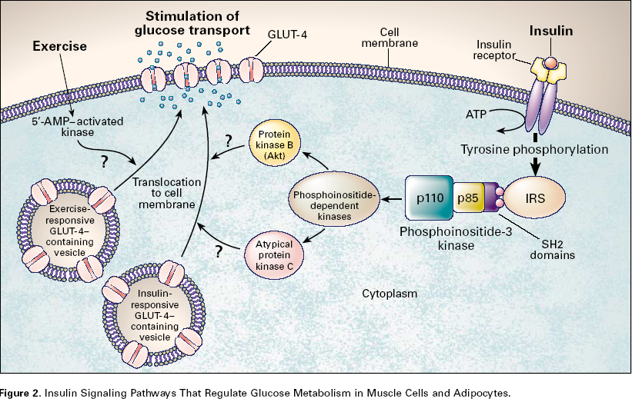
Effect of physical activity

