Slide 1


Slide 2
Health-Related Quality of Life in diabetes
Parisa Amiri, Ph.D.
Research Institute for Endocrine Sciences
Shahid Beheshti University of Medical Sciences

Slide 3
Measures of Health: A brief typology
Mortality-based measures
  death rates, life expectancies, etc.
Morbidity-based measures
  Indicators
  Health status measures
  - Single, objective
    % Hypertension
    % Obesity
    % Population who exercise
  - Multi-dimensional, subjective
    Generic
    Disease-specific
Health-related quality of life

Slide 4
Quality of life
Quality of Life define as an individual's perception of their position in life in the context of the culture and value systems in which they live and in relation to their goals, expectations, standards and concerns [1].
1. P Theofilou. Quality of Life: Definition and Measurement. Europe's journal of psychology, 2013.

Slide 5
Health-related quality of life
The Constitution of the World Health Organization (WHO) defines health as “A state of complete physical, mental, and social well-being not merely the absence of disease”
Health-related quality of life (HRQoL) includes domains related to individual’s physical, mental, emotional, and social functioning.
It goes beyond direct measures of population health, life expectancy, and causes of death, and focuses on the impact of health status on quality of life.
WORLD HEALTH ORGANIZATION. MEASURING QUALITY OF LIFE. DIVISION OF MENTAL HEALTH AND PREVENTION OF SUBSTANCE ABUSE , 1997.

Slide 6
Health-related quality of life in chronic diseases
Treatments have traditionally focused on symptomatic and physiological markers of disease rather than on functional status and overall well-being.
Chronic diseases usually involve multiple treatments. Similar medical outcomes may lead to different experiences and level of satisfaction from the patients’ perspective.
With a growing number of interventions and increases in healthcare costs, policy makers needs guidance in prioritizing treatment options.

Slide 7
HRQoL in those with diabetes:
A patient-oriented outcome
Negative effect of diabetes on HRQoL is well documented [1].
Improved HRQL is associated with diabetes self-management and changes in lifestyle, which are crucial for diabetes care [1].
The ultimate aim of diabetes care is preventing the patient’s HRQOL to get worse. A shift from metabolic control to improving HRQL and other more patient-oriented outcomes seems essential [2].
Norris S L. Health-related quality of life among adults with diabetes. Curr Diab Rep. 2005;5:124 –130.
Zhang X et al. The effects of interventions on health-related quality of life among persons with diabetes: a systematic review. Med Care 2007;45(9):820-34.

Slide 8
Health-related quality of life measurements
QWB-SA
  Mobility
  Physical activity
  Social activity
  Symptoms
SF-6D (from SF-36 questionnaire)
  Physical function
  Physical Role limitation
  Pain
  General health
  Mental health
  Role emotional
  Social function
  Vitality
EuroQol EQ-5D
  Mobility
  Self-care
  Usual activities
  Pain/discomfort
  Anxiety/depression
HALex
  Self-rated health
  Physical activity limitations
HUI2
  Sensation
  Mobility
  Emotion
  Cognition
  Self-care
  Pain
HUI3
  Vision
  Hearing
  Speech
  Ambulation
  Dexterity
  Emotion
  Cognition

Slide 9
Audit of Diabetes Dependent QoL (ADDQoL-19)
Bradley C et al. The development of an individualized questionnaire measure of perceived impact of diabetes on quality of life: the ADDQoL. Qual Life Res. 1999;8(1-2):79-91.

Slide 10
Health-related quality of life in Iranian patients with type 2 diabetes
Mokhtari Z Health-related quality of life in Iranian patients with type 2 diabetes: An updated meta-analysis. Diabetes Metab Syndr 2019;13(1):402-407. doi: 10.1016/j.dsx.2018.10.007. Epub 2018 Oct 10.

Slide 11
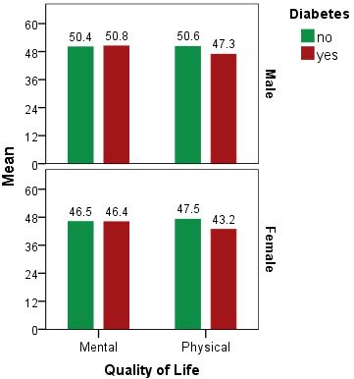
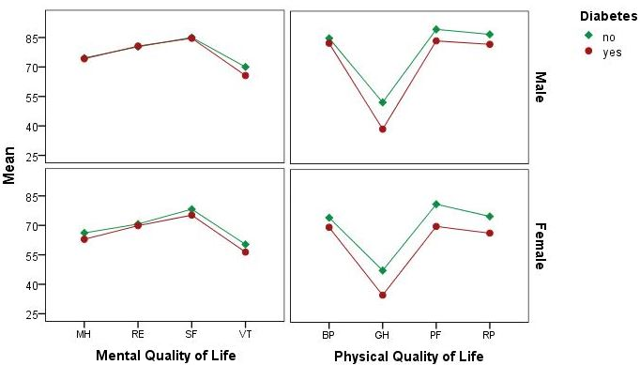
Health-related quality of life in those with and without diabetes type 2: TLGS

Slide 12
Related factors of quality of life in type 2 diabetes
Jing X et al. Related factors of quality of life of type 2 diabetes patients: a systematic review and meta-analysis. Health and Quality of Life Outcomes (2018) 16:189.

Slide 13
The effects of interventions on HRQoL among persons with diabetes
Interventions generally demonstrated improvement in HRQoL.
Surgery for treating diabetes comorbidities: 15.0 to 42.0 point improvement
Surgery for treating diabetes complications, 13.0 to 37.9
pharmacotherapy using insulin to optimize glycemic control, - 4.6 to 27.6
Pharmacotherapy for treating comorbidities, 3.8 to 33.2
Pharmacotherapy for treating complications, - 2.6 to 14.6
Zhang X et al. The Effects of Interventions on Health-Related Quality of Life Among Persons With Diabetes: A systematic review. Med Care 2007;45: 820–834.

Slide 14
The effects of interventions on HRQoL among persons with diabetes
Zhang X et al. The Effects of Interventions on Health-Related Quality of Life Among Persons With Diabetes: A systematic review. Med Care 2007;45: 820–834.

Slide 15
In summary
Individuals perception of their health status play a pivotal role in self-management of chronic diseases.
Diabetes could negatively affect individuals’ HRQoL in both physical and mental domains.
Diabetes management needs a holistic approach, not merely focusing on the control of blood sugar.
Making targeted strategies on related factors could improve the QOL of diabetes patients more efficiently.

Slide 16


