Slide 1
In the name of god
Case discussion MEN1

Slide 2
references
R1:Clinical Practice Guidelines for Multiple Endocrine Neoplasia Type 1 (MEN1)
Rajesh V. Thakker, Paul J. Newey, Gerard V. Walls, John Bilezikian,Henning Dralle, Peter R. Ebeling, Shlomo Melmed, Akihiro Sakurai, Francesco Tonelli, and Maria Luisa Brandi
J Clin Endocrinol Metab, September 2012, 97(9):2990–3011
R2 :williams textbook 2016
R3 :Multiple Endocrine Neoplasia Type 1
Thomas N Darling, MD, PhD; Chief Editor: Dirk M Elston, MD
medscapeUpdated: Dec 11, 2015
R4: Surgical management of pancreatico-duodenal tumors in multiple endocrine neoplasia syndrome type 1
goran akerstrom,peter stalberg
Clinics (Sao Paulo). 2012 Apr; 67(Suppl 1): 173–178

Slide 3
R2
at least six MEN syndromes with several subvariants were described:
MEN1, MEN2, von Hippel-Lindau (VHL) disease, neurofibromatosis type 1 (NF1), Carney complex (CNC), and McCune-Albright syndrome (MAS).
The first five of these are transmitted in the germline with autosomal dominant transmission; the sixth (MAS) develops as a result of very early embryonic somatic mutations leading to tumors in multiple cell types but without transmission to offspring.

Slide 4
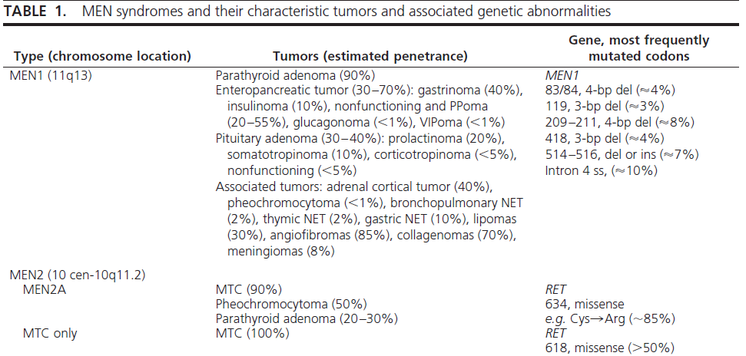

Slide 5
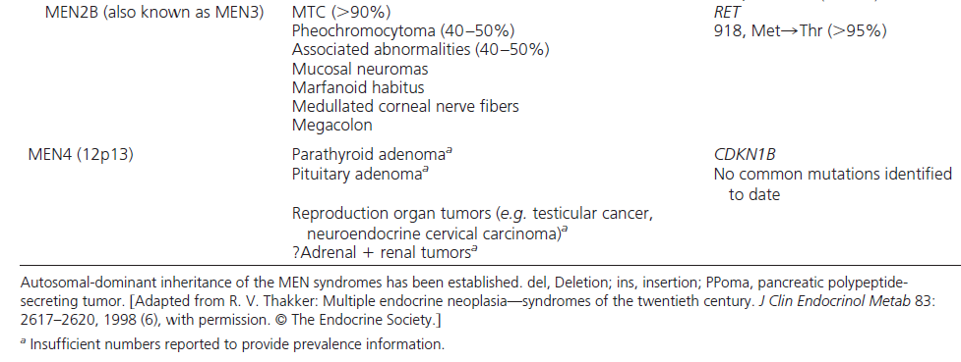
Continue table1

Slide 6
The disorder affects all age groups, with a reported age range of 5 to 81 yr .
MEN1 is inherited as an autosomal dominant disorder with a high degree of penetrance such that clinical and biochemical manifestations of the disorder will have developed in 80% and greater than 98% of MEN1 patients,respectively, by the fifth decade.
MEN1 is inherited as an autosomal-dominant disorder in such families, but a nonfamilial (i.e. sporadic) form may have developed in 8 to 14% of patients with MEN1, and molecular genetic studies have confirmed the occurrence of denovo mutations of theMEN1gene in approximately 10%
of all patients with MEN1

Slide 7
r1
Thus, untreated patients with MEN1 have a decreased life expectancy with a 50%probability of death by the age of 50 yr, and the cause of death in 50–70% of patients with MEN1 is usually a malignant tumor process or sequelae of the disease.
In particular, malignant pancreatic NET and thymic carcinoid tumors were associated with a marked increase in risk of death (hazard ratio,3; P0.005).

Slide 8
R2

Slide 9
Diagnosis
A diagnosis of MEN1 may be established in an individual by one of three criteria (Fig. 1)

Slide 10
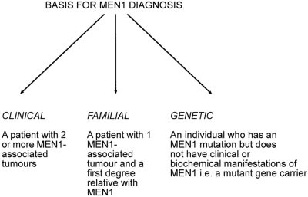
FIG. 1. Basis for a diagnosis of MEN1 in individuals. A diagnosis of
MEN1 based on clinical and familial criteria may be confounded by the
occurrence of phenocopies. [Reproduced from J. J. Turner et al.:
Diagnostic challenges due to phenocopies: lessons from multiple
endocrine neoplasia type 1 (MEN1). Hum Mutat 31:E1089–E1101,
2010 (90), with permission. © Wiley Periodicals Inc.]

Slide 11
r2

Slide 12
General recommendations
Patients with multiple endocrine neoplasia (MEN) type 1 (MEN1) and their families should be managed by a multidisciplinary team(MDT) consisting of relevant specialists with experience in the management of endocrine tumors (2|●●○○).
MDT representation should include specialist physicians (e.g. endocrinologist, gastroenterologist, and oncologist) in the management of neuroendocrine tumors (NET), endocrine surgeons, histopathologists (with expertise in NET), radiologists (including those with expertise in nuclear medicine), and clinical geneticists (2|●●○○).

Slide 13
Genetic testing r1
MEN1 germline mutation testing should be offered to:
index patients with MEN1and their first-degree relatives. This includes relatives who are either asymptomatic or who have clinical manifestations of MEN1(1|●●●○).
MEN1 germline mutation testing of asymptomatic relatives should be offered at the earliest opportunity because MEN1 manifestations may occur by the age of 5 yr(2|●●○○).

Slide 14
Genetic testing r1
MEN1 germline mutation testing may be recommended in individuals with an atypical MEN1 phenotype (e.g. multigland hyperparathyroidism) (2|●●○○).
All individuals offered MEN1 mutation testing should be provided with genetic counseling before testing(1|●●●●).
MEN1 germline mutation testing should be undertaken by a clinical genetics laboratory accredited in mutation analysis of the MEN1 gene (1|●●●●).

Slide 15
Genetic testing r1
If a coding region MEN1 mutation is not identified, then testing for partial or whole-gene deletion, or haplotype analysis of the MEN1 locus, or analysis of other genes should be considered (1|●●●○).
Relatives of a patient with a known MEN1 mutation should be offered MEN1 germline mutation analysis before biochemical and radiological screening tests for the detection of MEN1 tumors, so as to avoid the burden of undergoing multiple tests involving different modalities and to reduce financial costs (1|●●●○).

Slide 16
Genetic testing r1,r2
Individuals who are found to have a MEN1 germline mutation should be screened regularly (e.g. on an annual basis) for development of MEN1-associated tumors (1|●●●○).

Slide 17
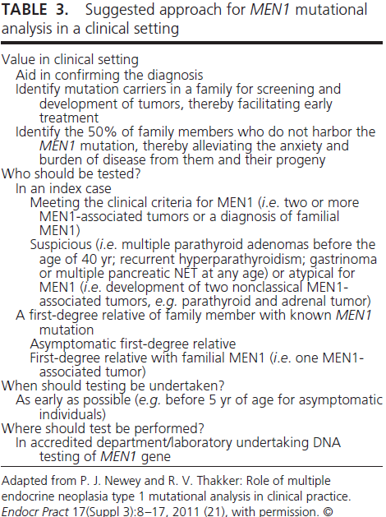

Slide 18
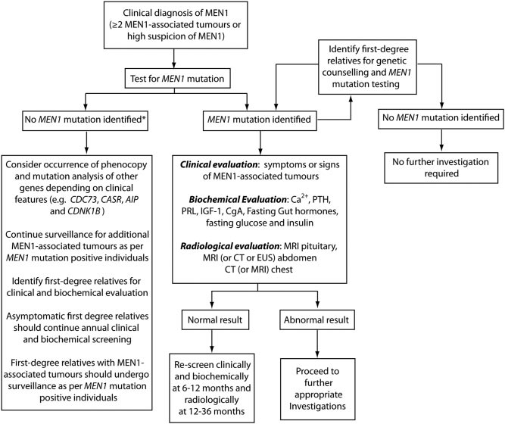
FIG. 2. An approach to screening in MEN1.

Slide 19
Screening for tumors r1
Individuals identified as having a high risk of developing MEN1-associated tumors [e.g. index cases (i.e.MEN1 patients) and their relatives who have been identified as having aMEN1mutation] should be offered a program of combined clinical, biochemical, and radiological screening as detailed below. The nature and timing of screening will depend on local resources, clinical judgment, and patient preferences (2|●●○○).

Slide 20
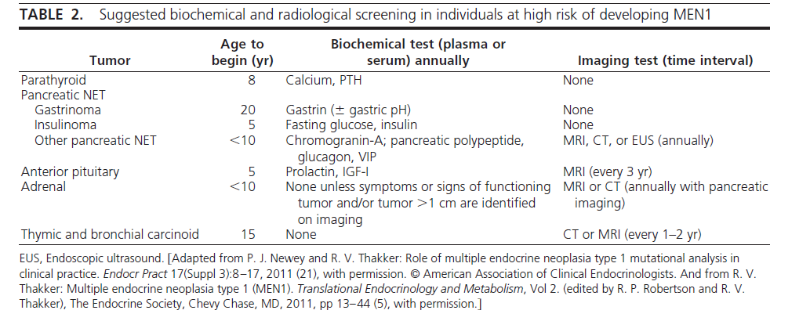

Slide 21
Parathyroid tumors Diagnosis r1
Screening for primary hyperparathyroidism should include annual assessment of plasma calcium and PTH concentrations (1|●●●●).

Slide 22
Parathyroid tumors Treatment r1
Surgery performed by an experienced endocrine surgeon is the treatment of choice, although the optimum timing has not been defined. Conventional open bilateral exploration with subtotal parathyroidectomy (at least 3.5 glands) or total parathyroidectomy is recommended(1|●●●○).
but it is controversial whether to perform subtotal (3.5 glands) or total parathyroidectomy.
Total parathyroidectomy may be reserved for those with extensive disease either at first or at repeat surgery.

Slide 23
r2
Early parathyroid surgery in MEN1 has been advocated by some,believing that HPT should always be treated as early as possible or that normalization of the serum calcium concentration might lead to a reduction of gastrin secretion and, possibly, lowered pancreatic islet cell growth or transformation,or both.

Slide 24
Parathyroid tumors Treatment
Concurrent transcervical thymectomy is also
suggested at the time of surgery (2|●●○○).
Total parathyroidectomy with autotransplantation may be considered (2|●●●○).
Minimally invasive parathyroidectomy is usually not recommended because multiple glands are typically affected (1|●●●○).

Slide 25
Pancreatic NET
Given that MEN1-associated pancreatic NET are frequently multiple and their behavior uncertain, their accurate diagnosis and management presents significant challenges.
For example,it cannot be assumed that tumor visualization on imaging studies correlates with the site of hormone excess in functioning tumor syndromes (e.g. gastrinoma, insulinoma).

Slide 26
Pancreatic NET r2
Rarely, pancreaticoduodenal neuroendocrine tumors occur in several members of a family without other features of MEN1; these tumors have been insulinomas or Glucagonomas.

Slide 27
Pancreatic NET Diagnosis
Screening for gastropancreatic NET should include, as a minimum, an annual plasma biochemical evaluation of a fasting gastrointestinal tract hormone profile that includes measurement of gastrin, glucagon, vasointestinal polypeptide, pancreatic polypeptide, chromogranin A, and insulin with an associated fasting glucose level (2|●●○○).

Slide 28
Pancreatic NET Diagnosis
A consensus for optimum radiological screening has not been established and will depend on local resources, clinical judgment, and patient preferences. A suggested minimum imaging protocol includes annual pancreatic and duodenal visualization with magnetic resonance imaging (MRI), computed tomography (CT), or endoscopic ultrasound (2|●●○○).

Slide 29
Gastrinoma diagnosis
The diagnosis is established by demonstration of an increased fasting serum gastrin concentration in association with increased basal gastric acid secretion (gastric pH, 2).
Ultrasonography, endoscopic ultrasonography, CT,MRI,selective abdominal angiography, or somatostatin-receptor scintigraphy are helpful in localizing the tumor .
The combined use of intraarterial calcium injections with hepatic venous gastrin sampling has been shown to regionalize the gastrinomas

Slide 30
Insulinoma diagnosis
The most reliable test is a supervised 72-h fast,during which increased plasma insulin concentration in association with hypoglycemia is demonstrated.
Elevated circulating C-peptide and proinsulin concentrations may establish the diagnosis . It also is important to exclude the presence of oral hypoglycemic agents (e.g. sulfonylureas) in plasma and urine samples obtained during hypoglycemia evaluation.
Preoperative localization with endoscopic ultrasonography, MRI,CTscanning, or celiac axis angiography, selective intraarterial stimulation with hepatic venous sampling, and intraoperative direct pancreatic ultrasonography is likely to improve the success rate of surgery

Slide 31
Nonfunctioning pancreatic NET diagnosis
Identification of nonfunctioning pancreatic NET is of particular clinical importance for the following reasons.
First, malignant pancreatic NET are now reported to be the commonest cause of death in individuals with MEN1.
Second, nonfunctioning tumors are increasingly recognized, with recent studies indicating that these tumors are the most common enteropancreatic NET associated with MEN1 and, furthermore, are associated with a worse prognosis than other functioning tumors including insulinoma and gastrinoma.

Slide 32
Nonfunctioning pancreatic NET diagnosis
Finally, the absence of both a clinical syndrome and specific biochemical abnormalities may result in delayed diagnosis of nonfunctioning pancreatic NET in the absence of radiological assessment.
comparison of imaging modalities for detection of pancreatic NET has demonstrated that endoscopic ultrasound is likely to represent the most sensitive method of detecting small pancreatic tumors, whereas somatostatin receptor scintigraphy is the most reliable method for detecting metastatic disease .

Slide 33
Other pancreatic NET
NET secreting GHRH, or GHRHomas, have been reported in some patients with MEN1, and approximately 33%of patients with GHRH omas will have other MEN1-related tumors . Surgical removal is the treatment of choice for these tumors.

Slide 34
Pancreatic NET Treatment
The main aim is to maintain patients disease- and symptom-free for as long as possible and to maintain a good quality of life (1|●●●●).
The aim of treatment for individuals with symptomatic functioning pancreatic NET including insulinoma is to achieve cure, if possible, by surgery (1●●●●).

Slide 35
Pancreatic NET Treatment(insulinoma)
Surgical treatment in insulinoma , which ranges from enucleation of a single tumor to distal pancreatectomy or partial pancreatectomy, or excision of all the macroscopic pancreatic tumors with enucleation of nodules in the remaining pancreas has been curative in many patients.
Chemotherapy consisting of streptozotocin,
5-flurouracil, and doxorubicin or hepatic artery embolization has been used for metastatic disease.

Slide 36
Pancreatic NET Treatment
The extent of disease should be evaluated fully before planning specific therapy (1|●●●○).
The optimal therapy of gastrinoma remains controversial. Surgery for a nonmetastasizing gastrinoma arising within the pancreas may be curative and should be considered, as long as it is performed by an experienced endocrine surgeon(2|●●○○).
Indeed, most centers undertake a nonsurgical management for gastrinomas in MEN1 unless pancreatic gastrinomas more than 2 cmin size are identified, in which case surgery is recommended.

Slide 37
Pancreatic NET Treatment
However, most MEN1 patients will have multiple small submucosal duodenal gastrinomas, and the management of such tumors remains controversial. We suggest medical management using proton-pump inhibitors for the majority of patients (2|●●○○).
However, in experienced surgical centers local excision of these tumors with lymph node dissection, duodenectomy, or less commonly duodenopancreatectomy may also be considered together with patient preferences, because such approaches may improve the cure rate (2|●●○○).

Slide 38
Pancreatic NET Treatment
Although Whipple pancreaticoduodenectomy provides the greatest likelihood of cure for gastrinoma in MEN1 patients, we do not suggest it for the majority of patients because it is associated with an increased operative mortality and long-term morbidity and because lesser operations in these patients are associated with excellent long-term survival (2|●●●○).
Medical therapies include proton-pump inhibitors and somatostatin analogs to suppress hyperacidity (1|●●●●).

Slide 39
Pancreatic NET Treatment
Treatment of disseminated gastrinomas
is difficult, and chemotherapy with streptozotocin and 5-fluorouracil; hormonal therapy with somatostatin analogs, octreotide or lanreotide; hepatic artery embolization;administration of human leukocyte interferon; and removal of all resectable tumor have been occasionally successful.

Slide 40
Pancreatic NET Treatment
Periodic gastroscopic surveillance is indicated in those with hypergastrinemia for the identification of peptic ulcer disease and gastric carcinoid (2|●●○○).
in the Glucagonomas and VIPomas,surgical removal is the treatment of choice.
The role of surgery for nonfunctioning pancreatic tumors is controversial. We suggest considering surgery for tumors that are more than 1 cm in size and/or demonstrate significant growth over 6–12 months (2|●●○○).
for tumors less than 1 cm in size, we suggest surgical resection for those that have significant growth, such as a doubling of tumor size, over a 3- to 6-month interval and exceed 1 cm in size.

Slide 41
r4
The surgical procedure generally consists of distal 80% subtotal pancreatic resection with the pancreas divided to the left of the portal vein, and enucleation of possible pancreatic head tumors.
Occasionally patients present with larger or multiple tumors, and more extensive procedures may be required,
and in cases with Zollinger–Ellison syndrome, excision of duodenal gastrinomas together with clearance of regional lymph node metastases.

Slide 42
Pancreatic NET Treatment
A histopathologist with expertise in NET should review all tumor tissues. Tumors should be classified according to the World Health Organization 2010 classification, Union for International Cancer Control TNM (7th edition), and the European Neuroendocrine Tumor Society site-specific T-staging system (1|●●●●).
Treatment of nonresectable tumor mass includes somatostatin analogs, biotherapy, targeted radionuclide therapy, locoregional treatments, and chemotherapy (1|●●●○).

Slide 43
Pancreatic NET Treatment
Chemotherapy may be used for inoperable or metastatic pancreatic NET (1|●●●○).
Sunitinib and everolimus may be considered for patients with advanced (inoperable or metastatic) progressive well-differentiated pancreatic NET (1|●●●○).

Slide 44
Pituitary tumors
pituitary adenomas have been reported to occur more frequently in women than men, and significantly more of these were macroadenomas, i.e. diameter greater than 1cm .Moreover, about one third of these
pituitary tumors showed at histology invasive features such as infiltration of tumor cells through surrounding normal juxtatumoral pituitary tissue.

Slide 45
Pituitary tumors Diagnosis
Biochemical screening for pituitary tumors, which will depend on clinical judgment and local resources, could include an annual assessment of plasma prolactin and IGF-I levels (2|●●●○),
as well as MRI of the pituitary every 3–5 yr (2|●●○○).
In patients with abnormal results, hypothalamic pituitary testing should be undertaken to characterize further the nature of the pituitary lesion and its effects on the secretion of other pituitary hormones (1|●●●○).

Slide 46
Pituitary tumors Treatment
Treatment of MEN1-associated pituitary tumors is similar to that for non-MEN1 pituitary tumors and consists of appropriate medical therapy (e.g. dopamine agonists for prolactinoma; octreotide or lanreotide for somatotrophinomas) or selective transsphenoidal surgical hypophysectomy, with radiotherapy reserved for residual unresectable tumor tissue (1|●●●●).

Slide 47
Thymic, bronchopulmonary, and gastric NET
Importantly, no hormonal or biochemical abnormality (e.g. plasma chromogranin A) is consistently observed in individuals with thymic or bronchial carcinoid tumors.
Thus, screening for these tumors is dependent on radiological imaging .
The optimum method for screening has not been established.
CT and MRI are reported to be sensitive at detecting thymic
and bronchial tumors, although with CT scanning there is
concern over the exposure to repeated doses of ionizing
radiation.
Octreotide scintigraphy may also reveal some thymic and bronchial carcinoids, although at present there is insufficient evidence to recommend its routine use.
Currently we suggest CT or MRI imaging every 1–2 yr
for the early detection of thymic and bronchial masses (Table
2)

Slide 48
Thymic, bronchopulmonary, and gastric NET Diagnosis
Biochemical evaluation with urinary
5-hydroxyindoleacetic acid and
chromogranin A is not helpful (1|●●●●).
CT or MRI of the chest every 1–2 yr is recommended for detection of thymic and bronchopulmonary carcinoid tumors (2|●○○○).

Slide 49
Thymic, bronchopulmonary, and gastric NET Diagnosis
Gastroscopic examination (with biopsy) every 3 yr in those with hypergastrinemia for detection of peptic ulcer disease and gastric carcinoid type II is recommende (2|●●○○).
Endoscopic ultrasound and somatostatin receptor scintigraphy may aid the diagnosis (1|●●●●).

Slide 50
Thymic, bronchopulmonary, and gastric NET Treatment
Curative surgery, where possible, is the treatment of choice for thymic and bronchial carcinoid tumors (1|●●●●).
Where disease is advanced and curative surgery is not possible, additional therapies include radiotherapy and chemotherapy (e.g. cisplatin, etoposide) (2|●○○○).
In addition, somatostatin analogs, such as octreotide or lanreotide, have resulted in improvements in symptoms and regression of some tumors.

Slide 51
Thymic, bronchopulmonary, and gastric NET
The optimal treatment of type II gastric carcinoids has not been established. Small (10 mm) lesions may remain under endoscopic surveillance. Larger tumors require endoscopic resection or local resection with partial or total gastrectomy. Indications for somatostatin analogs in the treatment of type II gastric carcinoids are not defined (2|●●○○).

Slide 52
Adrenal tumors Diagnosis
Minimal screening should comprise abdominal imaging by CT or MRI every 3 yr (2|●●○○).
Adrenal lesions should remain under radiological surveillance and should be assessed for malignant features (1|●●●○).
Images should be reviewed by a radiologist with expertise in adrenal imaging (1|●●●○).

Slide 53
Adrenal tumors Diagnosis
Biochemical evaluation of adrenal lesions should be restricted to those with clinical features or tumors more than 1cm in size and should focus on assessment for primary hyperaldosteronism and primary hypercortisolemia (1|●●●○).
Biochemical investigation (e.g. plasma renin and aldosterone concentrations, low-dose dexamethasone suppression test, urinary catecholamines and/or metanephrines) should be under taken for those with symptoms or signs suggestive of functioning adrenal tumors, or for those with tumors larger than 1 cm.

Slide 54
Adrenal tumors
The incidence of adrenocortical carcinoma is reported to be approximately 1% in MEN1 patients but increases to approximately 13% in MEN1 patients with adrenal tumors larger than 1 cm .
Thus, it is important that MEN1 patients with adrenal tumors are offered an annual imaging screen, and tumors that display atypical radiological characteristics (e.g.
increased Hounsfield unit on unenhanced CT scan), significant growth, or are larger than 4 cm are considered for surgical removal.

Slide 55
Adrenal tumors Treatment
Treatment of MEN1-associated adrenal tumors is similar to that for non-MEN1 adrenal tumors. Surgery is indicated for functioning tumors (e.g. primary hyperaldosteronism or hypercortisolism),
and nonfunctioning tumors with atypical features(1-4 cm in diameter), size greater than 4 cm, or significant growth over a 6-month interval (1|●●●○).

Slide 56
Meningioma
Central nervous system tumors including ependymomas,schwannomas, and meningiomas have been reported in MEN1 patients.
The treatment of MEN1-associated meningiomas is similar to that occurring in non-MEN1 patients.

Slide 57
Cutaneous manifestations of MEN1
Lipomas:visceral, pleural, or retroperitoneal lipomas may occur in patients with MEN1, and are frequently multiple.
Management is conservative. However, when surgically removed for cosmetic reasons, they typically do not recur.
Facial angiofibromas and collagenomas:These cutaneous findings, which occur with a higher frequency in patients with MEN1, may provide a useful means for possible presymptomatic diagnosis of MEN1 in the relatives of a patient with MEN1.Treatment for these cutaneous lesions is usually not required.

Slide 58
Thyroid tumors
However, the prevalence of thyroid disorders in the general population is high, and it has been suggested that the association of thyroid abnormalities in patients with MEN1 may be incidental and not significant.
The treatment of thyroid tumors in MEN1 patients is similar to that for non-MEN1 patients.

Slide 60
Management of Parathyroid Tumors
Surgery is the treatment of choice for HPT in MEN1, although the timing and the type of operation remain variable.
Parathyroid surgery is definitely indicated
in an MEN1 patient with a moderately elevated PTH and other moderately advanced features of HPT, such as
an albumin-adjusted serum calcium level higher than 3.0 mmol/L (12.0 mg/dL), kidney stones, or PTH-induced bone disease.

Slide 61
Treatment of Pancreaticoduodenal Neuroendocrine Tumors. R2
Is Tumor Size Important?
Metastasis has been associated with gastrinomas more than 3 cm in diameter. This association has led some to recommend resection for all pancreaticoduodenal tumors larger than 2.5 cm.
Another analysis of this strategy suggested a failure to prevent later emergence of hepatic metastases. Some others have not found a relation of tumor size and metastasis and do not use a size criterion for surgery.

Slide 62
R2
Should All Pancreaticoduodenal Neuroendocrine Tumors in MEN1 Be Removed?
There is no consensus on this point. In MEN1, for every identifiable pancreatic tumor there are likely to be several smaller unidentified tumors that coexist or emerge at a later date.
Improvements in pancreatic surgical technique, however, have made it possible to excise smaller lesions surgically, although the benefit from doing this is less clear.
Certainly there is no compelling evidence to suggest that surgical removal of small tumors, unless they produce a hormonal syndrome, improves overall outcome.
Some urge removal of all detectable macroadenomas if removal would not be dangerous. Others urge a large size cutoff (2.5-3 cm in diameter) for removal.

Slide 63
R2
Should Metastatic Pancreaticoduodenal Cancer Be Debulked?
Total pancreatectomy with a high rate of complications has been used for very large tumors.
Many methods are under exploration for resecting or otherwise palliating pancreaticoduodenal neuroendocrine cancer. Results are too preliminary to justify endorsing any of these.

Slide 64
R2
Should Medications Be Used to Control Tumor Progression?
Pancreaticoduodenal neuroendocrine tumors are usually well differentiated and quite resistant to chemotherapy.
Several regimens have been tried including streptozotocin,
doxorubicin, and interferon, but there is no proof of long-term efficacy.
Octreotide has been effective in inhibiting hormone secretion by benign and malignant pancreaticoduodenal neuroendocrine tumors; however,it has not been effective by itself in blocking growth of these tumors except to a small degree for malignant gastrinoma.
Lanreotide, another somatostatin analogue, prolonged the interval to tumor progression in metastatic enteropancreatic neuroendocrine tumors, particularly in pancreatic islet cancers.
Inhibitors of mammalian target of rapamycin (mTOR) or tyrosine kinase give benefit in sporadic advanced islet neoplasia.The preceding trials have focused on the more common sporadic neuroendocrine tumors, and generally excluded MEN1.
Multidrug regimens need further evaluation.

Slide 65
R2
Somatostatin Analogue Linked to a Radioisotope.
Because of their selectivity for certain tumors, somatostatin analogues have been explored as vehicles to deliver a toxic radioactive isotope to that tumor.
The best results seem to be from
lutetium-177 bound to octreotate.However, controlled studies have not yet been done. These drugs are currently under investigation in the United States.

Slide 66
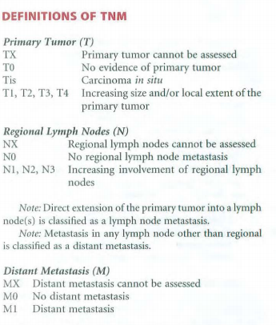
World Health Organization 2010 classification, Union for International Cancer Control TNM (7th edition)

