Slide 1


Slide 2









What’s New ?

Slide 3
Section 1. Improving Care and Promoting Health in Populations
● Section was renamed
● New recommendation : using reliable data metrics
● Discussion on the social determinants of health
● Telemedicine role in diabetes care

Slide 4
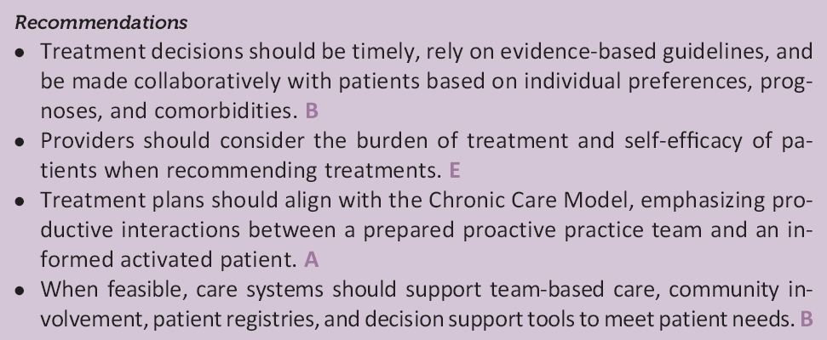
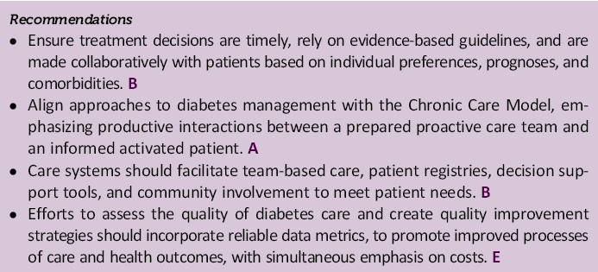
Section 1. Improving Care and Promoting Health in Populations
This section was renamed to better capture its subject matter and was reorganized for clarity.
2017
2018
Promoting Health and Reducing
Disparities in Populations
Improving Care and Promoting
Health in Populations
A new recommendation was added about using reliable data metrics to assess and improve the quality of diabetes care and reduce costs.
2017
2018

Slide 5

Section 1. Improving Care and Promoting Health in Populations
● Critical to these efforts* is provider adherence to clinical practice recommendations and accurate,
reliable data metrics that include sociodemographic variables to examine health equity within and
across populations **
* integrate traditional disease-specific metrics with measures of patient experience, as well as cost, in assessing the quality of diabetes care
* * Centers for Medicare & Medicaid Services. CMS Equity Plan for Medicare [Internet]. Available from https://www.cms.gov/About-CMS/Agency- Information/OMH/equity-initiatives/equity-plan .html. Accessed 26 September 2017

Slide 6
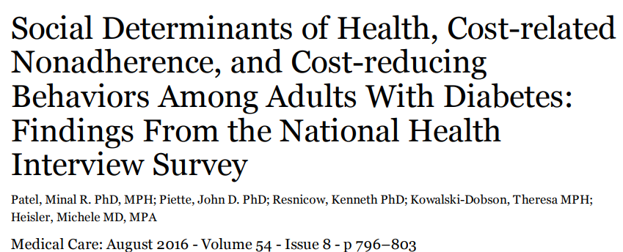
Section 1. Improving Care and Promoting Health in Populations
Additional discussion was included on the social determinants of health.
● Social determinants of health are defined as the economic, environmental, political, and social conditions in which people live and are responsible for a major part of health inequality worldwide.

Slide 7
Cost-related non-adherence (CRN) is prevalent among individuals with diabetes and can have significant negative health consequences.
Data from the 2013 wave of National Health Interview Survey (n=34,557 )
( ≥ 18 year-old ) (weighted response rate of 81.7%)
11% (n=4,158) of adults reported diabetes
CRN
DM : 14 % Non DM : 7 %
Associated with a greater likelihood of CRN
Financial stress (Prevalence Ratio (PR)=1.07 [95% CI: 1.05 to 1.09])
Financial insecurity with healthcare (PR=1.6 [95% CI: 1.5 to 1.67])
Food insecurity (PR=1.30 [95% CI: 1.2 to 1.4])
Asking the doctor for a lower cost medication was associated with a lower likelihood of CRN (PR=0.2 [95% CI: 0.2 to 0.3]),
and 27% with CRN reported this.
Other cost-reducing behavioral strategies (using alternative therapies, buying prescriptions overseas) were associated with a greater likelihood of CRN.
The NHIS is a cross-sectional household interview survey : comprise 90,000 individuals from 35,000 families each year.

Slide 8
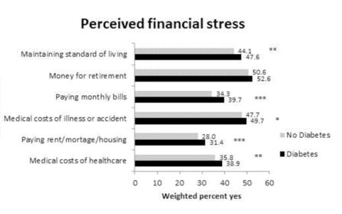
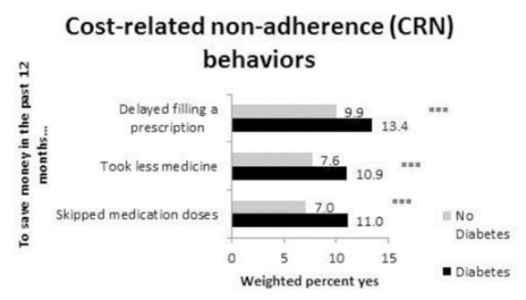
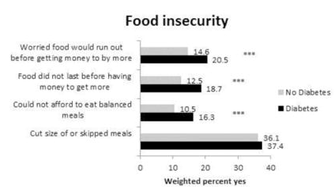
Compared to those without diabetes, a higher proportion of adults with diabetes endorsed various forms of financial insecurity with healthcare, perceived financial stress, food insecurity, and CRN, except 2 items where no group differences were observed: worried about saving for retirement, and cutting back on meals due to lack of money

Slide 9
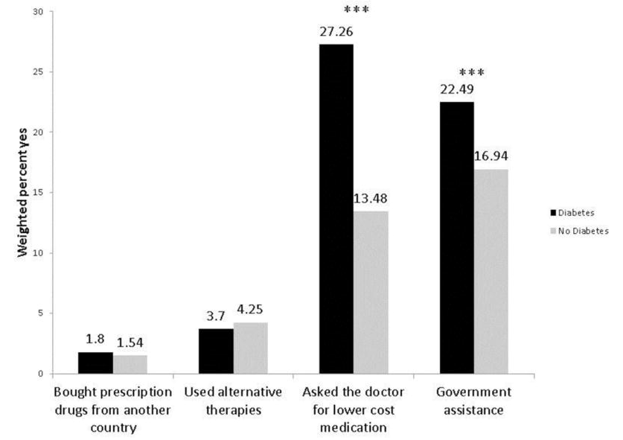
The diabetes group reported more individuals who asked their doctor for a lower cost medication (27% vs. 13.5%, p<0.001) and used government assistance programs (22% vs. 17%, p<0.001) compared to those without diabetes

Slide 10
Conclusions
Half of adults with diabetes perceived financial stress, and one-fifth reported financial insecurity with healthcare and food insecurity.
Talking to a health care provider about low-cost options may be protective against CRN in some situations.
Improving screening and communication to identify CRN and increase transparency of low-cost options patients are pursuing may help safeguard from the health consequences of cutting back on treatment.

Slide 11
Section 1. Improving Care and Promoting Health in Populations
Text was added describing the emerging use of telemedicine in diabetes care.
● For rural populations or those with limited physical access to health care, telemedicine is an approach with a growing body of evidence for its effectiveness, particularly with regards to glycemic control as measured by A1C.
● Telemedicine is defined as the use of telecommunications to facilitate remote delivery of health related services and clinical information .
● Interactive strategies that facilitate communication between providers and patients, including the use of web-based portal or text messaging and those that incorporate medication adjustment appear more effective.
● There is limited data available on the cost-effectiveness of these strategies.

Slide 12
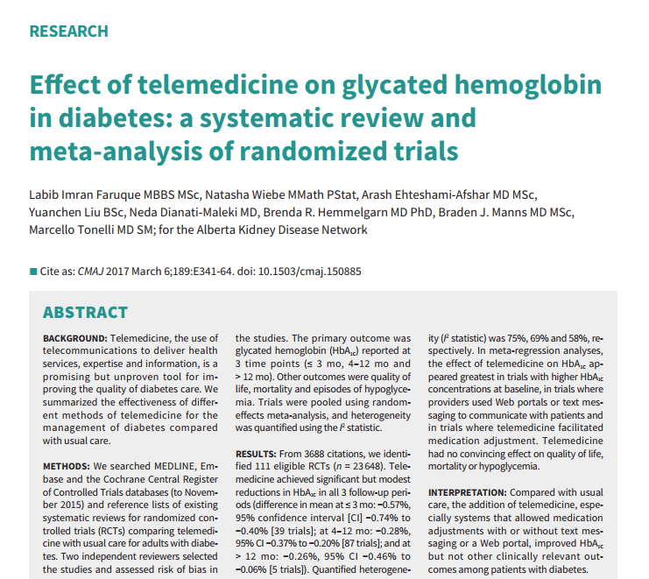
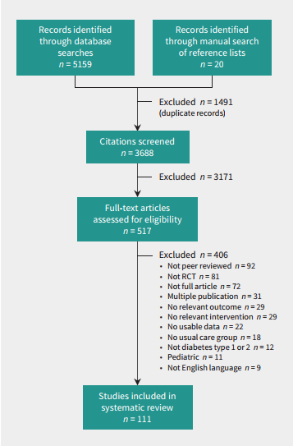

Slide 13
● Meta analysis
● Searched the following electronic databases : MEDLINE (1946–November 2015)
Embase (1974– November 2015)
Cochrane Central Register of Controlled Trials (November 2015)
From 3688 citations, we identified 111 eligible RCTs (n = 23 648)
Primary outcome : HbA1C
Secondary outcomes : Quality of life
Mortality
Incidence of hypoglycemia
time points : ≤ 3 mo, 4–12 mo and > 12 mo
In meta-regression analyses, the effect of telemedicine on HbA1C appeared greatest in trials with higher HbA1C concentrations at baseline, in trials where providers used Web portals or text messaging to communicate with patients and in trials where telemedicine facilitated medication adjustment.

Slide 14
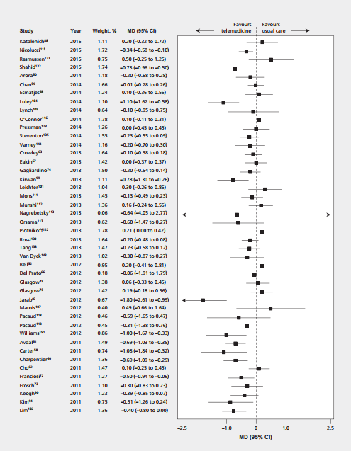
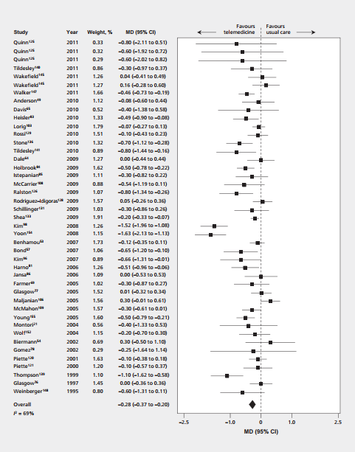
Telemedicine
Usual Care
Telemedicine
Usual Care

Slide 15
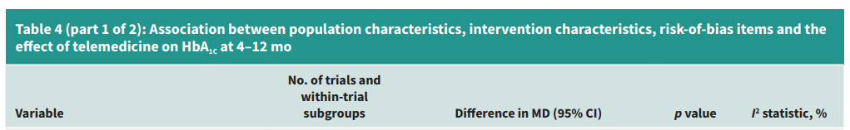
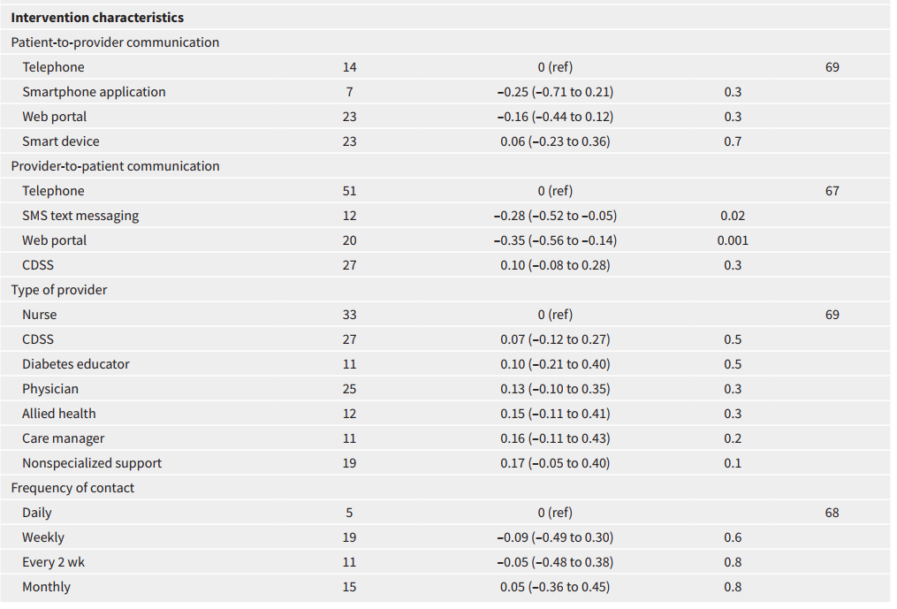
Telemedicine had no convincing effect on quality of life, mortality or hypoglycemia

Slide 16
Conclusion
● Telemedicine may be a useful supplement to usual clinical care to control HbA1C, at least in the short term
● Telemedicine interventions appeared to be most effective when they use a more interactive format, such as a Web portal or text messaging, to help patients with self-management

Slide 17
Section 2. Classification and Diagnosis of Diabetes
● Additional recommendations : A1C limitations
Hemoglobin variants
Assay interference
RBC turnover,…
● The recommendation for prediabetes and type 2 diabetes testing in children and adolescents modified
● Consideration of the community screening in specific situations
● Additional detail on Antihyperglycemic treatment in people with post transplantation diabetes mellitus

Slide 18
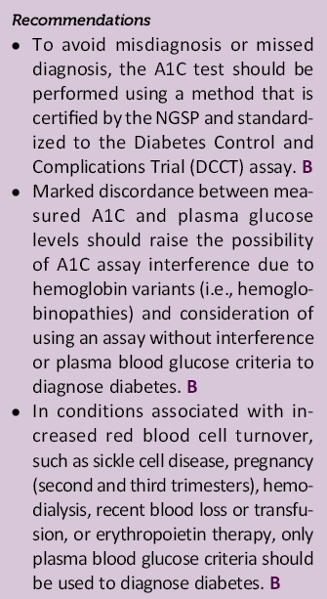
Section 2. Classification and Diagnosis of Diabetes
2018 (New recommendations)
Limitations in A1C
As a result of recent evidence describing potential limitations in A1C measurements due to
  hemoglobin variants,
  Assay interference,
  and conditions associated with red blood cell turnover,
Additional recommendations were added to clarify the appropriate use of the A1C test generally
and in the diagnosis of diabetes in these special cases.
DCCT :1982-1993
NGSP (National Glycohemoglobin Standardization Program) : From 1996

Slide 19
Section 2. Classification and Diagnosis of Diabetes
Hb A1C
● Using a method that is certified by the NGSP and standardized to the DCCT assay
● Discordance between A1C and plasma glucose → using an assay without interference or plasma blood glucose
● Only plasma blood glucose criteria should be used
Sickle cell disease
Pregnancy (second and third trimesters)
Hemodialysis
Recent blood loss or transfusion
Erythropoietin therapy
>> X-linked glucose-6-phosphate dehydrogenase G202A, carried by 11% of African Americans was associated with a decrease in A1C of about 0.8% in hemizygous men and 0.7% in homozygous women compared with those without the variant.
For patients with a hemoglobin variant but normal red blood cell turnover, such as those with the sickle cell trait, an A1C assay without interference from hemoglobin variants should be used.
www.ngsp.org/interf.asp.

Slide 20
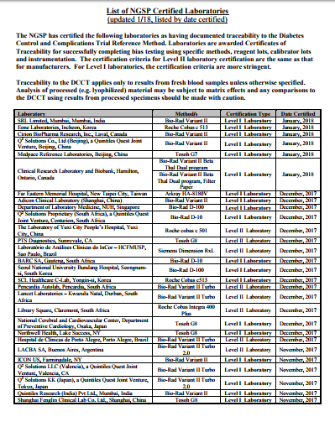

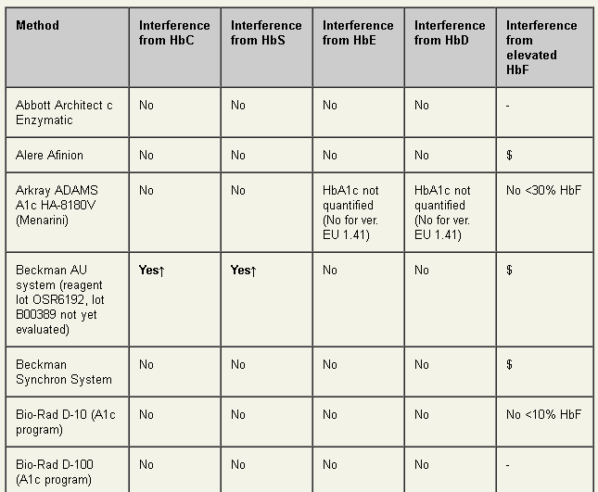
Section 2. Classification and Diagnosis of Diabetes

Slide 21
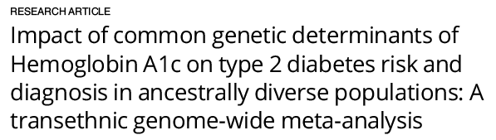

Background
Previous genome-wide association studies (GWAS) have identified 18 HbA1c-associated genetic variants.
In this study, we tested the hypotheses that, in a very large scale GWAS, we would identify more genetic variants associated with HbA1c and that HbA1c variants implicated in erythrocytic biology would affect
the diagnostic accuracy of HbA1c

Slide 22
Methods & findings
Using genome-wide association meta-analyses in up to 159,940 individuals from 82 cohorts
of European, African, East Asian, and South Asian ancestry, we identified 60 common genetic
variants associated with HbA1c (42 new variants).
We classified variants as implicated in glycemic, erythrocytic, or unclassified biology and tested whether additive genetic scores of erythrocytic variants (GS-E) or glycemic variants (GS-G) were associated with higher T2D incidence in multiethnic longitudinal cohorts (N = 33,241).
GS-G was associated with higher T2D risk (incidence OR = 1.05, 95% CI 1.04±1.06, per HbA1c-raising allele, p = 3 ×10⁻²⁹); whereas GS-E was not (OR = 1.00, 95% CI 0.99±1.01, p = 0.60).
In Europeans and Asians, erythrocytic variants in aggregate had only modest effects on the diagnostic accuracy of HbA1c.
In African Americans, the X-linked G6PD G202A variant (T-allele frequency 11%) was associated with an absolute decrease in HbA1c of 0.81%-units (95% CI 0.66±0.96) per allele in hemizygous men, and 0.68%-units (95% CI 0.38±0.97) in homozygous women.

Slide 23
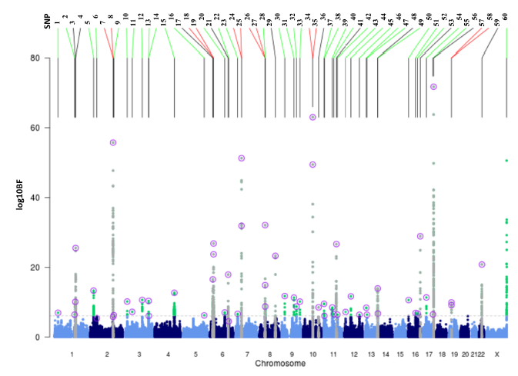

Slide 24
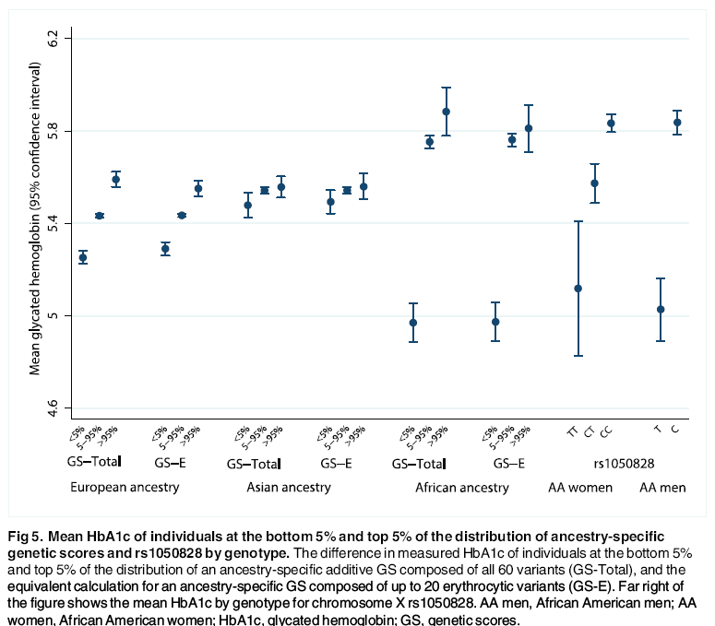

Slide 25
Conclusions
As G6PD deficiency can be clinically silent until illness strikes, we recommend investigation of
the possible benefits of screening for the G6PD genotype along with using HbA1c to diagnose
T2D in populations of African ancestry or groups where G6PD deficiency is common.
Screening with direct glucose measurements, or genetically-informed HbA1c diagnostic thresholds in people with G6PD deficiency, may be required to avoid missed or delayed diagnoses.
We estimated that if we tested all Americans for diabetes using HbA1c, about 650,000 African Americans would be missed because of these genetically lowered HbA1c levels.

Slide 26
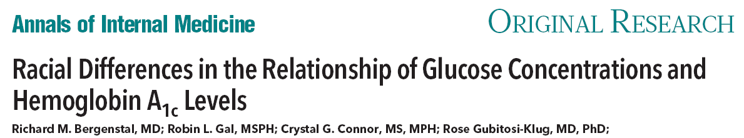
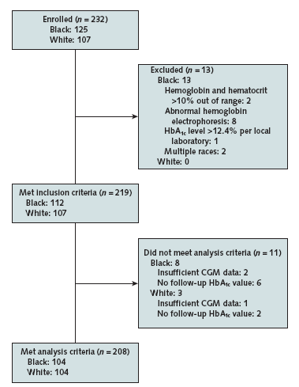
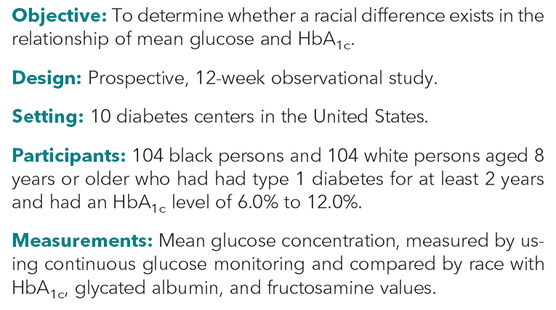
Glucose concentrations were measured for up to 12 weeks by using an investigational version of Abbott Diabetes Care's Freestyle Libre Pro Flash Glucose Monitoring system.

Slide 27
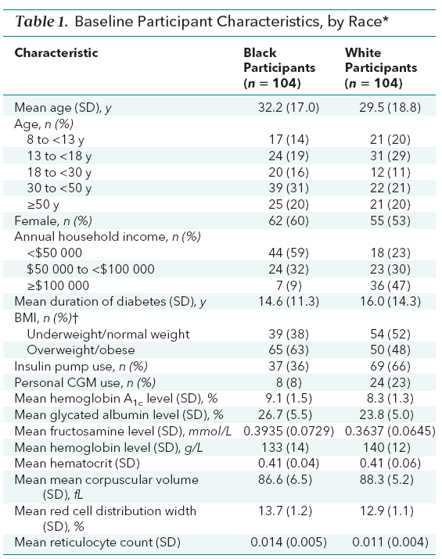
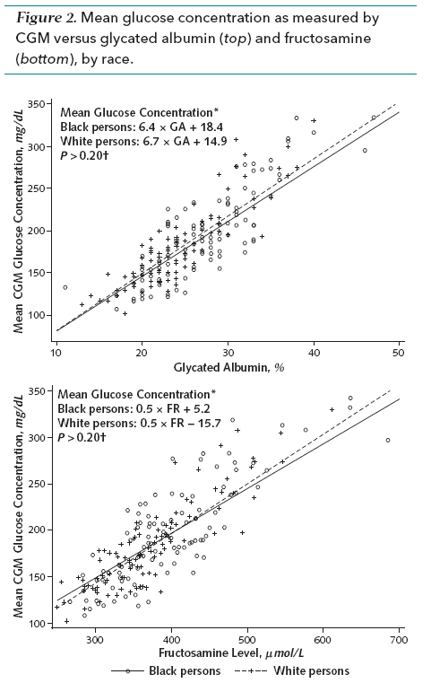

Slide 28
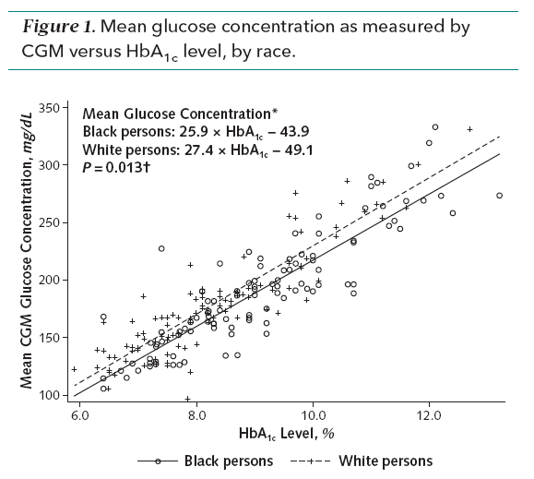
For a given HbA1c level, the mean glucose concentration was significantly lower in black persons than in white persons (P = 0.013), which was reflected in mean HbA1c values in black persons being 0.4 percentage points (95% CI, 0.2 to 0.6 percentage points) higher than those in white persons for a given mean glucose concentration
Conclusion
On average, HbA1c levels overestimate the mean glucose concentration in black persons compared with white persons, possibly owing to racial differences in the glycation of hemoglobin.

Slide 29
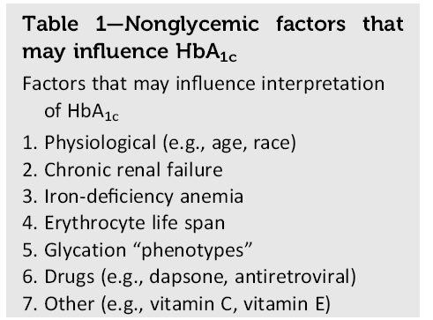

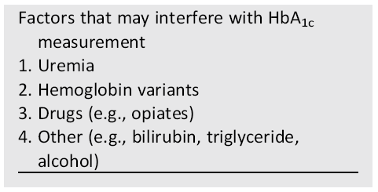

Slide 30
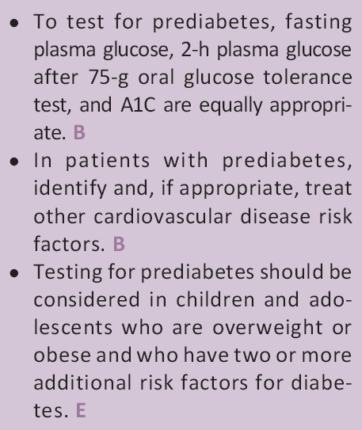
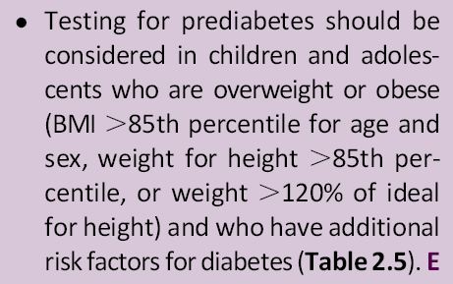
Section 2. Classification and Diagnosis of Diabetes
The recommendation for testing for prediabetes and type 2 diabetes in children and adolescents was changed, suggesting testing for youth who are overweight or obese and have one or more additional risk factors (Table 2.5)
2017
2018 (Recommendation changed)

Slide 31
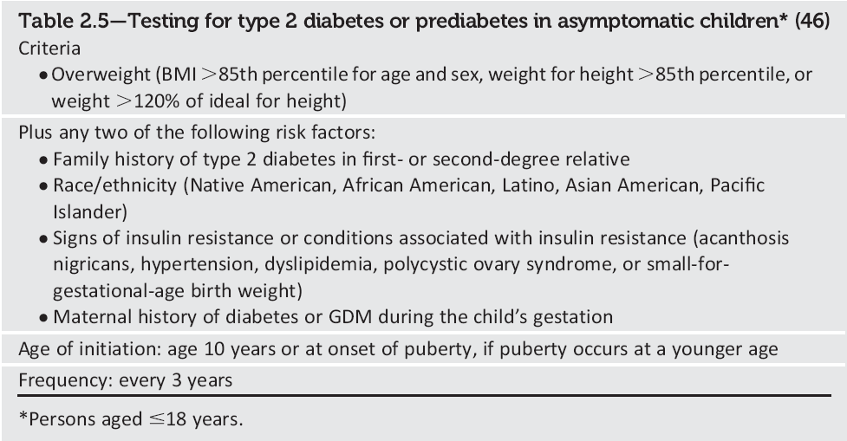
Section 2. Classification and Diagnosis of Diabetes
2017

Slide 32
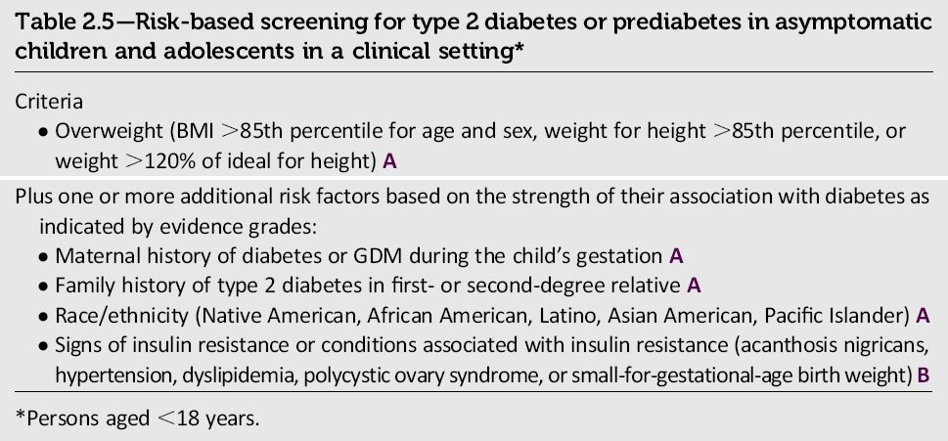
Section 2. Classification and Diagnosis of Diabetes
2018

Slide 33


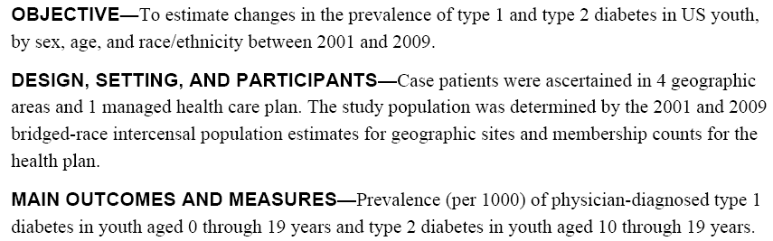

Slide 34
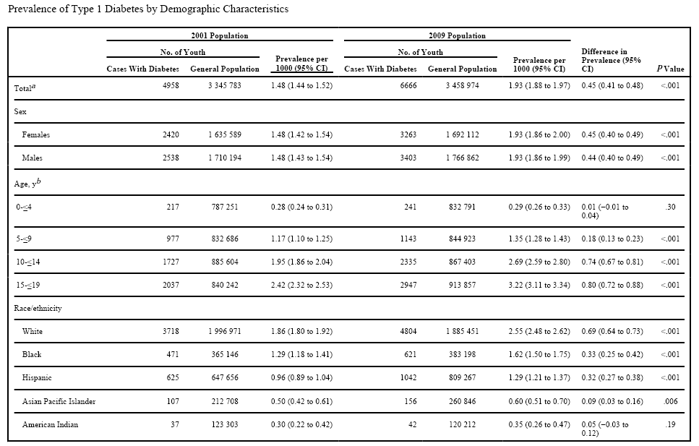
MAX

Slide 35
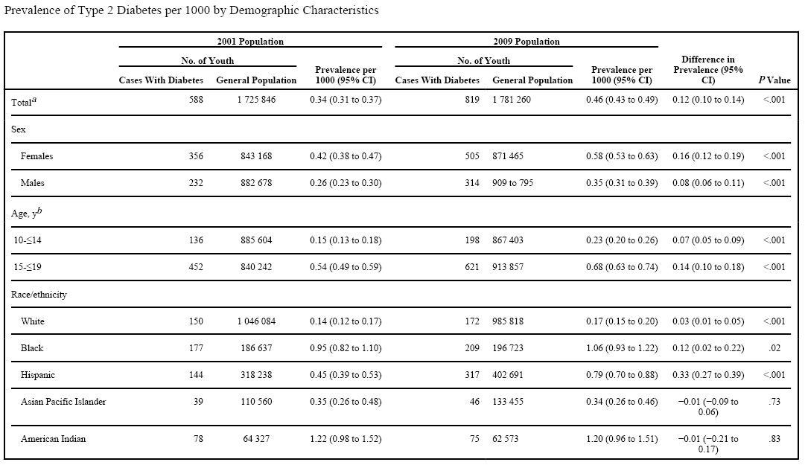

Slide 36
Adjusted for completeness of ascertainment, there was a 21.1% (95% CI, 15.6%–27.0%) increase in type 1 diabetes over 8 years.
Adjusted for completeness of ascertainment, there was a 30.5% (95% CI, 17.3%–45.1%) overall increase in type 2 diabetes.
CONCLUSIONS
Between 2001 and 2009 in 5 areas of the United States, the prevalence of both type 1 and type 2 diabetes among children and adolescents increased.
Further studies are required to determine the causes of these increases.

Slide 37

Participants : age 2-<18 years and ≥ 1 year duration of T1D enrolled in the
        T1D Exchange (n = 11,435) and
        Diabetes Prospective Follow-up (n = 21,501)
        Total (n=32,936)
        September 2010 to August 2012
WHO and national BMI references were used to calculate BMIz

Slide 38
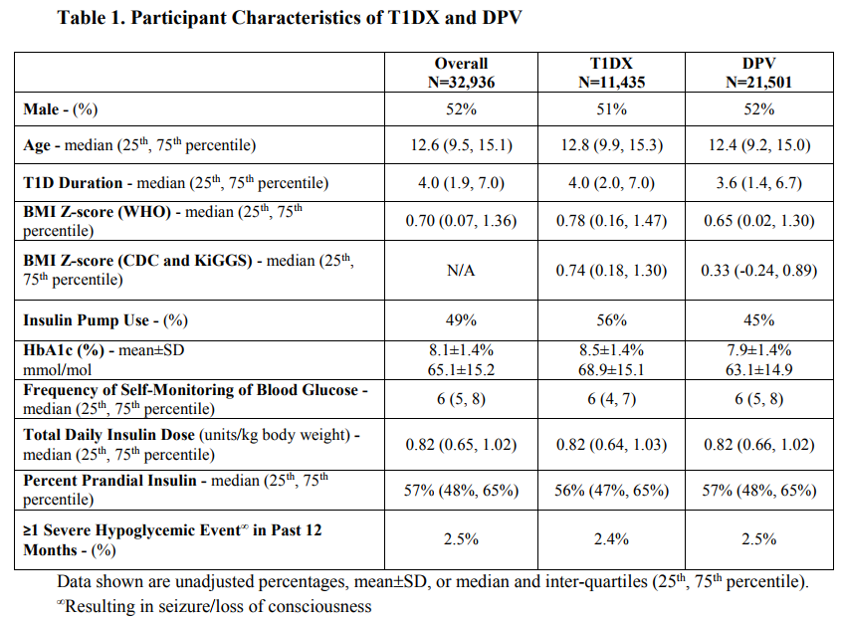

Slide 39

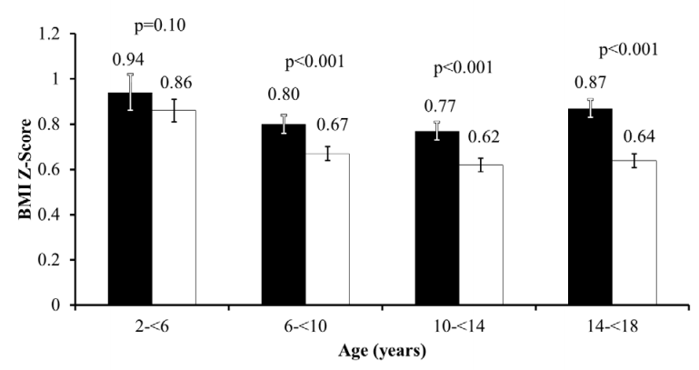
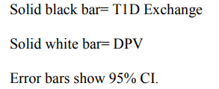
Participants in both registries had median BMI values that were greater than international and their respective national reference values. BMIz was significantly greater in the T1D Exchange vs the Diabetes Prospective Follow-up (P < .001). After stratification by age-group, no differences in BMI between registries existed for children 2-5 years, but differences were confirmed for 6- to 9-, 10- to 13-, and 14- to 17-year age groups (all P < .001).

Slide 40
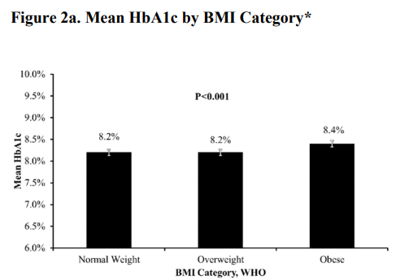
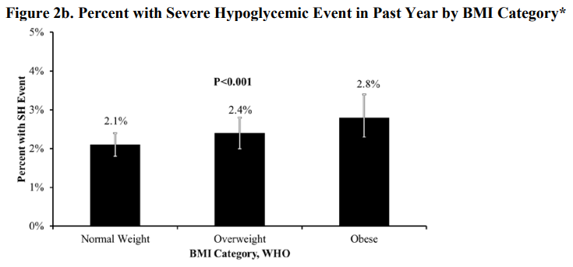
Greater BMIz were significantly related to greater HbA1c levels and more frequent occurrence of severe hypoglycemia across the registries, although these associations may not be clinically relevant.
CONCLUSIONS:
Excessive weight is a common problem in children with T1D in Germany and Austria and, especially, in the US.
Our data suggest that obesity contributes to the challenges in achieving optimal glycemic control in children and adolescents with T1D.

Slide 41
Section 2. Classification and Diagnosis of Diabetes
A clarification was added that, while generally not recommended, community screening may be considered in specific situations where an adequate referral system for positive tests is established.
2018
Community screening outside a health care setting is generally not recommended because people with positive tests may not seek, or have access to, appropriate follow-up testing and care. However, in specific situations where an adequate referral system is established beforehand for positive tests, community screening may be considered.
Community testing may also be poorly targeted; i.e., it may fail to reach the groups most at risk and inappropriately test those at very low risk or even those who have already been diagnosed
Tabaei BP, Burke R, Constance A, et al. Community-based screening for diabetes in Michigan. Diabetes Care 2003;26:668–670

Slide 42
Section 2. Classification and Diagnosis of Diabetes
Additional detail was added regarding current research on antihyperglycemic treatment in people with post transplantation diabetes mellitus.
2017
Although the use of immunosuppressive therapies is a major contributor to the development of PTDM, the risks of transplant rejection outweigh the risks of
PTDM and the role of the diabetes care provider is to treat hyperglycemia appropriately regardless of the type of immunosuppression
Sharif A, Hecking M, de Vries APJ, et al. Proceedings froman international consensus meeting on posttransplantation diabetes mellitus: recommendations and future directions. Am J Transplant 2014;14:1992–2000

Slide 43
Section 2. Classification and Diagnosis of Diabetes
Post transplantation DM management (2018)
● Few randomized controlled studies have reported on the short- and long term use of antihyperglycemic agents in the setting of PTDM.
● Most studies have reported that transplant patients with hyperglycemia and PTDM after transplantation have higher rates of rejection, infection, and rehospitalization.
● Insulin therapy is the agent of choice for the management of hyperglycemia and diabetes in the hospital setting. After discharge, patients with preexisting diabetes could go back on their pre transplant regimen if they were in good control before transplantation.
● Those with previously poor control or with persistent hyperglycemia should continue insulin with frequent home self-monitoring of blood glucose to determine when insulin dose reductions may be needed and when it may be appropriate to switch to noninsulin agents.

Slide 44
Section 2. Classification and Diagnosis of Diabetes
Post transplantation DM treatment (2018)
● No studies to date have established which noninsulin agents are safest or most efficacious in PTDM. The choice of agent is usually made based on the side effect profile of the medication and possible interactions with the patient’s immunosuppression regimen.
● Drug dose adjustments may be required because of decreases in the glomerular filtration rate, a relatively common complication in transplant patients.
● A small short-term pilot study reported that metformin was safe to use in renal transplant recipients , but its safety has not been determined in other types of organ transplant.
● Thiazolidinediones have been used successfully in patients with liver and kidney transplants, but side effects include fluid retention, heart failure, and osteopenia.

Slide 45
Section 2. Classification and Diagnosis of Diabetes
Post transplantation DM treatment (2018)
● Dipeptidyl peptidase 4 inhibitors do not interact with immunosuppressant drugs and have demonstrated safety in small clinical trials.
● Well-designed intervention trials examining the efficacy and safety of these and other antihyperglycemic agents in patients with PTDM are needed.

Slide 46


METHODS
PubMed search with the following key words:
“new-onset diabetes after transplantation” / “NODAT” or
“post transplantation diabetes” / “PTDM”
Study questions:
>> what is the efficacy of various available therapies for hyperglycemia management in PTDM
>> what is known about the safety of available glucose-lowering agents in this population?
Inclusion criteria : adult subjects (>18 years of age), diagnosis of NODAT and use of glucose-lowering therapy.
Exclusion criteria :children (<18 years of age), patients with known pre transplant diabetes, and studies not addressing glucose-lowering agents.
Articles number(n = 25)

Slide 47
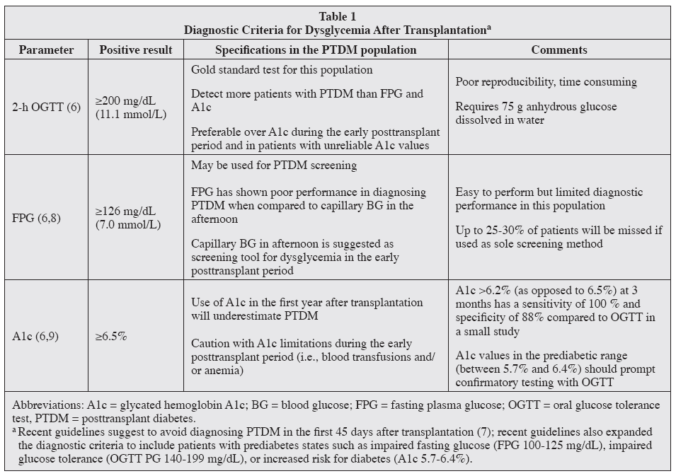

Slide 48
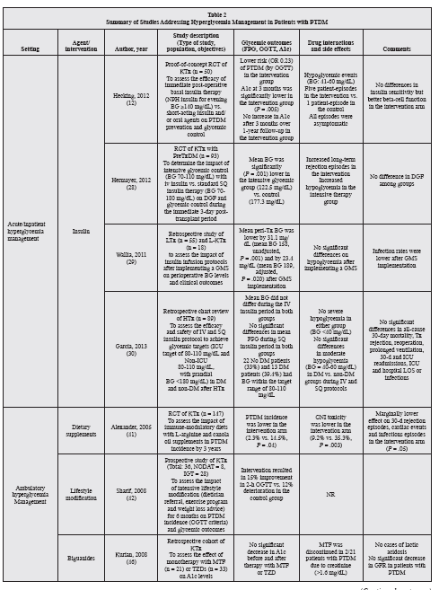
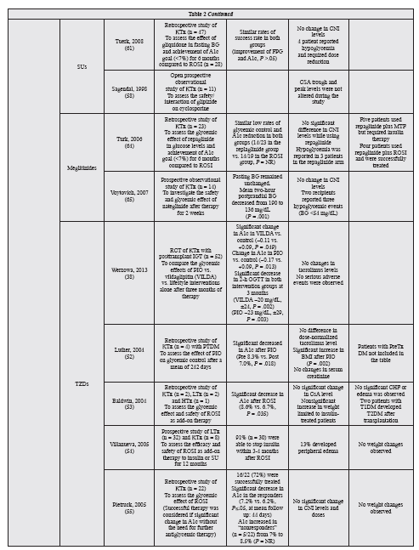

Slide 49
Results:
● Most of the 25 publications eligible for review were retrospective studies.
● Insulin therapy during the early post transplantation period showed promise in preventing PTDM development.
● Thiazolidinediones have been mostly shown to exert glycemic control in retrospective studies, at the expense of weight gain and fluid retention.
● Evidence with metformin, sulfonylureas, and meglitinides is very limited.
● Incretins have shown promising results in small prospective studies using sitagliptin, linaglitpin, and vildagliptin and a case series using liraglutide.

Slide 50
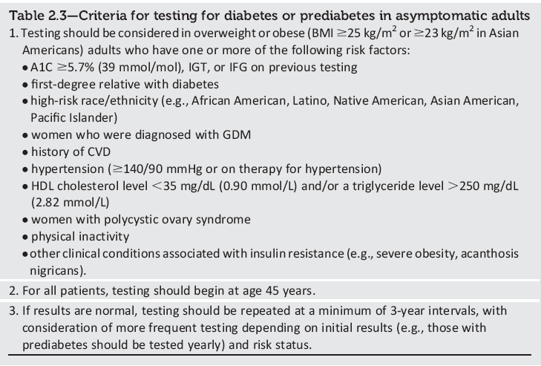
Section 2. Classification and Diagnosis of Diabetes
2017

Slide 51
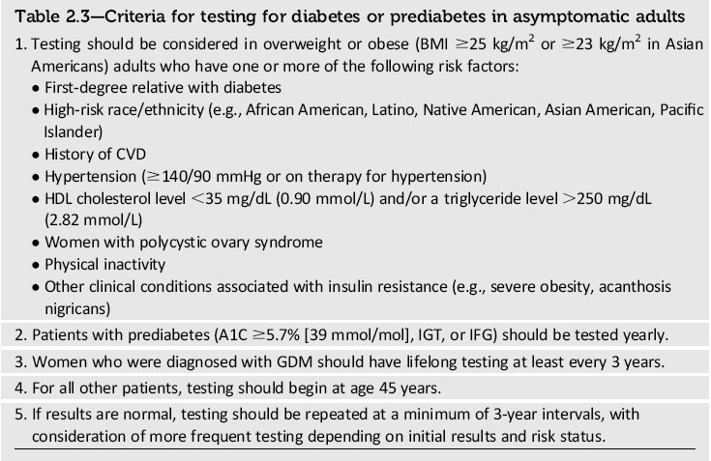
Section 2. Classification and Diagnosis of Diabetes
2018

Slide 52
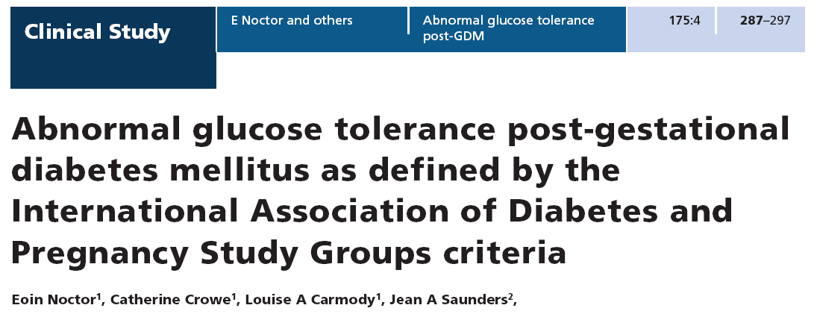
Section 2. Classification and Diagnosis of Diabetes
Because GDM confers increased risk for the development of type 2 diabetes after delivery and because effective prevention interventions are available, women diagnosed with GDM should receive lifelong screening for prediabetes and type 2 diabetes.
Objective :determination the cumulative incidence of abnormal glucose tolerance among women with previous GDM, and identify clinical risk factors predicting this.

Slide 53
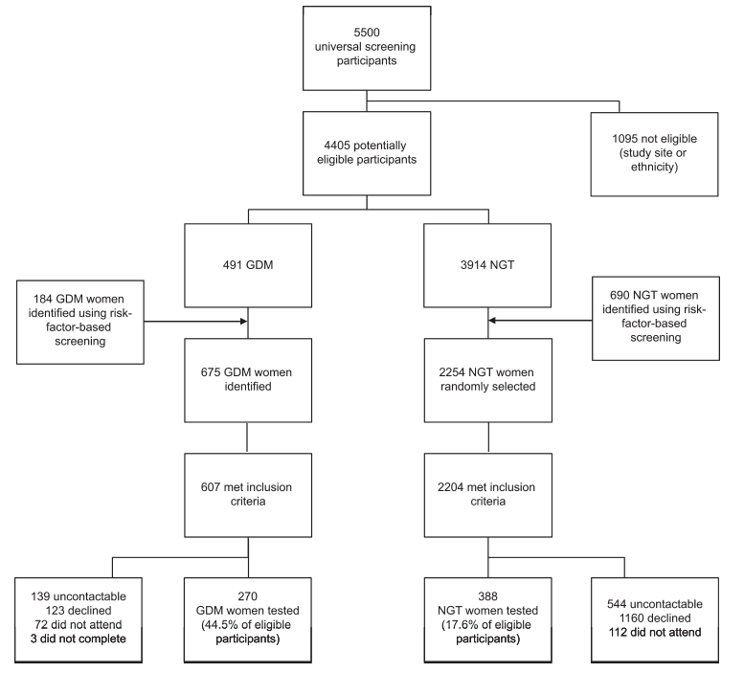
270 women with previous GDM were prospectively followed up for 5 years (mean 2.6) post-index pregnancy, and compared with 388 women with normal glucose tolerance (NGT) in pregnancy.

Slide 54
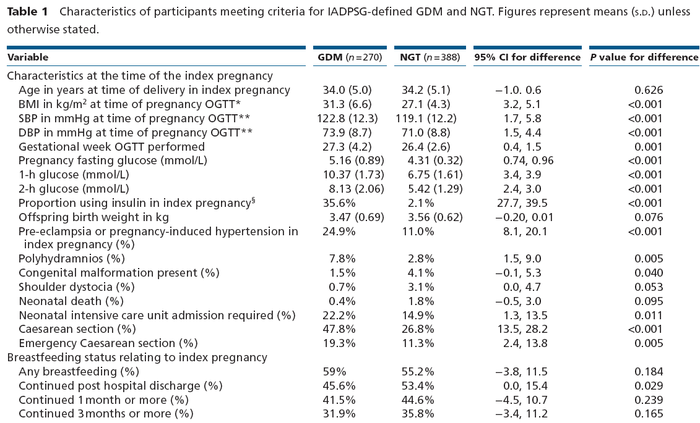

Slide 55
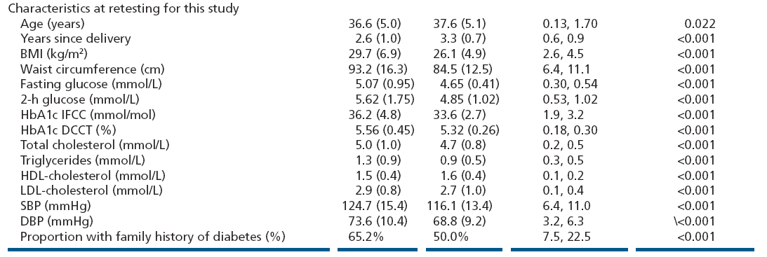

Slide 56
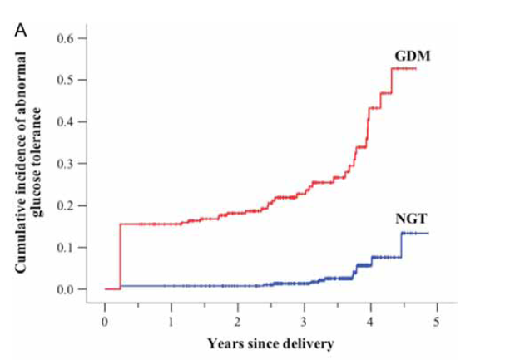
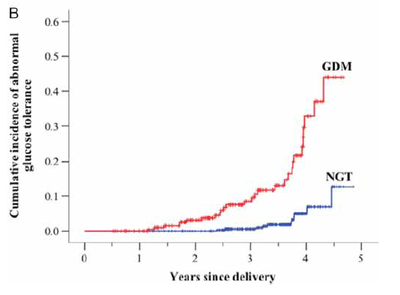
Kaplan–Meier curves showing the cumulative probability of abnormal glucose tolerance in previous GDM vs NGT.
includes all participants (GDM n = 270, n = 388)
(B) excludes women known to have abnormal glucose tolerance at 12 week post-partum testing (GDM n = 228, NGT n = 385).

Slide 57


Slide 58
Results:
26% of women with previous GDM had abnormal glucose tolerance vs 4% (P < 0.001).
Predictive factors were
glucose levels on the pregnancy oral glucose tolerance test
family history of diabetes
gestational week at testing
BMI at follow-up
Conclusions:
The proportion of women developing abnormal glucose tolerance remains high among those with
IADPSG-defined GDM.
This demonstrates the need for continued close follow-up, although the optimal frequency and
method needs further study.
International Association of the Diabetes and Pregnancy Study Groups (IADPSG)

Slide 59

Section 2. Classification and Diagnosis of Diabetes
2017

Slide 60

Section 2. Classification and Diagnosis of Diabetes
2018

Slide 61
Section 3. Comprehensive Medical Evaluation and Assessment of Comorbidities
● The table of a Comprehensive medical evaluation (Table 3.1) was substantially redesigned and reorganized
● The immunization section was updated
● Text was added about the importance of language choice
● Pancreatitis was added to comorbidities, and a new recommendation about the islet autotransplantation
● A recommendation was added to consider checking serum testosterone in
men with diabetes and signs and symptoms of hypogonadism.

Slide 62



Section 3. Comprehensive Medical Evaluation and Assessment of Comorbidities
The table describing the components of a Comprehensive medical evaluation (Table 3.1) was substantially redesigned and reorganized, incorporating information about the recommended frequency of the components of care at both initial and follow-up visits.

Slide 63
2017

Slide 64
2018

Slide 65


Slide 66



Slide 67


Slide 68


Slide 69



A cross-sectional registry-based study
From 2007 until 2012
In total, 29,630 patients were included in the study, and 4,881 (16.5%) of them received a diagnosis of diabetes.

Slide 70



Slide 71



Slide 72
RESULTS
In the fully adjusted model, diabetes was associated with lower age at dementia diagnosis (odds ratio [OR] 0.97 [99% CI 0.97–0.98]),Male sex (1.41 [1.27–1.55]), vascular dementia (1.17 [1.01–1.36]), and mixed dementia (1.21 [1.06–1.39]).
Dementia with Lewy bodies (0.64 [0.44–0.94]), Parkinson’s disease dementia (0.46 [0.28–0.75]), as well as treatment with antidepressants (0.85 [0.77–0.95]) were less common among patients with diabetes.
Patients with diabetes who had Alzheimer’s disease obtained significantly less treatment with cholinesterase inhibitors (0.78 [0.63–0.95]) and memantine (0.68 [0.54–0.85]).
CONCLUSIONS
Patients with diabetes were younger at dementia diagnosis and obtained less dementia medication for Alzheimer’s disease, suggesting less optimal dementia treatment.
Future research should evaluate survival and differences in metabolic profile in patients with diabetes and different dementia disorders.

Slide 73


Section 3. Comprehensive Medical Evaluation and Assessment of Comorbidities
The immunization section was updated for clarity to more closely align with recommendations from the Centers for Disease Control and Prevention.
www.cdc.gov/vaccines/
2017
2018
Centers
for Disease Control and Prevention (CDC)

Slide 74


Section 3. Comprehensive Medical Evaluation and Assessment of Comorbidities
2017
2018
Hepatitis B
Compared with the general population,
people with type 1 or type 2 diabetes
have higher rates of hepatitis B. This may
be due to contact with infected blood or
through improper equipment use (glucose monitoring devices or infected needles).
Because of the higher likelihood of transmission, hepatitis B vaccine is recommended for adults with diabetes.
Hepatitis B
Compared with the general population, people with type 1 or type 2 diabetes have higher rates of hepatitis B. This may
be due to contact with infected blood or through improper equipment use (glucose monitoring devices or infected needles). Because of the higher likelihood of transmission,
Hepatitis B vaccine is recommended for adults with diabetes age <60 years.
For adults age >=60 years, hepatitis B vaccine may be administered at the discretion of the treating clinician based on the patient’s likelihood of acquiring hepatitis B infection.

Slide 75


Section 3. Comprehensive Medical Evaluation and Assessment of Comorbidities
Text was added about the importance of language choice in patient-centered communication.
2017
2018

Slide 76



Slide 77


Slide 78


Slide 79



Slide 80


Slide 81




Slide 82


The task force made five key recommendations for discussing diabetes:
1. Use language that is neutral, nonjudgmental, and based on facts, actions, or physiology/biology;
2. Use language that is free from stigma;
3. Use language that is strengths-based, respectful, inclusive and imparts hope;
4. Use language that fosters collaboration between patients and providers; and
5. Use language that is person-centered.

Slide 83
Section 3. Comprehensive Medical Evaluation and Assessment of Comorbidities
Pancreatitis was added to the section on comorbidities, including a new recommendation about the consideration of islet autotransplantation to prevent postsurgical diabetes in patients with medically refractory chronic pancreatitis who require total pancreatectomy.
ASSESSMENT OF COMORBIDITIES
Autoimmune Diseases (T1D)
Cancer
Cognitive Impairment/ Dementia
Fatty Liver Disease
Pancreatitis (New)
Fractures
Hearing Impairment
HIV
Low Testosterone (Men)
Obstructive Sleep Apnea
Periodontal Disease
Psychosocial/Emotional Disorders

Slide 84



Section 3. Comprehensive Medical Evaluation and Assessment of Comorbidities
2018 (New recommendation)
Islet autotransplantation
Notes:
Moving on now to a discussion of the common comorbidities of diabetes, listed on this slide. We’ll highlight 2018 ADA recommendations relating to some of these comorbidities. For a detailed discussion of these common comorbidities, please refer to the chapter in its entirety.
[SLIDE]
84

Slide 85
Section 3. Comprehensive Medical Evaluation and Assessment of Comorbidities
Diabetes is linked to diseases of the exocrine pancreas such as pancreatitis, which may disrupt the global architecture or physiology of the pancreas, often resulting in both exocrine and endocrine dysfunction. Up to half of patients with diabetes may have impaired exocrine pancreas function (45). People with diabetes are at an approximately twofold higher risk of developing acute pancreatitis (46).
Conversely, prediabetes and/or diabetes has been found to develop in approximately one-third of patients after an episode of acute pancreatitis (47), thus the relationship is likely bidirectional. Postpancreatitis diabetes may include either new onset disease or previously unrecognized diabetes (48).
Studies of patients treated with incretin-based therapies for diabetes have also reported that pancreatitis may occur more frequently with these medications, but results have been mixed (49,50).
Islet autotransplantation should be considered for patients requiring total pancreatectomy for medically refractory chronic pancreatitis to prevent postsurgical diabetes.
Approximately one-third of patients undergoing total pancreatectomy with islet autotransplantation are insulin free one year postoperatively, and observational studies from different centers have demonstrated islet graft function up to a decade after the surgery in some patients (51–55). Both patient and disease factors should be carefully considered when deciding the indications and timing of this surgery. Surgeries should be performed in skilled facilities that have demonstrated expertise in islet autotransplantation.

Slide 86
51. Bellin MD, Gelrud A, Arreaza-Rubin G, et al.
Total pancreatectomy with islet autotransplantation:
summary of an NIDDK workshop. Ann Surg
2015;261:21–29
52. Sutherland DER, Radosevich DM, Bellin MD,
et al. Total pancreatectomy and islet autotransplantation
for chronic pancreatitis. J Am Coll Surg
2012;214:409–424
53. Quartuccio M, Hall E, Singh V, et al. Glycemic
predictors of insulin independence after total
pancreatectomy with islet autotransplantation.
J Clin Endocrinol Metab 2017;102:801–809
54. Webb MA, Illouz SC, Pollard CA, et al. Islet
auto transplantation following total pancreatectomy:
a long-term assessment of graft function.
Pancreas 2008;37:282–287
55. Wu Q, Zhang M, Qin Y, et al. Systematic review
and meta-analysis of islet autotransplantation
after total pancreatectomy in chronic
pancreatitis patients. Endocr J 2015;62:227–234

Slide 87

Section 3. Comprehensive Medical Evaluation and Assessment of Comorbidities
A recommendation was added to consider checking serum testosterone in men with diabetes and signs and symptoms of hypogonadism.
2018 (New recommendation)

Slide 88
2017
2018
Low Testosterone in Men
Mean levels of testosterone are lower in men with diabetes compared with age matched men without diabetes, but obesity is a major confounder .
Treatment in asymptomatic men is controversial.
The evidence that testosterone replacement affects outcomes is mixed, and recent guidelines do not recommend testing or treating men without symptoms.
Low Testosterone in Men
Mean levels of testosterone are lower in men with diabetes compared with age matched men without diabetes, but obesity is a major confounder .
Treatment in asymptomatic men is controversial.
Testosterone replacement in men with symptomatic hypogonadism may have benefits including improved sexual function, well being, muscle mass and strength, and bone density.
In men with diabetes who have symptoms or signs of low testosterone
(hypogonadism), a morning total testosterone should be measured using an accurate and reliable assay. Free or bioavailable testosterone levels should also be measured in men with diabetes who have total testosterone levels close to the lower limit, given expected decreases in sex hormone– binding globulin with diabetes.
Further testing (such as LH and FSH levels) may be needed to distinguish between primary and secondary hypogonadism.
67. GrossmannM. Low testosterone inmen with type 2 diabetes: significance and treatment. J Clin Endocrinol Metab 2011;96:2341–2353
68. Bhasin S, Cunningham GR, Hayes FJ, et al.; Task Force, Endocrine Society. Testosterone therapy in men with androgen deficiency syndromes: an Endocrine Society clinical practice guideline. J Clin Endocrinol Metab 2010;95:2536–2559

Slide 89
Section 4. Lifestyle Management
● A recommendation was modified to include individual and group settings as well as technology-based platforms for the delivery of effective diabetes self management education and support(DSMES).
● Additional explanation was added to the nutrition section to clarify the ADA’s
recommendations that there is no universal ideal macronutrient distribution and
that eating plans should be individualized.
● Text was added to address the role of low-carbohydrate diets in people with
diabetes.

Slide 90


Section 4. Lifestyle Management
A recommendation was modified to include individual and group settings as well as technology-based platforms for the delivery of effective diabetes self management education and support(DSMES).

Slide 91
Section 4. Lifestyle Management
Individual and group approaches are effective (12,27), with a slight benefit realized by those who engage in both (10).
Emerging evidence demonstrates the benefit of Internet-based DSMES services for diabetes prevention and the management of type 2 diabetes (28–30).
Technology enabled diabetes self-management solutions improve A1C most effectively when there is two-way communication between the patient and the health care team, individualized feed back,use of patient-generated health data, and education (30).

Slide 92
10. Chrvala CA, Sherr D, Lipman RD. Diabetes selfmanagement
education for adults with type 2 diabetes
mellitus: a systematic review of the effect on glycemic
control. Patient Educ Couns 2016;99:926–943
28. Pereira K, Phillips B, Johnson C, Vorderstrasse
A. Internet delivered diabetes self-management
education: a review. Diabetes Technol Ther
2015;17:55–63
29. Sepah SC, Jiang L, Peters AL. Long-term outcomes
of a Web-based diabetes prevention program:
2-year results of a single-arm longitudinal
study. J Med Internet Res 2015;17:e92
30. Greenwood DA, Gee PM, Fatkin KJ, Peeples
M. A systematic review of reviews evaluating
technology-enabled diabetes self-management
education and support. J Diabetes Sci Technol
2017;11:1015–1027

Slide 93


Section 4. Lifestyle Management
Additional explanation was added to the nutrition section to clarify the ADA’s recommendations that there is no universal ideal macronutrient distribution and that eating plans should be individualized.

Slide 94
Section 4. Lifestyle Management
Eating Patterns, Macronutrient
Distribution, and Meal Planning
Evidence suggests that there is not an ideal percentage of calories from carbohydrate, protein, and fat for all people with diabetes.
Therefore, macronutrient distribution should be based on an individualized assessment of current eating patterns, preferences, and metabolic goals.
Consider personal preferences (e.g., tradition, culture, religion, health beliefs and goals, economics)
as well as metabolic goals when working with individuals to determine the best eating pattern for them (42,51).
It is important that each member of the health care team be knowledgeable about nutrition therapy principles for people with all types of diabetes and be supportive of their implementation.
Emphasis should be on healthful eating patterns containing nutrient-dense foods with less focus on specific nutrients (52).

Slide 95
Section 4. Lifestyle Management
variety of eating patterns are acceptable for the management of diabetes (51,53). The Mediterranean
(54,55), Dietary Approaches to Stop Hypertension (DASH) (56–58), and plant-based diets (59,60) are all examples of healthful eating patterns that have shown positive results in research, but individualized
meal planning should focus on personal preferences, needs, and goals.
The diabetes plate method is commonly used for providing basic meal planning guidance (61) as it provides a visual guide showing how to control calories (by featuring a smaller plate) and carbohydrates (by limiting them to what fits in one-quarter of the plate) and puts an emphasis on low-carbohydrate (or nonstarchy)
vegetables.

Slide 96
51. MacLeod J, Franz MJ, Handu D, et al. Academy
of Nutrition and Dietetics Nutrition practice
guideline for type 1 and type 2 diabetes in adults:
nutrition intervention evidence reviews and recommendations.
J Acad Nutr Diet 2017;117:1637–
1658
52. Maryniuk MD. From pyramids to plates to
patterns: perspectives on meal planning. Diabetes
Spectr 2017;30:67–70
61. BowenME, Cavanaugh KL, Wolff K, et al. The
Diabetes Nutrition Education Study randomized
controlled trial: a comparative effectiveness
study of approaches to nutrition in diabetes selfmanagement
education. Patient Educ Couns
2016;99:1368–1376

Slide 97
53. Schwingshackl L, Schwedhelm C, Hoffmann
G, et al. Food groups and risk of all-causemortality:
a systematic review and meta-analysis of prospective
studies. Am J Clin Nutr 2017;105:1462–1473
55. Boucher JL. Mediterranean eating pattern.
Diabetes Spectr 2017;30:72–76
56. Cespedes EM, Hu FB, Tinker L, et al. Multiple
healthful dietary patterns and type 2 diabetes in
the Women’s Health Initiative. Am J Epidemiol
2016;183:622–633
58. Campbell AP. DASH eating plan: an eating
pattern for diabetes management. Diabetes
Spectr 2017;30:76–81

Slide 98
59. Rinaldi S, Campbell EE, Fournier J, O’Connor
C, Madill J. A comprehensive review of the literature
supporting recommendations from the
Canadian Diabetes Association for the use of a
plant-based diet for management of type 2 diabetes.
Can J Diabetes 2016;40:471–477
60. Pawlak R. Vegetarian diets in the prevention
and management of diabetes and its complications.
Diabetes Spectr 2017;30:82–88

Slide 99
Section 4. Lifestyle Management
Text was added to address the role of
low-carbohydrate diets in people with
diabetes.
The role of low-carbohydrate diets in patients with diabetes remains unclear (72).
Part of the confusion is due to the wide range of definitions for a low-carbohydrate diet (73,74).
While benefits to low-carbohydrate diets have been described, improvements tend to be in the short term and, over time, these effects are not maintained (74–77). While some studies have shown modest benefits of very low–carbohydrate or ketogenic diets (less than 50-g carbohydrate per day) (78,79), this approach
may only be appropriate for short-term implementation (up to 3–4months) if desired by the patient, as there is little long term research citing benefits or harm.

Slide 100


Slide 101


Slide 102
72. Wheeler ML, Dunbar SA, Jaacks LM, et al.
Macronutrients, food groups, and eating patterns
in the management of diabetes: a systematic review
of the literature, 2010. Diabetes Care 2012;
35:434–445
73. Thomas D, Elliott EJ. Low glycaemic index, or
low glycaemic load, diets for diabetes mellitus.
Cochrane Database Syst Rev 2009;1:CD006296
74. Snorgaard O, Poulsen GM, Andersen HK,
Astrup A. Systematic review and meta-analysis
of dietary carbohydrate restriction in patients
with type 2 diabetes. BMJ Open Diabetes Res
Care 2017;5:e000354
75. van Wyk HJ, Davis RE, Davies JS. A critical review
of low-carbohydrate diets in people with
type 2 diabetes. Diabet Med 2016;33:148–157
76. Meng Y, Bai H,Wang S, Li Z,Wang Q, Chen L.
Efficacy of low carbohydrate diet for type 2 diabetes
mellitus management: a systematic review
andmeta-analysis of randomized controlled trials.
Diabetes Res Clin Pract 2017;131:124–131
77. Tay J, Luscombe-Marsh ND, Thompson CH,
et al. Comparison of low- and high-carbohydrate
diets for type 2 diabetesmanagement: a randomized
trial. Am J Clin Nutr 2015;102:780–790

Slide 103
78. Goday A, Bellido D, Sajoux I, et al. Short-term
safety, tolerability and efficacy of a very lowcalorie-
ketogenic diet interventional weight loss
program versus hypocaloric diet in patients with
type 2 diabetes mellitus. Nutr Diabetes 2016;6:
e230
79. Saslow LR, Mason AE, Kim S, et al. An online
intervention comparing a very low-carbohydrate
ketogenic diet and lifestyle recommendations
versus a plate method diet in overweight individuals
with type 2 diabetes: a randomized controlled
trial. J Med Internet Res 2017;19:e36

Slide 104


Section 5. Prevention or Delay of Type 2 Diabetes
The recommendation regarding the use of metformin in the prevention of prediabetes was reworded to better reflect the data from the Diabetes Prevention Program.

Slide 105
Section 6. Glycemic Targets
● Additional recommendations : A1C limitations
Hemoglobin variants
Assay interference
RBC turnover,…
● The recommendation for prediabetes and type 2 diabetes testing in children and adolescents modified
● Consideration of the community screening in specific situations
● Additional detail on Antihyperglycemic treatment in people with post transplantation diabetes mellitus

Slide 106


Section 6. Glycemic Targets
Based on new data, the recommendation for the use of continuous glucose monitoring (CGM) in adults with type 1 diabetes is no longer limited to those ages 25 and above but has been expanded to all adults(18 and above) who are not meeting glycemic targets.
ADA 2017
ADA 2018

Slide 107


Slide 108
Section 6. Glycemic Targets
Additional text was added about a new
intermittent or “flash” CGM device that
was recently approved for adult use.
The intermittent or “flash” CGM device, very recently approved for adult use only (18), differs from previous CGM devices. Specifically, it does not have alarms, does not require calibration with SMBG, and does not communicate continuously (only on demand). It is reported to have a lower cost than traditional systems. A study in adults with well-controlled type 1 diabetes found that flash CGM users spent less time in hypoglycemia than those using SMBG (19).

Slide 109
Section 6. Glycemic Targets
Details were added about new CGM devices
that no longer require confirmatory
self-monitoring of blood glucose for treatment
decisions.
For most CGM systems, confirmatory SMBG is required to make treatment decisions, though a randomized controlled trial of 226 adults suggested that an enhanced CGM device could be used safely
and effectively without regular confirmatory SMBG in patients with well-controlled type 1 diabetes at low risk of severe hypoglycemia (1).Two CGMdevices are now approved by the U.S. Food and Drug Administration (FDA) for making treatment decisions without SMBG confirmation (18,20), including the flash CGM device.

Slide 110
18. U.S. Food and Drug Administration. FDA approves
first continuous glucose monitoring system
for adults not requiring blood sample calibration
[Internet]. Available from https://www.fda.gov/
NewsEvents/Newsroom/PressAnnouncements/
ucm577890.htm. Accessed 2 October 2017
19. Bolinder J, Antuna R, Geelhoed-Duijvestijn P,
Kr¨oger J, Weitgasser R. Novel glucose-sensing
technology and hypoglycaemia in type 1 diabetes:
a multicentre, non-masked, randomised controlled
trial. Lancet 2016;388:2254–2263
20. U.S. Food and Drug Administration. FDA expands
indication for continuous glucose monitoring
system, first to replace fingerstick testing for
diabetes treatment decisions [Internet]. Available
from https://www.fda.gov/newsevents/
newsroom/pressannouncements/ucm534056
.htm. Accessed 14 September 2017

Slide 112
Section 6. Glycemic Targets
As in Section 2, this section now includes
an expanded discussion of the limitations
of A1C in certain populations based on the
presence of hemoglobin variants, differences
in red blood cell turnover rates, ethnicity,
and age.

Slide 113
Section 6. Glycemic Targets
As with any laboratory test,
there is variability in the measurement of
A1C. Although such variability is less on an
intraindividual basis than that of blood
glucose measurements, clinicians should
exercise judgment when using A1C as the
sole basis for assessing glycemic control,
particularly if the result is close to the
threshold that might prompt a change in
medication therapy. Conditions that affect
red blood cell turnover (hemolytic and
other anemias, recent blood transfusion,
use of drugs that stimulate erythropoesis,
end-stage kidney disease, and
pregnancy) may result in discrepancies
between the A1C result and the patient’s
true mean glycemia. Hemoglobin
variants must be considered, particularly
when the A1C result does not correlate
with the patient’s SMBG levels. Options
for monitoring include more frequent and/
or different timing of SMBG or CGM use.

Slide 114
Section 6. Glycemic Targets
Conditions that affect red blood cell turnover (hemolytic and other anemias, recent blood transfusion, use of drugs that stimulate erythropoesis, end-stage kidney disease, and
pregnancy) may result in discrepancies between the A1C result and the patient’s true mean glycemia.
Though some variability exists among different individuals, generally the association between mean glucose and A1C within an individual correlates over time (42).
In a recent report, mean glucose measured with CGM versus central laboratory– measured A1C in 387 participants in three randomized trials demonstrated that A1C may underestimate or over estimate mean glucose. Thus, as suggested, a patient’s CGM profile has considerable potential for optimizing his or her glycemic management (42).
42. Beck RW, Connor CG, Mullen DM, Wesley
DM, Bergenstal RM. The fallacy of average: how
using HbA1c alone to assess glycemic control can
be misleading. Diabetes Care 2017;40:994–999

Slide 115
Section 6. Glycemic Targets
Moreover,African Americans heterozygous for the
common hemoglobin variant HbS may
have, for any level of mean glycemia,
lower A1C by about 0.3 percentage points
than those without the trait (46). Another
genetic variant, X-linked glucose-6-phosphate
dehydrogenase G202A, carried by 11% of
African Americans, was associated with a
decrease in A1C of about 0.8% in hemizygous
men and 0.7% in homozygous
women compared to those without the
trait (47).
46. Lacy ME,Wellenius GA, Sumner AE, et al. Association
of sickle cell traitwith hemoglobin A1c in
African Americans. JAMA 2017;317:507–515
47. Wheeler E, Leong A, Liu C-T, et al.; EPIC-CVD
Consortium; EPIC-InterAct Consortium; Lifelines
Cohort Study. Impact of common genetic determinants
of hemoglobin A1c on type 2 diabetes
risk and diagnosis in ancestrally diverse populations:
a transethnic genome-wide meta-analysis.
PLoS Med 2017;14:e1002383

Slide 118


Section 6. Glycemic Targets
To clarify the classification of hypoglycemia, level 1 hypoglycemia was renamed “hypoglycemia alert value” from “glucose alert value.”
2017
2018

Slide 119
75. International Hypoglycemia Study Group.
Glucose concentrations of less than 3.0 mmol/L
(54 mg/dL) should be reported in clinical trials:
a joint position statement of the American Diabetes
Association and the European Association for
the Study of Diabetes. Diabetes Care 2017;40:
155–157

Slide 120
CGM with automated low glucose suspend has been
shown to be effective in reducing hypoglycemia
in type 1 diabetes (34). For patients
with type 1 diabetes with severe hypoglycemia
and hypoglycemia unawareness
that persists despite medical treatment,
human islet transplantation may be an option,
but the approach remains experimental
(83,84).
34. Bergenstal RM, Klonoff DC, Garg SK, et al.;
ASPIRE In-Home Study Group. Threshold-based
insulin-pump interruption for reduction of hypoglycemia.
N Engl J Med 2013;369:224–232
83. Hering BJ, ClarkeWR, Bridges ND, et al.; Clinical
Islet Transplantation Consortium. Phase 3 trial
of transplantation of human islets in type 1 diabetes
complicated by severe hypoglycemia. Diabetes
Care 2016;39:1230–1240
84. Harlan DM. Islet transplantation for hypoglycemia
unawareness/severe hypoglycemia: caveat
emptor. Diabetes Care 2016;39:1072–1074

Slide 123
Section 7. Obesity Management for the Treatment of Type 2 Diabetes
To provide a second set of cost information, the table of medications for the treatment of obesity (Table 7.2) was updated to include National Average Drug Acquisition Cost (NADAC) prices.

Slide 124


Slide 125


Slide 126
Section 8. Pharmacologic Approaches to Glycemic Treatment

