Slide 2
Oral
hypoglycemic
agents
H. Delshad M.D
Endocrinologist
Research Institute for Endocrine Sciences

Slide 3
TYPE 2 DIABETES MELLITUS
Is a complex heterogeneous condition characterized by abnormalities of both:
►Insulin Secretion
►Insulin action

Slide 4
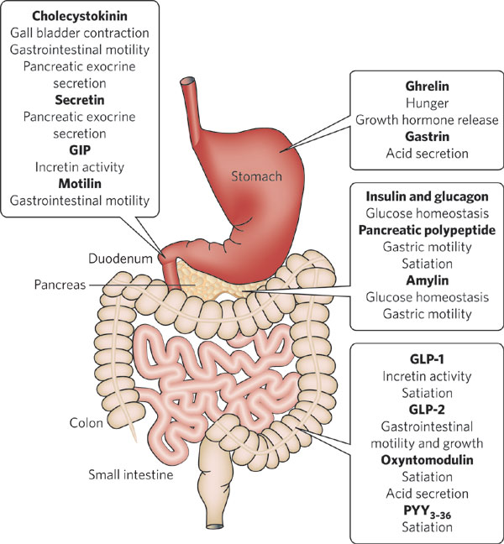
• Insulin • Glucagon • Incretins • Amylin
Glucose homeostasis is governed by a
complex interplay among different hormones

Slide 5
The pattern of glucose - induced insulin secretion In
response to an increase in the glucose concentration
• An acute first phase, lasting a few minutes,
• A sustained second phase of secretion which
persists for the duration of the high glucose stimulus.

Slide 6
Type 2 Diabetes : A Failure of Mealtime Insulin Secretion Early- phase Insulin secretion loss occurs early and second - phase release loss later in T2DM
Normal subjects
Patients with type 2 diabetes
PPG < 150 mg/dl
PPG > 300 mg/dl
Notes:
As a person deteriorates from having a normal insulin profile to having impaired glucose tolerance and, finally, type 2 diabetes, the insulin response to glucose becomes both blunted and delayed, and eventually fails completely. As we might expect, these changes have profound effects on glucose metabolism.
1. Coates PA, et al. A glimpse of the ‘natural history’ of established type 2 diabetes mellitus from the spectrum of metabolic and hormonal responses to a mixed meal at the time of diagnosis. Diabetes Res Clin Pract 1994; 26: 177–87.

Slide 7
DIABETES MELLITUS Modalities of Therapy
●The main goals are :
1- To lower blood glucose levels safely to as
near normal as possible
2- Preservation of beta-cell function
●There are 5 main component in the management of diabetes:
1- Education
2- Diet
3- Exercise
4- Glucose monitoring
5- Medication

Slide 8
Classes of OHA
Medications that increase insulin secretion
• Sulfonylureas
• Meglitinides
• D-phenylalanine derivatives
Medications that improve insulin action
• Biguanides
• Thiazolidinediones
Medications that slow glucose absorption
• a-Glucosidase inhibitors
Medications that restore incretin action
• GLP-l agonists
• DPP-IV inhibitors

Slide 9
Management of T2DM
Intervention | Expected ↓ in HbA_{1c} (%)
Lifestyle interventions | 1 | to | 2%
Metformin | 1 | to | 2%
Sulfonylureas | 1 | to | 2%
Glinides | 0.5 | to | 0.8%
Thiazolidinediones | 1 | to | 1.5%
α-Glucosidase inhibitors | 0.5 | to | 1.4%
GLP-1 agonist | 0.5 | to | 0.8%
DPP-IV inhibitors | 0.5 | to | 1.0%
Pramlintide | 0.5 | to | 1.0%
Insulin | 1.5 | to | 3.5%
Notes:
9
9

Slide 10
SULFONYLUREASur

Slide 11
Sulfonylureas
Are sulfonamide derivatives
Their hypoglycemic actions were discovered inadvertently when one of the initial agents was given to treat patients with typhoid fever
Since 1950s, have been used extensively as insulin secretagogues for the treatment of T2DM.
Sulfonylureas cause only first-phase insulin release
(preformed insulin) whereas nutrients stimulate both first-phase and second-phase insulin release

Slide 12
Sulfonylureas
► First generation = 1955
○Tolbutamide
○ Acetohexamide
○ Tolazamide
○ Chlorporpamide
►Second generation = early 1980s
○ Glyburide (Glibenclamide)
○ Glipizide
○ Gliclazide
○ Glimepiride

Slide 13
Sulfonylureas
The SUR affinity of the first-generation is only about 1/1000 of that of the second generation
The effective doses of the second-generation are in the range of 1–20 mg, whereas those of the first-generation are ∼250–3000 mg.

Slide 14
Intracellular mechanisms through which glucose stimulates insulin secretion

Slide 15
Pancreatic Effects of Sulfonylureas
The efficacy of sulfonylureas depends on adequate remaining function of the β - cells

Slide 16
Extrapancreatic Effects of Sulfonylureas
Sulfonylureas exert minor glucose lowering effects independently of increased insulin secretion :
• A small reduction in glucagon concentrations
• Increased peripheral glucose transport
• Increased hepatic glucose deposition
But these effects are not regarded to be of sufficient magnitude to be clinically relevant

Slide 17
Sulfonylureas : Pharmacokinetic
They are generally well absorbed, and reach peak plasma concentration in 2 – 4 hours.
Are highly bound to plasma proteins which can lead to interactions with other protein-bound drugs such as Salicylates, Sulfonamides and Warfarin.
Displacement of protein – bound sulfonylurea can increase the risk of hypoglycemia

Slide 18
Sulfonylureas : Pharmacokinetic
Glyburide (glibenclamide)
Hypoglycemic effect appears to be equal to that of other sulfonylureas. Is associated with a high rate of serious and fatal hypoglycemia.
Modest weight gain.
Relative lack of specificity on the different KATP channels.
Glipizide
Short-acting formulation and extended-release formulation
The short-acting form is rapidly absorbed and is completely bioavailable.
Is eliminated with a half-life of 2 to 4 hours
Glimepiride & Gliclazide
More selective for the βcell KATP channel
Bind 2.5- to 3.0-fold faster and dissociate 8.0- to 9.0-fold faster than glyburide
from its β-cell KATP-binding site
Insulin release is more rapid and of shorter duration than that with glyburide.

Slide 19
Sulfonylureas :
Indications and contraindications
Sulfonylureas : Pharmacokinetic
As monotherapy and in combination with Metformin or a TZDs
Begin with a low dose, with SMBG at least once daily during the first few weeks.
Up titrate the dosage at 2 – 4 week intervals
Hypoglycemia, or early hypoglycemic symptoms are the main limitation to dose escalation
Maximal blood glucose – lowering effect is usually achieved at a dose that is well below the recommended maximum

Slide 20
Sulfonylureas :Efficacy
As monotherapy sulfonylureas reduce HbA1c of 1 – 2%
A rapid deterioration of glycemic control during sulfonylurea therapy “ secondary failure ” occurs in approximately 5 – 10% of patients per year
Sulfonylureas generally have little effect on blood lipids.
Occasionally, their use will cause a small decrease in plasma triglyceride or increase in HDL cholesterol.

Slide 21
Sulfonylureas :Adverse effects
• Weight gain : 1 – 4 kg
• Hypoglycemia
• Very occasionally, sensitivity reactions :
usually transient cutaneous rashes.
• Erythema multiforme is rare.
• Fever, jaundice, acute porphyria, photosensitivity
and blood dyscrasias are also rare.
• Chlorpropamide (no longer in common use) :
- Facial flushing with alcohol
- Water retention and hyponatremia.

Slide 22
ATI'-dependent potassium channels and their physiologic functions
Sulfonylureas : cardiovascular safety
Isoforms of the Sulfonylure receptor
Tissue | Receptor | Basal state | Stimulus | Effect
Pancreatic–β cells | SUR-1 | Open | Hyperglycemia | Insulin secretion
Myocardial cells | SUR-2A | Closed | Ischemia Hypoxia | Energy consumption
Vascular smooth | SUR-2B | Closed | Ischemia Hypoxia | Vasodilatation

Slide 23
Each SUR1 has a sulfonylurea (S) binding site and a benzamido (B) binding site.
SUR2A on cardiac muscle and SUR2B on vascular smooth muscle cells do not
have a sulfonylurea binding site.
Glibenclamide & Glipizide : interact with the cardiac and vascular SUR2A/B
Glimepiride & Gliclazide : show very little interaction with SUR2A/B

Slide 24
CV Risk of Diabetes Drugs
Schramm TK et al.
Eur Heart J (2011)
Mortality and cardiovascular risk associated with different insulin secretagogues compared with Metformin in type 2 diabetes, with
or without a previous myocardial infarction: a nationwide study
All Danish residents >20 years, initiating single-agent SUL or Metformin between 1997 and 2006 were followed for up to 9 years . All-cause mortality, CV mortality, myocardial infarction (MI) and stroke associated with individual ISs were investigated in patients with or without previous MI. A total of 107,806 subjects were included, of whom 9607 had previous MI.
Conclusion : Monotherapy with the most used SUL, including Glimepiride, Glibenclamide, Glipizide, and tolbutamide, seems to be associated with increased mortality and cardiovascular risk compared with Metformin.
Gliclazide and Repaglinide appear to be associated with a lower risk than other SUL.

Slide 25
GLINIDES

Slide 26
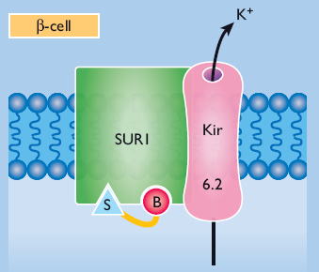
Meglitinides ( short - acting prandial insulin releasers)
Glinides
1980s : Meglitinide -the non- sulfonylurea moiety of Glibenclamide contains the
benzamido group and could
stimulate insulin secretion
similarly to a sulfonylurea .
Meglitinide, Repaglinide (1998)
and Nateglinide (2001)
were introduced as prandial insulin releasers.

Slide 27
Pharm
Glinides :Pharmacokinetic
Repaglinide is almost completely and rapidly absorbed with peak plasma concentrations after about 1 hour.
• It is quickly metabolized in the liver and mostly excretes in the bile
• Taken about 15 minutes before a meal, Repaglinide produces a prompt insulin response which lasts about 3 hours, coinciding with the duration of meal digestion.
Nateglinide has a slightly faster onset and shorter duration of action

Slide 28
Glinides :Indications and contraindications
For individuals who exhibit post-prandial Hyperglycemia while retaining near normal fasting glycemia.
For individuals with irregular lifestyles & unpredictable or missed meals.
For some elderly patients, particularly if other agents are contraindicated.
Repaglinide is ideally taken 15 – 30 min. before a meal.
Start with a low dose (e.g. 0.5 mg), titrate every 2 weeks up to a maximum of 4 mg before each main meal.

Slide 29
Glinides
Efficacy
Reductions in HbA 1c are similar to or smaller than with sulfonylureas
As add-on to metformin, they can reduce HbA1c by an additional 0.5 – 1.5% .
Adverse effects
Hypoglycemic episodes are fewer and less severe than with sulfonylureas.
Sensitivity reactions, usually transient, are uncommon.
They may cause a small increase in body weight

Slide 30
Efficacy
Insulin Secretagogues
Nateglinide
Repaglinide
Glipizide
Glimepiride
Gliclazide
Glyburide
(micronized)
Glyburide
(nonmicronized)
Most rapid
Least rapid

Slide 31
Treatment of T2DM
Choice of drug therapy should ideally address underlying pathophysiology
ADA/EASD Guidelines : 2010
AACE Guidelines : 2011

Slide 32
Step
ADA/EASD Guidelines
(2010)
1
At diagnosis
Lifestyle + Metformin
2-3 months
Step
HbA1c > 7 %
2
Tier 1
Tier 2
Add
Basal Insulin
Add
Sulfonylureas
Add
GLP-1 Agonist
Add
TZDs ± SUL
Step
3
INTENSIVE INSULIN

Slide 33
AACE Guidelines (2011)

Slide 34
HbA1C = 6.5 – 7.5 %
1- Metformine
2- TZDs
3- DPP-Inhibitors
4- α –glucosidase
inhibitors
AACE Guidelines
( 2011 )
• Monotherapy :
2-3 months A1C > 6.5%
DUAL THERAPY

Slide 35
HbA1C = 7.5 – 9.0 %
Dual Therapy :
Metformine
GLP-1 Agonist
DPP-4 Inhibitor
TZDs
Sulfonylurea
Glinide
2
1
+

Slide 36
HbA1C > 9.0 %
Drug-naïve , asymptomatic , recent DM
Under treatment with OHA or Symptomatic
Triple Therapy
Insulin ± Other agents

Slide 37
Triple Therapy
Metformine
GLP-1 Agonist
TZDs
Glinide
Sulfonylurea
1
2
3
DPP-4 Inhibitor
2

