Slide 1
In The Name Of GOD

Slide 2
Problem list
Lateral neck mass { MTC}…..surgery
Thyroid nodule { MTC}…..surgery
Servical L.N involvement…..surgery
high Ctn leveles

Slide 3
Biochemical persistent MTC meysam orangi

Slide 4
Whether lateral neck mass was Ectopic MTC ?
What is term of macrocalcitonin ?
What we shoud do before MTC surgery ?
What is correlation between preoperative/postoperative serum Ctn level with metastasis ?
What is imaging modality for diagnosis residual/recurrence or metastasis in postoperative high Ctn level ?
What we shoud be do in the case ?

Slide 5
Whether lateral neck mass was Ectopic MTC ?

Slide 6

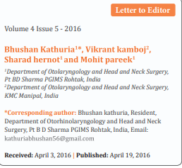

Slide 7
A 36 year old female presented with a progressively growing right sided unilateral neck mass since 4 years. There was no history of any difficulty in swallowing, breathing, change in voice or any associated pain. On examination around 6 X 4cm, firm, non tender swelling with well defined margins and smooth surface was present in the right side of lower part of the neck. The swelling was moving with deglutition, pushing the trachea to opposite side with feeble right side carotid pulsations. On evaluation ultrasonography revealed a hypoechoic nodular lesion measuring 6.5 X 3.5 cm, probably arising from the right lobe of thyroid gland. Also few anechoic cystic areas were noticed within the lesion with mild vascularity suggestive of a malignancy.
Further FNAC of the lesion was done, which was suggestive of spindle cell Carcinoma or thyroid malignancy, however confirmatory histopathological diagnosis was not possible and excision biopsy was adviced.

Slide 8
Next computerized tomography scan was planned, which demonstrated a heterogenous enhancing lobulated lesion (6 X 3.3 X 3.8 cm) in the right posterior parathyroid region in carotid space displacing the right lobe of thyroid. Carotid artery was compressed anteriomedially, and jugular vein was compressed laterally. The lesion was extentding laterally beneath the sternocleomastoid muscle displacing it anteriolaterally and inferiorly it extended along the paratracheal region. The differential diagnosis on imaging was Parathyroid paraganglioma, thyroid malignancy or Schwannoma

Slide 9
Patient was planned for excision of the lesion. Intraoperatively a solid lesion was seen separate from the thyroid gland pushing the right side carotid artery medially and internal jugular vein was lying superolaterally over the mass. The mass appeared to arise within the carotid space. The thyroid gland was grossly normal. The mass was excised separately leaving thyroid gland in situ

Slide 10
The histopathology report disclosed the lesion as medullary carcinoma thyroid. Retrospectively patient was evaluated postoperatively for other tumor markers (CEA - Carcinoembryonic antigen, serum Calcitonin level, Serum PTH -parathyroid harmone and 24 hr urine VMA-vanillylmandelic acid levels) which were found to be normal and ultrasonography of abdomen for adrenal glands was also inconclusive.
Finally the patient underwent total thyroidectomy with central and bilateral selective neck dissection. On histopathological examination thyroid gland was normal and there was no evidence of nodal metastasis. Patient was successively followed up for 3 months with normal serum level of tumour markers

Slide 11
What is term of macrocalcitonin ?

Slide 12
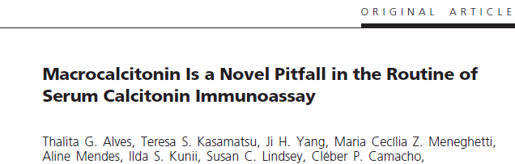

Slide 13
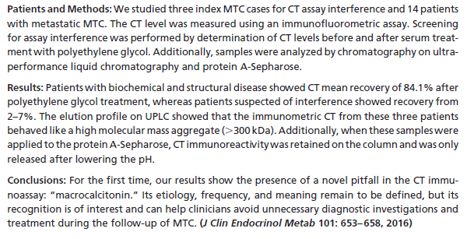

Slide 14
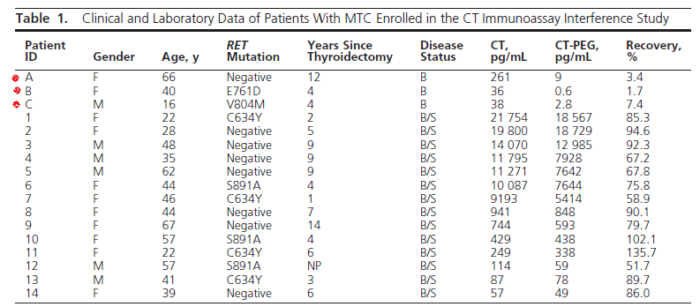

Slide 15
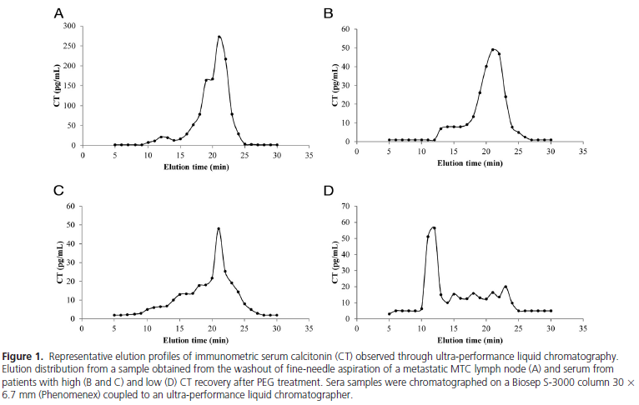

Slide 16
Although the exact etiology and frequency of the macro- CT phenomenon
remain to be explored, its discovery opens new perspectives for refining the
management of patients with MTC. Additional importance for this work
arises if a CT measurement was used in the initial management of thyroid
nodules, as proposed by some authors.
In these cases, additional caution must be taken, especially if the CT
measurement was only moderately increased (< 150 pg/mL). Finally, rather
than a simple immunological artifact, macro-CT recognition is noteworthy
because it can help clinicians avoid unnecessary diagnostic investigations
and treatments during MTC follow-up.

Slide 17
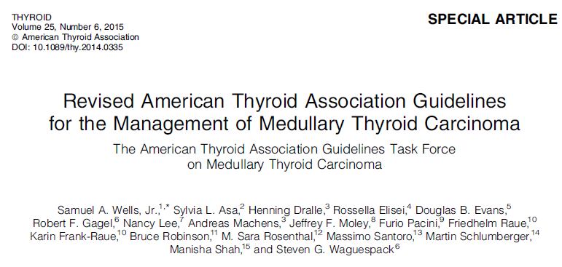

Slide 18
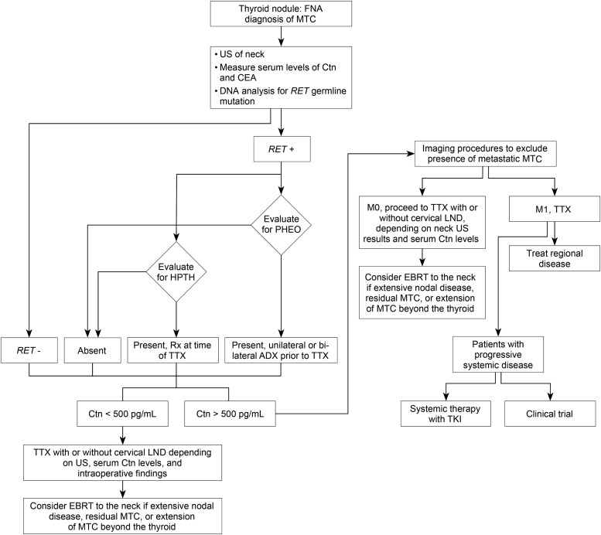

Slide 19
RECOMMENDATION 21:
Patients presenting with a thyroid nodule and a cytological or histological diagnosis of MTC should have a physical examination, determination of serum levels of Ctn and
CEA, and genetic testing for a RET germline mutation. The presence of a PHEO and HPTH should be excluded in patients with hereditary MTC. Grade B Recommendation
RECOMMENDATION 22:
Ultrasound examination of the neck should be performed in all patients with MTC .Contrast-enhanced CT of the neck and chest, three-phase contrast-enhanced multi-detector liver CT, or contrast-enhanced MRI of the liver, and axial MRI and bone scintigraphy are recommended in patients with extensive neck disease and signs or symptoms of regional or distant metastases, and in all patients with a serum Ctn level greater than 500 pg/mL. Grade C Recommendation
RECOMMENDATION 23:
Neither FDG-PET/CT nor F-DOPA-PET/CT is recommended to detect the presence of distant metastases. Grade E Recommendation

Slide 20
What is correlation between preoperative/postoperative serum Ctn level with metastasis ?

Slide 21
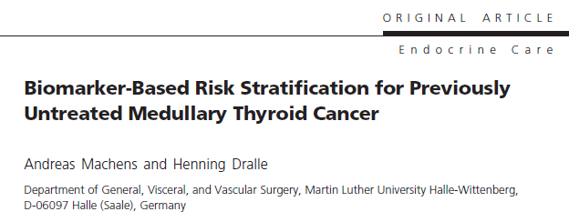

Slide 22
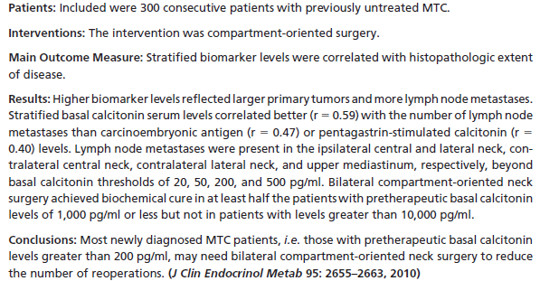

Slide 23
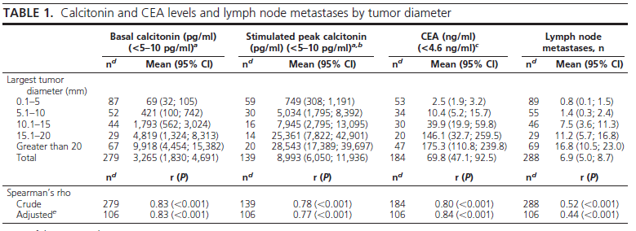

Slide 24
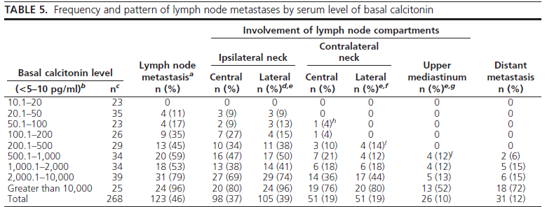

Slide 25
RECOMMENDATION 24:
Patients with MTC and no evidence of neck lymph node metastases by US examination and no evidence of distant metastases should have a total thyroidectomy and dissection of the lymph nodes in the central compartment (level VI). Grade B Recommendation
RECOMMENDATION 25:
In patients with MTC and no evidence of neck metastases on US, and no distant metastases, dissection of lymph nodes in the lateral compartments (levels II–V) may be considered based on serum Ctn levels. The Task Force did not achieve consensus on this recommendation. Grade I Recommendation

Slide 26
RECOMMENDATION 26:
Patients with MTC confined to the neck and cervical lymph nodes should have a total thyroidectomy, dissection of the central lymph node compartment (level VI), and dissection of the involved lateral neck compartments (levels II–V). When preoperative imaging is positive in the ipsilateral lateral neck compartment but negative in the contralateral neck compartment, contralateral neck dissection should be considered if the basal serum calcitonin level is greater than 200 pg/mL. Grade C Recommendation

Slide 27
RECOMMENDATION 29:
In patients having an inadequate lymph node dissection at the initial thyroidectomy a repeat operation, including compartment oriented lymph node dissection, should be considered if the preoperative basal serum CTN level is less than 1000 pg/mL and five or fewer metastatic lymph nodes were removed at the initial surgery. Grade C Recommendation

Slide 28
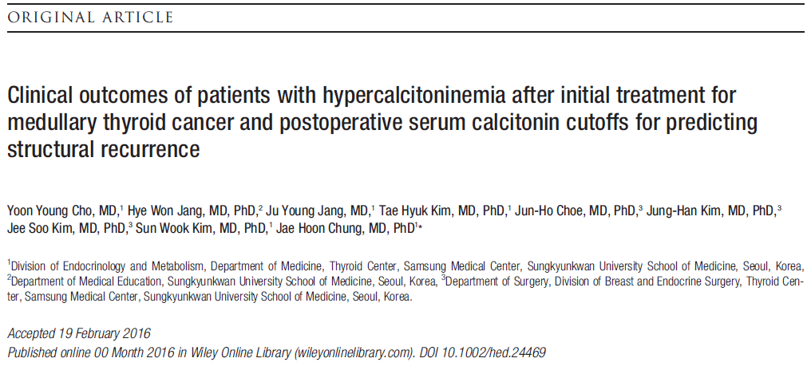

Slide 29
Mareial and methods
We retrospectively reviewed patients who underwent thyroid surgery for MTC at Samsung Medical Center between May 1996 and May 2015 (n=140).
After exclusion, a total of 118 patients were eligible for the analysis. Patients were classified as follows: (1) excellent response, undetectable calcitonin, and normal CEA levels without structural disease; (2) biochemical incomplete response, detectable calcitonin, or elevated CEA levels without structural disease; or (3) structural incomplete response, persistent structural disease regardless of serum calcitonin, and CEA levels.

Slide 30
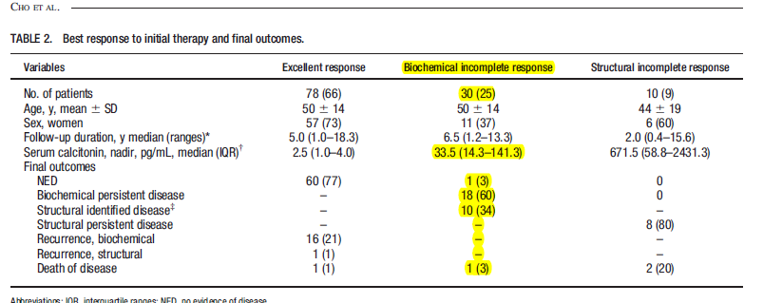

Slide 31
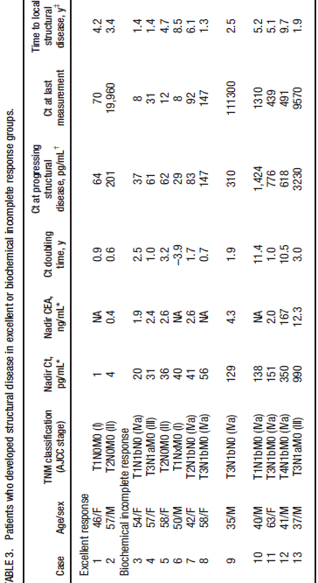

Slide 32
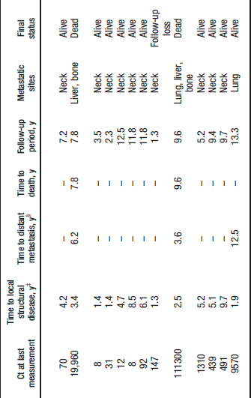

Slide 33
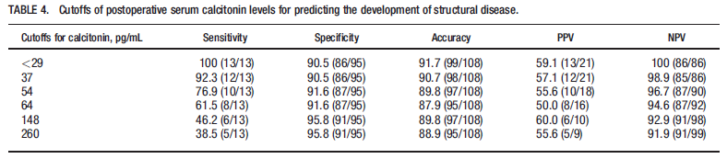

Slide 34
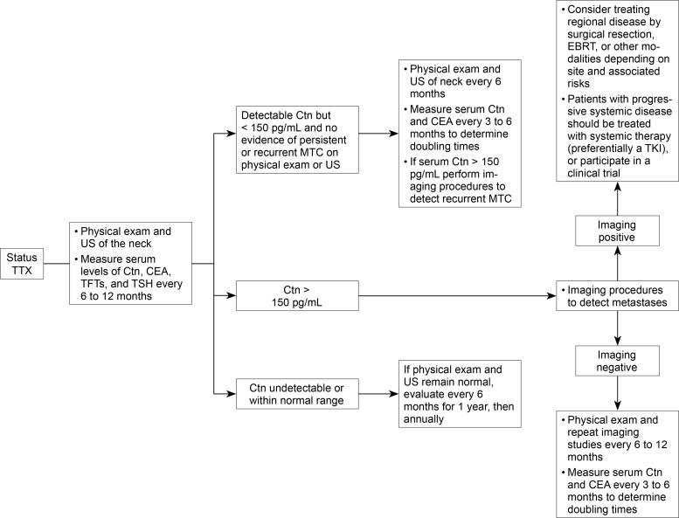

Slide 35
What is imaging modality for diagnosis residual/recurrence or metastasis in postoperative high Ctn level ?

Slide 36
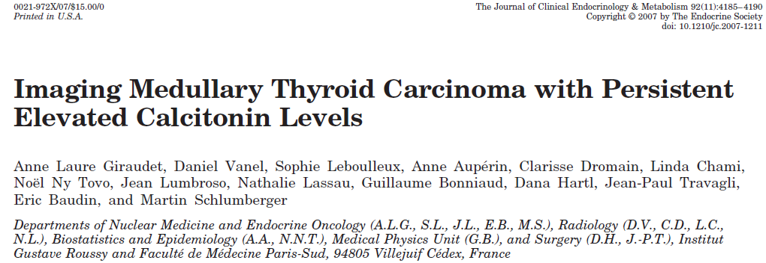

Slide 37
Patients and Methods:
Fifty-five consecutive elevated calcitonin level MTC patients were enrolled to undergo neck and abdomenultrasonography (US); neck, chest, and abdomen spiral computed tomography (CT); liver and whole-body magnetic resonance imaging (MRI); bone scintigraphy; and 2-[fluorine-18]fluoro-2-deoxy-D-glucose(FDG) positron emission tomography (PET)/CT scan (PET).
Results:
Fifty patients underwent neck US, CT, and PET, and neck recurrence was demonstrated in 56, 42, and 32%, respectively. Lung and mediastinum lymph node metastases in the 55 patients were demonstrated in 35 and 31% by CT and in 15 and 20% by PET. Liver imaging with MRI, CT, US, and PET in 41 patients showed liver in 49, 44, 41, and 27% patients, respectively. Bone metastases in 55 patients were demonstrated in 35% by PET, 40% by bone scintigraphy, and 40% by MRI; bone scintigraphy was complementary with MRI for axial lesions but superior for the detection of peripheral lesions. Ten patients had no imaged tumor site despite elevated calcitonin level (median 196 pg/ml; range 39–816). FDG uptake in neoplastic foci was higher in progressive patients but with a considerable overlap with stable ones.
Conclusion:
The most efficient imaging work-up for depicting MTC tumor sites would consist of a neck US, chest CT, liver MRI, bone scintigraphy, and axial skeleton MRI. FDG PET scan appeared to be less sensitive and of low prognostic value

Slide 38
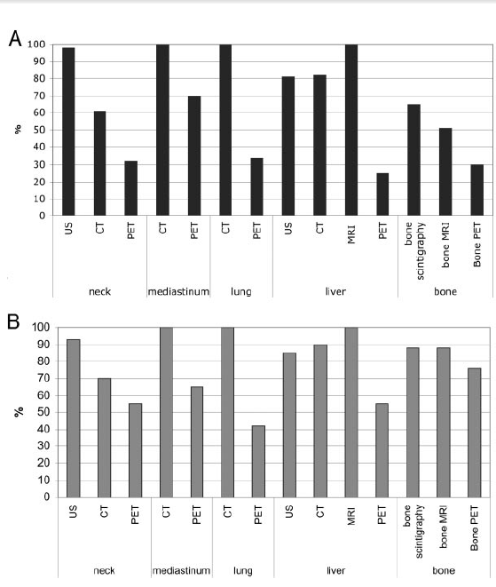
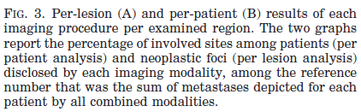

Slide 39
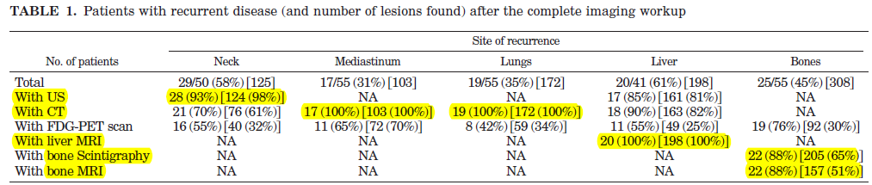

Slide 40
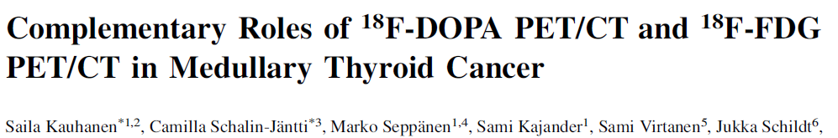


Slide 41
Methods: Nineteen MTC patients with increased calcitonin or CEA on follow-up (mean 6 SD, 93 6 91
mo; range, 4–300 mo) after primary therapy were prospectively imaged with 4 techniques: 18F-
DOPA PET/CT, 18F-FDG PET/CT, MDCT, and MRI. Images were analyzed for pathologic lesions, which
were surgically removed when possible. The correlation between the detection rate for each
method and the Calcitonin and CEA concentrations and histopathologic findings was investigated.
Results: On the basis of histology and followup, one or more imaging methods accurately localized
metastatic disease in 12(63%) of 19 patients. The corresponding figures for 18F-DOPA PET/CT,
18F-FDG PET/CT, MDCT, and MRI were 11 (58%) of 19, 10 (53%) of 19, 9 (47%) of 19, and 10 (59%) of
17, respectively. Calcitonin and CEA correlated with 18F-DOPA PET/CT (P 5 0.0007 and P 5 0.0263,
respectively) and 18F-FDG PET/CT findings (both P , 0.0001). In patients with an unstable calcitonin
doubling time (n 5 8), 18F-DOPA and 18F-FDG PET/CT were equally sensitive. In contrast, for
patients with an unstable CEA doubling time (n 5 4), 18F-FDG PET/CT was more accurate.
Conclusion: For most MTC patients with occult disease, 18F-DOPA PET/CT accurately detects
metastases. In patients with an unstable calcitonin level, 18F-DOPA PET/CT and 18F-FDG PET/CT are
complementary. For patients with an unstable CEA doubling time, 18F-FDG PET/CT may be more
feasible. MRI is sensitive but has thehighest rate of false-positive results.

Slide 42
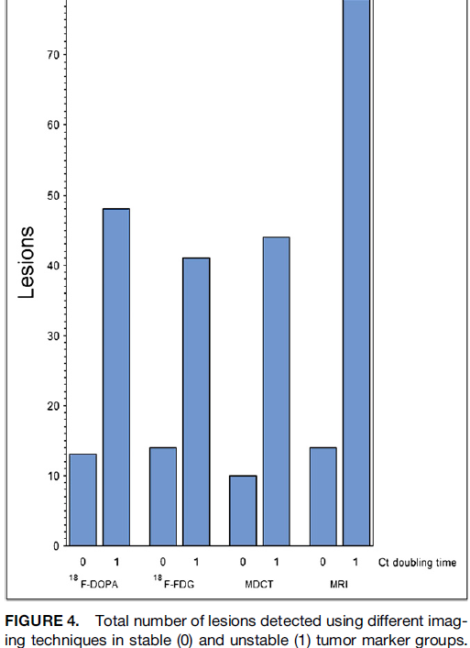

Slide 43
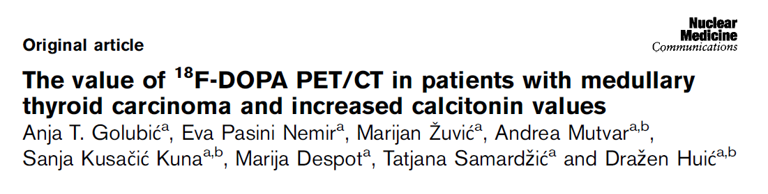
Nuclear Medicine Communications 2017, 38:636–641

Slide 44
Patients and methods: Twenty-eight MTC patients after initial total thyreoidectomy with increasing follow-up
calcitonin levels suggestive for active disease after negative conventional imaging findings (neck ultrasound or
thorax,abdomen, pelvis multislice computed tomography asstandard imaging) were scanned using 18F-DOPA
PET/CTfrom November 2012 to April 2016. The mean calcitonin level was 108.5 (range: 6.7–290) pmol/l and
the mean carcinoembryonic antigen level was 15.7 (range: 1.1–221.9) μg/l. The mean follow-up period was 19.7 months.
Results 18F-DOPA PET/CT was positive in 16 out of 28(57%) patients, mostly because of metabolically active
neck and mediastinal lymph nodes metastases. Previously unknown bone metastases were found in six
patients. A positive scan was reported in four patients (25% of positive scans) with a very low calcitonin value
of less than 49.9 pmol/l. PET/CT findings led to a change of management and therapy in 16 out of 28 patients,
with surgical procedure performed in eight patients, radiotherapyin five patients, and chemotherapy in two
Patients

Slide 45
Conclusion: 18F-DOPA PET/CT is a clinically useful modality in MTC
whenever the calcitonin level is increased.There is a clear trend toward
more positive scans with the higher calcitonin values, but patients with
Moderately elevated calcitonin values should also be taken into
consideration for molecular imaging with 18F-DOPA PET/CT as the
tumor burden in these patients is probably low, enabling further
therapy to be individualized and consequently more efficient

Slide 46
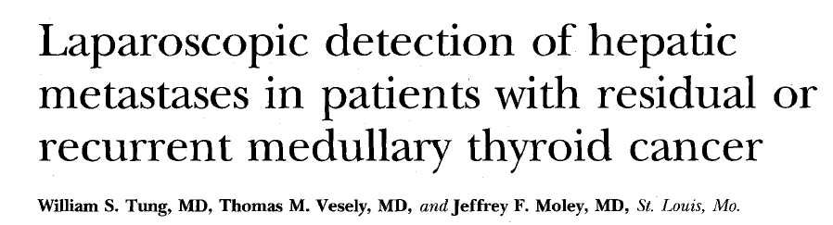

Slide 47
Background. After initial operations for medullary thyroid cancer (MTC), reoperation with removal
of metastatic disease confined to the neck may benefit some patients. The identification of distant
metastases precludes the possibility of curative reoperation.
Methods: Forty-one patients with hypercalcitoninemia after initial surgical treatment for MTC
underwent lapmvscopic (n = 36) or open (n = 5) examination and biopsy of the liver. Thirty-seven of
these patients underwent imaging by computed tomography (CT), magnetic resonance imaging
(MR1) of the liver, or both, and 17 underwent selective venous catheterization (SVC) with
measurement of hepatic and peripheral vein stimulated calcitonin levels.
Result :Liver metastases were found in eight patients, seven by laparoscopy and one by open
examination. Seven of these patients had normal CT or MRI scans of the liver. Laparoscopy or open
Liver examination revealed metastases in 2 of 11 patients with elevated hepatic vein—peripheral
Vein stimulated calcitonin ratios (greater than 1.3). Metastases appeared as small (less than 5 mm),
brightwhite nodules on the surface of the liver.
Conclusions. Direct examination and biopsy of the liver by laparoscopy may show small deposits of
metastatic MTC in patients with normal CT and MRI scanning.

Slide 48
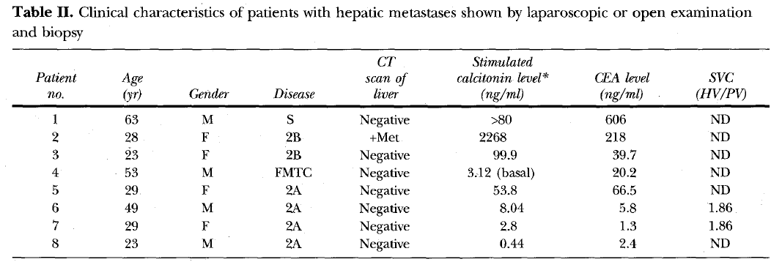

Slide 49
RECOMMENDATION 48:
If the postoperative serum Ctn level exceeds 150 pg/mL patients should be
evaluated by imaging procedures, including neck US, chest CT, contrast-enhanced
MRI or three-phase contrast-enhanced CT of the liver, and bone scintigraphy and
MRI of the pelvis and axial skeleton. Grade C Recommendation
RECOMMENDATION 54
In patients with persistent or recurrent MTC following thyroidectomy, one should
consider laparoscopic or open evaluation and biopsy of the liver to exclude occult
Metastases before subjecting them to a long and arduous repeat neck operation. Grade C Recommendation

Slide 50
What we shoud be do in the case ?

Slide 51
Reoperation { servical L.N dissection}
MRI of liver
MRI of axial bone
MRI of pelvic
PET/CT
laparoscopic or open evaluation and biopsy of the liver
RET protoonkogen analysis

