Slide 2
Pharmacotherapy for
Non-Alcoholic Fatty Liver Disease
An Updated Review
Anita Eftekharzadeh, MD
Endocrinologist
Research Institute for Endocrine Sciences
July 2016, Tehran

Slide 3
Outline
Rationale and Definitions
Review of Literature
Insulin sensitizers
Anti-lipidemic
Antioxidants
Anti-inflammatory
Probiotics
Cytoprotective/ anti-apoptotic agents
Upcoming drugs
Herbal
Treatment of patients with T2DM and NAFLD
Pediatric NAFLD
Monitoring of treatment
Recommendations
Take home messages

Slide 4
Sub-classification of NAFLD
NAFL
• Pure steatosis
• Steatosis and mild lobular inflammation
NASH
• Early NASH: no or mild (F0-F1) fibrosis
• Fibrotic NASH: significant (≥F2) or advanced (≥F3, bridging) fibrosis
• NASH-cirrhosis (F4)
Hepatocellular carcinoma
Diabetologia 2016; 59 1121-1140

Slide 5
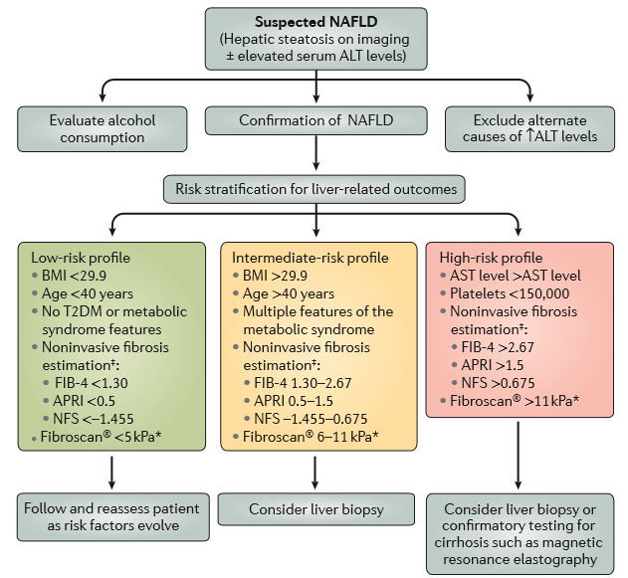
Proposed risk stratification for patients with NAFLD
Nat Rev Gastroenterol Hepatol.
2016 Apr;13(4):196-205

Slide 6
Non-invasive measures
NAFLD fibrosis score (NFS): Estimates fibrosis using age, BMI, AST, ALT, Plt, Albumin and history of IFG/DM
Hepatology 2007;45(4):846-854
Fibrosis-4 (FIB-4) Index: Noninvasive estimate of liver scarring in HCV and HBV patients, using age, AST, ALT and Plt.
J Viral Hepat. 2013;20(1):72-76
APRI: The aspartate aminotransferase-to-platelet ratio index (APRI), a tool for detecting hepatic fibrosis
Hepatology. 2011;53(3):726-36

Slide 7
NAFLD activity score (nas)
NAS is the sum of the separate scores for steatosis (0–3), hepatocellular ballooning (0–2) and lobular inflammation (0–3)
The majority of patients with NASH have a NAS score of ≥5.
This system was developed as a tool to quantify changes in NAFLD during therapeutic trials.
The cutoff NAS score ≥5 cannot be used as a surrogate of histological diagnosis of NASH that is usually performed by expert-based evaluation of pathologic patterns for NASH.
Hepatology 2005;41 1313–1321

Slide 8
Rationale
Successful treatment of NASH should improve outcome, i.e. decrease NASH-related mortality, reduce progression to cirrhosis or HCC.
Given the low probability of adverse liver-related outcomes in those in the low-risk categories of NAFLD, most patients do not warrant pharmacological treatment
Resolution of the histological lesions of NASH is accepted as a surrogate endpoint.
Diabetologia 2016; 59 1121-1140
Nat Rev Gastroenterol Hepatol. 2016;13 196-205

Slide 9
Insulin Sensitizers
Thiazolidinediones
The PIVENS trial (the Pioglitazone, Vitamin E or placebo for NASH)
Fibrosis scores were not improved with either active treatment
Metfomin
RCT with 110 non-diabetic NAFLD; better than Vitamin E in improving ALT
Not confirmed by other trials
Incretin mimetics
Phase II trial with Liraglutide vs. placebo; 52 overweight Pt. with NASH
Possible role in delaying progression of fibrosis
Gastroenterology Research and Practice, 2016; 7109270

Slide 10
The pivens trial
Randomized, double blinded, multi center, placebo controlled
247 non-diabetic patients with Bx proven NASH; 96 wks
Three groups: pioglitazone 30 mg daily; vitamin E 800 IU daily; placebo
Primary endpoint: ↓in NAS by at least 2 points, & improvement in ballooning by 1 point
New England Journal of Medicine 2010; 362:1675-1685

Slide 11
The pivens
90% underwent end-of-treatment Bx at 96 wks
Vit E vs placebo:
Higher rate of improvement in NASH (43% vs. 19%)
Sig. better if “no worsening of ballooning” set as criterion (51% vs 25%)
Pioglitazone vs placebo:
No improvement in primary outcome (34% vs. 19%, p=0.04)
Sig. better if “no worsening of ballooning” set as criterion (48% vs 25%, p=0.003)
Fibrosis scores were not significantly improved with either active treatment
New England Journal of Medicine 2010; 362:1675-1685

Slide 12
Insulin Sensitizers
Pioglitazone
Metfomin
RCT with 110 non-diabetic NAFLD; better than Vitamin E in improving ALT (Bugianesi et al, 2005); Not confirmed by other trials
Most studies: No additional histological/ biochemical benefit
Incretin mimetics
Phase II trial with Liraglutide vs. placebo; 52 overweight Pt. with NASH
Possible role in delaying progression of fibrosis
Gastroenterology Research and Practice, 2016; 7109270

Slide 13
The LEAN Trial
Multicenter, double-blinded, RCT phase II; 48 wks
52 overweight (diabetic and non-diabetic) pts; Liraglutide 1.8 mg/d vs placebo
Primary outcome: disappearance of ballooning without worsening of fibrosis
Secondary outcome: changes in NAS, liver enzymes, non-invasive biomarkers, …
Lancet 2016; 387: 679–90

Slide 14
The lean trial
39% in the Tx group vs 9% in the Pl group had resolution of definite NASH with no worsening of fibrosis, thereby meeting the primary outcome
The RR of response when receiving Lira vs Pl, adjusted for diabetes was 3∙7 (1∙0–13∙5; p=0∙047)
Fewer patients in the Lira group had progression of fibrosis than in the Pl group (9% vs 26%)
No differences were seen in lobular inflammation and overall NAFLD activity score
Lancet 2016; 387: 679–90

Slide 15
Antilipidemics
Fibrate
Improvement(?) in liver enzymes, but no histologic changes
Niacin
Possible hepatotoxic effects in some studies
NPC1L1 inhibitor
RCT with 32 bx proven NAFLD; Ezetimibe 10 vs. placebo for 6 months; sig. improvement in ballooning/ fibrosis but no change in inflammation/ steatosis; significant increase in hepatic long-chain FA, oxidative stress, IR and HbA1C
Gastroenterology Research and Practice, 2016; 7109270

Slide 16
Polyunsaturated fatty acids (PUFA)
RCT with 37 pts; Bx proven NASH; PUFA vs. placebo; 48 wks; sig. improvement in steatosis & NAS in placebo group, worsening of IR in PUFA group.
RCT with 34 pts; Bx proven NASH; n-3 fish oil 3000 mg/d for 1 y; No difference between the 2 group
Gastroenterology Research and Practice, 2016; 7109270

Slide 17
Statins
Beneficial effect on NAFLD likely due to anti-inflammatory, antioxidants and antifibrogenic properties
RCT involving hyperlipidemic pts with US evidence of NAFLD; comparing Atorvastatin 20 daily, Fenofibrate 200 daily and combination
Atorvastatin alone and combination had a higher degree of biochemical and US NAFLD regression
Gastroenterology Research and Practice, 2016; 7109270

Slide 18
Antioxidants
Vitamin E
The PIVENS trial/ The TONIC trial: No improvement in fibrosis
Vit E 1000 IU/d + Vit C 1000 mg/d for 6 M (45 pts with Bx proven NASH): improvement in fibrosis but not in necroinflammaton and ALT
Vit E + pioglitazone vs Vit E alone (small study): improvement in fobrosis
Vit E + ursodeoxycholic acid (UDCA) for 2 y (48 pts with Bx proven NASH): improvement in ALT and steatosis
S-adenosyl methionine (SAM), N-acetyl cysteine (NAC)
Short duration, small samples, not enough evidence to support or oppose its use
Gastroenterology Research and Practice, 2016; 7109270

Slide 19
Anti-inflammatory
Pentoxifylline
A xanthine derivative, inhibits TNF alpha
RCT with 49 pts (Bx proven NASH); placebo controlled trial; Significant improvement in ALT, steatosis, inflammation, fibrosis; No change in ballooning
RCT with 30 pts; no improvement in ALT & histology
Meta-analysis of RCTs: Pentoxifylline significantly reduced ALT, BMI, FPG, steatosis, lobular inflammation and fibrosis
Larger well designed RCTs still needed to confirm these results
Gastroenterology Research and Practice, 2016; 7109270

Slide 20
Probiotics
Intestinal bacterial content may be related to the pathogenesis of NASH
Probiotics tested: Lactobacillus bulgaricus, Streptococcus thermophilus, Bifidobacterium longum
Meta-analysis of 4 double-blind RCT with 134 Bx proven NAFL/NASH patients: probiotics significantly decrease T.Chol, aminotransferases, HOMA-IR and TNF alpha.
Gastroenterology Research and Practice, 2016; 7109270

Slide 21
Cytoprotective/ antiapoptotic agents
Ursodeoxycholic acid (UDCA)
Mixed results with low and high dose UDCA
Systematic review: UDCA monotherapy improved liver enzymes, steatosis and fibrosis in few studies
UDCA combined with other drugs showed greater improvement in steatosis and inflammation
There might be variation in outcome with low and high dose UDCA
Gastroenterology Research and Practice, 2016; 7109270

Slide 22
Other therapeutic agents
Renin-Angiotensin-Aldosterone System (RAAS) inhibitors:
Cross-sectional study; 290 pts with NAFLD; with and without RAAS blocker; less ballooning and lower fibrosis stage in pts on RAAS blockers.
54 pts with HTN and NASH; randomized to Valsartan/Telmisartan for 20 M; Both improved OT/PT and IR; Telmisartan improved NAS & fibrosis
Gastroenterology Research and Practice, 2016; 7109270

Slide 23
Herbal
Milk thistle (silymarin)
Antioxidant, anti-inflammatory, antifibrogenic activity; help with liver cell regeneration
RCT; Silybin in combination with vitamin E and phospholipids; improved steatosis
RCT; In combination with phophatidylcholine; 138 pts for 12 M; significant improvement in liver enzymes, HOMA-IR, liver histology
Gastroenterology Research and Practice, 2016; 7109270

Slide 24
Upcoming drugs

Slide 25
Therapeutic agent | Target | Proposed mode of action
BMS986036 | Modulation of FGF21 metabolism | Improvement of hepatic lipid and glucose metabolism; anti-inflammatory
Cenicriviroc | CCR2 and CCR5 | Inhibition of CCR2- and CCR5-mediated monocyte/macrophage infiltration and inflammation
Elafibranor | Modulation of hepatic PPARα and PPARδ pathways | Stimulation of NEFA oxidation; improvement of lipid and glucose metabolism; prevention of inflammation
Emricasan | Caspase pathways (pan-caspase inhibitor) | Inhibition of fibrosis by blocking caspase protease activation and apoptosis pathways
GR-MD-02 | Galectin-3 inhibitor | Prevention of inflammation and fibrosis
Obeticholic acid | FXR agonist | Regulation of hepatic glucose and lipid metabolism
Px-104 | FXR agonist | Regulation of hepatic glucose and lipid metabolism
Simtuzumab | LOXL2 enzyme activity | Inhibition of fibrosis by a LOXL2 monoclonal antibody
FXR, Farnesoid X receptor; LOXL2, Lysyl oxidase-like 2
Diabetologia 2016;59 1112-1120

Slide 26
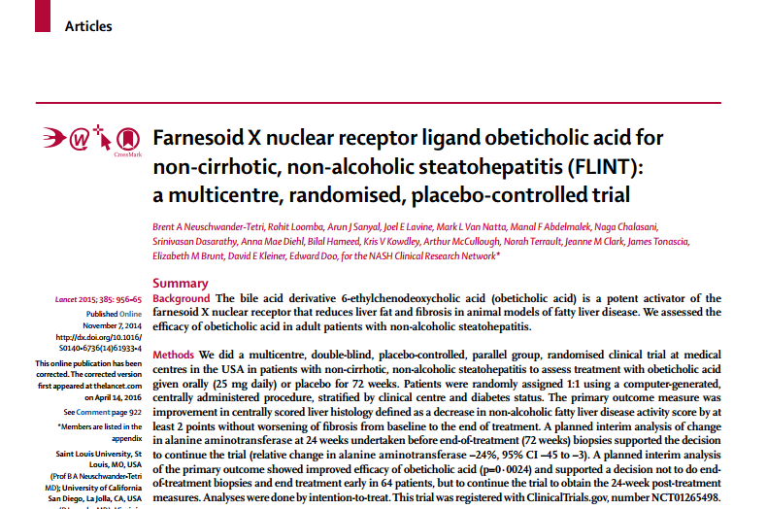
The FLINT study
Multicenter, double-blind RCT
283 pts assigned to either 25 mg Obeticholic acid or placebo
The primary outcome measure was a decrease in NAS by at least 2 points without worsening of fibrosis from baseline to the end of treatment (72 wks).
Stopped early because of efficacy.
Obeticholic acid improved hepatic steatosis, inflammation, hepatocyte ballooning, and fibrosis.
Lancet 2015;385 956-965

Slide 27
Rationale and Definitions
Review of Literature
Insulin sensitizers
Anti-lipidemic
Antioxidants
Anti-inflammatory
Probiotics
Cytoprotective/ anti-apoptotic agents
Upcoming drugs
Herbal
Treatment of patients with T2DM and NAFLD
Pediatric NAFLD
Monitoring of treatment
Recommendations
Take home messages

Slide 28
Type 2 DM and NAFLD
More aggressive form of hepatocyte injury
Higher risk of fibrosis, end-stage liver disease and HCC
Strong association with cardiovascular disease
May worsen microvascular disease in diabetes
Diabetologia 2016;59 1112-1120

Slide 29
Type 2 DM and NAFLD
Metformin:
Negative results in children and adults
Pioglitazone:
Enhances insulin sensitivity and prevents excessive lipolysis; Unpublished positive results in IFG/IGT with NAFLD
GLP-1 receptor agonists (Liraglutide)
Improve Bx proven NASH as suggested by the LEAN trial
Diabetologia 2016;59 1112-1120

Slide 30
Type 2 DM and NAFLD
Depeptidyl peptidase 4 (DPP-4) inhibitors
Sitagliptin: neutral/ decrease ALT; impact on histology unknown
Vildagliptin: small reduction in hepatic triacylglycerol accumulation
Sodium-glucose cotransporter 2 (SGLT 2) inhibitors (antifibrotic in animals)
Canagliflozin 300 mg vs Sitagliptin (52 wks): significant reduction in ALT; might be due to ↓ in Hb A1C and body weight.
The role of reversing glucotoxicity per se on NASH (independent of treating insulin resistance) has never been examined in an RCT in type 2 DM

Slide 31
Pediatric NAFLD
Diet and exercise training reduce steatosis, but do not affect ballooning, inflammation and fibrosis.
Vit E, metformin, probiotics and docosahexanoic acid have shown beneficial effects on ballooning, steatosis and inflammation.
Fibrotic lesions are refractory to treatment.
Long-term outcome of pediatric NASH is poor.
Diabetologia 2016; 59 1121-1140

Slide 32
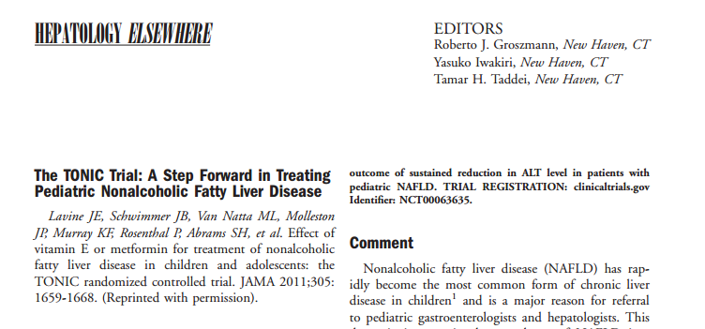
Treatment of NAFLD in Children (TONIC)
Vitamin E, metformin vs. placebo
Multicenter, double-blind RCT
137 pts, aged 8-17 y, 800 IU Vit E or 1000 mg Metformin or placebo
Hepatology 2012;55 1292-1300

Slide 33
Pediatric NAFLD
The primary outcome: sustained reduction in ALT (50% or less of the baseline level or 40 U/L or less at visits every 12 weeks from 48 to 96 weeks of treatment)
Improvements in histological features of NAFLD and resolution of NASH were secondary outcome measures.
Vitamin E improved liver enzyme levels and histology but,
Treatment group did not met the primary end point of a sustained reduction (> 6 month)
No improvement in fibrosis
Neither vitamin E nor Metformin was superior to placebo in attaining the primary outcome of sustained reduction in ALT level
Hepatology 2012;55 1292-1300

Slide 34
Monitoring of treatment
Monitoring should include routine biochemistry, assessment of comorbidities and non-invasive monitoring of fibrosis.
NAFL patients without worsening of metabolic risk factors, should be monitored at 2–3-year intervals.
Patients with NASH and/or fibrosis should be monitored annually, those with NASH cirrhosis at 6-month intervals.
If indicated on a case-by-case basis, liver biopsy could be repeated after 5 years
Journal of Hepatology 2016vol. 64j 1388–1402

Slide 35
Monitoring of treatment
Noninvasive methods to document treatment efficacy are lacking.
Liver biopsy is necessary to determine treatment efficacy.
Normalization of ALT level combined with even modest weight loss increases the probability of histological improvement in NASH to ~90% in those receiving vitamin E. (PIVENS trial)
A decreased in the FIB-4 and APRI indices after 6 months of treatment were shown to be predictive of improved fibrosis after 72 weeks of treatment in those receiving obeticholic acid. (FLINT study)
Nat Rev Gastroenterol Hepatol. 2016 Apr;13(4):196-205

Slide 36
recommendations

Slide 37
recommendations
2016
European Association for the Study of the Liver (EASL)
European Association for the Study of Diabetes (EASD)
European Association for the Study of Obesity (EASO)
2014
World Gastroenterology Organization (WGO)

Slide 38
Regulation
No drug has currently been tested in phase III trials and is approved for NASH by regulatory agencies.
No specific therapy can be firmly recommended.
Safety and tolerability are essential prerequisites.
Diabetologia 2016; 59 1121-1140

Slide 39
Grading | Notes | Symbol
Grading of evidence
High quality | Further research is very unlikely to change our confidence in the estimate effect | A
Moderate quality | Further research is likely to have an important impact on our confidence in the estimate of effect and may change the estimate effect | B
Low or very low quality | Further research is very likely to have an important impact on our confidence in the estimate of effect and may change the estimate effect. Any estimate of effect is uncertain | C
Grading of recommendations
Strong recommendation | Factors influencing the strength of the recommendation included the quality of the evidence, presumed patient-important outcomes, and cost | 1
Weaker recommendation | Variability in preferences and values, or more uncertainty: more likely a weak recommendation is warranted Recommendation is made with less certainty; higher cost or resource consumption | 2

Slide 40
Recommendations
Pharmacotherapy should be reserved for patients with NASH (esp. for those with stage F2 and higher) (B1)
Patients at high risk of disease progression (with DM, MetS, persistently increased ALT, high necro-inflammation) could also be candidates to prevent disease progression. (B1)
Diabetologia 2016; 59 1121-1140
Journal of Clinical Gastroentrology 2014; 48 467-473

Slide 41
Recommendations
Pioglitazone (most efficacy data, off-label outside T2DM) or Vitamin E (better safety and tolerability in the short-term) or their combination could be used for NASH (B2)
The optimal duration of therapy is unknown (C2)
In patients with increased ALT at baseline, treatment should be stopped if there is no reduction in aminotransferases after 6 months of therapy (C2)
In patients with normal ALT at baseline, no recommendations can be made (C2)
Diabetologia 2016; 59 1121-1140

Slide 42
Take home messages
Not every patient with fatty liver needs pharmacotherapy
Pharmacotherapy should be started on a stage-based (biopsy proven?) approach
Pay special attention to high risk patients (with DM, MetS, HTN, persistently increased ALT)
Vitamin E and pioglitazone are the most effective drugs in treating NASH
Vitamin E may have better efficacy when combined with other agents
Long term side effects of each medication should be kept in mind

Slide 43
references
European Association for the Study of the Liver (EASL), European Association for the Study of Diabetes (EASD) & European Association for the Study of Obesity (EASO). EASL-EASD-EASO Clinical Practice Guidelines for the Management of Non-Alcoholic Fatty Liver Disease. Diabetologia (2016) 59: 1121.
Newaz Hossain, Pushpjeet Kanwar, and Smruti R. Mohanty. A Comprehensive Updated Review of Pharmaceutical and Nonpharmaceutical Treatment for NAFLD. Gastroenterology Research and Practice (2016).
Kenneth Cusi. Treatment of patients with type 2 diabetes and non-alcoholic fatty liver disease: current approaches and future directions. Diabetologia (2016) 59: 1112.
World Gastroenterology Organisation Global Guidelines: Nonalcoholic Fatty Liver Disease and Nonalcoholic Steatohepatitis. Journal of Clinical Gastroenterology (2014) 48: 467–473
Alkhouri, Naim, and Ariel E. Feldstein. “The TONIC Trial: A Step Forward in Treating Pediatric Nonalcoholic Fatty Liver Disease.” Hepatology (Baltimore, Md.) 55.4 (2012): 1292–1295.

Slide 44
Thank you for your attention

