Slide 1
IN THE NAME OF GOD

Slide 2
Preoperative management of patients with thyroid dysfunction who are candidates for CABG
Mozhgan Karimifar
MD Isfahan University of Medical Sciences
15 NOVEMBER 2018

Slide 3
Thyroid disease is common; the prevalence is higher in women and with increasing age.
Although most patients with well compensated thyroid disease do not need special consideration prior to surgery, patients who have a newly diagnosed thyroid disorder around the time of surgery require a discussion of the risks and benefits of proceeding with surgery.

Slide 4
AGENDA
Preoperative management of patients who are candidates for CABG and have:
Hypothyroidism
Hyperthyroidism

Slide 5
HYPOTHYROIDISM

Slide 6
Defining severity of hypothyroidism
Severe hypothyroidism
Moderate hypothyroidism
Mild hypothyroidism

Slide 7
Severe hypothyroidism
Includes patients with:
myxedema coma
severe clinical symptoms of chronic hypothyroidism such as:
altered mentation
pericardial effusion
heart failure
very low levels of total thyroxine (T4) (eg, less than 1.0 mcg/dL) or free T4 (eg, less than 0.5 ng/dL).
Weinberg AD, Brennan MD, Gorman CA, et al. Outcome of anesthesia and surgery in hypothyroid patients. Arch Intern Med 1983; 143:893.
Bennett-Guerrero E, Kramer DC, Schwinn DA. Effect of chronic and acute thyroid hormone reduction on perioperative outcome. Anesth Analg 1997; 85:30.

Slide 8
Moderate hypothyroidism
Includes all other patients with overt hypothyroidism elevated TSH and low free T4 without the features of severe hypothyroidism.
Weinberg AD, Brennan MD, Gorman CA, et al. Outcome of anesthesia and surgery in hypothyroid patients. Arch Intern Med 1983; 143:893.
Bennett-Guerrero E, Kramer DC, Schwinn DA. E?ect of chronic and acute thyroid hormone reduction on perioperative outcome. Anesth Analg 1997; 85:30.

Slide 9
Mild hypothyroidism
Includes patients with subclinical hypothyroidism, defined biochemically as a normal serum free T4 concentration in the presence of an elevated serum TSH concentration.
Weinberg AD, Brennan MD, Gorman CA, et al. Outcome of anesthesia and surgery in hypothyroid patients. Arch Intern Med 1983; 143:893.
Bennett-Guerrero E, Kramer DC, Schwinn DA. E?ect of chronic and acute thyroid hormone reduction on
perioperative outcome. Anesth Analg 1997; 85:30.

Slide 10
Cardiovascular Complications of Hypothyroidism
Coronary events (↑cholesterol levels,↑DBP, ↑CRP)
Aanemia
Nonspecific ST changes and low voltage on electrocardiogram
Ventricular tachycardia with a long QT interval “Torsade de pointes”(less common)
Diminished cardiac output of 30% to 50%
Bradicardia
Marcia Rashelle PalacePerioperative management of Thyroid Dysfunction Health Services Insights ﻿2017- https://doi.org/10.1177/11786329166896

Slide 11
Cardiovascular Complications of Hypothyroidism
↓contractility (↓ventricular diastolic relaxation compliance and diastolic filling are impaired)
calcium-dependent adenosine triphosphatase and phospholamban
↑ in peripheral vascular resistance resulting in increased cardiac afterload
↓pulse pressure via an ↑ in DBP and a ↓ in SBP
carotid intimal media thickness
endothelial derived relaxation factor (nitric oxide)
↑catecholamine levels
predisposition to develop hypotension under anesthesia, likely due to downregulation of β-adrenergic receptors
Marcia Rashelle Palace Management of Thyroid Dysfunction Health Services Insights ﻿2017- https://doi.org/10.1177/11786329166896

Slide 12
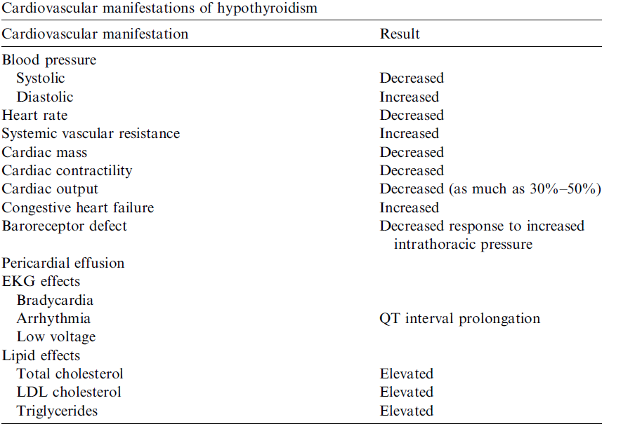
Nikolaos Stathatos, MD, Leonard Wartofsky, MD* N. Stathatos, L. Wartofsky / Endocrinol Metab Clin
N Am 32 (2003) 503–518Perioperative management of patients with hypothyroidism

Slide 13
What is the surgical outcomes of hypothyroidism patients?

Slide 14
Mild hypothyroidism
Indeed we have few data about surgical outcomes of subclinical hypothyroid patients.
In a prospective study comparing postoperative outcomes after CABG in patients with known preoperative mild hypothyroidism and euthyroid patients (between July 2005 and June 2007).
Park YJ, Yoon JW, Kim KI, et al. Subclinical hypothyroidism might increase the risk of transient atrial fibrillation
after coronary artery bypass grafting. Ann Thorac Surg 2009; 87:1846.

Slide 15
Mild hypothyroidism (continue)
There were no significant differences in major adverse cardiovascular events or other outcomes include:
Wound problems
Mediastinitis
Leg infection
Respiratory complications
Delirium
Reoperation during the same hospitalization
was seen.
But ↑ in the rate of postoperative AF
Park YJ, Yoon JW, Kim KI, et al. Subclinical hypothyroidism might increase the risk of transient atrial fibrillation
after coronary artery bypass grafting. Ann Thorac Surg 2009; 87:1846.

Slide 16
Mild (subclinical) hypothyroidism
In one study on outcomes after percutaneous transluminal coronary artery (PTCA) , the same results were seen.
However, there was an increase in the rate of postoperative AF in the subclinical hypothyroidism group.
Sherman SI, Ladenson PW. Percutaneous transluminal coronary angioplasty in hypothyroidism. Am J Med 1991; 90:367.

Slide 17
Moderate hypothyroidism
In another retrospective study, 40 hypothyroid surgical patients, most of whom had mild to moderate severe hypothyroidism, were compared with 80 euthyroid surgical patients who served as controls.
Marcia Rashelle Palace Perioperative Management of Thyroid Dysfunction Health Services Insights ﻿2017- https://doi.org/10.1177/11786329166896
Notes:
uptodate

Slide 18
Moderate overt hypothyroidism
In noncardiac surgery group who had hypothyroidism → intraoperative hypotension
In cardiac surgery group who had hypothyroid ism→heart fauiler
In addition, the hypothyroid group had a
higher rate of gastrointestinal and
neuropsychiatric complications
Marcia Rashelle Palace Perioperative Management of Thyroid Dysfunction Health Services
Insights ﻿2017- https://doi.org/10.1177/11786329166896

Slide 19
CABG in Patients With Hypothyroidism
Subclinical hypothyroidism (TSH concentration, 4.50 - 19.9 mIU/L) occurs commonly in patients with CAD.
In a meta-analysis of 55,000 subjects with CAD, those with subclinical hypothyroidism did not have an increase in total deaths, but the CAD mortality rate was increased, particularly in those with TSH concentrations > 10 mIU/L .
2011 ACCF/AHA Guideline for Coronary Artery Bypass Graft Surgery (Journal of the American College of Cardiology Vol. 58, No. 24, 2011 © 2011 by the American College of Cardiology Foundation and the American Heart Association, Inc.)
Notes:
2011 ACCF/AHA Guideline for
Coronary Artery Bypass Graft Surgery (Journal of the American College of Cardiology Vol. 58, No. 24, 2011
© 2011 by the American College of Cardiology Foundation and the American Heart Association, Inc.)

Slide 20
CABG in Patients With Hypothyroidism
Patients with subclinical hypothyroidism may be at increased risk for developing AF after CABG , and 1 study even suggested that triiodothyronine supplementation in patients undergoing CABG (including those who are euthyroid) decreased the incidence of postoperative AF .
Conversely, controlled studies of triiodothyronine in subjects undergoing CABG have shown no benefit
2011 ACCF/AHA Guideline for Coronary Artery Bypass Graft Surgery (Journal of the American
College of Cardiology Vol. 58, No. 24, 2011 © 2011 by the American College of
Cardiology Foundation and the American Heart Association, Inc.)
Notes:
2011 ACCF/AHA Guideline for
Coronary Artery Bypass Graft Surgery (Journal of the American College of Cardiology Vol. 58, No. 24, 2011
© 2011 by the American College of Cardiology Foundation and the American Heart Association, Inc.)

Slide 21
CABG in Patients With Hypothyroidism
Rarely, patients may develop severe hypothyroidism after CABG, which manifests as
Lethargy
prolonged required ventilation
hypotension
Thyroid replacement is indicated in these individuals.
2011 ACCF/AHA Guideline for Coronary Artery Bypass Graft Surgery (Journal of the American College of Cardiology Vol. 58, No. 24, 2011 © 2011 by the American College of Cardiology Foundation and the American Heart Association, Inc.)
Notes:
2011 ACCF/AHA Guideline for
Coronary Artery Bypass Graft Surgery (Journal of the American College of Cardiology Vol. 58, No. 24, 2011
© 2011 by the American College of Cardiology Foundation and the American Heart Association, Inc.)

Slide 22
Severe hypothyroidism
in the anesthesia literature reported:
intraoperative hypotension
cardiovascular collapse
extreme sensitivity to opioids, sedatives, and anesthesia
In some case reports, myxedema coma is described as a rare postoperative complication in patients with unrecognized severe hypothyroidism .
Abbott TR. Anaesthesia in untreated myxoedema. Report of two cases. Br J Anaesth 1967; 39:510.
Kim JM, Hackman L. Anesthesia for untreated hypothyroidism: report of three cases. Anesth Analg 1977;
56:299.

Slide 23
myxedema coma
This represents a medical emergency with a high mortality rate. The hallmarks of myxedema coma are decreased mental status and
Hypothermia
But
Hypotension
Bradycardia
Hyponatremia
Hypoglycemia, and
Hypoventilation are often present as well.
Abbott TR. Anaesthesia in untreated myxoedema. Report of two cases. Br J Anaesth 1967; 39:510.
Kim JM, Hackman L. Anesthesia for untreated hypothyroidism: report of three cases. Anesth Analg 1977;
56:299.

Slide 24
Study | OUT COME
In a meta-analysis of 55,000 subjects with CAD, those with subclinical hypothyroidism*(follow-up between 1972 and 2007)(2011) | did not have an increase in total deaths the CAD mortality rate was increased, particularly in those with thyroid-stimulating hormone concentrations 10 mIU/L
A retrospective study of hypothyroid patients undergoing CABG (1984) | had a higher incidence of heart failure, GI complications, a lower incidence of postoperative fever than did members of a matched euthyroid group.#
Patients with subclinical hypothyroidism | increased risk for developing AF after CABG
In one report,23 patients with advanced heart failure (mean ejection fraction, 22%) were given liothyronine over 6 hours | with an increase in cardiac output and decrease in systemic vascular resistance but without increase in heart or metabolic rate.233§(because of its effect of relaxing vascular smooth muscle.)
A randomized study of DITPA in heart failure showed some improved cardiac performance | but the study was terminated because of significant metabolic side effects including weight loss.§
patients with low T3 syndrome(2014) | are at high risk for death and low cardiac output following coronary artery bypass surgery [1].æ
Gender-Specific Practice Guidelines for Coronary Artery Bypass Surgery: Perioperative Management*(2005) | Low intraoperative levels of levothyroxine and free thyroxin are associated with a high CABG mortality in hypothyroid women.
Notes:
*Rodondi N, den Elzen WP, Bauer DC, et al. Subclinical hypothyroidism and the risk of coronary heart disease and mortality. JAMA. 2010;304:1365–74.
#Ladenson PW, Levin AA, Ridgway EC, et al. Complications of surgery in hypothyroid patients. Am J Med. 1984;77:261– 6.
§w441æ 2014 by The Society of Thoracic Surgeons

Slide 25
Recommendations for Hypothyroid Patients

Slide 26
In the absence of clinical trial data, the management of patients with recently diagnosed hypothyroidism who surgery is based upon observational data and clinical experience.
Therapeutic decisions on the severity of hypothyroidism

Slide 27
Subclinical hypothyroidism
Not postponing surgery in patients with subclinical hypothyroidism (elevated serum TSH, normal free T4).
Marcia Rashelle Palace Perioperative Management of Thyroid Dysfunction. Health Services Insights ﻿1–5 © The Author(s) 2017
Reprints and permissions: sagepub.co.uk/journalsPermissions.nav
DOI: 10.1177/1178632916689677

Slide 28
Moderate (overt) hypothyroidism
Retrospective and prospective studies of cardiac patients found no adverse outcomes in cardiac patients with mild to moderate hypothyroidism who had cardiac surgery or catheterization without thyroid replacement.
Drucker DJ, Burrow GN. Cardiovascular surgery in the hypothyroid patient. Arch Intern Med 1985; 145:1585.
Myerowitz PD, Kamienski RW, Swanson DK, et al. Diagnosis and management of the hypothyroid patient with
chest pain. J Thorac Cardiovasc Surg 1983; 86:57.
Notes:
Uptodate
Drucker DJ, Burrow GN. Cardiovascular surgery in the hypothyroid patient. Arch Intern Med 1985; 145:1585.
Myerowitz PD, Kamienski RW, Swanson DK, et al. Diagnosis and management of the hypothyroid patient with
chest pain. J Thorac Cardiovasc Surg 1983; 86:57.

Slide 29
Moderate (overt) hypothyroidism
In fact, as retrospective and prospective studies of cardiac patients undergoing cardiac surgery or catheterization found no increase in the rate of adverse events in those patients whose hypothyroidism had not been treated, it is reasonable to proceed with the revascularization procedure before repleting thyroid hormone.
Marcia Rashelle Palace Perioperative Management of Thyroid Dysfunction. Health Services Insights ﻿1–5 © The Author(s) 2017
Reprints and permissions: sagepub.co.uk/journalsPermissions.nav
DOI: 10.1177/1178632916689677

Slide 30
HYPERTHYROIDISM

Slide 31
Clinical manifestations of hyperthyroidism that may impact perioperative outcome
Patients with hyperthyroidism have :
An ↑ in cardiac output, due both to
increased peripheral oxygen needs and
increased cardiac contractility
↑ Heart rate
Widening of pulse pressure
Vasodilation and ↑ in sodium and water retention mediated by the renin-angiotensin-aldosterone system
Marcia Rashelle Palace Perioperative Management of Thyroid Dysfunction.
Health Services Insights ﻿1–5 © The Author(s) 2017
Notes:
uptodate

Slide 32
Atrial fibrillation and hyperthyroidism
Atrial fibrillation occurs in 10% to 15% of patients with overt hyperthyroidism and in a similar percentage of those with subclinical hyperthyroidism.
The prevalence of atrial fibrillation increases with age.
Marcia Rashelle Palace Perioperative Management of Thyroid Dysfunction. Health Services Insights ﻿1–5 © The Author(s) 2017
Reprints and permissions: sagepub.co.uk/journalsPermissions.nav
DOI: 10.1177/1178632916689677
Notes:
uptodate

Slide 33
Defining Severity of the hyperthyroidism
Subclinical hyperthyroidism is defined as a low TSH with normal free T4 and T3
Overt hyperthyroidism is defined as a suppressed TSH with elevated free T4 and/or T3 concentrations
Notes:
uptodate

Slide 34
Evaluating the perioperative outcomes of hyperthyroid patients
There are no published studies evaluating the perioperative outcomes of hyperthyroid patients compared with euthyroid patients. Because of the risk of precipitating thyroid storm.
Marcia Rashelle Palace Perioperative Management of Thyroid Dysfunction. Health Services Insights ﻿1–5 © The Author(s) 2017

Slide 35
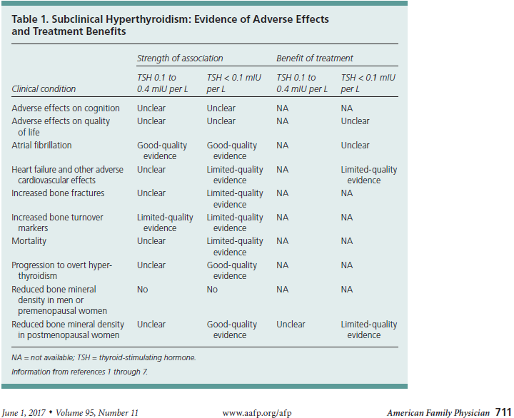

Slide 36
Subclinical hyperthyroidism
Patients with subclinical hyperthyroidism can typically proceed with elective or urgent surgeries.
Unless contraindicated:
Administer a beta blocker (eg, atenolol 25 to 50 mg daily) preoperatively to older patients (>50 years), or younger patients with cardiovascular disease, especially atrial arrhythmias, and taper after recovery.
Baeza A, Aguayo J, Barria M, Pineda G. Rapid preoperative preparation in hyperthyroidism.
Clin Endocrinol (Oxf) 1991; 35:439
Notes:
uptodate

Slide 37
Long-term clinical trials are required to determine if correcting subclinical hyperthyroidism improves cardiovascular or skeletal outcomes.

Slide 38
Overt hyperthyroidism
In patients with untreated or poorly controlled hyperthyroidism, an acute event such as surgery can precipitate thyroid storm, a potentially life-threatening condition.
Elective surgery –suggest postponing all elective surgeries in patients with newly discovered, overt hyperthyroidism until the patient has achieved adequate control of their thyroid condition (usually three to eight weeks).
Urgent surgery – For overtly hyperthyroid patients in whom surgery cannot be postponed, preoperative treatment of hyperthyroidism should be initiated as soon as possible.
Baeza A, Aguayo J, Barria M, Pineda G. Rapid preoperative preparation in hyperthyroidism.
Clin Endocrinol (Oxf) 1991; 35:439.

Slide 39
THANKS FOR YUR ATTENTION

Slide 40
Severe hypothyroidism
Older case studies in the anesthesia literature reported intraoperative hypotension, cardiovascular collapse, and extreme sensitivity to opioids, sedatives, and anesthesia in undiagnosed patients with more severe hypothyroidism, including myxedema .
In some case reports, myxedema coma is described as a rare postoperative complication in patients with unrecognized severe hypothyroidism .
This represents a medical emergency with a high mortality rate. The hallmarks of myxedema coma are decreased mental status and hypothermia, but hypotension, bradycardia, hyponatremia, hypoglycemia, and hypoventilation are often present as well.
Notes:
Uptodate

