Slide 1

In the name of
A Case Presentation
Maryam Zahedi
Shahid beheshti Adault Endocinology Fellow

Slide 2
Problem List:
Short stature
Obesity
Round Face
Brachydactyly
Hypocalcemia
Hyperphosphatemia
High serum PTH levels
hypothyroidism
Dental and oral malformation
Secondary Amenorrhea

Slide 3
Main questions:
What is the diagnosis?
If the diagnosis is PHP, what is the classification in this patient?
What are the main clinical featueres in the PHP and related diseases?
What is the cause of secondary amenorrhea in this patient?
What is the effect of PHP on Bone density?
Does genetic conselling is needed in this patient?
What could be the position of the Growth hormone treatment in this patient?

Slide 4
Main questions:
What is the diagnosis?
If the diagnosis is PHP, what is the classification in this patient?
What are the main clinical featueres in the PHP and related diseases?
What is the cause of secondary amenorrhea in this patient?
What is the effect of PHP on Bone density?
Does genetic conselling is needed in this patient?
What could be the position of the Growth hormone treatment in this patient?

Slide 5
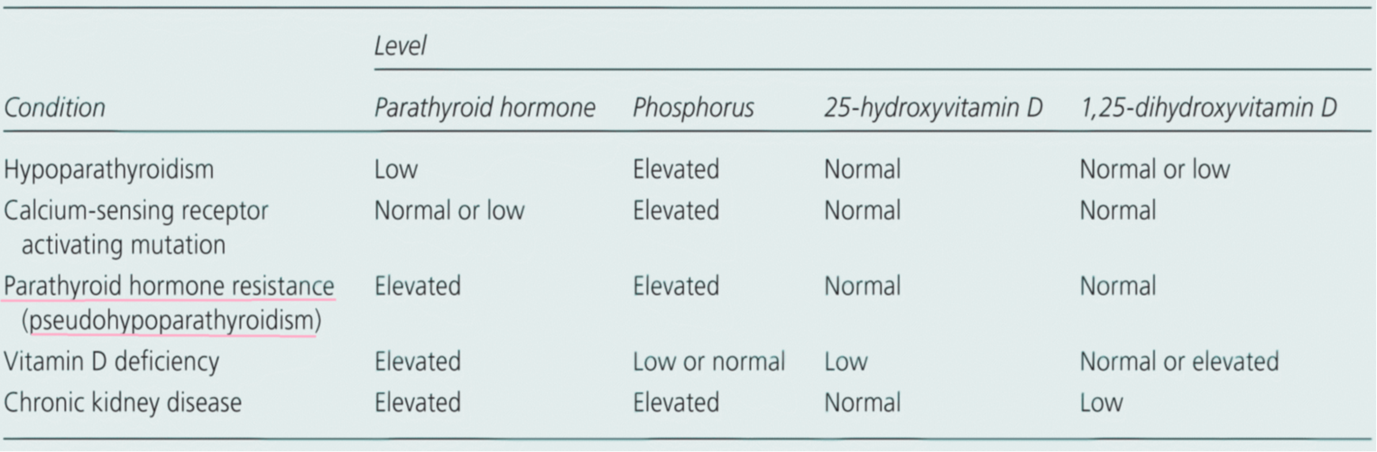
Laboratory Evaluation of Hypocalcemia
Parathyroid Disorders
American Family Phisician 2013

Slide 6
Algorithm for requesting investigations to elucidate the cause of hypocalcaemia
Diagnosis and management of hypocalcaemia
BMJ. 2008 Jun 7; 336(7656): 1298–1302.

Slide 7
pseudohypoparathyroidism Consensus Statement
^{Nature Reviews} | Endocinology volume 14 | AUGUST 2018 | 477
Differential diagnoses
The differential diagnosis of patients with :
obesity
early-onset (even congenital) hypothyroidism
short stature and/or
brachydactyly
With: High PTH, High p. and low Ca
consider diagnoses :
PHP or
related disorders

Slide 8
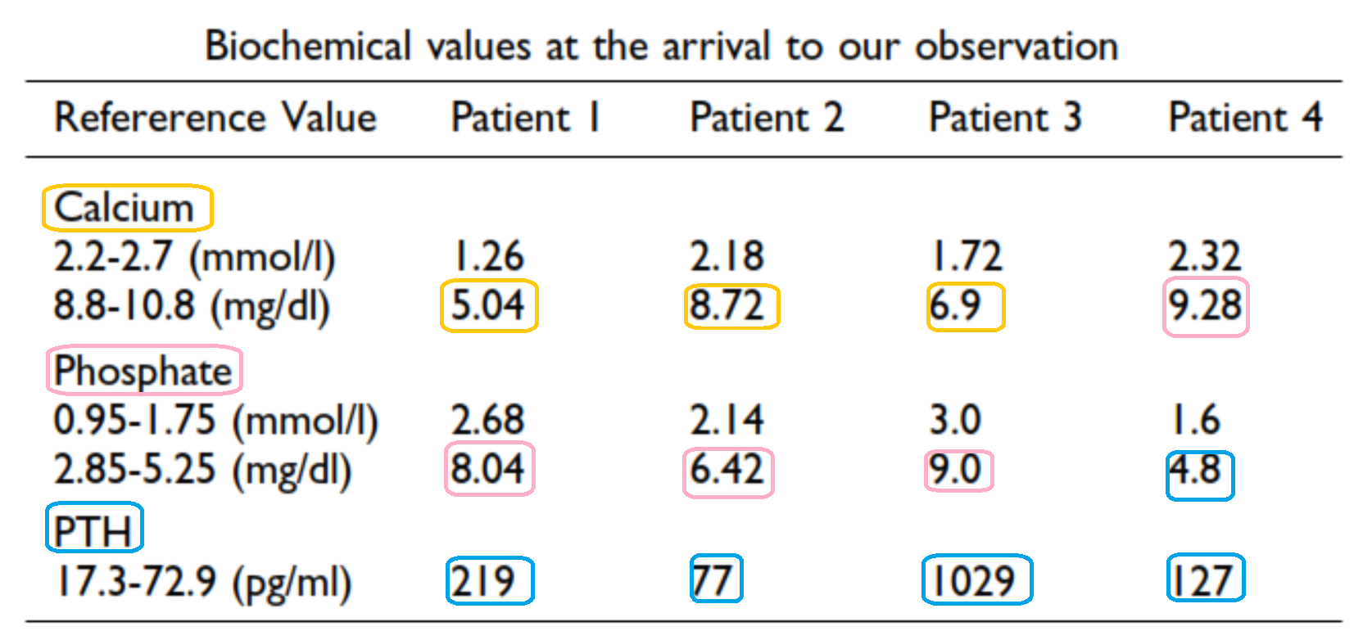
Pseudohypoparathyroidism, an often delayed diagnosis: a case series
Valentina Donghi1, Stefano Mora2*
Cases Journal 2009, 2:6734
four children (aged 8 to 13 years)
pseudohypoparathyroidism and the difficulty of an early diagnosis

Slide 9
Main questions:
What is the diagnosis?
If the diagnosis is PHP, what is the classification in this patient?
What are the main clinical featueres in the PHP and related diseases?
What is the cause of secondary amenorrhea in this patient?
What is the effect of PHP on Bone density?
Does genetic conselling is needed in this patient?
What could be the position of the Growth hormone treatment in this patient?

Slide 10
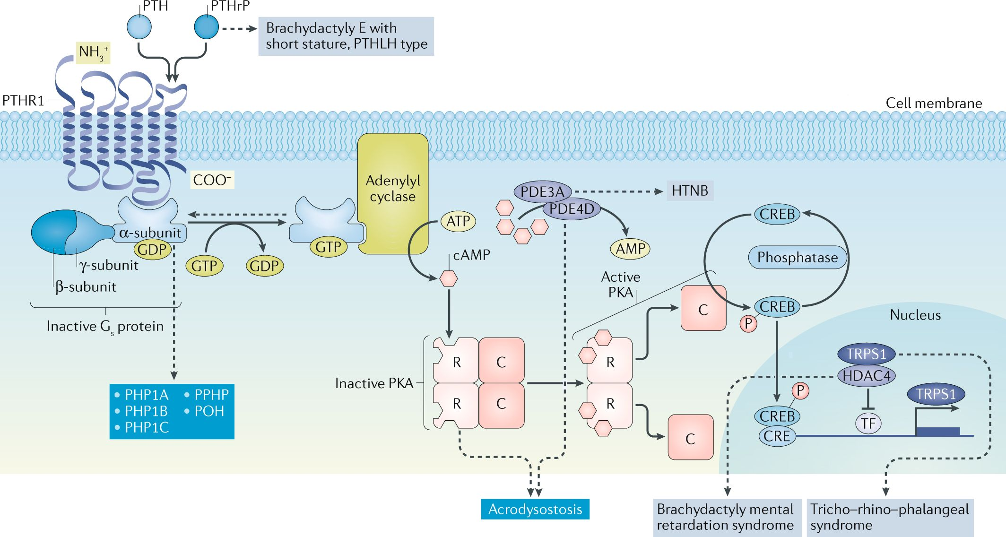
| Molecular defects in the PTH–PTHrP signaling pathway in PHP
^{and related disorders.} pseudohypoparathyroidism Consensus Statement
Nature Reviews | Endocinology volume 14 | AUGUST 2018 | 477

Slide 11
CLASSIFICATION
Pseudohypoparathyroidism ,Endocrinol Metab Clin N Am - (2018)
AHO features with or without hormonal resistance (particularly PTH, TSH, and GHRH).
cAMP response to exogenously administered PTH differentiates PHP1, in which blunted cAMP and phosphaturic responses are observed, from PHP2.
Because patients with PHP2 do not have other features of PHP, it is likely that in many cases these patients have undiagnosed vitamin D deficiency.

Slide 12
Pseudohypoparathyroidism ,Endocrinol Metab Clin N Am - (2018)
PHP1A refers to the combination of AHO, hormonal resistances, and low Gsa activity,
PHP1C refers to the combination of AHO and hormonal resistances, yet normal Gsa activity.
PHP1B refers to hormonal resistance and normal Gsa activity, typically in the absence of obvious AHO features, and
PPHP refers to AHO features and reduced Gsa activity, in the absence of hormonal resistance.

Slide 13
Main questions:
What is the diagnosis?
If the diagnosis is PHP, what is the classification in this patient?
What are the main clinical featueres in the PHP and related diseases?
What is the cause of secondary amenorrhea in this patient?
What is the effect of PHP on Bone density?
Does genetic conselling is needed in this patient?
What could be the position of the Growth hormone treatment in this patient?

Slide 14
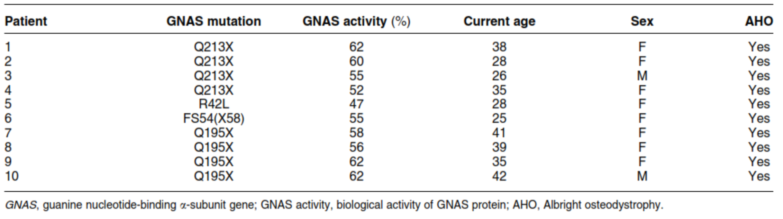
Hypothyroidism in patients with pseudohypoparathyroidism type Ia: clinical evidence of resistance to TSH and TRH
Anne-Sophie Balavoine1, Miriam Ladsous1, Fritz-Line Velayoudom1
2008 European Society of Endocrinology
A prospective study
Ten patients with PHP Ia

Slide 15
Hypothyroidism in patients with pseudohypoparathyroidism type Ia: 2008 European Society of Endocrinology

Slide 16
Brachydactyly in 14 Genetically Characterized Pseudohypoparathyroidism Type Ia Patients
LUISA DE SANCTIS, SERGIO VAI, MARIA RITA ANDREO, DAMIANO ROMAGNOLO
J Clin Endocrinol Metab, April 2004, 89(4):1650–1655

Slide 17
Pseudohupoparathyroidism consensus 2018
brachydactyly is not specific to PHP and related disorders and can be found in patients with, for example:
tricho–rhino–phalangeal syndrome,
brachydactyly mental retardation syndrome or
Turner syndrome
isolated brachydactyly type E

Slide 18
Main questions:
What is the diagnosis?
If the diagnosis is PHP, what is the classification in this patient?
What are the main clinical featueres in the PHP and related diseases?
What is the cause of secondary amenorrhea in this patient?
What is the effect of PHP on Bone density?
Does genetic conselling is needed in this patient?
What could be the position of the Growth hormone treatment in this patient?

Slide 19
Secondary Amenorrhea
DD:
Premature Ovarian Failyre
Progression of resistancy to gonadotropins

Slide 20
Reproductive Dysfunction in Women with Albright’s Hereditary Osteodystrophy*
ANNE B. NAMNOUM, GEORGE R. MERRIAM, ARNOLD M. MOSES, ANDMICHAEL A. LEVINE
Journal of Clinical Endocrinology and Metabolism ,1998
17 affected women aged 17–43 yr
All patients had typical PTH resistance and an approximately 50% reduction in erythrocyte Gsa activity

Slide 21
Reproductive Dysfunction,Journal of Clinical Endocrinology and Metabolism ,1998

Slide 22
Reproductive Dysfunction,Journal of Clinical Endocrinology and Metabolism ,1998

Slide 23
FIG. 1. Serum LH responses to administration of GnRH. Serum concentrations of LH are presented before and after the iv injection of 100 mg GnRH at time zero. The shaded area represents LH values corresponding to one standard deviation above and below the mean for normal women who were stud- ied on day 5 of their menstrual cycle.
FIG. 2. Serum FSH responses to administration of GnRH. Serum concentrations of FSH are presented before and after the iv injection of 100 mg GnRH at time zero. The shaded area represents FSH values corresponding to one standard deviation above and below the mean for normal women who were studied on day 5 of their menstrual cycle.
Reproductive Dysfunction,Journal of Clinical Endocrinology and Metabolism ,1998

Slide 24
Main questions:
What is the diagnosis?
If the diagnosis is PHP, what is the classification in this patient?
What are the main clinical featueres in the PHP and related diseases?
What is the cause of secondary amenorrhea in this patient?
What is the effect of PHP on Bone density?
Does genetic conselling is needed in this patient?
What could be the position of the Growth hormone treatment in this patient?

Slide 25
Bone Mineral Density in Pseudohypoparathyroidism Type 1a
Dominique N. Long, Michael A. Levine, and Emily L. Germain-Lee
J Clin Endocrinol Metab. 2010 Sep; 95(9): 4465–4475.
Twenty-two children and adults with PHP1a were studied

Slide 26
BMD, J Clin Endocrinol Metab. 2010

Slide 27
Main questions:
What is the diagnosis?
If the diagnosis is PHP, what is the classification in this patient?
What are the main clinical featueres in the PHP and related diseases?
What is the cause of secondary amenorrhea in this patient?
What is the effect of PHP on Bone density?
Does genetic conselling is needed in this patient?
What could be the position of the Growth hormone treatment in this patient?

Slide 28
Genetic counselling
Pseudohypoparathyroidism ,Endocrinol Metab Clin N Am - (2018)
Because of the variety of genes and molecular mechanisms involved in PHP, genetic counseling should be performed.
an autosomal dominant mode of inheritance, that is, an approximately 50% risk of recurrence.
In contrast, the phenotype associated with an inactivating defect in GNAS depends on the parent-of-origin.

Slide 29
Pseudohypoparathyroidism ,Endocrinol Metab Clin N Am - (2018)
Maternally inherited mutations involving GNAS exons 1 to 13 lead to PHP1A/1C,
paternally inherited may lead to PPHP, POH, or osteoma cutis.

Slide 30
Main questions:
What is the diagnosis?
If the diagnosis is PHP, what is the classification in this patient?
What are the main clinical featueres in the PHP and related diseases?
Does genetic conselling is needed in this patient? What is the cause of secondary amenorrhea in this patient?
What could be the position of the Growth hormone treatment in this patient?

Slide 31
Recombinant Human GH Replacement Therapy in Children with Pseudohypoparathyroidism Type Ia:
First Study on the Effect on Growth
Giovanna Mantovani, Emanuele Ferrante, Claudia Giavoli, Agnes Linglart
J Clin Endocrinol Metab, November 2010, 95(11):5011–5017
eight prepubertal PHP-Ia children with GH deficiency
3- to 8-yr treatment with rhGH.
Height and HV were measured before and at 6-month intervals during therapy
Nine sex- and age-matched children with idiopathic GH deficiency were monitored during rhGH therapy for comparison

Slide 32
In both groups height and HV SDS significantly improved during treatment (P <0.05 and P< 0.001, respectively), with no statistically significant difference between the two series in terms of SDS before treatment and the increase observed at 1, 2, and 3 yr of therapy.
Recombinant GH,J Clin Endocrinol Metab,2010

Slide 33
Thanks for your Attention

