Slide 1
Problem list
Weakness
edema
weight gain
purple striae
Hirsutisem
Acnea

Slide 3
DDx
pregnancy induced CS
Adrenal adenoma
Adrenal carcinoma

Slide 5
clinical diagnosis
The clinical diagnosis of CS during pregnancy may be missed because of the overlapping features of weight gain, hypertension, fatigue, hyperglycemia, and emotional changes characteristic of pregnancy.
Clues that can lead to suspicion of CS include large purple instead of white striae, hirsutism, acne, the presence of hypokalemia, muscle weakness, and pathologic fractures.
Arq Bras Endocrinol Metabol 2007;51(8):1293–302

Slide 6
Establishing Cushing syndrome diagnosis during gestation
LDDST usually fails to suppress cortisol secretion; this test during pregnancy should not be preferred because of false-positive results due to blunted response to dexamethasone.
Elevated UFC should be used as the best choice in screening for CS during pregnancy. Values greater than 3 times the upper limit should be taken into consideration in the last 2 trimesters.
Serum cortisol circadian variation is altered in women with CS but preserved in normal pregnancy. late-night cortisol greater than 5 ng/dL or greater than 50% of morning cortisol is suggestive of CS.
Nighttime salivary cortisol measurement is the best test to evaluate the circadian rhythm of cortisol and theoretically could be a good screening, although there is no specific study that defines the cutoff during gestation.

Slide 7
In the CS during pregnancy , mean ACTH levels were nonsuppressed in half of those with primary adrenal disorders, perhaps because of continued stimulation of the maternal HPA axis by placental CRH.

Slide 8
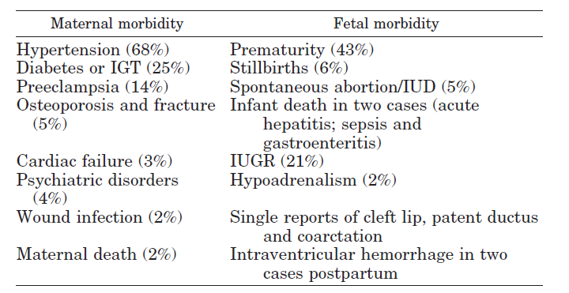
Complications

Slide 9
Differential diagnosis
We recommend adrenal imaging with US, HDST, and plasma ACTH levels as an initial step in the differential diagnosis of pregnant patients with CS.
Patients with borderline or low plasma ACTH or without suppression on HDST are likely to have an adrenal etiology.
Whereas US imaging identified adrenal lesions in 73% of these cases, second-line imaging with MRI may be needed in the event of a negative US scan.
The Journal of Clinical Endocrinology & Metabolism 2005 90(5):3077–3083

Slide 10
DDx
pregnancy induced CS
Adrenal adenoma
Adrenal carcinoma

Slide 11
Illicit Adrenal Receptors
Subsequent molecular studies have shown, however, that most ectopic receptors are expressed at low levels in the normal adrenal gland, without significant steroid secretion stimulation. therefore, that aberrant expression of the receptor in the adrenal gland may be a primary event, sufficient to initiate adrenal growth and hypersecretion.
The capacity of ligands other than ACTH to stimulate the adrenal cortex.
A variety of adrenal cortisol-stimulating receptors have been described ,not only in adrenal hyperplasia but also in patients with adenomas and unilateral or bilateral incidental adrenal lesions associated with subclinical hypercortisolism.

Slide 13
Adrenal responsiveness testing : should be applied to all patients with bilateral adrenal lesions and hypercortisolism.
RNA extraction and real-time RT-PCR :
Total RNA from hyperplasia tissue was extracted.
Quantitative RT-PCR was performed

Slide 15
However, not all patients aberrantly expressing the LH receptor in the adrenal cortex will develop hypercortisolism during periods of increased LH secretion, and thus factors other than LH must contribute to pregnancy-induced Cushing’s syndrome.

Slide 17
Pregnancy-induced CS is an even rarer phenomenon with only 10 cases reported in the world literature.
The appearance of the adrenal glands (on imaging and histologically) :
no abnormality in six cases
one bilateral micronodular hyperplasia
one bilateral macronodular hyperplasia (MAH)
one adenoma.
The exact aetiology is unknown, the most commonly postulated mechanism involves aberrant LH⁄hCG receptor (LHCGR) expression.

Slide 18
LHCGR DNA and protein are present in the zona reticularis of the adrenal cortex. Therefore, LH⁄ hCG-induced CS may be attributable to upregulation of a normally weakly expressed eutopic receptor.
The elevations in LH occurring during a normal menstrual cycle may be sufficient to cause suppression of ACTH production. However, because of the transient nature of the elevated LH and comparatively lower concentration than in pregnancy, clinical hypercortisolism may not be evident.
A recurrence of CS in the post-menopausal state in the setting of elevated gonadotropins is possible with either postulated aetiology.

Slide 19
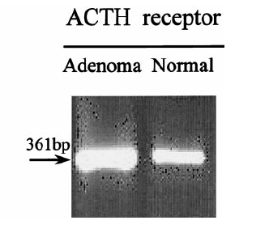
RT-PCR analysis of RNA from adrenal tissue of a normal control showed amplified bands for LH/hCG receptors in addition to ACTH receptor (positive control).

Slide 20
Treatment
When a surgically amenable form of CS is found (for example, primary adrenal disease, ectopic ACTH syndrome or a pituitary adenoma), surgery, ideally during the second trimester, is the treatment of choice.
If the aetiology cannot be determined or surgery is contraindicated, medical therapy is an alternative, usually with metyrapone.

Slide 21
Treatment
Management of in Pregnancy Decision-making process about therapy must take into account the stage of pregnancy at the time of diagnosis, cause and severity of hypercortisolism, and the potential benefits of therapy.
Maternal and fetal outcomes of untreated Cushing syndrome are poor.
For adrenal tumors, unilateral adrenalectomy for adrenal adenoma has been performed safely even into the early third trimester, although most surgery was performed between 6 and 28 weeks of gestation.
Medical treatment in pregnancy is usually avoided to minimize the potential for teratogenesis and induction of fetal adrenal insufficiency.
It will be most useful given either as preparation or as a substitute for surgery for those patients with persistent disease postoperatively and for those who are not good surgical candidates.
Generally, cesarean delivery should be avoided because of the problems of wound healing in hypercortisolism.
Endocrinol Metab Clin N Am 40 (2011) 779–794

Slide 23
Metyrapone is a steroidogenesis inhibitor that inhibits the enzyme 11-b-hydroxylase in the steroidogenesis pathway in the adrenal cortex, reducing serum cortisol levels . This in turn stimulates ACTH, which increases the production of deoxycorticosterone and the accumulation of other mineralocorticoids, leading to hypertension .Uncontrolled hypertension, meanwhile, predisposes the patient to pre-eclampsia and a high maternal mortality if left untreated.
The relationship between metyrapone administration and the incidence of pre-eclampsia is largelydebatable. In a recent prospective study, it has been shown that maternal plasma CBG together with total and free cortisol concentrations in gestational hypertension and pre-eclampsia
subjects are reduced when compared to controls .Due to the small numbers of available cases of untreated CS during pregnancy, it remains unclear if metyrapone directly causes pre-eclampsia, although the existing studies do appear to point towards such an
association. Nevertheless, it is imperative that anti-hypertensives such as methyldopa are used in conjunction with metyrapone in controlling blood pressure to ensure a safer outcome during pregnancy.

Slide 24
Ketoconazole, an anti-fungal medication with anti-steroidogenic properties, has been used in a number of case reports with good maternal and fetal outcomes ,but has also been implicated as a teratogen (FDA Category C).
A recent populationbased case–control study found no association between the use of ketoconazole and congenital anomalies, but the number of exposed cases and controls was very small .
Thus, at this time, more stratified studies are required to establish the safety profile of ketoconazole in pregnancy, and its use therapeutic use is therefore limited to individuals in need of emergency medical therapy.

