Slide 1
Re-operative and advanced thyroid cancer surgery
Dr. Shirzad Nasiri
Associate prof. Endocrine Surgery
Tehran University of Medical Sciences

Slide 2
Recurrent thyroid cancer
risk factors:
    age >45 or <15
    tumor size >4cm
    bilateral and multi-centric
    extra thyroidal extension
    large LN metastasis
    macroscopic local invasion
    agressive histologies
    BRAF

Slide 3
dynamic risk stratification
50% of intermediate &high risk will become low risk
10% of low risk will become high risk

Slide 4
prevention
pre-operative recognition of malignancy
the first surgery, the last surgery
central neck dissection

Slide 5
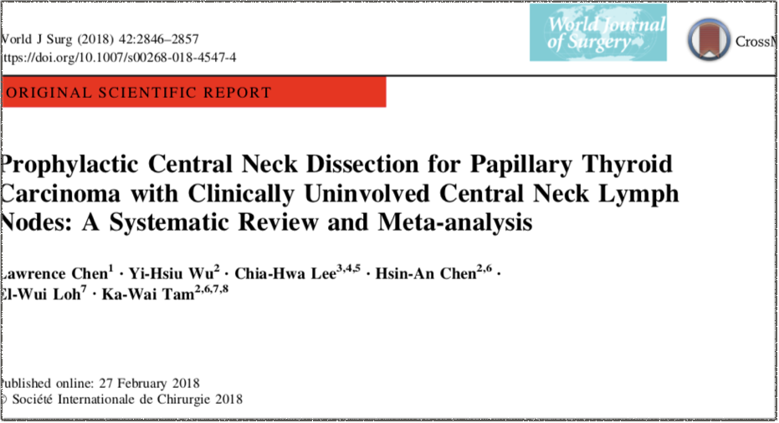

Slide 6
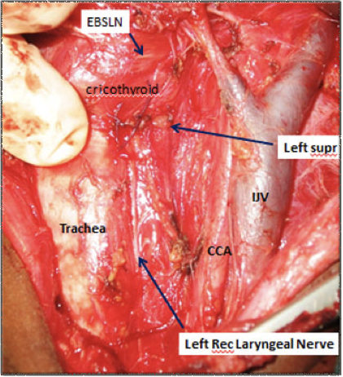
Prophylactic CND
permanent remission
accurate staging
lower Tg
reduced re-operation
more morbidity
survival?

Slide 7
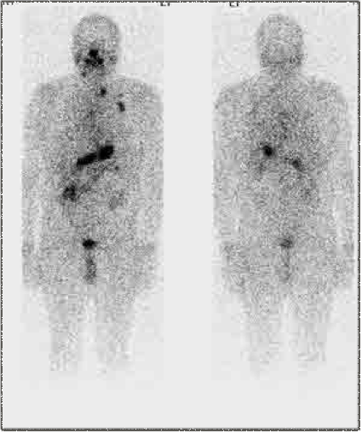
diagnosis of recurrence
scintigraphy
  sensitivity: 50-60%
  in BRAF pos. WBS is not useful
  I avidity is typically lost in high percentage of recurrent DTC
  is not reliable to base surgery on

Slide 8
serum Tg
lowest serum value 3 months after surgery
level in LN aspirate will not be affected by anti-Tg
sensitivity:
      on levothyroxine: 50%
      off levothyroxine: 85-95%

Slide 10
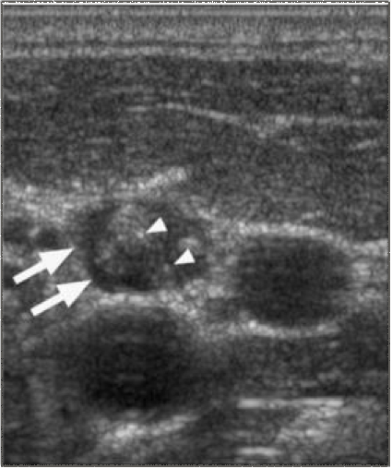
ultrasound
Sen: 90% Spe: 79%
relatively poor at:
    skull base
    retro-mandibular
    retro-pharyngeal
    retro-tracheal

Slide 11
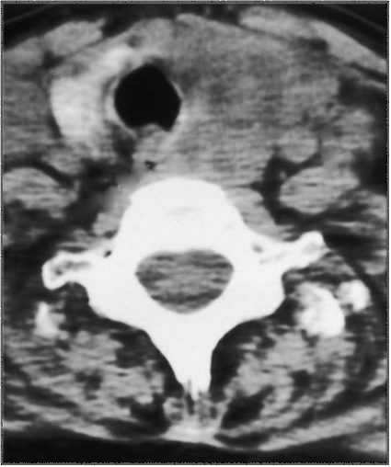
CT
choice for laryngeal and tracheal invasion
better than MRI for LN
contrast?
most sensitive modality for multiple small lung mets.

Slide 12
PET/CT
in Tg pos. but WBS neg. patients
less useful in low volume dis. and lung mets.
neg. result must not stop further investigation
better when:
    Tg>10
    negative WBS
    TSH stimulation

Slide 13
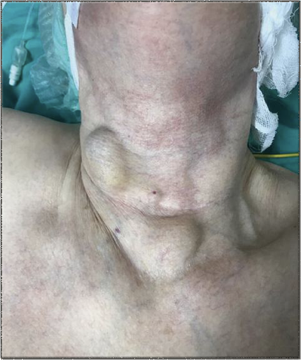
location
80% in the same side as tumor
62% in lateral neck
      73% level 4
      13% level 3
      13% level 2
37% in central neck
86% patients with lateral recurrence have central dis.

Slide 14
management
recurrence in LN < 5-8 mm could be observed
recurrence in LN > 8 mm should be operated
remnant >1 cm or in patients going to receive I therapy should be resected
type of surgery

Slide 15
advanced thyroid cancer

Slide 16
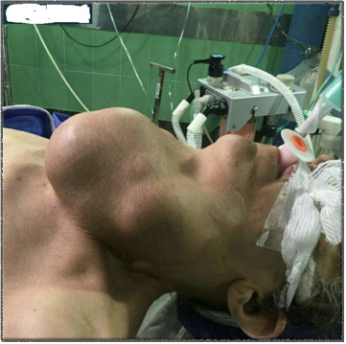
symptoms: hoarseness, dysphagia, hemoptysis, dyspnea
signs: fixed mass, skin invasion

Slide 17
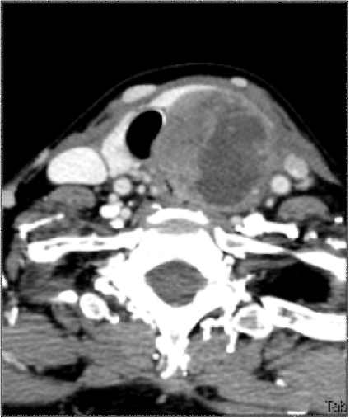
imaging
CT is more reliable to detect invasion
do endoscopy if CT shows transmural involvement

Slide 18
management
surgical goal is resection with negative margins and relief of symptoms
distant mets. is not contraindication for surgery
certain subtypes like tall cell, hurtle cell and insular need more extensive resection
aggressive tumors are not I avid

Slide 19
types of extension
the central route involving the paratracheal lymph nodes, the recurrent laryngeal nerve, and the aerodigestive axis.
the lateral route involving lymph nodes of the lateral compartment, the carotid sheath, and the lateral nerves.
the mediastinal route involving the upper mediastinal lymph nodes, the great vessels, the thymus, and other mediastinal organs

Slide 20
RLN invasion
VC paralysis and thyroid nodule
pre-operative laryngoscopy
pre-operative diagnosis

Slide 21
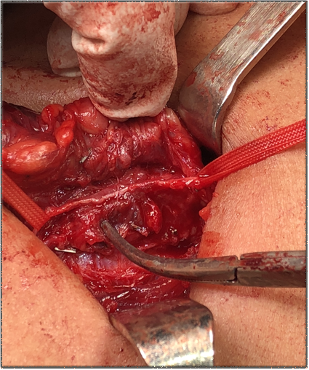
rules
save the RLN if cord is mobile
if cord is paralyzed sacrifice the nerve
don’t sacrifice bilateral nerves
nerve resection dose not affect survival

Slide 22
vascular invasion
no piecemeal resection
encircle the enemy
carotid a. involvement

Slide 23
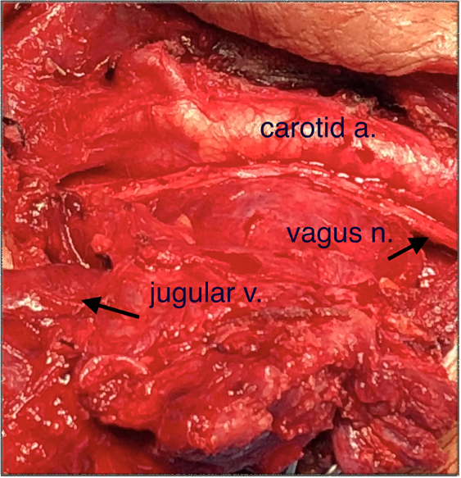
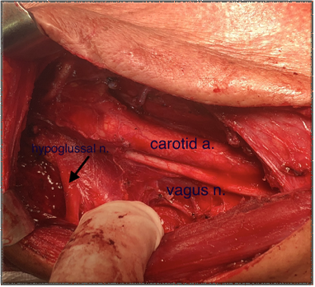

Slide 25
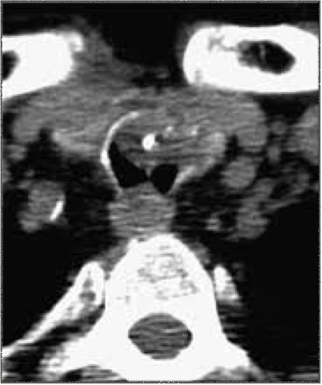
tracheal invasion
localization of the invading cancer (larynx, cricoid, or cervical trachea)
tumor extension in longitudinal and horizontal direction
tumor extension through the tracheal wall (Shin stages 1–2 versus 3–4)
RLN function

Slide 27
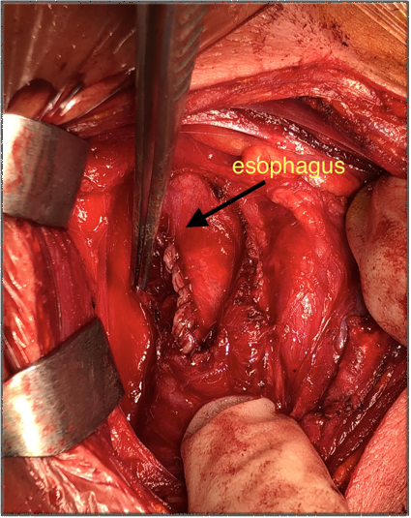
esophageal invasion
occurs in combination with extensive laryngotracheal or tracheal invasion
extramucous esophageal resection eradicates the tumor.
jejunal free graft

Slide 28
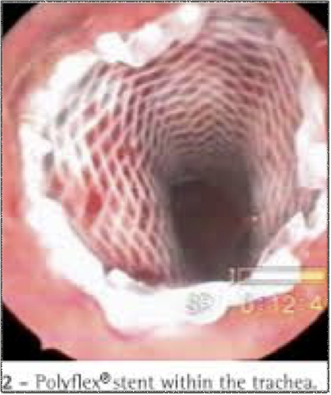
Palliative local procedures
for end-stage disease in patients with thyroid cancer invading the aerodigestive tract when radical surgery is not feasible or is contraindicated.
limited tumor resection coupled with intraluminal stenting may be preferable over extensive, yet incomplete tumor resections.

Slide 29
Any questions?

