Slide 1


Slide 2
Bariatric Surgery:
Adverse Effects on Bone metabolism

Slide 3
Obesity
an important and increasing public health issue worldwide.
The prevalence of obesity in the US: exceeding 30% for most age and sex groups.
prevalence of morbid obesity in the united states : more than 5% of the population
Approximately 2.8 million deaths/year are reported as a result of being overweight or obese (cardiovascular diseases, diabetes, musculoskeletal disorders and cancers).

Slide 4
Bariatric or weight-loss surgery
manifest and sustainable weight reduction
improves more than 40 obesity-related diseases or conditions
Surgical weight loss may reduce mortality by as much as 30% to 40% in the severely obese.
Attempts to treat obesity through surgical procedures were first attempted more than 60 years ago.
The use of bariatric surgery has increased at least 7-fold worldwide in the last decade.

Slide 5
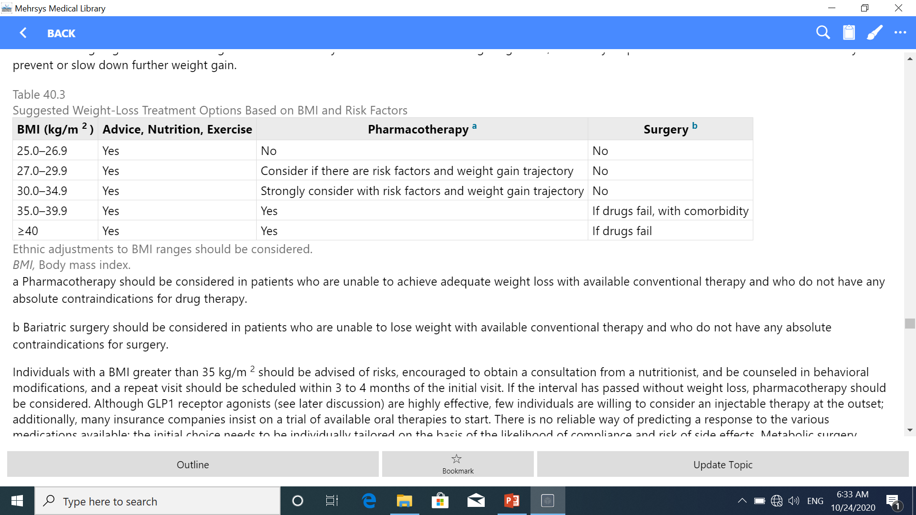

Slide 6
Three categories of bariatric surgeries :
Restrictive (Adjustable gastric banding, Sleeve gastrectomy)
Malabsorptive (Biliopancreatic diversion)
Combination of these two (Roux-en-Y gastric bypass).

Slide 7
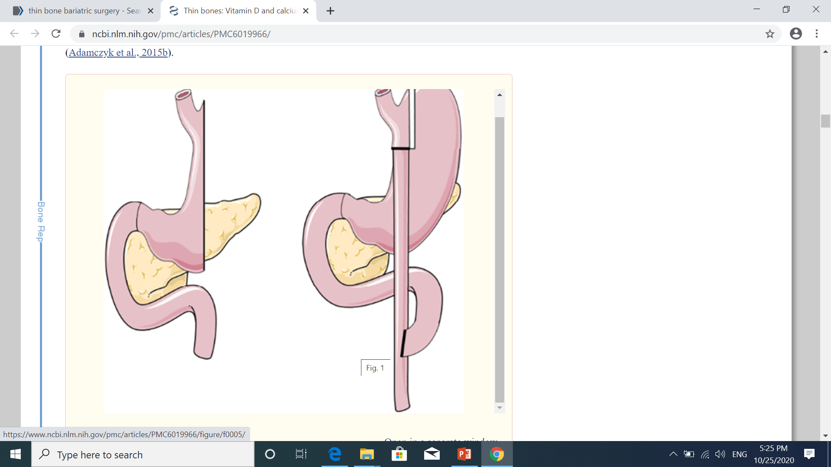

Slide 8
Similar weight loss : almost 11 pounds (5 kg) per month for the first 4 months, with weight nadir between 6 and 24 months and effects that can persist over years.
Perioperative mortality with bariatric surgery is low and reported as 0.04% to 0.3%, similar to that of a cholecystectomy.

Slide 9

Changes In Gastrointestinal Anatomy And Physiology
Limited Food Intake And/Or Malabsorption
Nutritional Deficiencies
Induce Bone Loss, Eventually Resulting In Higher Fracture Risk

Slide 10
Questions:
What's The Long-term Effect Of Bariatric Surgery On Bone Metabolism?
is there a significant changes in serum 25-(OH)-D, Ca , PTH, ALP levels?
What's The Incidence Of Osteoporosis And Fracture Risk After Bariatric Surgery?
What's The Preoperative Predictors Of Bone Loss After Bariatric Surgery?
How To Evaluate Patients Before And After Bariatric Surgery?
How To Treat Nutritional Deficiencies After Bariatric Surgery?

Slide 11
Four Possible Mechanisms Underlying Bone Loss After Bariatric Surgery:
Decrease in mechanical loading
Malabsorption of calcium and vitamin D
The weight loss following surgery affects levels of adipokines (bone-fat interaction)
The anatomic changes affect gastrointestinal hormone secretion which affects bone metabolism (ghrelin, GIP,GLP-1, peptide YY, Amilyn, Insulin)

Slide 12
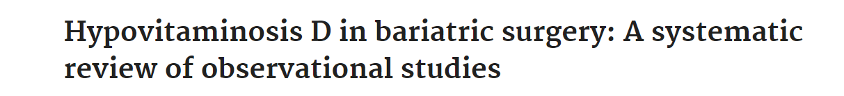
51 observational studies (2000-2015)
25(OH)D level pre (by BMI category) and post bariatric surgery
Dose response of vitamin D supplementation
The effect of the surgical procedure on 25(OH)D level following supplementation

Slide 13
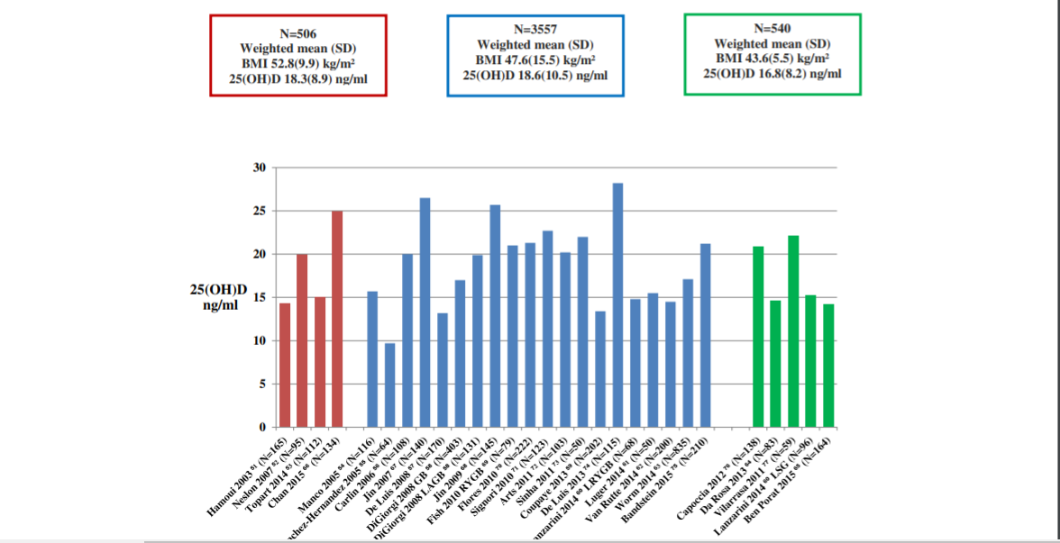
Mean 25(OH)D level (ng/ml), by BMI categories, before bariatric surgery in observational studies
The difference between the weighted mean 25(OH)D levels in BMI categories was not clinically significant and did not show a decrease in 25(OH)D level with increasing BMI

Slide 14
Mean 25(OH)D level pre-surgery : < 30 ng/ml (29 studies)
< 20 ng/ml (17 studies)
Post-surgery ± vitamin D supplementation(51 studies): < 30 ng/ml ( only few exceptions)
Vitamin D Supplementation Dose and Response: not consistently in concordance with the dose administered (optimal vitamin D dose?)

Slide 15
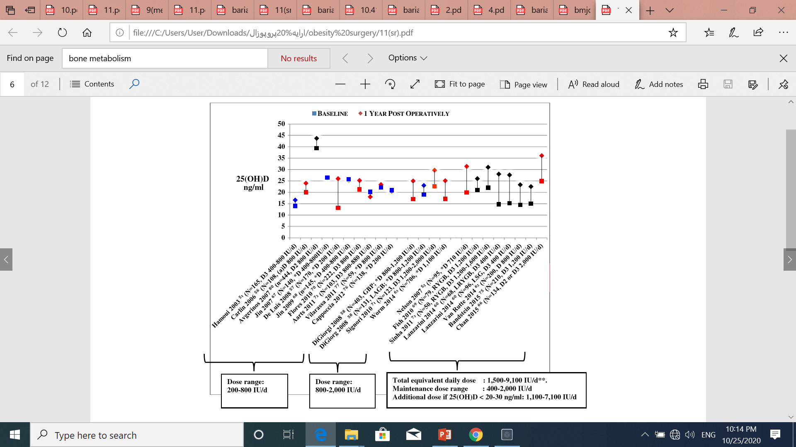

Slide 16
There was no difference in mean 25(OH)D level following supplementation between malabsorptive/ combination procedures and restrictive procedures.

Slide 17
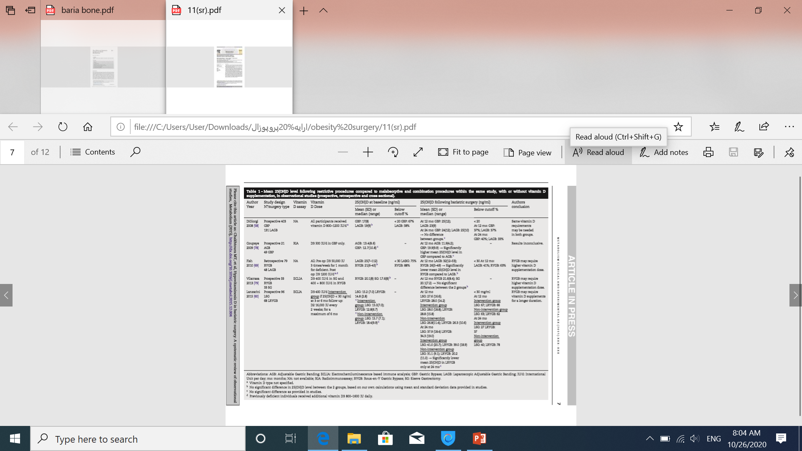

Slide 18
Vitamin D in obesity
Serum 25(OH)D is about 20% lower in obese people than normal weight
the prevalence of 25(OH)D deficiency : between 40 and 80%

Slide 19
Possible mechanism:
Decreased bioavailability of 25-hydroxyvitamin D (its sequestration in the additional adipose tissue)
Decrease in the activity of the hepatic 25- hydroxylase activity secondary to non-alcoholic fatty liver disease )
Tendency to wear clothes (lower sunlight exposure)
Volumetric dilution (greater volumes of serum, fat, muscle, and liver).

Slide 20
Does lower 25-hydroxyvitamin D have clinical consequences in obesity?
The lack of adverse effects on bone?
volumetric dilution.
other effects of obesity :greater skeletal loading or the action of hormones such as leptin, adiponectin, or oestrogen .

Slide 21
Vitamin D deficiency after bariatric surgery:
Fat malabsorption in malabsorptive procedures( duodenal surgical bypass)
Dietary intolerance with reduced intake of dairy products, vomiting, and nonadherence to supplement recommendations

Slide 22
Treat vit D deficiency before surgery:
Obese people will need higher loading doses than normal weight to achieve the same serum level of vitamin D,
because the metabolic clearance rate is not affected by obesity, the maintenance dose should be the similar

Slide 23
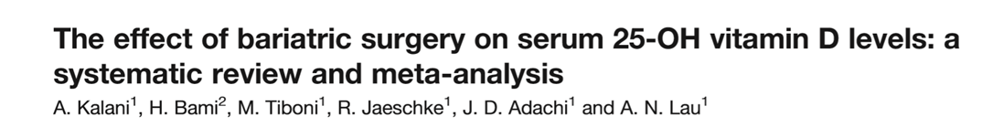
7 studies (N=4,282 bariatric surgical recipients. 15,630 controls).
2004 to 2015.
Follow up time:12, 24 month
25(OH)D level pre and post bariatric surgery
BMD (TH,LS) and incidence of fractures (secondary outcome)

Slide 24
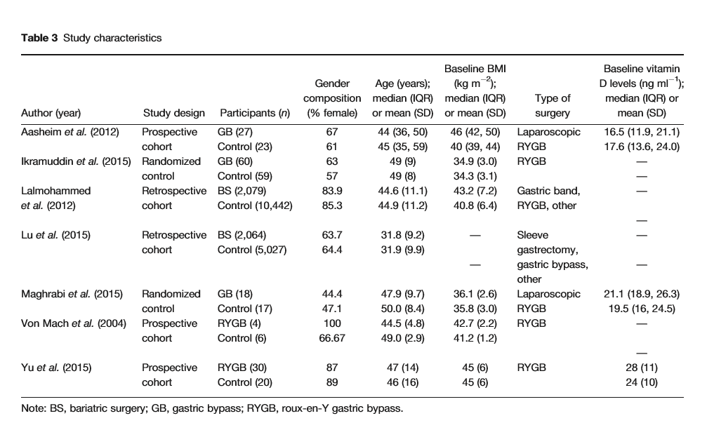

Slide 25
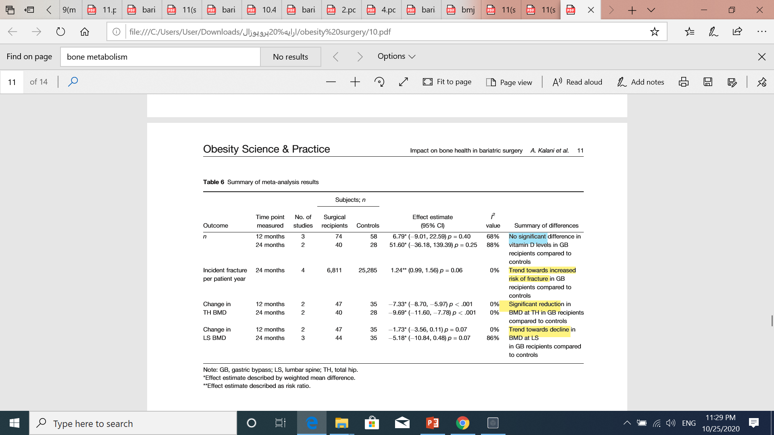

Slide 26
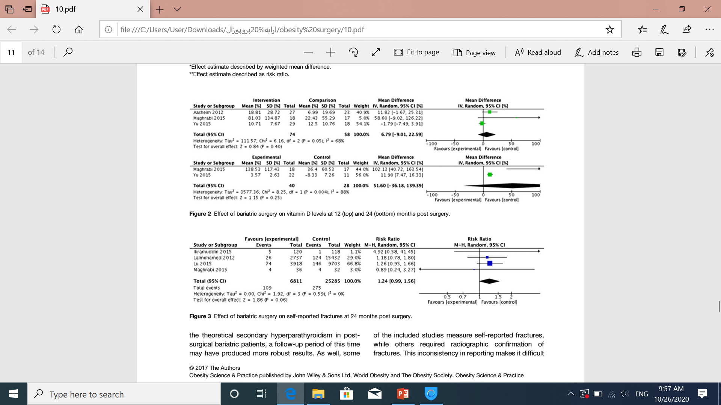
trend towards an increased fracture risk in the surgical population (n = 6,811) compared to controls (n = 25,285) (RR = 1.24; 95% CI: 0.99, 1.56; p = 0.06; I2 = 0%)

Slide 27
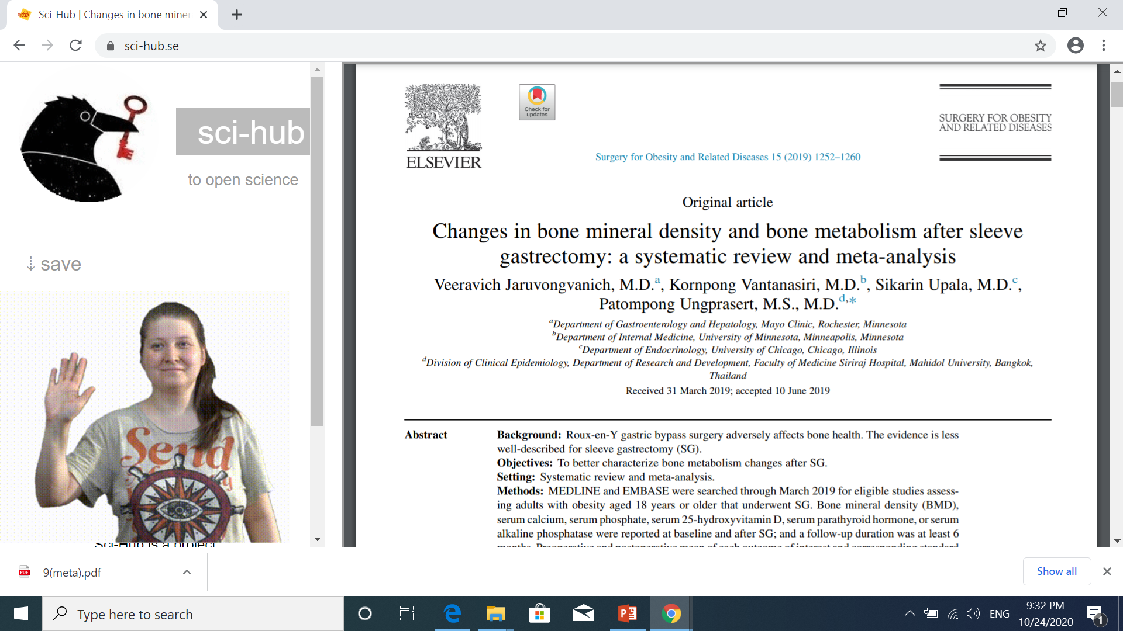
To better characterize bone metabolism changes after SG
Participants : adult with obesity≥ 18 years who underwent through march 2019
BMD, serum Ca, P, 25-(OH) D, PTH ,ALP baseline and after SG.
N: 22 studies (1905 patients)
The median follow-up time : 12 months (6–60 mo).
Vitamin D and calcium supplements were prescribed to all participants in 14 studies; only vitamin D was prescribed in 1 study, not prescribed in 3 studies, and not reported in 3 studies.

Slide 28
There were significant decreases in total hip BMD and femoral neck BMD after SG. No significant change in lumbar spine BMD was observed.
There were significant increases in serum Ca, P, 25(OH) D, Serum PTH hormone was significantly decreased. Serum ALP was not significantly altered after SG.

Slide 29
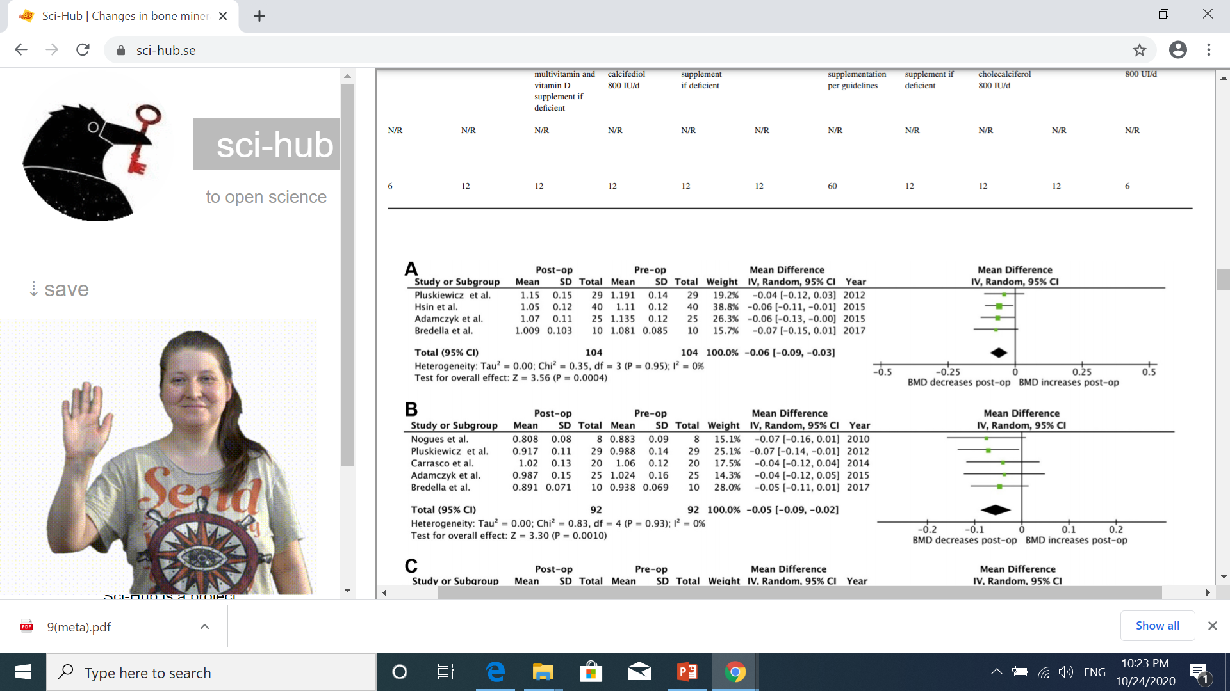
Forest plots of bone mineral density changes at total hip

Slide 30
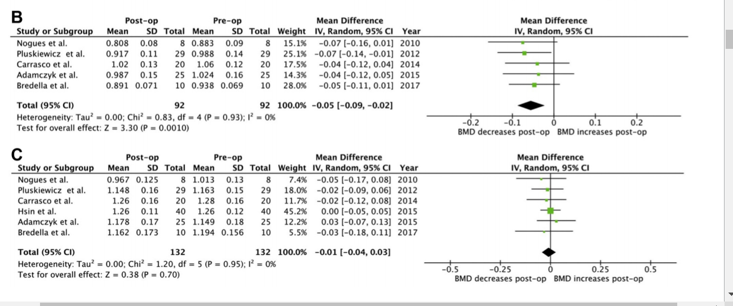
Forest plots of bone mineral density changes at femoral neck and lumbar spine

Slide 31
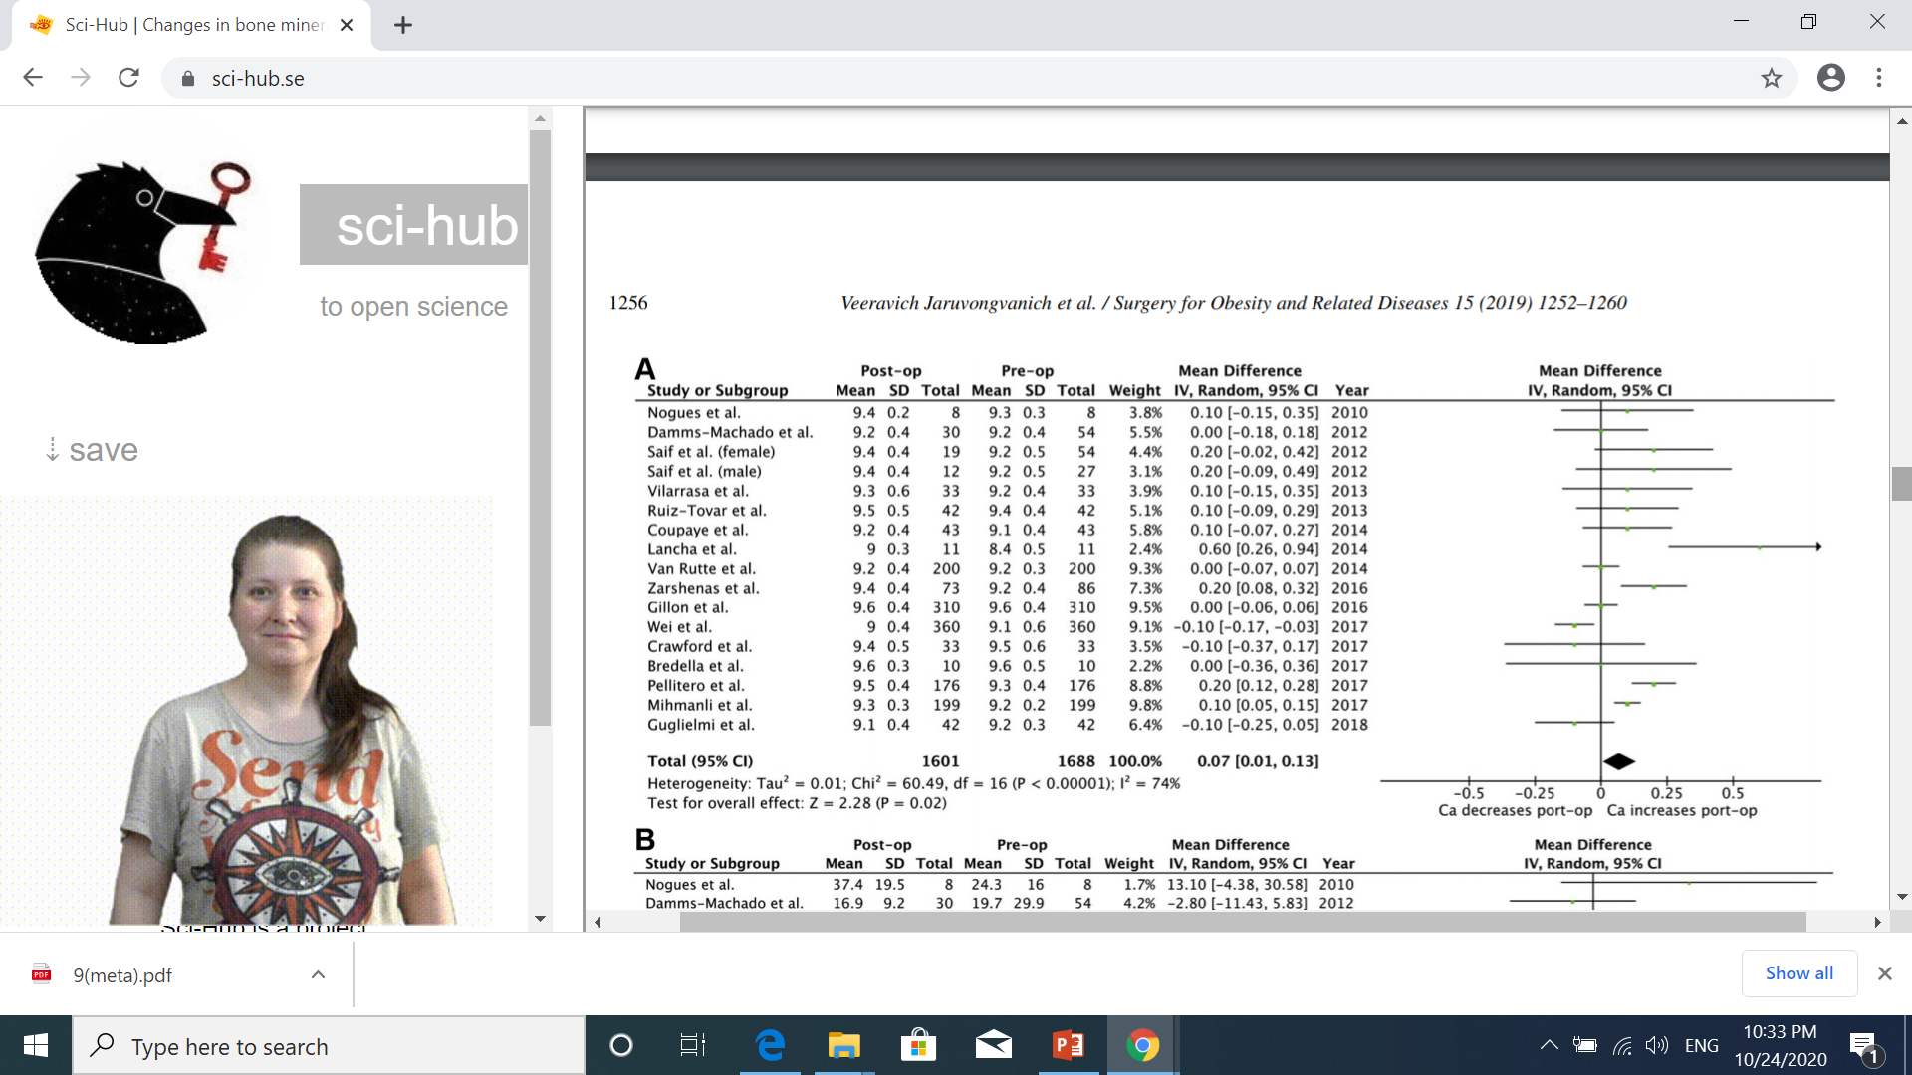
Forest plots of serum calcium changes after sleeve gastrectomy

Slide 32
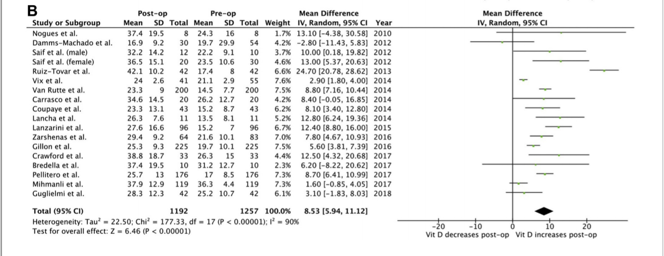
Forest plots of serum and 25-hydroxyvitamin D changes after sleeve gastrectomy

Slide 33
lower degree of secondary hyperparathyroidism and lower rate of bone mass loss
malabsorption and vitamin D deficiency are less common and less severe among patients who undergo SG

Slide 34
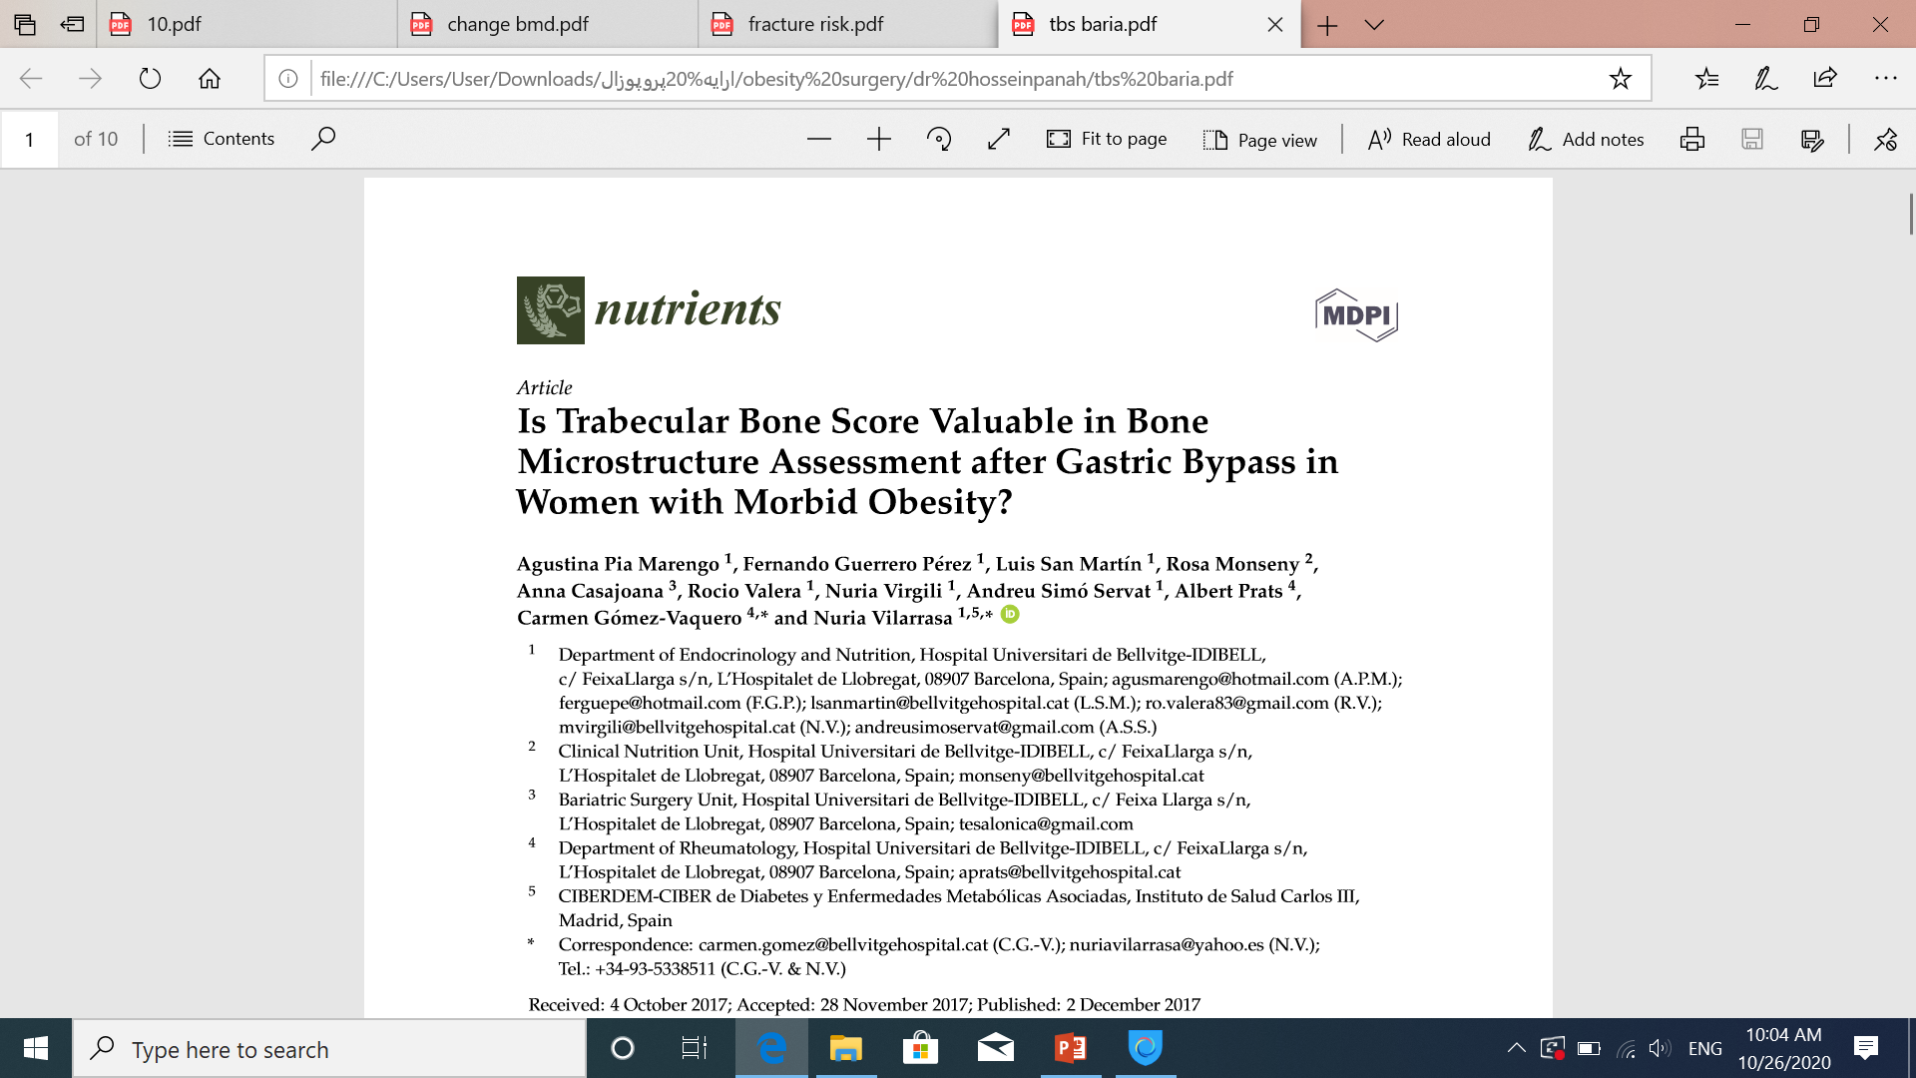
N= 38
Age=46/3±8/2 yr
Ca, p, 25-OH-D
BMD,TBS
Follow up: befor, 1yr, 3yr

Slide 35
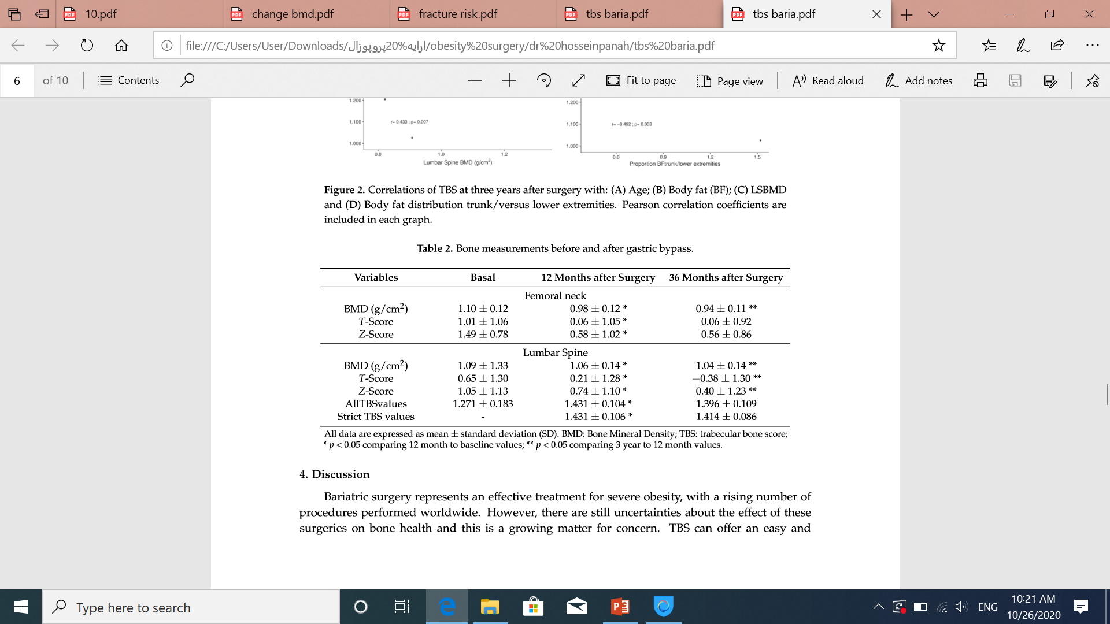
BMD at femoral neck and lumbar spine (LSBMD) signiﬁcantly decreased 13.53 ± 5.42% and 6.03 ± 6.79%, respectively, during the three-year follow-up

Slide 36
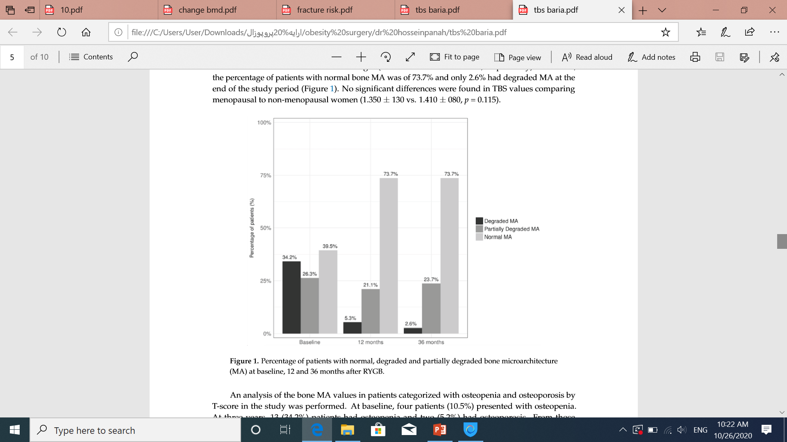
TBS was within normal ranges at one and three years (1.431±106 and 1.413±85, respectively), and at the end of the study, 73.7% of patients had normal bone MA.

Slide 37
Questions:
What's The Long-term Effect Of Bariatric Surgery On Bone Metabolism?
is there a significant changes in serum 25-(OH)-D, Ca , PTH, ALP levels?
What's The Incidence Of Osteoporosis And Fracture Risk After Bariatric Surgery?
What's The Preoperative Predictors Of Bone Loss After Bariatric Surgery?
How To Evaluate Patients Before And After Bariatric Surgery?
How To Treat Nutritional Deficiencies After Bariatric Surgery?

Slide 38
Factors play a role on the risk of bone mass loss after bariatric surgery:
The type of surgery
Initial body weight
Age
Postmenoupausal state
Hypogonadal state in obese men
Physical activity
Type 2 DM
Cushing disease
Hypothyroidism

Slide 39

N=59
BMI=43/9
Age=46±8 yr
Presurgery, 12 month,36 month

Slide 40
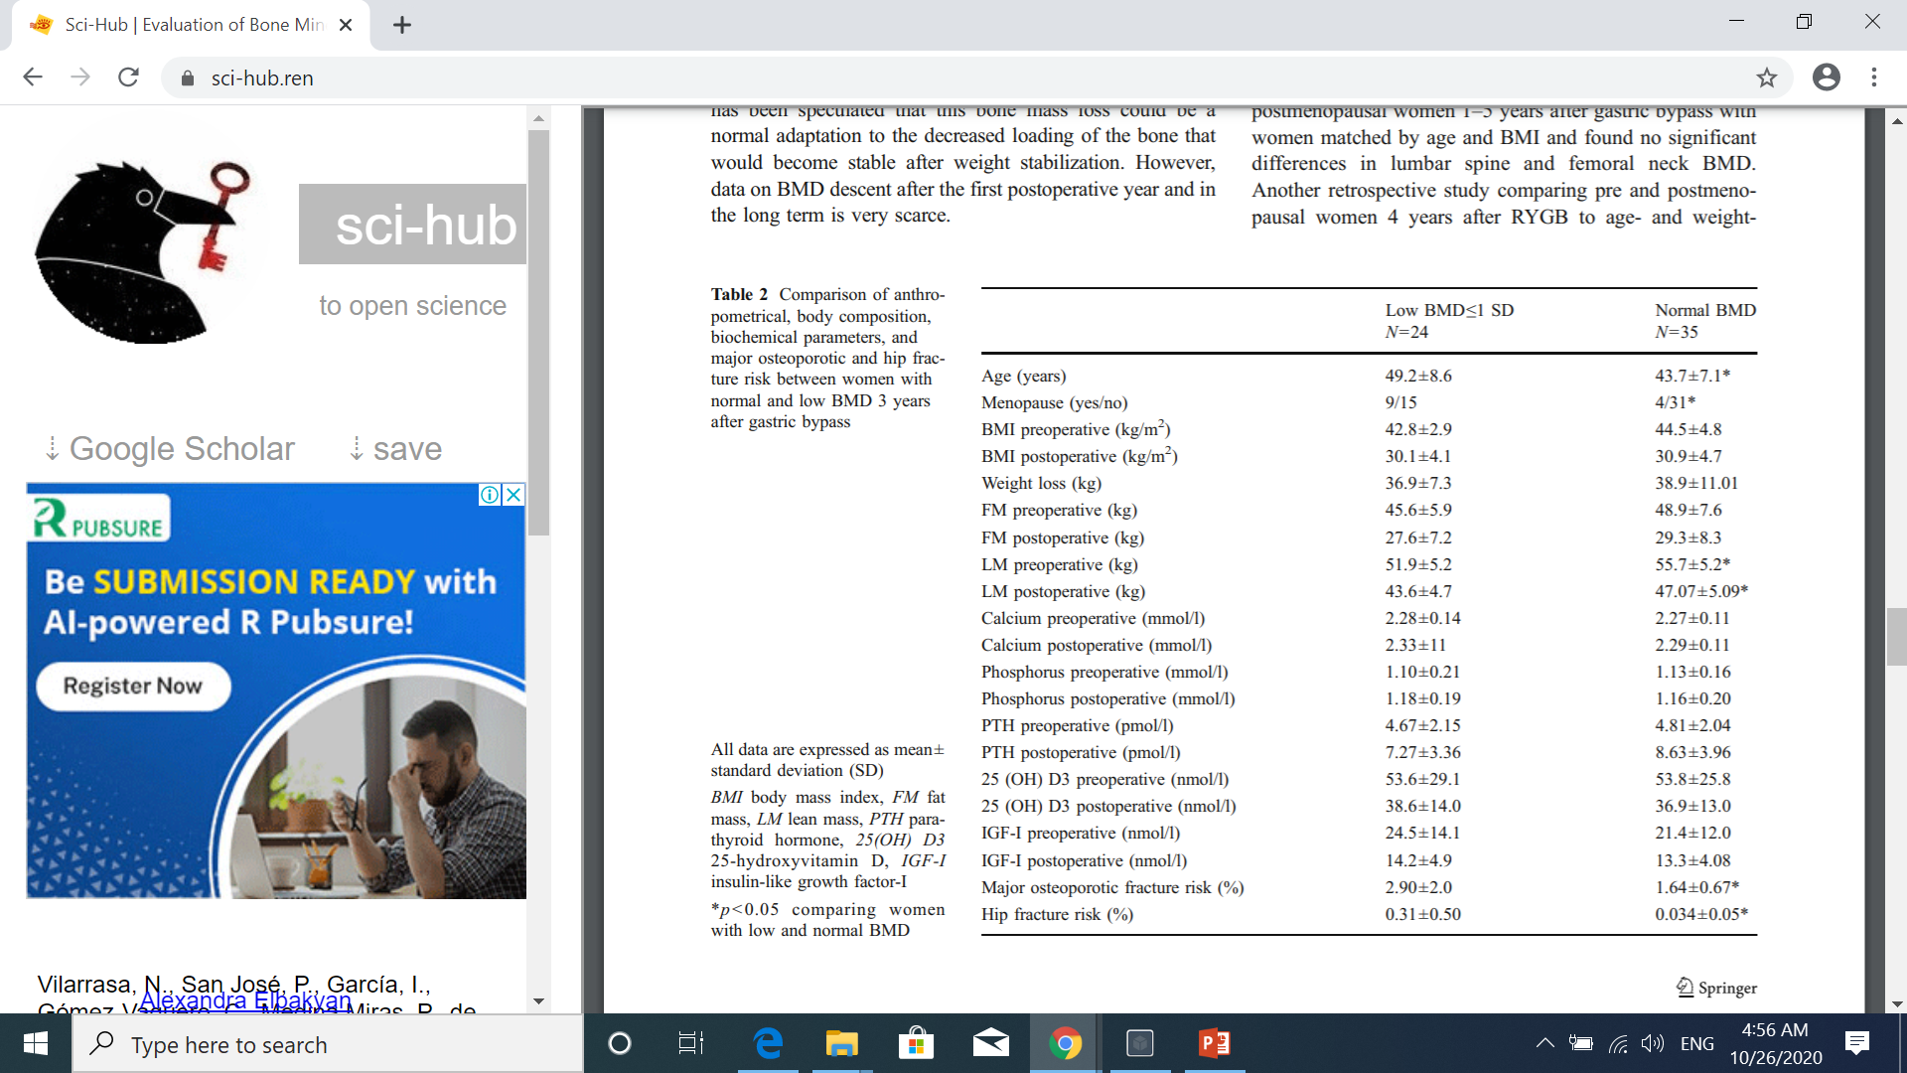

Slide 41
Questions:
What's The Long-term Effect Of Bariatric Surgery On Bone Metabolism?
is there a significant changes in serum 25-OH vitamin D, Ca , PTH, ALP levels?
What's The Incidence Of Osteoporosis And Fracture Risk After Bariatric Surgery?
What's The Preoperative Predictors Of Bone Loss After Bariatric Surgery?
How To Evaluate Patients Before And After Bariatric Surgery?
How To Treat Nutritional Deficiencies After Bariatric Surgery?

Slide 42

Clinical practice guidelines for the perioperative nutrition, metabolic, and nonsurgical support of patients undergoing bariatric procedures – 2019 update: cosponsored by american association of clinical endocrinologists/american college of endocrinology, the obesity society, american society for metabolic & bariatric surgery (AACE/TOS/ASBMS guidelines)
Abnormalities of bone metabolism, including secondary hyperparathyroidism and vitamin D deficiency are common in obesity both before and after bariatric surgery
following malabsorptive and combination procedures : monitoring at 1, 3, 6 and 12 months.
There are insufficient data to warrant preoperative assessment of bone mineral density with dual-energy x-ray absorptiometry (DXA) outside formal CPG recommendations by the National Osteoporosis Foundation .
following malabsorptive and combination procedures: BMD befor and after 2 yr.

Slide 43
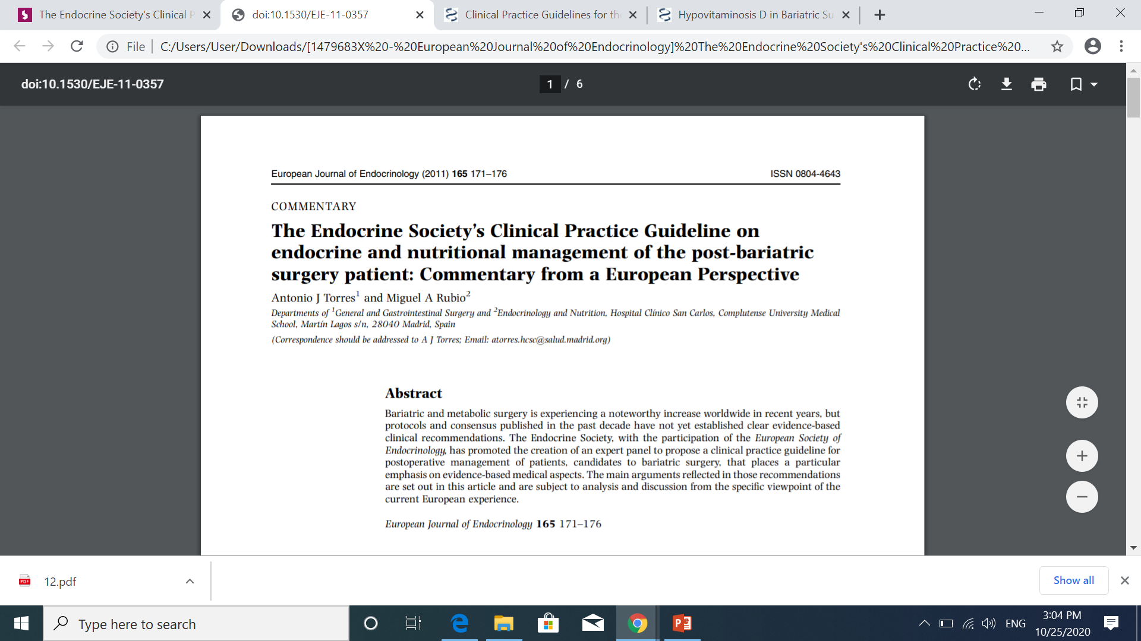
Calcium, phosphorus, vitamin D, PTH, and alkaline phosphatase levels every 6 months.
Bone densitometry (dual-energy x-ray absorptiometry (DEXA) yearly until adequate control is ensured.(Malabsorptive)

Slide 44
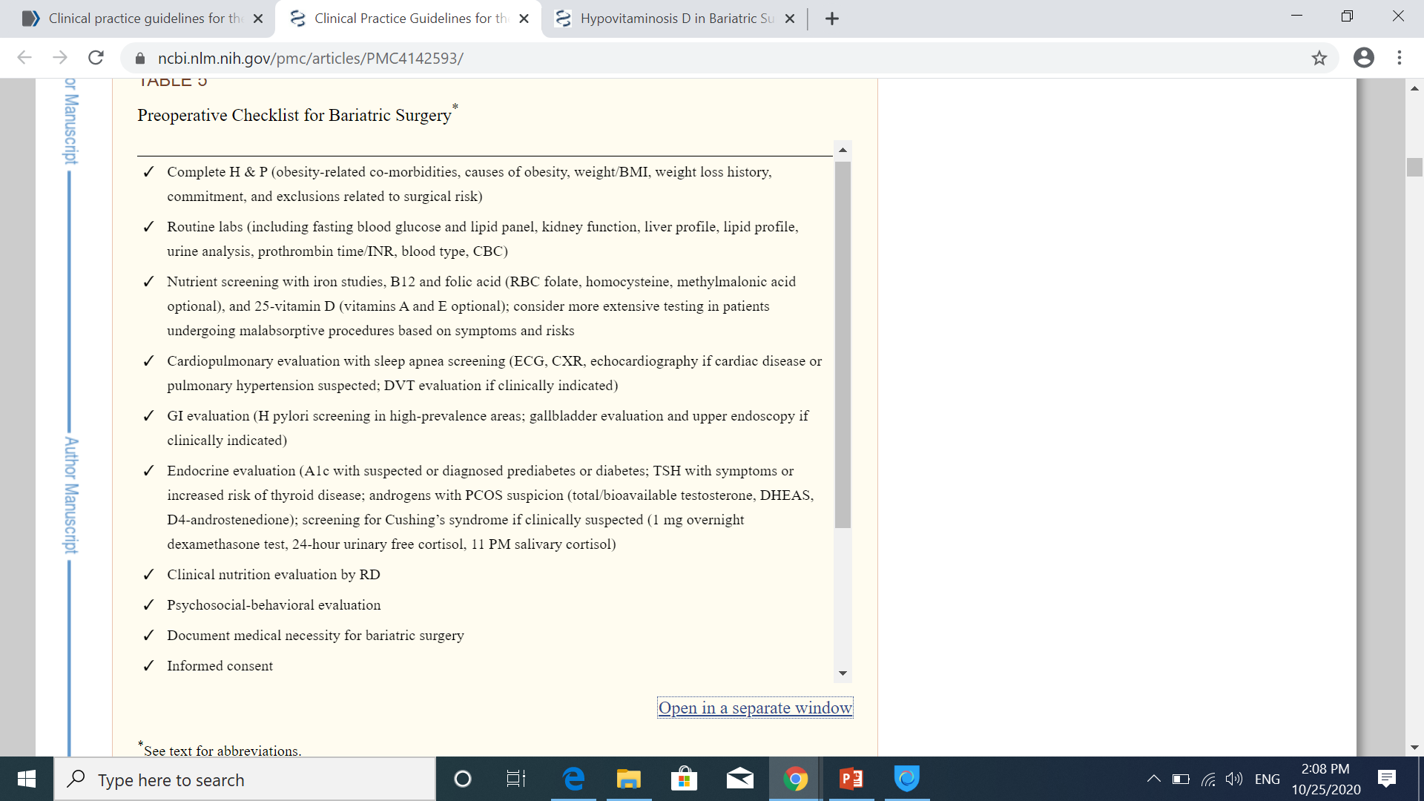
Clinical Practice Guidelines for the Perioperative Nutritional, Metabolic, and Nonsurgical Support of the Bariatric Surgery Patient—2013 Update: Cosponsored by American Association of Clinical Endocrinologists, The Obesity Society, and American Society for Metabolic & Bariatric Surgery

Slide 45
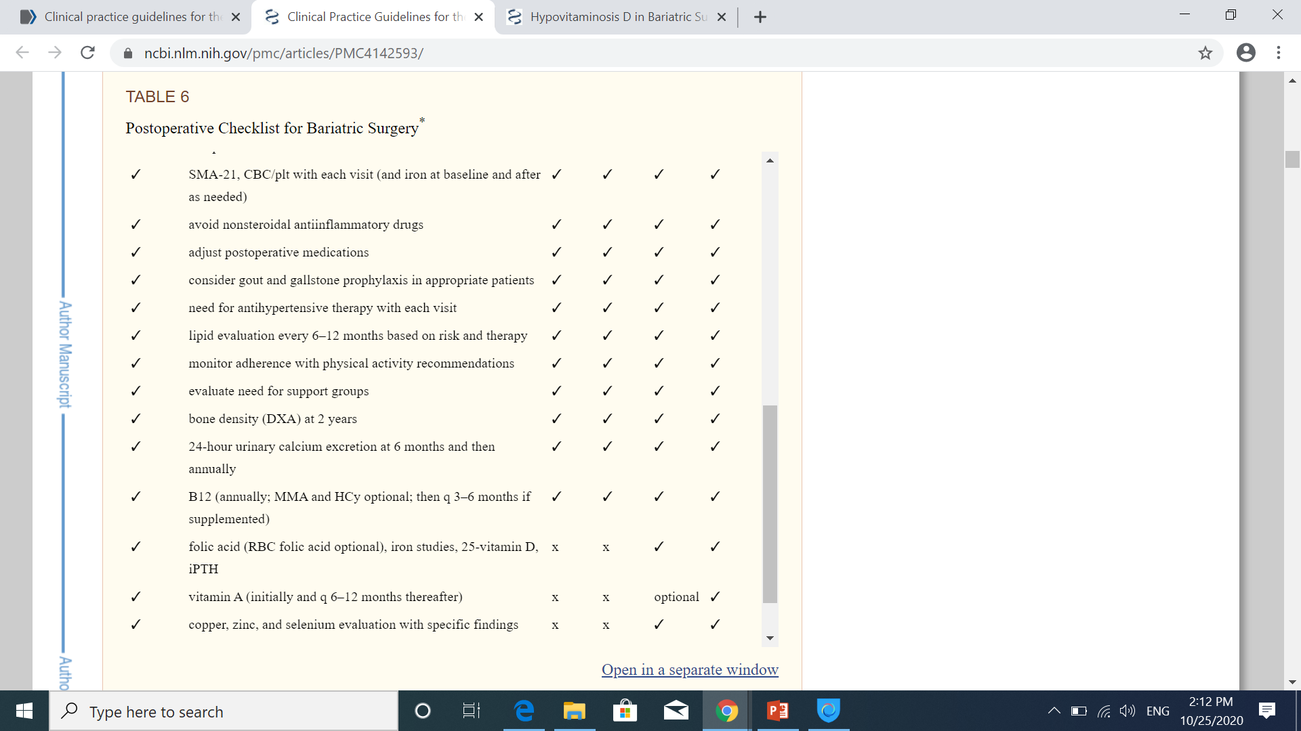

Slide 46
Questions:
What's The Long-term Effect Of Bariatric Surgery On Bone Metabolism?
is there a significant changes in serum 25-OH vitamin D, Ca , PTH, ALP levels?
What's The Incidence Of Osteoporosis And Fracture Risk After Bariatric Surgery?
What's The Preoperative Predictors Of Bone Loss After Bariatric Surgery?
How To Evaluate Patients Before And After Bariatric Surgery?
How To Treat Nutritional Deficiencies After Bariatric Surgery?

Slide 47
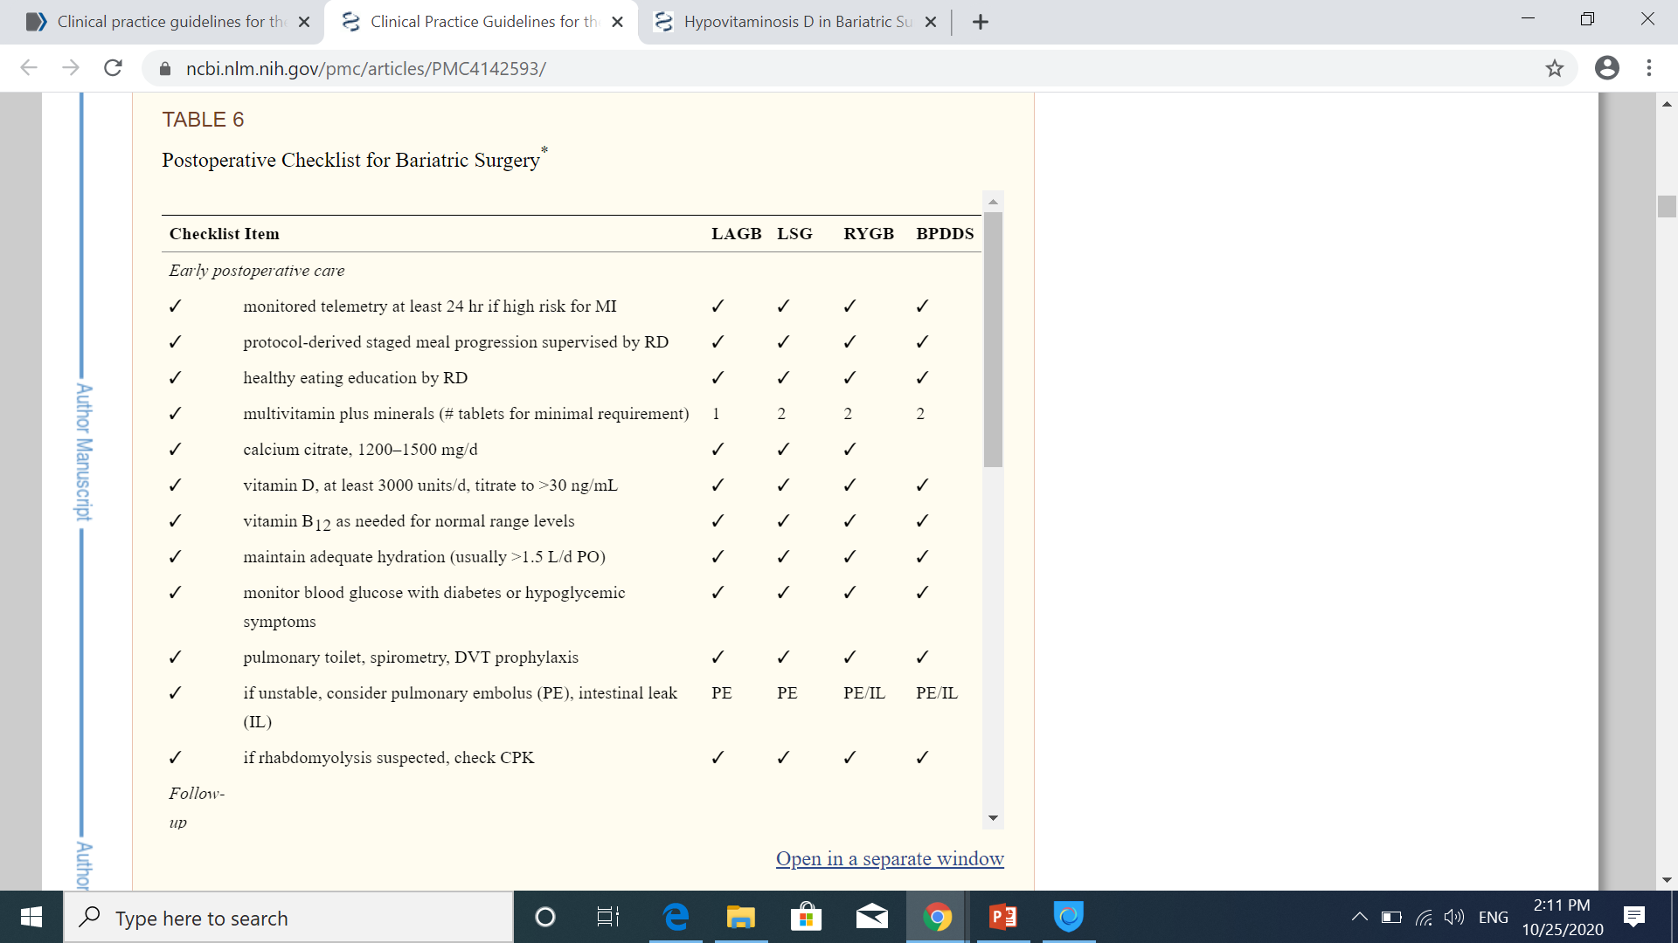

Slide 48


Slide 49


Slide 50


Slide 51
11
The inverse relation between BMI and serum 25-hydroxyvitamin D [25(OH)D] level has been demonstrated in the large Framingham [22] and NHANES III [23] studies and confirmed in a meta-analysis of multiple cohorts, using Mendelian randomization [24]. In the latter analysis, an increasing BMI allele score (combining a battery of 12 BMI SNPs) was significantly associated with lower 25(OH)D level [24]. Decreased sun exposure, altered dietary habits, and lack of intake of adequate amounts of various minerals and vitamins in obese individuals are all contributing factors [25,26]. Furthermore, obese individuals have decreased bioavailability of vitamin D, secondary to its sequestration in subcutaneous and visceral fat, despite normal vitamin D cutaneous synthesis and gastrointestinal absorption, compared to lean control subjects [27]. Compared to lean subjects, obese individuals have decreased expression of the vitamin D metabolizing enzymes, 25-hydroxylase and 1α-hydroxylase in cutaneous and visceral adipose tissues [28]. A decrease in the activity of the hepatic 25- hydroxylase activity has been previously described, and may be secondary to non-alcoholic fatty liver disease [29]. Volumetric dilution, rather than sequestration, has been suggested to explain the low 25(OH)D level in obese
The role of obesity-associated inflammation on vitamin D level has been also suggested and needs to be further elucidated

