Slide 1
IN THE NAME OF GOD
Case Presentation
Zahra Shiravand-MD
June 2024

Slide 2
Patient history
The patient is a 55-year-old woman from Tehran
A known case of Cushing's disease from 1377-78
Has two children (1367 & 1374)

Slide 3
Chief complaint
A 55-year-old female, known case of Cushing syndrome with an initial complaint of facial puffiness, truncal obesity, high blood pressure, muscle weakness, abdominal purplish striae, facial acne, menstruation disorder from 30Y (1378) with multiple endocrine surgeries and persistent symptoms, who referred for follow-up treatment.

Slide 4
Present illness
Her first presentation is related to 1378, due to facial puffiness, truncal obesity, high blood pressure, muscle weakness, abdominal purplish striae, facial acne, and menstruation disorder (from 6 months prior to referral), the following tests were used to make the initial diagnosis and will be further investigated :
ACTH: 80 pg/ml (9-52)

Slide 5
Present illness
Then the patient underwent pituitary MRI and abdomen & pelvic & chest CT scan, which were normal.
With respect to negative pituitary MRI, abd & chest CT scan, moderate hypercortisolism and limited experience on IPSS/TSS in our country at that time, treatment with Ketoconazole 800 mg, oral hypoglycemic agent and antihypertensive medication with regular f/u was advised.

Slide 6
Present illness
Treatment was partially effective and signs and symptoms improved gradually. Regular menstrual cycles also resumed. After 1 year facial puffiness became more prominent and hypertension and diabetes became more resistant to our medications.
Her menstrual cycles which had become regular for about 6 months became irregular and amenorrhea developed finally.
During this period morning cortisol was between 19 to 23 µg/dl and 24h UFC was between 47 to 160µg.
Multiple measurement of serum ACTH showed values between 99 and 110 pg/ml (normal=9-52)

Slide 7
Present illness
In 1389/10/3, a pituitary MRI showed a 5 mm pituitary mass compatible with a microadenoma and the patient underwent TSS.
Post-surgical serum cortisol (90/4/7: 18 µg/dl) and urine cortisol (90/4/26: 127 µg) were still elevated and there was no menstrual bleeding.
Evaluation of bone mineral density revealed osteoporosis of spine and femur.
Treatment with bisphosphonates, ketoconazole, Insulin and antihypertensive medications were continued…

Slide 8
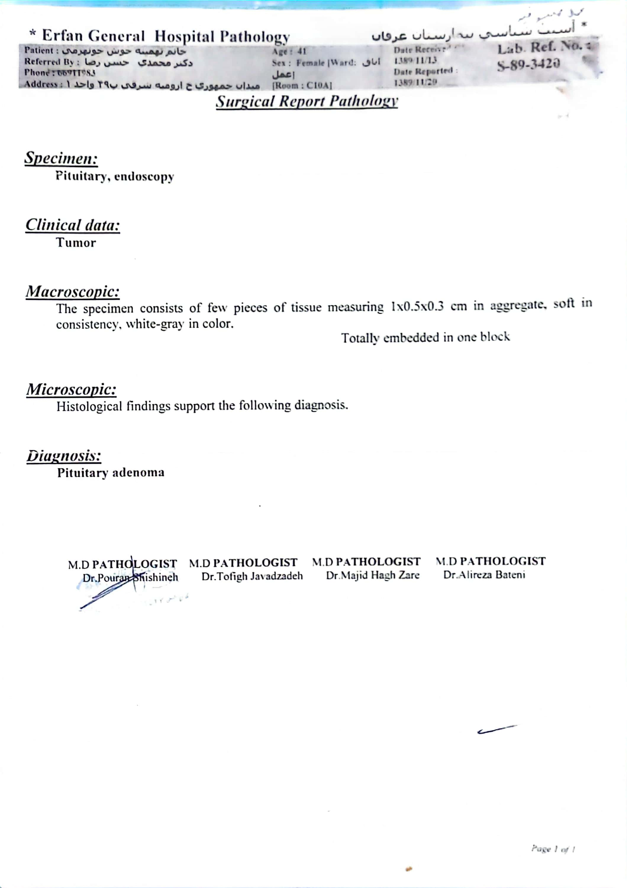
1389/11/13

Slide 9
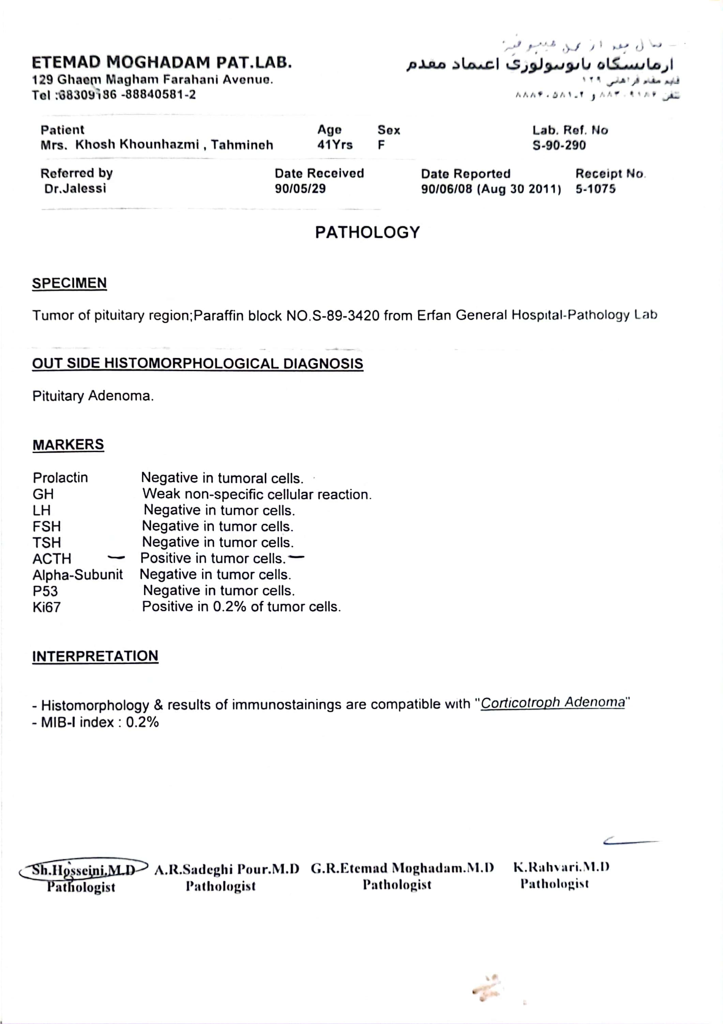

Slide 10
Present illness
During the ensuing years, serum cortisol and 24 UFC gradually increased despite treatment with ketoconazole and a pituitary MRI showed another 5 mm mass in the pituitary.
In 1393 we decided to send the patient for bilateral adrenalectomy because of sever osteoporosis, unresponsiveness to medical treatment and uncontrollable diabetes and hypertension, The patient did not agree to do it.
An abdominal CT scan was requested which surprisingly showed a large oval shaped left adrenal mass measuring 66 by 48 mm with minimal enhancement after contrast injection. The mass was interpreted as a benign looking functional adrenal tumor.

Slide 11
Present illness
The patient was asked to bring all her previous images for review.
Review of the abdominal CT scan done at 1378 revealed that she had a left adrenal mass at that time which had been passed unnoticed.
Comparison of the 2 imagines showed that the mass had increased markedly during these years.
The patient was prepared for laparoscopic surgery. a preoperative exercise test was positive for coronary artery disease and the patient underwent coronary angioplasty(PCI on RCA).
The patient underwent laparoscopic surgery in 95/8/10 for excision of the left adrenal mass. surgery was uneventful and a lobulated, partly encapsulated mass measuring 9 by 5 by 5 cm and weighing 85 gr was extracted.

Slide 12
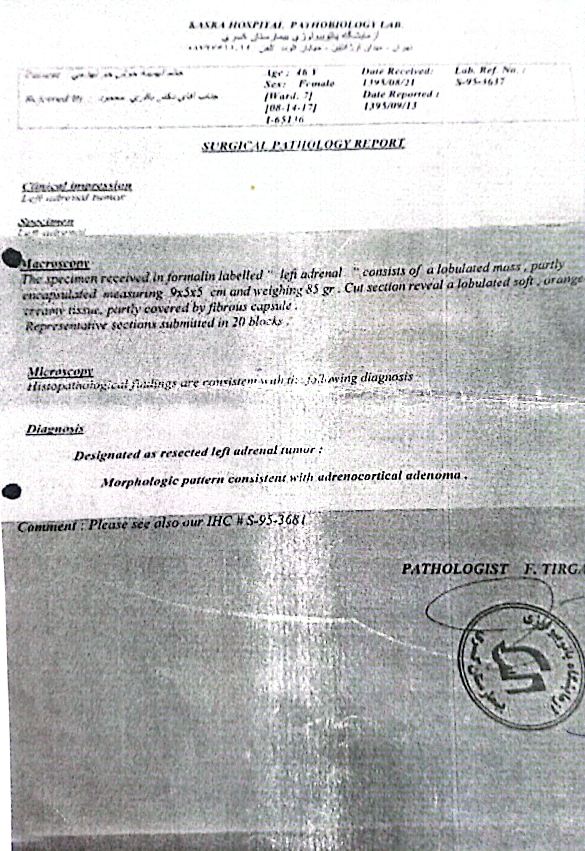
1395/8/10

Slide 13
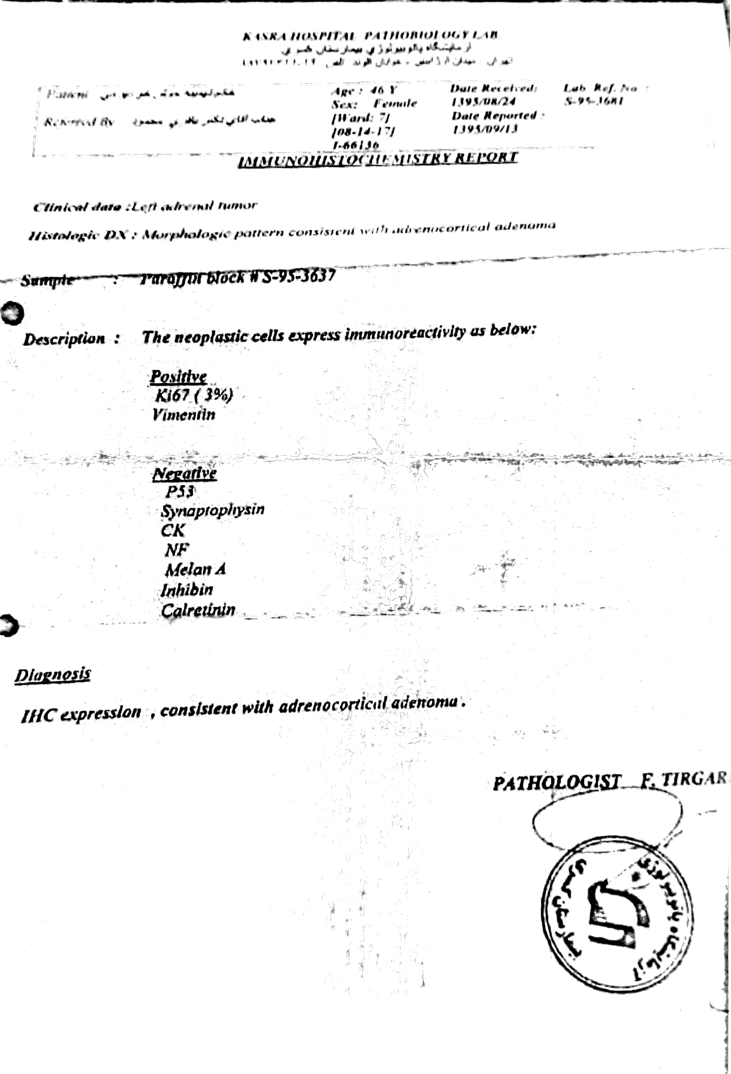

Slide 14
Present illness
The patient came to doctor after 2 weeks for re evaluation.
Her blood pressure and glucose were still very high and facial puffiness had not changed at all. Early morning Serum cortisol was 27µg/dl and the 24 hour UFC was 193µg(36-137) and ACTH was 49 pg/ml (9-52).
An MRI of the abdomen revealed a significant adrenal remnant (44×33 mm).
We tried to convince her for reoperation but she refused the surgery. indeed she had been tired from so much operations that could not have helped her.
Ketoconazole was restarted and medical management was continued for about 1 year.

Slide 15
Present illness
She was finally convinced to go for re-surgery (open) in 97/3/1 :

Slide 16
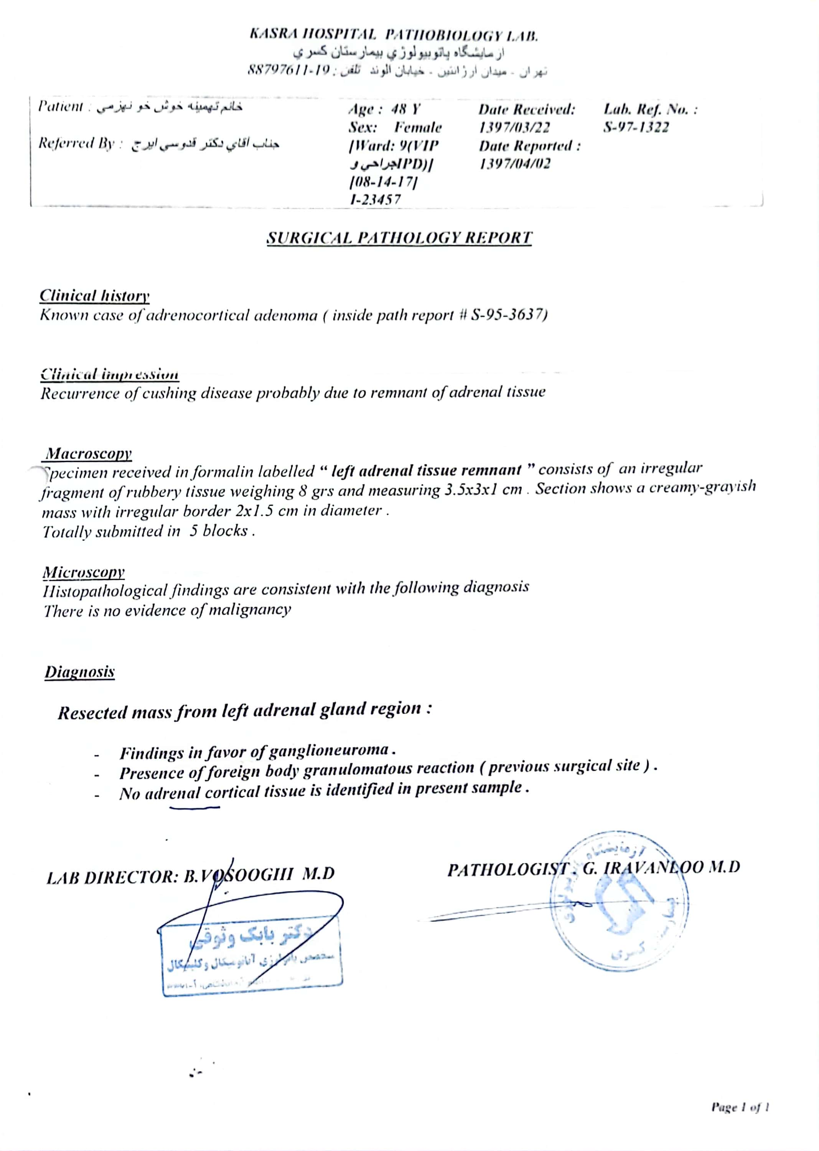
1397/3/1

Slide 17
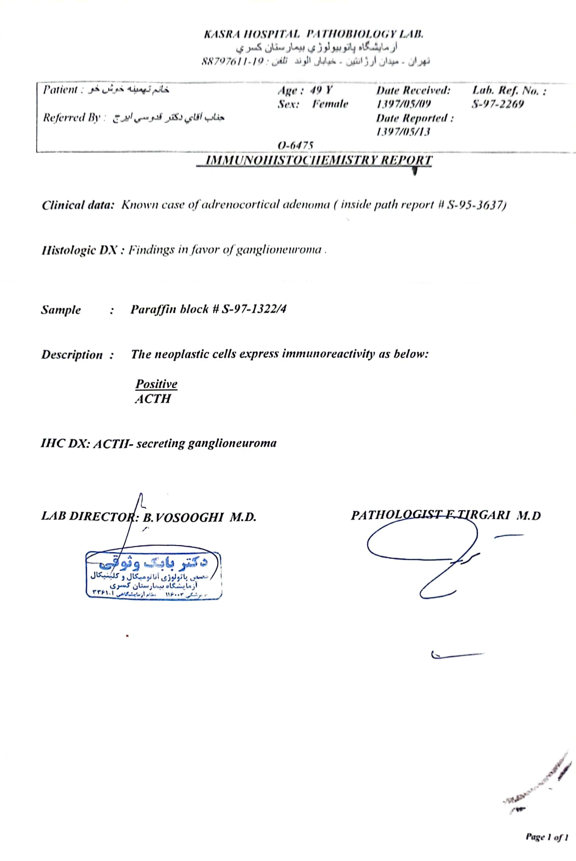

Slide 18
Present illness
One month after the surgery, the patient underwent abdominal CT and the only positive finding was right adrenal hyperplasia and the tests were as follows:
(without ketoconazole)
Serum cortisol: 18 µg/dl
ACTH: 104 pg/ml
24h cortisol: 187 µg (36-137) v: 1150 & Cr: 840
Octero scan: normal

Slide 19
Present illness
The attending physician was changed in 1398 and re-evaluation was done;
Following re-evaluation, the patient underwent p.MRI and a microadenoma (5.2×4.3mm) was reported on the left side of the pituitary gland, and a Ga-DOTA-TATE PET/CT was performed in 98/6/5, which is as follows:
(Ketoconazole was discontinued for one week)
ACTH: 85 pg/ml
Serum cortisol: 11.9 µg/dl
High dose DST | 24h urine | 24h urine
2300 | 2100 | 2950 | V(cc)
1104 | 1155 | 1230 | Cr(mg) weight=88kg
15.8 | 353 | 377(36-137) | Cortisol (µg)

Slide 22
Present illness
According to the patient's DOTA-TATE PET CT report, she was a candidate for EUS/FNA in 98/6/30 :

Slide 23
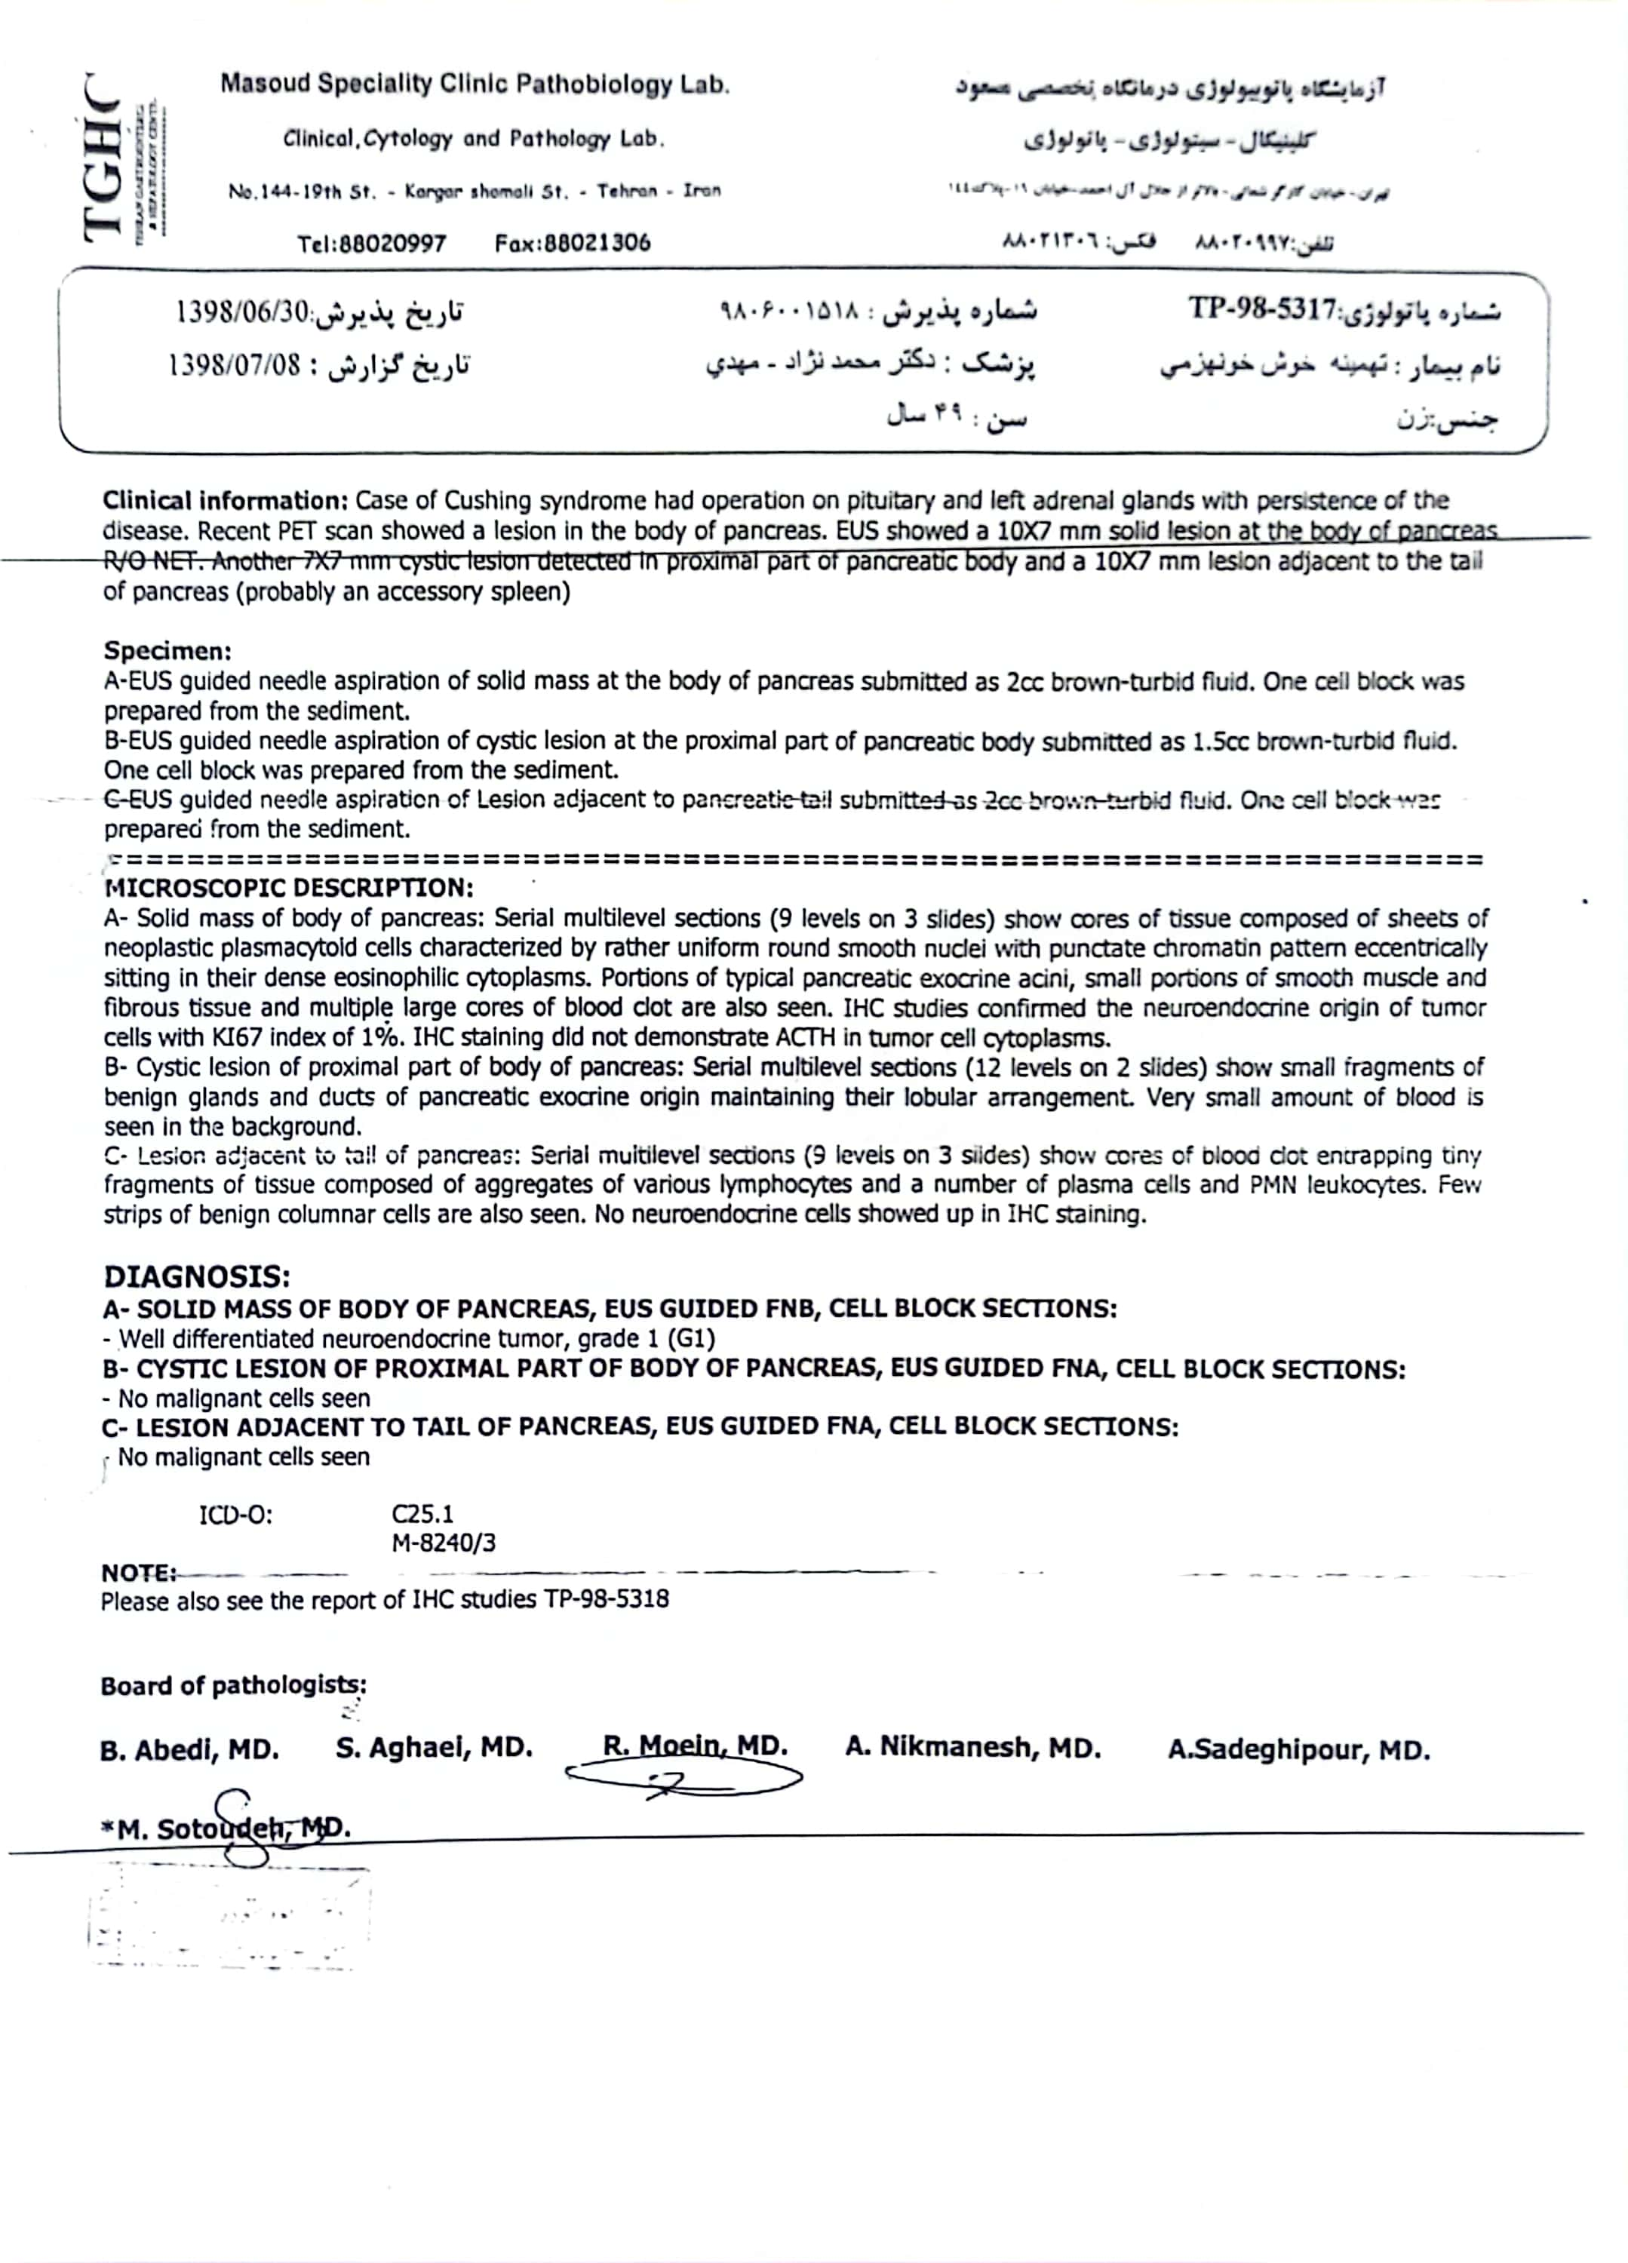

Slide 24
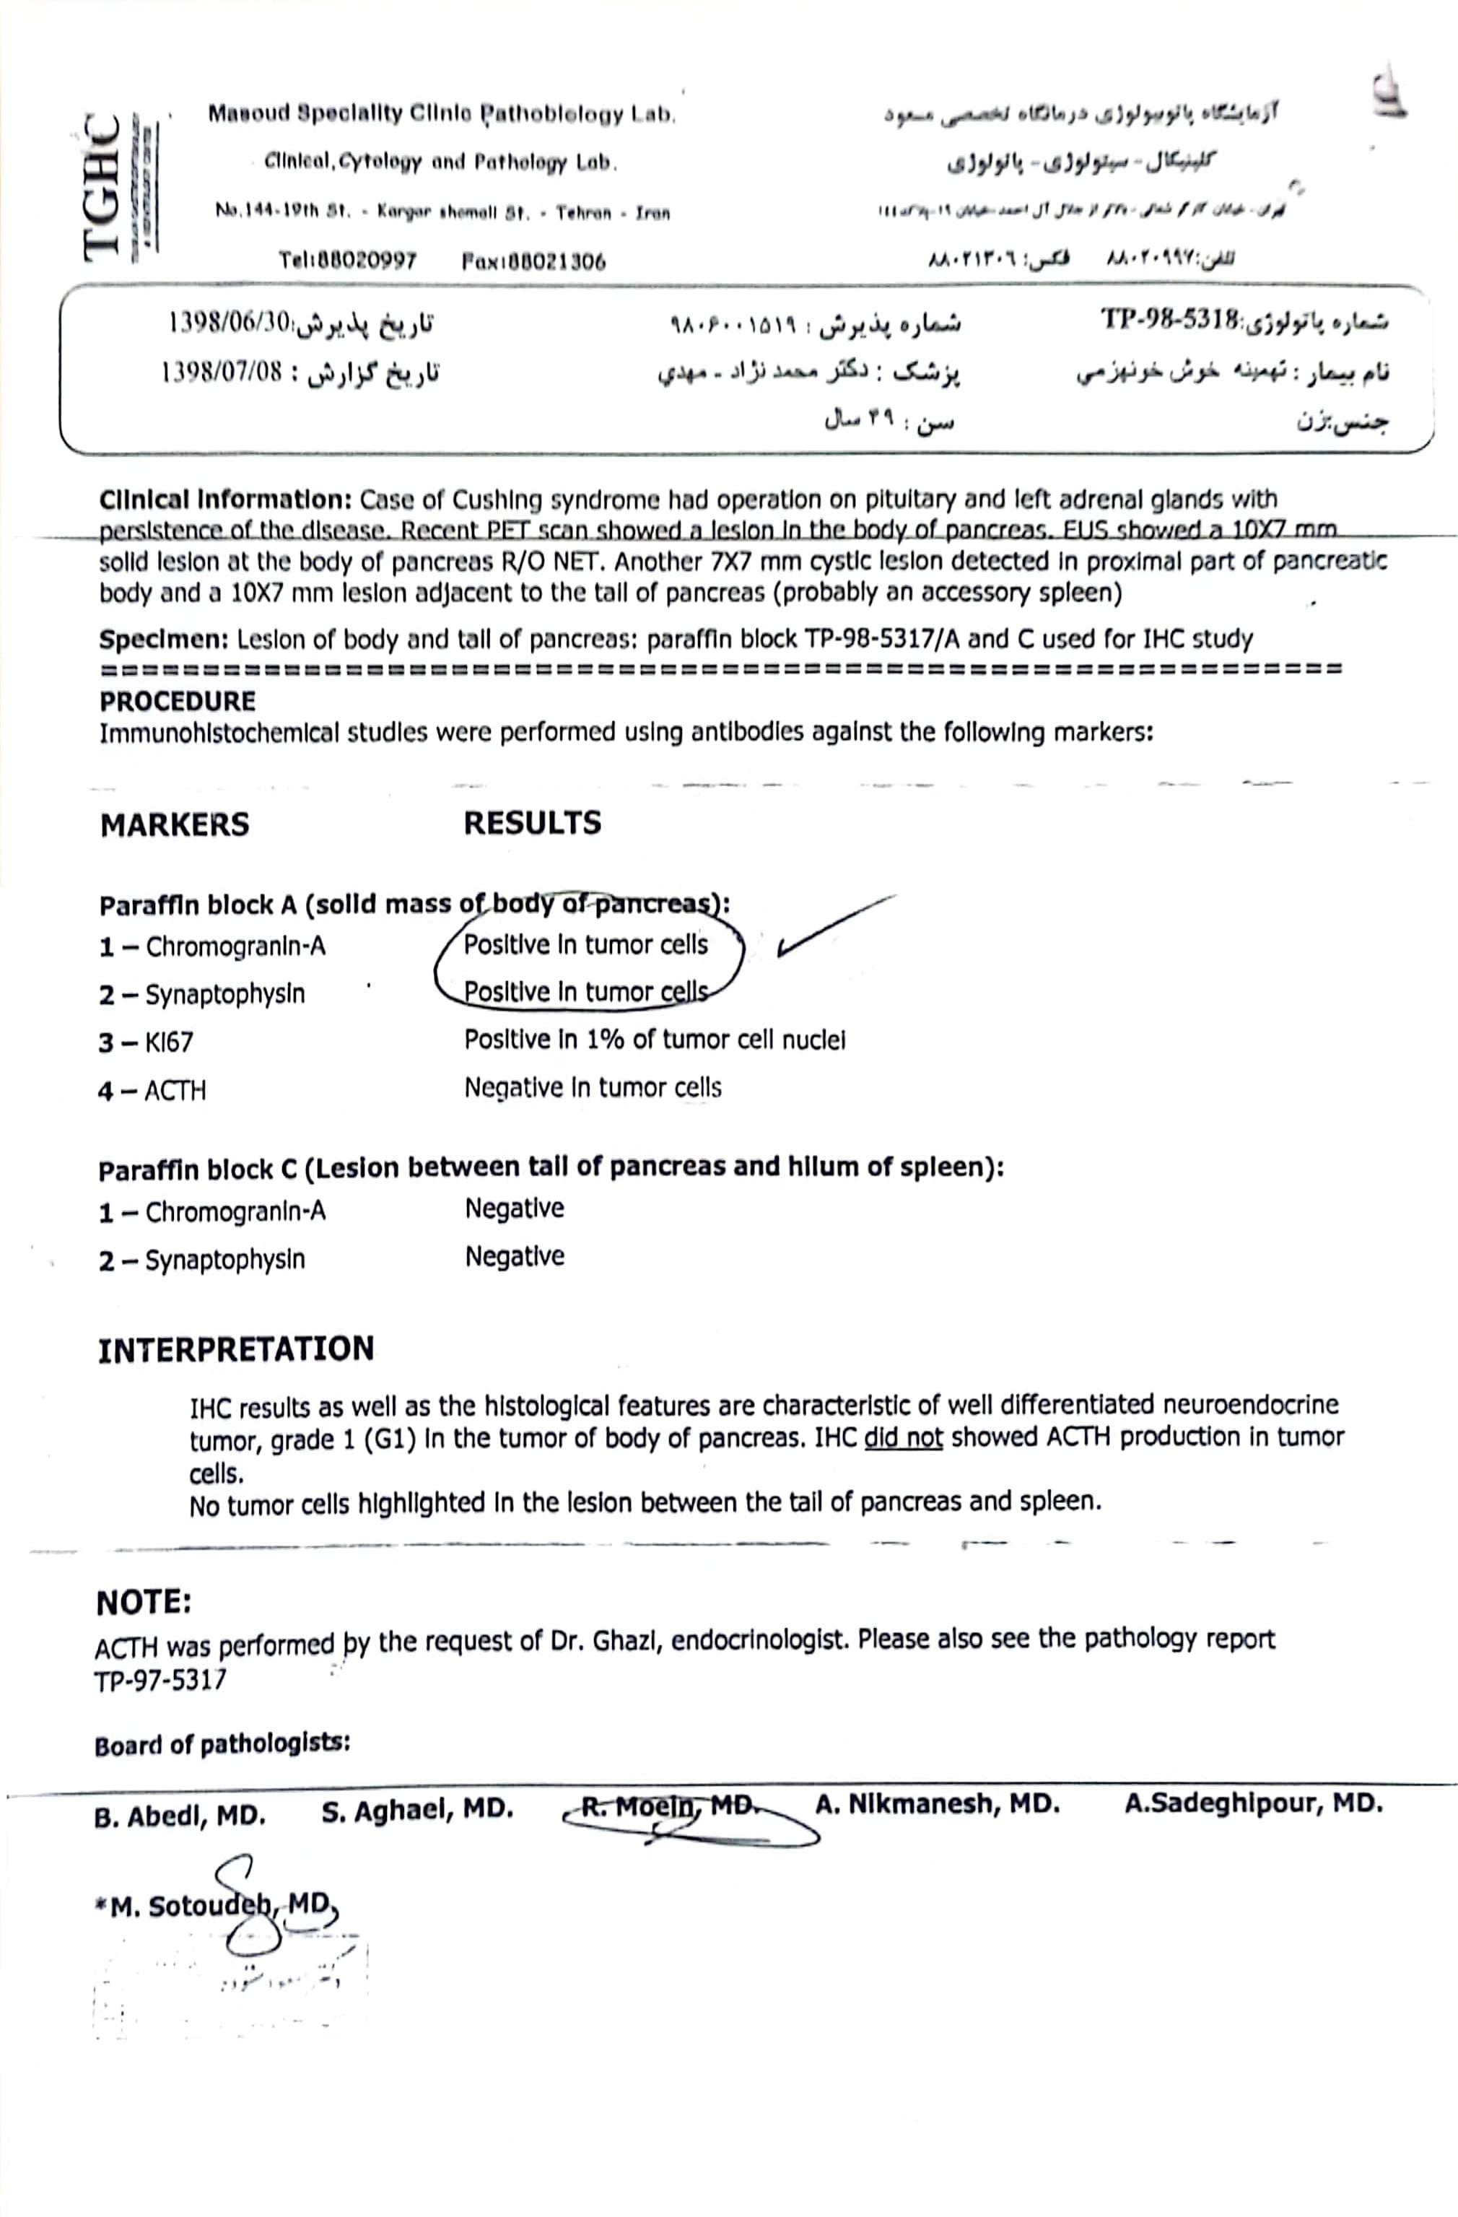

Slide 25
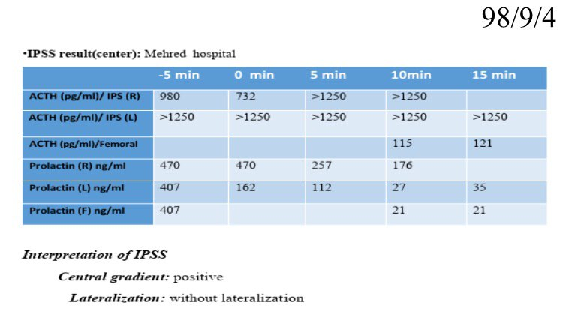
Present illness

Slide 26
Present illness
According to the results of IPSS, the second TSS in 1398 was performed for the patient, and the pathology is as follows :

Slide 27
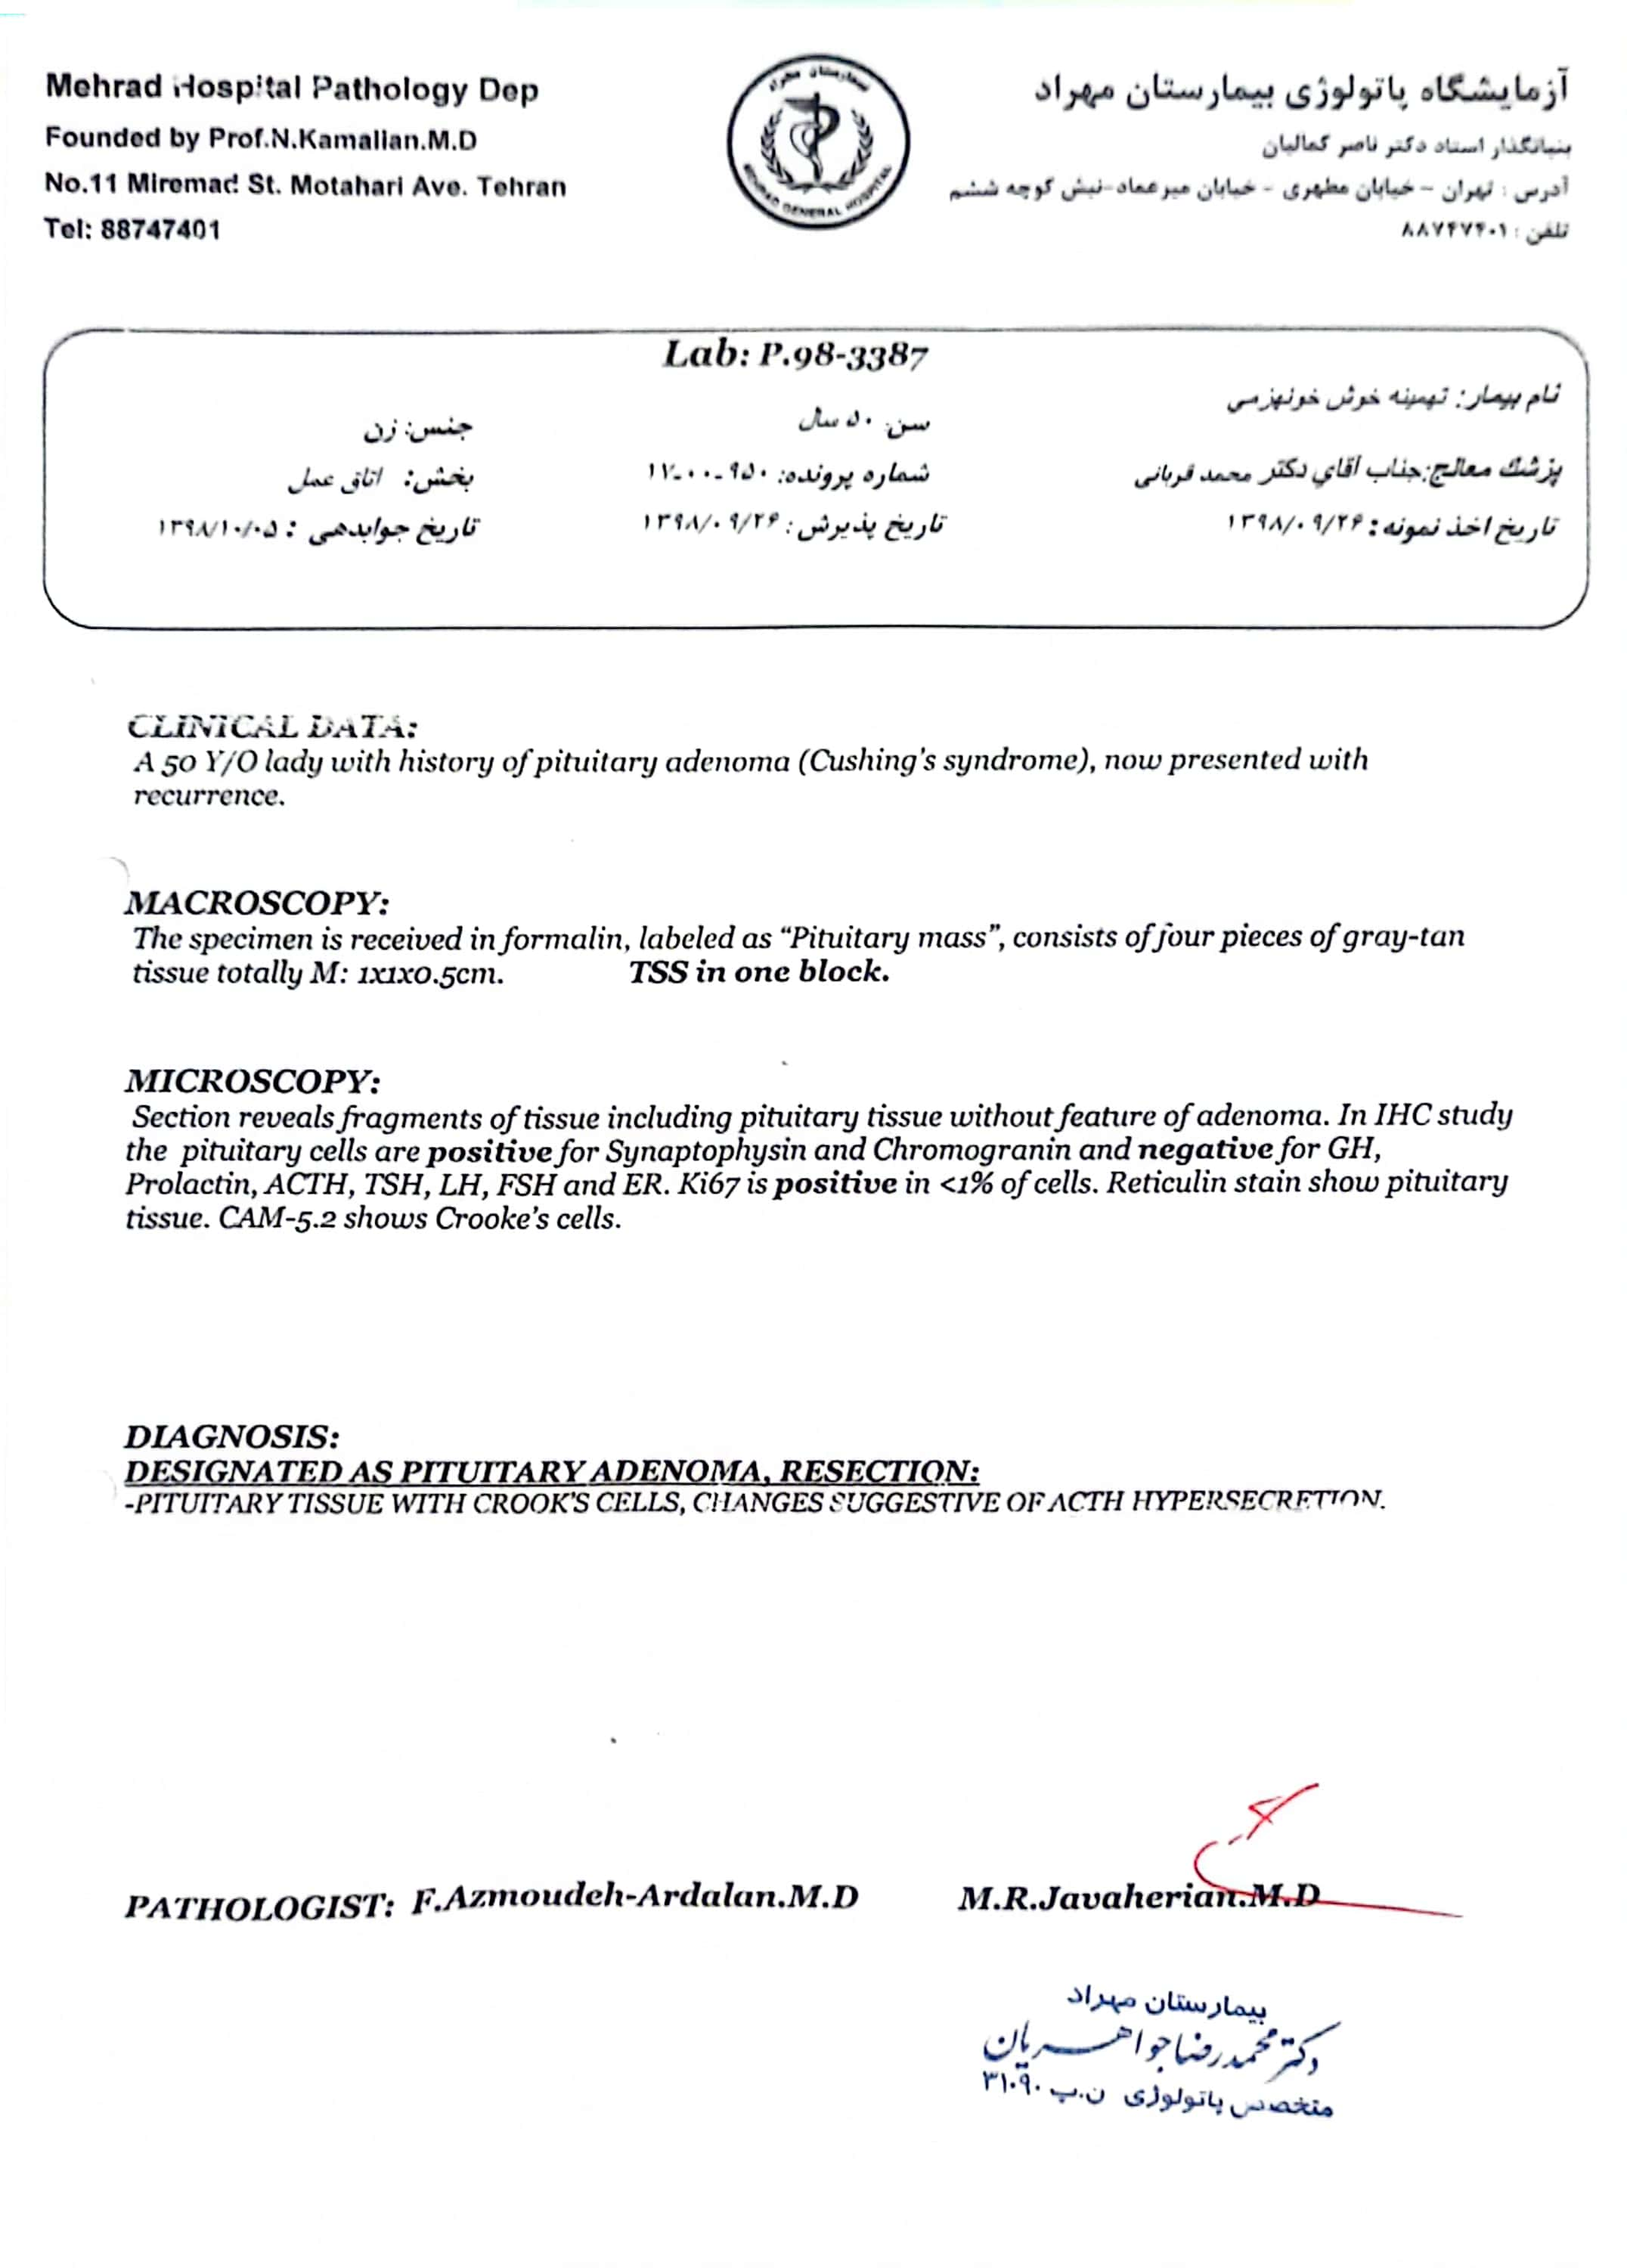

Slide 28
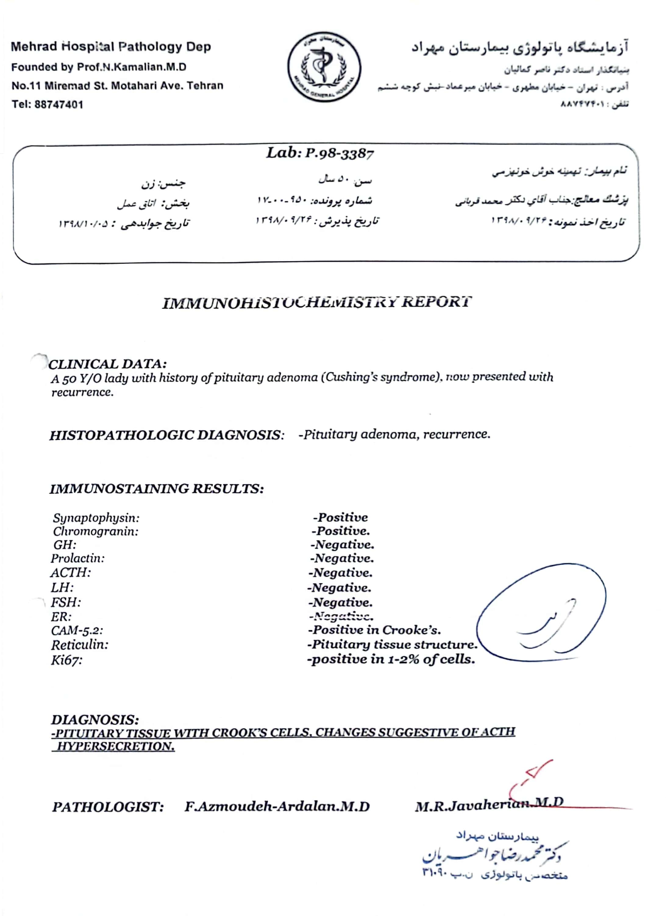

Slide 29
Present illness (98/11/9)
Serum cortisol: 26 µg/dl
24h UFC: 86.9µg(V: 550-Cr:1018)
ACTH: 85 pg/ml
FBS: 186 mg/dl
Ca: 9.6 mg/dl
P: 3.5 mg/dl
K: 4.4 mEq/l
LH: <0.1 mIUlml
FSH: 0.4 mIUlml
T4: 4.3 µg/dl
TSH: <0.005 uIU/ml
Chromogranin A: 500 ng/ml
TG: 272 mg/dl
HDL: 37 mg/dl
LDL: 84 mg/dl
AST: 16 IU/L
ALT: 20 IU/L
with Ketoconazole 400 mg/day & weight=88 kg

Slide 30
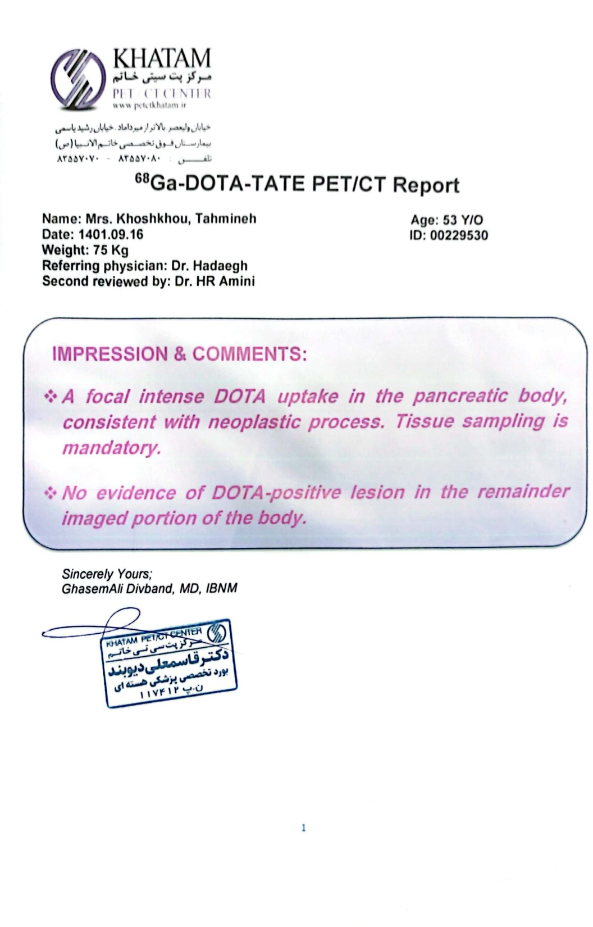

Slide 31
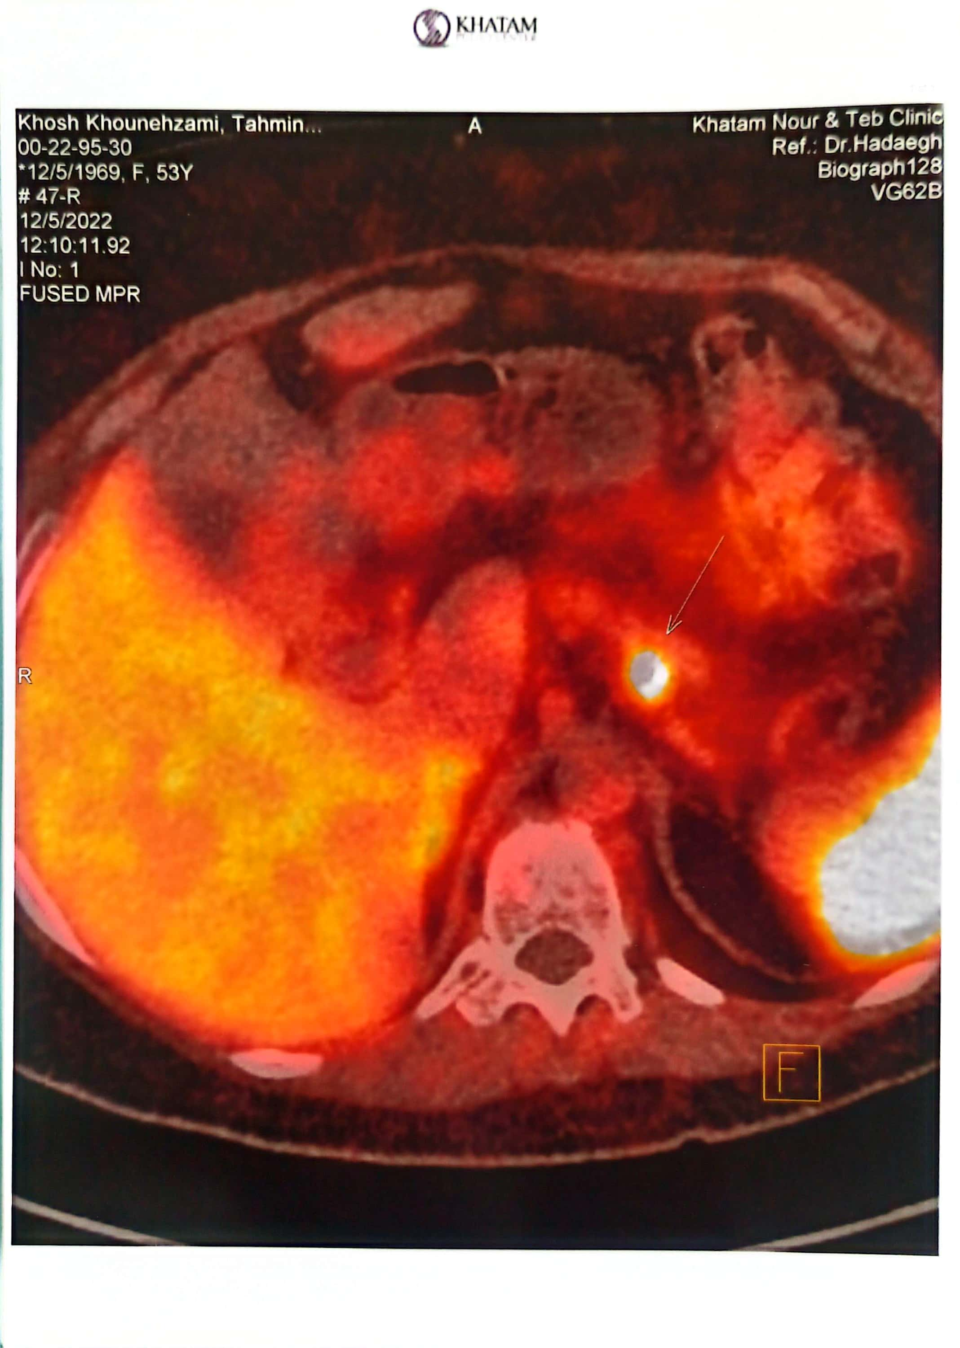

Slide 32
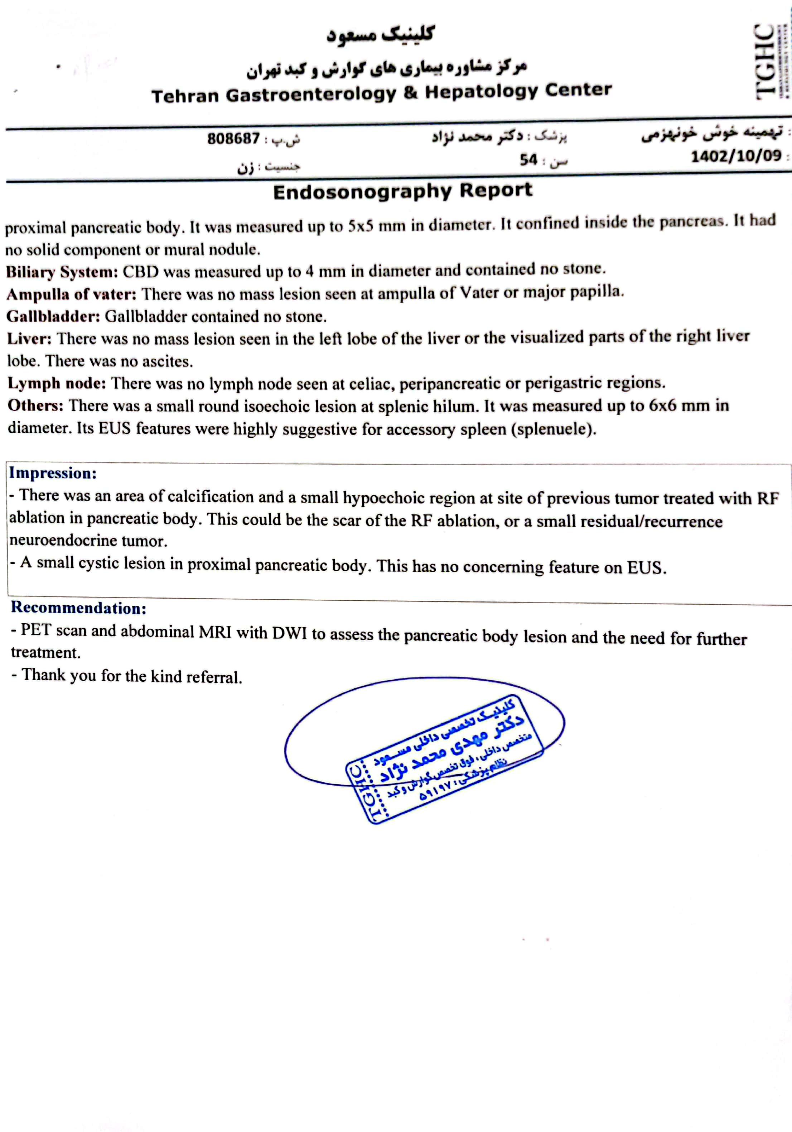
EUS guided Radiofrequency of pancreatic lesion 1402/3/7
Endo sono again 1402/10/18 :

Slide 33
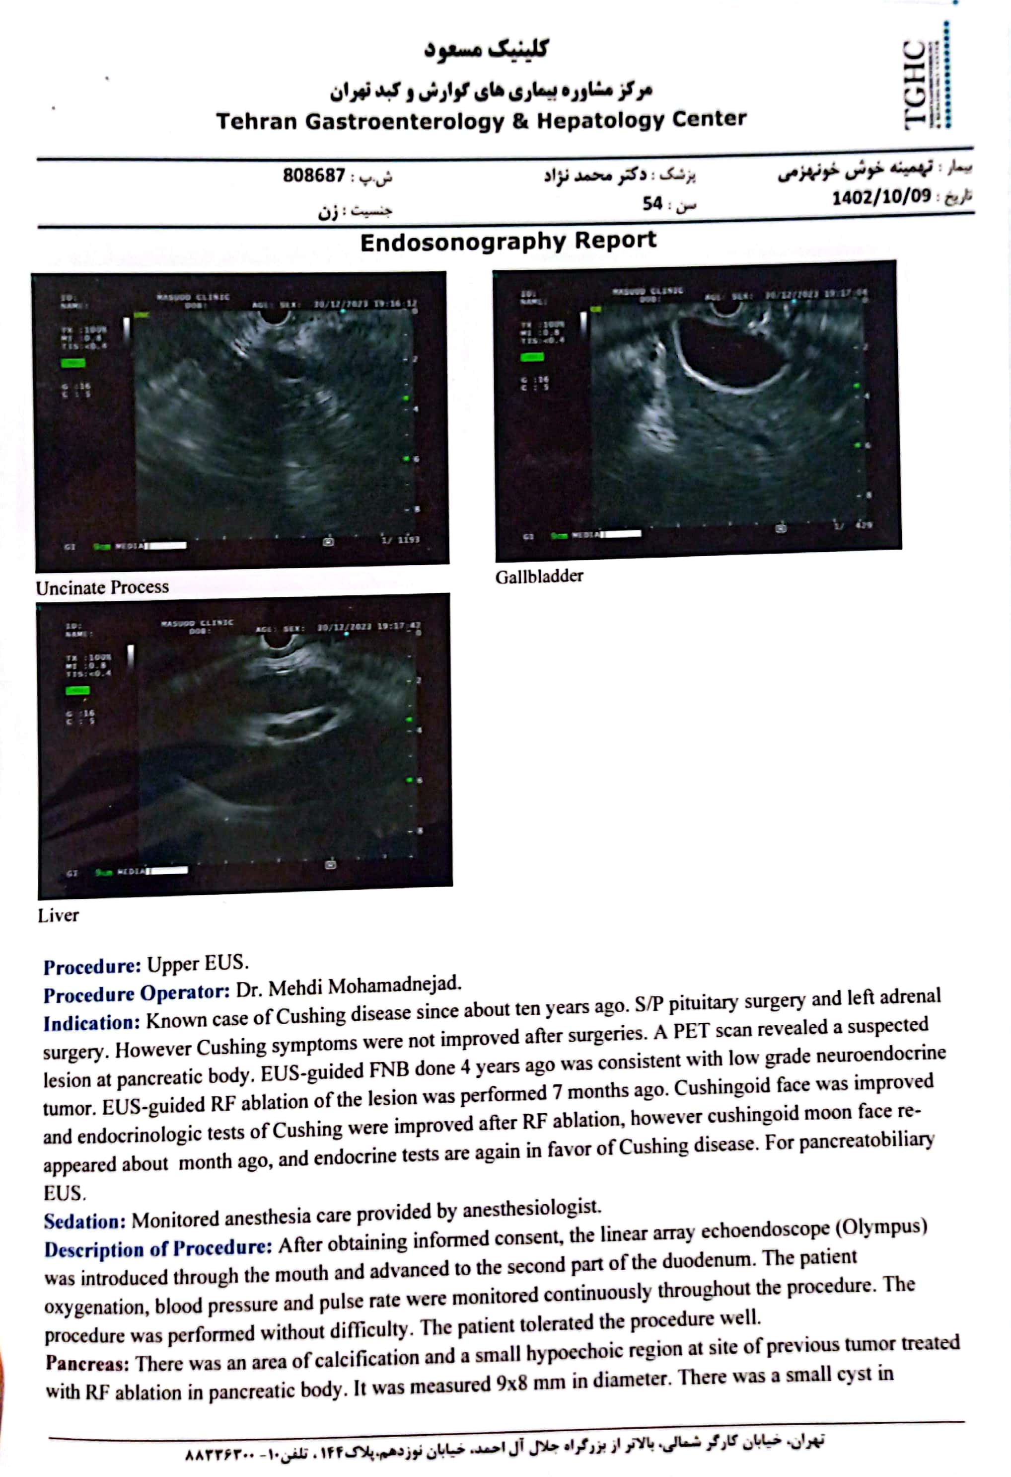
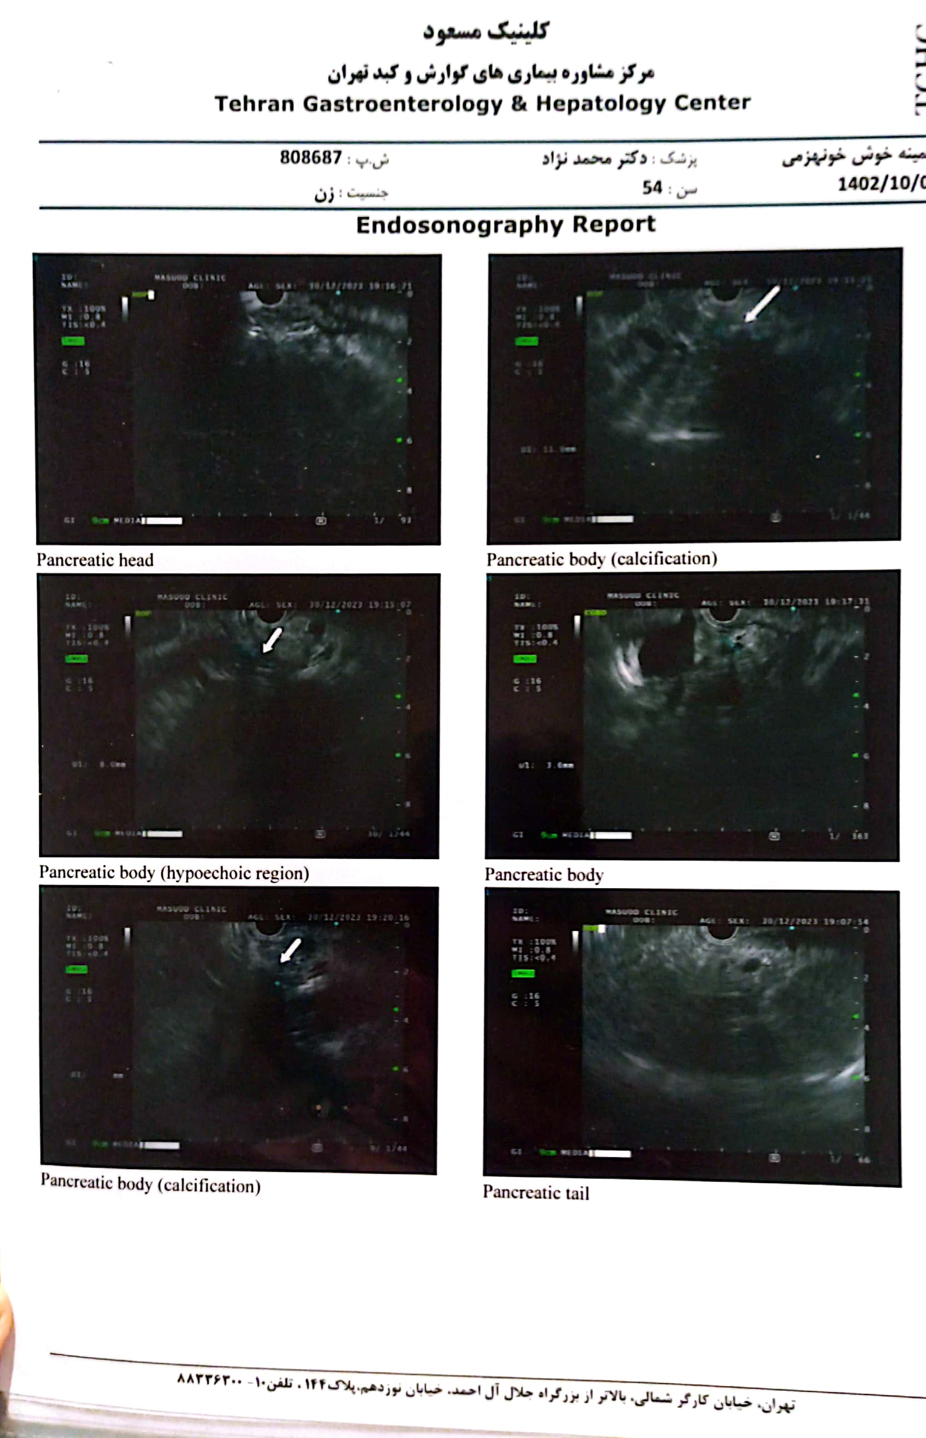

Slide 34
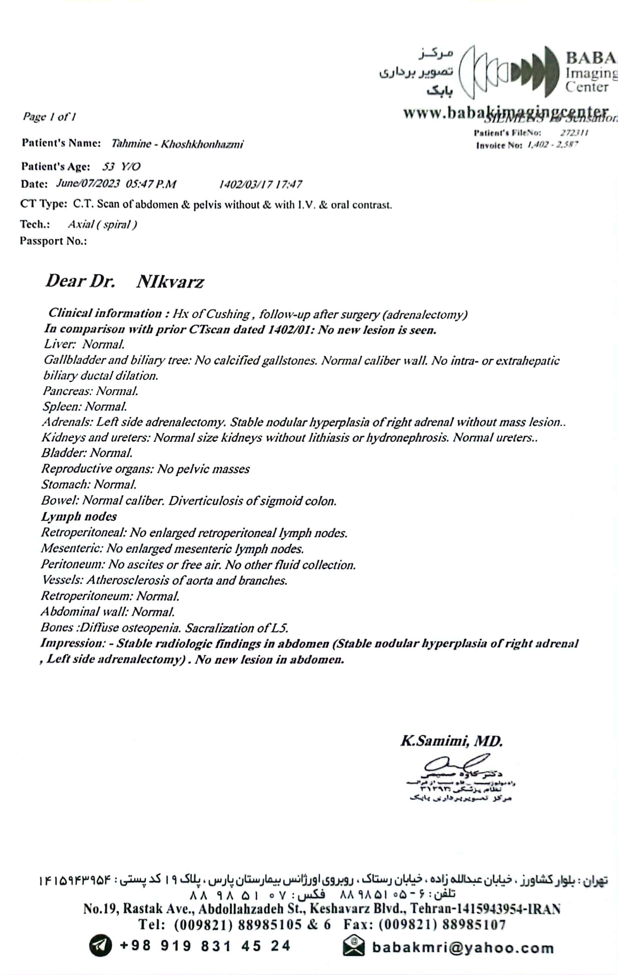
Abd & pelvic CT scan +/- contrast 1402/3/17

Slide 35
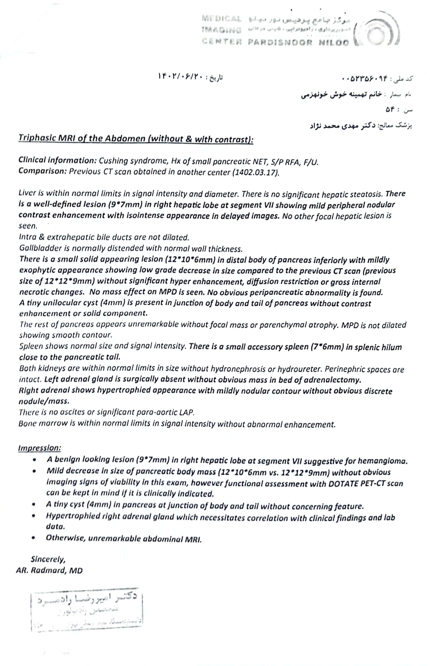
Abd & pelvic MRI 1402/6/20

Slide 36
Ga-DOTA-TATE PET/CT 1402/10/20

Slide 37
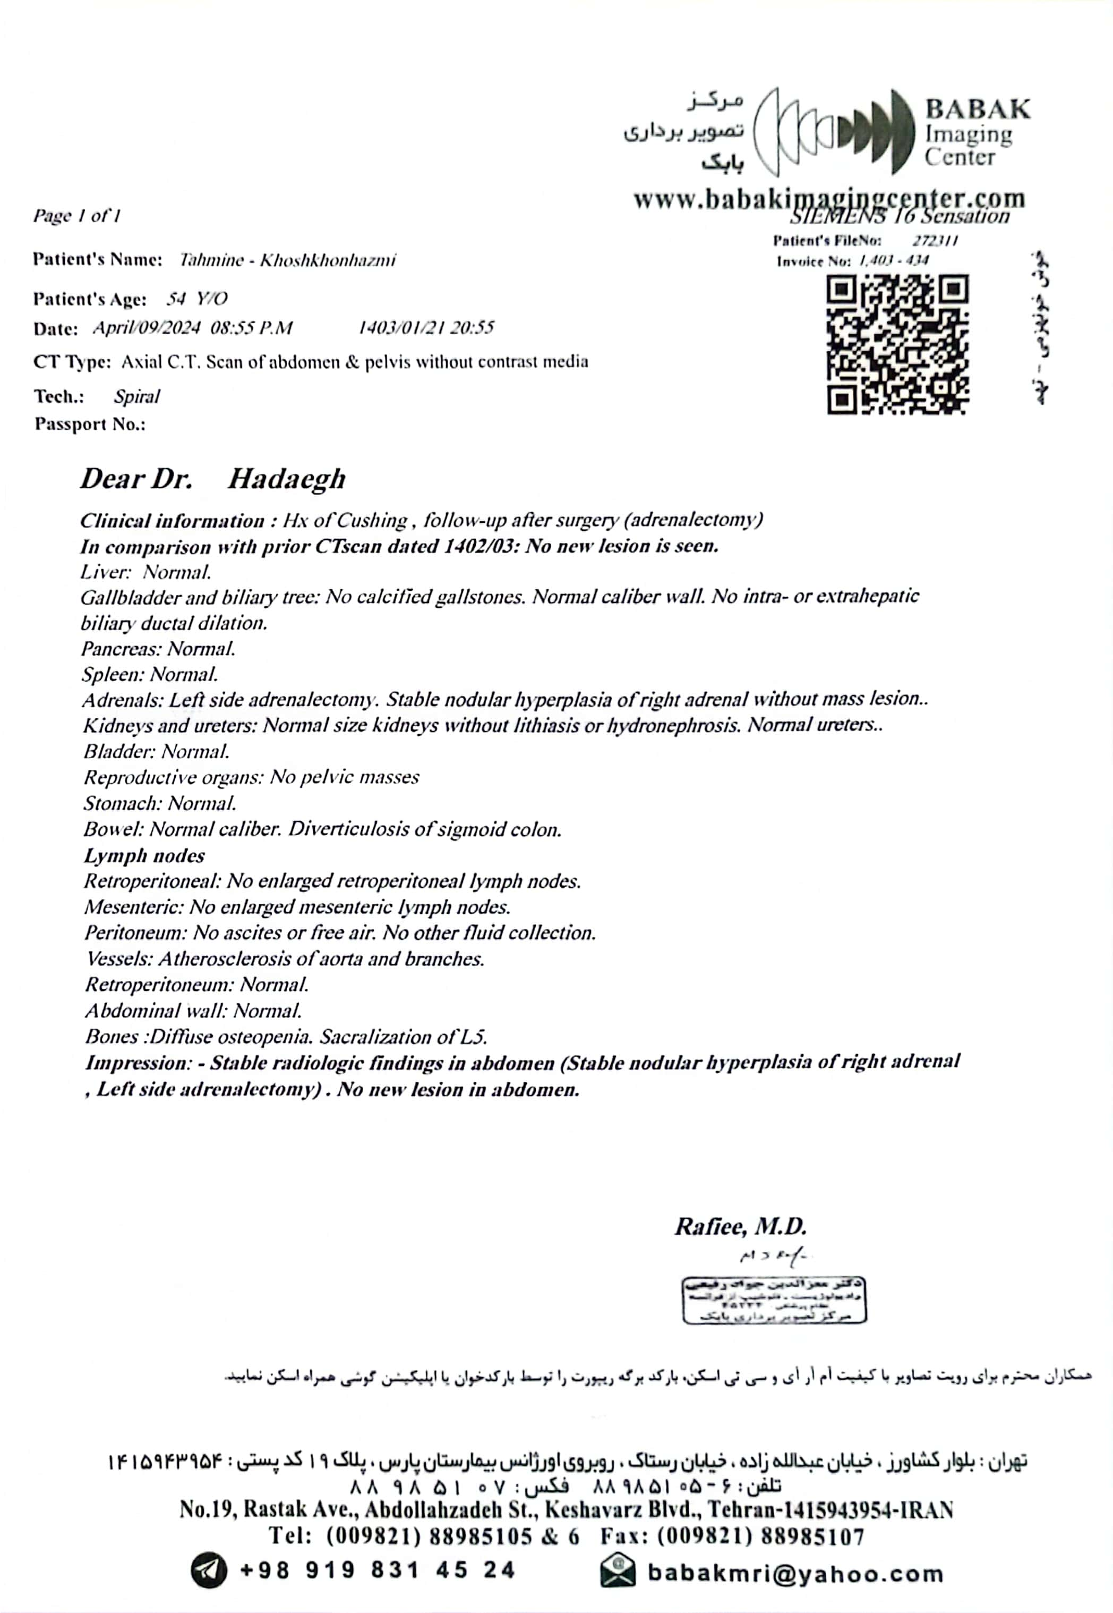
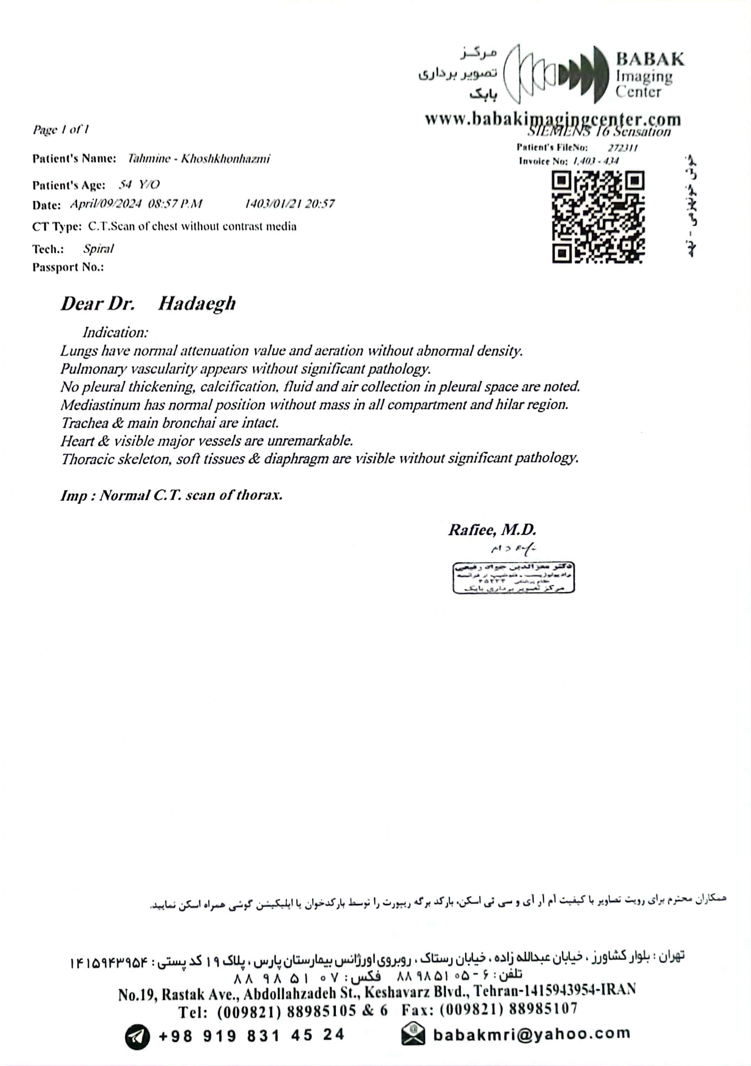
Abd &pelvic & chest CT scan +/- contrast 1403/1/21

Slide 38
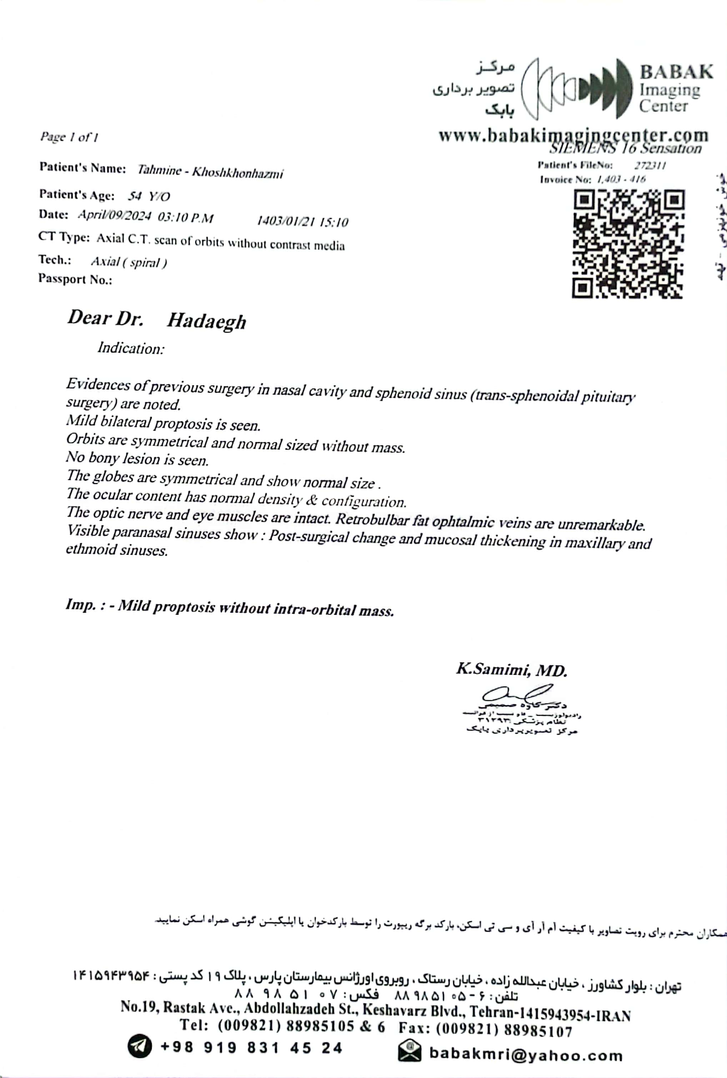
Orbital CT scan & OCT 03/1/21

Slide 39
Present illness
After EUS guided Radiofrequency of pancreatic lesion in 1402/3/7;
The patient is on treatment with sandostatin LAR since 1402/10/1, she complains of muscle weakness, blood sugar and blood pressure are under control, She has been in menopause from three years ago, and recent tests are as follows :

Slide 40
Last tests
03-2-6 pars | 02-12-15 pishrafteh | 02-9-17 pishrafteh | 02-4-18 pishrafteh | 02-3-17 pars | 02-1-16 pars
20 | 18.2 | 21.9 | 17.02 | 16.8 | 23.6 | Cortisol 8am µg/dl
61.7 (9-52) | 59.6 | 75 | 82.8 | - | - | ACTH pg/ml
57.9 (36-137) | 21.2 (1.5-63) | 88.7 (1.5-63) | - | - | 171 (36-173) | UFC µg/24h
9.6 | - | 9.9 | 10 | - | 9.9 | Ca Mg/dl
3.6 | - | 3.9 | - | - | 3.1 | Ph Mg/dl
46.9 (15-68) | - | - | - | - | 118 (15-68) | IPTH pg/ml
- | - | 39.3 | 25.8 | - | - | 25OHD Ng/ml
4.7 | - | 1.1 | - | - | 6.9 | T4 µg/dl
Weight=77 kg 1403/2/6
With ketoconazole 1403/2/6

Slide 41
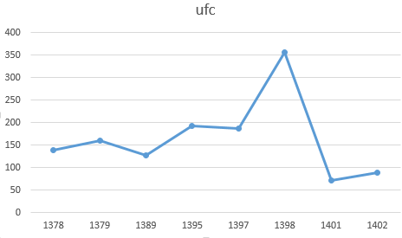
*
*
*=without ketoconazole

Slide 42
FH
At the age of 60, her mother was diagnosed with high blood pressure and ischemic heart disease.
No history of thyroid disease
No history of hypercalcemia

Slide 43
DH
N/C 2.6 mg/BD
Plavix 75mg/D
ASA 80mg/D
Valsartan 40mg/D
Ranolazine 500mg/BD
Famotidine 20mg/BD
B1 300mg/D
Pantoprazole 20mg/D
Diltiazem 60mg/BD
Atorvastatin 40mg/D
Nicorandil 10mg/D
Montelukast 10mg/D
Symbicort 320/BD
Fluxetine 20mg/D
Gabapentin 100mg/D
Zolpidem 10mg/Qhs
Synoripa5l500mg/BD
Levothyroxin100µg/D
Alendronate 70mg/Weekly
Ketoconazole 200mg/BD
Octerotide LAR 30mg/Monthly
DDAVP 2P/D
Ursophar 300mg/D

Slide 44
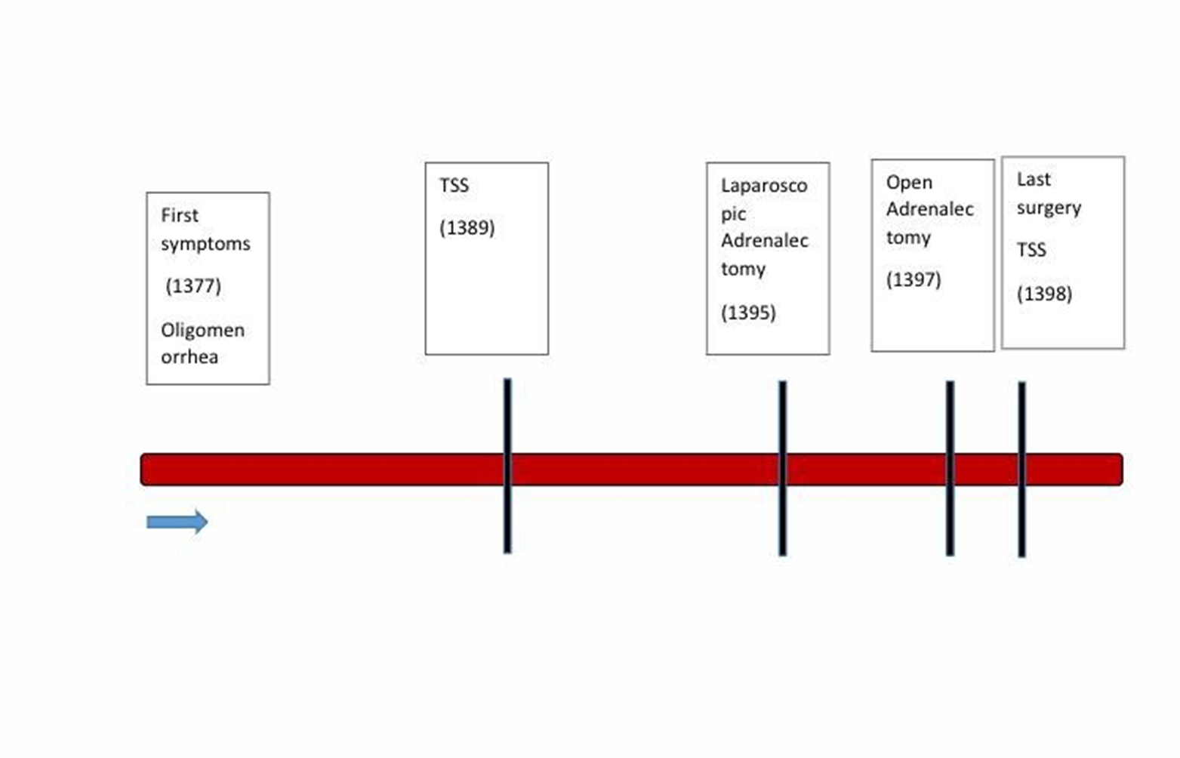
PSH
Radio frequency pancreatic NET
(1402)

Slide 45
PMH/PSH
Nephrolithiasis (1370)
Uterine prolapse (1376)
Becker’s cyst surgery (1392)
PCI on LAD/LCX (1394)
PCI on RCA (1397)
Hypothyroidism (from 1399)
Cataract (1401)

Slide 46
ROS
Head & neck: facial puffiness / hirsutism under the chin/acnea
Cardiovascular: normal
Chest & Respiratory: normal
Abdomen & pelvic: no Purple striae/Truncal obesity
Upper limb: normal
Lower limb: proximal myopathy/Non pitting edema
Skin: generalized dryness and itching/easy bruising

Slide 47
P/E
The patient is a woman with Cushingoid appearance, low mood and oriented and cooperated in answering the questions.
BP: 130/90 mmHG
PR: 80
T: 37
RR: 20
SPO2: 95%
Weight: 77kg
BMI: 34kg/m2

Slide 48
P/E
Head & neck: dorsocervical fat pad/Facial puffiness/Moon face/ hirsutism under the chin/thyroid was normal size
Cardiovascular: normal
Chest & Respiratory: normal
Abdomen & pelvic: no Purple striae/Truncal obesity
Upper limb: normal
Lower limb: proximal myopathy/Non pitting edema 1+

Slide 49
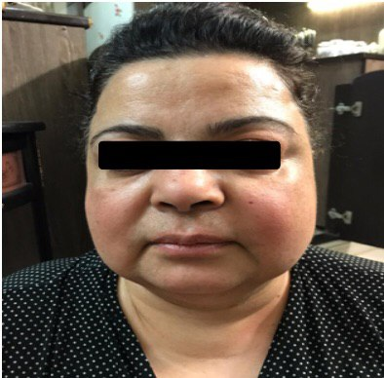
1398

Slide 50
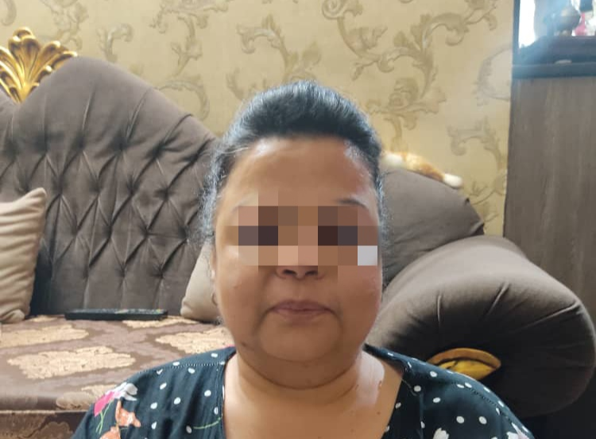
1403

Slide 51
Problem list
A 55-year-old female known case of cushing syndrome from the age of 25y, with multiple endocrine surgery and persistent symptoms.

Slide 52
AGENDA
CRH/ACTH cosecreting tumors
Pancreatic NET(epidemiology & management)
Radiofrequency ablation in pancreatic NET
Long acting Somatostatin analog in pancreatic NET
lutetium Lu 177 dotatate in pancreatic NET

Slide 53
CRH/ACTH cosecreting tumor

Slide 54
In regard to Cushing’s syndrome, the number of ectopic corticotropin-releasing hormone (CRH)-dependent cases reported so far is very small and can be divided into two main categories those with isolated ectopic CRH production and those with concomitant adrenocorticotropin hormone (ACTH) hypersecretion. Until 2015, only four cases of a pNET with ACTH/CRH co-secretion in adults were reported in the world.
very few case reports of CRH producing tumors have been published; those that have mostly originated from gangliocytomas, glioneuroblastomas, and medullary thyroid cancer.
Bronchial and thymic carcinoids, islet cell carcinomas, pheochromocytomas, medullary thyroid cancers, pancreatic tumors, gastrinomas, liver tumors and small-cell lung cancers have been identified as sources of ACTH/CRH co-secretion.

Slide 55
CRH/ACTH cosecreting tumor
In those cases with ectopic secretion of both CRH and ACTH, the levels of ACTH and cortisol are variable.
Regarding the responses tο CRH test and HDDST, in patients with ectopic ACTH/CRH co-secreting tumors, the data are similar to those reported for ectopic ACTH syndrome.
They do not respond to CRH stimulation, an increase in ACTH of less than 35 % and an increase in cortisol of less than 20 % compared to baseline value following 1.0 μg/kg IV of CRH) or to HDDST (cortisol suppression less than 50 % of baseline value).

Slide 56
CRH/ACTH cosecreting tumor
Τhe findings of BIPSS apparently depend strongly on the ratio of ACTH/CRH secretion.
ectopic CRH syndrome, Although very rare, is a well-known cause of false positive BIPSS, as the data will suggest a pituitary source due to pituitary corticotroph hyperplasia.
Ectopic CRH secretion stimulates the pituitary gland causing hyperplasia which, in turn, can simulate an ACTH secreting pituitary adenoma.

Slide 57
CRH/ACTH cosecreting tumor
Measurement of plasma CRH level is the best method for establishing the diagnosis, especially in patients in whom the results of endocrine tests are indicative of ectopic CS, whereas imaging findings are suggestive of pituitary hyperplasia.
In either ACTH-independent or ACTH-dependent CS, CRH levels are expected to be undetectable due to the negative feedback from hypercortisolemia.
In all the reported cases with ectopic CRH secretion, in which CRH was measured in plasma, its levels were normal or elevated.

Slide 58
Pancreatic NET(epidemiology & management)

Slide 59
Pancreatic NET(epidemiology & management)

Slide 60
Pancreatic NET(epidemiology & management)
These tumors demonstrate a range of behavior from the nonfunctional to hormone-secreting functional tumors.
Surgery is the primary treatment modality for Pancreatic NETs.
While functional PNETs should undergo resection for symptom control as well as potential curative intent, nonfunctional PNETs are increasingly managed nonoperatively.

Slide 61
Pancreatic NET(epidemiology & management)
PNETs represent approximately 2% of all pancreatic neoplasms, yet the overall incidence appears to be increasing.
PNETs are mainly sporadic, though approximately 10% occur in the context of genetic predispositions including multiple endocrine neoplasia type 1 (MEN1), von Hippel Lindau (VHL) disease, tuberous sclerosis complex (TSC1 and TSC2), and neurofibromatosis (NF1).

Slide 62
Pancreatic NET(epidemiology & management)
PNETs can present with a range of clinical behaviors; they may occur as small benign lesions, slow-growing indolent tumors with a favorable prognosis, locally invasive lesions, or as widespread metastatic disease.
functional lesions have previously thought to comprise approximately 30-40% of all PNETs.

Slide 63
Pancreatic NET(epidemiology & management)
The main prognostic determinant for PNETs is tumor grade. tumor grade is determined by immunohistochemistry analysis of tissues obtained via biopsy.
Well differentiated neuroendocrine tumors are assigned a grade 1–3 based on the Ki67 proliferation index and mitotic index per high power field.
Median overall survival for patients with grade 1 PNETs is 12 years compared to grade 3 disease with a median survival of 10 months.

Slide 64
Pancreatic NET(epidemiology & management)

Slide 65
Pancreatic NET(epidemiology & management)
While histologic grade remains the mainstay of PNET prognosis, alternative prognostic markers is an area of ongoing investigation larger tumor size (>2 cm), symptomatic tumors, Ki67 >3%, and positive lymph nodes have also been correlated with increased risk of recurrence.
Tissue diagnosis is often obtained by endoscopic ultrasound with fine-needle aspiration (FNA) for patients with PNETs less than 2 cm; however, diagnostic yield from FNA has been poor.
US Neuroendocrine Tumor Study Group demonstrated that in an endoscopic ultrasound FNA on a lesion less than 2 cm, tumor differentiation and Ki67 index could only be determined in 26.4% and 20.1% of cases.

Slide 66
Pancreatic NET(epidemiology & management)
The use of PET/CT imaging to detect SSTR-expressing PNET with sensitivity of 93% and specificity of 91%.
68Ga-DOTATATE PET/CT has demonstrated efficacy in the detection of primarily low-grade tumors, G1 and G2 PNETs, with detection rates that have been reported as 95% and 87.5%, respectively.
However, for higher grade tumors (G3), this imaging modality is significantly less effective, with 37.5% detected.
An additional work-up should be pursued in patients with high clinical suspicion and negative DOTATATE scan, such as traditional radiolabeled fluorodeoxyglucose (FDG) PET imaging.

Slide 67
Pancreatic NET(epidemiology & management)
The most sensitive method for diagnosing PNETs is endoscopic ultrasound (EUS), with a mean sensitivity range of 75–97%.
EUS is particularly sensitive for PNETs that are less than 2 cm. In fact, in a recent meta-analysis, EUS demonstrated increased rates of PNET detection even after other imaging modalities failed to identify a lesion.
.

Slide 68
Pancreatic NET(epidemiology & management)
All localized, functional PNETs should be considered for surgical resection.
Resection for functional tumors provides source control for symptoms secondary to hormone secretion, in addition to curative-intent treatment for the prevention of metastases.
Limited data suggests that endoscopic ultrasound-guided radiofrequency ablation may be feasible with small FPNET.
This modality induces coagulative necrosis via directed thermal energy, and it has been used in the treatment of other solid tumors. several studies have demonstrated this technique is safe and with minimal post-procedure complications.

Slide 69
Pancreatic NET(epidemiology & management)
Although pancreatic neuroendocrine tumors are generally considered to have a good overall prognosis after resection, disease recurrence has been observed in 21% to 42% of patients with PNETs. As for well-differentiated NF-PNETs (grade 1 and 2), the recurrence rate is reported to be 17% after resection.
This study found that the risk factors for recurrence were positive margins status, higher 2010 WHO grade, and LN metastasis. Size was not an independent risk factor for recurrence but reflected these risk factors.

Slide 70
Pancreatic NET(epidemiology & management)
How often the patient see the doctor depends on the type of treatment you had, the Among patient undergoing surgery, commonly reported sites of recurrence are the liver, pancreas remnant, and lymoh nodes.
side effects and whether the cancer has spread to other parts of the body, the patient usually see her doctor every 6 months. The Patient might see them less often if she had surgery to remove the tumour and there are no signs of it coming back.

Slide 71
Radiofrequency ablation in pancreatic NET

Slide 72
Radiofrequency ablation in pancreatic NET
EUS-guided radiofrequency ablation (RFA) has been described as a potentially effective and safe treatment of P-NETs.
In view of the abovementioned data, nonsurgical, effective, safe, and minimally invasive alternative therapies are needed to avoid short and long term AEs associated with surgery.
In the 61 patients, we demonstrated an overall effectiveness of 96 % on a mean follow-up period of 11 months, without differences between functional vs non-functional P-NETs (100 % vs. 93 %, P = 0.3).

Slide 73
Radiofrequency ablation in pancreatic NET
These results are similar to those of Barthet et al, which showed complete disappearance or necrosis of the lesion in 92.3 % of P-NETs at 1-year follow-up evaluation.
Tumor location was not predictive of incomplete response or non-response to EUS-RFA treatment (failure rate 3.8 % at pancreatic head vs 10.3 % at pancreatic body vs 8.3 % at pancreatic tail, P = 0.6); conversely, tumor size affected the response rate, because failure occurred more frequently in larger tumors (mean size in the non-response group 21.8 mm ± 4.71 vs. 15.07 mm ± 7.34 in the response group, P = 0.048).

Slide 74
Radiofrequency ablation in pancreatic NET
A size ≤ 18 mm of P-NET at EUS was associated with a positive response to EUS-RFA with a sensitivity of 80 %, a specificity of 78.6 %
RFA is likely to be a very safe procedure, since only 13 % of patients presented mild AE, and only one case of necrotizing pancreatitis was reported (1.6 %).
Treatment of pancreatic head lesions is likely to be associated with an increased risk of complications (70 % of the registered AEs occurred in head lesions), but the small number of included patients preventing that finding from reaching statistical significanc.

Slide 75
Radiofrequency ablation in pancreatic NET
On the basis of our data, the selection of patients for EUS-RFA remains challenging.
It should be based on patient profile (comorbidities, surgical risk, life expectancy), tumor features (location and mass size) and endoscopist experience.
In conclusion, EUS-RFA is an effective and safe treatment for management of P-NETs. According to the current data, it is reasonable to suggest RFA for P-NETs < 18 mm, irrespective of their functional status.
Larger series with longer follow-up are needed to better define which patients with P-NETs would benefit from endoscopic therapy and which would be better treated surgically.

Slide 76
Radiofrequency ablation in pancreatic NET
Finally, the setting for the radiofrequency generator has not been standardized; this could generate a selection bias influencing the response to treatment.
Treatment of P-NETs was achieved with a mean of 1.3 (range 1–3) RFA sessions, with an overall effectiveness of 96 % (75 %–100 %) on a mean follow-up period of 11 months (range 1–34 months).

Slide 77
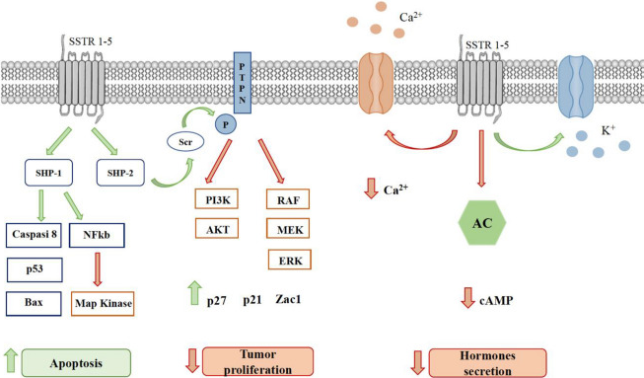
Long acting Somatostatin analog in pancreatic NET

Slide 78
Long acting Somatostatin analog in pancreatic NET
LA SSAs represent the first-line treatments of low-grade advanced well differentiated NENs, the so called neuroendocrine tumors (NETs).
Both LA OCT and LAN demonstrated to improve the rate of progression in randomized placebo-controlled trials.
If these studies definitively clarified the antiproliferative activity of LA OCT and LAN in low grade GEP NETs.

Slide 79
Long acting Somatostatin analog in pancreatic NET
OCT LAR at the dose of 30 mg every 28 days demonstrated a significant improvement of the median time to progression vs placebo in patients with advanced NET (14.3 vs 6 months, HR 0.34, p <0.0001).
Notably, in this study 95.3% of the included patients had Ki-67 values up to 2%.
LAN autogel at the dose of 120 mg every 28 days was associated with a significant improvement of the median PFS as compared to placebo in patients with advanced entero-pancreatic NET (not reached vs 18 months, HR 0.47, p <0.001).

Slide 80
Long acting Somatostatin analog in pancreatic NET
The study reporting the highest PFS included mainly low-grade tumors (G1 and G2 NET in 79% of cases) and both localized tumor.
The objective response rate varied at a lesser extent ranging from 0 to 15% which was a partial response in the vast majority of cases.
The most frequent type of response to SSA was stable disease, ranging from 45 to 89%.
Unfortunately, the development of resistance to SSA could occur and this issue should be taken into account in patients’ management.

Slide 81
Long acting Somatostatin analog in pancreatic NET
The Ki-67 index, the main proliferative marker in NET, has been reported to be predictive for survival and progression outcomes in NET patients treated with SSA. A Ki-67 cut-off of 5% is a recognized predictive factor both for standard and high doses.
Among the circulating biomarkers, conflicting data are available on chromogranin A (CgA). few studies report the decrease of CgA after SSA therapy as a positive predictive factor.
With regards to clinical factors, a worse patient performance status, as well as the tumor growth rate at baseline have been identified as negative predictors of response to SSA.

Slide 82
Long acting Somatostatin analog in pancreatic NET
On the other hand, it should be underlined that the optimal candidates for SSA therapy are well differentiated low-grade NETs.
Most of data are obtained on low-grade GEP NETs. In this setting, median PFS ranges about 25–30 months in patients with radiologic or symptomatic progression under therapy with SSAs at standard doses.

Slide 83
lutetium Lu 177 dotatate in pancreatic NET

Slide 84
lutetium Lu 177 dotatate in pancreatic NET

Slide 85
lutetium Lu 177 dotatate in pancreatic NET
On 23 April 2024, the US Food and Drug Administration (FDA) approved lutetium Lu 177 dotatate for pediatric patients 12 years and older with somatostatin receptor (SSTR)-positive gastroenteropancreatic neuroendocrine tumours (GEP-NETs).
You should stop taking your long-acting somatostatin analog at least 4 weeks before LUTATHERA treatment. You may continue taking short-acting somatostatin analogs up to 24 hours before your LUTATHERA treatment. Avoid repeated high doses of glucocorticoids during treatment with LUTATHERA.

Slide 86
lutetium Lu 177 dotatate in pancreatic NET
PRRT drugs act by delivering radioactivity directly to the cancer cells, enhancing the cell-killing ability of the treatment.
In fact, patients who were treated with Lutathera in the clinical trial had a 79 percent reduction in risk of disease progression or death, as compared to patients treated with octreotide alone.

Slide 88
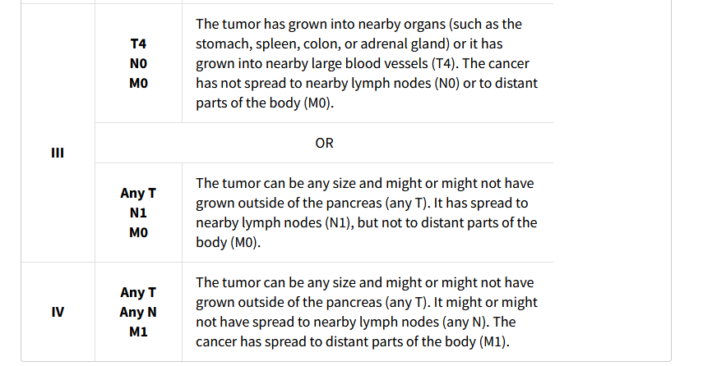

Slide 89
Thank you for your attention

