Slide 1
Insulin titration and intensification
Mahshid Babaei
Endocrinologist
98.5.16

Slide 2
Given the progressive nature of this disease, characterized by gradual impairment in β-cell function and loss of β-cell mass, most patients with type 2 diabetes will eventually require insulin therapy to achieve a goal A1C of < 7%.
Approximately 30% of PCPs never/rarely intensify insulin therapy versus 4% of specialists; the reason may be lack of experience or lack of time to educate people .

Slide 3
agenda
Insulin types
Insulin regimens
Basal insulin
Basal-bolus insulin
premix

Slide 4
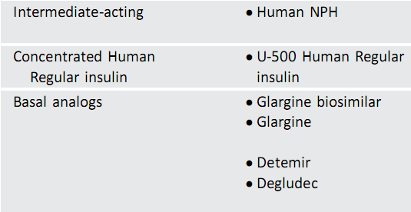
BASAL INSULIN

Slide 5
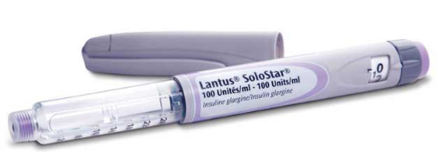
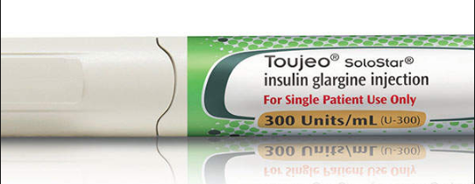

Slide 6
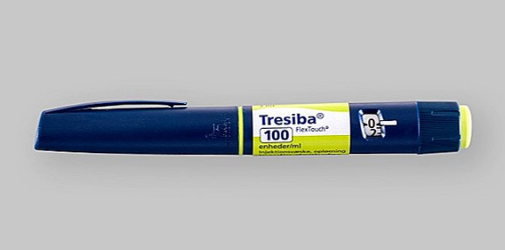

Slide 7
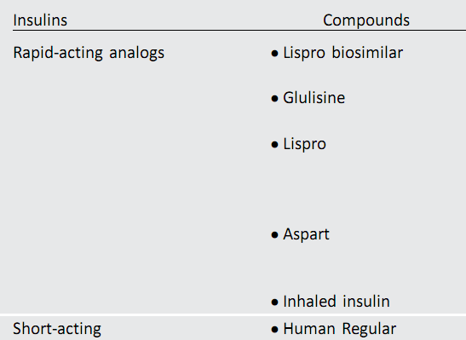
prandial insulin

Slide 8
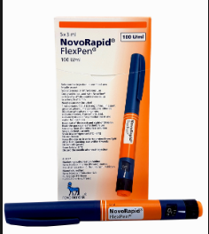
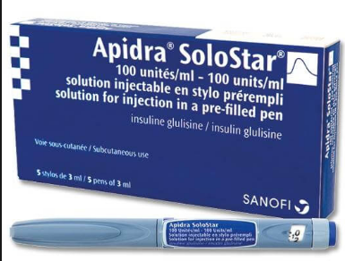

Slide 9
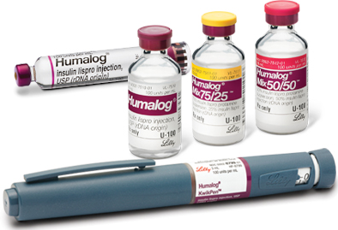

Slide 10
Premixed

Slide 11
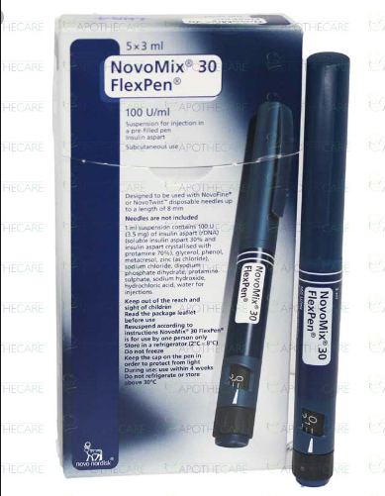
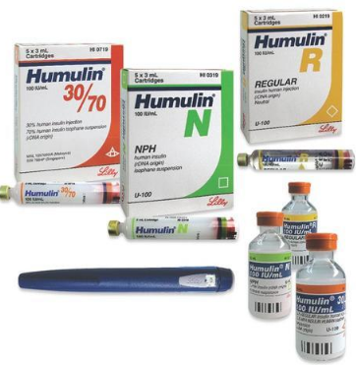

Slide 13
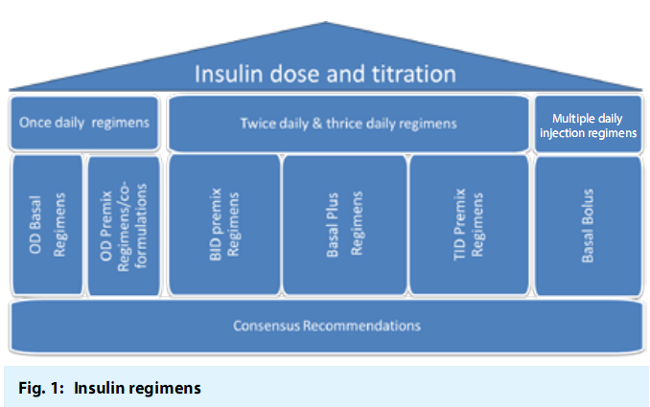
Insulin regimens

Slide 14
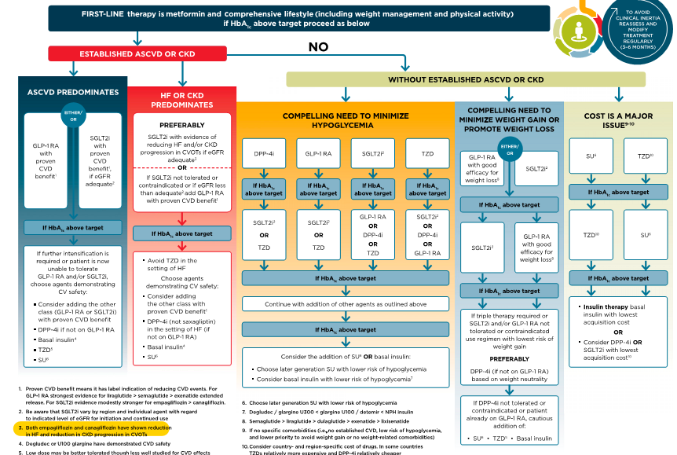
Basal insulin
Basal insulin
Basal insulin
Basal insulin
Basal insulin

Slide 15
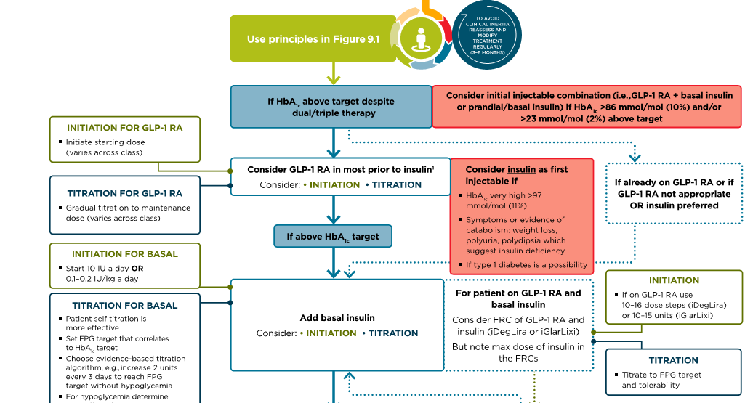
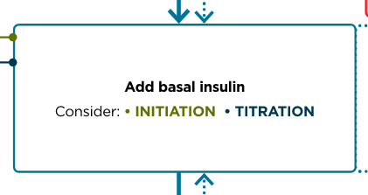
basal

Slide 16
Basal insulin alone is the most convenient initial insulin regimen and can be added to metformin and other oral agents.
Starting doses can be estimated based on:
body weight
degree of hyperglycemia
10 units a day (set dosage)
0.1–0.2 units/kg/day (weight-based)

Slide 17
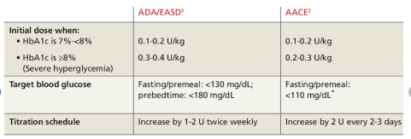

Slide 18
Typically, insulin is increased or decreased every three to seven days if the patient’s blood glucose level is not within set targets.
Insulin titration frequency:
twice per week or every 3 days.

Slide 19
Titration dose

Slide 20
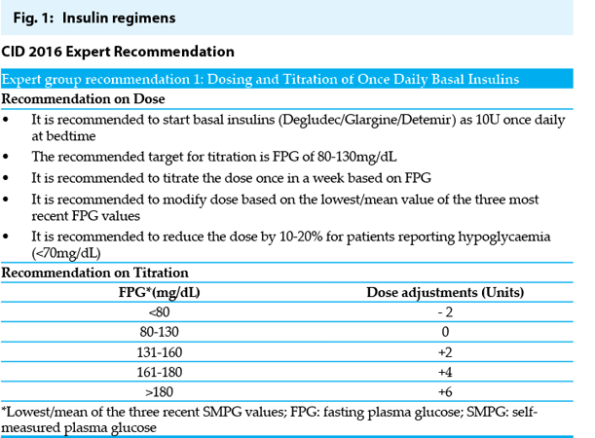

Slide 22
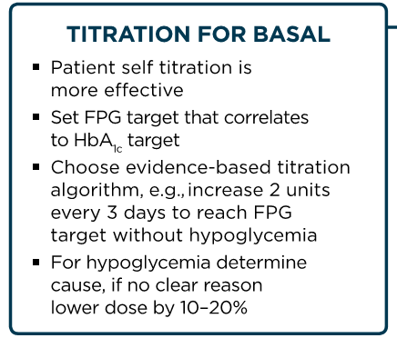

Slide 23
Other factors with potential impact on basal insulin titration:
(a) Day-to-day blood glucose variability,
(b) Insulin dose
(c) Practicability and complexity of titration algorithms.

Slide 24
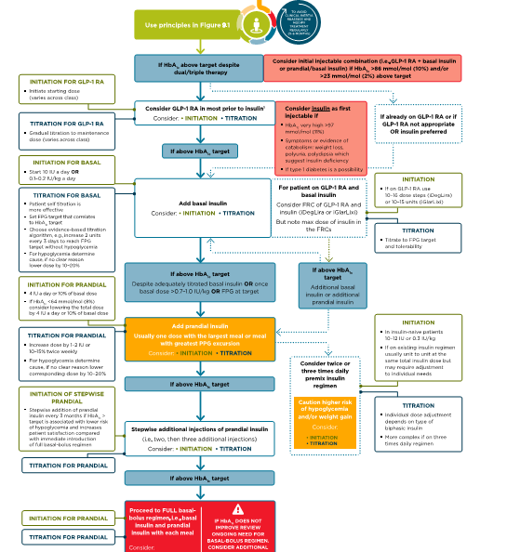
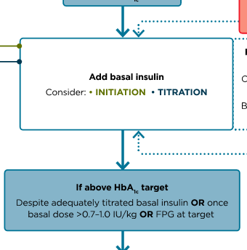
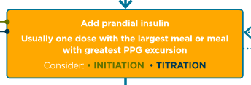

Slide 25
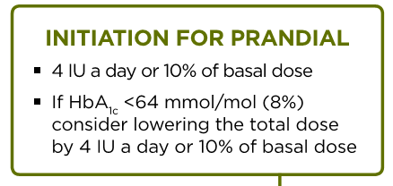
Basal plus regimen

Slide 26
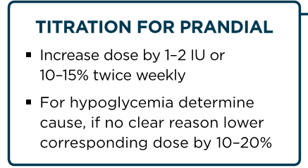

Slide 27
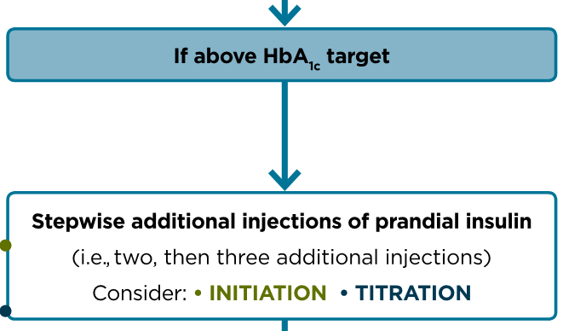

Slide 28
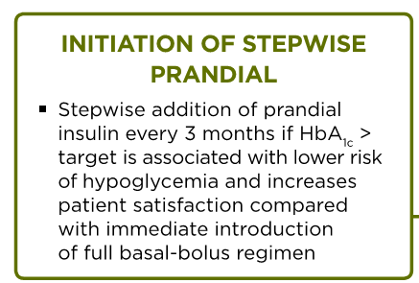

Slide 29
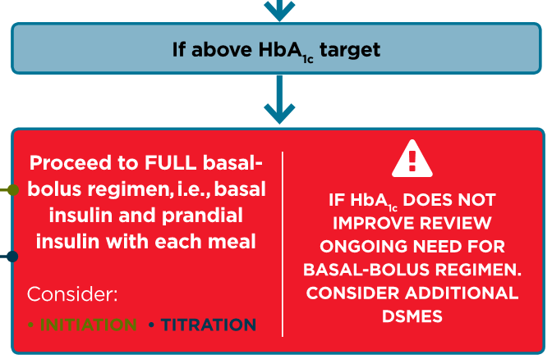

Slide 30
premix

Slide 32
Premix insulin analogs | Basal plus/basal bolus
Patient preference | Type 1 diabetes (any age)
Older age | Younger age
Need assistance with injections | Highly motivated and compliant
Organized lifestyle | Active lifestyle
Two meals a day or evening main meal | High variability in eating habits
Mosenzon O, et al. Diabetes Care 2013; 36(2):S212-S218.

Slide 33
Start and stay with NovoMix® 30
NovoMix® 30 Summary of Product Characteristics.
Garber A et al. The 1-2-3 study. Diabetes, Obesity and Metabolism 2006; 0: 1–10.
Raskin P et al. On behalf of the INITIATE Study Group. Basal insulin or premix analogue therapy in type 2 diabetes patients. Euro J Int Med 2007; 18: 56–62.

Slide 34
BIAsp 30: dosage regimen
Dose to titrate | Timing of blood glucose measurements used for dose titration
 | BIAsp 30 OD | BIAsp 30 BID | BIAsp 30 TID
Breakfast | – | Pre-dinner | Pre-lunch
Lunch | – | – | Pre-dinner
Dinner | Pre-breakfast | Pre-breakfast | Pre-breakfast
BIAsp, biphasic insulin aspart; BID, twice daily; OD, once daily; TID, three-times daily
Garber et al. Diabetes Obes Metab 2006;8:58–66; Raskin et al. Diabetes Care 2005;28:260–5
Notes:
Dosage regimen of BIAsp 30:
For once daily, the evening dose titration is done based on pre-breakfast blood glucose level.
For twice-daily BIAsp 30, the morning dose is to be titrated based on pre-dinner blood glucose level and evening dose is to be titrated based on pre-breakfast blood glucose level.
If a patient needs further intensification for three-times-a-day BIAsp 30: the morning dose can be titrated based on the pre-lunch blood glucose, midday dose is titrated on pre-dinner blood glucose and evening dose is titrated on pre-breakfast blood glucose.
This algorithm was adapted from a 48-week, open-label, observational study. Enrolled patients (n=100, HbA_{1c} ≥7.5 and ≤10%) were ≥18 years of age, had diabetes ≥12 months and had received a stable antidiabetic regimen for at least 3 months. Patients discontinued prior basal insulin and added one injection of BIAsp 30 (12 U or 70–100% of prior basal insulin dose within 15 min of dinner initiation). Patients self-titrated their BIAsp 30 dose with investigator guidance every 3 or 4 days to achieve pre-breakfast fasting blood glucose (FBG) of 4.4–6.1 mmol/L. At 16 weeks, a pre-breakfast injection of 6 U of BIAsp 30 was added if week 15 HbA_{1c} exceeded 6.5%; the added dose was titrated to achieve pre-dinner BG of 4.4–6.1 mmol/L. After an additional 16 weeks, 3 U of pre-lunch BIAsp 30 was added if HbA_{1c} exceeded 6.5%. This added dose was adjusted based on 2-h post-lunch BG to achieve PPG of 5.6–7.8 mmol/L. Subjects achieving HbA_{1c} ≤6.5 at 15 and 31 weeks completed the study at weeks 16 and 32, respectively.

Slide 35
BIAsp 30: titration algorithm
FBG or pre-dinner SMBG |  | BIAsp 30 dose adjustment
(mg/dL)
<80 |  | –2 U
80–110 |  | –
111–140 |  | +2 U
141–180 |  | +4 U
>180 |  | +6 U
BIAsp, biphasic insulin aspart; FBG, fasting blood glucose; SMBG, self-measured blood glucose
Adapted from Raskin et al. Diabetes Care 2005;28:2811
Notes:
BIAsp 30 offers a simple dose titration based on FBG or pre-dinner SMBG.
This example of the BIAsp 30 titration algorithm is taken from Raskin et al. (2005). This was a 28-week parallel-group study that randomised 233 insulin-naïve patients with HbA_{1c} values ≥8.0% on >1000 mg/day metformin alone or in combination with other OADs. Metformin was adjusted up to 2550 mg/day before insulin therapy was initiated with 5–6 units BIAsp 70/30 twice daily or 10–12 units glargine at bedtime and titrated to target blood glucose (80–110 mg/dL) by algorithm-directed titration.

Slide 36
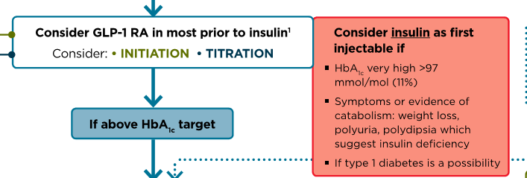
+

Slide 38
a patient takes 40 units of glargine daily and 12 units of aspart before each meal, and has a correction factor of 1 unit for every 20 mg per dL above 120 mg per dL .
If the blood glucose level at breakfast is 160 mg per dL , the patient would take 12 units of lispro for the meal plus an additional 2 units for correction before eating.

Slide 39
Thank you

