Slide 2
Imaging techniques in thyroid cancer follow-up
Bagher Larijani M.D., F.A.C.E.
Professor of Internal Medicine and Endocrinology
Endocrinology and Metabolism Research Institute
Tehran University of Medical Sciences
April , 2017

Slide 3
Outline
Thyroid cancer epidemiology
Imaging types
PTC and FTC
MTC
Anaplastic TC
ATA guideline
Conclusion

Slide 4
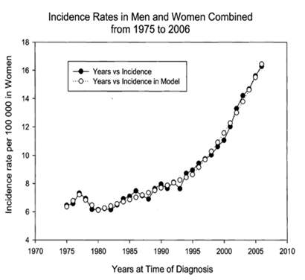
Thyroid Cancer (epidemiologic aspects)
Most common endocrine cancer 1-2% of all cancers
Incidence increasing
6 to 16 per 100 000
The modeled rates are the point estimates for the regression lines calculated by the Join point Regression Program.
Davies L, Welch HG. Increasing incidence of thyroid cancer in the United States, 1973-2002. JAMA 2006 May 10;295(18):2164-7.

Slide 5
Thyroid Cancer in Iran (epidemiologic aspects)
The annual crude incidence of thyroid cancer in Iran is low (females: 3.5, males: 1), compared to neighboring countries (Kuwait, females: 5, males: 3.2; Bahrain, females: 7.1 , males: 3.2).
Based on Globocan report 2002, the estimated age adjust population incidence for thyroid cancer in Asia is:
Highest in Israel (Female: 11.4 100000, Male: 4 100000)
Lowest in China (Female: 0.6 100000, Male: 0.2 100000)
The incidence of thyroid cancer in Iran is nearly the same as incidence reported in US.
Larijani B, Mohagheghi MA, Bastanhagh MH, Mosavi-Jarrahi AR, Haghpanah V. Primary thyroid malignancies in Tehran, Iran. Med Princ Pract. 2005 14(6):396-400.
Haghpanah V, Soliemanpour B, Heshmat R, Larijani B. Endocrine cancer in Iran: based on cancer registry system. Indian J Cancer. 2006 ;43(2):80-5.

Slide 6
Imaging Types
Cervical ultrasonography (US)
whole-body RAI scan
FDG(Fludeoxyglucose)-PET scan
CT and MRI

Slide 7
Cervical ultrasonography (US)
Ultrasonography plays an important role in the assessment of lymph node status in patients with thyroid nodules or newly diagnosed thyroid cancer.
In the detection of recurrent disease in treated thyroid cancer patients.
Cervical lymph nodes are the most common site of recurrent papillary thyroid cancer.
Schneider DF, Chen H. New developments in the diagnosis and treatment of thyroid cancer. CA Cancer J Clin. 2013 ;63(6):374-94.
Torabi M1, Aquino SL, Harisinghani MG. Current concepts in lymph node imaging. J Nucl Med. 2004 ;45(9):1509-18.

Slide 8
Cervical ultrasonography (US)
Benign lymph nodes tend to be thin and oval in shape and have an echogenic hilum.
Malignant ones may have microcalcifications or cystic regions, are "plump" or rounded, lack a defined hilum, and may be intensely vascular.
Schneider DF, Chen H. New developments in the diagnosis and treatment of thyroid cancer. CA Cancer J Clin. 2013 ;63(6):374-94.
Torabi M1, Aquino SL, Harisinghani MG. Current concepts in lymph node imaging. J Nucl Med. 2004 ;45(9):1509-18.

Slide 9
Cervical ultrasonography (US)
There are sonographic features of adenopathy that have a reasonably high specificity for malignancy but lesser sensitivity.
In a study of 56 lymph nodes (28 benign and 28 malignant) from patients who had a thyroidectomy for cancer.
Of 8 sonographic characteristics that were examined for sensitivity and specificity, cystic appearance (100 % specific but only 11 % sensitive), bright hyperechoic spots (100 %specific, 46 % sensitive) loss of a fatty hilum, and peripheral vascularization were determined to be major ultrasound criteria of lymph node malignancy, while round shape, hypoechogenicity, or the loss of hyperechoic hilum were minor criteria.
Leboulleux S, Girard E, Rose M, et al. Ultrasound criteria of malignancy for cervical lymph nodes in patients followed up for differentiated thyroid cancer. J Clin Endocrinol Metab 2007; 92:3590.
Kessler A, Rappaport Y, Blank A, et al. Cystic appearance of cervical lymph nodes is characteristic of metastatic papillary thyroid carcinoma. J Clin Ultrasound 2003; 31:21.

Slide 10
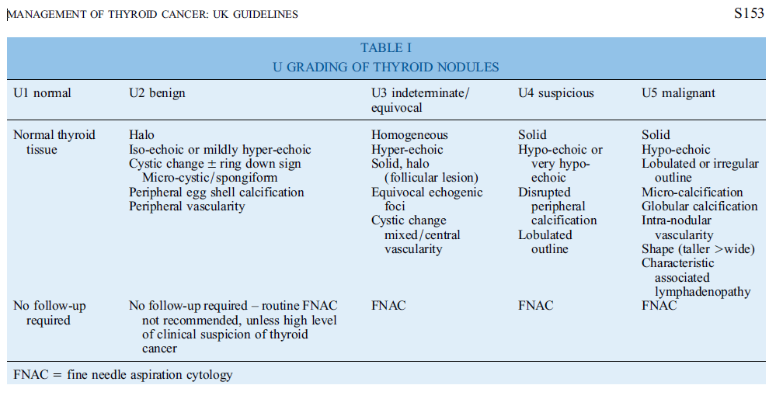
Perros P, Boelaert K, Colley S, et al. British Thyroid Association Guidelines for the Management of Thyroid Cancer. Clinical Endocrinology 2014, 81 (Suppl. 1), 1–122

Slide 11
Cervical ultrasonography (US)
False positive:
In older, diabetic, or obese patients, fatty involution of lymph nodes (called lipoplastic lymphadenopathy) may enlarge nodes and mimic a palpable thyroid metastasis, which may confuse ultrasonic diagnosis.
Giovagnorio F, Drudi FM, Fanelli G, et al. Fatty changes as a misleading factor in the evaluation with ultrasound of superficial lymph nodes. Ultrasound Med Biol 2005; 31:1017.

Slide 12
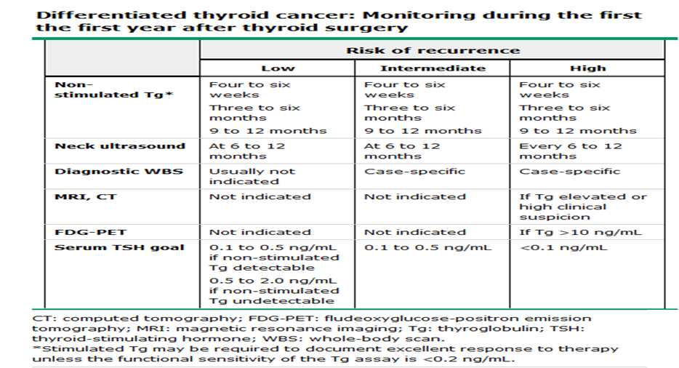
Haugen BR, Alexander EK, Bible KC. ATA thyroid nodule/DTC guidelines. Thyroid 2016 26, 1

Slide 13
Cervical ultrasonography (US)
Ultrasound-guided aspiration biopsy of enlarged cervical lymph nodes for cytological and immunocytological analysis can differentiate metastases from thyroid cancer and inflammatory lymphadenopathy
It is often diagnostically helpful to rinse the needle to aspirate a suspicious lymph node to assay the washings for thyroglobulin.
The presence of high levels of thyroglobulin in needle washings of aspirates of lymph nodes is presumptive evidence of metastatic thyroid cancer despite negative cytology
Boi F, Baghino G, Atzeni F, et al. The diagnostic value for differentiated thyroid carcinoma metastases of thyroglobulin (Tg) measurement in washout fluid from fine-needle aspiration biopsy of neck lymph nodes is maintained in the presence of circulating anti-Tg antibodies. J Clin Endocrinol Metab 2006; 91:1364.

Slide 14
Cervical ultrasonography (US)
Sonography during the initial several months after surgery for thyroid cancer may give misleading results.
During this time there may be abundant noncancerous, enlarged lymph nodes and inflammatory postoperative changes that appear as heterogeneous and frequently sono dense focal structures.
These findings should not be confused with tumor and can be avoided by delaying the examination for three or more months.
Chung YE, Kim EK, Kim MJ, et al. Suture granuloma mimicking recurrent thyroid carcinoma on ultrasonography. Yonsei Med J 2006; 47:748.

Slide 15
Cervical ultrasonography (US)
Neck ultrasound is performed at 6 to 12 month intervals depending on risk assessment
Ultrasonography has been particularly useful at identifying malignant cervical lymph nodes, the most common site of recurrent papillary thyroid cancer
Leboulleux S, Girard E, Rose M, et al. Ultrasound criteria of malignancy for cervical lymph nodes in patients followed up for differentiated thyroid cancer. J Clin Endocrinol Metab 2007; 92:3590.

Slide 16
Cervical ultrasonography (US)
If there is biochemical or ultrasound evidence of recurrence, other tests that may be indicated to identify the sites of disease include a diagnostic whole-body scan (radioiodine imaging on a low-iodine diet with TSH stimulation), CT or MRI, skeletal radiographs, or skeletal radionuclide imaging.
Leboulleux S, Girard E, Rose M, et al. Ultrasound criteria of malignancy for cervical lymph nodes in patients followed up for differentiated thyroid cancer. J Clin Endocrinol Metab 2007; 92:3590.

Slide 17
Ann D. King. Imaging for staging and management of thyroid cancer. Cancer Imaging (2008) 8, 57-69

Slide 18
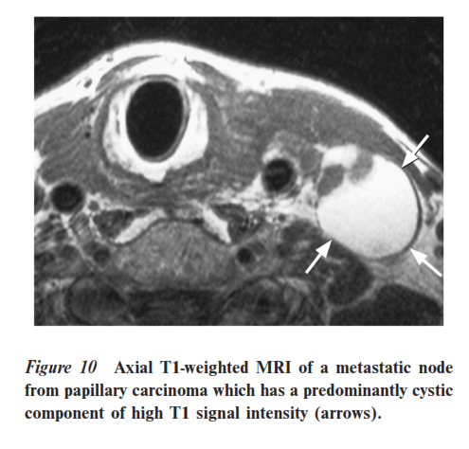
Ann D. King. Imaging for staging and management of thyroid cancer. Cancer Imaging (2008) 8, 57-69

Slide 19
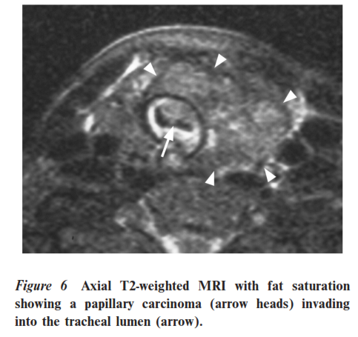
Ann D. King. Imaging for staging and management of thyroid cancer. Cancer Imaging (2008) 8, 57-69

Slide 20
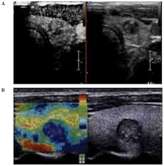
Elastography
Comparison between contrast-enhanced ultrasound (CEUS) and ultrasonic elastography (UE) images of thyroid microcarcinoma nodules in a single patient.
a) CEUS cross-section demonstrating weak enhancement of the nodule.
b) The coloring indicates a malignant lesion, consistent with the pathological findings.
Notes:
Comparison between contrast-enhanced ultrasound (CEUS) and ultrasonic elastography (UE) images of thyroid microcarcinoma nodules in a single patient. (A) CEUS cross-section demonstrating weak enhancement of the nodule. The ultrasonic indication was that the nodular nature was to be determined. (B) Longitudinal UE section demonstrating >90% blue coloring of the nodule (score, 4 points). The coloring indicates a malignant lesion, consistent with the pathological findings.

Slide 21
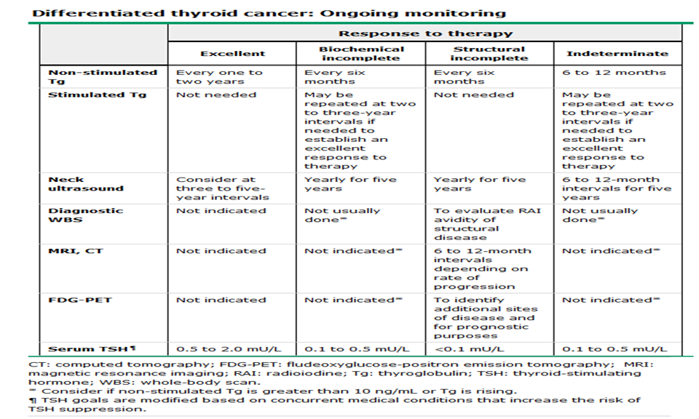
Haugen BR, Alexander EK, Bible KC. ATA thyroid nodule/DTC guidelines. Thyroid 2016 26, 1

Slide 22
Diagnostic whole-body scan
Diagnostic whole-body radioiodine scanning may have a role in the follow-up of patients with high or intermediate risk (with higher-risk features) of persistent disease.
However, we are in agreement with the ATA guidelines that routine follow-up diagnostic whole-body scanning one year after radioiodine ablation is not required in low and intermediate-risk (with lower-risk features) patients
Cooper DS, Doherty GM, et al. Revised American Thyroid Association management guidelines for patients with thyroid nodules and differentiated thyroid cancer. Thyroid 2009; 19:1167.
Mazzaferri EL, et al. A consensus report of the role of serum thyroglobulin as a monitoring method for low-risk patients with papillary thyroid carcinoma. J Clin Endocrinol Metab 2003; 88:1433.

Slide 23
Diagnostic whole-body scan
Two studies , but not a third, suggested that whole-body scanning is unnecessary if rhTSH-stimulated serum Tg concentrations are less than 2 ng/mL.
Another study reported that a combination of
rhTSH-stimulated Tg and
neck ultrasound
has a better predictive value than either rhTSH-stimulated Tg alone or in combination with radioiodine scanning.
Cooper DS, Doherty GM, et al. Revised American Thyroid Association management guidelines for patients with thyroid nodules and differentiated thyroid cancer. Thyroid 2009; 19:1167.
Mazzaferri EL, et al. A consensus report of the role of serum thyroglobulin as a monitoring method for low-risk patients with papillary thyroid carcinoma. J Clin Endocrinol Metab 2003; 88:1433.

Slide 24
Diagnostic whole-body scan
When diagnostic radioiodine scanning is performed:
Using rhTSH stimulation for radioactive iodine scanning when the likelihood of requiring additional radioactive iodine therapy is low.
If the patient is very likely to need additional radioiodine therapy (high-risk patients), thyroid hormone withdrawal is the preferred approach.
Pacini F, Molinaro E, Castagna MG, et al. Recombinant human thyrotropin-stimulated serum thyroglobulin combined with neck ultrasonography has the highest sensitivity in monitoring differentiated thyroid carcinoma. J Clin Endocrinol Metab 2003; 88:3668–3673.

Slide 25
FDG-PET scanning
In patients with evidence of distant metastases, FDG-PET scanning may provide useful prognostic information
This was illustrated in a study of 125 patients with well-differentiated thyroid cancer who underwent FDG-PET scanning; uptake of FDG in a large volume of tissue correlated with poor survival, predicting outcome better than uptake of radioiodine.
In most studies, T4 therapy was not withdrawn before FDG-PET scanning was done, but in one small study, more lesions were identified after therapy was withdrawn.
Schroeder PR, Haugen BR, Pacini F, et al., A comparison of short-term changes in health-related quality of life in thyroid carcinoma patients undergoing diagnostic evaluation with recombinant human thyrotropin compared with thyroid hormone withdrawal, J Clin Endocrinol Metab, 2006;91:878–84.

Slide 26
FDG-PET scanning
FDG-PET may complement iodine-131 (131-I) scanning
In a study of 239 patients with metastases and high Tg, the sensitivity of FDG-PET was 49 percent, the sensitivity of 131-I was 50 percent, and the combined sensitivity was 90 percent. FDG-PET was more likely to be positive in 131-I negative patients
Pacini F, Capezzone M, Elisei R, et al., Diagnostic 131-iodine whole-body scan may be avoided in thyroid cancer patients who have undetectable stimulated serum Tg levels after initial treatment, J Clin Endocrinol Metab, 2002;87:1499–1501.

Slide 27
FDG-PET scanning
Not presently considered in any staging system, thyroid cancers initially detected by fluorodeoxyglucose positron emission tomography (PET) are more likely to be more aggressive variants of thyroid cancer.
Are C, Hsu JF, Schoder H, et al. FDG-PET detected thyroid incidentalomas: Need for further investigation. Ann Surg Oncol. 2007;14:239–47

Slide 28
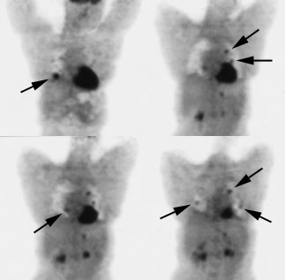
A patient with history of Hurthle cell carcinoma of the thyroid.
Tg level was elevated and whole body scan with ¹³¹I was negative.
Pulmonary metastases are significantly evident on the coincidence FDG PET examination (below left black arrows)
PET in Endocrinology, RINM Shariati Hospital, Dr. Babak Fallahi 2011

Slide 29
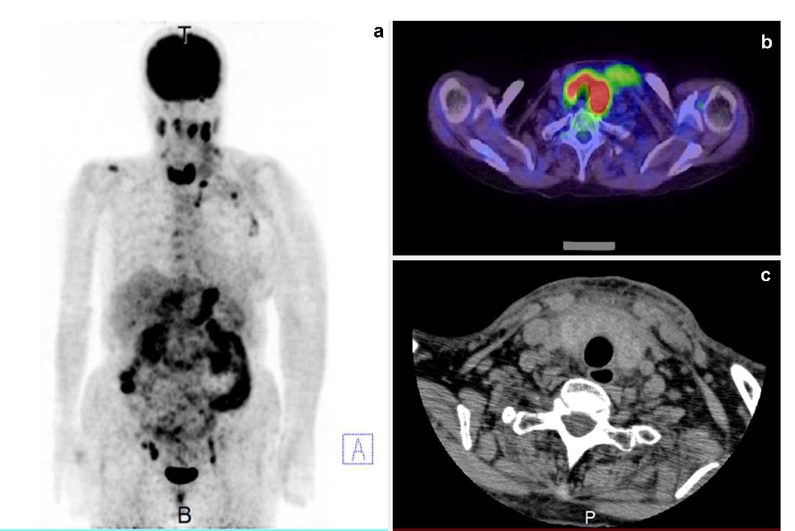
The patient was a 74-year-old female with diffuse inﬁltration of gastric adenocarcinoma cells in the thyroid.
a) 18F-FDG PET imaging: Accumulation was found in the stomach, lymph node metastases, and in the whole thyroid gland.
b) Transverse section of the thyroid on 18F-FDG PET/CT imaging. Diffuse uptake in bilateral thyroid lobes was observed.
c) Transverse section of the thyroid on CT imaging after admission. The thyroid gland was diffusely swollen. Its size enlarged and its CT value decreased after hospitalization.
J Med Ultrason (2001). 2017 Jan;44(1):133-139.

Slide 30
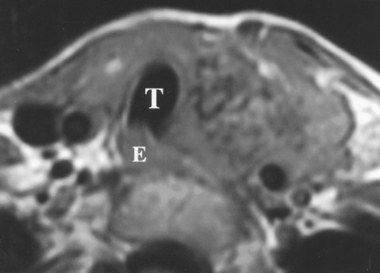
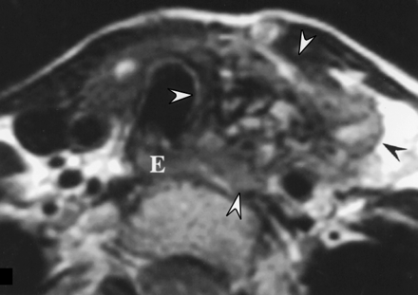
MRI of a papillary carcinoma

Slide 31
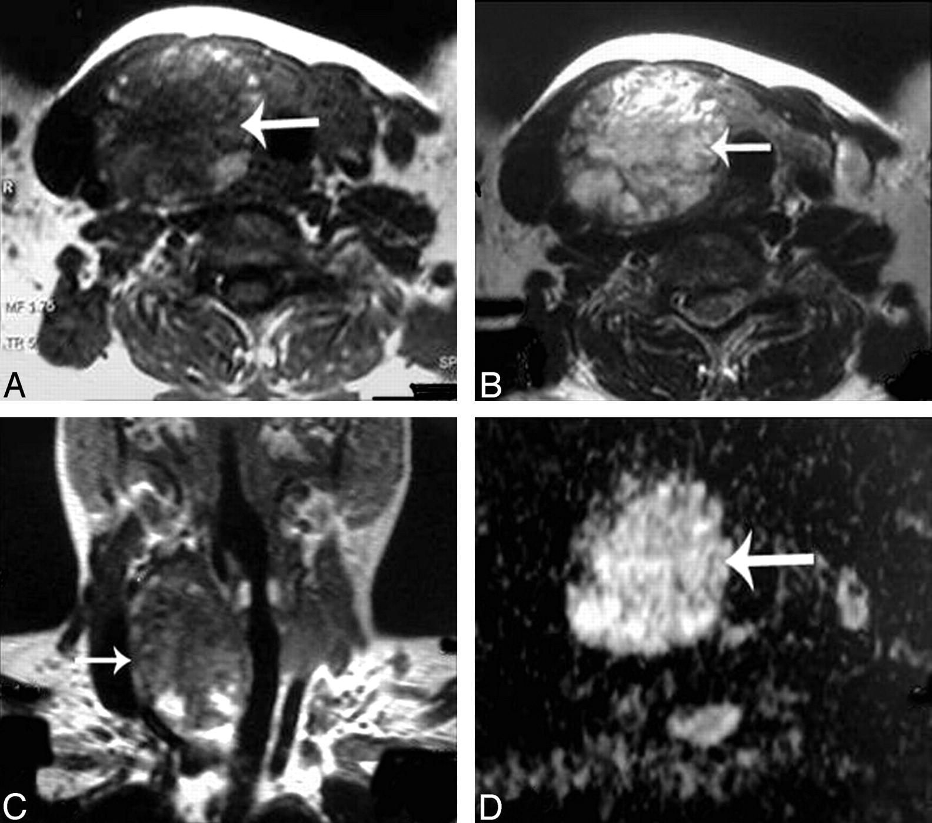
The Diffusion MRI: apparent diffusion coefficient (ADC) values value is a new promising noninvasive imaging approach used for differentiating malignant from benign solitary thyroid nodules. Adenomatous nodule: a-c) well-defined oval mainly solid solitary nodule (arrow) affecting the right thyroid lobe with contralateral tracheal displacement. ADC map image with hyperintensity of the nodule (arrow) denoting increased diffusion
Diffusion MRI

Slide 32
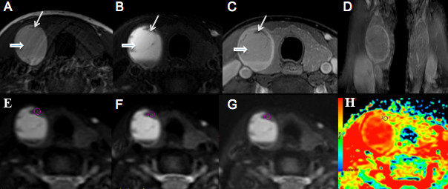
Perfusion imaging
A 44-year-female patient with right lobe thyroid adenoma
a-c) Non-contrast and contrast transversal images showed a hemorrhage in the right lobe (short thick arrow).
d) Coronal images showed the well-circumscribed lesion with homogenous enhancement.
e-g) showed ADC value obtained from ADC map. ROIs were placed in the lesion at right upper area to avoid the hemorrhage area.
h) ADC map generated at b-factor of 300 s/mm².

Slide 33
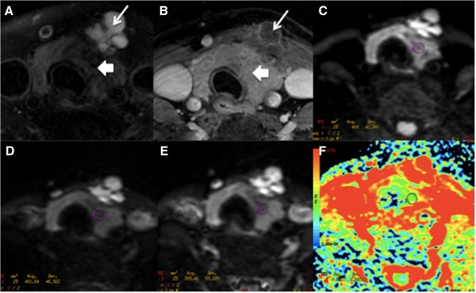
Perfusion imaging
A-36-year-female patient with thyroid papillary carcinoma at left lobe and isthmuses is shown.
a-b) Non-contrast and contrast transversal images showed abnormal signal at left lobe and isthmus with multiple cysts (long arrows).
c-d) showed ADC value measured from ADC map with b factors of 300, 500 and 800 s/mm²
f) ADC map generated at b-factor of 300 s/mm².

Slide 34
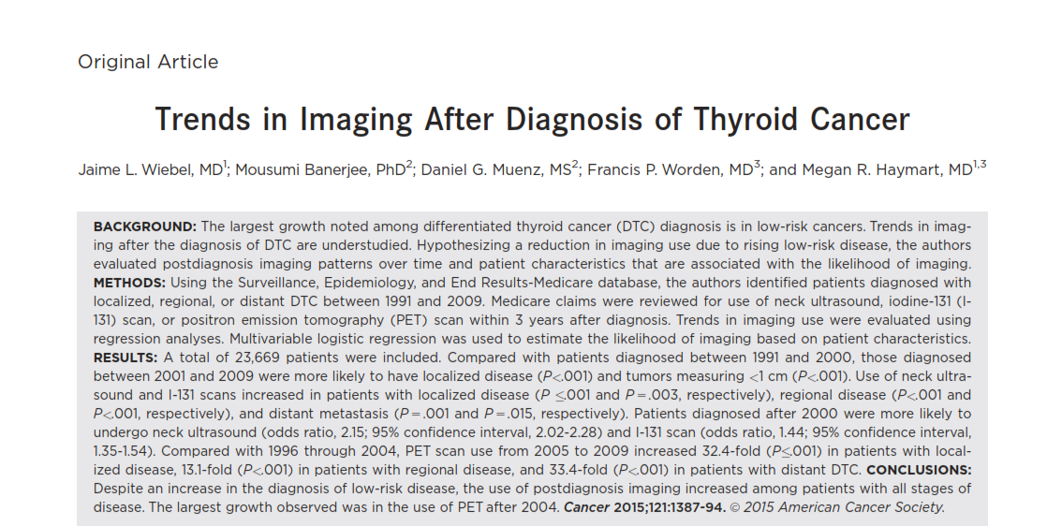
Literatures
Wiebel JL, Banerjee M, et al. Trends in Imaging After Diagnosis of Thyroid Cancer. Cancer 2015;121:1387-94.

Slide 35
Six to 12 months after treatment of DTC, a neck ultrasound and thyroglobulin level are obtained to evaluate the presence of persistent disease.
If thyroglobulin is elevated but there is no abnormality noted on neck ultrasound:
a diagnostic radioiodine (iodine-131 [I-131]) scan is the preferred test.
Positron emission tomography (PET) can be used if the I-131 scan is negative and non–iodine-avid disease is suspected.
Wiebel JL, Banerjee M, et al. Trends in Imaging After Diagnosis of Thyroid Cancer. Cancer 2015;121:1387-94.

Slide 36
Wiebel JL, Banerjee M, et al. Trends in Imaging After Diagnosis of Thyroid Cancer. Cancer 2015;121:1387-94.

Slide 37
Wiebel JL, Banerjee M, et al. Trends in Imaging After Diagnosis of Thyroid Cancer. Cancer 2015;121:1387-94.

Slide 38
Wiebel JL, Banerjee M, et al. Trends in Imaging After Diagnosis of Thyroid Cancer. Cancer 2015;121:1387-94.

Slide 39
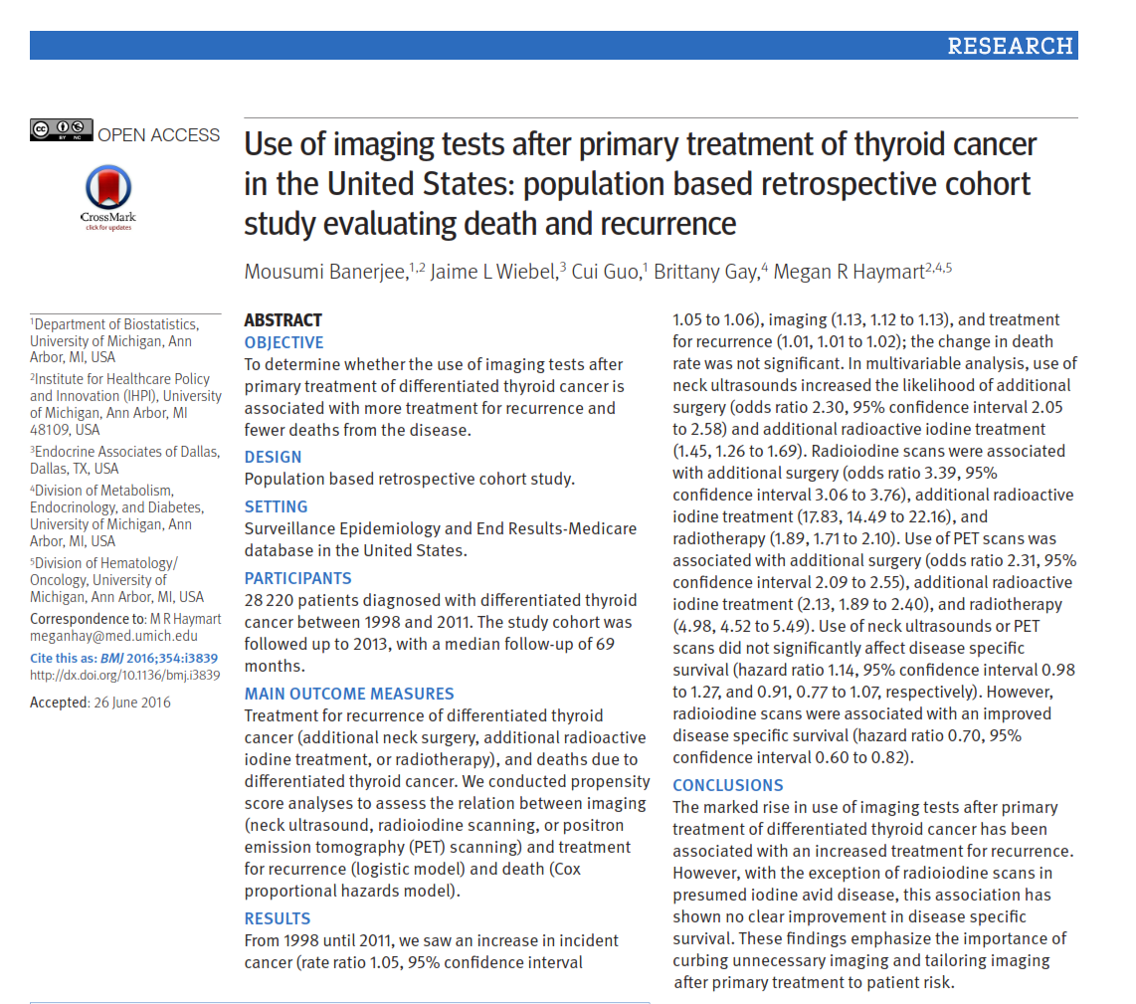
Banerjee M, Wiebel JL. Use of imaging tests after primary treatment of thyroid cancer in the United States: population based retrospective cohort study evaluating death and recurrence. BMJ 2016;354:i3839

Slide 40
Population based retrospective cohort study (SEER).
28 220 patients with differentiated thyroid cancer 1998 - 2011. The study cohort was followed up to 2013, with a median follow-up of 69 months.
Analyses to assess the relation between imaging (neck ultrasound, radioiodine scanning, or positron emission tomography (PET) scanning) and treatment for recurrence and death.
Banerjee M, Wiebel JL. Use of imaging tests after primary treatment of thyroid cancer in the United States: population based retrospective cohort study evaluating death and recurrence. BMJ 2016;354:i3839

Slide 41
Banerjee M, Wiebel JL. Use of imaging tests after primary treatment of thyroid cancer in the United States: population based retrospective cohort study evaluating death and recurrence. BMJ 2016;354:i3839

Slide 42
Banerjee M, Wiebel JL. Use of imaging tests after primary treatment of thyroid cancer in the United States: population based retrospective cohort study evaluating death and recurrence. BMJ 2016;354:i3839

Slide 43
The marked rise in use of imaging tests after primary treatment of differentiated thyroid cancer has been associated with an increased treatment for recurrence.
With the exception of radioiodine scans in presumed iodine avid disease, this association has shown no clear improvement in disease specific survival.
These findings emphasize the importance of curbing unnecessary imaging and tailoring imaging after primary treatment to patient risk.
Banerjee M, Wiebel JL. Use of imaging tests after primary treatment of thyroid cancer in the United States: population based retrospective cohort study evaluating death and recurrence. BMJ 2016;354:i3839

Slide 44
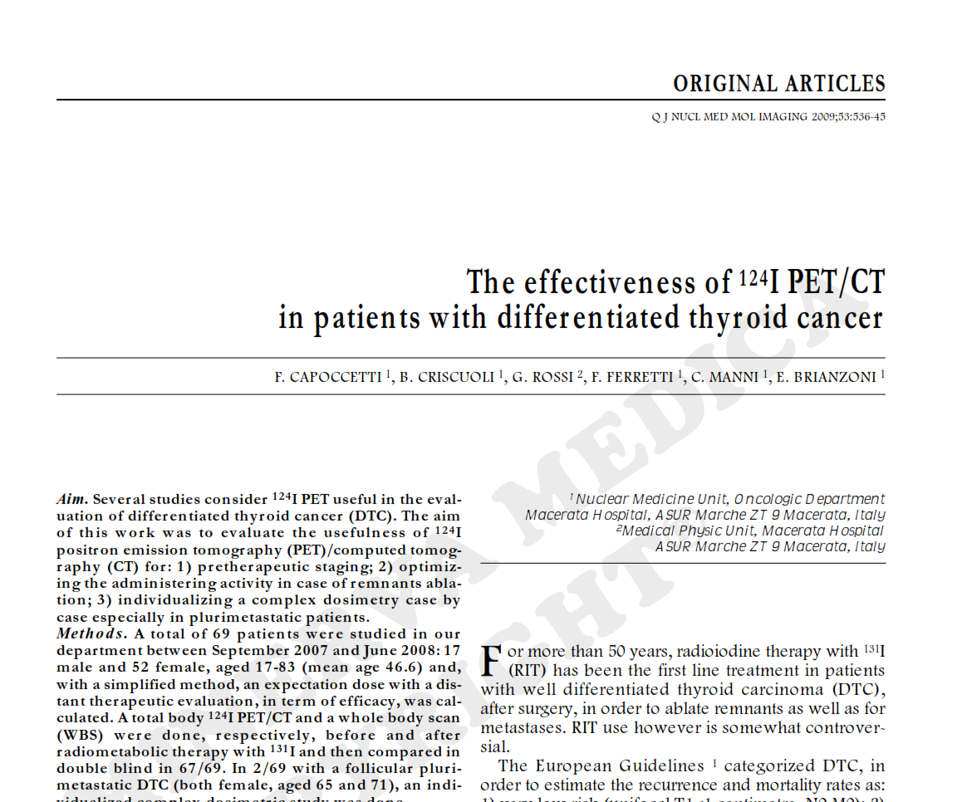
Capoccetti F, Criscuoli B, Rossi G, et al. The effectiveness of 124I PET/CT in patients with differentiated thyroid cancer. Q J Nucl Med Mol Imaging. 2009 Oct;53(5):536-45.

Slide 45
69 patient were studied, 17 male and 52 female, mean age 46.6
Total body 124I PET/CT and Whole Body Scan (WBS) were done befoe and after radiometabolic therapy with 131I
Iodine-124 PET/CT is a powerful dignostic tool before administration of 131I therapeutic dose.
Capoccetti F, Criscuoli B, Rossi G, et al. The effectiveness of 124I PET/CT in patients with differentiated thyroid cancer. Q J Nucl Med Mol Imaging. 2009 Oct;53(5):536-45.

Slide 46
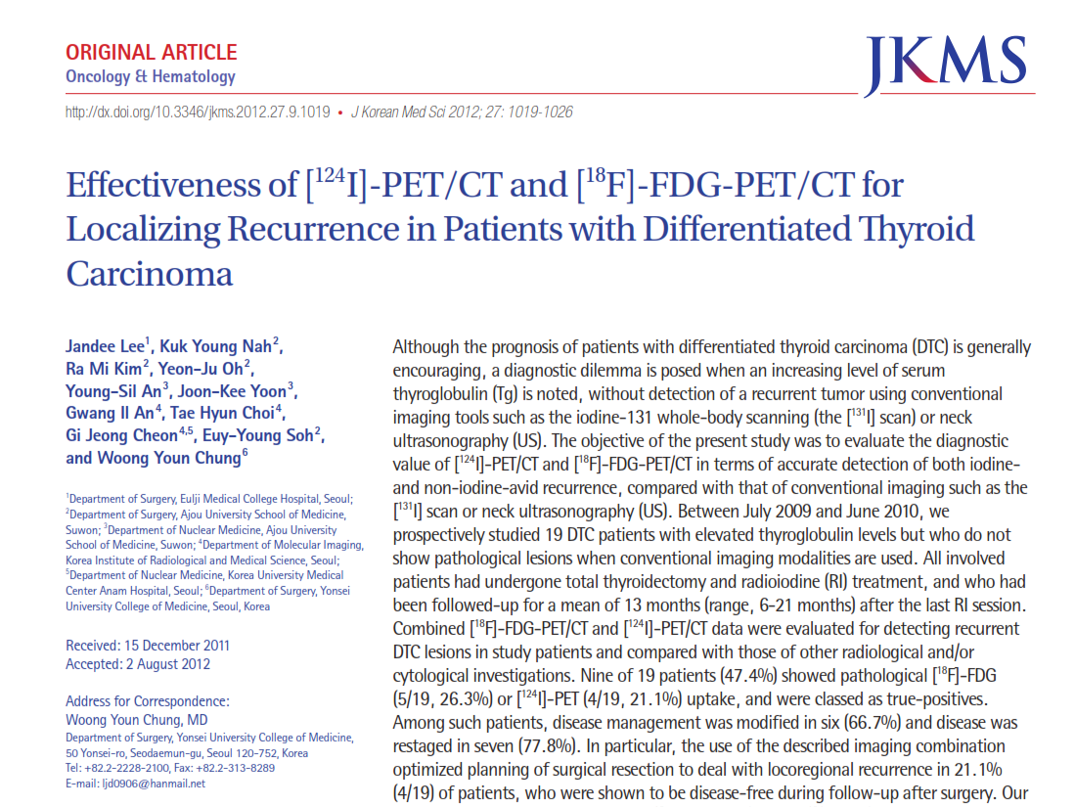
Lee J, Nah KU. Effectiveness of [124 I]-PET/CT and [ 18 F]-FDG-PET/CT for Localizing Recurrence in Patients with Differentiated Thyroid Carcinoma. .J Korean Med Sci 2012; 27: 1019-1026

Slide 47
19 DTC patients with elevated thyroglobulin levels but who do not show pathological lesions when conventional imaging modalities are used.
Combined [18F]-FDG-PET/CT and [124I]-PET/CT data were evaluated for detecting recurrent DTC lesions in study patients and compared with those of other radiological and/or cytological investigations.
Lee J, Nah KU. Effectiveness of [124 I]-PET/CT and [ 18 F]-FDG-PET/CT for Localizing Recurrence in Patients with Differentiated Thyroid Carcinoma. .J Korean Med Sci 2012; 27: 1019-1026

Slide 48
The results indicate that combination of [18F]-FDG-PET/CT and [124I]-PET/CT affords a valuable diagnostic method that can be used to make therapeutic decisions in patients with DTC who are
tumor-free on conventional imaging studies
but who have high Tg levels.
Lee J, Nah KU. Effectiveness of [124 I]-PET/CT and [ 18 F]-FDG-PET/CT for Localizing Recurrence in Patients with Differentiated Thyroid Carcinoma. .J Korean Med Sci 2012; 27: 1019-1026

Slide 49
Imaging in MTC
MTC can spread by local invasion or metastasis within the neck or distantly.
When MTC is diagnosed by fine needle aspiration (FNA) biopsy, ultrasonography of the neck is indicated to look for cervical lymph node involvement.
Mirallié E, Vuillez JP, Bardet S, et al. High frequency of bone/bone marrow involvement in advanced medullary thyroid cancer. J Clin Endocrinol Metab. 2005 ;90(2):779-88..

Slide 50
Imaging in MTC
For patients with local lymph node metastases on ultrasound or with preoperative serum basal calcitonin >500 pg/mL (indicating high risk of local or distant metastatic disease), additional imaging is required to assess for metastatic disease .
Cross-sectional imaging including chest CT, neck CT, three-phase contrast-enhanced liver CT or contrast-enhanced liver magnetic resonance imaging (MRI), axial MRI, and bone scintigraphy have been suggested.
In patients suspected of having skeletal metastases, MRI may be superior to other imaging modalities.
Mirallié E, Vuillez JP, Bardet S, et al. High frequency of bone/bone marrow involvement in advanced medullary thyroid cancer. J Clin Endocrinol Metab. 2005 ;90(2):779-88..

Slide 51
Imaging in MTC
The sensitivity of FDG-PET scanning for detecting metastatic disease is variable but improves with higher calcitonin levels (sensitivity 78 versus 20 percent for basal calcitonin value > or <1000 pg/mL, respectively).
Nicolas Aide and Stéphane Bardet. Would Patient Selection Based on Both Calcitonin Blood Level and Doubling Time Improve 18F-FDG PET Sensitivity in Restaging of Medullary Thyroid Cancer? J Nucl Med 2007; 48:501.

Slide 52
Imaging in MTC
The use of radionuclide imaging with 111-In-octreotide or 99m-Tc-DMSA is not currently recommended for routine initial screening for metastatic disease.
However, three patients have been described who had regional and distant metastases of MTC detected by somatostatin receptor scintigraphy but not by CT scan.
How to select patients with a negative CT scan to undergo somatostatin receptor scintigraphy is not clear. Scanning may be more useful in localizing residual or recurrent disease after primary therapy.
American Thyroid Association Guidelines Task Force, Kloos RT, et al. Medullary thyroid cancer: management guidelines of the American Thyroid Association. .Thyroid 2009; 19:565

Slide 53
In MTC:
18 F-FDG PET/CT is not routinely recommended in the primary staging of the disease, but it has been reported to be useful in the follow-up to evaluate high levels of calcitonin and CEA.
Detection rates have been found to be higher in shorter tumor marker doubling times and in sporadic cases as compared to MEN syndromes.
Its prognostic significance is still under debate in medullary thyroid cancer.
Araz M, Çayır D. 18F-Fluorodeoxyglucose-Positron Emission Tomography/Computed Tomography for Other Thyroid Cancers: Medullary, Anaplastic, Lymphoma and So Forth
Mol Imaging Radionucl Ther 2017;26:1-8

Slide 54
Ann D. King. Imaging for staging and management of thyroid cancer. Cancer Imaging (2008) 8, 57-69

Slide 55
Imaging in Anaplastic Thyroid Cancer
In a study:
Typically obtain ultrasound of the neck (if not already performed), positron emission tomography (PET) using 18 F-fluorodeoxyglucose (18FDG; neck to pelvis), and brain MRI or CT.
If PET scanning is not readily available, cross-sectional imaging of the brain, neck, chest, abdomen, and pelvis with CT or MRI provides adequate initial staging information.
Smallridge RC, Ain KB, Asa SL, et al. - American Thyroid Association guidelines for management of patients with anaplastic thyroid cancer. Thyroid. 2012;22:1104–1139.

Slide 56
Imaging in Anaplastic Thyroid Cancer
PET scan is being used with increasing frequency to evaluate and monitor patients with anaplastic thyroid cancer.
In patients with anaplastic thyroid cancer, there is intense uptake of 18FDG in the primary thyroid tumor, cervical, and mediastinal lymph nodes, and in distant metastases
Smallridge RC, Ain KB, Asa SL, et al. - American Thyroid Association guidelines for management of patients with anaplastic thyroid cancer. Thyroid. 2012;22:1104–1139.

Slide 57
Imaging in Anaplastic Thyroid Cancer
CT of the neck and mediastinum can accurately delineate the extent of the thyroid tumor and identify tumor invasion of the great vessels and upper aerodigestive tract.
Typical findings include masses that are isodense or slightly hyperdense relative to skeletal muscle, dense calcifications, and areas of necrosis.
MRI is similarly useful for defining the local extent of disease and for identifying distant metastases.
In patients with bony metastases, skeletal radiographs typically show lytic lesions.
Chiacchio S., Lorenzoni A., Boni G., et al. Anaplastic thyroid cancer: prevalence, diagnosis and treatment. Minerva Endocrinol 2008; 33:341
Miyakoshi A, Dalley RW, Anzai Y. Magnetic resonance imaging of thyroid cancer. Top Magn Reson Imaging. 2007;18(4):293-302.

Slide 58
Imaging in Anaplastic Thyroid Cancer
Because 20 to 30 percent of patients with anaplastic thyroid cancer have coexisting differentiated thyroid cancer, the presence of metastases does not automatically indicate that they originate from anaplastic thyroid cancer.
The serum thyroglobulin level and/or PET scan may help distinguish between the two. In patients with metastatic differentiated thyroid cancer, the thyroglobulin level is markedly elevated, whereas it should be normal in patients with anaplastic thyroid cancer.
In addition, compared with metastases from differentiated thyroid cancer, metastases from anaplastic thyroid cancer are hypermetabolic and have more avid uptake on PET scanning.
Smallridge RC, Ain KB, Asa SL, et al. American Thyroid Association guidelines for management of patients with anaplastic thyroid cancer. Thyroid 2012; 22:1104.

Slide 59
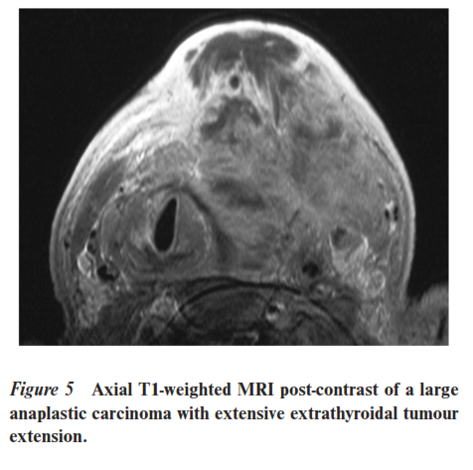
Ann D. King. Imaging for staging and management of thyroid cancer. Cancer Imaging (2008) 8, 57-69

Slide 60
Anaplastic Thyroid Cancer Imaging
Limited data published on anaplastic thyroid carcinomas revealed that 18 F-FDG PET/CT may have a role in both staging and follow-up of these patients.
SUV max and metabolic tumor volume values seem to have a prognostic importance.
18 F-FDG PET/CT can be of value in the differential diagnosis of primary thyroid lymphoma and thyroiditis.
Metastatic tumors of the thyroid are not as uncommon as previously assumed, so special attention should be paid on thyroidal 18 F-FDG uptake in patients with known malignancies.
In poorly differentiated thyroid cancers, it is reasonable to use 18 F-FDG PET/CT for follow-up due to high 18 F-FDG uptake and metabolic tumor rate.
Araz M, Çayır D. 18F-Fluorodeoxyglucose-Positron Emission Tomography/Computed Tomography for Other Thyroid Cancers: Medullary, Anaplastic, Lymphoma and So Forth
Mol Imaging Radionucl Ther 2017;26:1-8

Slide 61
Hürthle cell cancer
Hürthle cell cancer is a rather rare histopathologic subtype of thyroid cancer with less iodine avidity.
18 F-FDG PET/CT seems to have an important role with high detection rates and sensitivity-specificity in Hürthle cell cancer.
Araz M, Çayır D. 18F-Fluorodeoxyglucose-Positron Emission Tomography/Computed Tomography for Other Thyroid Cancers: Medullary, Anaplastic, Lymphoma and So Forth
Mol Imaging Radionucl Ther 2017;26:1-8

Slide 63
ATA Guideline: What is the role of US and other imaging techniques (RAI SPECT/CT, CT, MRI, PET-CT) during follow-up?
Cervical ultrasonography
is highly sensitive in the detection of cervical metastases in patients with DTC.
Following surgery, cervical US to evaluate the thyroid bed and central and lateral cervical nodal compartments should be performed at 6–12 months and then periodically, depending on the patient’s risk for recurrent disease and Tg status. (Strong recommendation, Moderate-quality evidence)
If a positive result would change management, ultra- sonographically suspicious lymph nodes ‡8–10 mm (see Recommendation 71) in the smallest diameter should be biopsied for cytology with Tg measurement in the needle washout ﬂuid. (Strong recommendation, Low-quality evidence)
Low-risk patients who have had remnant ablation, negative cervical US, and a low serum Tg on thyroid hormone therapy in a sensitive assay (<0.2 ng/mL) or after TSH stimulation (Tg <1 ng/mL) can be followed primarily with clinical examination and Tg measurements on thyroid hormone replacement. (Weak recommendation, Low-quality evidence)
Haugen BR, Alexander EK, Bible KC, et al. ATA thyroid nodule/DTC guidelines. Thyroid 2016 26, 1

Slide 64
Diagnostic whole-body RAI scans
After the ﬁrst posttreatment WBS performed following RAI remnant ablation or adjuvant therapy, low-risk and intermediate-risk patients (lower risk features) with an undetectable Tg on thyroid hormone with negative antiTg antibodies and a negative US (excellent response to therapy) do not require routine diagnostic WBS during follow-up. (Strong recommendation, Moderate-quality evidence)
Diagnostic WBS, either following thyroid hormone withdrawal or rhTSH, 6–12 months after adjuvant RAI therapy can be useful in the follow-up of patients with high or intermediate risk (higher risk features) of persistent disease and should be done with123I or low activity131I. (Strong recommendation, Low-quality evidence)
SPECT/CT RAI imaging is preferred over planar imaging in patients with uptake on planar imaging to better anatomically localize the RAI uptake and distinguish between likely tumors and nonspeciﬁc uptake. (Weak recommendation, Moderate-quality evidence)
Haugen BR, Alexander EK, Bible KC, et al. ATA thyroid nodule/DTC guidelines. Thyroid 2016 26, 1

Slide 65
FDG(Fludeoxyglucose)-PET scanning
FDG-PET scanning should be considered in high risk DTC patients with elevated serum Tg (generally >10 ng/mL) with negative RAI imaging. (Strong recommendation, Moderate-quality evidence)
FDG-PET scanning may also be considered as (i) a part of initial staging in poorly differentiated thyroid cancers and invasive Hurthle cell carcinomas, especially those with other evidence of disease on imaging or because of elevated serum Tg levels, (ii) a prognostic tool in patients with metastatic disease to identify lesions and patients at highest risk for rapid disease progression and disease-speciﬁc mortality, and (iii) an evaluation of posttreatment response following systemic or local therapy of metastatic or locally invasive disease. (Weak recommendation, Low-quality evidence)
To date, there is no evidence that TSH stimulation proves the prognostic value of FDG-PET imaging.
Haugen BR, Alexander EK, Bible KC, et al. ATA thyroid nodule/DTC guidelines. Thyroid 2016 26, 1

Slide 66
CT and MRI
Cross-sectional imaging of the neck and upper chest (CT, MRI) with IV contrast should be considered (i) in the setting of bulky and widely distributed recurrent nodal disease where US may not completely delineate disease, (ii) in the assessment of possible invasive recurrent disease where potential aerodigestive tract invasion requires complete assessment, or (iii)when neck US is felt to be inadequately visualizing possible neck nodal disease (high Tg, negative neck US). (Strong recommendation, Moderate-quality evidence)
CT imaging of the chest without IV contrast (imaging pulmonary parenchyma) or with IV contrast (to include the mediastinum) should be considered in high risk DTC patients with elevated serum Tg (generally >10 ng/ mL) or rising Tg antibodies with or without negative RAI imaging. (Strong recommendation, Moderate-quality evidence)
Imaging of other organs including MRI brain, MR skeletal survey, and/or CT or MRI of the abdomen should be considered in high-risk DTC patients with elevated serum Tg (generally >10 ng/mL) and negative neck and chest imaging who have symptoms referable to those organs or who are being prepared for TSH-stimulated RAI therapy (withdrawal or rhTSH) and may be at risk for complications of tumor swelling. (Strong recommendation, Low-quality evidence)
Haugen BR, Alexander EK, Bible KC, et al. ATA thyroid nodule/DTC guidelines. Thyroid 2016 26, 1

Slide 67
Ethanol injection
Imaging techniques are used for follow up of different thyroid cancer treatment strategies including ethanol therapy which has been widely employed for treatment of the disease.
Assessed the efficacy of percutaneous ethanol injection in treating autonomous thyroid nodules.
35 patients diagnosed by technetium-99 scanning with hyperfunctioning nodules and suppressed sensitive TSH (sTSH) were given sterile ethanol injections under ultrasound guidance.
Our findings indicate that ethanol injection is an alternative to surgery or radioactive iodine in the treatment of autonomous thyroid nodules.
Larijani B, Pajouhi M, Ghanaati H, Bastanhagh MH, et al. Treatment of hyperfunctioning thyroid nodules by percutaneous ethanol injection. BMC Endocr Disord. 2002 Dec 6;2(1):3.

Slide 68
Molecular aspects
Similar to other malignancies, a multidisciplinary approach is necessary for diagnosis, treatment and follow-up of thyroid cancers and molecular techniques can play a key role in this regard.
Increased understanding of thyroid CSCs will provide a structure for the discovery of biomarkers and drugs which will result in aids for patients with anaplastic thyroid cancer.
Case differences might be originated from different genetic backgrounds.
Haghpanah V, Fallah P., Tavakoli R, Larijani B. Antisense-miR-21 enhances differentiation/apoptosis and reduces cancer stemness state on anaplastic thyroid cancer.Tumor Biology. 2015

Slide 69
Conclusion
Imaging Types in DTC Include Cervical ultrasonography (US)whole-body RAI scan FDG(Fludeoxyglucose)-PET scan CT and MRI.
Greater imaging use clearly contributes to increased costs.

Slide 70
مسجد نصیرالملک، شیراز

