Slide 1
In the name of GOD, The Compassionate & The merciful Female sexual dysfunction
Fahimeh Ramezani Tehrani
Professor
Reproductive endocrinology research center
Research institute for endocrine sciences
Shahid beheshti university of medical sciences
Jan.2016

Slide 2
FSD IS A CHALLENGING TOPIC
Sensitive topic
Inadequate training
Insufficient clinical time with patients to discuss
in depth sexual history
Limited treatment options

Slide 3
agenda
Impact of FSD
Prevalence of FSD
Factors affecting FSD
Sexual cycle
Hormones affecting sexual function
Etiology of FSD
Diagnosis of FSD
Classification of FSD
Factors influencing orgasm
Conclusion

Slide 4
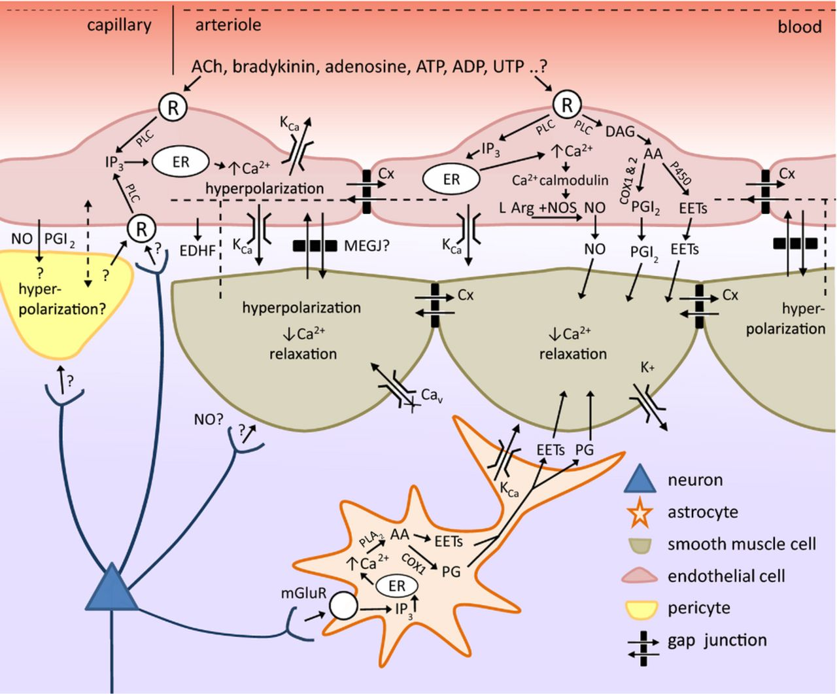
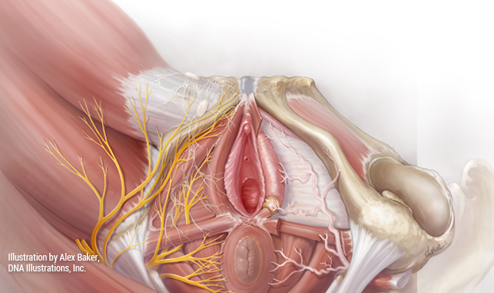
Female Sexual function is a complex
Sexual function results from a complex neurovascular process that is controlled by psychological, social and hormonal inputs.

Slide 5
Points need to be considered in approach to Sexuality
The spectrum of normal sexual response varies from one woman to another
Sexual response varies throughout a woman’s lifetime
Physicians should be aware of their patients’ values, attitude and concerns about their sexuality
Gender role

Slide 6
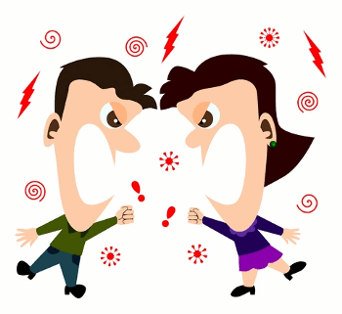
Importance
Sexual functioning is an important part of the human experience
Despite marked reductions in sex hormones with menopause and age, there is no universal decline in sexuality
More than 75% of the middle-aged women in the study of Women’s Health Across the Nation (SWAN) reported that sex was moderately to extremely important
FSD can negatively affect health-related quality of life, self-esteem, mood, relationships with sexual partners and general well-being
More than one half of divorce in Iran is directly or indirectly related to sexual problems
Quality of Life and Health Burden 2009, J Sex Med 2009, WHO 2011 , Women Health 2010

Slide 7
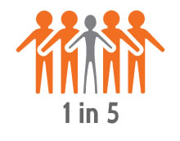
PREVALENCE
40% of women will experience some types of FSD over their lifetime( WHO 2008).
National Health and Social Life Survey (Laumann 1999)
33% of women lack sexual interest
25% of women do not experience orgasm
20% of women report lubrication difficulties
20% of women report sex is not pleasurable
Iranian sexual health study(Ramezani 2014)
Prevalence in reproductive aged women: 27.3%
12% of women had never have experienced orgasm
Prevalence in menopausal women: 47.9%

Slide 8
FACTORS AFFECTING SEXUAL RESPONSE
Mental health
Depressed women may masturbate more frequently than normal one
Sexual dysfunction in the partner
Relationship
Childhood sexual abuse/rape
Pregnancy
Sexual value system, folklore, religious beliefs
Physical changes
Body image
Medical restrictions
Emotional needs
Postpartum
PRL
Nursing
Low self-esteem
Negative body image

Slide 9
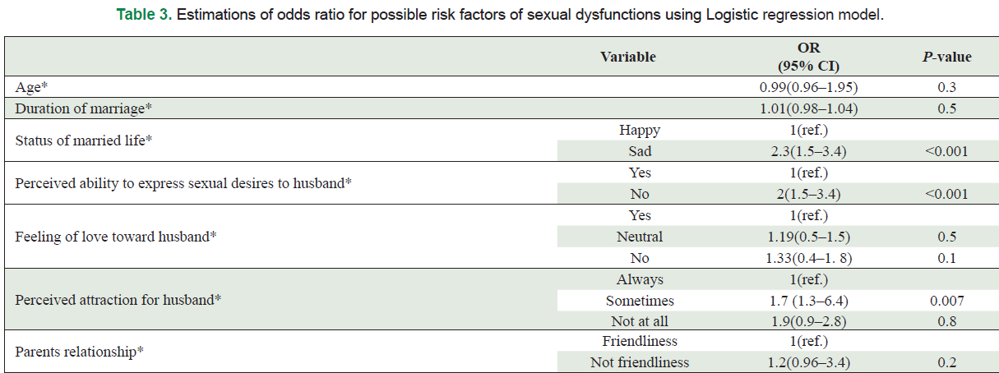

Slide 10
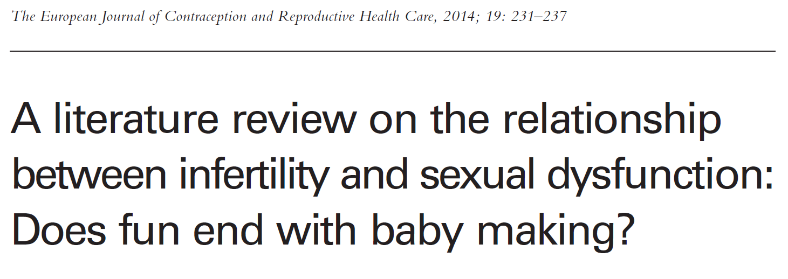
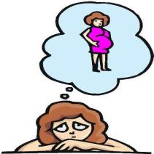
infertility
Impact of FSD on fertility
Orgasmic uterine contraction involved in upsucking transport of spermatozoa
Female orgasm is not essential for fertility or pregnancy
Dyspareunia/vaginsmus
Impact of infertility on FSD
Femininity is frequently linked with fecundity and maternity
Reduce sexual desire
Impaired sexual function/time scheduled coitus/stress

Slide 11
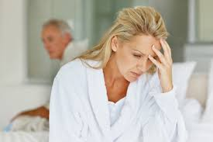
FACTORS AFFECTING SEXUAL RESPONSE
Aging
Menopause ? Lack of estrogen and testosterone
Reduction in responsiveness
Increased desire for non genital sexual expression
Sexual attitude at an earlier age
Partner’s general and sexual health
Medical complications have weaker association with SD than that between male

Slide 12
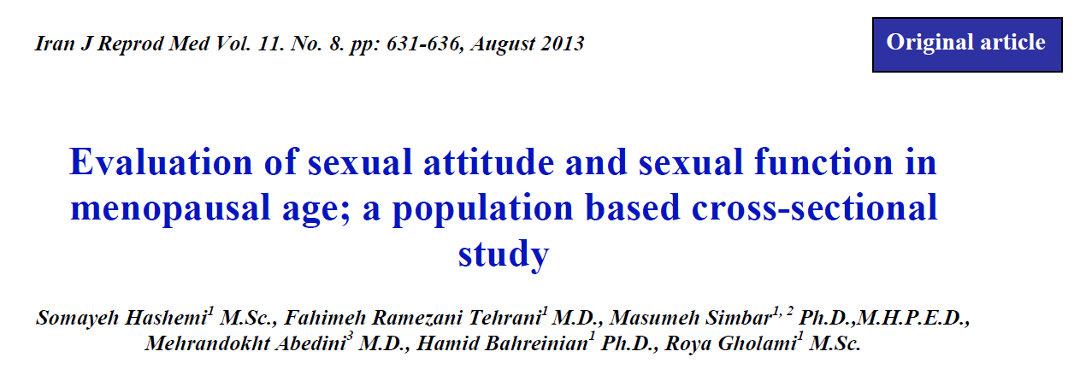

Slide 13
Mode of delivery
There is no definite correlation between sexual activity and method of delivery

Slide 14
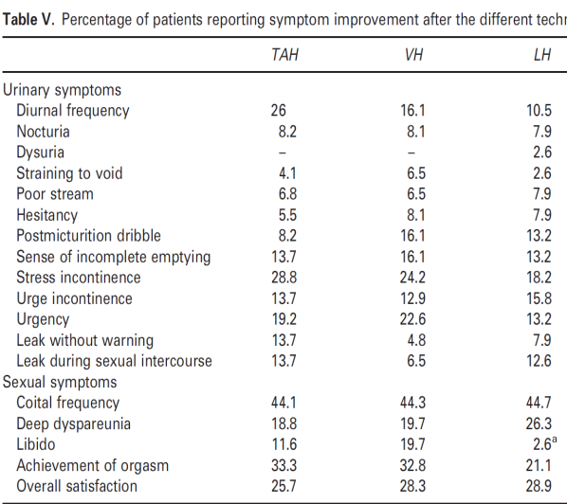
hysterectomy
Decreased sexual pleasure due to lack of uterine contraction?
Cervix and orgasm?
There is no definite correlation between sexual activity and method of hysterectomy

Slide 15
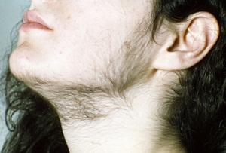
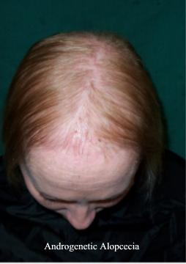
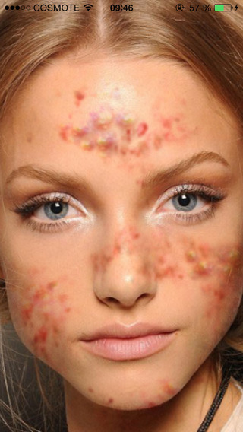
Whether SEXUAL DYSFUNCTION IS MORE PREVALENT AMONG pcos women?
No consensus
Impact of hyperandrogenemia on sexual function of PCOS women
Impact of features of PCOS, e.g. changes in physical appearance (obesity and androgen-related symptoms including hirsutism, acne and alopecia), disturbances in menstrual cycle, infertility and metabolic disturbances on sexual function

Slide 16
Table 4 Correlations between total FSFI and each domain score and hormonal profiles in women with PCOS and controls.
 | FSH |  | LH |  | PRL |  | 17OHP |  | TES |  | A4 |  | DHEAS
 | PCOS | Controls | PCOS | Controls | PCOS | Controls | PCOS | Controls | PCOS | Controls | PCOS | Controls | PCOS | Controls
Total FSFI score | -.013 | -.062 | -.001 | .037 | -.180 | -.014 | .007 | .077 | .002 | .006 | .036 | -.026 | .034 | .156 *
Desire | -.049 | -.082 | .143 | -.029 | -.065 | 0.001 | .014 | .046 | .021 | .065 | .065 | . 050 | -.062 | .065
Lubrication | -.042 | -.010 | -.094 | .066 | -.070 | .018 | .044 | .055 | .051 | .006 | .026 | -.074 | .117 | .064
Arousal | .005 | -.093 | -.130 | -.013 | -.159 | .030 | .086 | -.012 | -.017 | -.014 | -.050 | -.055 | -.154 | .093
Orgasm | .026 | -.118 | .018 | -.048 | -.250* | .003 | -.166 | .104 | -.202 | .072 | -.223 | .041 | -.038 | .206 **
Pain | -.019 | .047 | .040 | .117 | -.065 | -.008 | .059 | .100 | .147 | -.039 | .173 | -.009 | .132 | .053
Satisfaction | -.177 | -.071 | -.105 | -.052 | -.197 | -.020 | .056 | .106 | -.085 | .111 | .011 | .103 | -.062 | .275 ***

Slide 17
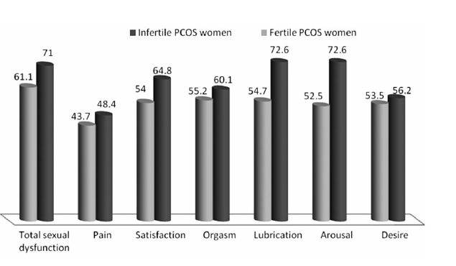

Slide 18
Ramezani et al in press
P values | Groups |  | Variables
 | No prenatal androgen exposure n = 674 | Prenatal androgen exposure n = 94
 |  |  | Before adjusting
0.02 * | 27.10 (22.80-30.10) | 25.20 (20.40-29.80) | Total score
0.34 | 3.60 (3.60-4.80) | 3.60 (3-4.20) | Desire
0.05 | 3.90 (2.70-4.80) | 3.60 (2.40-4.50) | Arousal
0.05 | 5.10 (4.20-5.70) | 4.80 (3.90-5.40) | Lubrication
0.09 | 4.80 (4-5.60) | 4.80 (3.60-5.20) | Orgasm
0.03 * | 4.80 (4-5.60) | 4.80 (3.60-5.50) | Satisfaction
0.10 | 4.80 (3.60-5.60) | 4.40 (2.90-5.50) | Pain
 |  |  | After adjusting
0.05 * | 26.32 ± 15.59 | 24.71 ± 8.37 | Total score
0.51 | 3.97 ± 4.09 | 3.83 ± 2.23 | Desire
0.02 * | 3.64 ± 3.35 | 3.26 ± 1.76 | Arousal
0.31 | 4.72 ± 2.86 | 4.57 ± 1.58 | Lubrication
0.30 | 4.54 ± 3.57 | 4.35 ± 1.95 | Orgasm
0.21 | 4.80 ± 3.11 | 4.59 ± 1.77 | Satisfaction
0.11 | 4.54 ± 4.07 | 4.20 ± 2.22 | Pain

Slide 19
DRD4-5 locus haplotype (Dopamine receptor) is associated with desire, arousal and FSD score.
A variant of 5H2 Serotonin gene(GG) is associated with low desire/arousal scores.
Interleukin receptor gene is associated with vulvudynia
GWAS approach demonstrated that 5HT1E Serotonin receptor gene is associated with arousal problem and Parvalbumin gene(GABA interneuron) is associated with low FSF.

Slide 26
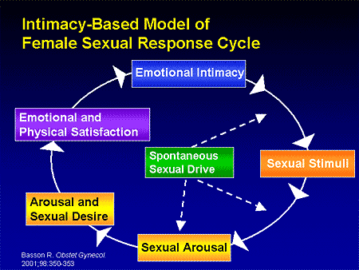

Slide 27
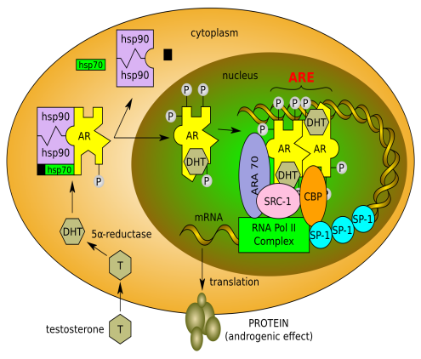
Androgens
Androgens play an important role in healthy female sexual function, especially in sexual interest and desire, arousal, and orgasm
vulvar epithelium
vaginal mucosa
submucosa
stroma
smooth muscle
vascular endothelium
Relaxation vaginal smooth muscle
nitric oxide synthetize activity

Slide 28
DHEA
The most abundant circulating sex steroid hormones in women which produce by ovaries and adrenal glands
Circulating DHEA and DHEAS provide a large precursor reservoir for the intracellular production of androgens and estrogens in non-reproductive tissues

Slide 29
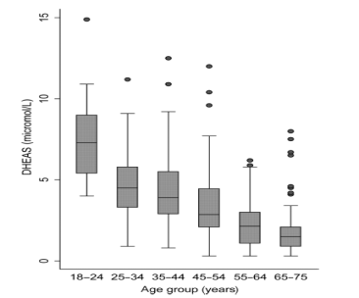
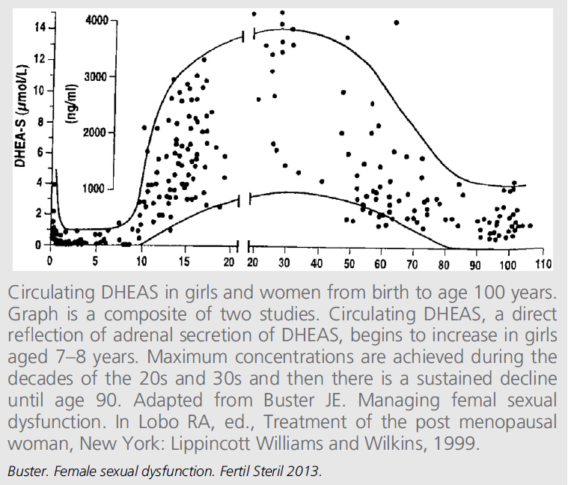
DHEA (continue..)
Serum levels of both DHEA and DHEAS decline with age proposing in widespread speculation that the age-related decline in these C19 steroids results in loss of well being, deterioration in cognition and lowered libido

Slide 30
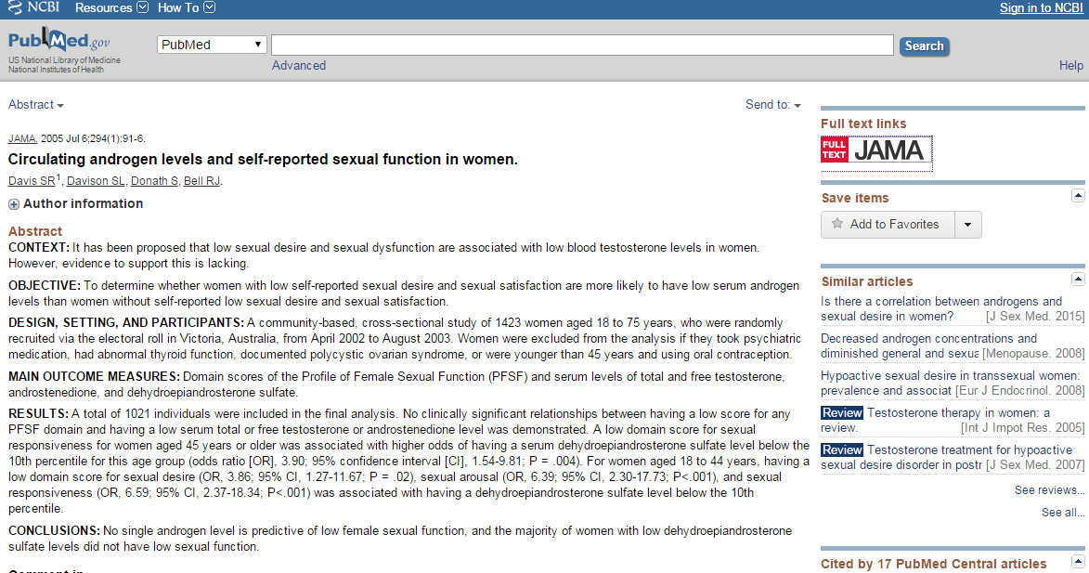
A community-based, cross-sectional study of 1423 women aged 18 to 75 years,
who were randomly recruited via the electoral roll in Victoria,
Main Outcome Measures Domain scores of the Profile of Female Sexual Function (PFSF) and serum levels of total and free testosterone, androstenedione, and dehydroepiandrosterone sulfate
No clinically significant relationships between having a low score for any PFSF domain and having a low serum total or free testosterone or androstenedione level was demonstrated

Slide 32
Androgens & fsd
Data on linking low androgen levels and FSD are still inconclusive.
There are a multitude of reasons why women can have low androgen levels.
Age-related decline
Premature ovarian failure
Iatrogenic menopause
Conditions causing rise in SHBG (Age, Pregnancy, Oral estrogen therapy, OCPs, Antiepileptic drugs)
Anorexia nervosa
Cirrhosis
Hyperthyroidism
Treatment with glucocorticoids
Hypopituitarism
Addison’s disease

Slide 33
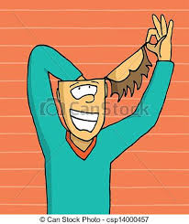
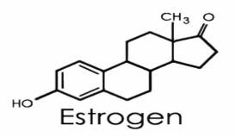
Estrogen
Estrogen is essential for the maintenance of urogenital health
A decline in serum estrogen levels results in
thinning of vaginal mucosal epithelium
atrophy of vaginal wall smooth muscle
Vaginal pH shifts from acidic to alkaline
vaginal secretion are reduced, contributing to genital symptoms of dryness, irritation/burning, pruritis, and recurrent vaginitis
urinary symptoms, such as frequency, urgency, nocturia, dysuria, incontinence, and postcoital/recurrent urinary infection, may be present
vaginal vault becomes pale in appearance
increase frequency of vaginal infections, urinary tract infections, incontinence,
Estradiol < 35 pg/mL is associated with FSD
HSSD
dyspareunia

Slide 36
Etiologies of Female Sexual Dysfunction
Vasculogenic
Neurogenic
Hormonal/Endocrine
Musculogenic
Psychogenic

Slide 37
Vasculogenic
Risk factors: hypertension, hypercholesterolemia, smoking, heart disease
Associated with ED in men and sexual dysfunction in women
Diminished vaginal and clitoral blood flow (atherosclerosis)
Results in symptoms of vaginal dryness and dyspareunia
Alteration of circulating estrogen levels: atrophy of vaginal and clitoral smooth muscle
Traumatic arterial disruption: pelvic fracture, blunt trauma, surgical disruption, chronic perineal pressure (bicycle riding)

Slide 38
Neurogenic
Spinal cord injury (SCI) to the central or peripheral nervous system
Diabetes mellitus
Complete upper motor neuron lesions of the sacral cord
Incomplete SCI: capacity for psychogenic arousal and vaginal lubrication

Slide 39
Hormonal/Endocrine
Disorders of the hypothalamic-pituitary axis
Medical or surgical castration
Premature ovarian failure
Chronic birth control use
Symptoms: decreased desire, vaginal dryness, lack of sexual arousal

Slide 40
Musculogenic
Lavator ani muscles
Perineal membrane
bulbocavernosus and ischiocavernosus muscle
Contraction contributes to arousal and orgasm
Hypertonicity ---> vaginismus or dyspareunia
Hypotonicity ---> vaginal hypoanesthesia, coital anorgasmia, urinary incontinence during sexual intercourse or orgasm

Slide 41
Psychogenic
Emotional and relational issues
self esteem
body image
quality of the relationship with the partner
Medications
serotonin re-uptake inhibitors

Slide 42
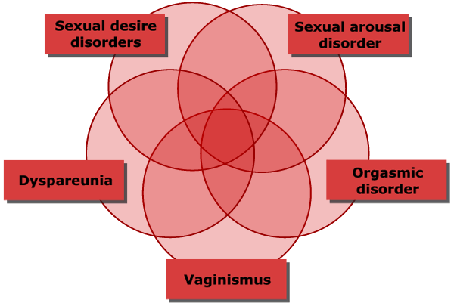

Slide 43
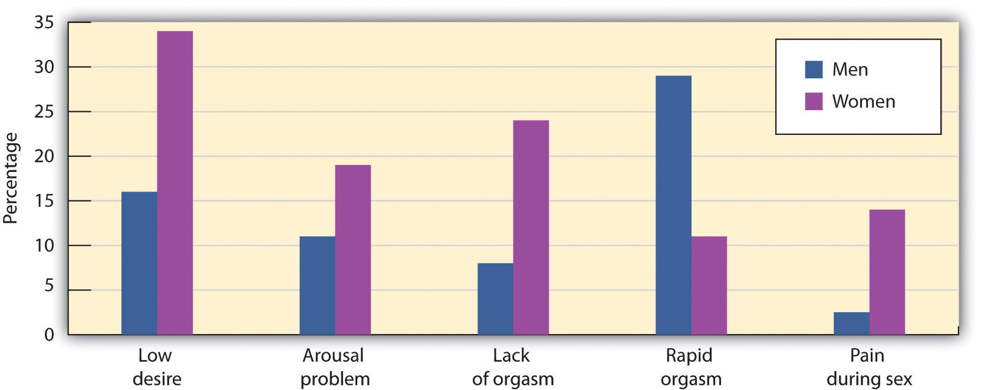
Prevalence of sexual dysfunction in men & women J Sex Med 2011

Slide 44
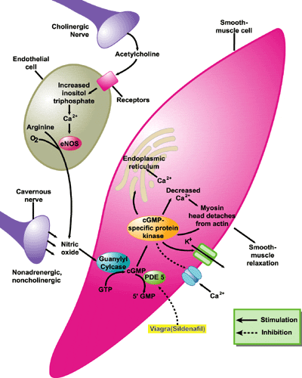
Sexual desire
Feeling of desire may be triggered by
Internal factors(fantasies, memories, feeling of arousal)
External factors( interested/ intersting partner)
Modulators
Promotors:Norepinephrine, dopamine, oxytocin, serotonin
Inhibitor: GABA, PRL

Slide 45
points
Clitoris is the most sexually sensitive part of women
Its stimulation produces the most intense sexual feeling and the most intense orgasm.
Many women first need to experience nonphysical and non genital physical stimulation before clitoral stimulation can be enjoyed.
In absent of arousal, direct stimulation of clitoris can be unpleasant and even painful.
Desire in women in long term relationship are mainly motivated by factors other than sexual desire.

Slide 46
Hypoactive Sexual Desire Disorder
Causes:
Physiological factors
Hormones
neurotransmitters
CNS
Psychological factors
daily hassles
Relationship issues
conflict
attraction
sexual compatibility
sexual skill
desired level of intimacy
power dynamics
Guilt
Psychological disorders
Notes:
Stress - sign. Drop in income associated with HSDD

Slide 47
Female Sexual Arousal Disorder
Causes:
Physiological
Hormones
Neurotransmitters
CNS activation
Touch sensation
Psychological
Anxiety
Performance demand
Expectancies
Relationship issues
conflict
attraction
sexual compatibility
sexual skill
desired level of intimacy
power dynamics
Notes:
SNS activation: 15-30 minutes after exercise (normally functioning & HSDD)
touch sensation:
anxiety: focusing on non-erotic cues
performance demand: sexually functional women became more aroused when asked to (sexually functional)
expectancies: FSAD women falsely informed that they had shown strong physiological response, subsequent time showed stronger arousal in subsequent measurement

Slide 48
Female Orgasmic Disorder
Causes:
physiological
Lack of CNS activation
psychological
distraction
discomfort about sex
guilt
endorse sex myths
negative attitudes about sex

Slide 49
Pain Disorders: Dyspareunia
Causes:
Anatomical
Pathological
Iatrogenic
Psychological
Notes:
Anatomical- rigid hymen, thin vaginal walls ass. With menopause
pathological - genital infection, endometriosis, tumors
iatrogenic- (as a result of a surgical procedures) - episiotomy
psychological - fear and anxiety in sexual situations, sexual trauma, depression, discord b/w partners

Slide 50
Pain Disorder: Vaginismus
Involuntary spasm of vaginal musculature interfering with intercourse
Causes:
medical conditions (23-32%)
family background
sexual trauma (40%)
Notes:
Prevalence - approx. 14% (dyspareunia and vaginismus)

Slide 51
Women's sexually sensitive areas
Clitoris
Periurthral glands
Urethra
Nipples
Breasts
Labia
Much of skins generally
Vagina(especially anterior wall)
Lower third response to touch
Upper two third response to pressure
G-spot ? Using ultrasonographic imagine during coitus, penis stimulate base of clitoris and clitorourethral complex, G spot may be a functional entity
Some individual cervix

Slide 52
Experience of orgasm
By age 15: 23%
By age 20: 53%
By age 25: 77%
By age 30: 90%
Never : 9%
Arch Sex Beh 2009

Slide 53
Pleasure experienced can range from “just nice” to “transient un conciouness”.
Does not require consciousness, can occur during sleep.
Not required consensual sexual arousal
Androgen receptor in pelvic muscles (Cur Open OBS GYN 2004)
Duration
Subjective: 12.2 ± 9.8 s
Objective: 19.9 ± 9.8 s
Pet study demonstrated that Pelvic muscles are represented by two sites in pontine tegmentum area(J SEX Med2013)
Ventrolateral side: activated by orgasm per se
Dorsolateral side: activated by orgasm, those attempted by failed to have orgasm
Uterine contraction due to the secretion of oxytocin
Dopaminergic and adrenergic transmission is prosexual and orgasm promoting but serotonergic is inhibitory of arousal and orgasm

Slide 54
Factors influencing the pleasure of orgasm
The early orgasm of youth is less pleasurable
Sexual pleasure learning during sexual maturation
Both genital and anal stimulation
Pelvic muscle exercise, especially the bulbocavernous
Female prostate secretion
Hormones
Hypogonadism : less intensity
Estrogen: not direct, indirect through vagina and uterus
Prolactin release at orgasm
Oxytocin : calmness, improve social intentions and trust, reduce fear
Chemical enhancements
Amyl nitrite
Heroin injection
Ecstasy
Drug induced spontaneous orgasm
Clomipiramine
Oxytocin
Venlafaxine
Mitrazipine
pramipexole

Slide 55
J SEX Med 2013

Slide 56
J SEX Med 2013

Slide 57
diagnosis
History
FSD questionnaire
Physical exam
Lab test?

Slide 59
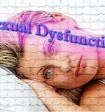
Home messages
Sexuality is an essential part of human life.
Physicians should be aware of women’ s values, attitude and concerns about their sexuality
Sexual function results from a complex neurovascular process that is controlled by psychological, social and hormonal profiles
Sexual pleasure learning is matured by time
Satisfaction is more important than orgasm in women
Female orgasm may be associated with ejaculation
Relationship is the most important factor influencing women’s sexual factors.

Slide 60
Thank you for your attention

