Slide 1
IN theNAME of GOD What's New in the ADA's 2015 Diabetes Guidelines?
Bita Rabbani

Slide 2
ADA Evidence Grading System for Clinical Practice Recommendations
Level of Evidence | Description
A | Clear or supportive evidence from adequately powered well-conducted, generalizable, randomized controlled trials Compelling nonexperimental evidence
B | Supportive evidence from well-conducted cohort studies or case-control study
C | Supportive evidence from poorly controlled or uncontrolled studies Conflicting evidence with the weight of evidence supporting the recommendation
E | Expert consensus or clinical experience

Slide 3
2 : Classification and Diagnosis of Diabetes
The BMI cut point for screening overweight or obese Asian Americans for prediabetes and type 2 diabetes was changed to 23 kg/m2 (vs. 25 kg/m2) to reflect the evidence that this population is at an increased risk for diabetes at lower BMI levels relative to the general .population

Slide 4
:CATEGORIES OF INCREASED RISK FOR DIABETES (PREDIABETES)
* Consider testing in asymptomatic people should be considered in adults of any age who are overweight or obese (BMI >25 kg/m2 or >23 kg/m2 in Asian Americans) and who have one or more additional risk factors for diabetes. For all patients, particularly those who are overweight or obese ,testing should begin at age 45 years. B
* If tests are normal, repeat testing at least at 3-year intervals is reasonable. C
* To test for diabetes/prediabetes, the A1C, FPG, or 2-h 75-g OGTT are appropriate .B
* In those with prediabetes and diabetes, identify and, if appropriate, treat other CVD risk factors .B
* Testing to detect prediabetes and type 2 diabetes should be considered in children and adolescents who are overweight or obese and who have two or more additional risk factors for diabetes. E

Slide 5
Recommendations:
Testing for Diabetes in Asymptomatic Patients
2015
*Testing to assess risk for future diabetes in asymptomatic people should be considered in adults of any age who are overweight or obese (BMI >25 kg/m2 or >23 kg/m2 in Asian Americans) and who have one or more additional risk factors for diabetes. For all patients, particularly those who are overweight or obese, testing should begin at age 45 years. B
2014
*Testing to detect type 2 diabetes and prediabetes in asymptomatic people should be considered in adults of any age who are overweight or obese (BMI >25 kg/m2) and who have one or more additional risk factors for diabetes. In those without these risk factors, testing should begin at age 45 years. B

Slide 7
4. Foundations of Care: Education, Nutrition, Physical Activity , Smoking Cessation, Psychosocial Care, and Immunization
** Recent evidence supports that all individuals ,including those with diabetes should be encouraged to reduce the amount of time spent being sedentary(e.g., working at a computer, watching TV) particularly by breaking up extended amounts of time (>90 .min)spent sitting

Slide 8
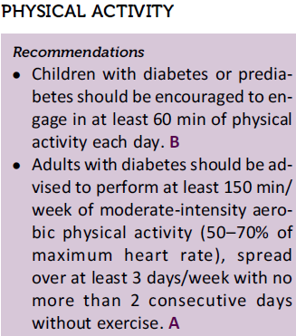
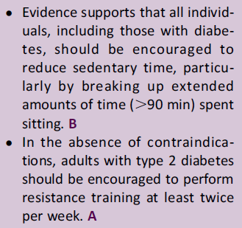

Slide 9
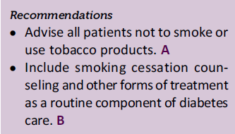
SMOKING CESSATION
There is no evidence that e-cigarettes are a healthier alternative to smoking or that e-cigarettes can facilitate smoking cessation. Rigorous study of their shortand long-term effects is needed in determining their safety and efficacy and their cardiopulmonary effects in comparison with .smoking and standard approaches to smoking cessation

Slide 10
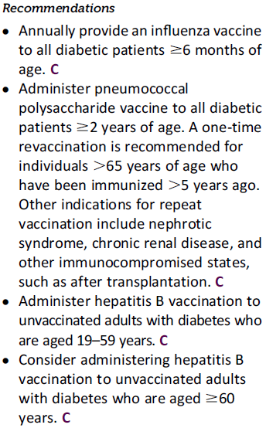
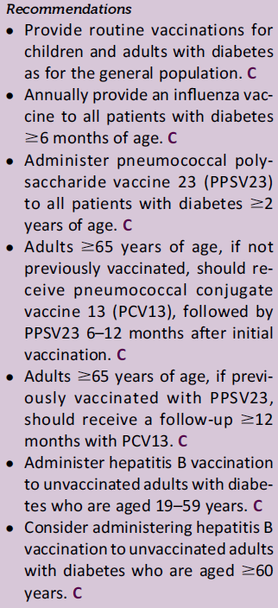
IMMUNIZATION
2014
2015

Slide 11
Pneumococcal Vaccines in Older Adults
** Both PCV13 and PPSV23 should be administered routinely in series . to all adults 65 years of age or older
Previous Vaccination With PPSV23
Adults 65 years of age or older who previously have received one or more doses of PPSV23 should also receive PCV13 if they have not yet received it. PCV13 should be given no sooner than 12 months after receipt of the most recent PPSV23 dose. For those for whom an additional dose of PPSV23 is indicated, this subsequent PPSV23 dose should be given 6–12 months after PCV13 and at least 5 years since the most recent dose of PPSV23.
Pneumococcal Vaccine-Naïve People
Adults 65 years of age or older who have not previously received pneumococcal vaccine or whose previous vaccination history is unknown should receive a dose of PCV13 first, followed by PPSV23.
A dose of PPSV23 should be given 6–12months following a dose of PCV13. If PPSV23 cannot be given within this time period, a dose of PPSV23 should be given during the next visit. The two vaccines should not be coadministered, and the minimum interval between vaccine dosing should be 8 weeks

Slide 12
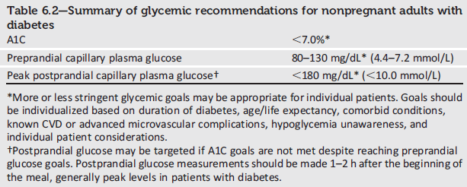
6. Glycemic Targets
The ADA now recommends a premeal blood glucose target of 80–130 mg/dL,
rather than 70–130 mg/dL, to better reflect new data comparing actual average glucose levels with A1Ctargets.

Slide 13
The American Diabetes Association (ADA) and the American Association for Clinical Chemistry have determined that the correlation (r 5 0.92) in the ADAG trial is strong enough to justify reporting both the A1C result and the eAG result when a clinician orders the A1C test.
the international A1C Derived Average Glucose (ADAG) trial ,which based the correlation with A1C on frequent SMBG and CGM in 507 adults(83% non-Hispanic whites) with type 1, type 2, and no diabetes , and an empirical study of the average blood glucose levels at premeal , postmeal, and bedtime associated with specified A1C levels using data from the ADAG trial .

Slide 14
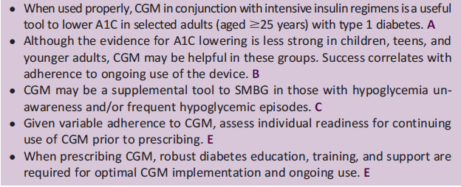
Continuous Glucose Monitoring (CGM)
Recommendations :

Slide 15
7. Approaches to Glycemic Treatment
PHARMACOLOGICAL THERAPY FOR TYPE 2 DIABETES :
Initial Therapy-
-Combination Therapy

Slide 16
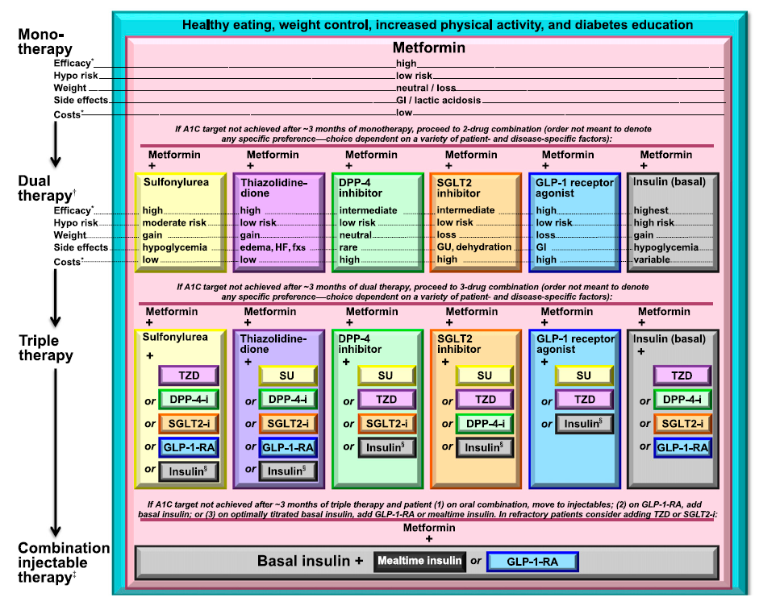
Antihyperglycemic Therapy in Type 2 Diabetes

Slide 17
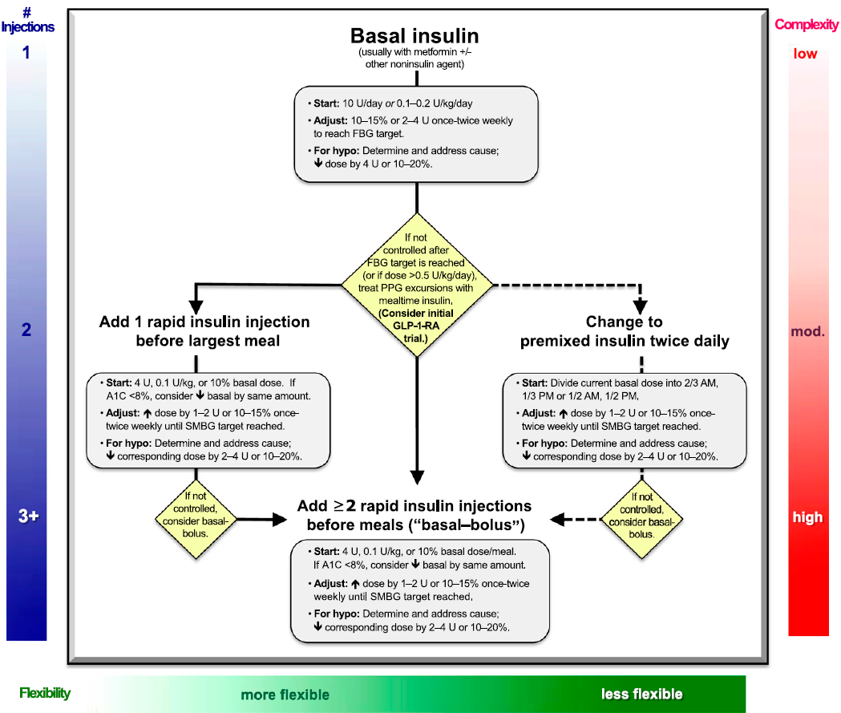
Approach To Starting and Adjusting Insulin in Type 2 Diabetes

Slide 18
8. CARDIOVASCULAR DISEASE AND RISK MANAGEMENT
HYPERTENSION / BLOOD PRESSURE CONTROL
Recommendations
Screening and Diagnosis
* Blood pressure should be measured at every routine visit. Patients found to
have elevated blood pressure should have blood pressure confirmed on a
separate day. B

Slide 19
HYPERTENSION / BLOOD PRESSURE CONTROL
Goals
* People with diabetes and hypertension should be treated to a systolic blood pressure goal of <140 mmHg .A
* Lower systolic targets, such as <130 mmHg, may be appropriate for certain individuals, such as younger patients, if it can be achieved without undue treatment burden .C
* Patients with diabetes should be treated to a diastolic blood pressure <90 mmHg .A
* Lower diastolic targets, such as <80 mmHg, may be appropriate for
certain individuals, such as younger patients, if it can be achieved without undue treatment burden .B

Slide 20
HYPERTENSION / BLOOD PRESSURE CONTROL
Treatment
- Patients with blood pressure >120/80 mmHg should be advised on lifestyle changes to reduce blood pressure .B
- Patients with confirmed blood pressure higher than 140/90 mmHg should, in addition to lifestyle therapy, have prompt initiation and timely subsequent titration of pharmacological therapy to achieve blood pressure goals. A
- Lifestyle therapy for elevated blood pressure:.B
*Weight loss if overweight
*DASH-style dietary pattern including reducing sodium, increasing potassium intake
*Moderation of alcohol intake
*Increased physical activity

Slide 21
HYPERTENSION / BLOOD PRESSURE CONTROL
Treatment
- Pharmacological therapy for patients with diabetes and hypertension comprise a regimen that includes either an ACE inhibitor or an angiotensin II receptor blocker B; if one class is not tolerated, substitute the other. C
- Multiple drug therapy (two or more agents at maximal doses) generally required to achieve blood pressure targets .B
- If ACE inhibitors, ARBs, or diuretics are used, serum creatinine/eGFR and potassium levels should be monitored .E
- In pregnant patients with diabetes and chronic hypertension, blood pressure target goals of 110–129/65–79 mmHg are suggested in interest of long-term maternal health and minimizing impaired fetal growth; ACE inhibitors, ARBs, contraindicated during pregnancy .E

Slide 22
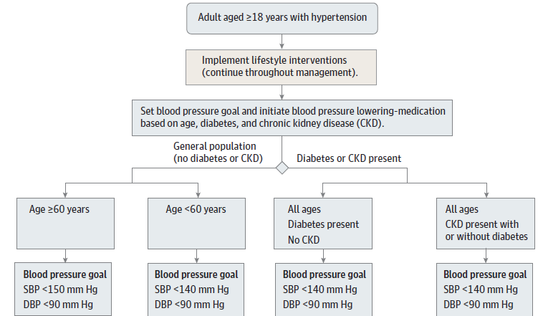
recent publication by the Eighth Joint National Committee recommended,for individuals over 18 years of age with diabetes, a DBP threshold of<90 mmHg and SBP <140 mmHg

Slide 23
DYSLIPIDEMIA/LIPID MANAGEMENT
With consideration for the new statin treatment recommendations, the Standards now provide the following lipid monitoring guidance:
a screening lipid profile is reasonable at diabetes diagnosis , at an initial medical evaluation and/or at age 40 years, and periodically
thereafter(e.g., every 1–2 years).
initiation (and initial statin dose) is now driven primarily by risk status rather Treatment than LDL cholesterol level.

Slide 24
Treatment Recommendations and Goals
*To improve lipid profile in patients with diabetes, recommend lifestyle :modification A, focusing on
-Reduction of saturated fat, trans fat, cholesterol intake
-Increase of n-3 fatty acids, viscous fiber, plant stanols/sterols
-Weight loss (if indicated)
-Increased physical activity
*Intensify lifestyle therapy and optimize glycemic control for patients with: C
-Triglyceride levels >150 mg/dL(1.7 mmol/L) and/or
- HDL cholesterol <40 mg/dL (1.0 mmol/L) in men and <50 mg/dL (1.3 mmol/L) in women
- For patients with fasting triglyceride levels > 500 mg/dL (5.7 mmol/L), evaluate for secondary causes and consider medical therapy to reduce the risk of pancreatitis. C

Slide 25
Treatment Recommendations and Goals
*For patients of all ages with diabetes and overt CVD, high-intensity statin therapy should be added to lifestyle therapy. A
* For patients with diabetes aged <40 years with additional CVD risk factors, consider using moderate or high-intensity statin and lifestyle therapy. C
*For patients with diabetes aged 40–75 years without additional CVD risk factors, consider using moderate-intensity statin and lifestyle therapy. A
*For patients with diabetes aged 40–75 years with additional CVD risk factors,consider using high-intensity statin and lifestyle therapy. B
*For patients with diabetes aged >75 years without additional CVD risk factors, consider using moderate-intensity statin therapy and lifestyle therapy. B

Slide 26
Treatment Recommendations and Goals
* For patients with diabetes aged>75 years with additional CVD risk factors ,consider using moderate- or high-intensity statin therapy and lifestyle therapy. B
* In clinical practice, providers may need to adjust intensity of statin therapy based on individual patient response to medication (e.g., side effects, tolerability, LDL cholesterol levels). E
*Cholesterol laboratory testing may be helpful in monitoring adherence to therapy, but may not be needed once the patient is stable on therapy. E
* Combination therapy (statin/fibrate and statin/niacin) has not been shown to provide additional cardiovascular benefit above statin therapy alone and is not generally recommended. A
* Statin therapy is contraindicated in pregnancy. B

Slide 27
Recommendations for Statin Treatment in People with Diabetes
Age | Risk factors | Recommended statin dose* | Monitoring with lipid panel
<40 years | None | None | Annually or as needed to monitor for adherence
 | CVD risk factor(s)** | Moderate or high
 | Overt CVD*** | High
40–75 years | None | Moderate | As needed to monitor adherence
 | CVD risk factors | High
 | Overt CVD | High
>75 years | None | Moderate | As needed to monitor adherence
 | CVD risk factors | Moderate or high
 | Overt CVD | High

Slide 28
9. Microvascular Complications and Foot Care
FOOT CARE
Recommendations
* For all patients with diabetes, perform an annual comprehensive foot examination to identify risk factors predictive of ulcers and amputations. The foot examination should include inspection and assessment of foot pulses. B
* Patients with insensate feet, foot deformities, and ulcers should have their feet examined at every visit. E
*Provide general foot self-care education to all patients with diabetes.B
* A multidisciplinary approach is recommended for individuals with foot ulcers and high-risk feet(e.g., dialysis patients and those with Charcot foot, prior ulcers, or amputation). B

Slide 29
FOOT CARE
* Refer patients who smoke or who have a loss of protective sensation (LOPS), structural abnormalities,or a history of prior lower extremity complications to foot care specialists for ongoing preventive care and lifelong surveillance.C
* Initial screening for peripheral arterial disease (PAD) should include a history for claudication and an assessment of the pedal pulses. C
* Refer patients with significant claudication or a positive anklebrachial index (ABI) for further vascular assessment and consider exercise, medications, and surgical options. C

Slide 30
11. Children and Adolescents
TYPE 1 DIABETES :
* Special consideration should be given to the unique risks of hypoglycemia in young children (aged ,6 years), as they are often unable to recognize, articulate, and/or manage their hypoglycemic symptoms. This “hypoglycemia unawareness” should be considered when establishing individualized glycemic .targets

Slide 31
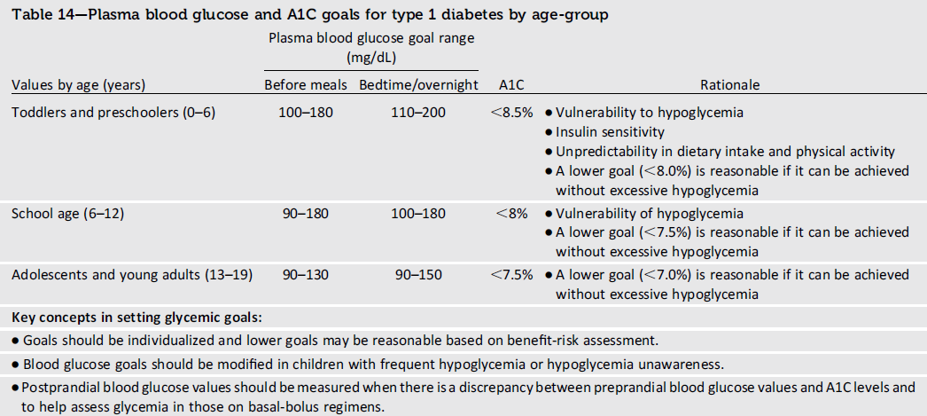
ADA 2014 Recommendation * Consider age when setting glycemic goals in children and adolescents with type 1 diabetes. E

Slide 32
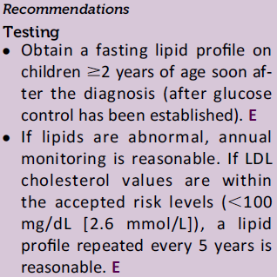
Dyslipidemia
Recommendations
Screening
* If there is a family history of hypercholesterolemia or a cardiovascular event before age 55 years, or if family history is unknown , then consider obtaining a fasting lipid profile in children>2 years of age soon after the diagnosis (after glucose control has been established). If family history is not of concern, then consider the first lipid screening at puberty (>10 years). For children diagnosed with diabetes at or after puberty, consider obtaining a fasting lipid profile soon after the diagnosis (after glucose control has been established). E
* For both age-groups, if lipids are abnormal, annual monitoring is reasonable. If LDL cholesterol values are within the accepted risk levels (<100 mg/dL [2.6 mmol/L]), a lipid profile repeated every 5 years is reasonable. E
2015
2014

Slide 33
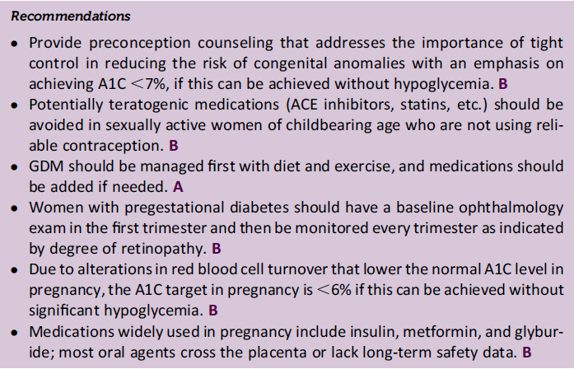
12. Management of Diabetes in Pregnancy

Slide 34
PRECONCEPTION COUNSELING
Targeted preconception counseling visits should include routine rubella, rapid plasma reagin, hepatitis B virus, and HIV testing as well as Pap smear, cervical cultures, blood typing, and prescription of prenatal vitamins (with at least 400mg of folic acid). Diabetes specific management should include A1C, thyroid-stimulating hormone, creatinine, and urine albumin-to-creatinine ratio testing; review of the medication list for potentially teratogenic drugs (i.e., ACE inhibitors, statins); and referral for an ophthalmologic exam.
Given the alteration in red blood cell kinetics during pregnancy, A1C levels may need to be monitored more frequently than usual(e.g., monthly).

Slide 35
MANAGEMENT OF PREGESTATIONAL TYPE 1 DIABETES AND TYPE 2 DIABETES IN PREGNANCY
*Insulin Use in Pregnancy :In the first trimester , there is often a decrease in total daily dose of insulin. In the second trimester , rapidly increasing insulin resistance requires weekly or biweekly increase in insulin dose to achieve glycemic targets.
In general, a small proportion of the total daily dose should be given as basal insulin and a greater proportion as prandial insulin .
All insulins are pregnancy category B except for glargine and glulisine, which are labeled C.
*Concerns Related to Type 1 Diabetes in Pregnancy:
hypoglycemia in the first trimester And prepartum period.
*Concerns Related to Type 2 Diabetes in Pregnancy:
hypertension and other comorbidities often render pregestational type 2 diabetes as high or higher risk than pregestational type 1 diabetes.

Slide 37
Optimum BMI Cut Points to Screen Asian Americans for Type 2 Diabetes Americans for Type 2 Diabetes Maria Rosario G. Araneta¹⇑, Alka M. Kanaya², William C. Hsu
The BMI cut point for identifying Asian Americans who should be screened for undiagnosed type 2 diabetes should be <25 kg/m², and ≥23 kg/m² may be the most practical.

Slide 38
BMI Cut Points to Identify At-Risk
Asian Americans for Type 2
Diabetes Screening
Diabetes Care 2015;38:150–158 :
10.2337/dc14-2391

Slide 39
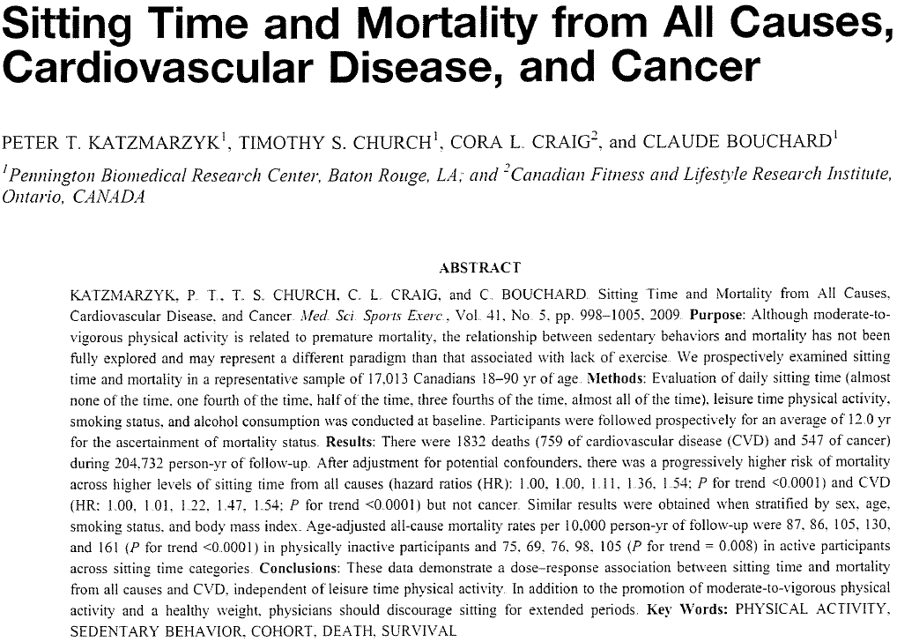

Slide 40
Use of 13-Valent Pneumococcal Conjugate Vaccine and 23-Valent Pneumococcal Polysaccharide Vaccine Among Adults Aged ≥65 Years: Recommendations of the Advisory Committee on Immunization Practices (ACIP)
Weekly
September 19, 2014 / 63(37);822-825

Slide 41
Empirically Establishing Blood Glucose Targets to Achieve HbA_{1c} Goals
Abstract
OBJECTIVE To determine the average fasting, postprandial, and bedtime self-monitored blood glucose (SMBG) concentrations associated with specified HbA_{1c} levels using data from the A1c-Derived Average Glucose (ADAG) study.
RESEARCH DESIGN AND METHODS The ADAG study was a multicenter observational study that used continuous glucose monitoring and SMBG testing to determine the relationship between mean average glucose and HbA_{1c}. We used the SMBG data from 470 of the ADAG study participants (237 with type 1 diabetes and 147 with type 2 diabetes) to determine the average fasting, premeal, 90-min postmeal, and bedtime blood glucose (BG) for predefined target HbA_{1c} groups between 5.5 and 8.5% (37–69 mmol/mol). t Tests were used to compare mean BG values between type 1 and type 2 diabetes groups.
RESULTS The average fasting BG needed to achieve predefined HbA_{1c} target levels of 5.5–6.49% (37–47 mmol/mol), 6.5–6.99% (48–52 mmol/mol), 7.0–7.49% (52–58 mmol/mol), 7.5–7.99% (58–64 mmol/mol), and 8.0–8.5% (64–69 mmol/mol) were 122 mg/dL with 95% CI 117–127, 142 mg/dL (135–150), 152 mg/dL (143–162), 167 mg/dL (157–177), and 178 mg/dL (164–192), respectively. Postmeal BG to achieve the HbA_{1c} level of 6.5–6.99% (48–52 mmol/mol) and 7.0–7.49% (52–58 mmol/mol) were 164 mg/dL (159–169) and 176 mg/dL (170–183), respectively. Bedtime BG was 153 mg/dL (145–161) and 177 mg/dL (166–188), respectively.
CONCLUSIONS We have determined the average BG at premeal, postmeal, and bedtime to achieve a variety of HbA_{1c} targets. These results, based on empirical data, will help patients and providers set realistic day-to-day SMBG targets to achieve individualized HbA_{1c} goals.
Diabetes Care 2014

Slide 42
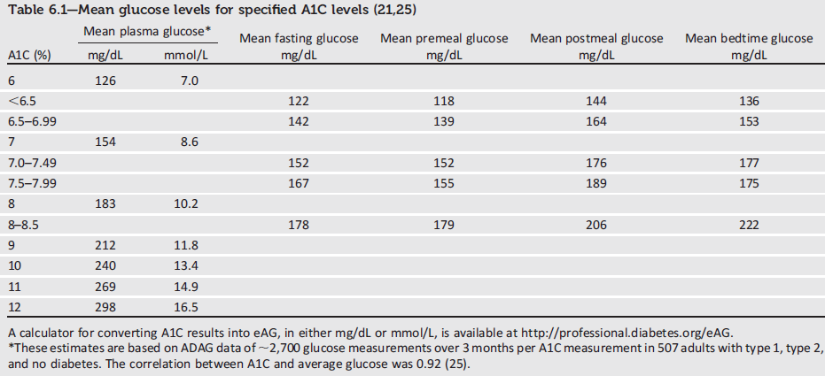
should note that the mean plasma glucose numbers in the table are based on 2,800 readings per A1C in the ADAG trial.

Slide 43
A recent registry study of 17,317 participants confirmed that more frequent CGM use is associated with lower A1C
Real-Time Continuous Glucose Monitoring Among Participants in the T1D Exchange Clinic Registry
Abstract
OBJECTIVE To assess the frequency of continuous glucose monitoring (CGM) device use, factors associated with its use, and the relationship of CGM with diabetes outcomes (HbA_{1c}, severe hypoglycemia [SH], and diabetic ketoacidosis [DKA]).
RESEARCH DESIGN AND METHODS Survey questions related to CGM device use 1 year after enrollment in the T1D Exchange clinic registry were completed by 17,317 participants. Participants were defined as CGM users if they indicated using real-time CGM during the prior 30 days.
RESULTS Nine percent of participants used CGM (6% of children <13 years old, 4% of adolescents 13 to <18 years, 6% of young adults 18 to <26 years, and 21% of adults ≥26 years). CGM use was more likely with higher education, higher household income, private health insurance, longer duration of diabetes, and use of insulin pump (P < 0.01 all factors). CGM use was associated with lower HbA_{1c} in children (8.3% vs. 8.6%, P < 0.001) and adults (7.7% vs. 7.9%, P < 0.001). In adults, more frequent use of CGM (≥6 days/week) was associated with lower mean HbA_{1c}. Only 27% of users downloaded data from their device at least once per month, and ≤15% of users reported downloading their device at least weekly. Among participants who used CGM at baseline, 41% had discontinued within 1 year.
CONCLUSIONS CGM use is uncommon but associated with lower HbA_{1c} in some age-groups, especially when used more frequently. Factors associated with discontinuation and infrequent use of retrospective analysis of CGM data should be considered in developing next-generation devices and education on CGM use.

Slide 44
while another study showed that children with >70% sensor use missed fewer school day
Impact of continuous glucose monitoring on quality of life,treatment satisfaction, and use of medical care resources: analyses from the SWITCH study
Abstract
To investigate the impact of continuous glucose monitoring (CGM) on health-related quality of life(HRQOL), treatment satisfaction (TS) medical resource use, and indirect costs in the SWITCH study. (n=153) using continuous subcutaneous insulin infusion (CSII) were randomized to a 12 month sensor-On/Off or sensor-Off/On sequence (6 months each treatment), with a 4-month washout between periods. HRQOL in children and TS in adults were measured using validated questionnaires. Medical resource utilization data were collected. In adults, TS was significantly higher in the sensor-On arm, and there were significant improvements in ratings for treatment convenience and flexibility. There were no clinically significant differences in children’s HRQOL or parents’ proxy ratings. The incidence of severe hypoglycaemia, unscheduled visits, or diabetes-related hospitalizations did not differ significantly between the two arms. Adult patients made fewer telephone consultations during the sensor-On arm; children’s caregivers madesimilar numbers of telephone consultations during both arms, and calls were on average only 3 min longer during the sensor-On arm. Regarding indirect costs, children with[70 % sensor usage missed fewer school days, compared with the sensor-Off arm (p=0.0046) but there was no significant difference in the adults days of work off. The addition of CGM to CSII resulted in better metabolic control without imposing an additional burden on the patient or increased medical resource use, and offered the potential for cost offsets.

Slide 45
Frequency of Continuous Glucose Monitoring Use and Change in Hemoglobin A1C for Adults with Type 1 Diabetes in a Clinical Practice Setting.
McQueen RB¹, Ellis SL², Maahs DM³, Anderson HD¹, Nair KV¹, Campbell JD¹.
OBJECTIVE:
To estimate the frequency of continuous glucose monitoring (CGM) use and change in hemoglobin A1c (HbA1c) compared to self-monitoring of blood glucose (SMBG) alone in adults with type 1 diabetes in a clinical practice setting.
METHODS:
We retrospectively identified 66 adult type 1 diabetes patients at the Barbara Davis Center for Diabetes (BDC) who first initiated CGM between 2006 and 2011 and 67 controls using SMBG. The frequency of CGM use was estimated from survey recall and defined as the mean number of days/month of CGM use during a maximum follow-up of 10 months. Change in HbA1c was calculated as the difference between the baseline value and the lowest follow-up value.
RESULTS:
The mean change in HbA1c for CGM users was -0.48% (95% confidence interval [CI]: -0.67, -0.28) and for SMBG users was -0.37% (95% CI: -0.56, -0.18). The between-group mean difference in change in HbA1c, adjusted for patient characteristics, was -0.11% (95% CI: -0.38, 0.16), whereas the subgroup with a baseline HbA1c ≥7.0% and users of CGM ≥21 days/month was -0.36% (95% CI: -0.78, 0.05). Nearly half (n = 32, 48%) used CGM <21 days/month. The reasons for low frequency of CGM use or discontinuation included sensor costs, frequency of alarms, inaccuracy, and discomfort.
CONCLUSIONS:
These CGM data from clinical practice suggest a trend toward decreasing HbA1c for
adults with type 1 diabetes, especially in patients with higher baseline HbA1c and
higher frequency of CGM use. Future studies are needed to assess the use of CGM in larger populations of clinical practice adult type 1 diabetes patients.

Slide 46
Initial therapy
In circumstances where metformin is contraindicated or not tolerated, one of the second-line agents may be used, although the choices become more limited if renal insufficiency is the reason metformin is being avoided.
In these circumstances it is unwise to use sulfonylureas, particularly glyburide (known as glibenclamide in Europe), because of the risk of hypoglycemia. DPP-4 inhibitors are probably a preferable choice, although, with the exception of linagliptin, dosage adjustments are required.
A Patient-Centered Approach: Update to a Position Statement of the American Diabetes Association and the European Association for the Study of Diabetes
Silvio E. Inzucch

Slide 47
Diabetes Obes Metab. 2014 Jun;16(6):560-8. doi: 10.1111/dom.12281. Epub 2014 Mar 24. Groop PH¹, Del Prato S, Taskinen MR, Owens DR, Gong Y, Crowe S, Patel S, von Eynatten M, Woerle HJ. Author information Abstract AIMS: Renal disease is a frequent comorbidity of type 2 diabetes mellitus (T2DM) and an important factor complicating the choice of glucose-lowering drugs. The aim of this analysis was to evaluate the efficacy and safety of the dipeptidyl peptidase (DPP)-4 inhibitor linagliptin (5 mg/day) in mono, dual or triple oral glucose-lowering regimens in subjects with T2DM and mild or moderate renal impairment (RI). METHODS: In this pooled analysis of three 24-week, placebo-controlled, phase 3 trials, subjects with mild (estimated glomerular filtration rate (eGFR) 60-<90 ml/min/1.73 m(2) , n = 838) or moderate RI (30-<60 ml/min/1.73 m(2), n = 93) were compared with subjects with normal renal function (≥90 ml/min/1.73 m(2), n = 1212). RESULTS: Subjects with RI were older, had longer duration of diabetes, and increased prevalence of diabetes-related comorbidities. After 24 weeks, linagliptin achieved consistent placebo-corrected mean glycated haemoglobin (HbA1c) changes across the three renal function categories: normal (-0.63%; p < 0.0001), mild RI (-0.67%; p < 0.0001) and moderate RI (-0.53%; p < 0.01), with no inter-group difference (p = 0.74). Renal function with linagliptin remained stable across all categories. In linagliptin-treated subjects, overall adverse event (AE) rates and serious AE rates were similar to placebo. The incidence of hypoglycaemia with linagliptin and placebo was 11.1 versus 6.9%, 11.9 versus 9.0% and 15.9 versus 12.0% in the normal, mild RI and moderate RI categories, respectively. CONCLUSIONS: This pooled analysis provides evidence that linagliptin is an effective, well-tolerated and convenient treatment in subjects with T2DM and mild or moderate RI.
Management of Hyperglycemia in Type 2 Diabetes, 2015: A Patient Centered Approach Update to a Position Statement of the American Diabetes Association and the European Association for the Study of Diabetes
Diabetes Care 2015;38:140–149 | DOI: 10.2337/dc14-2441
Linagliptin treatment in subjects with type 2 diabetes with and without mild-to-moderate renal impairment.

Slide 48
Advancing to Dual Combination and Triple Combination Therapy
If the A1C target is not achieved after approximately 3 months, consider a
.combination of metformin and one of these six treatment options
* Rapid-acting secretagogues ( meglitinides) may be used instead of sulfonylureas in patients with irregular meal schedules or who develop late postprandial hypoglycemia on a sulfonylurea . * Other drugs not shown in the figure (e.g., a-glucosidase inhibitors, colesevelam,
Bromocriptine , pramlintide ) may be tried in specific situations, but are generally not favored due to modest efficacy, the frequency of administration , and/or side effects.

Slide 49
Diabetes Obes Metab. 2014 May;16(5):457-66. doi: 10.1111/dom.12244. Epub 2013 Dec 29.
Efficacy and safety of sodium glucose co-transport-2 inhibitors in type 2 diabetes: a meta-analysis of randomized clinical trials.
Monami M¹, Nardini C, Mannucci E.
Abstract
AIMS:
Sodium glucose co-transport-2 (SGLT-2) inhibitors, a new class of glucose-lowering agents, reduce tubular glucose reabsorption, producing a reduction of blood glucose without stimulating insulin release. The aim of the present meta-analysis is the assessment of the overall efficacy and safety profile of these drugs.
METHODS:
A meta-analysis was performed including all trials with a duration of at least 12 weeks, comparing a SGLT-2 inhibitor with a non-SGLT-2 inhibitor agent in type 2 diabetes. The principal outcome of this analysis was the effect of SGLT-2 inhibitors on HbA1c at 12, 24 and 52 weeks. Hypoglycaemia, genital and urinary infections were retrieved and combined to calculate Mantel-Haenszel odds ratio (MH-OR). Furthermore, data on body mass index (BMI), endpoint fasting plasma glucose, systolic and diastolic blood pressure, creatinine, hematocrit and lipid profile were collected.
RESULTS:
Among placebo-controlled trials, HbA1c reduction at 12, 24 and 52 weeks was 0.5 [0.4; 0.6], 0.6 [0.6; 0.5] and 0.6 [0.7; 0.5]%. In placebo-controlled studies, 24-week reduction of HbA1c with SGLT-2 inhibitors was greater in trials enrolling patients with a lower mean age and duration of diabetes, and a higher baseline BMI, HbA1c and fasting glucose. In placebo-controlled trials, SGLT-2 inhibitors determined a weight loss during the first 24 weeks, which was maintained up to 52 weeks.
CONCLUSIONS:
SGLT-2 inhibitors are effective in the treatment of type 2 diabetes, providing additional benefits, such as weight loss, reduction of blood pressure and increase in high-density lipoprotein (HDL)-cholesterol. Apart from genital and urinary infections, rather frequent but usually mild, SGLT-2 inhibitors appear to be well tolerated.

Slide 50
Diabetes Obes Metab. 2014 May;16(5):433-42. doi: 10.1111/dom.12239. Epub 2013 Dec 16.
Dapagliflozin compared with other oral anti-diabetes treatments when added to metformin monotherapy: a systematic review and network meta-analysis.
Goring S¹, Hawkins N, Wygant G, Roudaut M, Townsend R, Wood I, Barnett AH.
Abstract
AIMS:
Indirect evidence from randomized controlled trials (RCTs) was used to estimate the effect of dapagliflozin, a new agent with a novel mechanism of action (SGLT-2 inhibition), relative to other anti-diabetes therapies after 1 year of treatment.
METHODS:
A systematic literature review and Bayesian network meta-analysis (NMA) of RCTs involving anti-diabetes treatments added to metformin were conducted. RCTs enrolling subjects with type 2 diabetes inadequately controlled on metformin monotherapy were included. Comparators included dipeptidyl peptidase-4 (DPP-4) inhibitors, thiazolidinediones (TZDs), sulphonylureas, glucagon-like peptide-1 (GLP-1) analogues and dapagliflozin. Outcomes of interest were mean change from baseline HbA1c, weight and systolic blood pressure, and incidence of hypoglycaemia.
RESULTS:
From 4270 abstracts, six RCTs were included in the primary analysis; no RCTs involving GLP-1 analogues met primary inclusion criteria. All RCTs were actively controlled with sulphonylureas. The mean change in HbA1c from baseline was similar across comparators. The treatment effect (95% credible interval) of dapagliflozin on HbA1c was -0.08% (-0.25, 0.10) relative to DPP-4 inhibitors, -0.02% (-0.24, 0.21) relative to TZDs and 0.00% (-0.16, 0.16) relative to sulphonylureas. Non-sulphonylureas showed significantly lower risk of hypoglycaemia relative to sulphonylureas. Dapagliflozin had a significant effect on weight change: the relative difference was -2.74 kg (-5.35, -0.10) compared with DPP-4 inhibitors, and -4.67 kg (-7.03, -2.35) compared with sulphonylureas. Systolic blood pressure was not meta-analysed due to infrequent reporting.
CONCLUSION:
Compared with DPP-4 inhibitors, TZDs and sulphonylureas, dapagliflozin offers similar HbA1c control after 1 year, with similar or reduced risk of hypoglycaemia and the additional benefit of weight loss, when added to metformin

Slide 51
Diabetes Obes Metab. 2011 Dec;13(12):1088-96. doi: 10.1111/j.1463-1326.2011.01463.x.
Alogliptin as a third oral antidiabetic drug in patients with type 2 diabetes and inadequate glycaemic control on metformin and pioglitazone: a 52-week, randomized, double-blind, active-controlled, parallel-group study.
Bosi E¹, Ellis GC, Wilson CA, Fleck PR.
Abstract
AIM:
To assess the efficacy and safety of adding alogliptin versus uptitrating pioglitazone in patients with type 2 diabetes and inadequate glycaemic control on metformin and pioglitazone.
METHODS:
In this randomized, double-blind, active-controlled, parallel-group study, patients with type 2 diabetes and A1c ≥7.0 and ≤10.0% on metformin (≥1500 mg or maximum tolerated dose; Met) and pioglitazone 30 mg (Pio30) received alogliptin 25 mg (Alo25; n = 404) or pioglitazone 15 mg (n = 399) added to Met+Pio30 for 52 weeks. The primary endpoint was change from baseline (CFB) in A1c at weeks 26 and 52, with sequential testing for non-inferiority of Met+Pio30+Alo25 at weeks 26 and 52 and then for superiority at week 52.
RESULTS:
Met+Pio30+Alo25 showed superior glycaemic control versus Met+Pio45 at week 52 [least squares (LS) mean CFB in A1c, -0.70 vs. -0.29%; p < 0.001]. At week 52, Met+Pio30+Alo25 resulted in greater CFB in A1c regardless of baseline A1c (p < 0.001); higher proportions of patients achieving A1c ≤7.0 (33.2 vs. 21.3%) and ≤6.5% (8.7 vs. 4.3%; p < 0.001); greater CFB in fasting plasma glucose (FPG; LS mean CFB, -0.8 vs. -0.2 mmol/L; p < 0.001); and greater improvements in measures of β-cell function (p < 0.001). Hypoglycaemia incidence was low (Met+Pio30+Alo25, 4.5%; Met+Pio45, 1.5%), mostly mild to moderate, but with two severe events in the Met+Pio30+Alo25 group. No meaningful differences in incidences of individual adverse events were observed between treatments.
CONCLUSIONS:
Adding alogliptin to an existing metformin-pioglitazone regimen provided superior glycaemic control and potentially improved β-cell function versus uptitrating pioglitazone in patients with type 2 diabetes, with no clinically important differences in safety.

Slide 52
- Consider initiating combination insulin injectable therapy when blood glucose is >300–350 mg/dL (16.7–19.4 mmol/L) and/or A1C is >10–12%.
-For all patients, consider initiating therapy with a dual combination when A1C is > 9% to more expeditiously achieve the target A1C . .level

Slide 53
Early combination therapy for the treatment of type 2 diabetes mellitus: systematic review and meta-analysis.
Diabetes Obes Metab. 2014 May;16(5):410-7. doi: 10.1111/dom.12233. Epub 2013 Dec 16.
Phung OJ¹, Sobieraj DM, Engel SS, Rajpathak SN.
Abstract
AIMS:
Guidelines for type 2 diabetes recommend add-on agents when metformin alone fails to provide adequate glycaemic control. However, early combination therapy may benefit health outcomes. We conducted a systematic review and meta-analysis to investigate this question.
METHODS:
We searched MEDLINE and Cochrane CENTRAL (up to July 2012) without language restrictions. We sought randomized controlled trials (RCTs) evaluating initial combination therapy with metformin versus metformin monotherapy in patients with untreated type 2 diabetes. Weighted mean differences (WMDs) for changes from baseline and relative risks (RRs) [with 95% confidence intervals (CIs)] were calculated using random-effects model.
RESULTS:
In 15 RCTs (N = 6693), the mean age range was 48.4-62.7 years; mean baseline glycosylated haemoglobin (A1c) was 7.2-9.9% and mean diabetes duration was 1.6-4.1 years, with median follow-up of 6 months and with 13 comparisons for A1c change, 14 comparisons for A1c goal attainment of <7% and 13 comparisons for change in fasting plasma glucose (FPG). Drugs combined with metformin included thiazolidinediones (TZDs), insulin secretagogues, dipeptidyl peptidase-4 (DPP-4) inhibitors or sodium glucose transporterase (SGLT-2) inhibitors. Compared to metformin alone, combination therapy with metformin provided statistically significant reductions in A1c (WMD -0.43%, 95% CI -0.56, -0.30), increases in attainment of A1c goal of less than 7% (RR 1.40, 95% CI 1.33-1.48) and reductions in FPG (WMD -14.30 mg/dl, 95% CI -16.09, -12.51).
CONCLUSIONS:
These results suggest a potential benefit of initial combination therapy on glycaemic outcomes in diabetes compared to metformin monotherapy across a wide range of baseline A1c levels. Further research should explore if early combination treatment may also affect longer term health outcomes in diabetes.

Slide 54
Combination Injectable Therapy
Over the past 3 years, however, the effectiveness of combining GLP-1 receptor agonists (both shorter-acting and newer weekly formulations) with basal insulin has been demonstrated, with most studies showing equal or slightly superior efficacy to the addition of prandial insulin, and .with weight loss and less hypoglycemia
* Management of Hyperglycemia in Type 2 Diabetes, 2015: A Patient Centered Approach Update to a Position Statement of the American Diabetes Association and the European Association for the Study of Diabetes
Diabetes Care 2015;38:140–149 | DOI: 10.2337/dc14-2441
As an alternative, the statement mentioned that, in selected patients, simpler (but somewhat less flexible) premixed formulations of intermediate- and short/rapid acting insulins in fixed ratios could also . be considered
. **Glucagon-like peptide-1 receptor agonist and basal insulin combination treatment for the management of type 2 diabetes: a systematic review and meta-analysis.
Lancet. 11 September 2014 ,

Slide 55
Lixisenatide plus basal insulin in patients with type 2 diabetes mellitus: a meta-analysis Aims The efficacy of the once-daily prandial GLP-1 receptor agonist lixisenatide plus basal insulin in T2DM was assessed by pooling results of phase III trials. Methods A meta-analysis was performed of results from three trials in the GetGoal clinical program concerning lixisenatide or placebo plus basal insulin with/without OADs. The primary endpoint was change in HbA_{1c} from baseline to week 24. Secondary endpoints were change in PPG, FPG, insulin dose, and weight from baseline to week 24. Hypoglycemia rates and several composite endpoints were assessed. Results Lixisenatide plus basal insulin was significantly more effective than basal insulin alone at reducing HbA_{1c} at 24 weeks. Composite and secondary endpoints were improved significantly with lixisenatide plus basal insulin, with the exception of FPG, which showed no significant difference between the groups. Lixisenatide plus basal insulin was associated with an increased incidence of hypoglycemia versus basal insulin alone. Conclusions Lixisenatide plus basal insulin resulted in significant improvement in glycemic control versus basal insulin alone, particularly in terms of controlling PPG. Prandial lixisenatide in combination with basal insulin is a suitable option for treatment intensification in patients with T2DM insufficiently controlled with basal insulin, as these agents have complementary effects on PPG and FPG, respectively

Slide 56
Cochrane Database Syst Rev. 2013 Oct 30;10:CD008277. doi: 10.1002/14651858.CD008277.pub2.
Blood pressure targets for hypertension in people with diabetes mellitus.
BACKGROUND:
Several clinical guidelines published in recent years have recommended lower targets (less than 130/80 mmHg) for people with diabetes mellitus. It is not known whether attempting to achieve targets lower than the standard target reduces mortality and morbidity in those with elevated blood pressure and diabetes.
OBJECTIVES:
To determine if 'lower' BP targets (any target less than 130/85 mmHg) are associated with reduction in mortality and morbidity compared with 'standard' BP targets (less than 140 - 160/90 - 100 mmHg) in people with diabetes.
SEARCH METHODS:
We searched the Database of Abstracts of Reviews of Effectiveness (DARE) and the Cochrane Database of Systematic Reviews for related reviews. We conducted electronic searches of the Hypertension Group Specialised Register (January 1946 - October 2013), the Cochrane Central Register of Controlled Trials (CENTRAL) (2013, Issue 9), MEDLINE (January 1946 - October 2013), EMBASE (January 1974 - October 2013) and ClinicalTrials.gov. The most recent search was performed on October 4, 2013.Other search sources were the International Clinical Trials Registry Platform (WHO ICTRP), and reference lists of all papers and relevant reviews.
SELECTION CRITERIA:
Randomized controlled trials comparing people with diabetes randomized to lower or to standard BP targets as previously defined, and providing data on any of the primary outcomes below.
DATA COLLECTION AND ANALYSIS:
Two review authors independently assessed and established the included trials and data entry. Primary outcomes were total mortality; total serious adverse events; myocardial infarction, stroke, congestive heart failure and end-stage renal disease. Secondary outcomes were achieved mean systolic and diastolic BP, and withdrawals due to adverse effects.
MAIN RESULTS:
We found five randomized trials, recruiting a total of 7314 participants and with a mean follow-up of 4.5 years. Only one trial (ACCORD) compared outcomes associated with 'lower' (< 120 mmHg) or 'standard' (< 140 mmHg) systolic blood pressure targets in 4734 participants. Despite achieving a significantly lower BP (119.3/64.4 mmHg vs 133.5/70.5 mmHg, P < 0.0001), and using more antihypertensive medications, the only significant benefit in the group assigned to 'lower' systolic blood pressure (SBP) was a reduction in the incidence of stroke: risk ratio (RR) 0.58, 95% confidence interval (CI) 0.39 to 0.88, P = 0.009, absolute risk reduction 1.1%. The effect of SBP targets on mortality was compatible with both a reduction and increase in risk: RR 1.05 CI 0.84 to 1.30, low quality evidence. Trying to achieve the 'lower' SBP target was associated with a significant increase in the number of other serious adverse events: RR 2.58, 95% CI 1.70 to 3.91, P < 0.00001, absolute risk increase 2.0%.Four trials (ABCD-H, ABCD-N, ABCD-2V, and a subgroup of HOT) specifically compared clinical outcomes associated with 'lower' versus 'standard' targets for diastolic blood pressure (DBP) in people with diabetes. The total number of participants included in the DBP target analysis was 2580. Participants assigned to 'lower' DBP had a significantly lower achieved BP: 128/76 mmHg vs 135/83 mmHg, P < 0.0001. There was a trend towards reduction in total mortality in the group assigned to the 'lower' DBP target (RR 0.73, 95% CI 0.53 to 1.01), mainly due to a trend to lower non-cardiovascular mortality. There was no difference in stroke (RR 0.67, 95% CI 0.42 to 1.05), in myocardial infarction (RR 0.95, 95% CI 0.64 to 1.40) or in congestive heart failure (RR 1.06, 95% CI 0.58 to 1.92), low quality evidence. End-stage renal failure and total serious adverse events were not reported in any of the trials. A sensitivity analysis of trials comparing DBP targets < 80 mmHg (as suggested in clinical guidelines) versus < 90 mmHg showed similar results. There was a high risk of selection bias for every outcome analyzed in favor of the 'lower' target in the trials included for the analysis of DBP targets

Slide 57
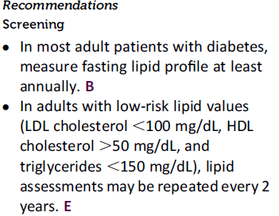

Slide 58
Cochrane Database Syst Rev. 2013 Jan 31;1:CD004816. doi: 10.1002/14651858.CD004816.pub5.
Statins for the primary prevention of cardiovascular disease.
BACKGROUND:
Reducing high blood cholesterol, a risk factor for cardiovascular disease (CVD) events in people with and without a past history of CVD is an important goal of pharmacotherapy. Statins are the first-choice agents. Previous reviews of the effects of statins have highlighted their benefits in people with CVD. The case for primary prevention was uncertain when the last version of this review was published (2011) and in light of new data an update of this review is required.
OBJECTIVES:
To assess the effects, both harms and benefits, of statins in people with no history of CVD.
SEARCH METHODS:
To avoid duplication of effort, we checked reference lists of previous systematic reviews. The searches conducted in 2007 were updated in January 2012. We searched the Cochrane Central Register of Controlled Trials (CENTRAL) in The Cochrane Library (2022, Issue 4), MEDLINE OVID (1950 to December Week 4 2011) and EMBASE OVID (1980 to 2012 Week 1).There were no language restrictions.
SELECTION CRITERIA:
We included randomised controlled trials of statins versus placebo or usual care control with minimum treatment duration of one year and follow-up of six months, in adults with no restrictions on total, low density lipoprotein (LDL) or high density lipoprotein (HDL) cholesterol levels, and where 10% or less had a history of CVD.
DATA COLLECTION AND ANALYSIS:
Two review authors independently selected studies for inclusion and extracted data. Outcomes included all-cause mortality, fatal and non-fatal CHD, CVD and stroke events, combined endpoints (fatal and non-fatal CHD, CVD and stroke events), revascularisation, change in total and LDL cholesterol concentrations, adverse events, quality of life and costs. Odds ratios (OR) and risk ratios (RR) were calculated for dichotomous data, and for continuous data, pooled mean differences (MD) (with 95% confidence intervals (CI)) were calculated. We contacted trial authors to obtain missing data.
MAIN RESULTS:
The latest search found four new trials and updated follow-up data on three trials included in the original review. Eighteen randomised control trials (19 trial arms; 56,934 participants) were included. Fourteen trials recruited patients with specific conditions (raised lipids, diabetes, hypertension, microalbuminuria). All-cause mortality was reduced by statins (OR 0.86, 95% CI 0.79 to 0.94); as was combined fatal and non-fatal CVD RR 0.75 (95% CI 0.70 to 0.81), combined fatal and non-fatal CHD events RR 0.73 (95% CI 0.67 to 0.80) and combined fatal and non-fatal stroke (RR 0.78, 95% CI 0.68 to 0.89). Reduction of revascularisation rates (RR 0.62, 95% CI 0.54 to 0.72) was also seen. Total cholesterol and LDL cholesterol were reduced in all trials but there was evidence of heterogeneity of effects. There was no evidence of any serious harm caused by statin prescription. Evidence available to date showed that primary prevention with statins is likely to be cost-effective and may improve patient quality of life. Recent findings from the Cholesterol Treatment Trialists study using individual patient data meta-analysis indicate that these benefits are similar in people at lower (< 1% per year) risk of a major cardiovascular event.
.

