Slide 1


Slide 2
Insulin Therapy in Type 2 Diabetes
Farzad Hadaegh ,M.D
Prevention of metabolic disorders research center,Obesity Research Center
Research Institute for Endocrine sciences
Shahid Beheshti University
of Medical Sciences
August , 2013
Tehran

Slide 3
Outline
Introduction
Insulin basal(Human Vs. analouges basal)
Premixed (Human Vs. analouges )
Premix vs. basal insulin
Premix Vs. Basal bolus
Guidelines
Conclusion
Practical points

Slide 4
Progressive beta cell damage
Type 2 diabetes is a progressive disease
At the time of diagnosis, patients with type 2 diabetes have an estimated loss of about 50% of their insulin-producing cells

Slide 5
Up to 50% loss of β-cell function occurs before diagnosis
100
Diagnosis of type 2 diabetes
80
60
β-cell function (%)
40
20
0
-10
-9
-8
-7
-6
-5
-4
-3
-2
-1
1
2
3
4
5
6
Time from diagnosis (years)
Holman RR. Diabetes Res Clin Prac 1998; 40 (Suppl.):S21–S25.
Notes:
5
Extrapolation of the observed rate of decline of β-cell function in diet-treated subjects in the UKPDS suggests that loss of β-cell function can begin at least 10 years before diagnosis.
In the UKPDS, long-term increases in fasting plasma glucose were accompanied by progressive β-cell dysfunction as assessed by HOMA.¹
Mean β-cell function was already less than 50% at diagnosis,² and none of the therapies used in the study (sulfonylureas, metformin and insulin) were able to prevent or delay the progressive deterioration of β-cell function.¹
On average, β-cell function declines by 1% per year with normal aging, compared with 4% per year in diabetes.^{1,3}
¹UKPDS Group. UKPDS 16. Diabetes 1995; 44:1249–1258.
²Holman RR. Diabetes Res Clin Prac 1998; 40 (Suppl.):S21–S25.
³Chiu KC, et al. Clin Endocrinol 2000; 53:569–575.

Slide 6
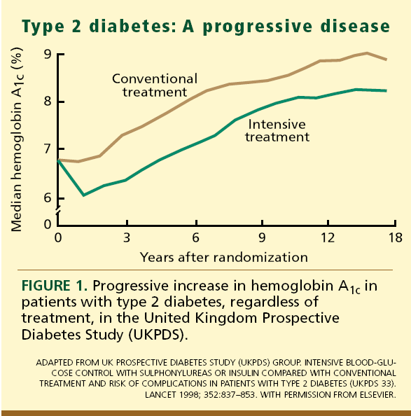

Slide 7
Need for Insulin
Insulin therapy is thus frequently required during the course of the disease to maintain glycemic control and prevent diabetes complications.
In the UK Prospective Diabetes Study, 9 years after diagnosis almost 80%of patients on oral agents required insulin supplementation

Slide 8
Goal achievement?
Attainment of glycemic targets using insulin remains difficult
In a recent review of 48 randomized clinical trials using insulin in T2DM patients with a mean baseline HbA1c of 8.7%, only 40–54% achieved an HbA1c of less than7%
Diabetes Res Clin Pract2011, 92:1–10

Slide 9
History
A 58- year- old women comes to see you for diabetes review. She has had type 2 diabetes for 8 years. She attended the local T2DM education programme at diagnosis.
Despite lifestyle modification, her BMI is 28
She is taking MFN 2g /daily , Gliclazide 320 mg/daily (good compliance) , atorvastatin 20 mg and ASA 80 mg
FBS 155 mg/dl ,HbA1c 8.5% , SMBG ?
No microalbuminuria , beginning of retinopathy, no cardiovascular complication
BP= 125/75 mmHg

Slide 10
History
A 58- year- old women comes to see you for diabetes review. She has had type 2 diabetes for 8 years. She attended the local T2DM education programme at diagnosis.
Despite lifestyle modification, her BMI is 28
She is taking MFN 2g /daily , Gliclazide 320 mg/daily (good compliance) , atorvastatin 20 mg and ASA 80 mg
FBS 155 mg/dl ,HbA1c 8.2% ,
No microalbuminuria , beginning of retinopathy, no cardiovascular complication
BP= 125/75 mmHg

Slide 11
ADA 2014
Lowering A1C to below or around 7% has been shown to reduce microvascular complications of diabetes, and if implemented soon after the diagnosis of diabetes is associated with long-term reduction in macrovascular disease.
Therefore, a reasonable A1C goal for many non pregnant adults is ,7%. (B)

Slide 12
ADA 2014
Providers might reasonably suggest more stringent A1C goals (such as,6.5%) for selected individual patients, if this can be achieved without significant hypoglycemia or other adverse effects of treatment.
Appropriate patients might include those with short duration of diabetes, long life expectancy, and no significant CVD. (C)

Slide 13
ADA 2014
Less stringent A1C goals (such as ,8%) may be appropriate for patients with a history of severe hypoglycemia, limited life expectancy, advanced microvascular or macrovascular complications, and extensive comorbid conditions and for those with longstanding diabetes

Slide 14
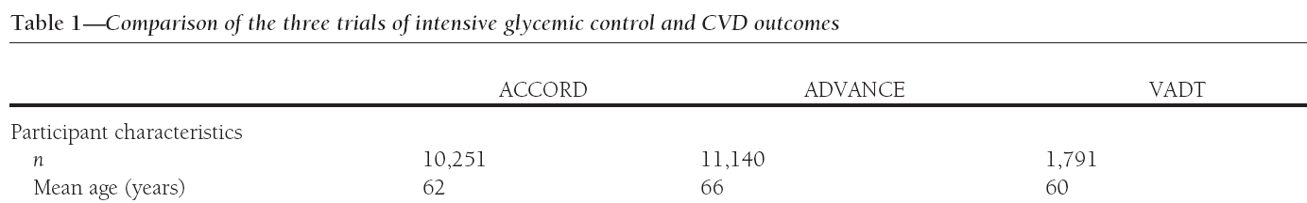
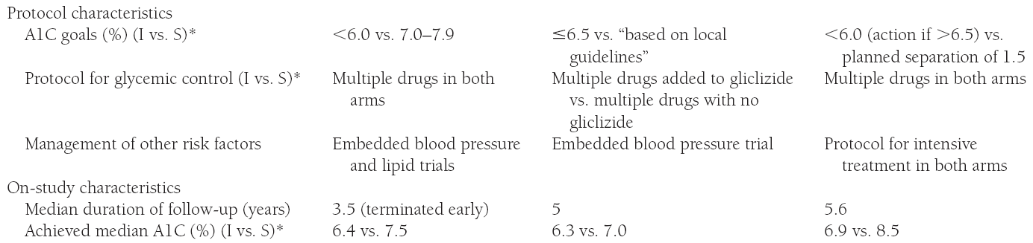
Failure to find benefit may have related to the A1C levels tested:
6.4% vs. 7.5% 6.3% vs. 7.0% 6.9% vs. 8.5%
So hyperglycemia matters to the heart but intense control (A1C < 7%) provides little additional benefit over moderate control (A1C 7-8%)
Sklyer JS, et al. Intentive glycemic control and the prevention of cardiovascular events. A position statement of the ADA/ACC/AHA. Diabetes Care 2009;32:187-92.

Slide 15
Point to remember
Negative results of The ACCORD trial , the ADVANCE TRIAL , the VADT TRIAL, does not mean that glucose control does not have an effect

Slide 16
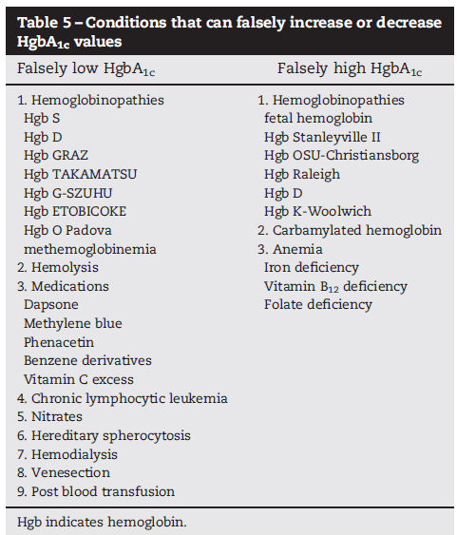
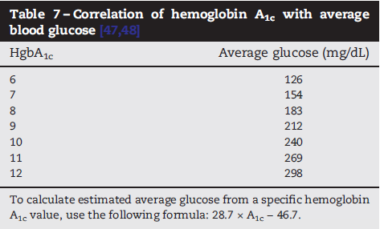
28.7 × 9 − 46.7 = 211.6 ≈ 212 mg/dl

Slide 17
Third line agent?
Oral agent (Triple therapy)
Different insulin regimens

Slide 18
Ideal Basal Insulin
Closely mimic normal pancreatic basal insulin secretion
No distinct peak effect
Continued effect over 24 hours
Reduce nocturnal hypoglycemia
Once-daily administration for patient compliance
Predictable absorption pattern

Slide 19
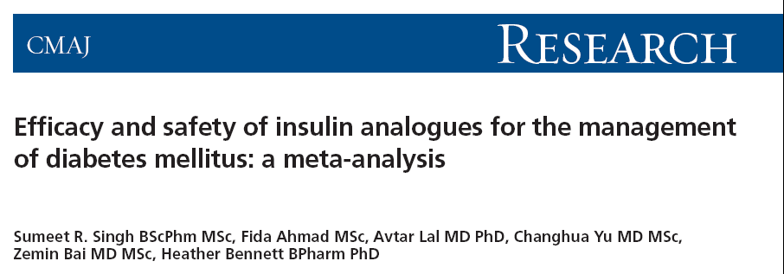
From the Canadian Agency for Drugs and Technologies in Health,,
Aim: To compare the outcomes of insulin analogues with conventional insulins in the treatment of DM₁, DM₂ and GDM
CMAJ 2009;180(4):385-97

Slide 20
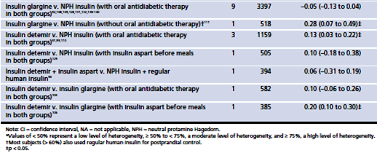
Differences in glycemic control, as measured by hemoglobin A1c , between insulin analogues and other treatments in patients with DM₂
Long-acting insulin analogues
Singh SR, Ahmad F, LaI A, et al. CMAJ 2009; 180:385-397

Slide 21

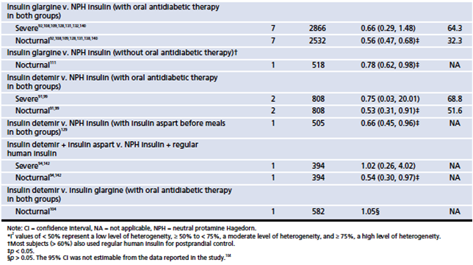
Efficacy and safety of insulin analogues for the management of diabetes mellitus: a meta-analysis
Singh SR, Ahmad F, LaI A, et al. CMAJ 2009; 180:385-397

Slide 22
Efficacy and safety of insulin analogues for the management of diabetes mellitus: a meta-analysis
  Interpretation
Most estimates of differences in HbA₁c between treatment groups were not statistically significant.
Where they were statistically significant in favor of insulin analogues, the differences were smaller than minimal clinically important differences described in the literature.
We found statistically significant benefits of insulin analogues over conventional insulins in terms of hypoglycemia
These agents may be an option for patients with problematic hypoglycemia despite optimization of conventional insulin therapy.
Singh SR, Ahmad F, LaI A, et al. CMAJ 2009; 180:385-397

Slide 23
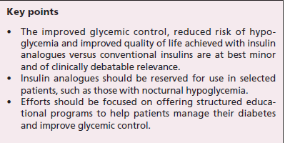

Slide 24
Premix insulins
Biphasic Human insulin (NPH +Regular )
Insulin analogues (Insulin Aspart 70/30, Lispro 75/25 and 50/50,)

Slide 25
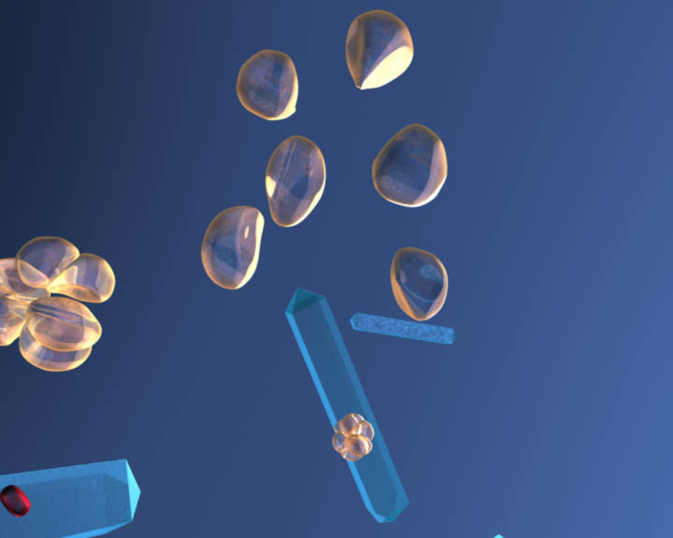
Formulation of premixes
Premixed suspension of:
Soluble insulin aspart
30%
30%
Soluble
human insulin
Protamine-crystallised
insulin aspart
NPH
NovoMix® 30 Premixed human
insulin

Slide 26
Premixed insulin:
Once, twice or three-times daily
Premixed human insulin
Premixed analogue insulin
Premixed injection
Premixed injection
Contains:
Basal component
Short-acting component
Possible regimens:
Twice daily with dinner and breakfast (figure)
Once daily with the largest meal is also possible if a patient wants to get familiar with dosing
Three-times daily, with each meal
Insulin action
Breakfast
Lunch
Dinner
Schematic representation of twice-daily injections
Notes:
26
[slide is animated]
Premixed insulins contain both rapid-acting and long- (intermediate-) acting insulin in one preparation. The exact proportions of each insulin within the mixture can vary: a usual mix is 30% rapid-acting insulin and 70% long-acting insulin (e.g., NovoMix® 30) or 25% rapid-acting insulin and 75% long-acting insulin (e.g., Humalog® Mix 25).

Slide 27
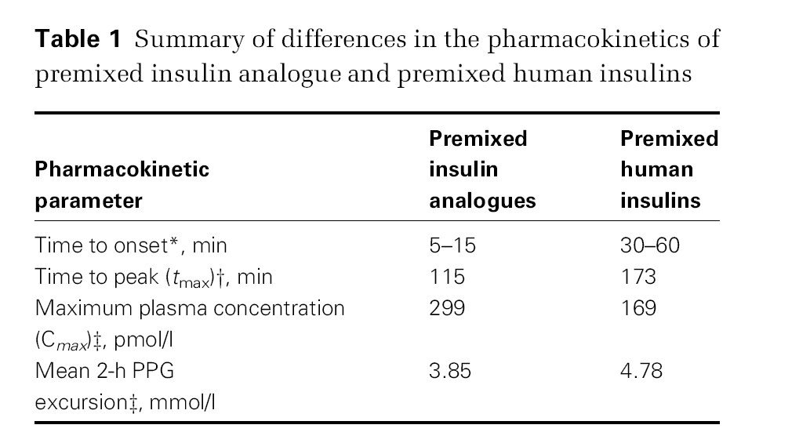

Slide 28
FPG or PPG?
FPG and PPG have different contribution to HbA1c
With mild HbA1c elevations (7.3-8.4%), the proportion of HbA1c elevation attributable to postprandial hyperglycaemia increases to as much as 70% of the glycaemic load
To reach recommended HbA1c targets <6.5% it is important that postprandial hyperglycaemia is specifically addressed.
Monnier L, et al Diabetes Care 2003; 26: 881–885.

Slide 29
To normalise blood glucose both FPG and PPG must be reduced
Most insulin is initiated when
HbA_{1c} >8.5%
100
PPG
80
40%
30%
FPG
% contribution to HbA_{1c}
50%
45%
60
70%
40
70%
50%
55%
60%
20
30%
0
<7.3
7.3–8.4
8.5–9.2
9.3–10.2
>10.2
HbA_{1c} range (%)
  Adapted from Monnier L et al. Diabetes Care 2003;26:881–5
Notes:
In order to normalise blood glucose, there is a need to address both fasting and post prandial glucose abnormalities. As patients get closer to HbA1c targets, the relative importance of PPG increases.

Slide 30
Human Vs. Analogues

Slide 31
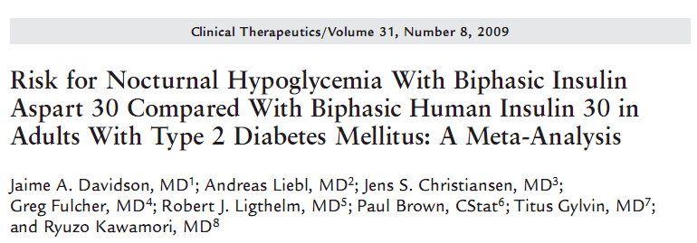
The aim of this study was to compare biphasic insulin aspart 30 (BIAsp 30) with biphasic human insulin 30 (BHI 30) with respect to glycemic control and the risk for hypoglycemia using a metaanalysis of clinical trials comparing these insulins in patients with type 2 diabetes mellitus (T2DM).
The predefined primary end point of the study was the overall rate of nocturnal hypoglycemia (major, minor, and symptoms-only hypoglycemia occurring from 12:00–6:00 am).

Slide 32
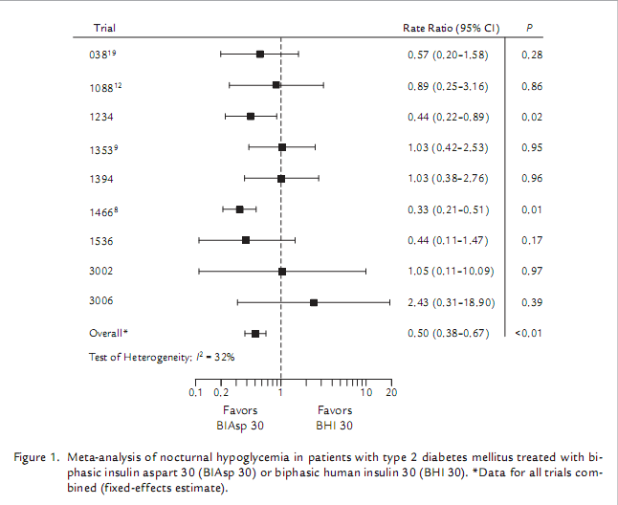

Slide 33
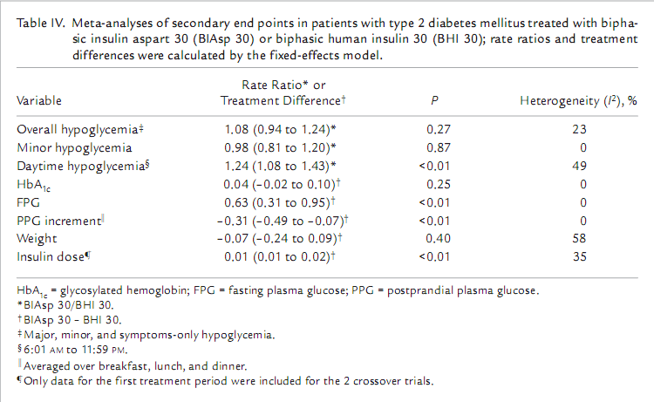

Slide 34
Key messages
This meta-analysis found BIAsp 30 to be associated with a significantly lower rate of nocturnal and major hypoglycemia, but a significantly increased risk for daytime hypoglycemia, compared with BHI 30 at a similar level of HbA1c in patients with T2DM.

Slide 35
Premixed Vs. Basal

Slide 36
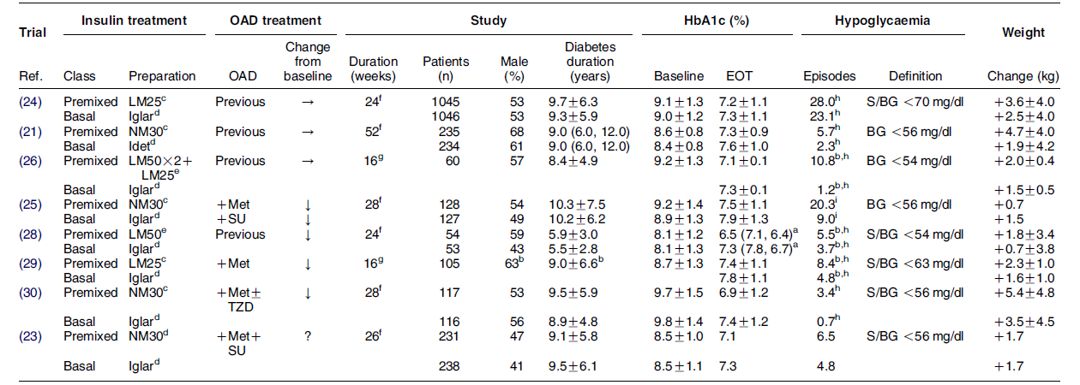
RCTs comparing basal and premixed insulin analogue regimens in previously insulin-naive patients with type 2 DM

Slide 37
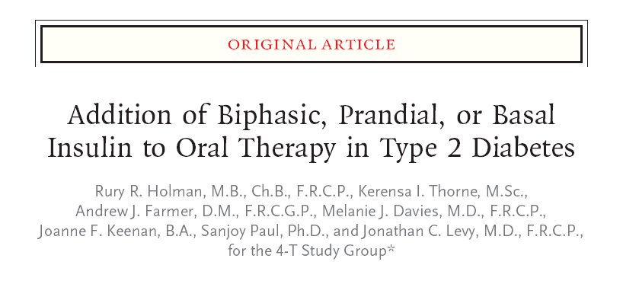
N Engl J Med 2007;357:1716-30.

Slide 38
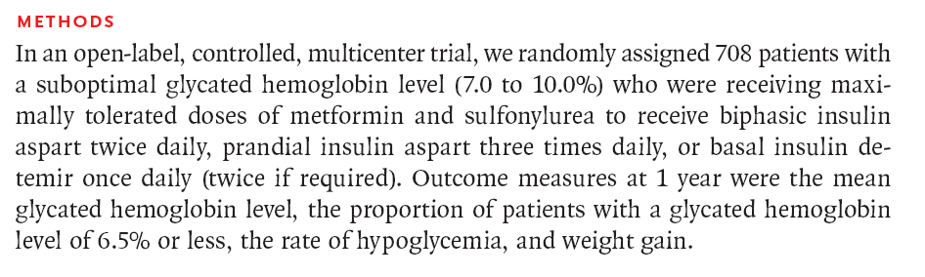

Slide 39
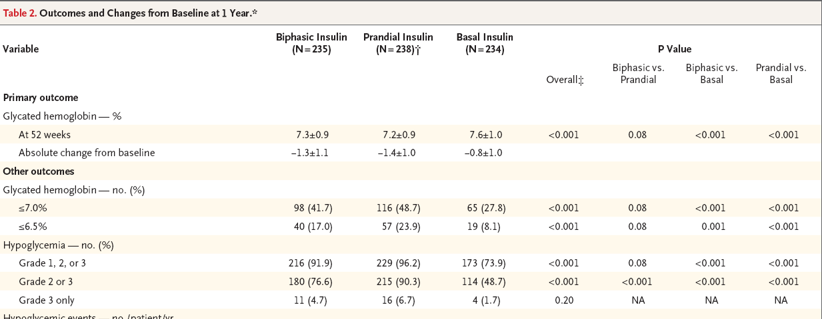

Slide 40
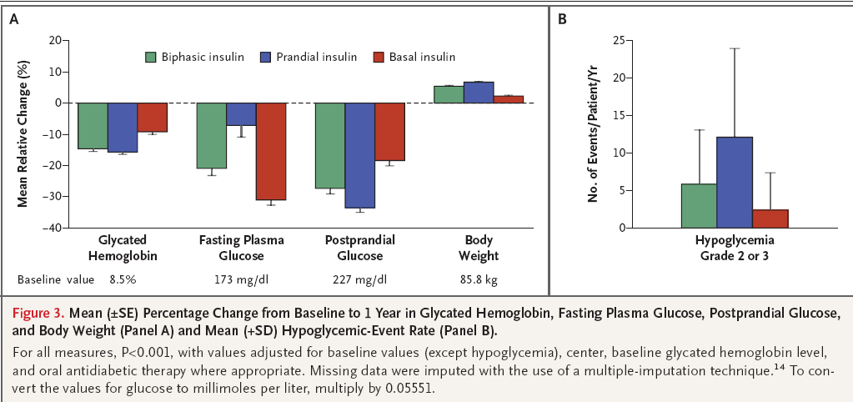

Slide 41
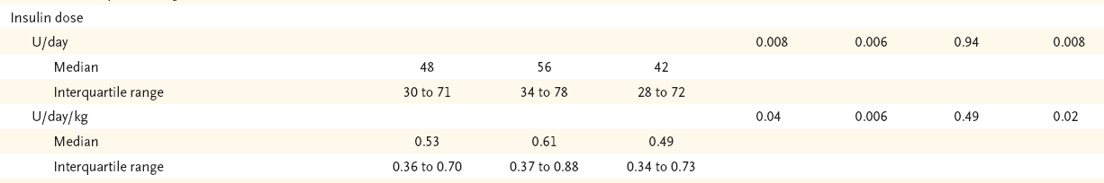

Slide 42
Key messages
A single analogue-insulin formulation added to metformin and sulfonylurea resulted in a glycated hemoglobin level of 6.5% or less in a minority of patients at 1 year.
The addition of biphasic or prandial insulin aspart reduced levels more than the addition of basal insulin detemir but was associated with greater risks of hypoglycemia and weight gain.
Basal insulin was equivalent to the other regimens after the first year in patients with a glycated hemoglobin level of 8.5% or less at the initiation of the study

Slide 43
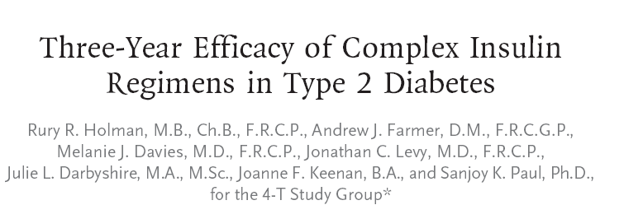
N Engl J Med 2009;361:1736-47.

Slide 44
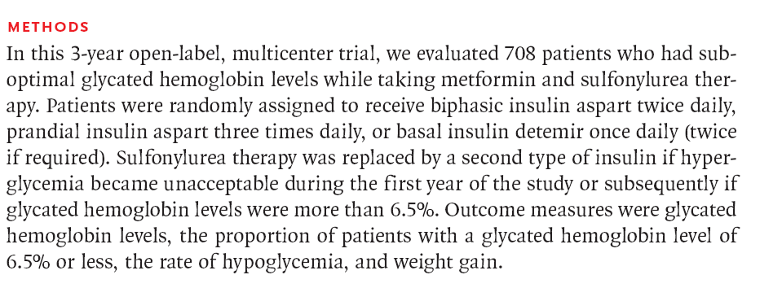

Slide 45
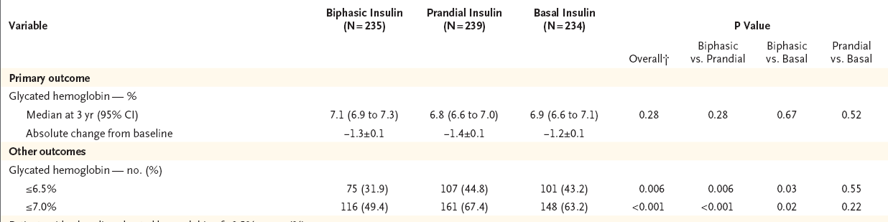

Slide 46
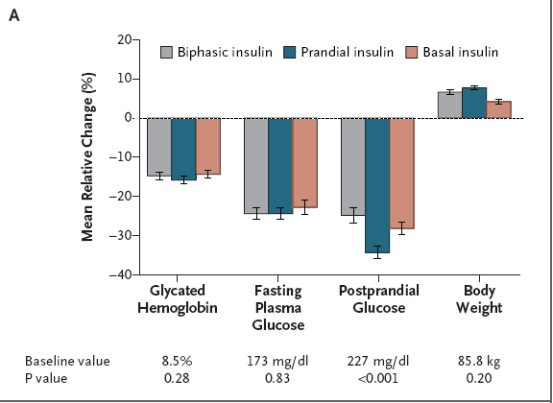

Slide 47
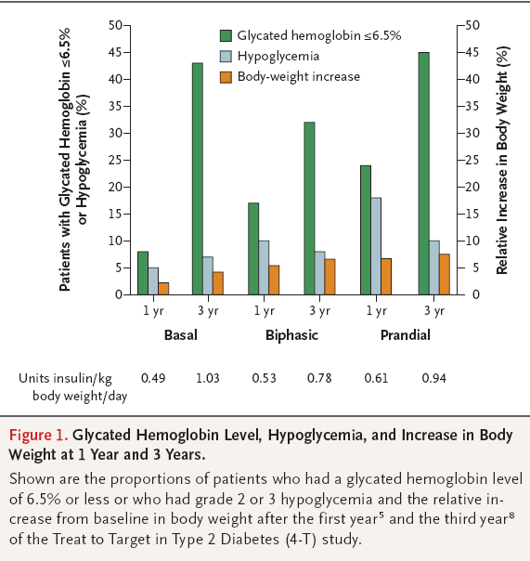

Slide 48
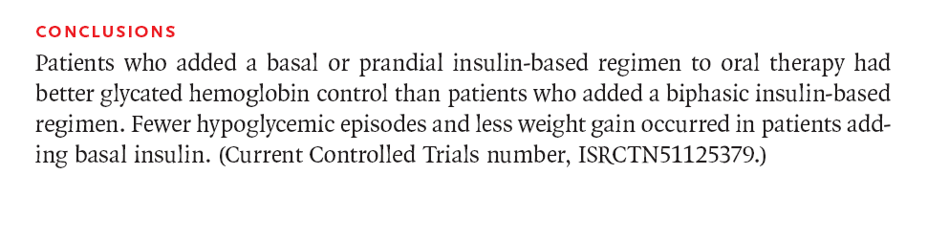

Slide 49
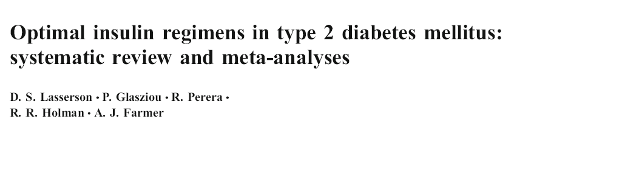
Twenty-two trials that randomised 4,379 patients were included.
Majority of them were shot term trials
High rate of heterogenity
Diabetologia (2009) 52:1990–2000

Slide 50
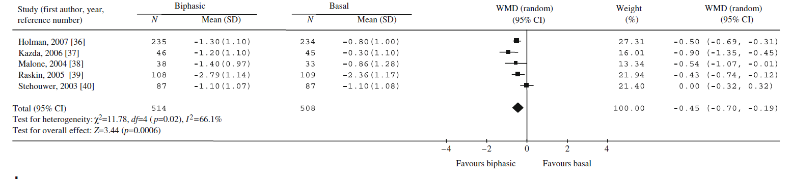
HbA1c
Biphasic insulin reduced HbA1c by a further 0.45% (95% CI 0.19–0.70)

Slide 51
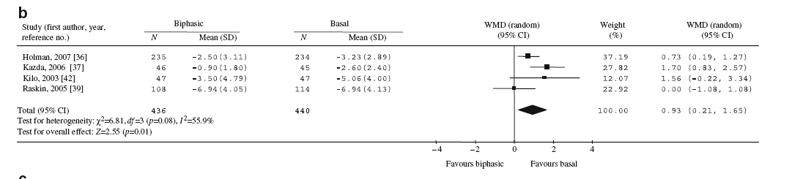
Fasting SMBG
Compared with biphasic insulin, basal insulin reduced fasting (SMBG) by a further 0.93 mmol/l (95% CI 0.21–1.65)

Slide 52
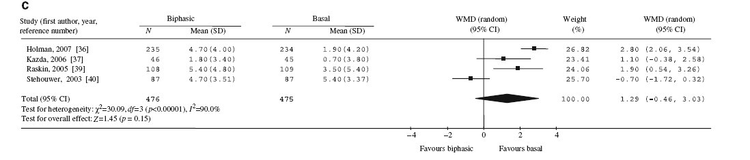
Weight
Compared with basal insulin, biphasic insulin was associated with a non-significant greater weight increase of 1.29 kg (95% CI −0.43, 3.03, p=0.15)

Slide 53
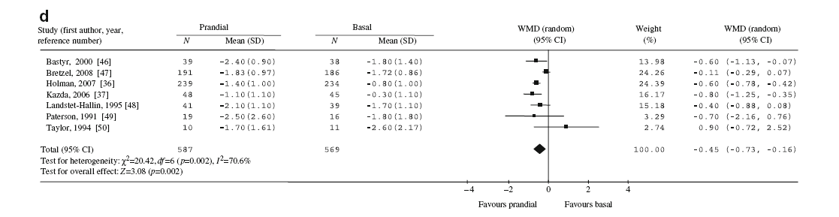
HbA1c

Slide 54
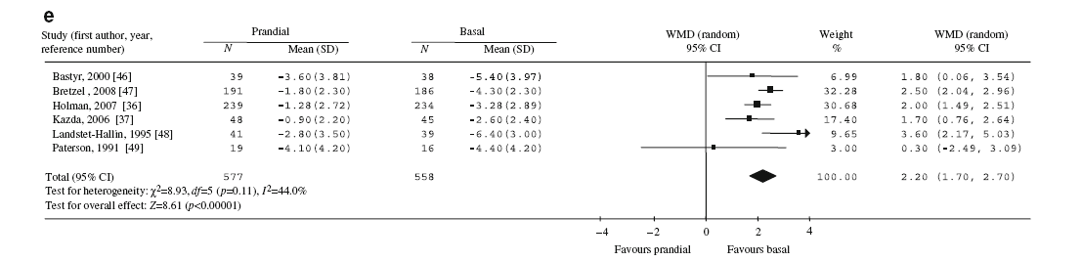
Fasting SMBG

Slide 55
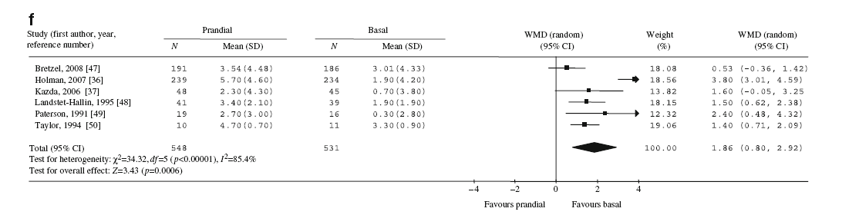
Weight

Slide 56
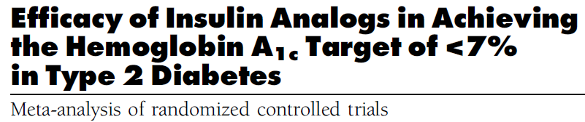
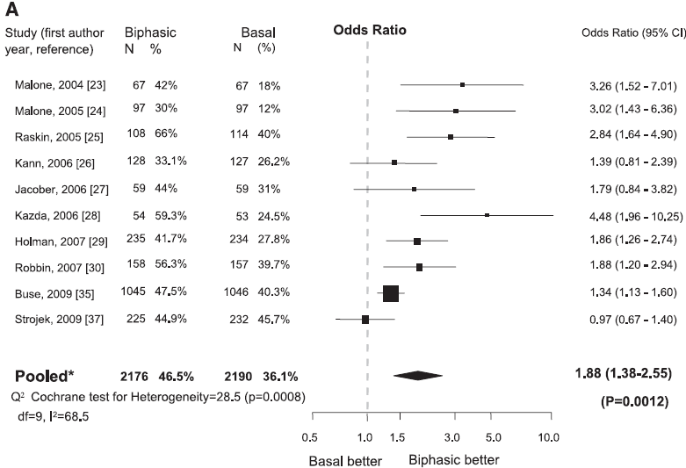
2
Diabetes Care 34:510–517, 2011

Slide 57
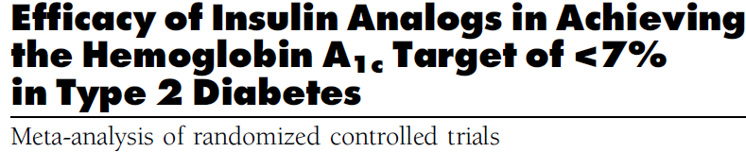
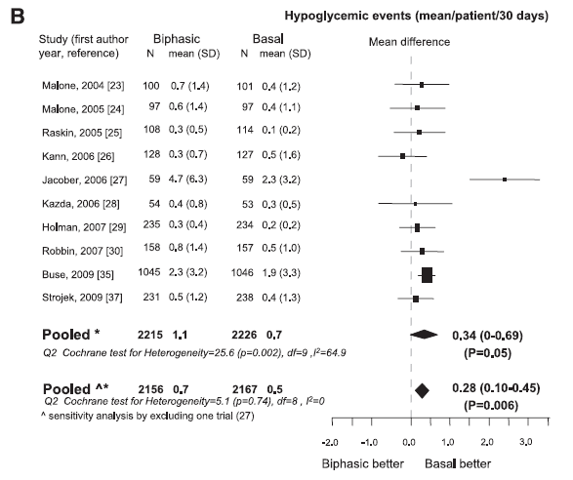

Slide 58
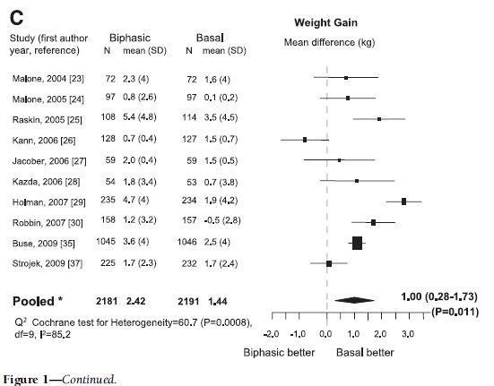

Slide 59
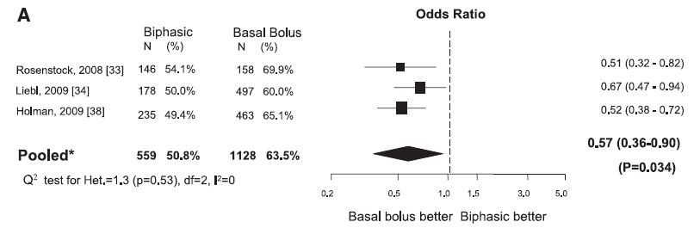

Slide 60
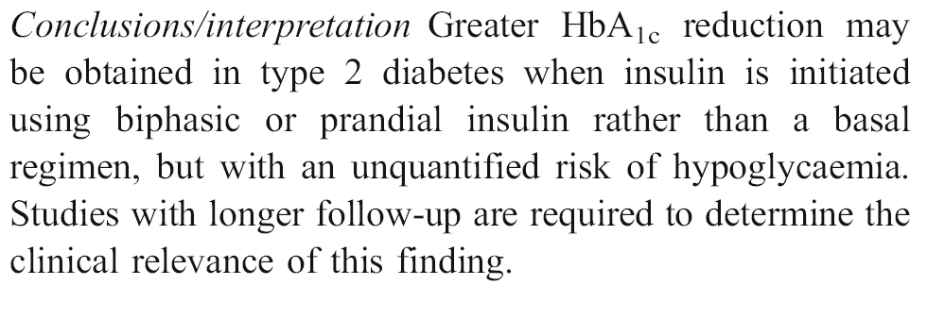

Slide 61
Unresolved issue
Are there patients who would benefit more from a premixed insulin analogue regimen than from a basal insulin analogue regimen or the reverse?

Slide 62
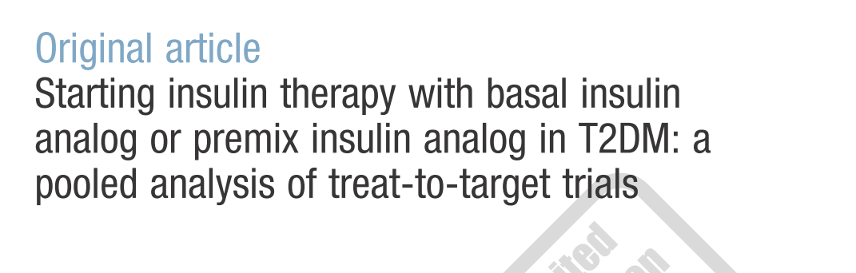
This analysis aimed to determine if measurable clinical characteristics prior to starting insulin could predict differences in improved glycemic control between these options
Current Medical Research & Opinion Vol. 26, No. 7, 2010, 1621–1628

Slide 63
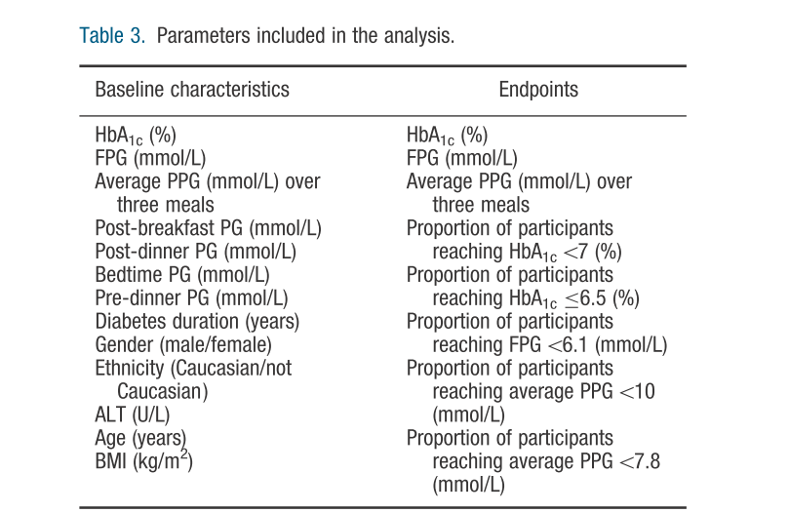

Slide 64
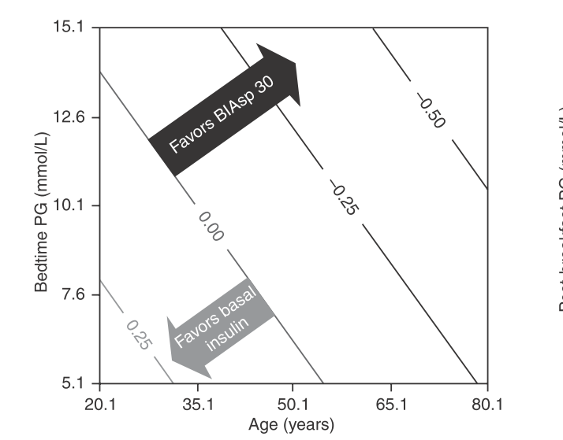
Endpoint = HbA1c
In older individuals with higher bedtime PG, BIAsp 30 appeared to be more beneficial. In contrast, basal insulin appeared to be a better choice in younger individuals with lower bedtime PG

Slide 65
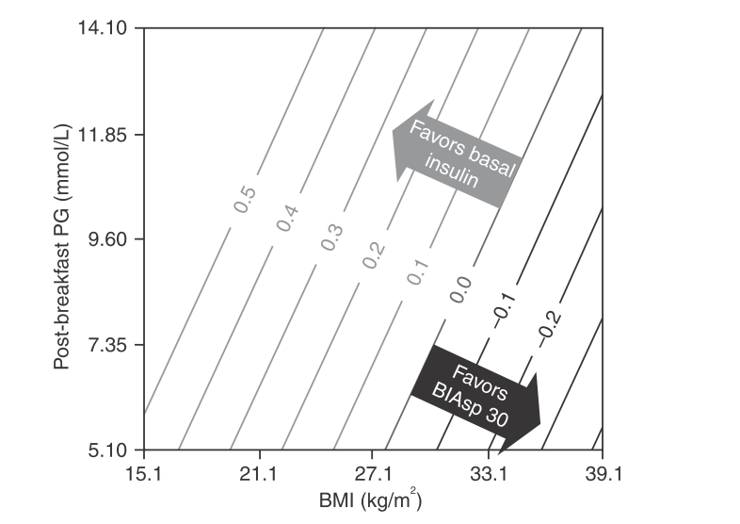
Endpoint = FPG
Basal insulin appeared to achieve better FPG in patients with lower BMI and higher post-breakfast PG while BIAsp 30 appeared to be better in patients with higher BMI and lower post-breakfast PG

Slide 66
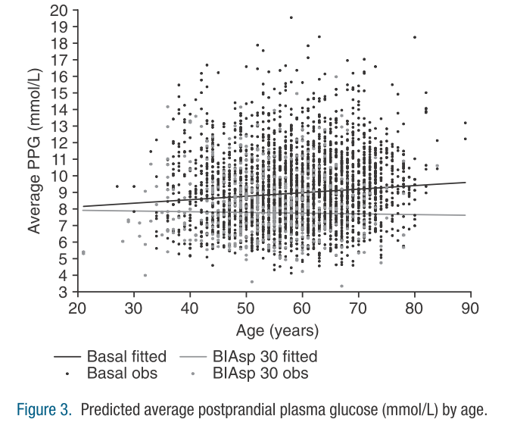
Endpoint = PPG
The model demonstrated that there were fewer differences in mean average PPG between treatments in younger patients; however, in older patients, average PPG values were lower with BIAsp 30 than with basal insulin.

Slide 67
Key messages
Premix analog rather than basal insulin may be an appropriate choice to target HbA1c values in older individuals and those with higher bedtime PG, while basal insulin may be more appropriate to target FPG in patients with lower BMI and higher post-breakfast PG.

Slide 68
Guidelines

Slide 69
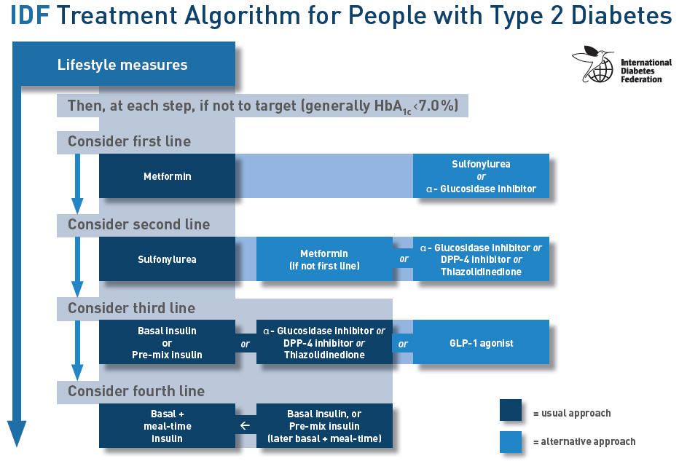

Slide 70
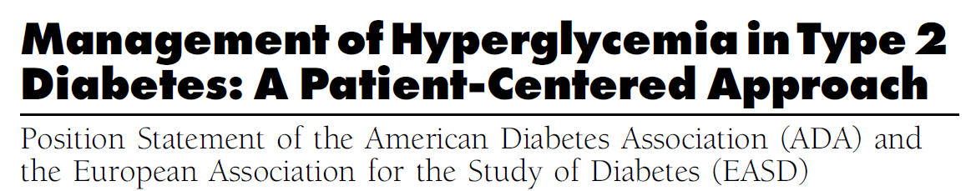
Glycemic targets and glucose-lowering therapies must be individualized
Diabetes Care Publish Ahead of Print, published online April 19, 2012

Slide 71
Individualization of treatment
Recommendation should be considered within the context of the needs, preferences, and tolerances of each patient
Recommendations are less prescriptive than and not as algorithmic as prior guidelines

Slide 72
In an international survey16 and a clinical practice review,17 PCPs and diabetes specialists reported that insulin initiation was prevented by lack of:
■ time required to train patients
■ clear guidelines and definitions
■ support, as represented by Certified Diabetes Educators
experience in taking a proactive role in insulin initiation
■ coordination of care between PCPs and endocrinologists
■ motivation

Slide 73
Basal insulin analogs have pharmacokinetic and pharmacodynamic advantages over NPH insulin—namely,
a less pronounced peak effect,
less variable absorption profiles,
and a longer duration of action
Insulin analogs are also associated with lower rates of hypoglycemia, particularly nocturnal hypoglycemia, compared with NPH, which may at least partly offset the overall higher treatment costs related to insulin analogs

Slide 75
For most patients basal insulin analogs, the average insulin dose is <50 U/d.
Targeting FBG levels first will solve most glycemic control problems in patients with T2DM
if HbA1c levels are still in excess of 8.5%, reductions in both FBG levels and postprandial glucose levels may be required to achieve the glycemic goal.

Slide 76
Starting Basal Insulin:Fix the Fasting First
“Overbasalization”: Too Much Basal
Insulin, Too Little Effect

Slide 77
Overbasalization occurs when FBG is not controlled with up-titration of basal insulin and HbA1c targets remain elusive.
Providers must understand the concept of overbasalization because it should trigger progression to mealtime insulin intensification in patients.

Slide 78
Maximal amounts of basal insulin can be achieved but should not comprise more than 50% of the total daily insulin calculation.
Violating 50/50 rule may lead to overbasalization.
At this point, administering additional basal insulin may change the pharmacokinetics of the basal insulin from having a profile without pronounced peaks of activity to a profile with an insulin peak

Slide 80
Adding to Basal Insulin:
A Stepwise Approach
Rapid-acting insulin analogs closely mimic physiologic meal-stimulated insulin release, with faster absorption, higher maximum concentration, shorter duration, and a lower risk of hypoglycemia than regular insulin.
Rapid-acting premixed insulin analogs—such as biphasic insulin aspart 30 (30% soluble insulin aspart and 70% protamine-crystallized insulin aspart)—have been developed, which can prevent excessive postprandial glucose levels whether injected at the beginning of a meal or 15 to 20 minutes after starting a meal.

Slide 81
During mealtime insulin intensification, the patient continues to receive basal insulin therapy but also administers a rapid-acting insulin at the largest meal of the day to manage glucose excursions after meals.

Slide 83
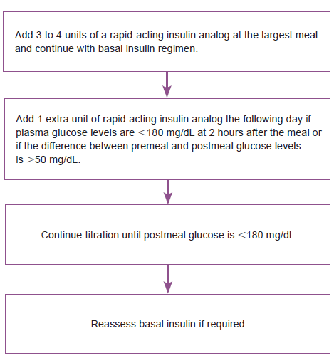

$$A=πr^{2}$$

Slide 84
It is important to check glucose levels just before the first bite of the meal and 2 hours after the meal to assess the effectiveness of the mealtime insulin and to provide guidance for further insulin titration.
There is no absolute need for carbohydrate counting with this method.

Slide 85
Stepwise approach to insulin intensification may lead to less hypoglycemia than premixed insulin, with similar proportions of patients achieving the glycemic control goal of HbA1c levels below 7%, as well as lower blood glucose levels.

Slide 86
Another option for intensifying a basal regimen
Is to add a dose of a rapid-acting analogue with the biggest meal, e.g., a dose of 0.1 U/kg (6 U is a good approximation).
The basal insulin dose may need to be decreased by an equivalent amount

Slide 87
Initiation & titration of prandial insulin
Can usually begin with ~4 units
Adjust by 2 units every 3 days until plasma glucose
is in range
When prandial insulin is started, insulin secretagogues (SU or glinides) should be discontinued
Nathan DM, et al. Diabetes Care 2009;32 193-203.
Notes:
87
Key Point
For the second injection, physicians can begin with approximately 4 units of insulin and adjust by 2 units every 3 days until blood glucose is in range.
Reference:
Nathan DM et al. Management of hyperglycemia in type 2 diabetes: a consensus
algorithm for the initiation and adjustment of therapy. Diabetes Care 2006;29(8):1963-72.

Slide 88
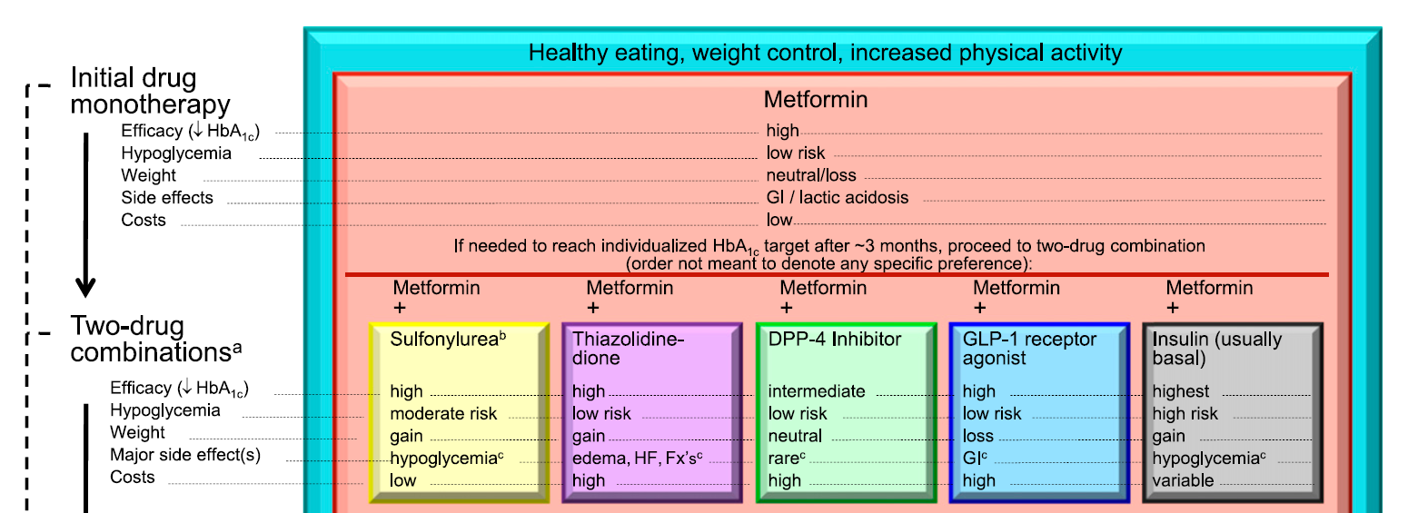

Slide 89
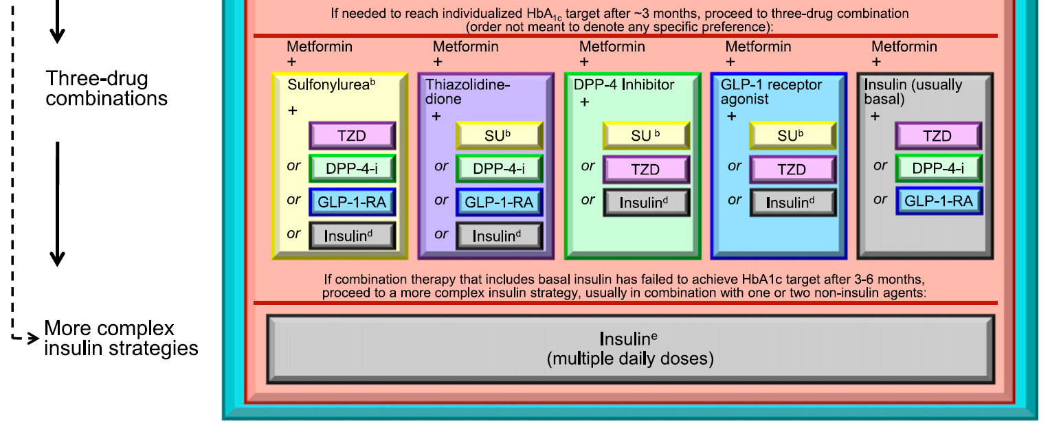

Slide 90

serious omission not
to include a self-mixed/split regimen as insulin treatment for type 2 diabetic patients in the ADA/EASD recommendations

Slide 91
In a more recent head-to-head comparison between selfmixed/ split and basal/bolus insulin regimens in hospitalized patients, the
glycemic responses were virtually
identical

Slide 92
Insulin regimens
The most precise and flexible prandial coverage is possible with “basal-bolus” therapy, involving the addition of premeal rapid-acting insulin analog to ongoing basal insulin
A second, perhaps more convenient but less adaptable method involves “premixed” insulin, consisting of a fixed combination of an intermediate insulin with regular insulin or a rapid analog
In comparison with basal insulin alone, premixed regimens tend to lower HbA1c to a larger degree, but often at the expense of slightly more hypoglycemia and weight gain

Slide 93
Premixed regimen
This strategy may be appropriate for certain patients who eat regularly and may be in need of a simplified approach beyond basal insulin
Disadvantages: inability to titrate the shorter- from the longer-acting component

Slide 94
Pros and cons of premixed analogue
No need for self mixing
Minimizing dosing error
Less injections (attractive alternative to basal bolus)
  Dosing immediately before or after meal
  Less flexibility
  cost

Slide 95
Pros and cons of premixed analogue
Higher FPG
Lower PPG
Lower HbA1C
More weight gain
More minorhypoglycemia

Slide 96
Conclusion
Individualization of treatment is the cornerstone of success

Slide 97
Case Presentations

Slide 98
Case 1
Ms. Hosseini

Slide 99
History
A 58- year- old women comes to see you for diabetes review. She has had type 2 diabetes for 8 years. She attended the local T2DM education programme at diagnosis.
Despite lifestyle modification, her BMI is 28
She is taking MFN 2g /daily , Gliclazide 320 mg/daily (good compliance) , atorvastatin 20 mg and ASA 80 mg
FBS 155 mg/dl ,HbA1c 8.5% , SMBG ?
No microalbuminuria , beginning of retinopathy, no cardiovascular complication
BP= 125/75 mmHg

Slide 100
What would you do next?
Life style intensification
Prescribe Pioglitazone
Prescribe Basal Insulin
Prescribe premixed insulin
Prescribe prandial insulin

Slide 101
Case 2
Mr. Mohamadi

Slide 102
Demography | Male; aged 63
Height & weight | Height: 164cm Weight: 60 kg BMI: 22.3 kg/m²
Medical history | Hypertension MI 2 years ago
Family history | Hypertension and MI in both parents Mother died of CVA at age 60
Treatment | Metformin 500 mg BID; Glibenclamide 20 mg/day; pioglitazone 15 mg OD
Glycaemic control | T2DM diagnosed 6 years ago Most recent HbA_{1c}: 8.8% (3 months ago) Past HbA_{1c}: 8.8% six months ago; 7.9% 1 year ago

Slide 103
More information
Mr Mohamadi is a farm laborer and is therefore very active
He has limited time for lunch but eats a large breakfast, snacks throughout the day when he is able and then eats a large but healthy evening meal
  You have asked him to test his blood sugar frequently over the next 2 weeks in order to get a sense of his pre- and post-meal glucose values
He is motivated to get his blood sugar under control because he finds that he is frequently tired and struggles with his physically demanding job when his blood sugar is high
He is willing to try insulin as he understands that there are limited OAD options left to consider

Slide 104
SMBG
Fasting | Post-Bfast | Before lunch | Post lunch | Before dinner | Post dinner | Before bedtime | HdA1c%
140 | 280 | 155 | 170 | 130 | 265 | 155 | 8.8%
135 | 275 | 150 | 160 | 140 | 250 | 160
Values are mg/dl

Slide 105
What is your recommendation?
Start the patient on basal insulin
Start the patient on BIAsp 30 OD
Start the patient on BIAsp 30 BID
Start the patient on basal-bolus
therapy

Slide 106
INITIATING INSULIN WITH PREMIXED
ANALOGUES
Aonce-daily regimen in cases where hyperglycemia is not severe, or with a twice-daily regimen when HbA1c values are> 8.5%.
When 1 injection is used, the oral antidiabetic drugs are maintained, but when starting with a twice-daily regimen sulfonylureas can be stopped.
When an analogue mix is used once daily it is typically added before the evening meal
In the 1-2-3 Study, the addition of predinner premixed analogue insulin to oral antidiabetic drugs allowed 41% of patients to attain HbA1c levels 7.0% in only 16 weeks

Slide 107
To start an analogue mix;
For once daily, the patient begins on 12 U before the evening meal and patient increases the insulin by 2 U every 3 days until fasting blood glucose is <110 mg/dL.
To use the twice-daily regimen, 6 U of analogue mix are started at breakfast and dinner ; then
The patient is told to titrate up the predinner dose first, using fasting glycemia as the end point, by adding 2 U every 3 days until fasting blood glucose is <110 mg/dL. Thereafter, the morning dose is increased by titrating against the predinner glucose. The patient increases the dose by 2 U every 3 days until the predinner glucose is also 110 mg/dL

Slide 108
Practical Strategy to Implement a Multi-Injection Insulin Regimens
Dose Calculation
  Split-mixed regimen in obese patients uses 70/30 premixed insulin with an initial total daily dose (0.4-0.8 u/kg) equally split between the prebreakfast and predinner meals
  Lower doses (total daily dose 0.2-0.5 u/kg) in thin patients
Dose Adjustment
  Dose is increased by 2-4 u increment every 3-4 days until the morning FPG and predinner blood glucose concentration are consistently in the range of 80-120 mg/dL

Slide 109
Case 3
Mr Ahmadi

Slide 110
History
A 60-year-old man comes to you with history of type 2 DM for 9 years.
PMH : MI, CHF
Two main complaints were increasing arthritis in his hands and decreasing vision due to cataracts.
Medications : Aspirin, Statin, Captopril, Glibenclamide 10 mg/dl, Metformin 2000mg/dl
BMI =31 Kg/m2. No evidence of nephropathy
Laboratory findings : LDL = 60 mg/dl, TG=270 mg/dl, HBA1C=8.2%

Slide 111
History..
SMBG records revealed a fairly flat curve of moderate hyperglycemia throughout the day with blood glucose values between 160 and 230 mg/dL, reflecting her 3 balanced meals.
He has severe fear from insulin therapy and weight gain

Slide 112
SMBG
Fasting | Post Bfast | Before lunch | Post lunch | Before dinner | Post dinner | Bedtime | HbA1c
160 | 220 | 140 | 230 | 150 | 210 | 140 | 8.2%
155 | 210 | 135 | 220 | 145 | 230 | 150
Values are mg/dl

Slide 113
What is your recommendation?
1-Add pioglitazone
2-Add basal insulin at bedtime
3-Add basal-bolus therapy
4-Add biphasic insulin

Slide 114
Case 4
Mr. zare

Slide 115


Slide 116
More information
Over the past 6 months you have increased Mr. zare dose of insulin from 0.4 U/kg to 0.8 U/kg which has resulted in improved glycemic control by also reports of several episodes of nocturnal hypoglycemia
Mr. zare does not like to be regimented and considers insulin injections and blood glucose monitoring a bother. Blood glucose control has been suboptimal over these past 2 years, but you have finally convinced him that a change in his insulin regimen is required.

Slide 117

SMBG
HbA1c 9.1%

Slide 118
What would you do next?
Start the patient on BIAsp 30 OD
Start the patient on BIAsp 30 BID
Start the patient on basal-bolus
therapy

Slide 119
Case 5: Poorly Controlled Type 2 Diabetes on No Treatment
40-year-old Iranian male diagnosed with diabetes 6 months ago on admit for MI
Current treatment: None for diabetes
Current exam:
  BMI 29 kg/m2
  A1C 13%, BG 497, Cr 1.3, ketones negative
Current complications:
  Hyperlipidemia, CAD

Slide 120
Case 5: Poorly Controlled Type 2 Diabetes on No Treatment
What is your goal for glucose?
  90 to 130 mg/dL premeal,
  <180 mg/dL postmeal
  80 to 110 mg/dL premeal,
  <140 mg/dL postmeal
  70 to 100 mg/dL premeal,
  <120 mg/dL postmeal

Slide 121
Case 5: Poorly Controlled Type 2 Diabetes on No Treatment
What is your treatment in addition to diet and exercise?
  One oral agent
  Two oral agents
  Basal insulin
  Premixed insulin
  Basal bolus therapy

Slide 122
Case 5: Poorly Controlled Type 2 Diabetes on No Treatment
Patient refused insulin
Placed on Glibenclamide(5mg/dl) and metformin (1500 mg/dl)
A1C 6.8% in 3 months; patient quit sweet tea, colas, and orange juice
Lesson learned:
  Do not underestimate the power of diet and exercise

Slide 123
Case 6
A 70-year-old Iranain female. Clinical Presentation: presents to the office, with her daughter, for a follow-up visit after routine blood work 2 weeks earlier showed a progressively increasing HbA1C level.
she doesn’t take her diabetes medication every day, because at times it makes her feel “shaky.” She is trying to follow a low-salt, low-carbohydrate diet, as stated by her daughter.
Pertinent Medical History:

Slide 124
Case 6
Type 2 Diagnosed 10 years ago, Hypertension: Hyperlipidemia:, Chronic renal insufficiency, Congestive heart failureDiabetic retinopathy:
Social History:The patient has been a widow for 10 years and lives with her daughter because her “memory is not as good as it used to be” and she has poor vision due to diabetic retinopathy.. The patient does not eat much during the day while her daughter is at work, because she doesn’t like to cook. However, the daughter states that she eats well at dinner

Slide 125
case6
Patient complains of dyspnea with exertion. BMI: 21.6 kg/m2 ,Lungs:
+ Fine crackles in bases bilaterally.
Metoprolol 50 mg daily, Glibenclamide 10 mg daily, Acarbose 100 mg/ daily ,Lisinopril 20 mg daily ,Furosemide 60 mg daily ,Atorvastatin 20 mg daily,Aspirin 81 mg daily,HbA1C:9.5%l, FPG 119mg/dl, Creatinin 2 mg/dl, LFT , Lipid and CBC OK

Slide 126
Case6
What A1C goal would you recommend for this patient?
  1-< 6.0%
  2-< 6.5%
  3-<7%
  4-<8 %

Slide 127
Case6
Please review the following and indicate which regimen changes you are likely to implement in order to improve this patient’s glycemic control while minimizing her risk of hypoglycemia.
1-Add pioglitazone
2-Add basal insulin at bedtime
3-Add basal-bolus therapy
4-Add biphasic insulin
5-Stop SU therapy
1, and either 2 or 4
1, and either 3 or 4
Either 2 or 4, and 5
Either 3 or 4, and 5

Slide 128
Case 7: Poorly Controlled Type 2 Diabetes on OHA
46-year-old Indian man with diabetes since age 33, on max doses of Pioiglitazone, glyburide and metformin; diet balanced; daily exercise
Current exam:
  BMI 24
  A1C 8.0%, Cr 1.1,
Current complications:
  Vitrectomy , proteinuria, hyperlipidemia

Slide 129
Case 7: Poorly Controlled Type 2 Diabetes on OHA
A1C 8.0%; SMBG 1/d; avg 110 mg/dL fasting; random BG 300 after breakfast
What treatment do you recommend?
  Basal insulin morning (~10 U)
  Premixed insulin morning (~10 U)
  Premixed insulin morning and evening (~5 U BID)
  Bolus insulin with the largest meal (~5 U)
  Starch blocker or glinide (repaglinide or nateglinide)

Slide 131
Conclusion
The reduced frequency of insulin injections and glucose monitoring, associated with its inherent simplicity, has led to put the basal insulin regimen as the first option in initiating insulin therapy in recent guidelines .
Basal insulin was unable for reaching the <7% HbA1c target in about 60% of patients starting with basal insulin.

Slide 132
Conclusion
The escalation in insulin regimens (from the simple basal to the complex basal-bolus) may result in a further gain of success rate, ranging roughly from 12% to 14%, which still leaves many patients not at goal???

