Slide 1
Insulin Initiation
Atieh Amouzegar MD
Research Institute For Endocrine Sciences
Endocrine Research Center
Shahid Beheshti University
04.04.1397

Slide 2
Outlines
Case presentation
Barriers of insulin therapy
Action-profile
Types of basal insulins
How to begin basal regimen
How to titrate basal regimen
OHA and insulin

Slide 3
Based on one recent study, the A1C level that
triggers glucose-lowering action is > 9%
Am J Manag Care 9:213–217, 2003

Slide 4
“patient-centered” approach
Individualizing therapy and goals for pts With T2DM
The individualized targets should take into account not only clinical conditions, such as
relevant comorbid conditions, age, duration of diabetes, and history of sever hypoglycemia, but also the patient-specific psycho-socioeconomic context

Slide 5
Barriers
Insulin causes blindness, renal failure, amputations, heart
attacks, strokes, or early death
Sense of personal failure
Low self-confidence
Low confidence in therapy
Injection phobia
Hypoglycemia concerns
Feeling that diabetes is a serious cause of concern
Negative impact on social life and job
Inadequate health literacy
Health care provider inadequately explaining risks/benefits
Limited insulin self-management training

Slide 6
Case
A 50-year-old woman currently preparing for discharge from the hospital after an CVA.
She has a 10-year history T2DM and HTN managed prior to admission with metformin 1000 mg and sitagliptin 50 mg BD, in addition to lisinopril 10 mg daily and aspirin 81 mg daily.
She reports adherence with her medication regimen, which has not been changed in more than 1 year.
HbA1c level is 9.5%.
In the hospital, her T2D was treated with insulin glargine U100 and prandial insulin.
Weight 80 kg, BMI, 28.4 kg/m², creatinine of 0.9 mg/dL.

Slide 7
Case ,Cont,d
What indicates is a candidate for the addition of basal insulin to manage her type 2 diabetes (T2DM)?
1-Maximum dose of metformin
2-Severe symptoms
3-HbA1c level of more than 8%
4-New complications

Slide 8
Summary of HbA1c Goals by ADA and AACE/ACE
Society | More Stringent | Standard | Less Stringent
ADA | <6.5% Short duration of T2DM Long life expectancy, low Risk for hypoglycemia No significant CVD | < 7% | < 8% Limited life expectancy, History of severe hypoglycemia Advanced micro/macrovascular complications Extensive comorbid conditions Long history of T2D and unable to attain lower goals despite education Monitoring, and effective use medications including insulin
AACE/ACE | ---- | ≤ 6.5% | 6.5% Risks for hypoglycemia and severe concurrent serious illness
Diabetes Care. 2018 Jan;41(Suppl 1):S152-S153

Slide 9
Answer
Basal insulin becomes an option when:
1-patients do not reach therapeutic HbA1c goals after 3 months of oral medications titrated to maximum doses.
2- If severe symptoms are present such as ketosis or weight loss.
Although metformin and sitagliptin are at maximum doses, there are other oral medications she could use.
However, in patients who are already taking maximum doses of 2 OHA and who have an HbA1c >8%, the chance of reaching their goal HbA1c level is lower with adding another oral agent vs adding insulin.

Slide 10
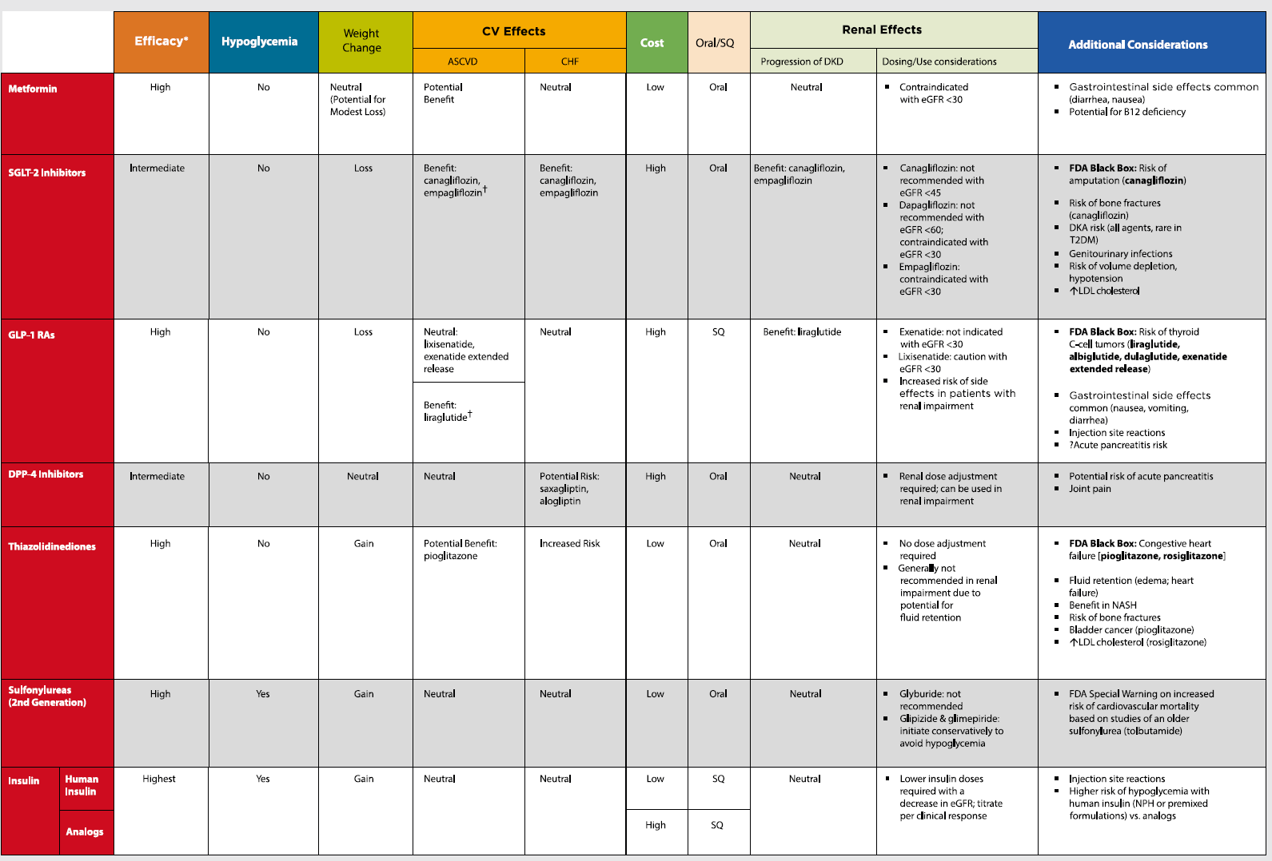

Slide 11
Notice!
Avoid using insulin as a threat or describing it as a sign of personal failure or punishment.

Slide 12
The Role of Basal Insulin
ADA recommends starting basal insulin in Pts with newly diagnosed T2DM
With symptoms
HbA1c > than 10%
Blood glucose level ≥ 300 mg/dL

Slide 13
Consider
1- Weight gain
2-Hypoglycemia

Slide 14
Balancing Good Glycemic Control with a Low Risk of Hypoglycemia…
Glycemic control
Hypoglycemia
Notes:
14
Key Point
Essentially, the key to good insulin therapy is to balance good glycemic control with a low risk of hypoglycemia.

Slide 15
Patient Counseling Topics
Review symptoms and treatment of hypoglycemia
Proper training and correct use of glucose monitor
Target desired glycemic levels for each patient

Slide 16
Barriers to initiating Insulin
Patients may have fear—founded or unfounded—of injections, hypoglycemia, or weight gain.
There are limitations after you start treatment, such as hypoglycemia, nonadherence due to complexity of the regimen, and weight gain.

Slide 17
what would be an appropriate treatment plan for her to follow at home?
Long acting Insulin (glargine , determir, Abasaglar ) at 10 units daily
Metformin 1000 mg and sitagliptin 100 mg twice daily plus basal insulin 10 U
Metformin 1000 mg and sitagliptin 50 mg twice daily plus Long acting Insulin (glargine or determir )at 20 units daily
Metformin 1000 mg and sitagliptin 50 mg twice daily plus insulin NPH 16 units daily

Slide 18
Basal insulin
Intermediate acting
NPH
Long acting
Glargine
Detemir
Glargine biosimilar (Basaglar)
Ultra-long-acting insulins (less hypoglycemia at nighttime)
Degludec U100,U200
Glargine U300

Slide 19
Insulins | Compounds | Dosage form/product
Intermediate-acting analogs | Human NPH | U-100 vial U-100 prefilled pen
Basal analogs | Glargine Biosimilar Detemir Degludec | U-100 vial; U-100 prefilled pen;U-300 prefilled pen; U-100 prefilled pen U-100 vial; U-100 prefilled pen U-100 prefilled pen; U-200 prefilled pen
U-300 glargine and U-200 degludec are three and two times as concentrated as their U-100 formulations and allow higher doses of basal insulin administration per volume used
Diabetes Care. 2018 Jan;41(Suppl 1):S73-S85

Slide 22
The most precise and flexible prandial coverage is possible with “basal-plus/bolus” therapy
FPG above target
HbA_{1c} above target
Basal bolus Basal + 3 prandial
Basal plus
Basal +
2 prandial
HbA_{1c} above target
Basal plus
Basal +
1 prandial
Basal insulin
once daily
(treat-to-target)
± 2nd/3rd
Drug
Lifestyle ± Metformin
HbA_{1c} > target, FBG on target
PPG ≥180 mg/dL
HbA_{1c} > target
Progressive deterioration of β-cell function
Adapted from Raccah et al. Diabetes Metab Res Rev 2007;23:257.

Slide 23
How do you pick basal insulin ?
The most affordable for the patient
Insulin will be covered by the patient's insurance
Available and accessible
How often the patient is able to administer insulin
Diabetes Care. 2018 Jan;41(Suppl 1):S73-S85

Slide 24
Basal Insulin Therapy and Hypoglycemia
The introduction of long-acting basal analogs, which have relatively flat and predictable time-action profiles compared with NPH, offers options for achieving glucose control with fewer episodes of hypoglycemia in the management of T2DM
Least hypoglycemia risk
It would be for patients who are experiencing nocturnal hypoglycemia
Diabetes Care. 2018 Jan;41(Suppl 1):S73-S85

Slide 25
How to begin Basal
Two accepted approaches for choosing a dose of basal insulin include :
Starting with a fixed dose of 10 units per day
Determining a weight-based dose of 0.1- 0.2 U/kg of body weight (in patients with usual insulin sensitivity and renal and hepatic function/day)
Although larger amounts (0.3–0.4 U/kg/day) are reasonable in the more severely hyperglycemic

Slide 26
Titrations of Basal Insulin
Every 3 days, if the fasting blood glucose is not in the target range of 80–130 mg/dl, the dose of basal insulin can be increased by:
2 units if glucose is relatively close to the fasting target (e.g. if fasting blood glucose is 130–180 mg/dl)
4 units if fasting blood glucose is > 180 mg/dl after 3 days of monitoring
A consensus treatment of the American Diabetes Association and the European Association for the study of diabetes. Diabetes Care 32:193–203, 2009

Slide 27
Titrations of Basal Insulin
If hypoglycemia with blood glucose < 70 mg/dl occurs, basal insulin should be decreased by 10% or 4 units, whichever yields the larger change
Severe hypoglycemia occur, more drastic reduction in dosing may be warranted
Be aware that the need for prandial insulin therapy will become likely the more if the daily dose exceeds 0.5 U/kg/day, especially as it approaches 1 U kg/day
After the insulin dose is stabilized, the frequency of monitoring should be reviewed
A consensus treatment of the American Diabetes Association and the European Association for the study of diabetes. Diabetes Care 2018

Slide 28
Cont’d
If basal insulin has been titrated to an acceptable fasting blood glucose level (or if the dose is 0.5 units/kg/day) and A1C remains above target, consider advancing to combination injectable therapy
Diabetes Care. 2018 Jan;41(Suppl 1):S73-S85

Slide 29
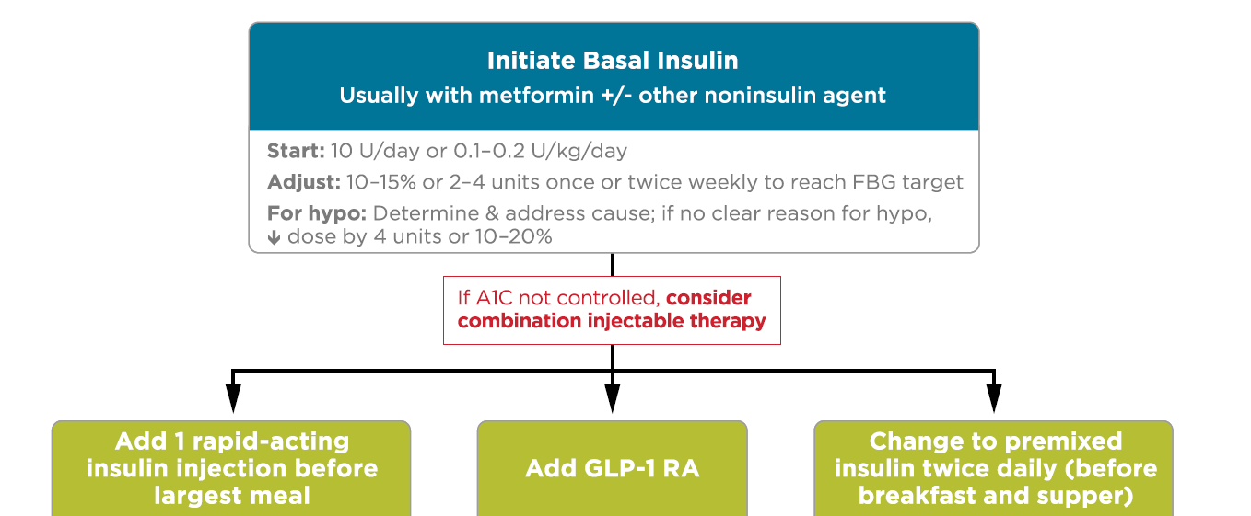
Diabetes Care. 2018 Jan;41(Suppl 1):S73-S85
Diabetes Care. 2018 Jan;41(Suppl 1):S73-S85
Diabetes Care. 2018 Jan;41(Suppl 1):S73-S85

Slide 30
A common pitfall with basal insulin dosing is increasing the dose too much before adding prandial insulin
Often, providers may note continual “fasting” hyperglycemia and titrate glargine up to 60, 80, or 100 units per day before adding prandial insulin
A consensus treatment of the American Diabetes Association and the European Association for the study of diabetes. Diabetes Care 32:193–203, 2009

Slide 31
Basal Insulin and Oral Antidiabetic Agents
Basal insulin is usually prescribed in conjunction with metformin and sometimes one additional noninsulin agent.
In general, GLP-1 receptor agonists should not be discontinued with the initiation of basal insulin.
Diabetes Care. 2006;29:1269-1274.
Diabetologia. 2006;49:442-451

Slide 32
Cont’d
When initiating combination injectable therapy, metformin therapy should be maintained while other oral agents may be discontinued on an individual basis to avoid unnecessarily complex or costly regimens (i.e., adding a fourth antihyperglycemic agent).

Slide 33
Cont’d
Sulfonylureas, DPP-4 inhibitors, and GLP- 1 receptor agonists are typically stopped once more complex insulin regimens beyond basal are used.

Slide 34
Adding rapid acting Vs GLP1 agonists
Studies have demonstrated the noninferiority of basal insulin plus a single injection of rapid-acting insulin at the largest meal relative to basal insulin plus a GLP-1 receptor agonist
Basal insulin plus GLP-1 agonists are associated with less hypoglycemia and with weight loss instead of weight gain but may be less tolerable and have a greater cost
Lancet 2014;384: 2228–2234
Diabetes Care 2014;37:2763–2773

Slide 35
What’s the difference between Gla-300 and Gla-100?
Smaller surface area^{1,2}
More compact smaller SC depot with Gla-300 vs Gla-100^{1,2}
Gla-100
Gla-300
For illustrative purposes only²
Different absorption kinetics:
More gradual and slower release¹⁻⁴
Gla-300 has a distinct PK/PD profile vs Gla-100: More stable, prolonged duration of action beyond 24 hours⁴
Insulin glargine metabolism is the same regardless of Gla-100 or Gla-300 administration; M1 metabolite was confirmed as the prinicpal active moiety circulating in blood³
PD, pharmacodynamic; PK, pharmacokinetic; SC, subcutaneous 1. Pettus J, et al. Diabetes Metab Res Rev. 2015 Oct 28. doi: 10.1002/dmrr.2763. [Epub ahead of print]; 2. Adapted from Sutton G et al. Expert Opin Biol Ther. 2014;14:1849-60; 3. Steinstraesser A et al. Diabetes Obes Metab. 2014;16:873-6; 4. Becker RH et al. Diabetes Care. 2015;38:637-43
35

Slide 36
Gla-300, in comparison to Gla-100, provides:
Age 20 to 79 years old
More constant and prolonged PK/PD profile, low glycemic variability and stable blood glucose control beyond 24 hours¹⁻³
Comparable HbA_{1C} reduction ⁴⁻⁹
Lower risk of confirmed or severe and nocturnal hypoglycemia in T2DM and T1DM⁴⁻⁹
Flexibility to select the timing of injections to either am or pm dosing and within ± 3 hours window when needed¹⁰
Slightly lower weight gain⁴⁻⁹
Similar overall safety and tolerability⁴⁻⁹
The same metabolism as Gla-100 (M1) supporting long-term CV safety^{11,12}
CV, cardiovascular; HbA_{1C}, glycated hemoglobin A_{1C}; PD, pharmacodynamic; PK, pharmacokinetic; SMPG, self-monitored plasma glucose; T1DM, type 1 diabetes mellitus; T2DM, type 2 diabetes mellitus 1. Becker RH et al. Diabetes Care. 2015;38:637-43; 2. Becker RH et al. Diabetes Obes Metab. 2015;17:261-7; 3. Bergenstal RM et al. Diabetes Technol Ther 2015;17:A16–A17; 4. Riddle MC et al. Diabetes Care. 2014;37:2755-62; 5. Yki-Järvinen H et al. Diabetes Care. 2014;37:3235-43; 6. Bolli GB et al. Diabetes Obes Metab. 2015;17:386-94; 7. Terauchi Y et al. Diabetes Obes Metab. 2016;18:366-74; 8. Home PD et al. Diabetes Care. 2015;38:2217-25; 9. Matsuhisa M et al. Diabetes Obes Metab. 2016;18:375-83; 10. Riddle M et al. Diabetes Technol Ther. 2016;18:252-7; 11. Steinstraesser A et al. Diabetes Obes Metab. 2014;16:873-6; 12. ORIGIN Trial Investigators. N Engl J Med. 2012;367:319-28
36

Slide 37
EDITION 1
U300 met the primary endpoint of non-inferiority to Lantus® for reduction in HbA_{1C} at Month 6
HbA_{1C,} mmol/mol
Mean (SE) HbA_{1C,} %
% of participants with HbA_{1c} <7.0%
70
8.5
65
8.0
U300
Lantus®
60
7.5
Lantus®
55
U300
7.0
LS mean difference at Month 6: 0.00 (95% CI –0.11 to 0.11) %†
50
6.5
LOCF
Baseline
Week 12
Month 6
†The upper bound lower than the predefined non-inferiority margin of 0.4%
Modified intention-to-treat (mITT) population; LOCF, last observation carried forward; LS, least squares
Riddle MC et al. Diabetes Care 2014: in press
SAGLB.DIA.14.06.0065 / 2014.06

Slide 38
Insulin analogues
Biphasic insulin aspart 30 (NovoMix® 30) comprises:
30% soluble, rapid-acting insulin aspart
70% protaminated insulin aspart, which is intermediate-acting
Notes:
In NovoMix 30, insulin aspart is given as a mix of 30% soluble (free) molecules and 70% protaminated (crystallised) molecules.
The transfer of protamine groups between insulin molecules does not matter as the ratio of free and protaminated insulin aspart molecules remains constant.
NovoMix 30 allows the provision of both prandial and basal insulin in a single injection.

Slide 39
How to begin: Premix

Slide 40
Start and stay with NovoMix® 30
NovoMix® 30 Summary of Product Characteristics.
Garber A et al. The 1-2-3 study. Diabetes, Obesity and Metabolism 2006; 0: 1–10.
Raskin P et al. On behalf of the INITIATE Study Group. Basal insulin or premix analogue therapy in type 2 diabetes patients. Euro J Int Med 2007; 18: 56–62.

Slide 41
BIAsp 30: dosage regimen
Dose to titrate | Timing of blood glucose measurements used for dose titration
 | BIAsp 30 OD | BIAsp 30 BID | BIAsp 30 TID
Breakfast | – | Pre-dinner | Pre-lunch
Lunch | – | – | Pre-dinner
Dinner | Pre-breakfast | Pre-breakfast | Pre-breakfast
BIAsp, biphasic insulin aspart; BID, twice daily; OD, once daily; TID, three-times daily
Garber et al. Diabetes Obes Metab 2006;8:58–66; Raskin et al. Diabetes Care 2005;28:260–5
Notes:
Dosage regimen of BIAsp 30:
For once daily, the evening dose titration is done based on pre-breakfast blood glucose level.
For twice-daily BIAsp 30, the morning dose is to be titrated based on pre-dinner blood glucose level and evening dose is to be titrated based on pre-breakfast blood glucose level.
If a patient needs further intensification for three-times-a-day BIAsp 30: the morning dose can be titrated based on the pre-lunch blood glucose, midday dose is titrated on pre-dinner blood glucose and evening dose is titrated on pre-breakfast blood glucose.
This algorithm was adapted from a 48-week, open-label, observational study. Enrolled patients (n=100, HbA_{1c} ≥7.5 and ≤10%) were ≥18 years of age, had diabetes ≥12 months and had received a stable antidiabetic regimen for at least 3 months. Patients discontinued prior basal insulin and added one injection of BIAsp 30 (12 U or 70–100% of prior basal insulin dose within 15 min of dinner initiation). Patients self-titrated their BIAsp 30 dose with investigator guidance every 3 or 4 days to achieve pre-breakfast fasting blood glucose (FBG) of 4.4–6.1 mmol/L. At 16 weeks, a pre-breakfast injection of 6 U of BIAsp 30 was added if week 15 HbA_{1c} exceeded 6.5%; the added dose was titrated to achieve pre-dinner BG of 4.4–6.1 mmol/L. After an additional 16 weeks, 3 U of pre-lunch BIAsp 30 was added if HbA_{1c} exceeded 6.5%. This added dose was adjusted based on 2-h post-lunch BG to achieve PPG of 5.6–7.8 mmol/L. Subjects achieving HbA_{1c} ≤6.5 at 15 and 31 weeks completed the study at weeks 16 and 32, respectively.

Slide 42
BIAsp 30: titration algorithm
FBG or pre-dinner SMBG |  | BIAsp 30 dose adjustment
(mg/dL)
<80 |  | –2 U
80–110 |  | –
111–140 |  | +2 U
141–180 |  | +4 U
>180 |  | +6 U
BIAsp, biphasic insulin aspart; FBG, fasting blood glucose; SMBG, self-measured blood glucose
Adapted from Raskin et al. Diabetes Care 2005;28:2811
Notes:
BIAsp 30 offers a simple dose titration based on FBG or pre-dinner SMBG.
This example of the BIAsp 30 titration algorithm is taken from Raskin et al. (2005). This was a 28-week parallel-group study that randomised 233 insulin-naïve patients with HbA_{1c} values ≥8.0% on >1000 mg/day metformin alone or in combination with other OADs. Metformin was adjusted up to 2550 mg/day before insulin therapy was initiated with 5–6 units BIAsp 70/30 twice daily or 10–12 units glargine at bedtime and titrated to target blood glucose (80–110 mg/dL) by algorithm-directed titration.

Slide 43
Recommendations
Perform the A1C test at least two times a year in patients who are meeting treatment goals (and who have stable glycemic control).
Perform the A1C test quarterly in patients whose therapy has changed or who are not meeting glycemic goals.

Slide 44
CONCLUSIONS
The importance of individualizing treatment in pts with T2DM is established
Note the barriers which are very important
Initiate with a basal insulin
Among the available insulins, long acting insulins cover all the items that have been mentioned
Titrate appropriately
Act in the way that be treat to target

Slide 45
متشکرم

