Slide 1
Adrenal hemorrhage
Marjan Khayamzadeh MD

Slide 2
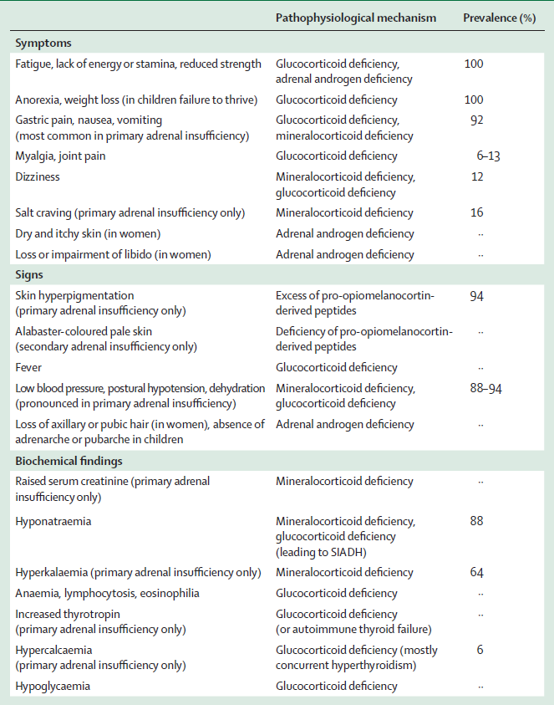

Slide 3
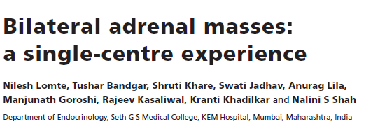

Slide 4
Retrospective analysis of 70 patients with bilateral adrenal masses presenting to a single tertiary care endocrine centre from western India (2002–2015).

Slide 5
The most common aetiology was pheochromocytoma (40%)
tuberculosis (27.1%)
primary adrenal lymphoma (PAL) (10%)
metastases (5.7%)
non-functioning adenomas (4.3%)

Slide 6
primary bilateral macronodular adrenal hyperplasia (4.3%)
and others (8.6%)

Slide 7
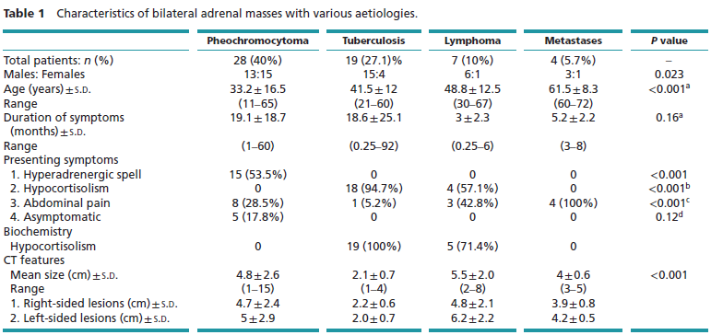

Slide 8
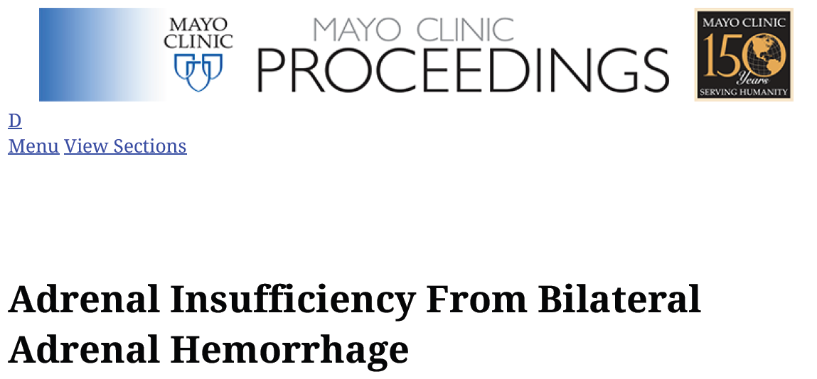

Slide 9
The diagnosis should be suspected in any complex highly stressful illness, in the postoperative period, or in the presence of a coagulopathy in conjunction with hypotension, fever, or electrolyte disturbances.

Slide 10
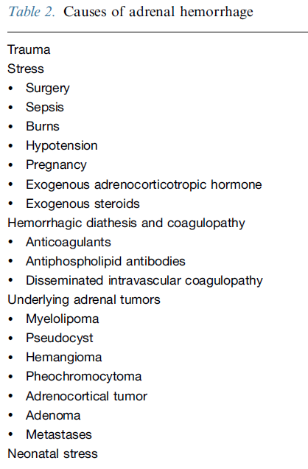

Slide 11
Case:
An healthy 70-year-old man radical cystectomy, lymphadenectomy, were performed.
On the fifth postoperative day, fever, nausea, vomiting, and increased wound drainage developed.
He became hypotensive and was found to have leukocytosis, thrombocytopenia (35,000 platelets/mm3), hyponatremia, and hyperkalemia.

Slide 12
Intra-abdominal sepsis causing disseminated intravascular coagulation was suspected.
CT examination revealed bilateral high-density adrenal gland masses, characteristic of recent adrenal hemorrhage.
A follow-up CT scan obtained 13 days after the initial scan showed a slight decrease in the size and density of the adrenal masses.

Slide 13
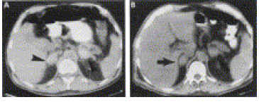

Slide 14
In the five cases reported herein, no definite histologic proof of adrenal hemorrhage was
available.The diagnosis was based on the initial CT appearance of high-density adrenal gland masses and their decreasing size and density on follow-up scans.

Slide 15
several clinical and pathologic conditions seem to be associated with adrenal hemorrhage in adults. One commonly associated condition is high-level corticotropin stimulation of the adrenal glands which might occur during the course of myocardial infarction, sepsis, pulmonary embolus, surgical stress, postoperative complications, shock, and other such illnesses.

Slide 16
Adrenal hemorrhage usually occurs within the first 3 weeks of a medical illness or the postoperative
period.
Anticoagulation and coagulopathies are also common predisposing risk factors for adrenal
hemorrhage. lupus anticoagulant could induce adrenal venous thrombosis and thus lead to
adrenal hemorrhagic infarction.

Slide 17
The symptoms and signs of bilateral adrenal hemorrhage are nonspecific. Chest, back, flank, or abdominal pain, usually associated with fever, is common. Hypotension is frequently a preterminal finding. Biochemical evidence of adrenal insufficiency (such as hyponatremia, leukocytosis, acidosis, hyperkalemia, and azotemia) can be absent or, if
present, attributed to the concomitant illness. A sudden decrease in hemoglobin concentration and hematocrit has also been described.

Slide 18
The diagnosis necessitates a high index of suspicion and can be confirmed by the use of CT of the abdomen. Once the diagnosis is suspected, lifesaving steroid replacement should be initiated without delay.

Slide 19
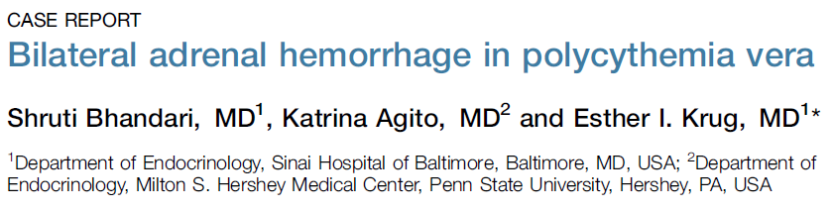

Slide 20
a 64-year-old man with polycythemia vera found to be unresponsive with fever, hypotension, tachycardia, and hypoglycemia.
Electrocardiogram showed ST-elevation with elevated troponin, hemoglobin, prothrombin time, and partial thromboplastin time.

Slide 21
He required aggressive ventilator and vasopressor support. Despite primary coronary intervention, he remained hypotensive. Random cortisol level was low. He received stress dose hydrocortisone with immediate hemodynamic stability.
BAH was highly suspected and was confirmed by non-contrast abdominal computed tomography.

Slide 22
The pathophysiology of BAH is still unknown. However, due to particular anatomy of its vascular supply adrenal gland is at risk of venous congestion and thrombosis. About 50 to 60 small branches from the 3 suprarenal arteries feed into a
subcapsular plexus that drains into the medullary sinusoids by few small venules forming a large central vein.

Slide 23
The transition from artery to capillary plexus is abrupt and constitutes a ‘vascular dam’. This complex microvascular system of the adrenal glands predispose them to be vulnerable to thrombosis or hemorrhagic necrosis.

Slide 24
Conclusion
This case illustrates the importance of being aware of the risk factors for BAH in critically ill patients. The presence of hypercoagulability and refractory hypotension should raise clinical suspicion of BAH. Abdominal CT scan, while valuable in establishing diagnosis of adrenal hemorrhage, must not delay initiation of lifesaving corticosteroid therapy.

Slide 25
CASE REPORT (1992): an 85-year-old man with PV associated with thrombocytosis who presented with
syncope and abdominal tenderness.
They concluded that coagulopathy is what appears to link PV with BAH.

Slide 26
CASE REPORT(2011):a 56-year-old man with PV who presented with epigastric discomfort, nausea, and vomiting.splenomegally was noted.
A well defined mass measuring 4*5*5.5 cm in right adrenal and a mass of 4*3*2cm in left adrenal were detected.
Basal cortisol,ACTH and ACTH stimulasion test confirmed adrenal insufficiency.

Slide 27
BAH was attributed to high thrombocyte count.
The case was considered to be bilateral adrenal hemorrhage associated with PV and consequent adrenal insufficiency and prednisolone was started.

Slide 28
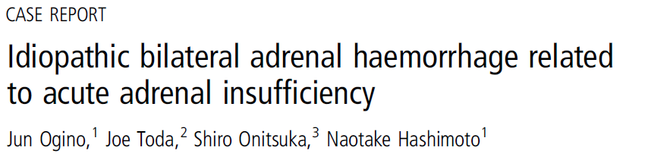

Slide 29
A 54-year-old woman presented with sudden
epigastralgia and left back pain. She had no significant history. Abdominal CT showed left adrenal enlargement and haemorrhage. Hydrocortisone therapy was started to prevent adrenal insufficienc. On the second hospital
day, abdominal CT showed additional right adrenal
enlargement and haemorrhage.

Slide 30
No specific findings were detected by bilateral adrenal angiography. 6 to 12 months later, abdominal CT showed decreased bilateral adrenal haemorrhage.
In parallel with this, repeated blood examinations showed improvement of ACTH and cortisol levels. The dosage of oral hydrocortisone replacement was gradually decreased and then stopped at 6 months after discharge.

