Slide 1
Modern Spectrum of Bone Turnover Markers:
Are They Clinically Useful?
Dr.Zahedi fellow of endocrinology

Slide 2
bone turnover markers
BTM can be measured in serum, plasma and urine and their levels relate to the activity of osteoblasts (bone formation markers) and osteoclasts (bone resorption markers)
Bone formation markers include proteins that are specific to bone (osteocalcin), or not so specific to bone such as fragments of type I procollagen released during formation of type I collagen (N-propeptide of type I collagen, PINP) and the bone isoform of alkaline phosphatase (bone ALP)
Bone resorption markers include fragments released from the telopeptide (end)region of type I collagen following its enzymatic degradation, including the N-telopeptide of type I collagen (NTX) and the C-telopeptide of type I collagen (CTX), deoxypyridinoline(DPD) and the enzyme tartrate resistant acid phosphatase (TRAP)

Slide 3
TRAP
Human serum contains two forms of tartrate-resistant acid phosphatase (TRAP), 5a and 5b. Of these, 5a contains sialic acid and 5b does not.
antigenic properties and pH optimum of TRAP purified from human osteoclasts are identical to those of serum TRAP 5b and completely different from those of serum TRAP 5a, suggesting that 5b would be derived from osteoclasts and 5a from some other source

Slide 4
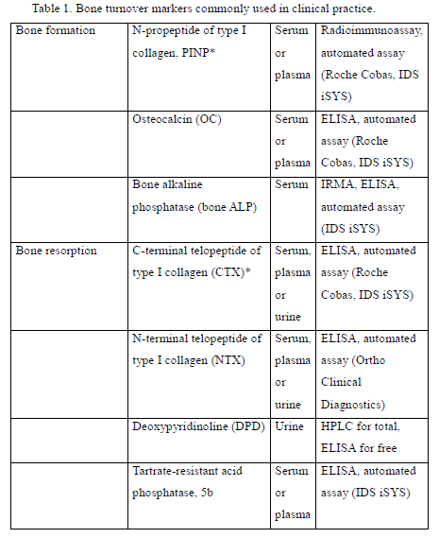

Slide 5
In women, the BTMs increase after the menopause and in other situations of accelerated bone loss
In men, there is little increase with age
In cohort studies of women (but not of men), the higher the BTM, the more rapid the bone loss and the greater the risk of fracture
Thus, the measurement of BTM may have clinical relevance to the individual
A typical goal of therapy might be to lower BTM to values found in women before the menopause.

Slide 6
History, assays and validation
Bone histomorphometry is the gold standard for assessment of bone turnover, but it is invasive, cannot be repeated many times in an individual and requires specialist laboratory interpretation
Bone turnover can also be quantified with calcium balance and kinetic studies, but they are time-consuming, use radio-isotopes and again need specialist interpretation
assays for total alkaline phosphatase (ALP) were available in the 1920s, only about half of the total ALP is from bone

Slide 7
History, assays and validation
Hydroxyproline assays were developed in the 1950s, but again were not specific for bone, and were laborious and dangerous (they resulted in explosions)
There were significant developments in the 1980s and 1990s with assays for pyridinium crosslinks (deoxypyridinoline and pyridinolone), bone ALP, PINP and osteocalcin and progression from HPLC to immunoassays
The introduction of automated immunoassay analysers in 2000 was a major technical advance. These are widely used in clinical practice for measuring many analytes, including hormones, as well as BTM and they do so with high precision (CV less than 5%) and reliability

Slide 8
History, assays and validation
BTM have been validated against gold standard methods for studying bone turnover such as a comparison with tracer kinetics and bone histomorphometry, both in health (Eastell 1988 2) and in response to osteoporosis treatments (Eastell 1997 3)
There were weak to moderate correlations (highest r-value was 0.41) between the bone formation markers PINP or bone ALP and bone formation estimates, and between CTX and bone resorption estimates

Slide 9
Currently-used BTM were evaluated in a study of 370 women with osteoporosis (Chavassieux 2015 4)

Slide 10
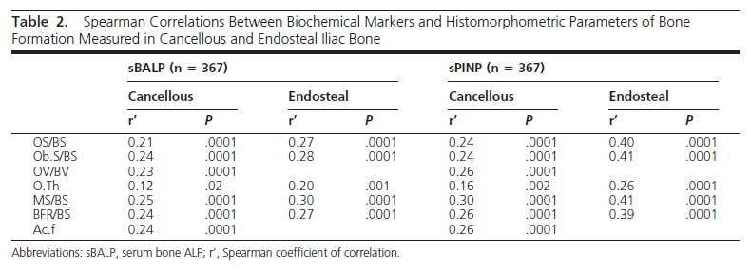
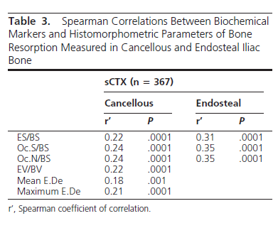

Slide 11
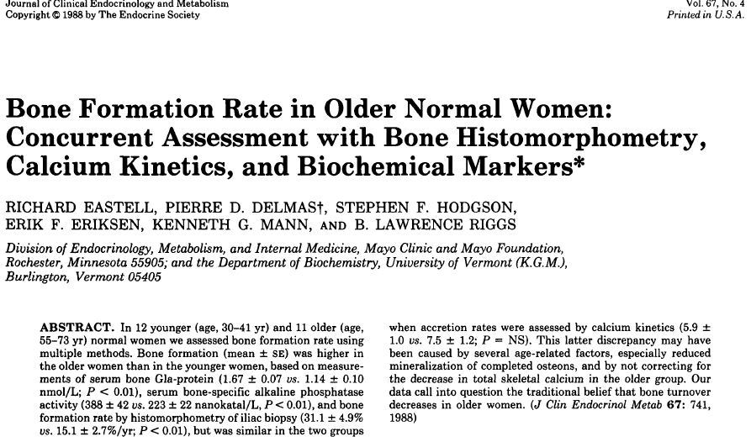

Slide 12
Bone Gla-protein (BGP; osteocalcin) is a specific osteoblast product, and serum BGP levels reflect almost entirely osteoblast synthesis
The bone isoenzyme of alkaline phosphatase (BAP) also is a specific osteoblast product
bone formation ratevolume referent (BFR-v) measured by histomorphometry of a transiliac biopsy sample

Slide 13
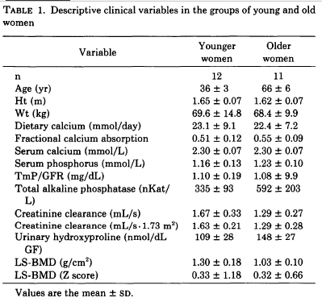
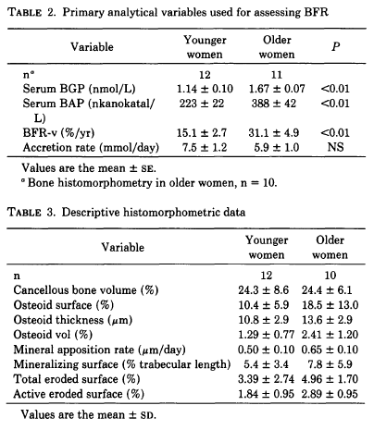

Slide 14
Practical aspects
There are different requirements for the use of BTM in clinical practice compared to the research setting
BTM need to be measured reliably and easily, be locally accessible, inexpensive and be unaffected by the time of day the samples are obtained
The bone resorption markers show a strong circadian rhythm and decrease shortly after feeding. Thus, it is recommended that blood samples for CTX be drawn from the patient following an overnight fast between 07:30 and 10:00 (Szulc 2017 5)

Slide 15
Practical aspects
The sample can be stored frozen until measured; if the storage is likely to be more than 12 weeks, it is recommended that this is at -70 to -80° C (Okabe 2001 6)
It is recommended for urinary NTX that the sample is taken as the second morning void, that excessive fluid consumption is avoided and preservative is not added
As well as measuring the bone resorption marker (NTX, CTX, DPD), it is usual to measure urinary creatinine and to express the result as the BTM to creatinine ratio to correct for urinary dilution
For bone formation markers, there is a weaker circadian rhythm and so the sample can be drawn at any time of the day (Szulc 2017 5).

Slide 16
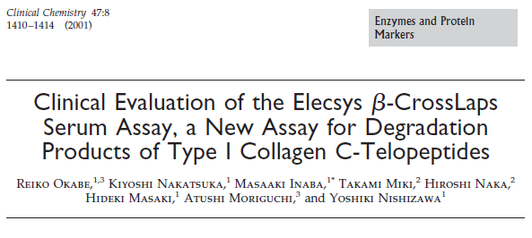
To investigate the stability of b-CTx immunoreactivity during sample preparation, blood samples drawn from 10 healthy subjects were stored in the presence or absence of EDTA at room temperature or 4 °C for 1, 2, 4, and 24 h before centrifugation at 1200g for 5 min. The resulting serum and plasma were immediately measured for b-CTx by the Elecsys b-CrossLaps serum assay.
To investigate the influence of storage of blood samples on b-CTx immunoreactivity, samples with various b-CTx concentrations obtained from patients with various metabolic bone diseases were stored at -30 °C for three different time periods between 0 and 12 weeks before measurement by the Elecsys b-CrossLaps serum assay.

Slide 17
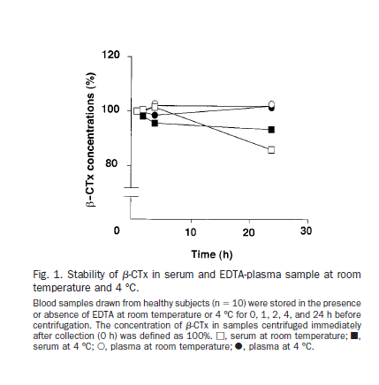
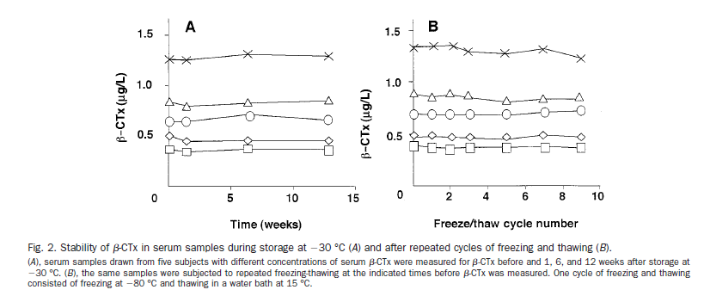

Slide 18
precision of elecsys b-CrossLaps serum assay The intraassay CV for the Elecsys b-CrossLaps serum assay, determined by measuring 10 replicates of four serum samples with different serum b-CTx concentrations in the same assay run, was 0.54 –2.6%; the interassay CV, determined by measuring the same samples daily over a 10-day period, was 1.9–4.1%

Slide 19
Choice of BTM
in chronic kidney disease, the markers that are usually excreted by the kidney circulate at very high levels and so markers that are not excreted by the kidney are best used, e.g. Bone ALP and intact PINP
In the evaluation of glucocorticoid treatment on bone, markers that are sensitive to the bone effects of these drugs may be most useful, e.g. osteocalcin and PINP which are affected in a dose-dependent manner
The IOF has proposed serum CTX and PINP as the two reference markers; they propose that all research studies should include these two at a bare minimum (Vasikaran 2011 7), but for clinical practice it may suffice to have one marker only.

Slide 20
Prediction of bone loss
Higher BTM are associated with bone loss from both trabecular and cortical bone at the hip; and also relate to greater periosteal expansion in the femoral neck (Marques 2016 )

Slide 21
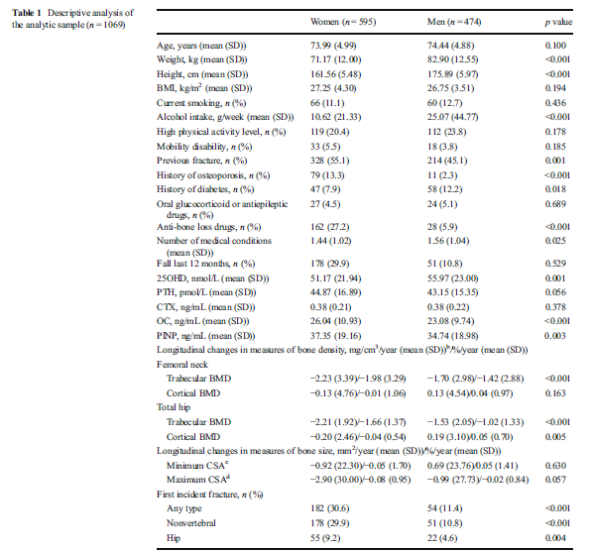

Slide 22
Only higher OC levels (upper quartile) were associated with higher annual % bone loss at both skeletal sites and across compartments (trabecular and cortical)

Slide 23
elevated BTM levels (Q4) had a significant association with accelerated bone loss at the total hip and across bone compartments, compared to those with BTM in the lower quartiles

Slide 24
Prediction of fracture
In a recent meta-analysis of 6 studies that had measurements of bone resorption (CTX) and bone formation (PINP), the hazard ratio per SD increase was similar for CTX (1,18, 95% CI 1.05 to 1.34) and PINP (1.23, 95% CI 1.09- 1.39)(Johansson 2014 14).
However, not all studies find an association between BTM and fracture risk (Marques 2016)
and the FRAX Position Development Conference members were unable to find sufficient evidence for inclusion of BTM into the FRAX fracture risk prediction algorithm (McCloskey 2011 15)

Slide 25
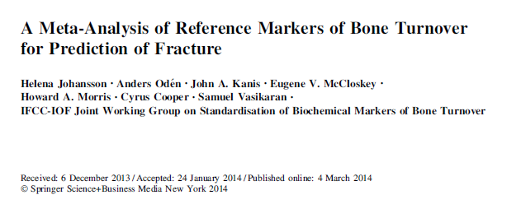
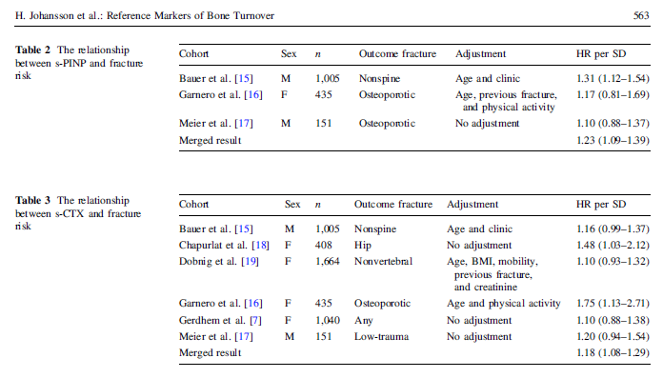

Slide 26
Bone turnover markers (BTMs) are currently not included in the FRAX algorithms because of the scarcity of quality population-based prospective studies with any particular analyte
The applicability of the research database in an international setting is also insecure; for example, more than one third of studies are from France and none from Asia
There is a need to enlarge the experience of the value of BTMs for fracture risk assessment in population-based studies around the world

Slide 27
Selection of therapy
we might use anti-resorptive therapies (bisphosphonates, raloxifene, denosumab) in patients with high BTM and anabolic therapies (teriparatide, abaloparatide) in patients with low BTM
Unfortunately, this approach is not supported by the results of clinical trials. In the Fracture Intervention Trial, treatment with alendronate was more effective at reducing non-vertebral fracture in those women with higher PINP but this was not true for other BTM or other fracture types (Bauer 2006 16).
In general, a low PINP is associated with lower rates of bone loss and lower response to zoledronic acid. (Eastell 2015 18) Further research is needed

Slide 28
Treatment used for osteoporosis
Despite having several treatments that reduce the risk of fracture in osteoporosis it is well established that adherence to these treatments can be poor, especially in the case of oral bisphosphonates for which the dosing instructions are complex
Bone mineral density is commonly used as a tool to monitor treatment in the individual and an increase that exceeds the least significant change, for example an increase in lumbar spine or total hip BMD more than 4% (Diez Perez 2012 19) may be considered a response
such changes occur over many months and persistence with medication declines very early in treatment (less than 50% after 12 months, Netelenbos 2011 20)
so an earlier response marker would be preferred

Slide 29
The International Osteoporosis Foundation has proposed that a BTM such as PINP or CTX measured within 3 months of starting therapy would help identify poor adherence with the commonest osteoporosis therapy, oral bisphosphonates (Diez Perez 2017 21).
Another advantage to using BTM rather than bone mineral density is that measurements are less expensive
a PINP measurement costs less than 20% that of a bone mineral density measurement
The proportion of treatment effect explained by BTM has usually been higher than for BMD (Vasikaran 2011 7)

Slide 30
Bisphosphonate
The oral bisphosphonates have been compared in the TRIO (Naylor 2015 22) to evaluate the clinical utility of BTM to assess response

Slide 31
The TRIO study comprised a 2-year, open-label, parallel, randomised control intervention trial of three orally administered bisphosphonate

Slide 32
Fig. 1 The percentage change from baseline (mean and standard error of the mean) for a bone resorption markers and b bone formation markers for the three bisphosphonate treatments (ibandronate, alendronate, risedronate) over 2 years

Slide 33
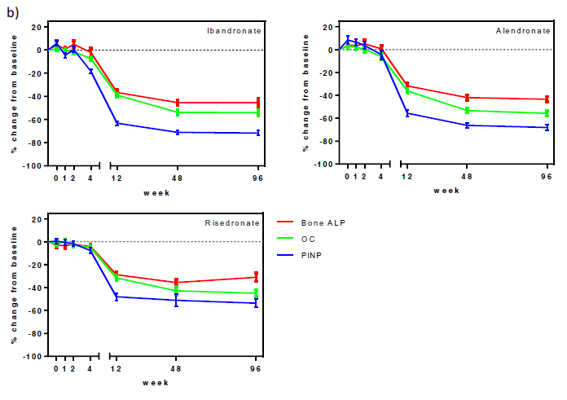

Slide 34
Percentage change from baseline Oral bisphosphonate therapy results in an early decrease in bone resorption markers and a later decrease in bone formation markers

Slide 35
Responder analysis—least significant change Both LSC and premenopausal RI approaches can identify those that reach the target for response and are associated with BMD change

Slide 36
Denosumab
Denosumab inhibits bone resorption, leading to an early and large decrease in bone resorption markers followed by a later and smaller decrease in bone formation markers
Bone resorption markers (such as CTX) decrease within 24 hours of treatment
In the FREEDOM Study, there was no overlap in CTX levels between treated and control subjects at one month indicating that everyone appears to respond (Eastell 2011 29)

Slide 37
Fracture REduction Evaulation of Denosumab in Osteoporosis every 6 Months
(FREEDOM)

Slide 38
Denosumab (Prolia) is a fully human monoclonal antibody to RANKL that blocks its binding to RANK, inhibiting the development and activity of osteoclasts, decreasing bone resorption, and increasing bone density
In the FREEDOM Trial, denosumab treatment for 3 years significantly reduced the risk of new vertebral (68%, p<.001), hip (40%, p=.04), and nonvertebral (20%, p=.01) fractures

Slide 39
Baseline characteristics

Slide 40
Fig. 1. Percent change from baseline in serum: (A) CTX, (B) PINP, (C) TRACP 5b, and (D) BALP over 36 months in the FREEDOM Trial. p<.0001

Slide 41
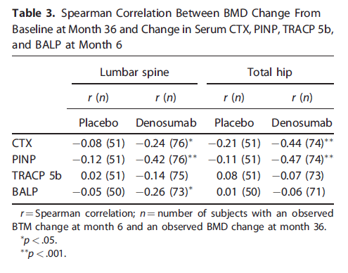

Slide 42
SERMs
raloxifene have a weaker effect on bone turnover than bisphosphonates and denosumab
Even so, their effect can be monitored using BTM
In 60 to 65% of women with osteopenia, a significant response could be demonstrated using the LSC approach with CTX or PINP (Naylor 2016 34)

Slide 43
Teriparatide
Teriparatide is an anabolic agent administered as a daily subcutaneous injection and bone formation markers increase within days of starting treatment (Glover 2009 36) ), peaking by 3 months
PINP has proven to be the most responsive BTM to this treatment
The licence for teriparatide is for 2-years as there is a concern about osteosarcoma with long-term use and the effect of the drug wanes after three years of therapy
There is accelerated bone loss after stopping teriparatide, but this can be prevented by administering bisphosphonates, raloxifene or denosumab (Ebina 2016 40).

Slide 44
Abaloparatide
Abaloparatide is a new licensed anabolic therapy for osteoporosis
the increase in PINP is less than with teriparatide (Miller 2016 42)
The clinical utility of BTMs for monitoring abaloparatide therapy have not yet been fully reported.

Slide 45
Practical approach to monitoring

Slide 46
A new review published by a joint scientific working group of the International Federation of Clinical Chemistry and Laboratory Medicine (IFCC) and the International Osteoporosis Foundation (IOF) finds that current evidence continues to support the potential for bone turnover markers (BTMs) to provide clinically useful information for monitoring osteoporosis treatment

Slide 47
The IFCC-IOF Working Group for the Standardization of Bone Marker Assays concluded that:
Important data are now available on reference interval values for CTX and PINP across a range of geographic regions and for individual clinical assays;
An apparent lack of comparability between current clinical assays for CTX has become evident, indicating the possible limitations of combining such data for meta-analyses;
To improve interpretation of patient results harmonization of units for reporting serum/plasma CTX (ng/L) and PINP (μg/L) is recommended;
Further study of the relationships between the clinical assays for CTX and PINP as well as physiological and pre-analytical factors contributing to variability in BTM concentrations is required.

Slide 48
Table 2. The critical values for PINP and CTX are supported by results in 50 women from the TRIO study

Slide 49
Sources of variability in BTMs
There is a large increase in PINP after a fracture, with a mean increase of 55% six weeks after wrist fracture (Ingle 1999 49) , 96% six weeks after ankle fracture (Ingle 1999 50) and 100% 12 weeks after tibial shaft fracture (Veitch 2006 51)
BTMs have also been report to be increased after vertebral fracture (Hashidate 2011 52)
Glucocorticoid therapy reduces the level of PINP in a dose-responsive manner
A daily dose of 10 mg prednisone resulted in a 20% reduction in PINP over a week

Slide 50
Current recommendations
The IOF and IFCC made recommendations concerning BTM and reviewed national guidelines; five out of nine national societies or organisations recommended the use of BTM for treatment monitoring
The IOF proposed that a PINP or CTX value at 12 weeks on treatment with oral bisphosphonate can identify poor response and be used to identify patients who are unlikely to be adhering to therapy or who have failed therapy
The IOF proposed using the BTMs at 12 weeks rather than 3 months on treatment and the responder rate in the TRIO study was similar for 12 and 48 weeks

