Slide 1
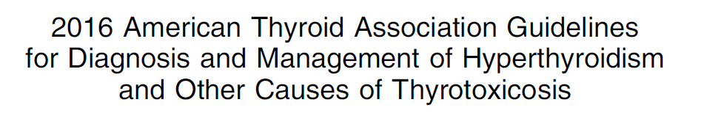

Slide 2
WHAT IS NEW IN THIS
VERSION?

Slide 3
The American Thyroid Association (ATA) previously co-sponsored guidelines for the
management of thyrotoxicosis that were published in 2011.
recommendations in 2016:one hundred twenty-four
recommendations in 2011:one hundred

Slide 4
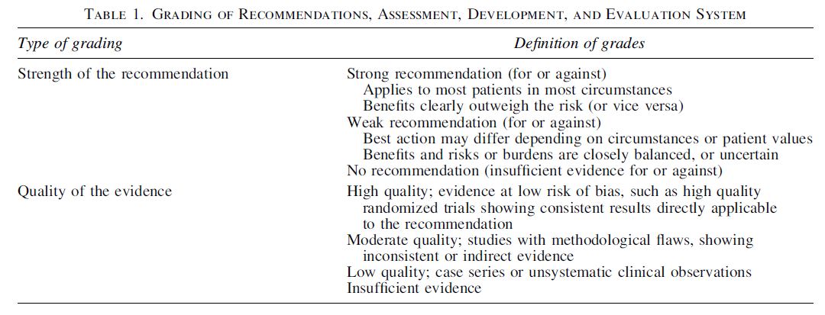

Slide 5
In the United States, the prevalence of hyperthyroidism is approximately 1.2% (0.5% overt and 0.7% subclinical)
the most common causes include:
Graves’ disease (GD)
toxic multinodular goiter (TMNG)
toxic adenoma (TA)

Slide 6
Serum TSH measurement has the highest sensitivity and specificity of any single blood test used in the evaluation of suspected thyrotoxicosis and should be used as an initial screening test. However, when thyrotoxicosis is strongly suspected, diagnostic accuracy improves when a serum TSH,free T4, and total T3 are assessed at the initial evaluation.

Slide 7
Spurious free T4 elevations may occur from heterophilic antibodies or in the setting of heparin therapy, due to in vitro activation of
lipoprotein lipase and release of free fatty acids that displace T4 from its binding proteins.
Heterophilic antibodies can also cause spurious high TSH values, and this should be ruled out by repeating the TSH in another assay, measurement of TSH in serial dilution, or direct measurement of human anti-mouse antibodies.

Slide 8
In immunometric assays, frequently used to measure TSH, excess biotin causes spuriously low results, while in competitive binding
assays, frequently used to measure free T4, excess biotin results in falsely high results. Patients taking high doses of biotin or supplements containing biotin, who have elevated T4 and suppressed TSH should stop taking biotin and have repeat measurements at least 2 days later.

Slide 9
RECOMMENDATION 1
The etiology of thyrotoxicosis should be determined. If the diagnosis is not apparent based on the clinical presentation and initial biochemical evaluation, diagnostic testing is indicated and can include, depending on available expertise and resources
(1) measurement of TRAb
(2) determination of the radioactive iodine uptake (RAIU)

Slide 10
(3)measurement of thyroidal blood flow on ultrasonography.
A 123I or 99mTc pertechnetate scan should be obtained when the clinical presentation suggests a TA or TMNG.
Strong recommendation, moderate-quality evidence.

Slide 11
In a patient with a symmetrically enlarged thyroid, recent onset of orbitopathy, and moderate to severe hyperthyroidism,the diagnosis of GD is likely and further evaluation of hyperthyroidism causation is unnecessary. In a thyrotoxic patient with a nonnodular thyroid and no definite orbitopathy,measurement of TRAb or RAIU can be used to distinguish GD from other etiologies.

Slide 12
In a study using a model of a theoretical population of 100,000 enrollees in a managed care organization in the United States, the use of TRAb measurements to diagnose GD compared to RAIU measurements reduced costs by 47% and resulted in a 46% quicker diagnosis.

Slide 13
The choice of initial diagnostic testing depends on cost,availability, and local expertise. TRAb is cost effective because if it is positive it confirms the diagnosis of the most common cause of thyrotoxicosis. If negative it does not distinguish among other etiologies, however, and it can be negative in very mild GD. If third-generation TRAb assays
are not readily available, RAIU is preferred for initial testing.

Slide 14
Diagnostic testing may be influenced by the choice of therapy.For example, measuring TRAb in a patient with GD who plans on taking methimazole (MMI) with the hope of achieving a remission will provide a baseline
measurement for disease activity.
Obtaining a RAIU in a patient who prefers RAI treatment will provide both diagnostic information and facilitate the calculation of the RAI dose.

Slide 15
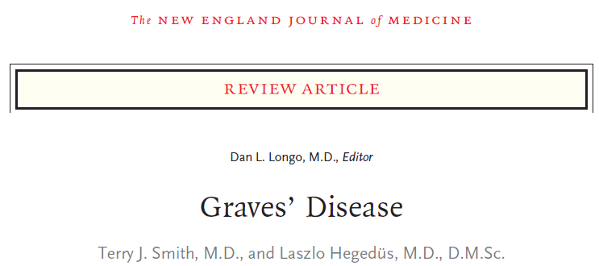

Slide 16
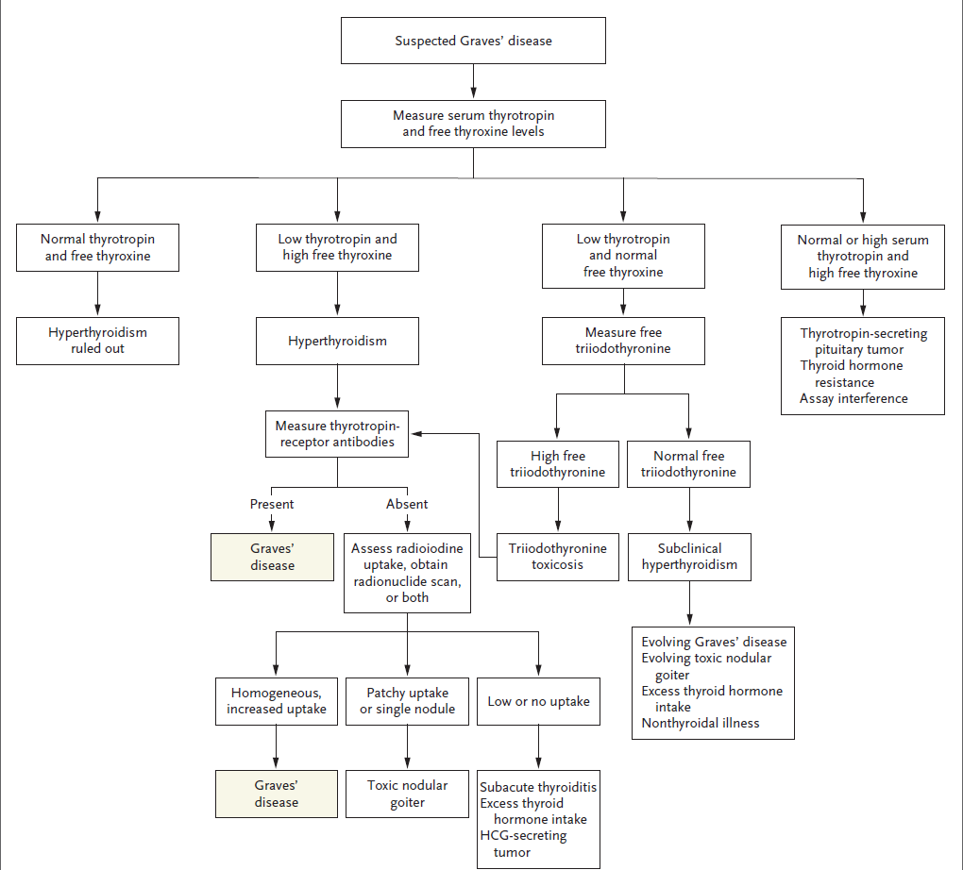

Slide 17
In patients with antithyroglobulin antibodies, which interfere with thyroglobulin measurement, an alternative but not widely available approach is measurement of fecal T4.
mean values are:
1.03 nmol/g in euthyroid patients
1.93 nmol/g in Graves’ hyperthyroidism
12–24 nmol/g in factitious thyrotoxicosis

Slide 18
Symptomatic management
In a randomized controlled trial of MMI alone versus MMI and a b-adrenergic blocking agent, after 4 weeks, patients taking b-adrenergic blockers had lower heart rates, less shortness of breath and fatigue, and improved ‘‘physical functioning’’ on the SF-36 health questionnaire.

Slide 19
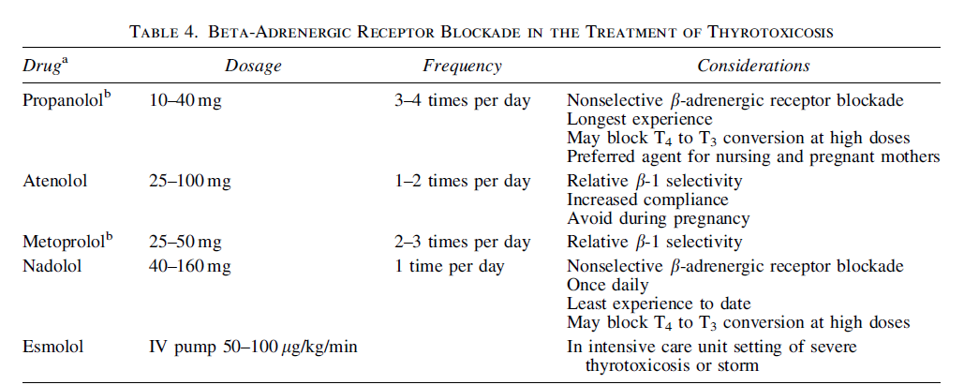

Slide 20
Management in gd
RECOMMENDATION 3
Patients with overt Graves’ hyperthyroidism should be treated with any of the following modalities:
RAI therapy
ATDs
Thyroidectomy
Strong recommendation, moderate-quality evidence.

Slide 21
In the United States, RAI has been the therapy most preferred by physicians, but a trend has been present in recent years to increase use of ATDs and reduce the use of RAI. A 2011 survey of clinical endocrinologists showed that 59.7%of respondents from the United States selected RAI as primary therapy for an uncomplicated case of GD, compared with 69% in a similar survey performed 20 years earlier.

Slide 22
In Europe, Latin America, and Japan, there has been a greater physician preference for ATDs. The long-term quality of life (QoL) following treatment for GD was found to be the same in patients randomly allocated to one of the three treatment options. Currently, no scientific evidence exists to support the recommendation of alternative therapies for the treatment of hyperthyroidism.

Slide 23
Once the diagnosis has been made, the
treating physician and patient should discuss each of the treatment options, including the logistics, benefits, expected speed of recovery, drawbacks, potential side effects, and costs.

Slide 24
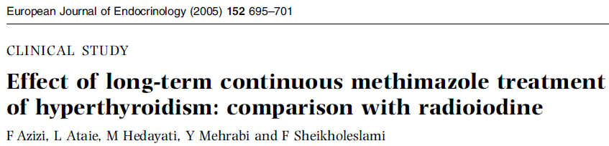

Slide 25
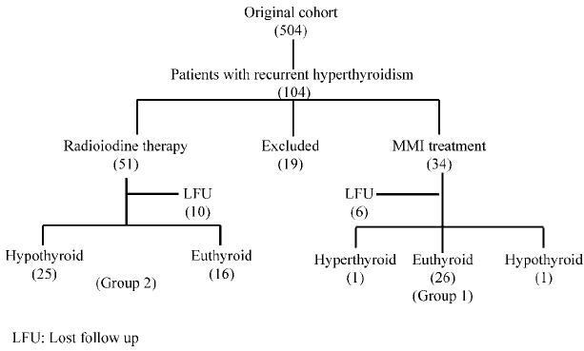

Slide 26
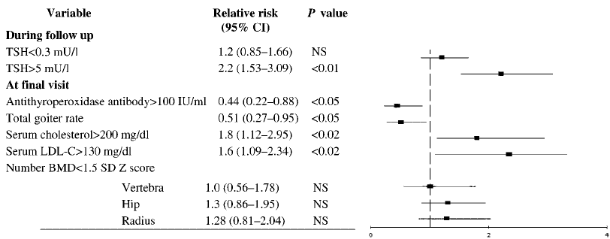

Slide 27
Results: There was no significant difference in age, sex, duration of symptoms and thyroid function between the two groups. No serious complications occurred in any of the patients. The cost of treatment was lower in group 1 than in group 2. At the end of 10 years, goiter rate was greater and
antithyroperoxidase antibody concentration was higher in group 1 than in group 2.

Slide 28
Serum cholesterol and low density lipoprotein-cholesterol concentrations were increased in group 2 as compared with group 1; relative risks were 1.8 (1.12–2.95, P , 0.02) and 1.6 (1.09–2.34,P , 0.02) respectively. Bone mineral density and echocardiographic measurements were not different between the two groups.

Slide 29
Conclusion: Long-term continuous treatment of hyperthyroidism with MMI is safe. The complications and the expense of the treatment do not exceed those of radioactive iodine therapy.

Slide 30
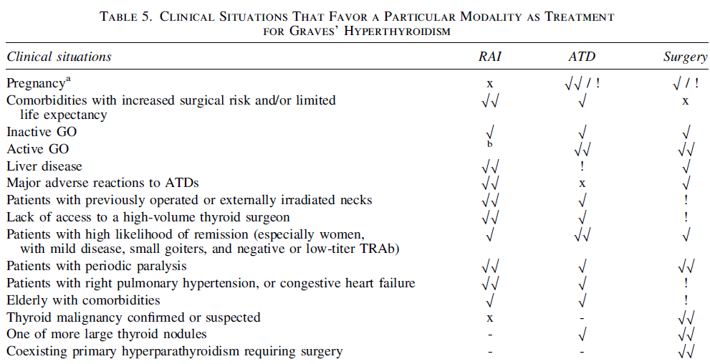

Slide 31
Rai therapy
RECOMMENDATION 4
Because RAI treatment of GD can cause a transient exacerbation of hyperthyroidism, b-adrenergic blockade should be considered even in asymptomatic patients who are at increased risk for complications due to worsening of hyperthyroidism (i.e., elderly patients and patients with comorbidities).
Weak recommendation, low-quality evidence.

Slide 32
RECOMMENDATION 5
In addition to b-adrenergic blockade, pretreatment with MMI prior to RAI therapy
for GD should be considered in patients who are at increased risk for complications due to worsening of hyperthyroidism.MMI should be discontinued 2–3 days prior to RAI.
Weak recommendation, moderate-quality evidence.

Slide 33
RECOMMENDATION 6
In patients who are at increased risk for complications due to worsening of hyperthyroidism, resuming MMI 3–7 days
after RAI administration should be considered.
Weak recommendation, low-quality evidence

Slide 34
A special diet is not required before RAI therapy, but nutritional supplements that may contain excess iodine and seaweeds should be avoided for at least 7 days. A low-iodine diet may be useful for those with relatively low RAIU to increase the proportion of RAI trapped.

Slide 35
Patients that might benefit from adjunctive MMI or carbimazole may be those who tolerate hyperthyroid symptoms poorly. Such patients frequently have free T4 at 2–3 times the upper limit of normal.
Young and middle-aged patients who are otherwise healthy and clinically well compensated despite significant biochemical
hyperthyroidism can generally receive RAI without pretreatment.

Slide 36
In elderly patients or in those with underlying cardiovascular disease, resuming MMI or carbimazole 3–7 days after RAI administration should be considered and generally tapered as thyroid function normalizes

Slide 37
In one study, if MMI was restarted 7 days after RAI, the free T4 measured 3 weeks after RAI was 6% lower than the values at the time of RAI administration, and if MMI was not restarted after RAI, the free T4 values were 36% higher than the values at the time of RAI administration.

Slide 38
In selected patients with Graves’
hyperthyroidism who would have been candidates for pretreatment with ATDs because of comorbidities or excessive symptoms, but who are allergic to ATDs, the duration of hyperthyroidism may be shortened by administering iodine (e.g., saturated solution of potassium iodide [SSKI]) beginning 1 week after RAI administration.

Slide 39
Rai in treatment of gd
The goal of RAI therapy in GD is to control hyperthyroidism by rendering the patient hypothyroid.
The success of RAI therapy in GD strongly depends on the administered activities.
In patients without adjunctive ATD,randomized controlled trials found 61% success with 5.4 mCi(200 MBq), 69% with 8.2 mCi (302 MBq), 74% with 10 mCi (370 MBq), 81% with 15 mCi (555 MBq) and 86% with 15.7 mCi (580 MBq) RAI.

Slide 40
Because of the high proportion of patients requiring retreatment,RAI therapy with low activities is generally not recommended.

Slide 41
A recent meta-analysis found no increase in the overall cancer risk after RAI treatment for hyperthyroidism; however, a trend towards increased risk of thyroid, stomach, and kidney cancer was seen, requiring further research.

Slide 42
Fetuses exposed to RAI after the 10th to 11th week of gestation may be born athyreotic and are also at a theoretical increased risk for reduced intelligence and/or cancer.
In breastfeeding women, RAI therapy should not be administered for at least 6 weeks after lactation stops to ensure that RIA will no longer be actively concentrated in the breast tissue. A delay of 3 months will be more reliale. Breastfeeding should not be resumed after RAI therapy.

Slide 43
Breastfeeding and maternal and infant iodine nutrition
Fereidoun Azizi, M.D. and Peter Smyth, MSc, Ph.D
Clin Endocrinol 2009 May:70(5);803-9

Slide 44
Adequate concentration of iodine in breast milk is essential to provide for optimal neonatal thyroid hormone stores and to prevent impaired neurological development in breastfed neonates. The current WHO/ICCIDD/UNICEF
recommendation for daily iodine intake (250 μg for lactating mothers) has been selected to ensure that iodine deficiency dose not occur in the postpartum period and that the iodine content of the milk is sufficient for the infant’s iodine requirement.

Slide 45
RECOMMENDATION 11
Follow-up within the first 1–2 months after RAI therapy for GD should include an assessment of free T4, total T3,and TSH. Biochemical monitoring should be continued at 4- to 6-week intervals for 6 months, or until the patient becomes hypothyroid and is stable on thyroid hormone replacement.
Strong recommendation, low-quality evidence.

Slide 46
Once euthyroidism is achieved, lifelong annual thyroid function testing is recommended at least annually, or if the patient experiences symptoms of hypothyroidism or hyperthyroidism.

Slide 47
Atd in treatment of gd
RECOMMENDATION 13
MMI should be used in virtually every patient who chooses ATD therapy for GD, except during the first trimester of pregnancy when PTU is preferred, in the treatment of thyroid storm, and in patients with minor reactions to MMI who refuse RAI therapy or surgery.
Strong recommendation, moderate-quality evidence.

Slide 48
At the start of MMI therapy, initial doses of 10–30 mg daily are used to restore euthyroidism, and the dose can then be titrated down to a maintenance level (generally 5–10 mg daily).The dose of MMI should be targeted to the degree of thyroid dysfunction because too low a dose will not restore a euthyroid state in patients with severe disease and an excessive dose can cause iatrogenic hypothyroidism in patients with mild disease.In addition,adverse drug reactions are more frequent with higher MMI doses.

Slide 49
MMI | FT4
5-10 mg | 1-1.5 times the ULN
10-20 mg | 1.5-2 times the ULN
30-40 mg | 2-3 times the ULN

Slide 50
These rough guidelines should be tailored to the individual patient, incorporating additional information on symptoms, gland size, and total T3 levels where relevant. Serum T3 levels are important to monitor
initially because some patients normalize their free T4 levels with MMI but have persistently elevated serum T3, indicating
continuing thyrotoxicosis.

Slide 51
MMI has the benefit of once-a-day administration and a reduced risk of major side effects.
When more rapid biochemical control is needed in patients with severe thyrotoxicosis, an initial split dose of MMI (e.g., 15 or 20 mg twice a day) may be more effective than a single daily dose because the duration of action of MMI may be less than 24 hours.

Slide 52
The use of potassium iodide (KI) as a beneficial adjunct to ATD therapy for GD has been investigated in previous studies.Indeed, a recent randomized controlled trial described the administration of 38 mg of KI together with15 mg of MMI daily, which resulted in better control of hyperthyroidism
and fewer adverse reactions compared to
30 mg of MMI given alone.

Slide 53
ADVERSE EFFECTS OF ATDS
Common minor allergic side effects:pruritus,limited rash
Rare serious allergic/toxic events:agranulocytosis,vasculitis or hepatic damage

Slide 54
Agranulocytosis:PTU at any dose appears to be more likely to cause agranulocytosis compared with low doses of MMI.No predictive risk factors for the development of agranulocytosis could be identified.
MMI hepatotoxicity has been described as typically cholestatic, but hepatocellular disease may be seen.In contrast, PTU can cause fulminant hepatic necrosis that may be fatal; liver transplantation has been necessary in some patients taking PTU.

Slide 55
Vasculitis:PTU and rarely MMI can cause antineutrophil cytoplasmic antibody (pANCA)-positive small vessel vasculitis as well as drug-induced lupus.
The risk appears to increase with duration of therapy as opposed to other adverse effects seen with ATDs that typically occur early in the ANCA-positive
vasculitis is more common in patients of Asian ethnicity, and the majority of reports come from Asia.

Slide 56
When the drug is discontinued, the ANCA
slowly disappear in most individuals .In most cases, the vasculitis resolves with drug
discontinuation, although immunosuppressive therapy may be necessary.
Rare cases of insulin autoimmune syndrome with symptomatic hypoglycemia have been reported in patients treated with MMI

Slide 57
Patients may be switched from one drug to another when necessitated by minor side effects, but 30 to 50% of patients have a
similar reaction to each drug.
patients with severe side effects should not be further expose to either drug.
There is no benefit from granulocyte colony-stimulating factor in patients with agranulocytosis.
n engl j med 375;16 nejm.org October 20, 2016

Slide 58
Monitoring of patient taking ATDs:
An assessment of serum free T4 and total T3 should be obtained about 2–6 weeks after initiation of therapy, depending on the severity of the thyrotoxicosis.
Once the patient is euthyroid, the dose of MMI can usually be decreased by 30%–50%, and biochemical testing repeated in 4–6 weeks.

Slide 59
Once euthyroid levels are achieved with the
minimal dose of medication, clinical and laboratory evaluation can be undertaken at intervals of 2–3 months. If a patient is receiving long-term MMI (>18 months), this interval can be increased to 6 months.

Slide 60
RECOMMENDATION 17
There is insufficient evidence to recommend for or against routine monitoring of WBC counts in patients taking ATDs.
No recommendation; insufficient evidence to assess benefits and risks.

Slide 61
If monitoring is employed, the maximum benefit would be for the first 90 days of therapy, when the vast majority of agranulosis occurs.
The contraindication to use PTU might be reconsidered in life-threatening thyrotoxicosis (i.e., thyroid storm) in a MMI-treated patient who has developed agranulocytosis, especially if the duration of therapy is brief.

Slide 62
RECOMMENDATION 19
There is insufficient information to recommend for or against routine monitoring of liver function tests in patients taking ATDs.
No recommendation; insufficient evidence to assess benefits and risks.

Slide 63
If monitoring is employed, the maximum benefit would be for the first 120 days of therapy, when the vast majority of instances of hepatotoxicity occur.

