Slide 1




Changing focus in type 2 diabetes
from glucose
to cardiovascular risk management
with a focus on SGLT2-inhibitors
Bernard Charbonnel
Professor of Endocrinology and Metabolic Diseases
University of Nantes, France
l’institut du thorax

Slide 2
Changing focus in type 2 diabetes
Two main questions
Is Type 2 Diabetes more a cardio-vascular disease than a metabolic disease?
Which lessons from
the outcome studies?
in other terms, is the management of
type 2 Diabetes driven
by blood glucose control
or by cardio-vascular events prevention?

Slide 3
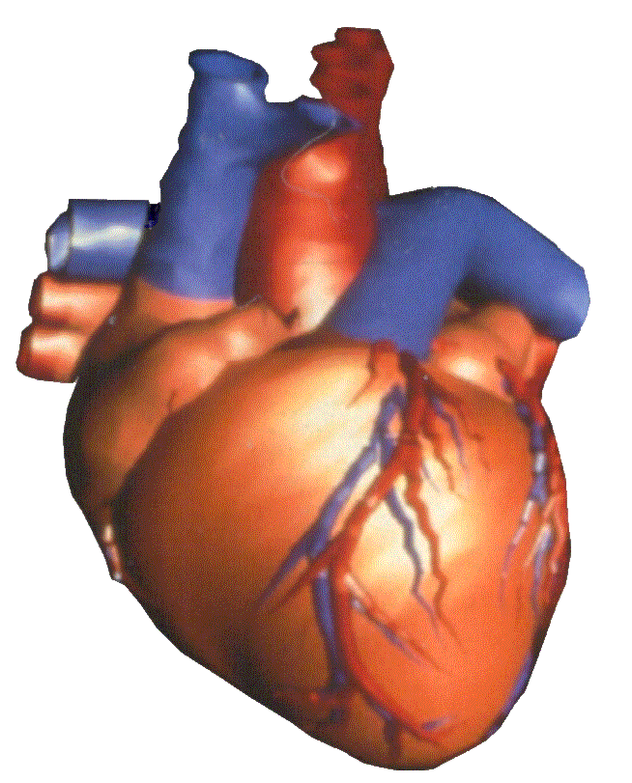
Of course, Diabetes is a cardio-vascular disease
50 % of the diabetic patients die from an heart attack
2/3 of patients in intensive care cardiology units have some kind of glucose intolerance
High prevalence of strokes in diabetic patients
Heart Failure is becoming the most frequent and serious cardio-vascular complication of Diabetes
Morrish NJ, Wang SL, Stevens LK, Fuller JH, Keen H. Mortality and causes of death in the WHO Multinational Study of Vascular Disease in Diabetes. Diabetologia 2001, 44 Suppl 2:S14–S21.

Slide 4
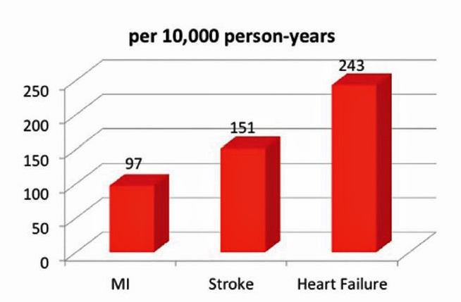
Heart Failure is becoming the most frequent cardio-vascular complication of Diabetes
Retrospective cohort study,
comparing Heart Failure to the classic primary endpoints* in many diabetes trials
*MACE:
Myocardial infarction – Stroke – CV death
Juhaeri J, Gao S, Dai WS: Pharmacoepidemiol Drug Saf 18:497–503, 2009

Slide 5
Diabetes is a cardio-vascular disease
but is also much more
than a cardio-vascular disease
Deaths, according to baseline diabetes, among 820,900 people
who had no known vascular disease at baseline, in 97 prospective studies.
cancers,
infectious diseases,
intentional self-harm,
degenerative disorders...
Between 1 and 7 years (<80 years old) of life lost due to Diabetes
~½ vascular and ~½ non-vascular
N Engl J Med 2011;364:829-41.

Slide 6
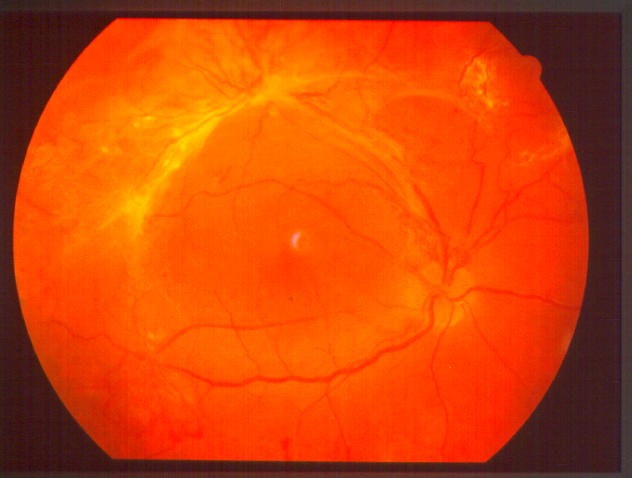

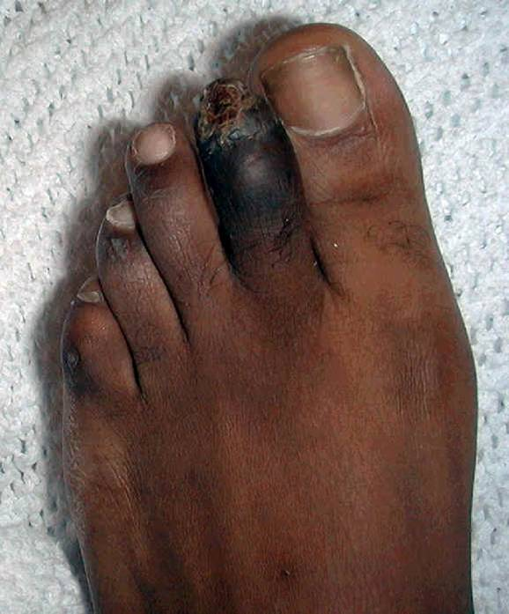
The burden of « micro-vascular » complications
Diabetic retinopathy remains a leading cause of blindness in people of working age
Diabetic Nephropathy: the most common cause of End Stage Renal Disease
The « diabetic foot » : a major cause of amputations

Slide 7
In summary,
Type 2 Diabetes is a cardio-vascular disease
but is much more,
both for mortality and morbidity
Which lessons from the outcome studies?

Slide 8
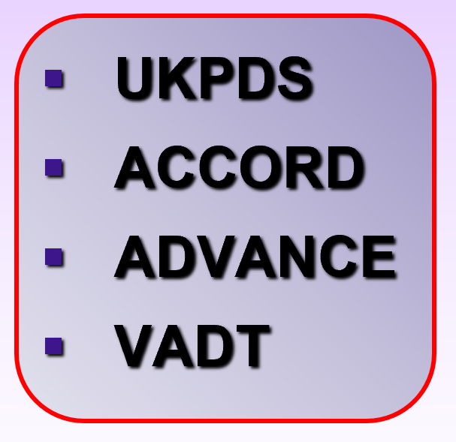
Which lessons from the outcome studies?
A good study raises ONE question
There are 2 types of outcome studies in diabetic patients which must not be confused
Studies adressing
the level of HbA1c:
Does reducing blood glucose (whatever the treatments used in that aim) prevent complications ?
The answer is:
microvascular complications: Yes
cardiovascular complications: Probably yes,
but it takes some time (> 5 years…)
and the level of evidence is not as strong as for the micro-vascular complications

Slide 9
Which lessons from the cardio-vascular outcome studies?
A good study raises ONE question
There are 2 types of outcome studies in diabetic patients which must not be confused
Studies adressing
the level of HbA1c:
Does reducing blood glucose (whatever the treatments used in that aim) prevent complications ?
Studies evaluating anti-diabetic agents:
Is a given anti-diabetic agent beneficial, neutral or deleterious, independently of any blood glucose lowering?

Slide 10
The 2 « old » agents for which good outcome studies are NOT available
Metformin
Sulfonylureas
A CV benefit has been suggested in a small subgroup of obese patients in the UKPDS but the level of evidence is weak
Many observational studies « in real life » seem to confirm this benefit
No good randomized outcome studies
The only one (UGDP 1970) suggested a CV toxicity
The many observational studies suggest an increased CV morbi-mortality compared to other agents

Slide 11
Safety studies evaluating anti-diabetic agents
Agents for which outcome studies are available
Acarbose
DPP4-inhibitors
Some GLP1r-agonists (lixisenatide – exenatide once a week)
Insulin (Glargine - Dégludec)
CV safety demonstrated
but no benefit added to the benefit of blood glucose lowering

Slide 12

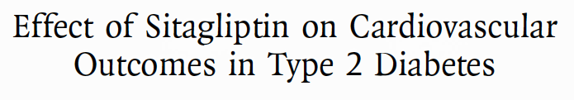
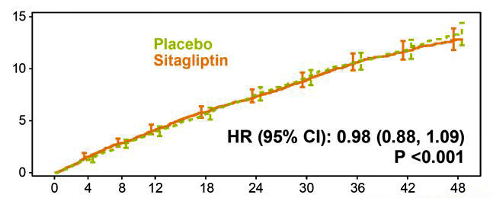
Outcome studies demonstrating CV neutrality
The example of Sitagliptin (TECOS Study)
Green JB et al. NEJM 2015
In a study population of 14 671 diabetic patients at high CV risk,
adding sitagliptin to other anti-diabetic agents
has shown neutrality which means cardio-vascular safety (placebo-like) of sitagliptin
CV death, nonfatal MI, nonfatal stroke, hospitalization for unstable angina
DPP4-inhibitors represent safe anti-diabetic agents and may prevent complications, but only through their blood glucose lowering effect

Slide 13
Safety studies evaluating anti-diabetic agents
Agents for which outcome studies are available
Acarbose
DPP4-inhibitors
Some GLP1r-agonists (lixisenatide – exenatide once a week)
Insulin (Glargine - Dégludec)
Pioglitazone¹
GLP1r-agonists
Dapagliflozin
Empagliflozin
Canagliflozin
CV safety demonstrated
but no benefit added to the benefit of blood glucose lowering
A CV benefit demonstrated added to the benefit of blood glucose lowering
but increased risk of heart failure

Slide 14
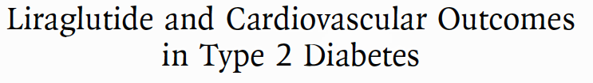

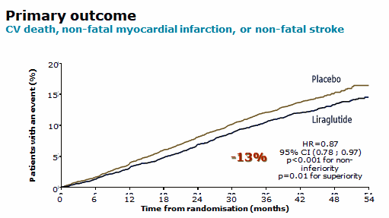
Outcome studies demonstrating CV benefit The example of Liraglutide (LEADER Study)
NEJM June 2016
Liraglutide demonstrates an extra benefit
added to that of decreasing blood glucose
With almost no difference (0,4%) for HbA1C between the 2 arms
at least in situations of CV secondary prevention

Slide 15
Outcome studies demonstrating CV benefit The example of Liraglutide (LEADER Study)
NEJM June 2016
A class effect for GLP1r-agonists:
similar positive results
published or announced
for Semaglutide - Dulaglutide - Albiglutide
Liraglutide demonstrates an extra benefit
added to that of decreasing blood glucose
With almost no difference (0,4%) for HbA1C between the 2 arms
at least in situations of CV secondary prevention

Slide 16
Changing focus in type 2 diabetes
from glucose to cardiovascular risk management
Is Type 2 Diabetes more a cardio-vascular disease than a metabolic disease?
in other terms, is the management of type 2 Diabetes driven
by blood glucose control
or by cardio-vascular events prevention?
At the light of the outcome studies,
the answer is:
Diabetes is both a cardio-vascular
and a metabolic disease
and management is driven both by glucose control and prevention of cardio-vascular events

Slide 17
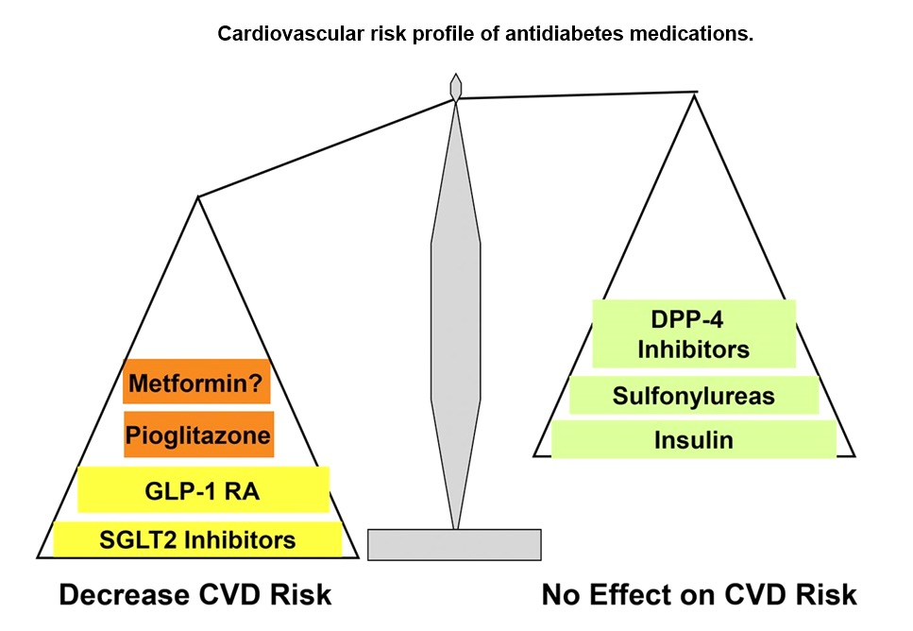
A new classification of anti-diabetic agents
All anti-diabetic agents reduce blood glucose
and can thus reduce the microvascular and probably the CV complications

Slide 18
A new classification of anti-diabetic agents
All anti-diabetic agents reduce blood glucose
But with or without a CV benefit
(added to the CV benefit of lowering blood glucose)

Slide 19
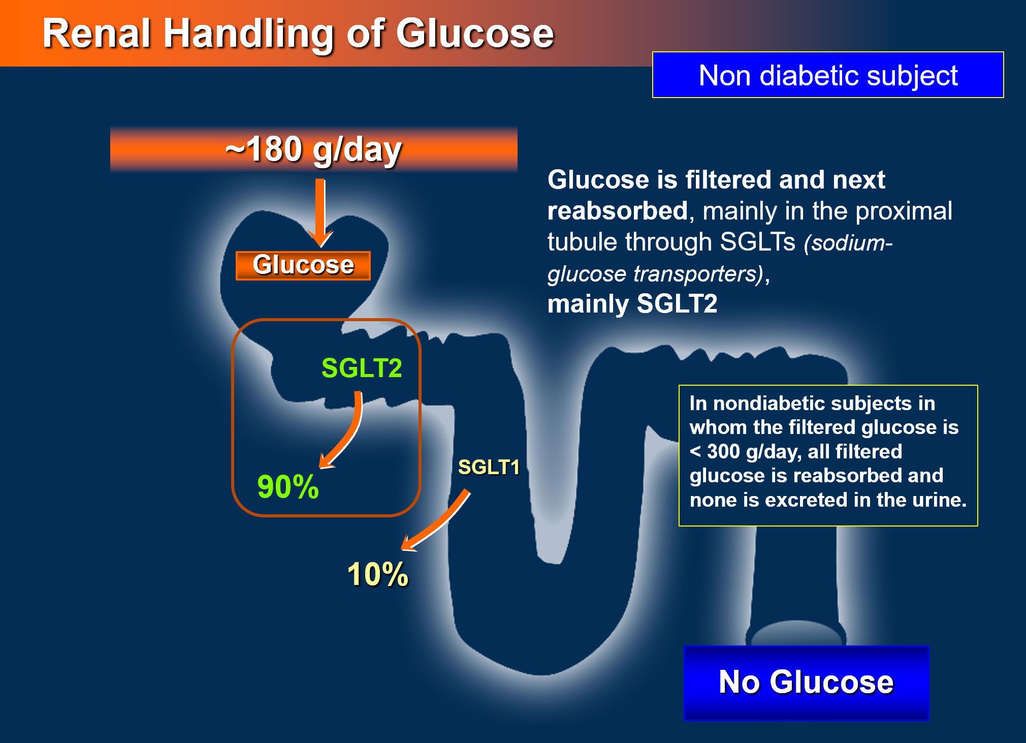
The example of SGLT2-inhibitors which both:
improve glucose control
and prevent cardio-vascular events

Slide 20

SGLT2-inhibitors: induce an osmotic diuresis
Diabetic subjects
> 200 g/day
Decrease blood glucose by inducing glycosuria
Glucose
(loss of glucose
but also related calories)
SGLT2
  Filtered glucose is not reabsorbed and thus eliminated in urine
Dapagliflozin
Canagliflozin
Empagliflozin
SG (Sodium – Glucose) LTransporter 2-inhibitors:
induce not only glycosuria but also natriuresis
Glycosuria
Notes:
20
20
The major role of the kidney in human physiology is to maintain intravascular volume and an acid-based electrolyte balance. Approximately 180 L of plasma per day pass through the kidney’s glomerular filtration system, wherein minerals such as sodium, potassium, and chloride are absorbed and returned to the bloodstream rather than passed out in the urine. Glucose is also filtered in this manner in order to retain energy essential for physiologic functioning between meals.¹
With a daily glomerular filtration rate of 180 L, approximately 162 g of glucose must be reabsorbed each day to maintain a plasma glucose concentration of 5.6 mmol/L (101 mg/dL). As shown on the slide, reabsorption of glucose occurs mainly in the proximal tubule and is mediated by 2 different transport proteins, sodium-glucose cotransporters 1 and 2 (SGLT1 and SGLT2). SGLT1, which occurs in the straight section of the tubule (S3), is responsible for approximately 10% of glucose reabsorption in the kidney. The other 90% is mediated by SGLT2, which occurs in the convoluted section on the tubule (S1).¹
Although it varies from person to person, the maximal reabsorptive capacity of the proximal tubule averages 375 mg per minute. Because the filtered glucose load in healthy nondiabetic subjects is less than this, all filtered glucose is returned to circulation and none is excreted in the urine.²
Wright EM, Hirayama BA, Loo DF. Active sugar transport in health and disease. J Intern Med. 2007;261:32-43.
Abdul-Ghani MA. Inhibition of renal glucose absorption: a novel strategy for achieving glucose control in type 2 diabetes mellitus. Endocr Pract. 2008;14:782-790.

Slide 21
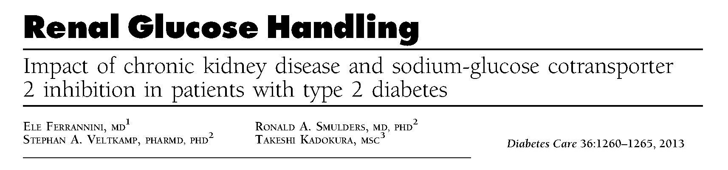
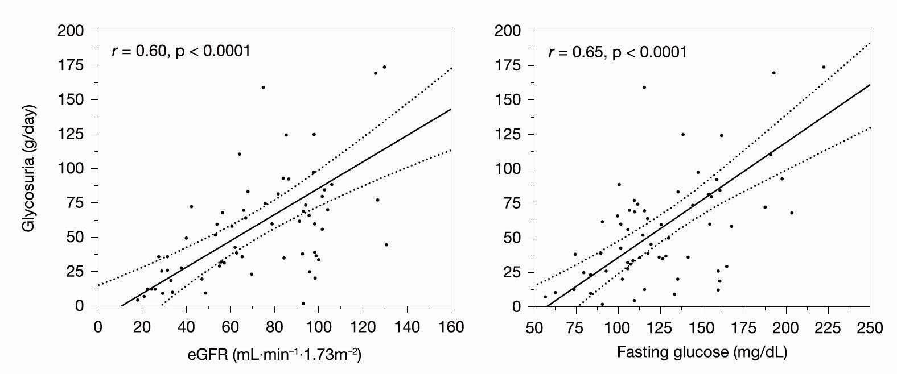
SGLT2-inhibition induced glycosuria can be described as a dual function of the GFR and plasma glucose levels with a coefficient of determination of 65%

Slide 22
The lower is GFR,
the lower is the amount of glucose filtered,
the lower is glycosuria
The higher is blood glucose,
the higher is the amount of glucose filtered,
the higher is glycosuria
SGLT2-inhibition induced glycosuria can be described as a dual function of the GFR and plasma glucose levels with a coefficient of determination of 65%

Slide 23
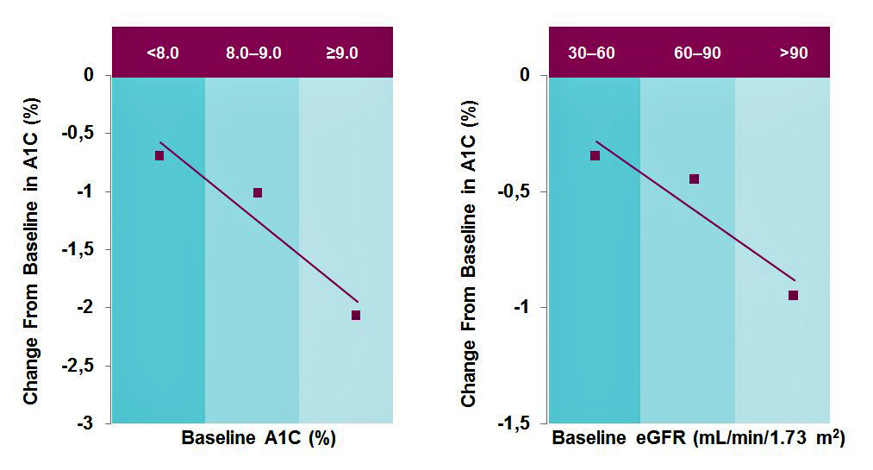
Metabolic response to SGLT2-inhibitors
A1C Reduction Is Proportional to Baseline A1C and Baseline eGFR*¹⁻⁶
Good HbA1c response
when HbA1c > 8,5%
and e-GFR > 70 mL/minute
HbA1c
eGFR
* These graphs represent models based on trends in data observed for SGLT2 inhibitors.
SGLT=sodium-glucose cotransporter; eGFR=estimated glomerular filtration rate.
Henry R et al. ADS-ASEA 2013. http://ads-adea-2013.p.asnevents.com.au/event/abstract/6757.
Kohan DE et al. Kidney Int. 2014;85:962-971.
Yale JF et al. Diabetes Obes Metab. 2013;15:463-473.
Barnett AH et al. Lancet Diabetes Endocrinol. 2014;doi:10.1016/S2213-8587(13)70208-0.
FARXIGA [package insert]. AstraZeneca Pharmaceuticals. March 2015.
Invokana [package insert]. Titusville, NJ: Janssen Pharmaceuticals, Inc; 2013.
This drug is not used in patients with moderate to severe renal impairment (patients with creatinine clearance [CrCl] < 60 ml/min or estimated glomerular filtration rate [eGFR] < 60 ml/min/1.73 m2).

Slide 24
Metabolic response to SGLT2-inhibitors
A1C Reduction Is Proportional to Baseline A1C and Baseline eGFR*¹⁻⁶
HbA1c
eGFR
Relatively poor HbA1c response in patients
with e-GFR < 60 mL/minute
and HbA1c < 7,5%
Metabolic response
CV/Renal outcomes
Still a CV and renal benefit
* These graphs represent models based on trends in data observed for SGLT2 inhibitors.
SGLT=sodium-glucose cotransporter; eGFR=estimated glomerular filtration rate.
Henry R et al. ADS-ASEA 2013. http://ads-adea-2013.p.asnevents.com.au/event/abstract/6757.
Kohan DE et al. Kidney Int. 2014;85:962-971.
Yale JF et al. Diabetes Obes Metab. 2013;15:463-473.
Barnett AH et al. Lancet Diabetes Endocrinol. 2014;doi:10.1016/S2213-8587(13)70208-0.
FARXIGA [package insert]. AstraZeneca Pharmaceuticals. March 2015.
Invokana [package insert]. Titusville, NJ: Janssen Pharmaceuticals, Inc; 2013.
This drug is not used in patients with moderate to severe renal impairment (patients with creatinine clearance [CrCl] < 60 ml/min or estimated glomerular filtration rate [eGFR] < 60 ml/min/1.73 m2).

Slide 25
SGLT2-inhibitors
Efficacy (metabolic)
(in patients with e-GFR > 60 mL/minute)

Slide 26
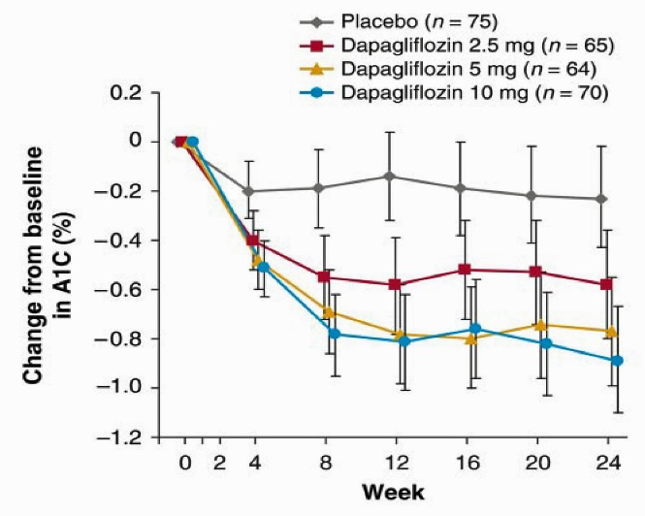
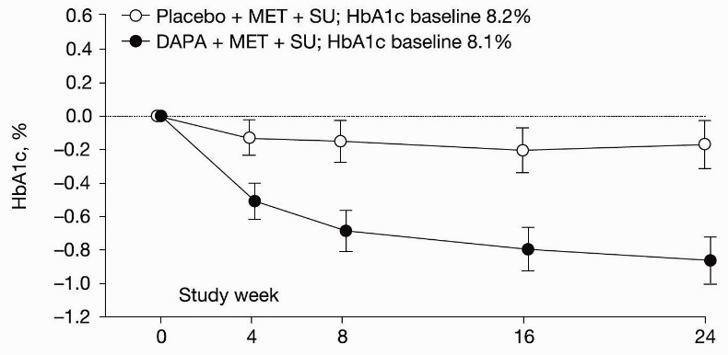
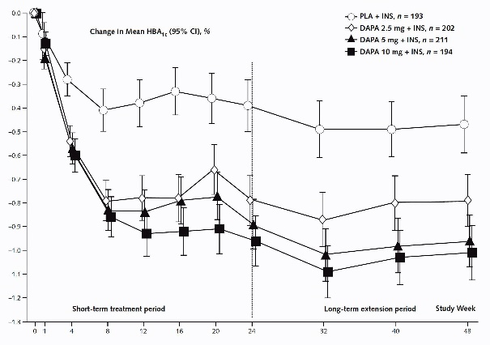
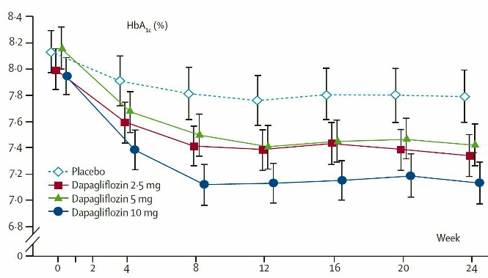
SGLT2-inhibitors (Dapagliflozin): a good blood glucose lowering efficacy at all stages of treatment intensification
Triple oral therapy
as add-on to metformin + sulfonylureas Dapagliflozin vs Placebo³ n=216
-0,69% for Dapa 10mg (baseline 8,1%)
Monothérapy:
Dapagliflozine vs Placebo¹ n=485 -0,66% for Dapa 10mg (baseline 8%)
Combined with insulin: Dapagliflozin vs Placebo⁴
(+ insulin high doses) n=607
-0,57% for Dapa 10mg (baseline 8,5%)
Dual therapy as add-on to metformin: Dapagliflozin vs Placebo² n=546
- 0,54% for Dapa 10mg (baseline 8%)
1 - Diabetes Care 33:2217–2224, 2010 2 - Lancet 2010; 375: 2223–33
3 - Diabetes Care 2015;38:365–372 4 - Ann Intern Med. 2012;156:405-415.

Slide 27
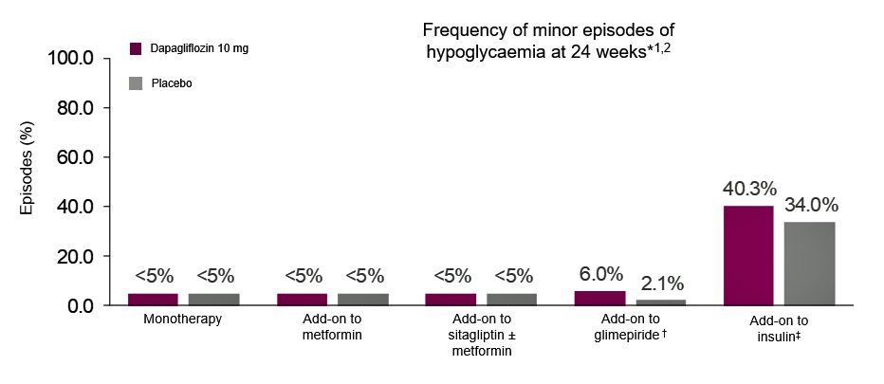
SGLT2-inhibitors (Dapagliflozin)
a good blood glucose lowering efficacy with no or very few hypoglycaemia
The frequency of hypoglycaemia was similar with dapagliflozin 10 mg versus placebo (including up to 102 weeks of treatment), with the exception of studies with add-on to SU and add-on to insulin therapies¹
1. Dapagliflozin. Summary of product characteristics, 2014; 2. EMDAC Background document. Available at: http://www.fda.gov/downloads/advisorycommittees/
committeesmeetingmaterials/drugs/endocrinologicandmetabolicdrugsadvisorycommittee/ucm378079.pdf. Last accessed September 2014.

Slide 28
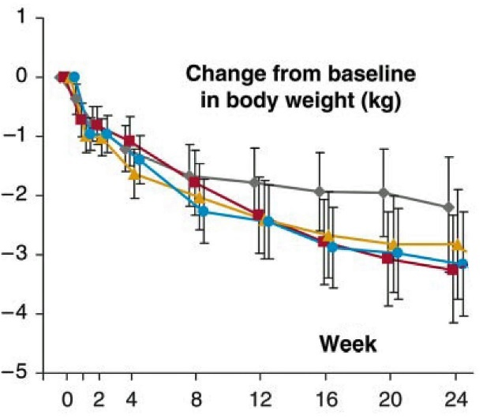
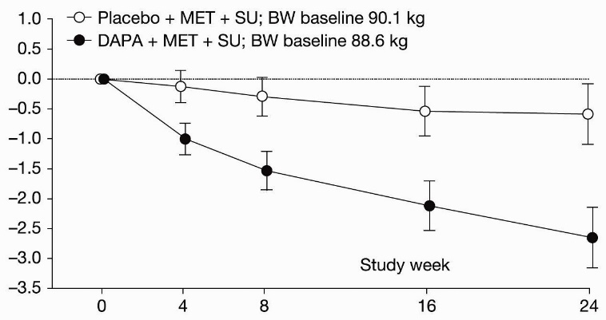
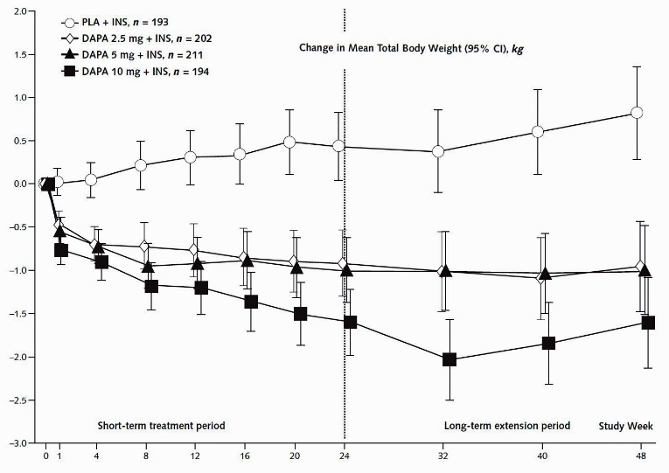
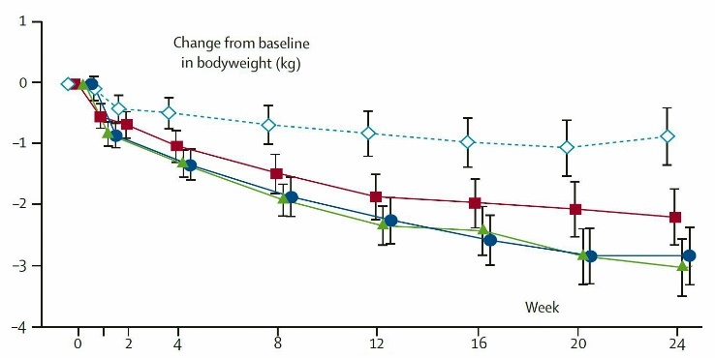
SGLT2-inhibitors (Dapagliflozin): the added value of weight loss
Triple oral therapy
as add-on to metformin + sulfonylureas Dapagliflozin vs Placebo³ n=216
-2,1 kgs for Dapa 10mg (Pbo substracted)
Monothérapy:
Dapagliflozine vs Placebo¹ n=485 -1 kg for Dapa 10mg (Pbo substracted)
Combined with insulin: Dapagliflozin vs Placebo⁴
(+ insulin high doses) n=607
-2 kgs for Dapa 10mg (Pbo substracted
Dual therapy as add-on to metformin: Dapagliflozin vs Placebo² n=546
- 2,1 kgs for Dapa 10mg (Pbo substracted)
1 - Diabetes Care 33:2217–2224, 2010 2 - Lancet 2010; 375: 2223–33
3 - Diabetes Care 2015;38:365–372 4 - Ann Intern Med. 2012;156:405-415.

Slide 29
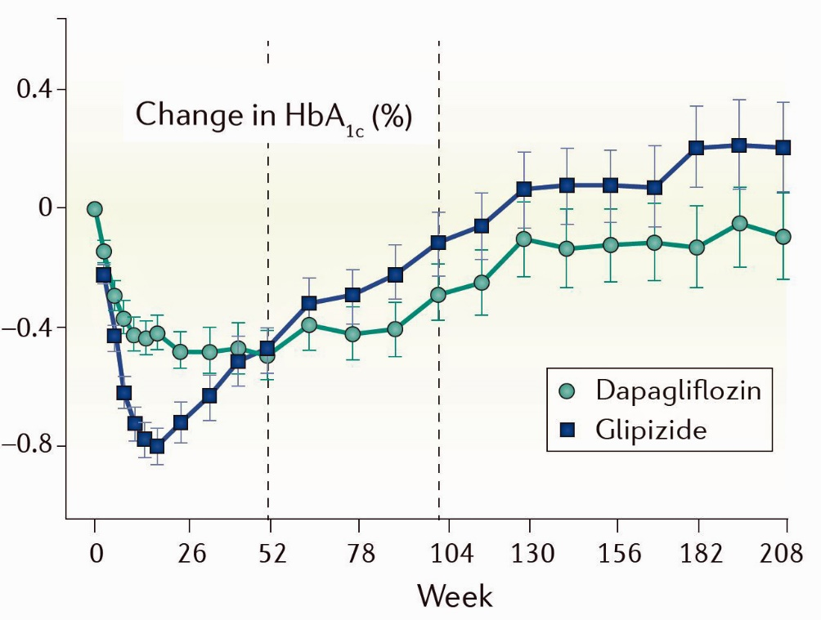
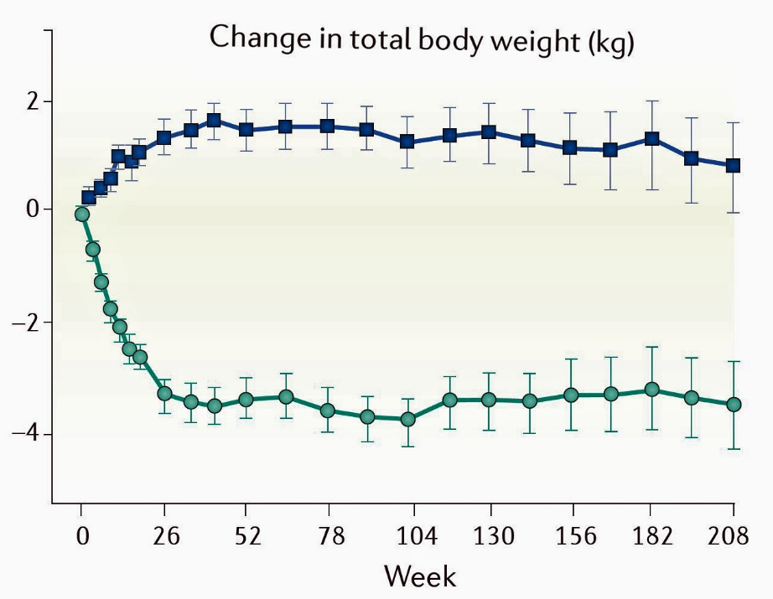
SGLT2i versus Sulfonylureas long-term
Dapagliflozin as add-on to metformin versus SU
comparable HbA_{1c} reductions (slightly better for dapagliflozin) over 4 years¹
With no hypo compared to >30% on SUs
Weight loss vs weight gain
Additional benefit of weight loss
(and reduced blood pressure)
sustained over 4 years¹
~5 kgs
1. Del Prato S, et al. Diabetes Obes Metab. 2015 Mar 4. doi: 10.1111/dom.12459; 2. Nauck MA, et al. Diabetes Care 2011;34:2015–22; 3. Dapagliflozin. Summary of product characteristics, 2014; 4. Bailey CJ, et al. Lancet 2010;375:2223–33.

Slide 30
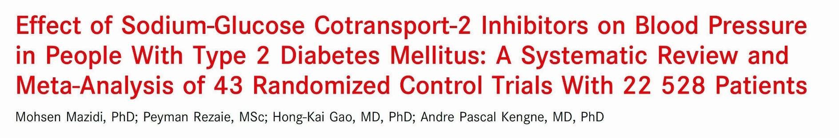
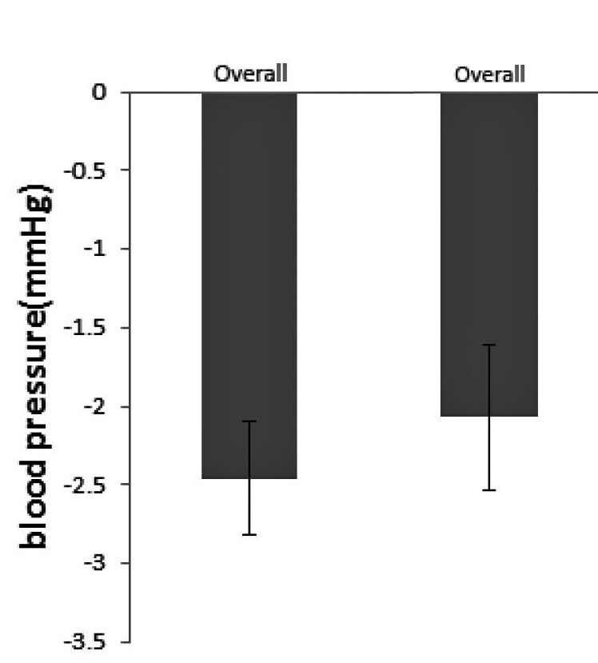
SGLT2-inhibitors: the added value of lowering blood pressure
Reduction in systolic
and, to a lesser extent, diastolic blood pressure
by > 2 mm Hg
accentuated during the daytime
and in hypertensive patients
Systolic
Diastolic
J Am Heart Assoc. 2017

Slide 31
Safety and tolerability
SGLT2-inhibitors: Globally well tolerated
The main reported side-effects
Genital mycotic infections, about 10-15% higher in women and about 5% higher in men compared with placebo.
Urinary tract infections (small increase)
Rare cases of ketoacidosis
For the only Canagliflozin:
bone fractures ?
toe amputations (number very small and plausible causal explanation not available)
Not observed
on Empagliflozin (EMPAREG Study)
or Dapagliflozin (DECLARE Study)

Slide 32
SGLT2-inhibitors
prevent cardio-vascular and renal events beyond their glucose lowering effect
Cardio-Vascular and Renal Benefits

Slide 33
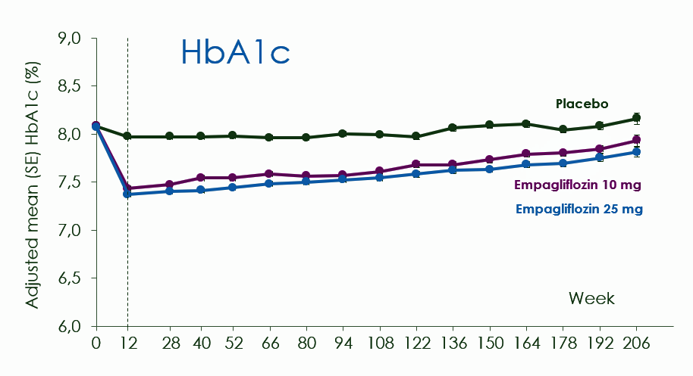
Studies evaluating safety of anti-diabetic agents
The question: is an anti-diabetic agent beneficial, neutral or deleterious, independently of blood glucose lowering?
In these so-called « safety studies » required by the FDA, the active drug is compared to a placebo, both added on the top of other treatments intensified at best during the study.
These other treatments are logically more intensified (more oral agents, more insulin) in the placebo arm to conteract the blood glucose lowering effect of the active drug.
For example in the EMPAREG study (empagliflozin vs placebo) there is only a small difference in HbA1C between the 2 arms
Mean difference at the end: 0,4%

Slide 34
Studies evaluating safety of anti-diabetic agents
The question: is an anti-diabetic agent beneficial, neutral or deleterious, independently of blood glucose lowering?
In these so-called « safety studies » required by the FDA, the active drug is compared to a placebo, both added on the top of other treatments intensified at best during the study.
These other treatments are logically more intensified (more oral agents, more insulin) in the placebo arm to conteract the blood glucose lowering effect of the active drug.
These studies are thus driven by the outcome on a given treatment and not by blood glucose lowering
For example in the EMPAREG study (empagliflozin vs placebo) there is only a small difference in HbA1C between the 2 arms
Mean difference at the end: 0,4%

Slide 35


SGLT2-inhibitors: 3 large randomized controlled outcome studies have demonstrated a CV benefit
Empagliflozin
Canagliflozin
Dapagliflozin
All patients with established cardiovascular disease
66% of the patients with established cardiovascular disease
34% in a situation of primary CV prevention
In a broader population
40% with established cardiovascular disease
60% in a situation of primary CV prevention
All these 3 studies have demonstrated an extra CV benefit
added to the CV benefit
of lowering blood glucose
Notes:
Qui donc n’existe pas, d’ailleurs pas de rationnel mécanistique

Slide 36
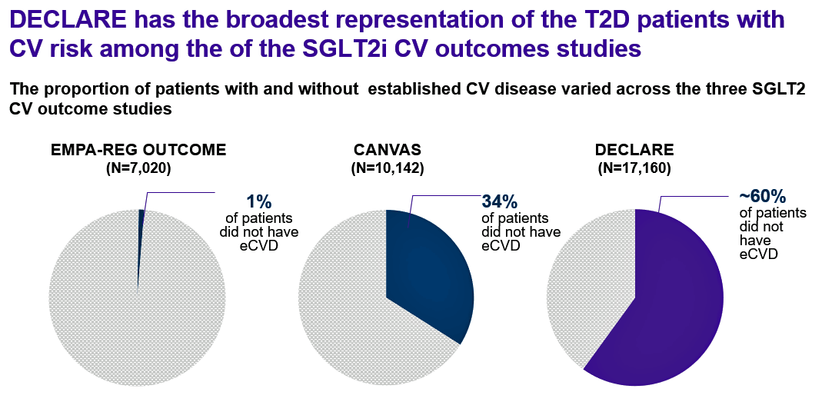
  Largest patient enrolment of the SGLT2 inhibitor CVOTs: 17,160 patients
  Broad trial population comprising patients with multiple CV risk factors (~60%) or established CV disease (~40%). The diversity of the trial population will strengthen the applicability of the trial results
1- Zinman B, et al. N Engl J Med 2015;373:2117–2128;; 2. Neal B, et al. N Engl J Med 2017; DOI: 10.1056/NEJMoa1611925;3. Sattar Diabetologia (2013) 56:686–695 4. Raz I, et al. Diabetes Obes Metab 2018. http://dx.doi.org/10.1111/dom.13217

Slide 37

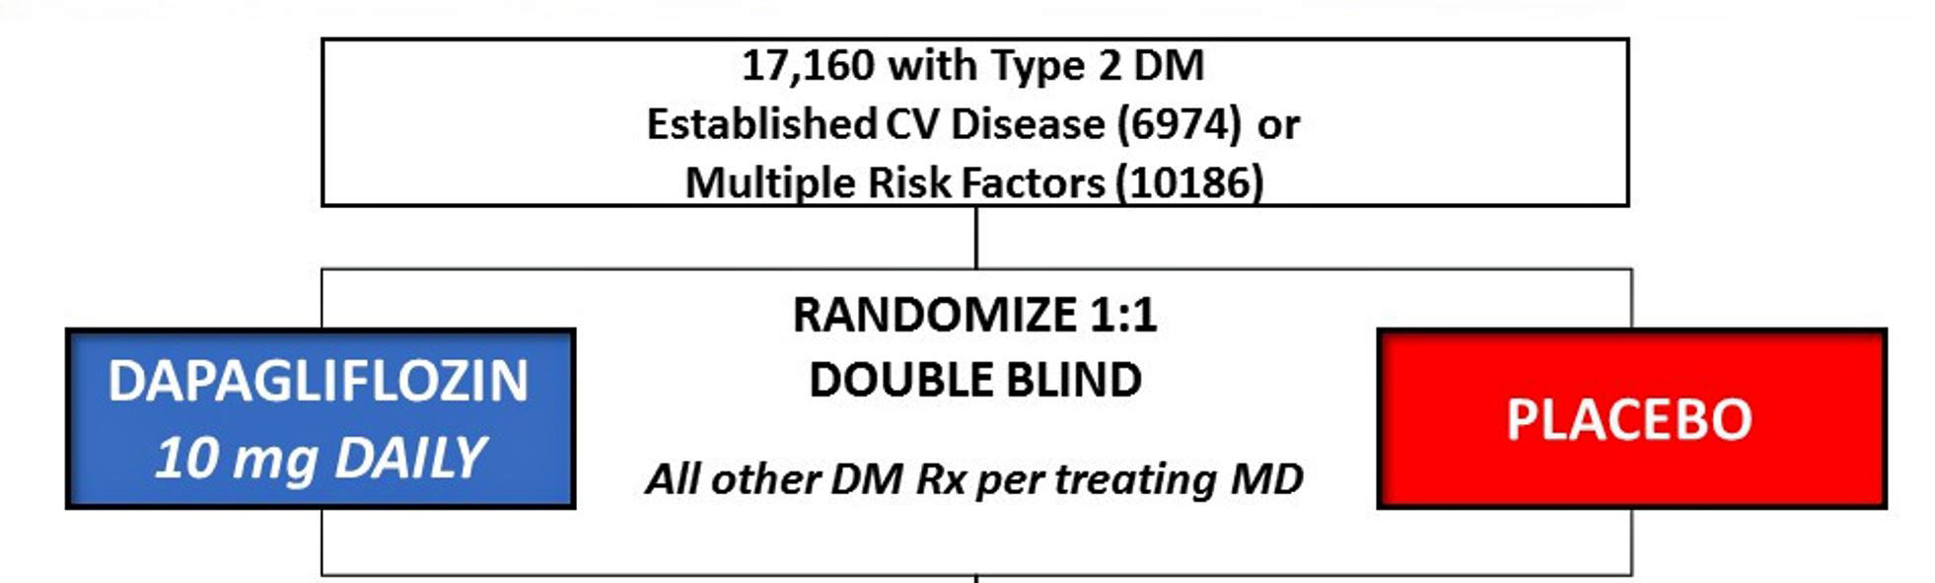

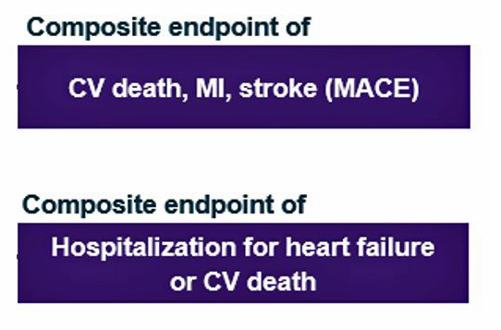
The DECLARE Outcome Study
Added to all other treatments intensified at best
HbA1c: small difference between the dapagliflozin and the placebo arms, ~0,4%
NEJM, November 10, 2018

Slide 38
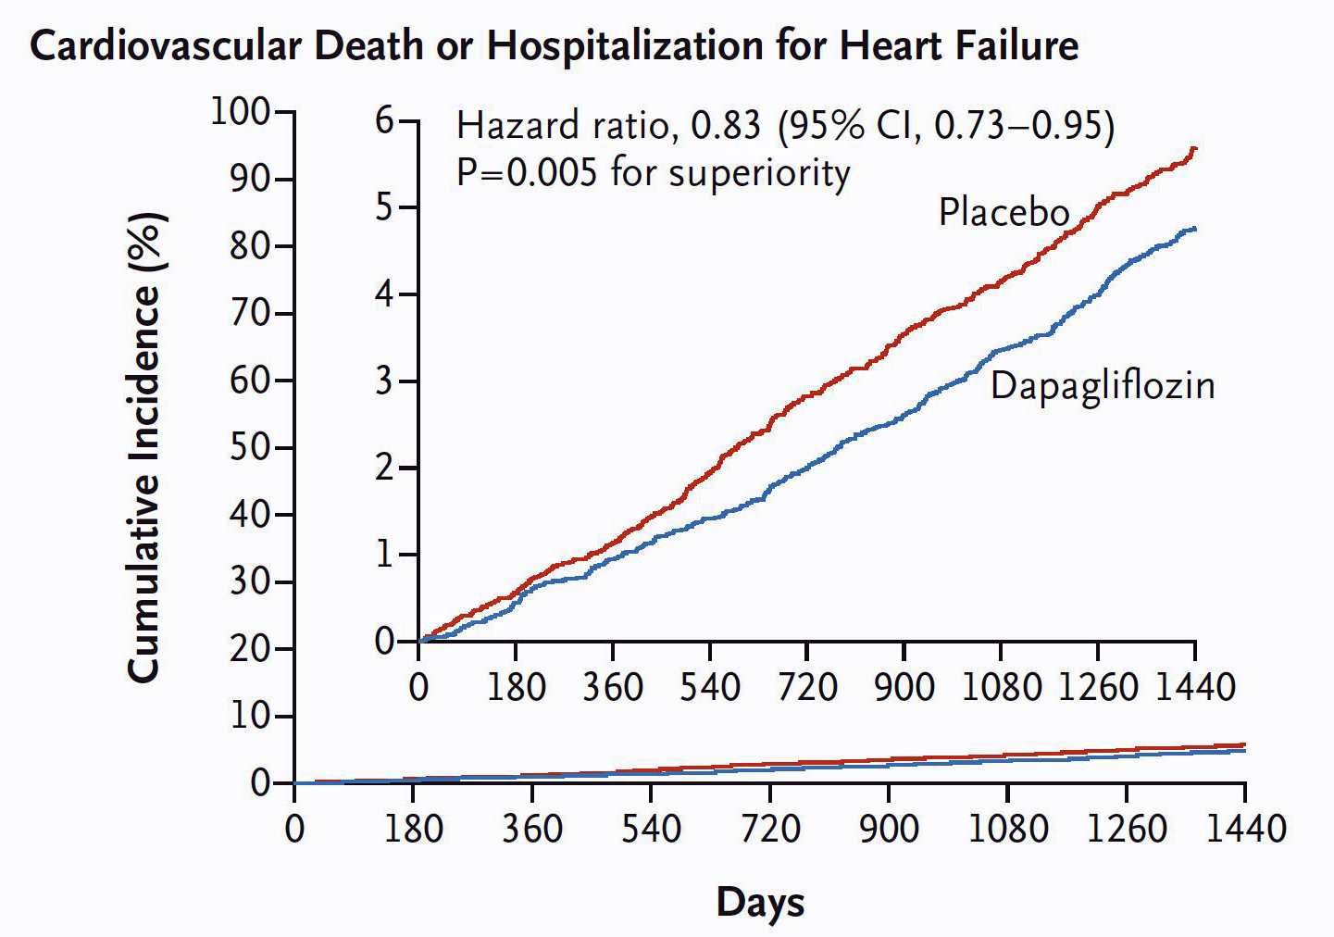
The DECLARE Outcome Study
Heart Failure
CV Death
-17%
Dapagliflozin demonstrates an extra (and early) benefit
added to that of decreasing blood glucose,
on CV mortality
and heart failure
NEJM, November 10, 2018

Slide 39
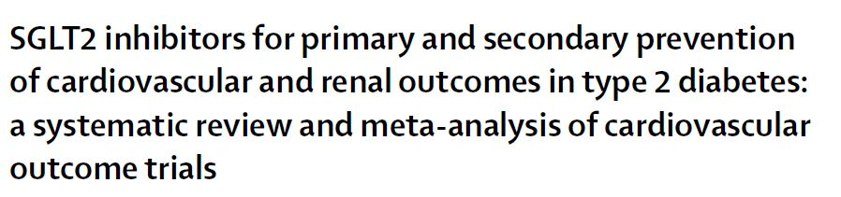
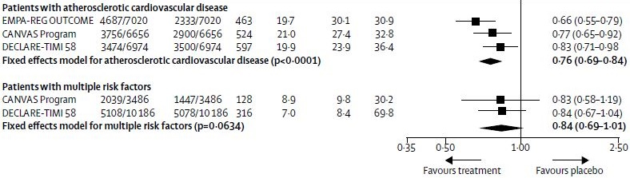
Heart Failure/CV Death
Similar benefit on Heart Failure/CV death with
Empagliflozin (EMPAREG Study)
Canagliflozin (CANVAS Study)
Dapagliflozin (DECLARE Stdudy)
Lancet, November 2018

Slide 40
Heart Failure/CV Death
Highly significant in situations of secondary CV prevention
Same amplitude of decrease but non significant (borderline) in situations of primary CV prevention
Similar benefit on Heart Failure/CV death with
Empagliflozin (EMPAREG Study)
Canagliflozin (CANVAS Study)
Dapagliflozin (DECLARE Stdudy)
Lancet, November 2018

Slide 41
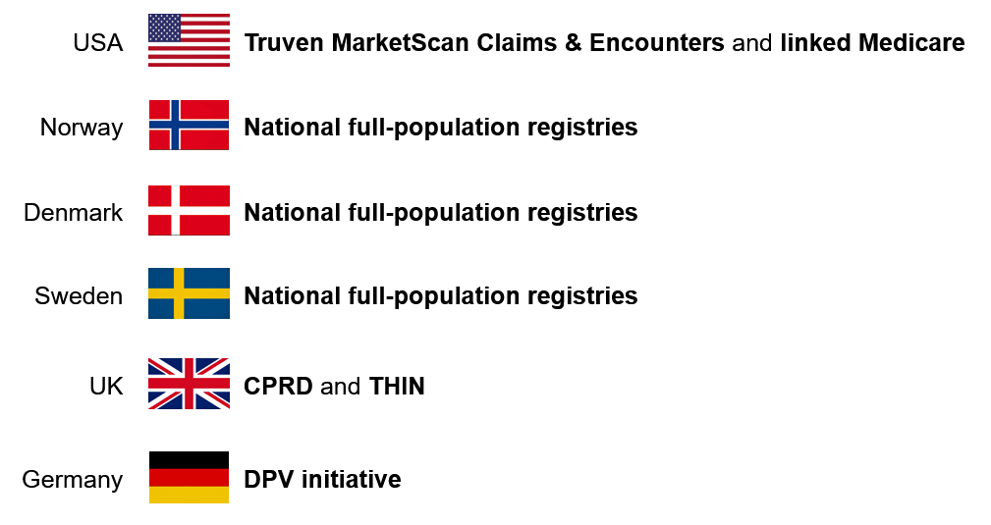
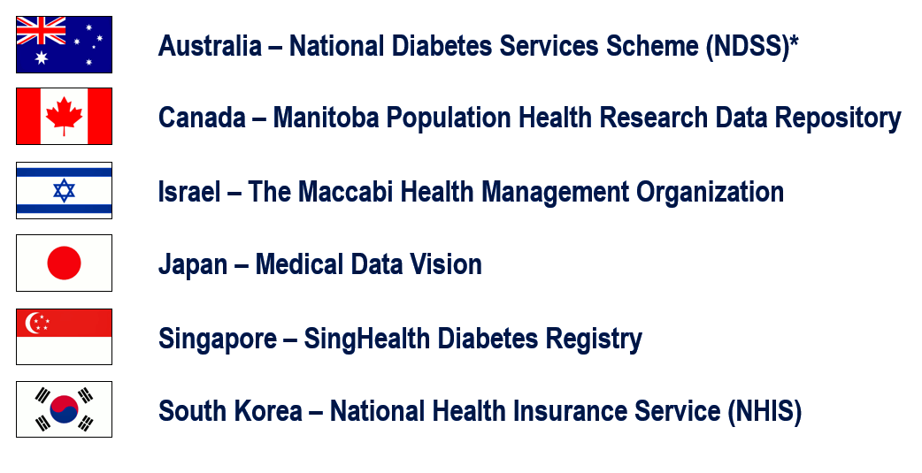

The real world evidence studies CVD REAL
Observational Studies
CVD-REAL 1 ¹
enrolled ~1,300,000 patients
over 6 Countries
CVDREAL 1
CVD-REAL 2 ²
enrolled ~3,900,000 patients
from 3 major world regions
Asia-Pacific, Middle East, and North America
1-Kosiborod M, et al. Circulation 2017 2-Kosiborod M, et al. JACC March 2018

Slide 42
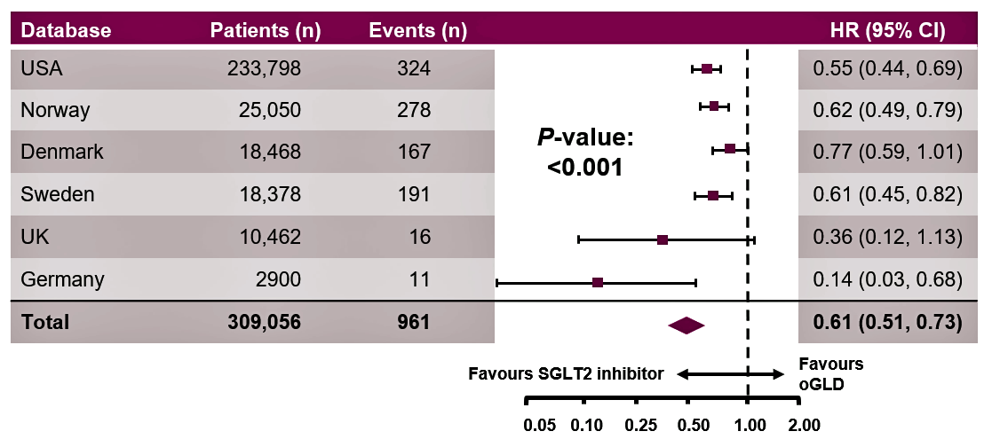
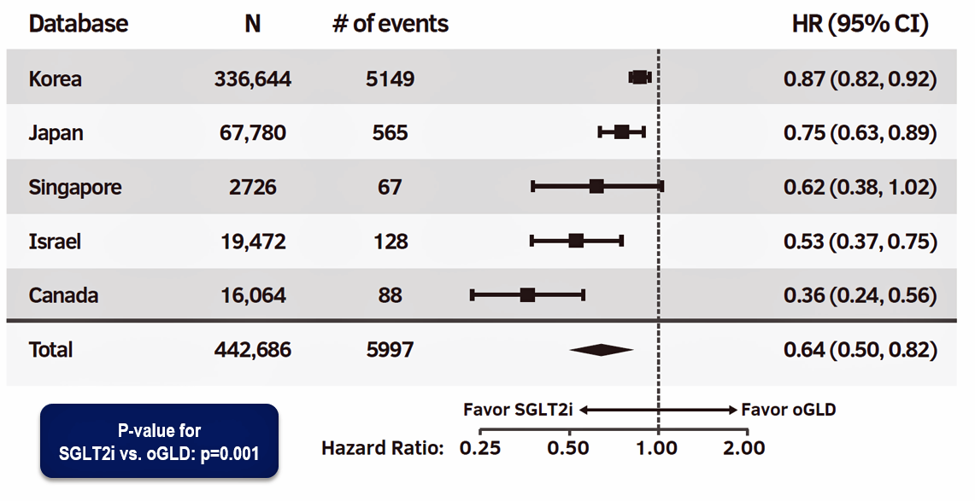
CVD-REAL: SGLT2 inhibitors were associated with a significantly reduced risk
of hospitalization for Heart Failure
Risk of hHF
in SGLT2i treated
vs other antidiabetic agents-treated
CVDREAL 1
-39%
-36%
good consistency between countries
1-Kosiborod M, et al. Circulation 2017 2-Kosiborod M, et al. JACC March 2018

Slide 43
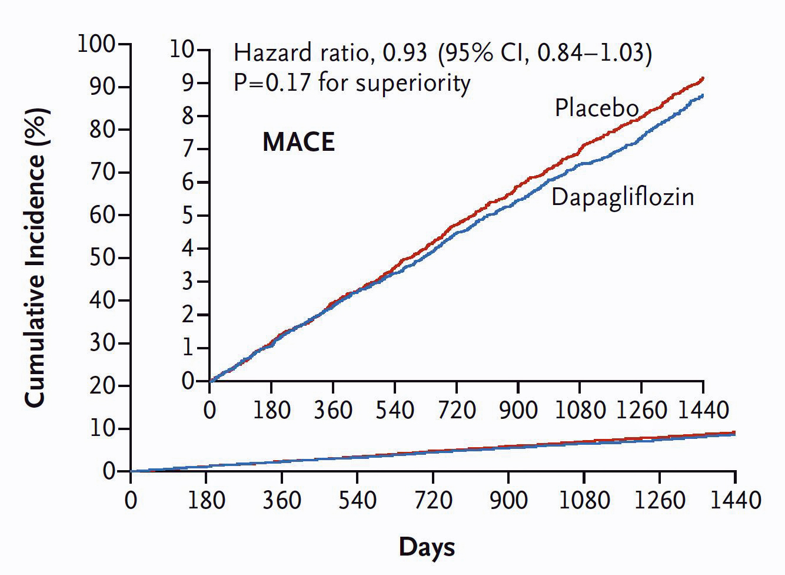
The DECLARE Outcome Study
MACE
CV death,
Myocardial infarction
Stroke
Dapagliflozin showed a positive (but not significant) trend towards a benefit
on MACE (atherosclerotic complications)
which means
at least CV safety
CV death,
Myocardial infarction,
Stroke
NEJM, November 10, 2018

Slide 44
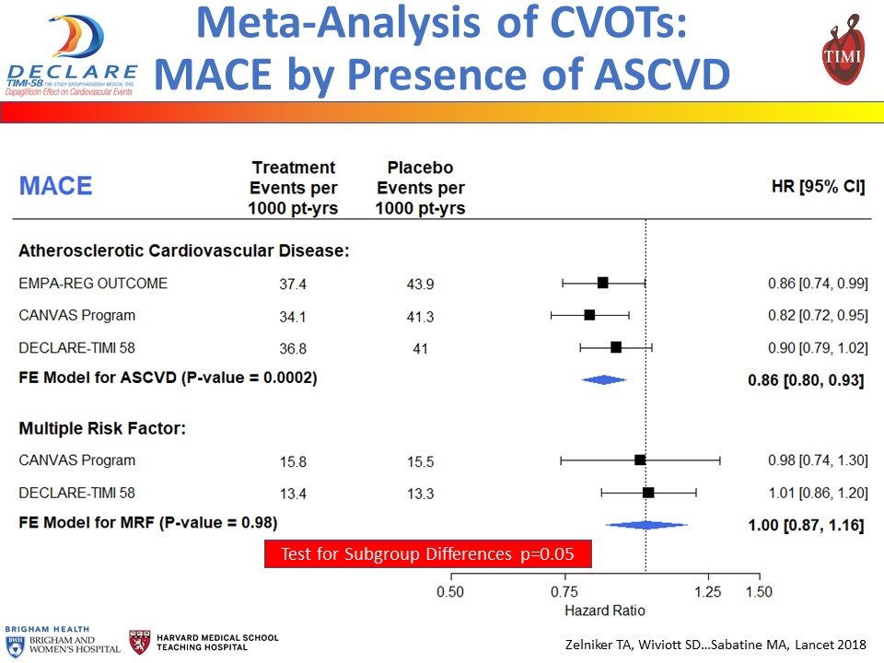
SGLT2-inhibitors: ± similar results in the 3 outcome studies
CV death,
Myocardial infarction
Stroke
Secondary CV prevention
Primary CV prevention

Slide 45
SGLT2-inhibitors: ± similar results in the 3 outcome studies
CV death,
Myocardial infarction
Stroke
Secondary CV prevention
The benefit on MACE is mainly demonstrated in the situations of secondary CV prevention
Primary CV prevention

Slide 46
SGLT2-inhibitors: ± similar results in the 3 outcome studies
CV death,
Myocardial infarction
Stroke
Secondary CV prevention
Primary CV prevention
No clear benefit on MACE in the situations of primary CV prevention

Slide 47
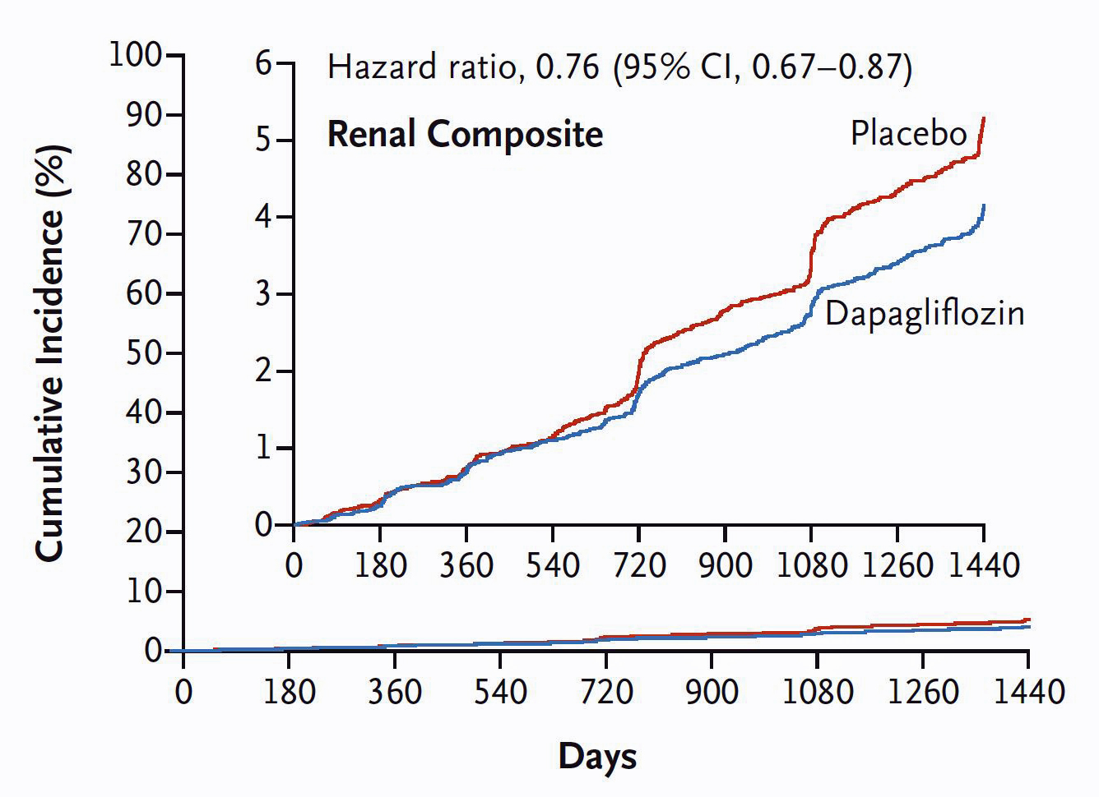
The DECLARE Outcome Study
Renal outcomes
40% decrease in GFR
End Stage Renal disease
Renal or CV Death
40% decrease in GFR
End Stage Renal disease
Renal or CV Death
Patients on dapagliflozin demonstrated a reduced risk in the composite of hard renal end-points
-24%
NEJM, November 10, 2018

Slide 48
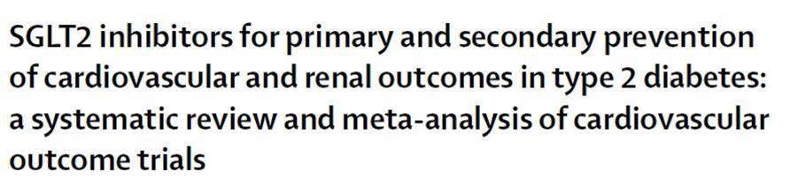
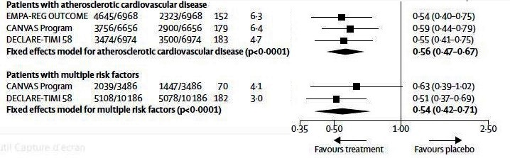
Composite of renal worsening,
end-stage renal disease, or renal death
Similar impressive benefit on renal outcomes with
Empagliflozin (EMPAREG Study)
Canagliflozin (CANVAS Study)
Dapagliflozin (DECLARE Stdudy)
Lancet, November 2018

Slide 49
Composite of renal worsening,
end-stage renal disease, or renal death
Highly significant in both situations of primary and secondary CV prevention
Similar impressive benefit on renal outcomes with
Empagliflozin (EMPAREG Study)
Canagliflozin (CANVAS Study)
Dapagliflozin (DECLARE Stdudy)
Lancet, November 2018

Slide 50
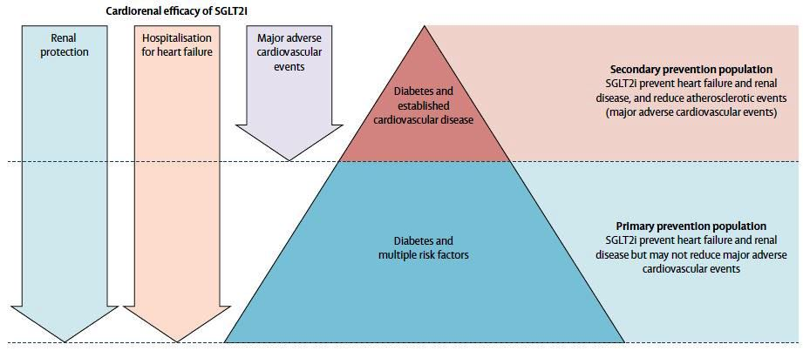
SGLT2-inhibitors: 3 large randomized controlled outcome studies have demonstrated a CV/renal benefit
The benefit of SGLT2-inhibitors has been demonstrated
for 3 different kind of events:
MACE (atherosclerosis), Heart Failure (Heart function) and Kidney
Lancet, November 2018

Slide 51
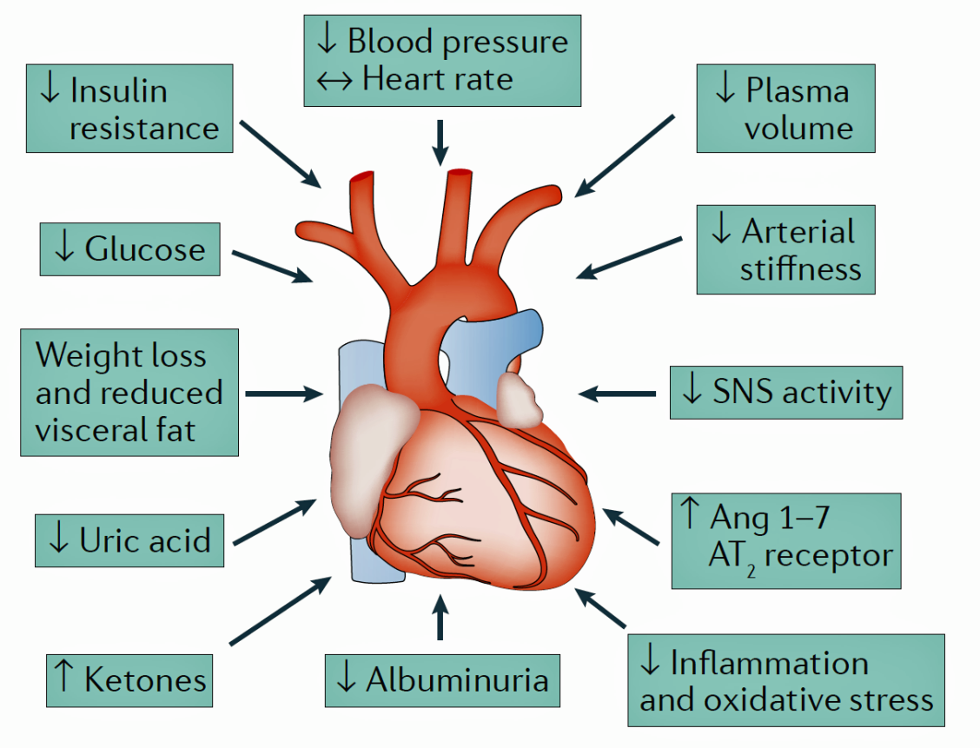
SGLT2-inhibitors: a positive CV profile
The mechanisms are speculative
Diuretic effect of SGLT2i can produce afterload reduction, leading to improved left ventricular function, reduced cardiac workload, and diminished myocardial oxygen demand
Preferential ketone oxidation by myocardial cells could provide an energetic advantage to the failing heart
Synergy of metabolic benefits: reduced blood pressure, reduced body weight, reduced blood glucose…
Other potential mechanisms such as inhibition of cardiac sympathetic nerves, increased glucagon, decreased uric acid…
The mechanisms of the renal protection (improvement of the tubulo-glomerular feed-back) are different
Adapted from R DeFronzo 2017

Slide 52
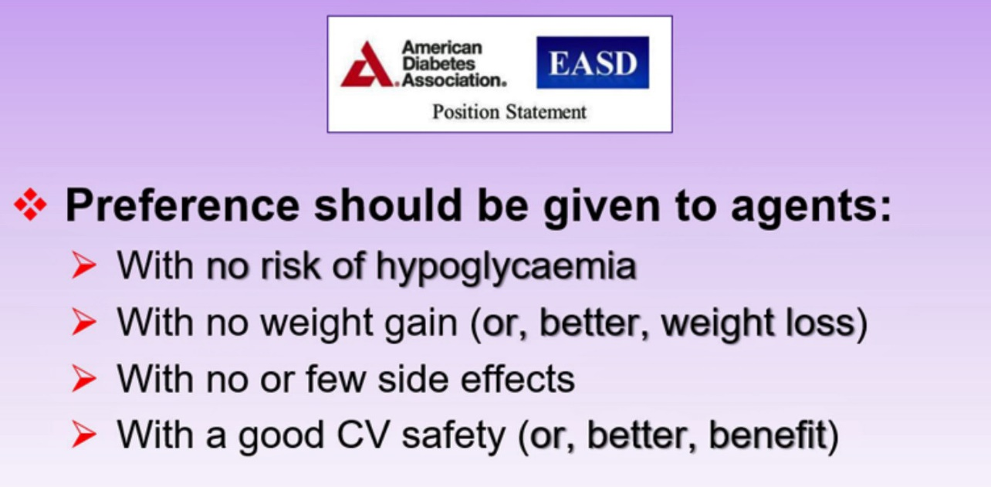

SGLT2-inhibitors
the place in the treatment algorithm
ADA/EASD statement September 2018
Diabetes Care November 2018
Diabetologia November 2018

Slide 53
SGLT2-inhibitors
the place in the treatment algorithm
why SGLT2-inhibitors are recommended,
if renal function is adequate,
early in the treatment algorithm,
in most of the clinical situations
not only for controlling blood glucose
with weight loss and no hypos
but also for their added benefit on different outcomes
ADA/EASD statement September 2018
Diabetes Care November 2018
Diabetologia November 2018

Slide 54
What should be added to metformin as 2nd line agent
Oral agents
Injections
The usual 2nd line option
In specific cases
The choice of the 2nd line agent will take into account
the CV status of the patient
and the 3 following characteristics of the agents:
risk of hypo – effect on weight - cost
ADA/EASD statement September 2018

Slide 55
What should be added to metformin as 2nd line agent
Oral agents
Injections
The usual 2nd line option
In specific cases
The choice of the 2nd line agent will take into account
the CV status of the patient
and the 3 following characteristics of the agents:
risk of hypo – effect on weight - cost
why SGLT2-inhibitors are recommended,
in most of the clinical situations,
especially in patients with established CV disease or CKD

Slide 56
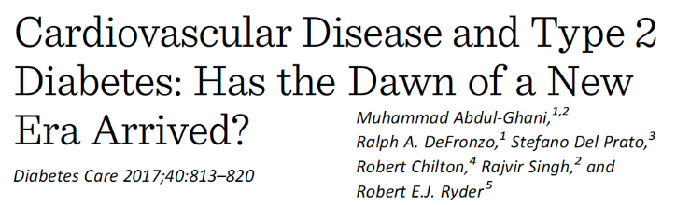
From glucose to cardiovascular risk management: a new paradigm
To prevent the complications
of Type 2 Diabetes
Glycaemic control is critical to prevent both micro and (on the long term) cardio-vascular complications
A new classification
of anti-diabetic agents
All agents reduce HbA1c but with or without an added benefit on outcomes

Slide 57
From glucose to cardiovascular risk management: a new paradigm
To prevent the complications
of Type 2 Diabetes
Glycaemic control is critical to prevent both micro and (on the long term) cardio-vascular complications
Beyond the benefit resulting from a good metabolic control, 2 classes of anti-diabetic agents have demonstrated an added benefit on outcomes
A new classification
of anti-diabetic agents
GLP1r-agonists: on MACE
in situations of secondary CV prevention
SGLT2-inhibitors:
on MACE in situations of secondary CV prevention,
on Heart Failure and renal events in all the situations
All agents reduce HbA1c but with or without an added benefit on outcomes

