Slide 1
Management of the Adult with CAH due to 21-Hydroxylase Deficiency
Dr Abolfazl Heidari

Slide 2
CAH is a group of autosomal recessive disorders characterized by impaired cortisol synthesis.
The incidence ranges from 1:10,000 to 1:20,000 births
The most common form of CAH is caused by mutations in CYP21A2, the gene encoding the adrenal steroid 21-hydroxylase enzyme (P450c21).
Because this enzyme deficiency accounts for approximately 95% of CAH, we will discuss only 21-hydroxylase deficiency here.

Slide 3
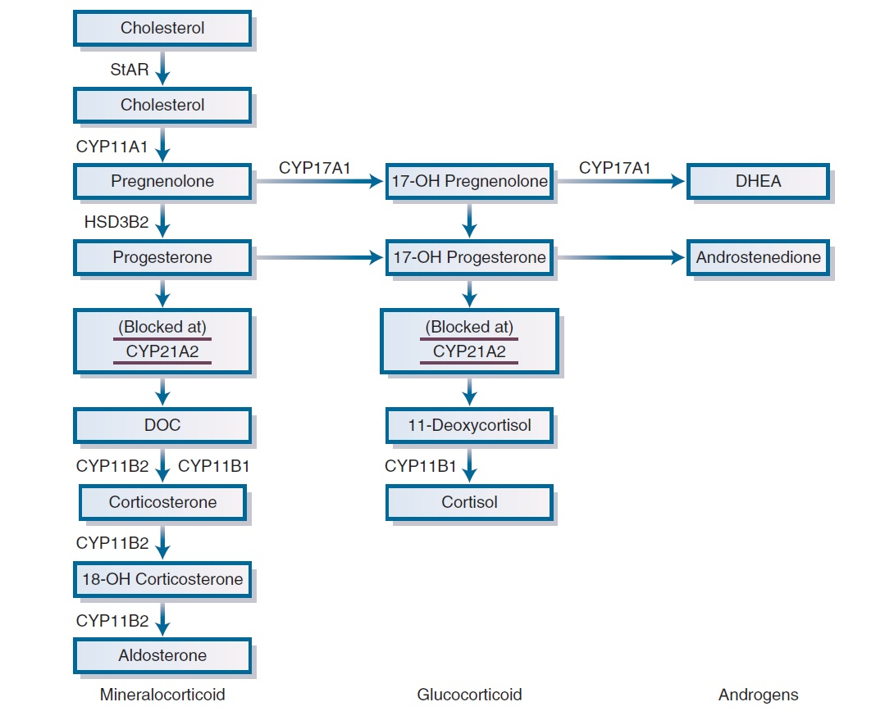

Slide 4
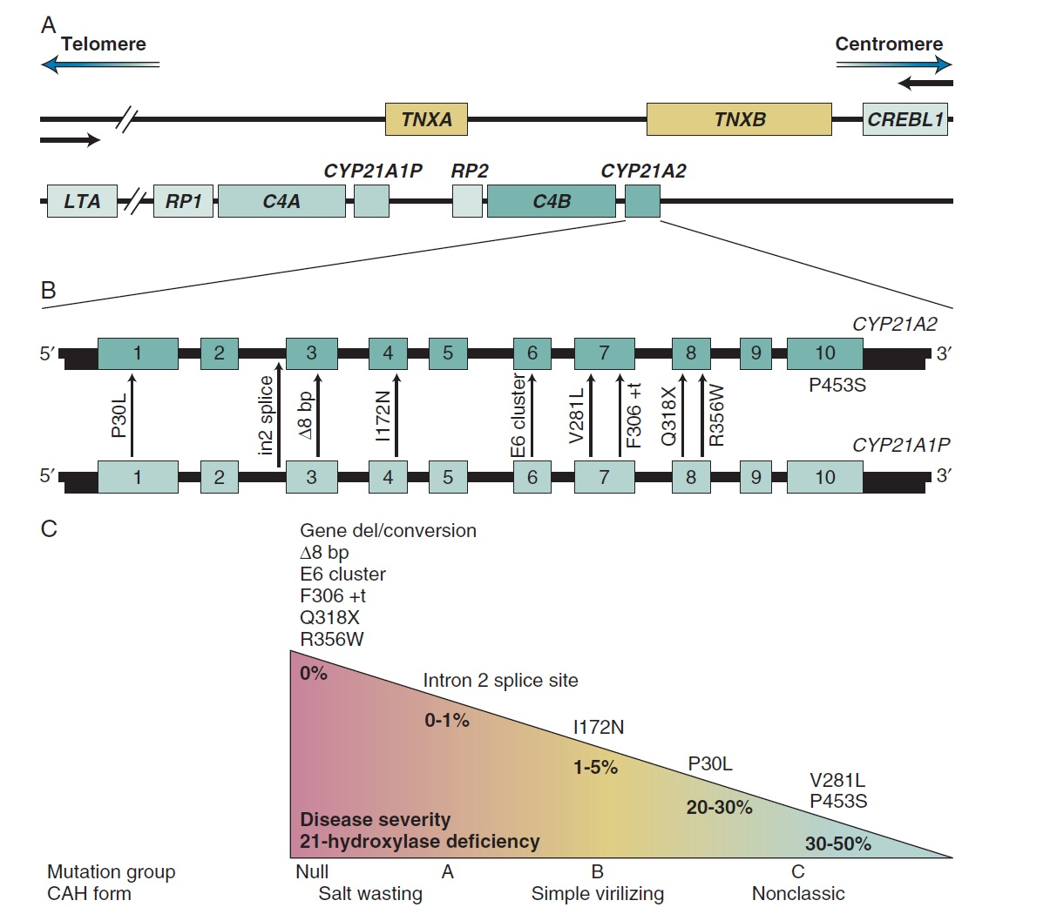

Slide 5
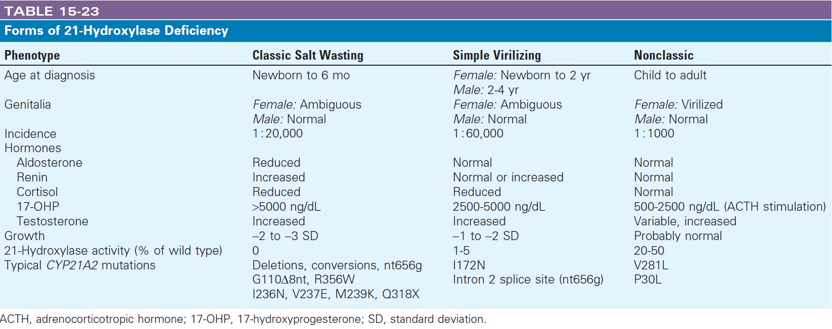

Slide 6
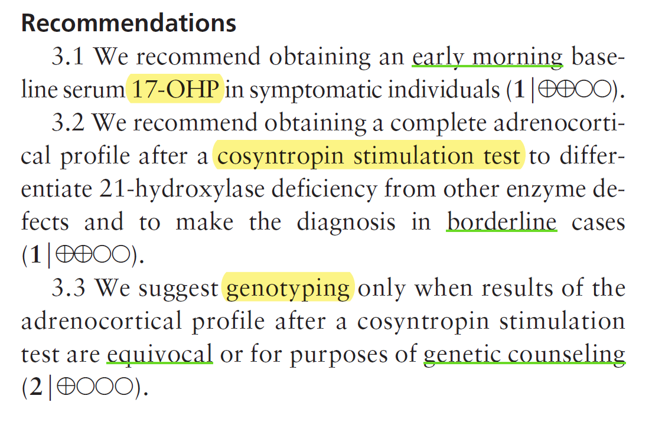
Diagnosis of NCCAH/CAH after infancy
An Endocrine Society Clinical Practice Guideline 2010

Slide 7
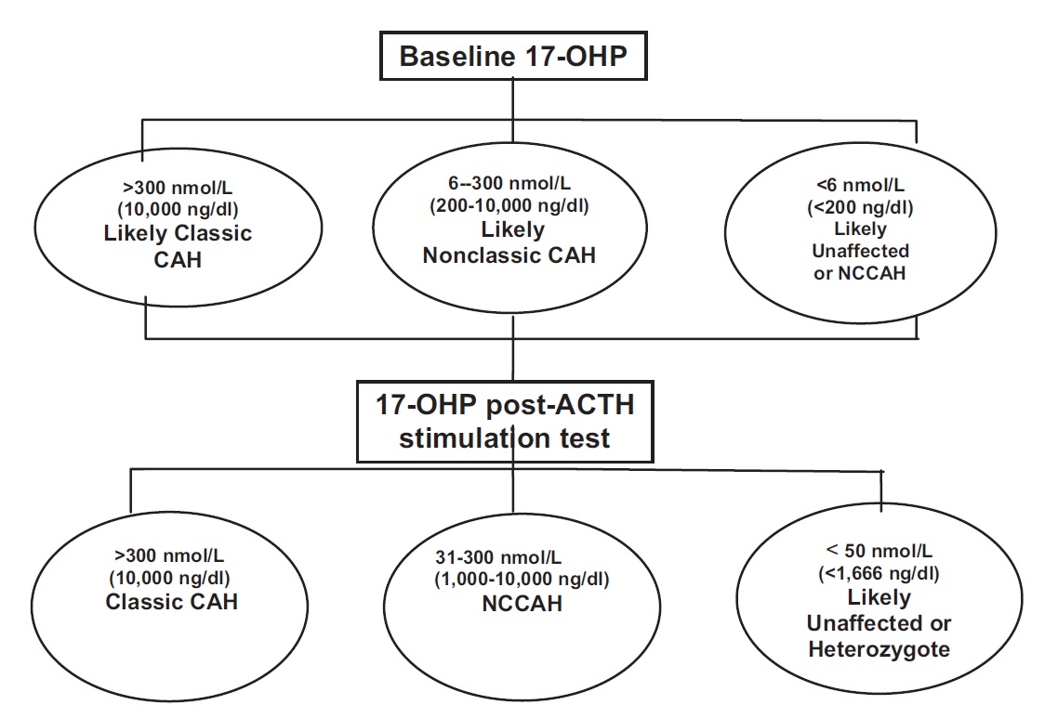
Diagnosis of NCCAH/CAH after infancy
An Endocrine Society Clinical Practice Guideline 2010

Slide 8
Complications of CAH in Adult
Cardiovascular (CV) risk
Female fertility
Male fertility
European Journal of Endocrinology (2017) 176, R167–R181

Slide 9
Cardiovascular (CV) risk
Overweight and obesity
  In the prospective cross-sectional study conducted in the United Kingdom (UK) among 199 patients, BMI was found to be higher in CAH patients than that in the general population.
  In the American cross-sectional study of 244 CAH patients, prevalence of obesity was similar to the adult U.S. obesity rate of 36% .
  In two French cohorts of respectively 108 and 219 patients, the prevalence of obesity and overweight in CAH patients was similar to that found in the general population.
Metabolic syndrome was also evaluated in CAH patients and was observed in nearly 20% of adults in the NIH cohort
European Journal of Endocrinology (2017) 176, R167–R181

Slide 10
Cardiovascular (CV) risk
Blood pressure
  In a recent epidemiological Swedish registry study, increased frequency of hypertension in individuals with CAH has been shown, but when analyzing the different subgroups, only SV females had increased blood pressure, whereas this was rare or nonexistent in the more severe phenotypes and genotypes.
Dyslipidemia
  In the epidemiological Swedish registry study, an increased rate of dyslipidemia was found, especially in males with a null genotype.
  In the NIH cohort, In adults, 6% had elevated total cholesterol, whereas approximately 15% had decreased HDL.
European Journal of Endocrinology (2017) 176, R167–R181

Slide 11
Cardiovascular (CV) risk
Carotid intima-media thickness (cIMT) is a well-established marker of early, subclinical atherosclerotic change, that is correlated to the risk for coronary artery disease and stroke.
However, cIMT results vary in existing studies of individuals with CAH. Adults with CAH have been found to have increased cIMT in one study.
In adolescent and adult CAH patients, normal left ventricular morphology has been reported, but mild diastolic dysfunction and impaired exercise performance were shown.
Recently, we reported the complex interactions between gonadotropins and steroid hormones on the duration of ventricular repolarization.
We found that CAH QT interval duration was shorter in women with CAH than that in control women
European Journal of Endocrinology (2017) 176, R167–R181

Slide 12
Cardiovascular (CV) risk
The long-term outcomes in CAH patients were studied using the Swedish national CAH registry.
The mean age of death was lower in CAH patients (41.2 ± 26.9 vs 47.7 ± 27.7 years (P < 0.001)).
The causes of death were
  adrenal crisis (42%)
  cardiovascular diseases (32%)
  cancer (16%)
  suicide (10%)
CAH is therefore associated with higher CV risk factors and probably with excess CV and metabolic morbidity.
European Journal of Endocrinology (2017) 176, R167–R181

Slide 13
Female fertility
Fertility in women with classic CAH is reduced, especially for the patients with the SW form, as a result of several issues such as
  biological (poor hormonal balance)
  mechanical (related to surgeries)
  psychological and sexual factors
European Journal of Endocrinology (2017) 176, R167–R181

Slide 14
Female fertility
Menstrual irregularities and anovulation are frequent in CAH women, affecting from 30% to 68% of women with the SW form and 30–75% of those with the SV form.
Several factors (androgen and progesterone overproduction and prenatal exposure to sexual steroid) are suspected to disturb the reproductive axis in CAH females.
European Journal of Endocrinology (2017) 176, R167–R181

Slide 15
Female fertility
A recent study has described LH pulsatility in women with classic CAH.
In CAH patients, 2 different profiles of LH pulsatility were recorded.
  One group of patients had LH pulsatility patterns similar to the controls.
  The other one had
    lower LH pulses amplitude and frequency and
    presented more frequently with:
      menstrual cycle disturbances,
      higher 17OH progesterone (17OHP), testosterone, progesterone and androstenedione levels and
      lower FSH levels
European Journal of Endocrinology (2017) 176, R167–R181

Slide 16
Female fertility
The consequences of the genital surgery are another factor implicated in the reduced fertility of CAH women.
Surgery can include clitoroplasty, vaginoplasty and labiaplasty.
Urinary incontinence, vaginal stenosis and inadequate introitus, poor cosmetics, anorgasmia and painful intercourse have been reported and currently remain relevant issues.
European Journal of Endocrinology (2017) 176, R167–R181

Slide 17
Female fertility
It is well established that there is a relationship between sexual activity and vaginal function; thus, genital surgery may result in sexual dissatisfaction.
Fertility rate, i.e. live births per woman, is significantly lower in CAH women than in the general female population.
European Journal of Endocrinology (2017) 176, R167–R181

Slide 18
Female fertility
Better fertility and fecundity in CAH women will be largely dependent on:
  surgical advances in genital reconstruction,
  earlier treatment,
  optimized compliance to therapy,
  availability of psychological support,
  organization of transition from pediatric to adult specialist care,
  procuration of menstrual cycle control and
  sexual well-being
European Journal of Endocrinology (2017) 176, R167–R181

Slide 19
Male fertility
It appears that adult males with CAH face a dual problem.
Adrenal steroid overproduction, especially androgen and progesterone, might interfere with FSH and LH production, resulting in gonadotropic deficiency.
In addition, testicular adrenal rest tumors (TARTs) may become hypertrophic under chronic ACTH stimulation and influence both endocrine and exocrine testicular functions.
European Journal of Endocrinology (2017) 176, R167–R181

Slide 20
Male fertility
TARTs have been identified with a prevalence of 30–95% depending on age and modality of diagnosis, i.e. palpation or ultrasound.
The prevalence of TARTs increases with age, after onset of puberty.
TARTs volume and prevalence seem higher in patients with SW form compared with those in the SV form.
Some studies report the development of TARTs despite good hormonal control, suggesting that undertreatment is not the only cause for their growth.
European Journal of Endocrinology (2017) 176, R167–R181

Slide 21
Male fertility
TARTs are most often responsible for impaired spermatogenesis.
In patients with and without TARTs, inhibin B levels differ significantly and there are higher total sperm counts and concentration in patients without TARTs.
In a large cohort of 164 male CAH patients who underwent testicular assessment with ultrasound, 71 had a sperm analysis.
  70% of the patients had severe oligospermia or azoospermia when TARTs were found versus only 3.6% when they were not.
European Journal of Endocrinology (2017) 176, R167–R181

Slide 22
Male fertility
TARTs can lead to compression of the seminiferous tubules that may finally lead to obstructive azoospermia and irreversible damage of the surrounding testicular tissue.
They also can destroy and replace healthy testicular tissue.
The profile of the gonadotropic–testicular axis in these patients will primarily show testicular failure and eventually reveal endocrine and exocrine testicular dysfunctions.
European Journal of Endocrinology (2017) 176, R167–R181

Slide 23
Male fertility
Treatment options for male patients with TARTs are still limited and mainly based on a good hormonal control with GC.
Surgery can be proposed but there are no data on fertility preservation.
Recently, Bry-Gaillard et al. have shown that mitotane could restore fertility in CAH patients with TARTs. After 8 months of treatment, gonadotropins levels, inhibin B and sperm counts have improved, and on the other hand, size of TARTs has shrunk.
European Journal of Endocrinology (2017) 176, R167–R181

Slide 24
Male fertility
Prevention has a real important place in the management of male CAH fertility.
A systematic ultrasound evaluation is recommended at puberty to detect lesions at an early stage.
A semen analysis should also be realized as soon as possible,
and the question of systematic sperm cryopreservation seems fully justified.
European Journal of Endocrinology (2017) 176, R167–R181

Slide 25
Male fertility
Reduced fertility in CAH men can also be secondary to hypogonadotropic hypogonadism due to poor hormonal control with increased adrenal androgens and progesterone, leading to an increase in estrogen levels by aromatization.
Besides these somatic causes of impaired fertility in CAH males, there might be aspects of psychosocial adaptation and sexual well-being.
A sexual well-being study of 20 CAH males has revealed impairments in sexual drive, erections and ejaculations.
European Journal of Endocrinology (2017) 176, R167–R181

Slide 26
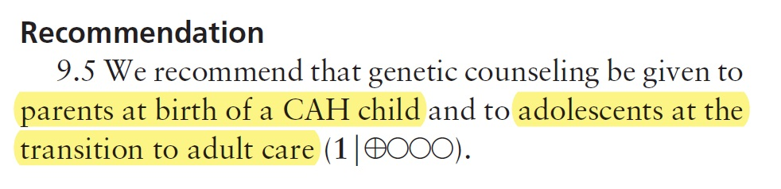
Genetic counseling
An Endocrine Society Clinical Practice Guideline 2010

Slide 27
Genetic counseling
CAH is autosomal recessive.
Based on a classical CAH incidence of 1:10,000–1:20,000, the incidence of carriers in the general population is 1:50–1:71.
Using a median value of 1:60, a patient with classic CAH would have a one in 120 probability of having a child with classic CAH.
For NCCAH, about two thirds of patients are compound heterozygotes, carrying one allele that causes classic CAH and one that causes NCCAH. The milder mutation will determine the phenotype; hence, the NCCAH parent has a one in 240 risk of having a child with classic CAH.
An Endocrine Society Clinical Practice Guideline 2010

Slide 28
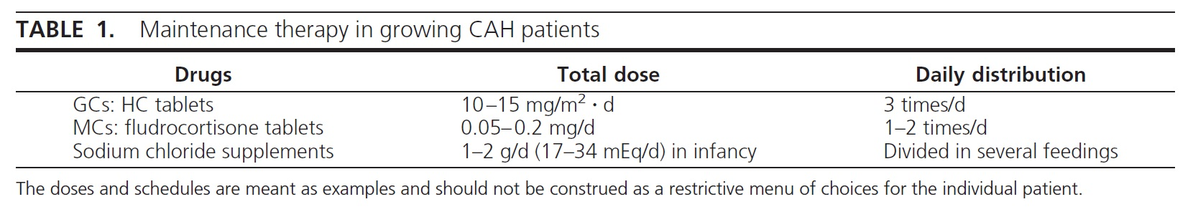
Treatment of classic CAH
An Endocrine Society Clinical Practice Guideline 2010

Slide 29
Treatment of classic CAH in adults
GC substitution is available since the 50s.
Although this treatment has notably changed the prognosis of children with CAH, it has remained the only medical solution for the last decades and has failed to meet all the needs for the patient.
Indeed, contrarily to primary adrenal insufficiency, the aim of GC treatment is not only to compensate for the deficient hormone but also to blunt the nocturnal ACTH secretion, which is the major driver of adrenal androgen production.
European Journal of Endocrinology (2017) 176, R167–R181

Slide 30
Treatment of classic CAH in adults
As cortisol is secreted mainly in the morning and, reaches a peak between 06:00 and 08:00 h, most oral GC regimens are proposed with at least half or 2/3 of the global dose in the morning.
Up until now, whatever regimen was used, the dilemma has persisted between using
  the physiological hydrocortisone (HC), well tolerated but with a poor control of androgen secretion or
  the long-acting prednisone, prednisolone or dexamethasone (DEX), with a higher risk of side effects.
European Journal of Endocrinology (2017) 176, R167–R181

Slide 31
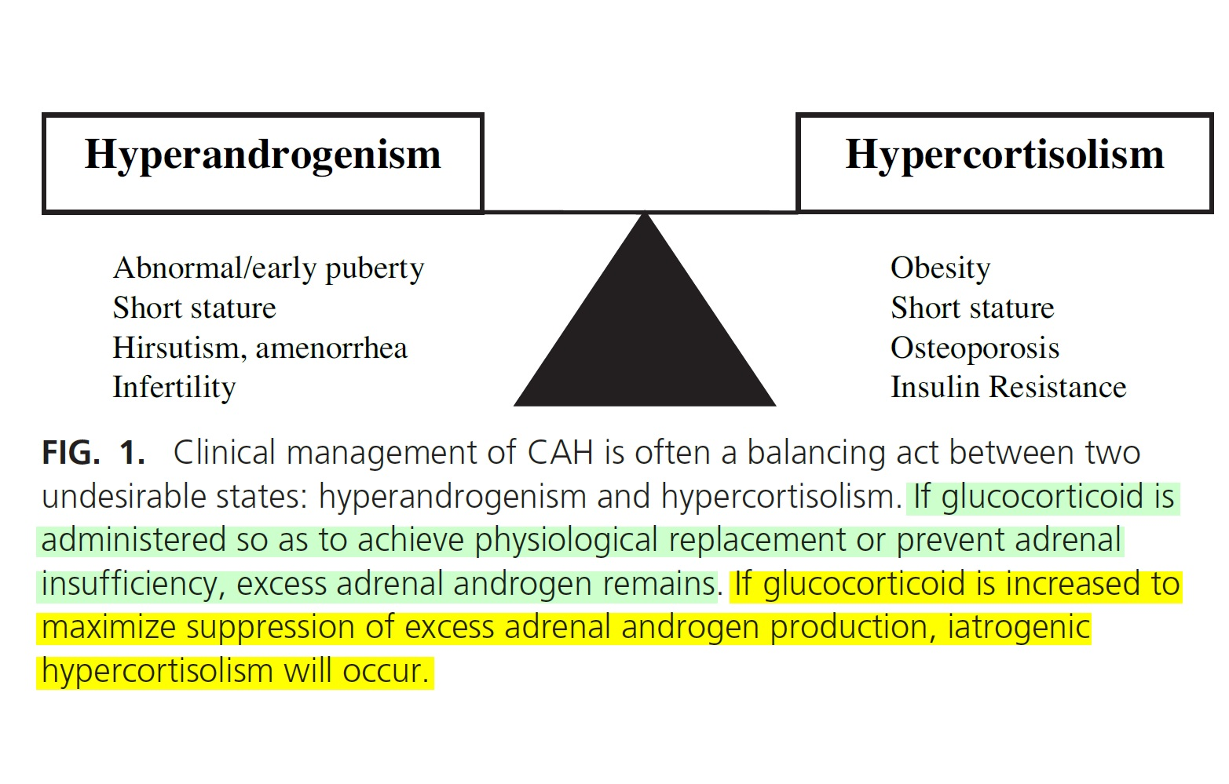
Approach to the Adult with CAH due to 21-Hydroxylase Deficiency J Clin Endocrinol Metab, March 2008, 93(3):653–660

Slide 32
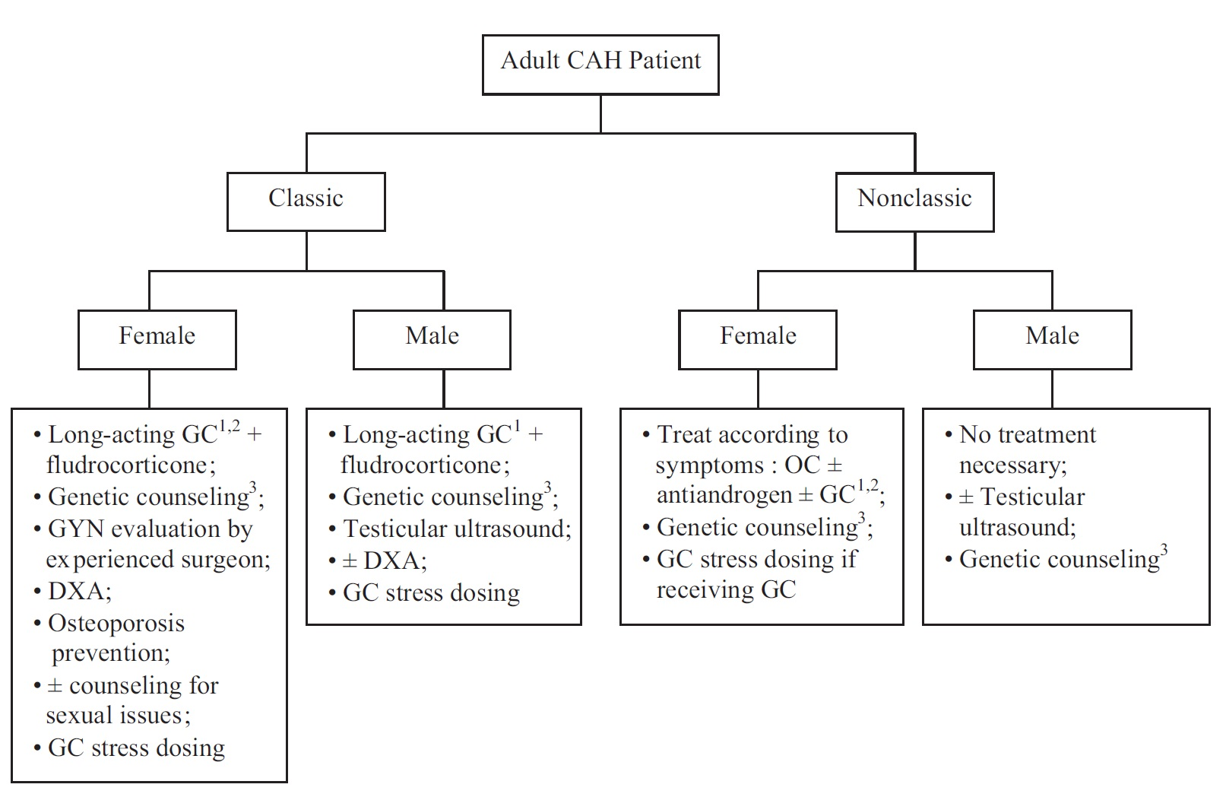
Approach to the Adult with CAH due to 21-Hydroxylase Deficiency J Clin Endocrinol Metab, March 2008, 93(3):653–660

Slide 33
New glucocorticoid approaches
Plenadren is a dual-release HC, which was developed for once-daily morning administration in patients with primary adrenal insufficiency.
It is a modified-release HC with an outer coating layer that provides an immediate release of the drug and an extended-release core.
It provides a more extended serum profile of cortisol compared with immediate-release HC.
In adults, a single morning dose of Plenadren gives similar cortisol exposure to a thrice daily regimen of immediate-release HC.
Preliminary studies in patients with primary adrenal insufficiency and CAH have demonstrated that this new formula compared with HC regimen, improves body weight, systolic and diastolic blood pressure and glucose metabolism.
European Journal of Endocrinology (2017) 176, R167–R181

Slide 34
New glucocorticoid approaches
This molecule also provides a more circadian based serum cortisol profile in patients with primary adrenal insufficiency.
Unfortunately, there are no data currently available regarding hormonal control in patients with CAH.
However, in the latter case, this molecule is unlikely to control excess androgens as the overnight rise in cortisol is not replicated, and evening administration of Plenadren would expose patients to high levels of cortisol during the night.
European Journal of Endocrinology (2017) 176, R167–R181

Slide 35
New glucocorticoid approaches
The second molecule, Chronocort, is under current development by Diurnal (Cardiff, UK).
This molecule is a modified-release HC, but it differs from Plenadren by having a delayed and sustained absorption profile rather than an immediate- and sustained-release profile.
Chronocort aims at replacing physiological cortisol concentrations by dosing at morning and night such that the night dose provides release of HC in the early hours of the morning providing a pre-waking rise in cortisol levels.
European Journal of Endocrinology (2017) 176, R167–R181

Slide 36
New glucocorticoid approaches
Parenteral GC
  continuous subcutaneous HC infusion
    ACTH levels and cortisol profiles were respectively lower and more physiological than those observed under conventional GC therapy. However, the impact of this treatment on quality of life remains a matter of debate
  subcutaneous hydrocortisone pump
    subcutaneous hydrocortisone pump approximated physiologic cortisol secretion.
    The cost of these pumps, the potential dysfunction and local irritation, may also be considered as limiting factors
European Journal of Endocrinology (2017) 176, R167–R181

Slide 37
Non-glucocorticoid approaches
The most radical treatment is the surgical removal of both adrenal glands.
  This approach must be carefully discussed as it can induce the development of TARTs in men and less frequently retroperitoneal adrenal rest tumors in women.
European Journal of Endocrinology (2017) 176, R167–R181

Slide 38
Non-glucocorticoid approaches
Chemical adrenalectomy may be obtained using mitotane, an adrenolytic agent for which the mechanisms of action remain poorly understood.
  Recent evidence focuses on apoptotic effects at adrenocortical level reducing the activity of the respiratory chain complex and inducing mitochondrial fragmentation, leading to programmed cell death.
  Mitotane also modulates the expression of several genes involved in steroid hormone biosynthesis.
In addition, the lack of LH increase after the decrease in free testosterone suggests that mitotane may have a toxic effect on the testes and also on the pituitary by reducing the viability of gonadotroph cell lines through activated apoptosis.
European Journal of Endocrinology (2017) 176, R167–R181

Slide 39
Non-glucocorticoid approaches
Two novel approaches are under current investigation:
  the development of androgen biosynthesis inhibitors
  the development of ACTH and CRH receptor antagonists
Abiraterone is an inhibitor of CYP17A1, an enzyme necessary for androgen synthesis.
In men treated for prostate cancer, abiraterone acetate has proven its efficiency in decreasing testosterone levels.
European Journal of Endocrinology (2017) 176, R167–R181

Slide 40
Non-glucocorticoid approaches
A recent phase I study in CAH women permitted to observe, after 6 days of treatment, a decrease by 2/3 of the androstenedione level when the administered dose was 100 mg/day. When the dose was increased up to 250 mg/day the androstenedione level was completely normalized after 6 days of treatment.
However, this approach does not compensate for the adrenal insufficiency, and therefore, requires the adjunction of a GC, and in some patients, MC treatment.
This treatment cannot be used in male patients, as it blocks all androgen synthesis.
European Journal of Endocrinology (2017) 176, R167–R181

Slide 41
Non-glucocorticoid approaches
Selective CRH receptor type 1 antagonist NBI-77860
In a single blind, placebo-controlled study, 8 patients with CAH have received a fixed dose of 300 or 600 mg.
Treatment was prescribed at 22:00 h, and ACTH and 17OHP were measured sequentially during the day after treatment administration.
There was a reduction of ACTH by a mean of 43% and 41%, under 300 and 600 mg respectively compared with placebo.
European Journal of Endocrinology (2017) 176, R167–R181

Slide 42
Prenatal management of CAH
Prenatal treatment was first introduced in the early 80s, using DEX, which is a synthetic GC with a long half-life, not deactivated by the placental 11-hydroxysteroid dehydrogenase type 2 and that crosses the placenta and becomes bioavailable to the fetus.
In the CAH fetus, DEX leads to ACTH suppression and reduction of androgen excess, which blocks the virilization of the external genitalia in female fetuses.
The dose of DEX used is 20 μg/kg maternal body weight (pre-conception)/day, divided in 2 or 3 daily doses, without exceeding 1.5 mg/ day. This dose corresponds to about 6 times the physiologic GC needs of the mother and 60 times the fetus’.
European Journal of Endocrinology (2017) 176, R167–R181

Slide 43
Prenatal management of CAH
DEX must be initiated before the presumed date of genital sensitivity to androgens, at the latest at the 7th week of gestation (WG) or 9th week of amenorrhea and continued until birth in CAH females to ensure its efficacy.
Prenatal DEX exposure has decreased over the years. Circulating cell-free DNA in maternal serum allows fetal sex determination by detecting the Y chromosome (SRY test). It was first described in the late 90s and used in CAH a few years later to prevent the use of DEX in CAH males and to initiate the treatment at the latest at 6 WG in females.
It has recently been shown that the sensitivity of the SRY test was guaranteed just after 4 WG in 96% cases.
European Journal of Endocrinology (2017) 176, R167–R181

Slide 44
Prenatal management of CAH
Moreover, trophoblast retrieval and isolation from the cervix was recently proven to be an approach that noninvasively and correctly identifies male fetal DNA in fetuses at risk for CAH as early as 5 WG.
In addition, the development of chorionic villi sampling (CVS) performed earlier than amniocentesis (approximately 14 WG vs 20 WG) and with a shorter response delay has allowed minimizing DEX exposure of non-CAH females.
Very interestingly, the first demonstration of non-invasive prenatal diagnosis of CAH using cell-free fetal DNA in maternal plasma, as early as 6 WG, has recently been published.
European Journal of Endocrinology (2017) 176, R167–R181

Slide 45
Thank you

