Slide 2
What’s New ?
ADA 2018
ADA 2019

Slide 3
Section 1. Improving Care and Promoting Health in Populations NEW
financial costs of diabetes to individuals and society
telemedicine is a growing field that may increase access to care for patients with diabetes

Slide 4
Section 1. Improving Care and Promoting Health in Populations
Care Delivery Systems
Diabetes poses a significant financial burden to individuals and society
It is estimated that the annual cost of diagnosed diabetes in 2017 was $327 billion, including $237 billion in direct medical costs and $90 billion in reduced productivity
After adjusting for inflation, economic costs of diabetes increased by 26% from 2012 to 2017
This is attributed to the increased prevalence of diabetes and the increased cost per person with diabetes. Ongoing population health strategies are needed in order to reduce costs and provide optimized care

Slide 5
population in 2017 with diabetes prevalence, epidemiological data, health care cost, and economic data into a Cost of Diabetes Model
Health resource use and associated medical costs are analyzed by age, sex, race/ethnicity, insurance coverage, medical condition, and health service category
Data sources include national surveys, Medicare standard analytical files, and one of the largest claims databases for the commercially insured population in the U.S

Slide 6
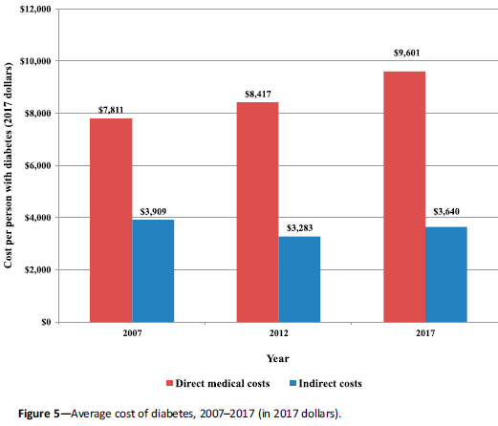

Slide 7
Section 1. Improving Care and Promoting Health in Populations
Strategies for System-Level Improvement
Telemedicine is a growing field that may increase access to care for patients with diabetes. Telemedicine is defined as the use of telecommunications to facilitate remote delivery of health-related services and clinical information (American Telemedicine Association. About telemedicine [Internet])
A growing body of evidence suggests that various telemedicine modalities may be effective at reducing A1C in patients with type 2 diabetes compared with usual care or in addition to usual care

Slide 8
Section 1. Improving Care and Promoting Health in Populations
For rural populations or those with limited physical access to health care, telemedicine has a growing body of evidence for its effectiveness, particularly with regard to glycemic control as measured by A1C
Interactive strategies that facilitate communication between providers and patients, including the use of web-based portals or text messaging and those that incorporate medication adjustment, appear more effective. There is limited data available on the cost-effectiveness of these strategies

Slide 9
A search in 6 databases
from inception until September 2016
randomized controlled studies
examined the use of telemedicine in adults with type 2 diabetes
extracted and classified according to the following telemedicine strategies: teleeducation, telemonitoring, telecase-management, telementoring and teleconsultation
A total of 107 studies involving 20,501 participants were included. Over a median of 6 months follow-up, telemedicine reduced haemoglobin A1c (HbA1c) by a mean of 0.43%

Slide 10
teleconsultation was the most effective telemedicine strategy, followed by telecase-management plus telemonitoring, and finally teleeducation plus telecase-management
The review indicates that most telemedicine strategies can be useful, either as an adjunct or to replace usual care, leading to clinically meaningful reduction in HbA1c

Slide 11
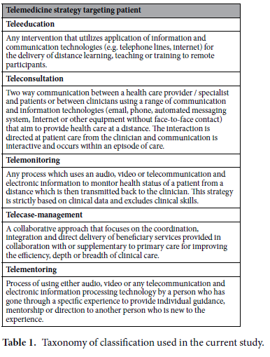

Slide 12
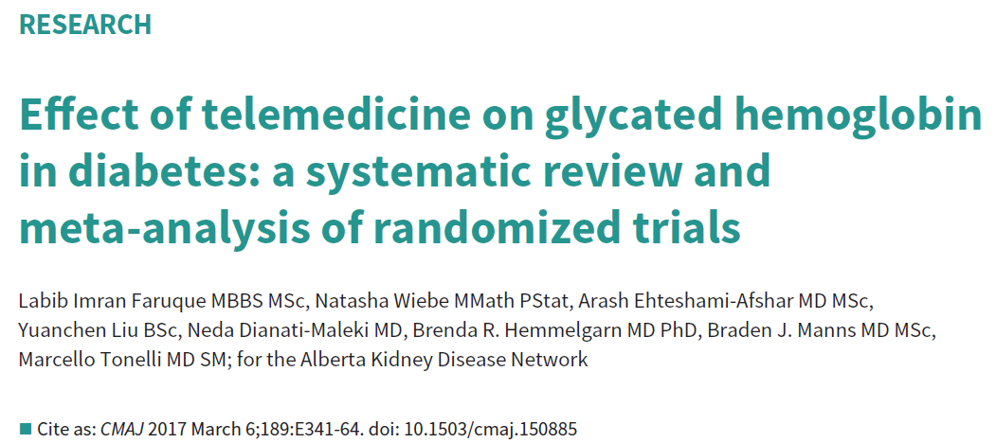
The primary outcome was glycated hemoglobin (HbA1C) reported at 3 time points (≤ 3 mo, 4–12 mo and > 12 mo)
Other outcomes were quality of life, mortality and episodes of hypoglycemia
From 3688 citations, they identified 111 eligible RCTs (n = 23 648)
Two independent reviewers selected the studies and assessed risk of bias in the studies

Slide 13
Telemedicine achieved significant but modest reductions (0.2-0.5) in HbA1C in all 3 follow-up periods
Telemedicine had no convincing effect on quality of life, mortality or hypoglycemia

Slide 15
Section 1. Improving Care and Promoting Health in Populations
The Affordable Care Act has resulted in increased access to care for many individuals with diabetes with an emphasis on the protection of people with preexisting conditions, health promotion, and disease prevention
In fact, health insurance coverage increased from 84.7% in 2009 to 90.1% in 2016 for adults with diabetes aged 18–64 years. Coverage for those ≥ 65 years remained near universal
Patients who have either private or public insurance coverage are more likely to meet quality indicators for diabetes care

Slide 16
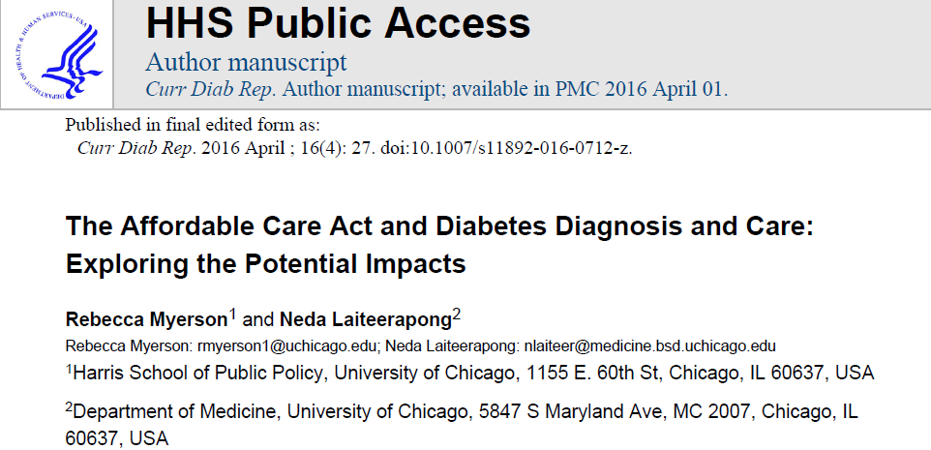
They estimate that approximately 2.3 million of the 4.6 million people in the USA with undiagnosed diabetes aged 18–64 in 2009–2010 may have gained access to free preventive care under the ACA, which could increase diabetes detection
They note two factors that may limit the success of the ACA for improving access to diabetes care
1- many states with the highest diabetes prevalence have not expanded Medicaid eligibility
2- primary care providers may not adequately meet the increase in Medicaid patients because federal funding to increase provider reimbursement for Medicaid visits recently expired

Slide 17
This is a cross-sectional, secondary analysis of the 2009-2010 and 2011-2012 National Health and Nutrition Examination Survey (NHANES) of adults aged 18 to 64 years with self reported diabetes and either no insurance, Medicaid, or private insurance (n=642)
Glycated hemoglobin was not different among insurance groups
access to health insurance is associated with improved diabetes management
There was no evidence for differences in diabetes quality measures between the privately and publicly insured

Slide 18
Section 1. Improving Care and Promoting Health in Populations
TAILORING TREATMENT FOR SOCIAL CONTEXT
half of adults with diabetes reported financial stress and one-fifth reported food insecurity (FI)
One population in which such issues must be considered is older adults, where social difficulties may impair their quality of life and increase their risk of functional dependency

Slide 19
A race-stratified random sample of 6,317 adults with type 2 or type 1 diabetes, aged 60 to 75 years
evaluate associations between health-related quality of life (HRQL) and geriatric syndromes (i.e.depression and falls), diabetes complications, and hypoglycemia in older adults with diabetes
Geriatric syndromes and hypoglycemia are associated with lower HRQL to a comparable degree as diabetes complications

Slide 20
Section 1. Improving Care and Promoting Health in Populations
Food Insecurity
The risk for type 2 diabetes is increased two-fold in those with FI and has been associated with low adherence to taking medications appropriately and recommended self-care behaviors, depression, diabetes distress, and worse glycemic control when compared with individuals who are food secure

Slide 21
Food insecurity is the ‘limited or uncertain availability of nutritionally adequate and safe foods’
a cross-sectional analysis of baseline data from adult patients with Type 2 diabetes
The sample consisted of 401 participants, 73% of whom reported some level of food insecurity

Slide 22
Food insecurity was significantly associated with self-care behaviours including less adherence to a general diet, less physical activity and with a greater occurrence of medication non-adherence and calorie restriction
Food insecurity was also associated with worse glycemic control
There was a high rate of food insecurity in a sample of patients with Type 2 diabetes who were of low socio-economic status
Food insecurity was associated with less adherence to recommended self-care behaviours and worse glycaemic control

Slide 23
Participants had poorly controlled type 2 diabetes (A1c ≥ 8.0 % on eligibility screen), household income < 250 % of the federal poverty level, were 30–70 years old
Almost half of participants had food insecurity. Food insecurity was associated with depression, diabetes distress, low medication adherence and worse glycemic control

Slide 24
Section 1. Improving Care and Promoting Health in Populations
See Table 9.1 for drug-specific and patient factors, including cost and risk of hypoglycemia, for treatment options for adults with FI and type 2 diabetes. Providers should consider these factors when making treatment decisions in people with FI

Slide 25
Section 2. Classification and Diagnosis of Diabetes NEW
the criteria for the diagnosis of diabetes was changed
The section was reorganized to improve flow and reduce redundancy
Additional conditions were identified that may affect A1C test accuracy including the postpartum period

Slide 26
Section 2. Classification and Diagnosis of Diabetes
DIAGNOSTIC TESTS FOR DIABETES
2018
2019

Slide 27
Section 2. Classification and Diagnosis of Diabetes
Fasting and 2-Hour Plasma Glucose
Numerous studies have confirmed that compared with FPG and A1C cut points, the 2-h PG value diagnoses more people with diabetes
ADA 2018
Fasting and 2-Hour Plasma Glucose
Compared with FPG and A1C cut points, the 2-h PG value diagnoses more people with prediabetes and diabetes
ADA 2019

Slide 28
Section 2. Classification and Diagnosis of Diabetes
A1C

Slide 29
Section 2. Classification and Diagnosis of Diabetes
A1C
When using A1C to diagnose diabetes, it is important to recognize that A1C is an indirect measure of average blood glucose levels and to take other factors into consideration that may impact hemoglobin glycation independently of glycemia including HIV treatment , age, race/ethnicity, pregnancy status, genetic background, and anemia/hemoglobinopathies

Slide 30
a retrospective cross-sectional cohort study among HIV-infected patients determining the sensitivity and specificity of HbA1c as a screening test compared to fasting blood glucose (FBG)
Twenty-two of the 395 patients included in the study were newly diagnosed with diabetes based on FBG ≥ 126 mg/dl
This study found that an HbA1c ≥ 6.5% is insensitive, but highly specific in diagnosing diabetes among HIV-infected patients
Current antiretroviral (ART) use has significant and variable influence on the relationship between HbA1c and FBG
The use of HbA1c in conjunction with FBG may be the best modality to screen for diabetes

Slide 31
Using a cutoff of HbA1c ≥ 6.5%, HbA1c had a sensitivity of 40.9% and specificity of 97.5% for identification of incident diabetes.
At an HbA1c level of 5.8% the product of sensitivity and specificity was maximized, with values of 88.8% and 77.5% respectively

Slide 32
Section 2. Classification and Diagnosis of Diabetes
Other Conditions Altering the Relationship of A1C and Glycemia
A1C is less reliable than blood glucose measurement in other conditions such as postpartum , HIV treated with certain drugs , and iron deficient anemia
Age
However, a recent ADA clinical guidance concluded that A1C, FPG, or 2-h PG can be used to test for prediabetes or type 2 diabetes in children and adolescents (chap 12)

Slide 33
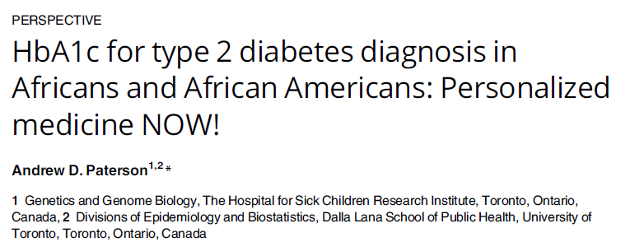
The G6PD variant rs1050828 is common in people of African and African American origin
rs1050828 has a minor allele frequency of 10%-15% in 7,564 African Americans without diabetes from 9 studies
to be associated with lower HbA1c
It has a large effect on HbA1c, which, if ignored, can result in people failing to meet criteria for T2D using HbA1c while being classified as having T2D using glucose tests

Slide 34
evaluated the status of carbohydrate metabolism by performing the OGTT and fasting glucose and A1C tests in 231 postpartum women with prior GDM 1 year after delivery
The prevalence of abnormal carbohydrate metabolism was 45.89% by the OGTT criterion, 19.05% by the A1C test criterion, 38.10% by the fasting glucose test criterion, and 46.75% by the A1C-fasting glucose test criteria

Slide 35
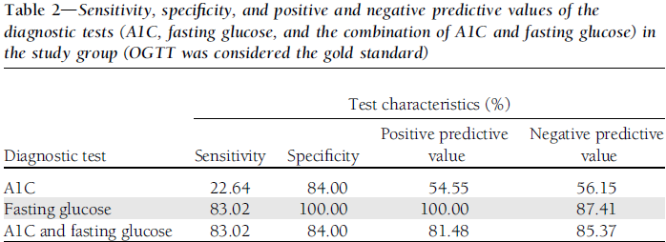

Slide 36
The A1C test criterion alone or in combination with fasting glucose test criterion does not provide a sensitive and specific diagnosis of abnormal carbohydrate metabolism in women who have had GDM
FPG measurement alone is not sensitive enough in this population to classify glucose tolerance status accurately and that an OGTT is needed to facilitate early detection and treatment

Slide 37
77 women with previous GDM (pGDM) and 41 controls 3–6 month after delivery: 3-h OGTT, frequently sampled intravenous glucose tolerance test
Follow-up examinations of pGDMs were performed up to 10 years

Slide 39
pGDM females with overt diabetes manifestation during the follow-up period showed more pronounced increasing HbA1c in contrast to females remaining normal glucose tolerant or developing prediabetes
It is suggested that the performance of HbA1c assessed early after delivery is inferior to the OGTT for the detection of early alterations in glucose metabolism
However, an increase in HbA1c levels could be used as an indicator of risk for diabetes manifestation

Slide 40
adults without self reported diabetes or chronic kidney disease in the National Health and Nutrition Examination Survey 1999–2006
aged ≥ 18 years of age and had complete blood counts, iron studies, and A1C levels
Iron deficiency was defined as at least two abnormalities including free erythrocyte protoporphyrin >70 g/dl erythrocytes, transferrin saturation <16%, or serum ferritin ≤ 15 g/l
Anemia was defined as hemoglobin< 13.5 g/dl in men and <12.0 g/dl in women

Slide 41
Among women (n=6,666), 13.7% had iron deficiency and 4.0% had iron deficiency anemia
Whereas 316 women with iron deficiency had A1C ≥ 5.5%, only 32 women with iron deficiency had A1C ≥ 6.5%
Among men (n=3,869), only 13 had iron deficiency and A1C ≥ 5.5%, and only 1 had iron deficiency and A1C ≥ 6.5%
Among women, iron deficiency was associated with a greater odds of A1C ≥ 5.5% (odds ratio 1.39 [95% CI 1.11–1.73]) after adjustment for age, race/ethnicity, and waist circumference but not with a greater odds of A1C ≥ 6.5% (0.79 [0.33–1.85])

Slide 43
Section 2. Classification and Diagnosis of Diabetes
Confirming the Diagnosis
Unless there is a clear clinical diagnosis (e.g., patient in a hyperglycemic crisis or with classic symptoms of hyperglycemia and a random plasma glucose >200 mg/dL [11.1 mmol/L]), a second test is required for confirmation
ADA 2018
Confirming the Diagnosis
Unless there is a clear clinical diagnosis (e.g., patient in a hyperglycemic crisis or with classic symptoms of hyperglycemia and a random plasma glucose >200 mg/dL [11.1 mmol/L]), diagnosis requires two abnormal test results from the same sample or in two separate test samples
ADA 2019

Slide 44
Prospective cohort study
13 346 ARIC(Atherosclerosis Risk in Communities) participants (12 268 without diagnosed diabetes) with 25 years of follow-up for incident diabetes, cardiovascular outcomes, kidney disease, and mortality
Confirmed undiagnosed diabetes was defined as elevated levels of fasting glucose (≥7.0 mmol/L [≥126 mg/dL]) and HbA1c ≥6.5% from a single blood sample

Slide 45
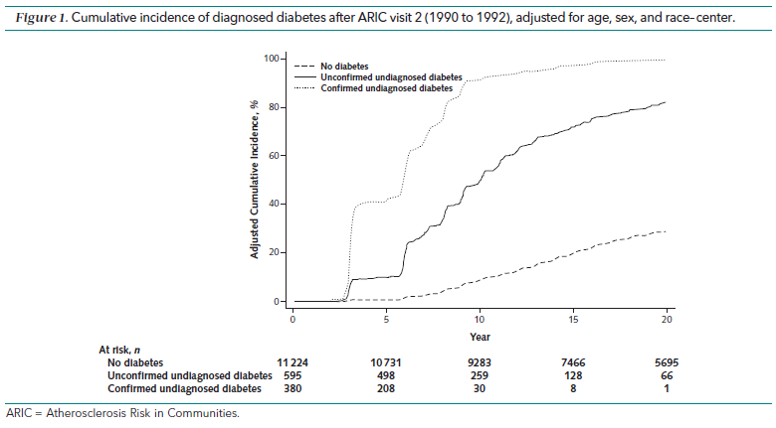

Slide 46
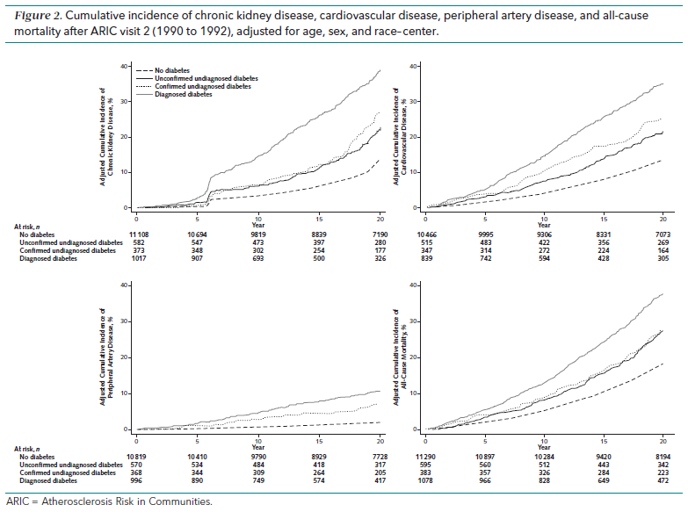

Slide 47
There were 978 persons with elevated fasting glucose level or elevated HbA1c level at baseline, among whom 39% had confirmed undiagnosed diabetes and 61% had unconfirmed undiagnosed diabetes
The confirmatory definition had moderate sensitivity (54.9%) but high specificity (98.1%) for identification of diabetes cases diagnosed during the first 5 years of follow-up, with specificity increasing to 99.6% by 15 years.
The 15-year positive predictive value was 88.7% compared with 71.1% for unconfirmed cases. Confirmed undiagnosed diabetes was significantly associated with cardiovascular and kidney disease and mortality, with stronger associations than unconfirmed diabetes

Slide 48
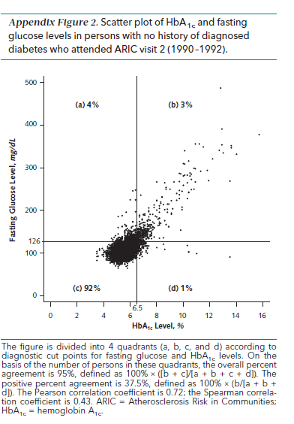
The overall percent agreement across diagnostic categories was 95%, with a positive percent agreement of 37.5%
isolated fasting glucose elevation (≥126 mg/dL) was 4 times more common (4% of the population) than isolated HbA1c elevation (≥6.5%) (1% of the population).

Slide 49
Section 2. Classification and Diagnosis of Diabetes
PREDIABETES AND TYPE 2 DIABETES
2018

Slide 50
Section 2. Classification and Diagnosis of Diabetes
PREDIABETES AND TYPE 2 DIABETES
2019

Slide 51
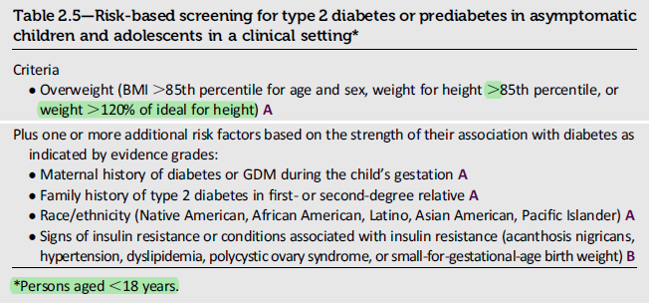
2019
2018

Slide 52
2019
2018

Slide 53
Section 2. Classification and Diagnosis of Diabetes
Age
Testing should begin at no later than age 45 years for all patients
Medications
Certain medications, such as glucocorticoids , thiazide diuretics, some HIV medications, and atypical antipsychotics , are known to increase the risk of diabetes

Slide 54
Section 2. Classification and Diagnosis of Diabetes
GESTATIONAL DIABETES MELLITUS
Definition
Women found to have prediabetes in the first trimester may be encouraged to make lifestyle changes to reduce their risk of developing type 2 diabetes, and perhaps GDM, though more study is needed

Slide 55
Women <14 weeks’ gestation and HbA1c ≥5.9%–6.4% measured at booking, without pre-existing diabetes
a multicentre, randomised controlled, two-arm, parallel-group, unblinded feasibility trial with 1:1 randomisation
minimum maternal age of 18 years

Slide 56
47 women were randomised into one of two groups
1- The early intervention group were offered outpatient visits every 3–6 weeks throughout pregnancy
2- The controls received standard care with their lead maternity carer and were asked to take a 75 g oral GTT to screen for GDM at 24 weeks’ gestation with appropriate follow-up if this test was positive
This study confirmed that the potential feasibility issues identified a priori were valid

Slide 57
Both pre-eclampsia and caesarean section are clinically relevant outcomes that impact significantly on maternal and neonatal morbidity and on healthcare costs
The emergency caesarean section rate in the control arm of this study was higher than our national total caesarean section rate
Logically, early intervention versus intervention commencing at 24 weeks’ gestation is more likely to improve outcomes related to placentation, such as pre-eclampsia and preterm birth, whist both interventions may improve outcomes related to fetal hyperinsulinaemia, such as macrosomia and neonatal hypoglycaemia

Slide 58
Section 2. Classification and Diagnosis of Diabetes
Diagnosis
GDM carries risks for the mother, fetus , and neonate
A recent follow-up study of women participating in a blinded study of pregnancy OGTTs found that 11 years after their pregnancies, women who would have been diagnosed with GDM by the one-step approach, as compared with those without, were at 3.4-fold higher risk of developing prediabetes and type 2 diabetes and had children with a higher risk of obesity and increased body fat, suggesting that the larger group of women identified by the one-step approach would benefit from increased screening for diabetes and prediabetes that would accompany a history of GDM

Slide 59
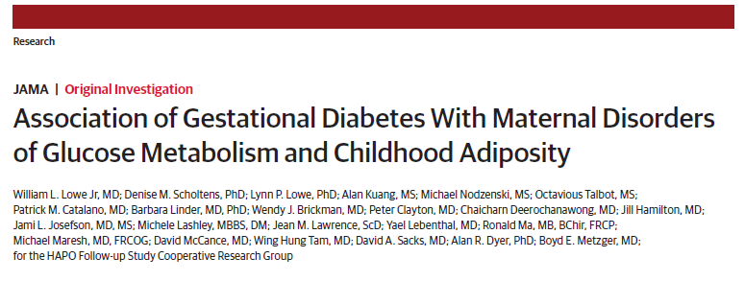
The Hyperglycemia and Adverse Pregnancy Outcome (HAPO) Study
4697 mothers and 4832 children
10-14 years follow up
study visits occurred between February 13, 2013, and December 13, 2016
Primary maternal outcome
Primary and secondry outcome for children

Slide 61
GD was significantly associated with a higher maternal risk for a disorder of glucose metabolism during long-term follow-up after pregnancy
Among children of mothers with GD vs those without it, the difference in childhood overweight or obesity defined by body mass index cutoffs was not statistically significant

Slide 62
Section 3. Prevention or Delay of Type 2 Diabetes NEW
This section was moved (it was Section 5)
The nutrition section was updated ) to highlight the importance of weight loss(
a section on tobacco use and cessation was added

Slide 63
Section 3. Prevention or Delay of Type 2 Diabetes
ADA 2018
ADA 2019
Recommendations
Technology-assisted tools including Internet-based social networks, distance learning, and mobile applications that incorporate bidirectional communication may be useful elements of effective lifestyle modification to prevent diabetes. B
Recommendations
3.3 : Based on patient preference, technology-assisted diabetes prevention interventions may be effective in preventing type 2 diabetes and should be considered .B

Slide 64
Section 3. Prevention or Delay of Type 2 Diabetes LIFESTYLE INTERVENTIONS
The Diabetes Prevention Program
Several major randomized controlled trials, including
the Diabetes Prevention Program (DPP),
the Finnish Diabetes Prevention Study (DPS), and
the Da Qing Diabetes Prevention Study (Da Qing study) , demonstrate that lifestyle/ behavioral therapy featuring an individualized reduced calorie meal plan is highly effective in preventing type 2 diabetes and improving other cardiometabolic markers (such as blood pressure, lipids, and inflammation)

Slide 65
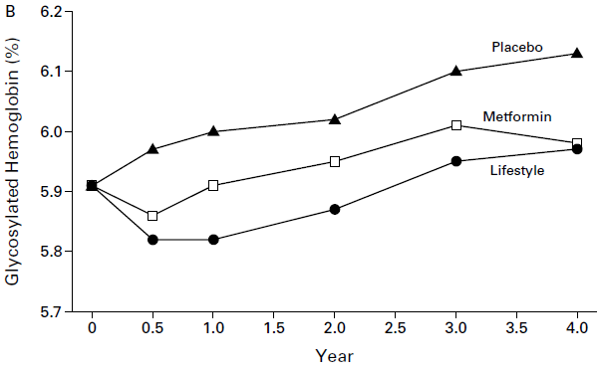
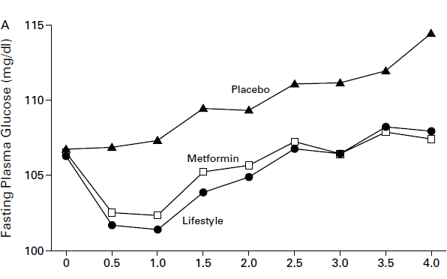
Diabetes Prevention Program (DPP) : )2002-nejm)
3234 nondiabetic persons with elevated fasting and post-load plasma glucose concentrations to placebo, metformin (850 mg twice daily), or a lifestyle-modification program with the goals of at least a 7 percent weight loss and at least 150 minutes of physical activity per week
Lifestyle changes(58%) and treatment with metformin (31%) both reduced the incidence of diabetes in persons at high risk
The lifestyle intervention was more effective than metformin

Slide 66
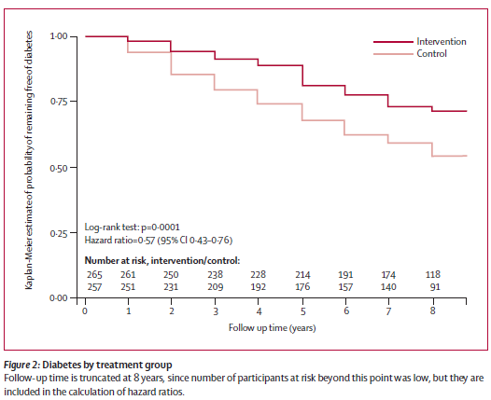
Finnish Diabetes Prevention Study (DPS) : (2006-lancet)
Overweight, middle-aged men (n=172) and women (n=350) with impaired glucose tolerance
Randomly assigned to intensive lifestyle intervention or control group
After a median of 4 years of active intervention period, participants who were still free of diabetes were further followed up for a median of 3 years
Lifestyle intervention in people at high risk for type 2 diabetes resulted in sustained lifestyle changes and a reduction in diabetes incidence

Slide 67
Section 3. Prevention or Delay of Type 2 Diabetes
Notably, in the 23-year follow-up for the Da Qing study, reductions in all-cause mortality and cardiovascular disease–related mortality were observed for the lifestyle intervention groups compared with the control group
However, longer-term (4-year) data reveal maximal prevention of diabetes observed at about 7–10% weight loss

Slide 68
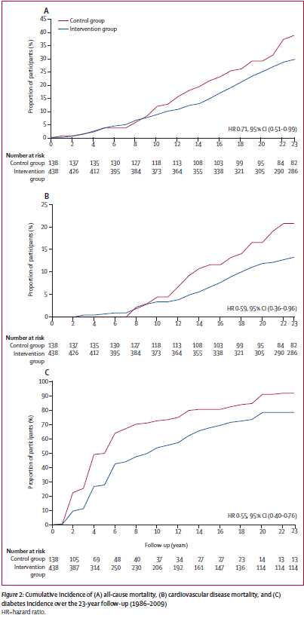
Da Qing Diabetes Prevention Study (Da Qing study):
(Lancet Diabetes Endocrinol 2014)
a cluster randomised trial in which 33 clinics in Da Qing, China
577 adults with impaired glucose tolerance
randomised (1:1:1:1) to a control group or lifestyle intervention groups (diet or exercise or both)Patients
the intervention phase lasted for 6 years
assess the primary outcomes of cardiovascular mortality, all-cause mortality, and incidence of diabetes in the intention-to-treat population
A 6-year lifestyle intervention programme for Chinese people with impaired glucose tolerance can reduce incidence of cardiovascular and all-cause mortality and diabetes

Slide 69
For this study, they analyzed one arm of a randomized trial[(DPP) participants randomized to the intensive lifestyle intervention] using Cox proportional hazards regression over 3.2 years of follow-up
This suggests that subjects who lose even more weight than the DPP average (5–7%), and who meet physical activity and dietary fat goals, could reduce their diabetes risk by 90%

Slide 70
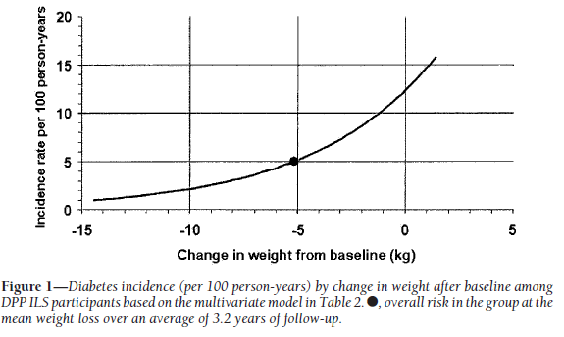

Slide 71
Section 3. Prevention or Delay of Type 2 Diabetes
Nutrition
Structured behavioral weight loss therapy, including a reduced calorie meal plan and physical activity, is of paramount importance for those at high risk for developing type 2 diabetes who have overweight or obesity
weight loss through lifestyle changes alone can be difficult to maintain long term
people being treated with weight loss therapy should have access to ongoing support and additional therapeutic options (such as pharmacotherapy) if needed

Slide 72
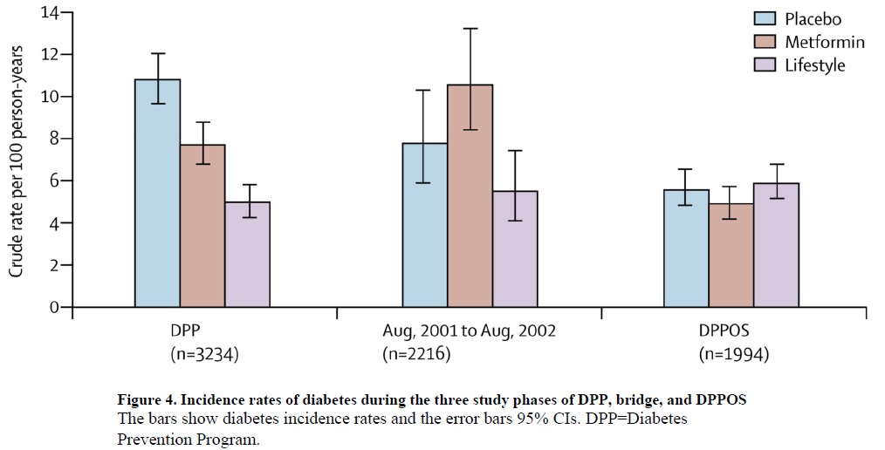
All active DPP participants were eligible for continued follow-up
During the 10-year follow-up since randomisation to DPP
shown that a reduction in diabetes cumulative incidence by either lifestyle intervention or metformin therapy persists for at least 10 years
Diabetes incidence rates in this follow-up study were similar between treatment groups: 5·9 per 100 person-years (5·1–6·8) for lifestyle, 4·9 (4·2–5·7) for metformin, and 5·6 (4·8–6·5) for placebo

Slide 73
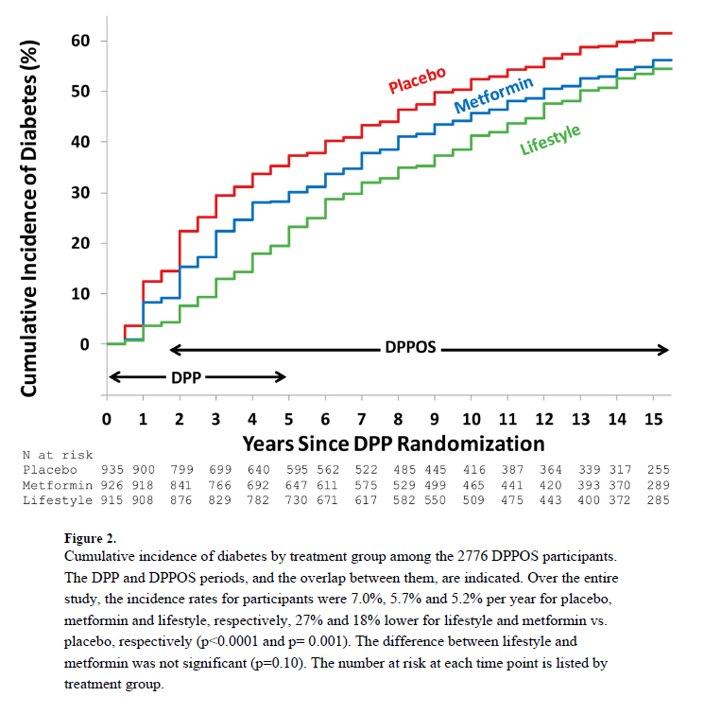
During 15 years of average follow-up, lifestyle intervention and metformin reduced diabetes incidence rates by 27% (p<0.0001) and 18% (p=0.001)
The prevalences at study-end of the aggregate microvascular outcome, composed of nephropathy, neuropathy, and retinopathy, were not significantly different among the treatment groups

Slide 74
Section 3. Prevention or Delay of Type 2 Diabetes
Based on intervention trials, the eating patterns that may be helpful for those with prediabetes include a Mediterranean eating plan and a low-calorie, low-fat eating plan
Additional research is needed regarding whether a low-carbohydrate eating plan is beneficial for persons with prediabetes
In addition, evidence suggests that the overall quality of food consumed (as measured by the Alternative Healthy Eating Index), with an emphasis on whole grains, legumes, nuts, fruits and vegetables, and minimal refined and processed foods, is also important

Slide 75
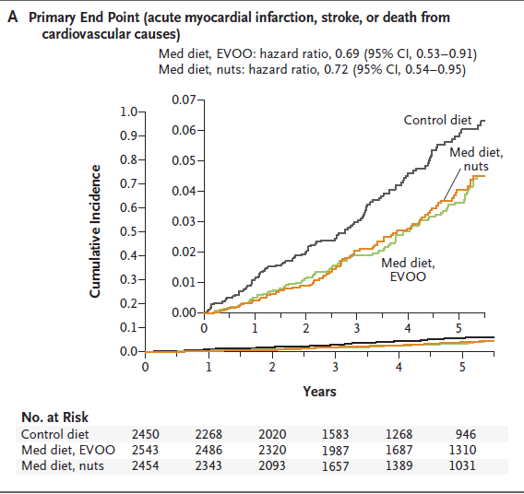
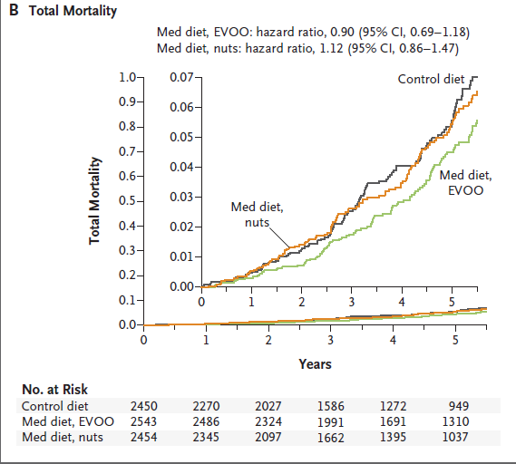
a multicenter trial in Spain[7447 participants (55 to 80 years of age, 57% women)]
high cardiovascular risk, but with no cardiovascular disease at enrollment
to one of three diets: a Mediterranean diet supplemented with extra-virgin olive oil, a Mediterranean diet supplemented with mixed nuts, or a control diet (advice to reduce dietary fat)
median follow-up of 4.8 years
In persons at high cardiovascular risk, the incidence of major cardiovascular events was lower among those assigned to a Mediterranean diet supplemented with extra-virgin olive oil or nuts than among those assigned to a reduced-fat diet

Slide 76
Several databases were searched for relevant articles that were published prior to May 2015
Cohort studies with a follow-up period of at least one year
Identified articles were systematically reviewed
those with pertinent data were selected for inclusion in a meta-analysis
The pooled risk ratio (RR) with 95% confidence interval (CI) for the incidence of diabetes was calculated
Low-carbohydrate diets did not show any benefit on the risk of diabetes

Slide 77
Diets rich in whole grains, fruits, vegetables, legumes, nuts, moderate in alcohol consumption, and lower in refined grains, red/processed meats, and sugar-sweetened beverages have demonstrated to reduce diabetes risk and improve glycemic control and blood lipids in patients with diabetes

Slide 79
Section 3. Prevention or Delay of Type 2 Diabetes
Technology-Assisted Interventions to Deliver Lifestyle Interventions
Technology-assisted interventions may effectively deliver the DPP lifestyle intervention, reducing weight and, therefore, diabetes risk
Such technology-assisted interventions may deliver content through smartphone and web-based applications and telehealth
The Centers for Disease Control and Prevention (CDC) Diabetes Prevention Recognition Program (DPRP) does certify technology-assisted modalities as effective vehicles for DPP-based interventions; such programs must use an approved curriculum, include interaction with a coach (which may be virtual), and attain the DPRP outcomes of participation, physical activity reporting, and weight loss. The selection of an in-person or virtual program should be based on patient preference

Slide 80
September 2017 Springer
J Med Internet Res 2017
This review focuses on studies that have examined the use of mobile phone text messaging, smartphone/web-based apps, and telehealth programs to help prevent or delay the onset of incident type 2 diabetes
Patients who are at risk for diabetes can be offered technology-assisted DPP and weight loss interventions to lower their risk of incident diabetes
In this meta-analysis, six databases were searched to identify studies reporting weight change that used technology to mediate diet and exercise interventions, and targeted individuals at high risk for developing type 2 diabetes
Technology-mediated diabetes prevention programs can result in clinically significant amounts of weight loss, as well as improvements in glycaemia in patients with prediabetes

Slide 81
Section 3. Prevention or Delay of Type 2 Diabetes
Tobacco Use
Smoking may increase the risk of type 2 diabetes ; therefore, evaluation for tobacco use and referral for tobacco cessation, if indicated, should be part of routine care for those at risk for diabetes
Of note, the years immediately following smoking cessation may represent a time of increased risk for diabetes and patients should be monitored for diabetes development and receive evidence-based interventions for diabetes prevention as described in this section

Slide 82
In three cohort studies involving men and women in the United States
had reported quitting smoking
they prospectively assessed changes in smoking status and body weight
estimated risks of type 2 diabetes, death from cardiovascular disease, and death from any cause
Smoking cessation that was accompanied by substantial weight gain was associated with an increased short-term risk of type 2 diabetes but did not mitigate the benefits of quitting smoking on reducing cardiovascular and all-cause mortality

Slide 83
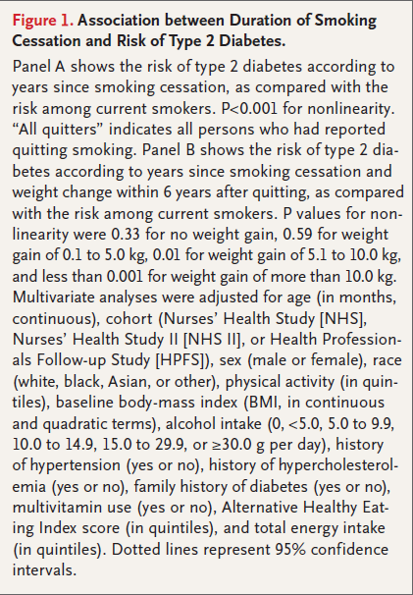

Slide 85
Section 3. Prevention or Delay of Type 2 Diabetes
PHARMACOLOGIC INTERVENTIONS
Pharmacologic agents including metformin, a-glucosidase inhibitors, glucagon like peptide-1 receptor agonists, thiazolidinediones, and several agents approved for weight loss have been shown in research studies to decrease the incidence of diabetes to various degrees in those with prediabetes

Slide 86
Prevention of Type 2 Diabetes in Subjects With Prediabetes and Metabolic Syndrome Treated With Phentermine and Topiramate Extended Release
(Diabetes Care 2014)
Subanalysis of a phase 3, randomized, placebo-controlled, double-blind study of overweight/obese subjects (BMI >27 to <45 kg/m2) with two or more comorbidities
475 subjects met the criteria for prediabetes and/or MetS
108 weeks follow up
PHEN/TPM ER plus lifestyle modification produced significant weight loss and markedly reduced progression to type 2 diabetes in overweight/obese patients with prediabetes and/or MetS, accompanied by improvements in multiple cardiometabolic disease risk factors

Slide 89
Section 3. Prevention or Delay of Type 2 Diabetes
In the Indian Diabetes Prevention Programme (IDPP-1), metformin and the lifestyle intervention reduced diabetes risk similarly at 30 months; of note, the lifestyle intervention in IDPP-1 was less intensive than that in the DPP

Slide 90
Asian Indians with IGT who were younger, leaner and more insulin resistant
Group 1 was the control, Group 2 was given advice on lifestyle modification (LSM), Group 3 was treated with metformin (MET) and Group 4 was given LSM plus MET
The median follow-up period was 30 months
Both LSM and MET significantly reduced the incidence of diabetes in Asian Indians with IGT; there was no added benefit from combining them

Slide 91
Section 4. Comprehensive Medical Evaluation and Assessment of Comorbidities NEW
new text about use of language to communicate about diabetes with people with diabetes and professional audiences
A new figure from the ADA-European Association for the Study of Diabetes (EASD)
A new recommendation was added to explicitly call out the importance of the diabetes care team

Slide 92
Section 4. Comprehensive Medical Evaluation and Assessment of Comorbidities NEW
The table listing the components of a comprehensive medical evaluation was revised, and the section on assessment and planning was used to create a new table (Table 4.2)
A new table was added listing factors that increase risk of treatment-associated hypoglycemia (Table 4.3)
A recommendation was added to include the 10-year atherosclerotic cardiovascular disease (ASCVD) risk
The fatty liver disease section was revised and a new recommendation regarding when to test for liver disease

Slide 93
Section 4. Comprehensive Medical Evaluation and Assessment of Comorbidities

Slide 94
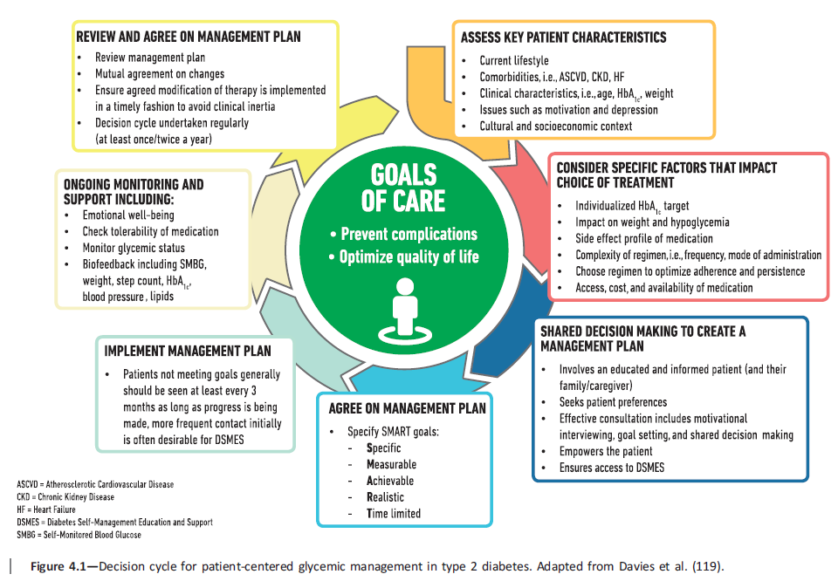
Section 4. Comprehensive Medical Evaluation and Assessment of Comorbidities
The goals of treatment for diabetes are to prevent or delay complications and maintain quality of life (Fig. 4.1)

Slide 95
Section 4. Comprehensive Medical Evaluation and Assessment of Comorbidities
Language has a strong impact on perceptions and behavior. The use of empowering language in diabetes care and education can help to inform and motivate people, yet language that shames and judges may undermine this effort
The American Diabetes Association (ADA) and American Association of Diabetes Educators consensus report, “The Use of Language in Diabetes Care and Education,” provides the authors’ expert opinion regarding the use of language by health care professionals when speaking or writing about diabetes for people with diabetes or for professional audiences

Slide 96
Section 4. Comprehensive Medical Evaluation and Assessment of Comorbidities
Although further research is needed to address the impact of language on diabetes outcomes, the report includes five key consensus recommendations for language use:
- Use language that is neutral, nonjudgmental, and based on facts, actions, or physiology/biology.
- Use language that is free from stigma.
Use language that is strength based, respectful, and inclusive and that imparts hope.
Use language that fosters collaboration between patients and providers.
- Use language that is person centered

Slide 97
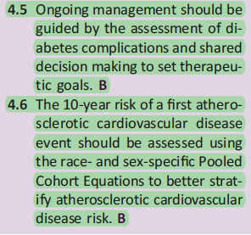
Section 4. Comprehensive Medical Evaluation and Assessment of Comorbidities
COMPREHENSIVE MEDICAL EVALUATION
New recommendations

Slide 98
Section 4. Comprehensive Medical Evaluation and Assessment of Comorbidities
The assessment of risk of acute and chronic diabetes complications and treatment planning are key components of initial and follow-up visits (Table 4.2)
The risk of atherosclerotic cardiovascular disease and heart failure (Section 10), chronic kidney disease staging (Section 11), and risk of treatment-associated hypoglycemia (Table 4.3) should be used to individualize targets for glycemia (Section 6 ), blood pressure, and lipids and to select specific glucose-lowering medication (Section 9), antihypertension medication, or statin treatment intensity

Slide 99
Section 4. Comprehensive Medical Evaluation and Assessment of Comorbidities

Slide 100
Section 4. Comprehensive Medical Evaluation and Assessment of Comorbidities

Slide 101
From January 2000 to December 2002
patients with type 2 diabetes aged 25–75 years without CKD(GFR ≥ 60 mL/min/1.73 m2) (n = 1,217)
followed-up in January 2011 and May 2012
The incidence of SH events was higher in older patients (P , 0.001), in those with a longer duration of diabetes (P , 0.001), in those who used insulin (P , 0.001) and sulfonylurea (P = 0.003)

Slide 102
The development of SH was independently associated with duration of diabetes and presence of macroalbuminuria, even with normal renal function in patients with type 2 diabetes

Slide 103
used inpatient National Claims History files from the Centers for Medicare and Medicaid Services (CMS) to identify all fee-for-service (FFS) Medicare beneficiaries 65 years or older from 1999 to 2011
older patients may be more susceptible to hypoglycemia and its adverse consequences owing to aging-related changes in renal function, drug clearance, counter-regulatory responses, as well as cognitive dysfunction and highly prevalent polypharmacy

Slide 104
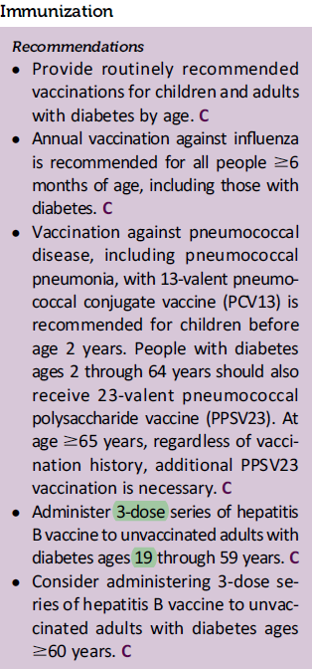
Section 4. Comprehensive Medical Evaluation and Assessment of Comorbidities
ADA 2018
ADA 2019

Slide 105
Section 4. Comprehensive Medical Evaluation and Assessment of Comorbidities
Cancer
New onset of atypical diabetes (lean body habitus, negative family history) in a middle-aged or older patient may precede the diagnosis of pancreatic adenocarcinoma
However, in the absence of other symptoms (e.g., weight loss, abdominal pain), routine screening of all such patients is not currently recommended

Slide 106
retrospectively reviewed medical records of 500 consecutive cancer patients (100 each with lung, breast, prostate, colorectal and PaC) and 100 non-cancer controls

Slide 107
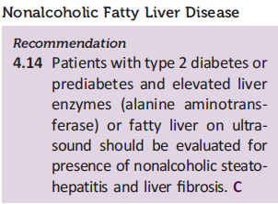
Section 4. Comprehensive Medical Evaluation and Assessment of Comorbidities
Nonalcoholic Fatty Liver Disease
Diabetes is associated with the development of nonalcoholic fatty liver disease, including its more severe manifestations of nonalcoholic steatohepatitis , liver fibrosis, cirrhosis, and hepatocellular carcinoma
Noninvasive tests, such as elastography or fibrosis biomarkers, may be used to assess risk of fibrosis, but referral to a liver specialist and liver biopsy may be required for definitive diagnosis

Slide 108
Guidance Statements
11. In patients with NAFLD, the metabolic syndrome predicts the presence of steatohepatitis, and its presence can be used to target patients for a liver biopsy
12. NAFLD Fibrosis Score or FIB-4 index are clinically useful tools for identifying NAFLD patients with higher likelihood of having bridging fibrosis (stage 3) or cirrhosis (stage 4)
13. VCTE (vibration-controlled transient elastography) or MRE are clinically useful tools for identifying advanced fibrosis in patients with NAFLD

Slide 109
Section 4. Comprehensive Medical Evaluation and Assessment of Comorbidities
Pioglitazone and vitamin E treatment of biopsy-proven nonalcoholic steatohepatitis have been shown to improve liver histology, but effects on longer term clinical outcomes are not known
Treatment with liraglutide and with sodium–glucose cotransporter 2 inhibitors (dapagliflozin and empagliflozin) has also shown some promise in preliminary studies, although benefits may be mediated, at least in part, by weight loss

Slide 110
Nejm 2010
randomly assigned 247 adults with nonalcoholic steatohepatitis and without diabetes to receive pioglitazone at a dose of 30 mg daily (80 subjects), vitamin E at a dose of 800 IU daily (84 subjects), or placebo (83 subjects), for 96 weeks
Vitamin E was superior to placebo for the treatment of nonalcoholic steatohepatitis in adults without diabetes
There was no benefit of pioglitazone over placebo for the primary outcome; however, significant benefits of pioglitazone were observed for some of the secondary outcomes

Slide 112
Lancet 2016
multicentre, double-blinded, randomised, placebo-controlled phase 2 trial
assess subcutaneous injections of liraglutide (1∙8 mg daily) compared with placebo for patients who are overweight and show clinical evidence of non-alcoholic steatohepatitis
Between Aug 1, 2010, and May 31, 2013, 26 patients were randomly assigned to receive liraglutide and 26 to placebo
Liraglutide was safe, well tolerated, and led to histological resolution of non-alcoholic steatohepatitis, warranting extensive, longer-term studies

Slide 115
randomized, active-controlled ,open-label trial, 57patients with type 2 diabetes and NAFLD were randomized to a dapagliflozin (5 mg/day) group (n=33) or to the control group (n=24) and were treated for 24 weeks
Hepatic steatosis and fibrosis were assessed by using a transient elastography (FibroScan)to measure the controlled attenuation parameter (CAP) and liver stiffness measurement(LSM), respectively
Based on these findings, the SGLT2 inhibitor dapagliflozin improves liver steatosis in patients with type 2 diabetes and NAFLD, and attenuates liver fibrosis in only patients with significant liver fibrosis,although it cannot denied that weight reduction or VAT by dapagliflozin may be associated with a decrease of liver steatosis or fibrosis

Slide 116
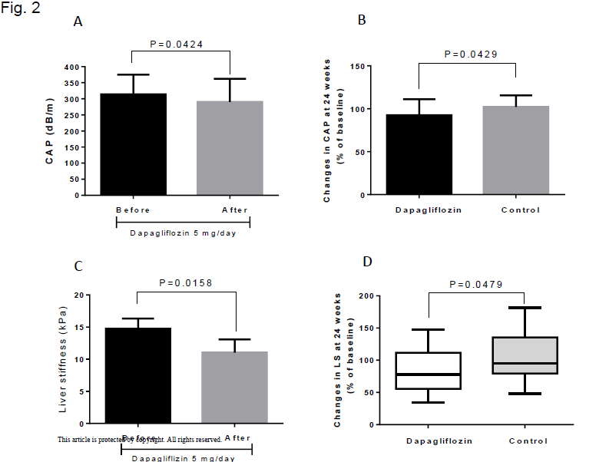

Slide 117
The effect of empagliflozin on liver enzymes was analysed from three data sources
EMPA-REG OUTCOME® trial (n = 7020),
pooled data from four 24-week placebo-controlled trials (n = 2477)
These highly consistent results suggest that empagliflozin reduces aminotransferases in individuals with type 2 diabetes, in a pattern (reductions in ALT>AST) that is potentially consistent with a reduction in liver fat, especially when ALT levels are high

Slide 118
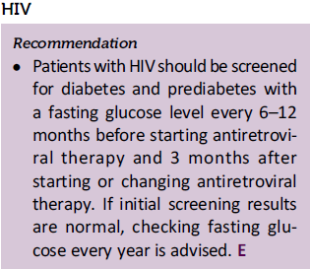
Section 4. Comprehensive Medical Evaluation and Assessment of Comorbidities
ADA 2018
ADA 2019

Slide 119
Section 4. Comprehensive Medical Evaluation and Assessment of Comorbidities
Obstructive Sleep Apnea
Patients with symptoms suggestive of obstructive sleep apnea (e.g., excessive daytime sleepiness, snoring, witnessed apnea) should be considered for screening

Slide 120
Section 5. Lifestyle Management NEW
there is not an ideal percentage of calories from carbohydrate, protein, and fat for all people with diabetes
more discussion about the importance of macronutrient distribution
Additional considerations bout eating patterns, macronutrient distribution, and meal planning sections
A recommendation : to decrease consumption of both sugar sweetened and nonnutritive-sweetened beverages and emphasis on water intake

Slide 121
Section 5. Lifestyle Management NEW
The sodium consumption recommendation was modified
Additional discussion :added to the physical activity section to include the benefit of a variety of leisure-time physical activities
The discussion about e-cigarettes was expanded

Slide 122
Section 5. Lifestyle Management
DIABETES SELF-MANAGEMENT EDUCATION AND SUPPORT
Patient performance of self-management behaviors, including its effect on clinical outcomes, health status, and quality of life, as well as the psychosocial factors impacting the person’s self-management should be monitored as part of routine clinical care

Slide 123
Section 5. Lifestyle Management
Evidence for the Benefits
Current research supports nurses, dietitians, and pharmacists as providers of DSMES)Diabetes Self-Management Education and Support(who may also develop curriculum
Members of the DSMES team should have specialized clinical knowledge in diabetes and behavior change principles
Certification as a certified diabetes educator (CDE) or board certified-advanced diabetes management (BC-ADM) certification demonstrates specialized training and mastery of a specific body of knowledge

Slide 124
The 10 Standards were divided among 20 interdisciplinary workgroup members
searched the current research for diabetes education and support, behavioral health, clinical, health care environment, technical, reimbursement, and business practice for the strongest evidence that guided the Standards revision

Slide 125
Diabetes Self-Management Education and Support facilitates the knowledge, skills, and ability necessary for diabetes self-care as well as activities that assist a person in implementing and sustaining the behaviors needed to manage their condition on an ongoing basis
The evidence indicates that health care providers and people affected by diabetes are embracing technology, and this is having a positive impact of DSMES access, utilization, and outcomes

Slide 126
Quality DSMES continues to be a critical element of care for all people with diabetes
The DSMES services must be individualized and guided by the concerns, preferences, and needs of the person affected by diabetes
Even with the abundance of evidence supporting the benefits of DSMES, it continues to be underutilized, but as with other health care services, technology is changing the way DSMES is delivered and utilized with positive outcomes

Slide 127
Section 5. Lifestyle Management
NUTRITION THERAPY
Because of the progressive nature of type 2 diabetes, lifestyle changes alone may not be adequate to maintain euglycemia over time. However, after medication is initiated, nutrition therapy continues to be an important component and should be integrated with the overall treatment plan

Slide 128
A systematic evaluation of the literature since 2014 informed new recommendations
These include additional focus on lifestyle management and diabetes selfmanagement education and support
For those with obesity, efforts targeting weight loss, including lifestyle, medication and surgical interventions, are recommended

Slide 129
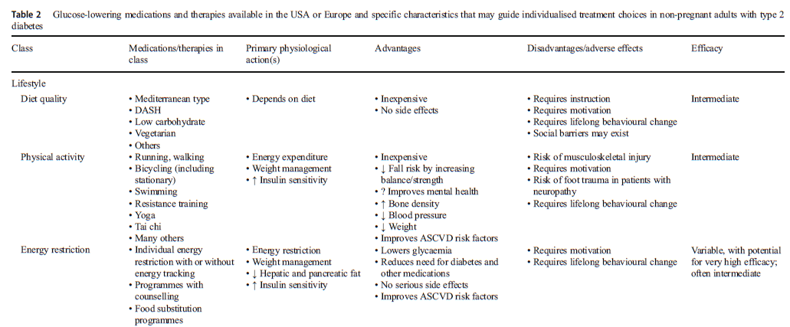

Slide 130
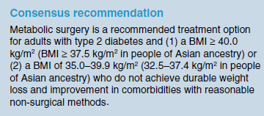
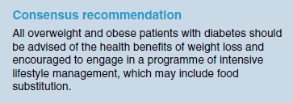

Slide 131
Section 5. Lifestyle Management
Eating Patterns, Macronutrient Distribution, and Meal Planning
a referral to an RD or registered dietitian nutritionist (RDN) is essential to assess the overall nutrition status of, and to work collaboratively with, the patient to create a personalized meal plan that considers the individual’s health status, skills, resources, food preferences, and health goals to coordinate and align with the overall treatment plan including physical activity and medication

Slide 132
MNT provided by RDNs is
effective in improving medical outcomes and quality of life, and is cost-effective
also successful and essential to preventing progression of prediabetes and obesity to type 2 diabetes
MNT is an effective intervention for the management of obesity, prediabetes, and diabetes

Slide 133
Impact of MNT on Obesity
As obesity is a key risk factor for the development of prediabetes and type 2 diabetes, adult weight management MNT delivered by an RDN is both clinically and economically effective for prevention and management
MNT results in both statistically significant and clinically meaningful weight loss in overweight or obese adults, as well as reduced risk for diabetes and disorders of lipid metabolism and hypertension

Slide 134
Impact of MNT on Prediabetes
The primary goal of intervening in individuals with prediabetes, is to prevent and/or delay progression to type 2 diabetes
MNT is effective for managing prediabetes via key positive clinical outcomes on body weight, energy balance, and healthy lifestyle changes
Lifestyle interventions focused on healthy eating and physical activity and, when compared, improved clinical outcomes more than metformin
Therefore, reducing obesity and prediabetes prevalence is vital to prevent type 2 diabetes

Slide 135
Impact of MNT on Type 2 Diabetes
all adults with type 2 diabetes be referred for MNT
continued MNT encounters produce maintenance and continued reductions of hemoglobin A1c (HbA1c) in adults with type 2 diabetes
MNT significantly lowered HbA1c by 0.3% to 2.0% at 3 months, and with ongoing MNT support, decreases were maintained or improved for more than 12 months
MNT is essential for the achievement of treatment goals for both diabetes and prediabetes

Slide 136
In people with type 1 diabetes, MNT contributed to significantly decreased HbA1c levels. At 6 months, 2 studies reported that individualized MNT using carbohydrate counting to determine premeal insulin doses assisted in decreasing baseline mean HbA1c levels by 1.0% and 1.9%
nonsignificant changes in total cholesterol, HDL cholesterol, and TG and BP

Slide 137
Section 5. Lifestyle Management
In addition, research indicates that low carbohydrate eating plans may result in improved glycemia and have the potential to reduce antihyperglycemic medications for individuals with type 2 diabetes
As research studies on some low-carbohydrate eating plans generally indicate challenges with long term sustainability, it is important to reassess and individualize meal plan guidance regularly for those interested in this approach
This meal plan is not recommended at this time for women who are pregnant or lactating, people with or at risk for disordered eating, or people who have renal disease, and it should be used with caution in patients taking sodium–glucose cotransporter 2 (SGLT2) inhibitors due to the potential risk of ketoacidosis

Slide 138
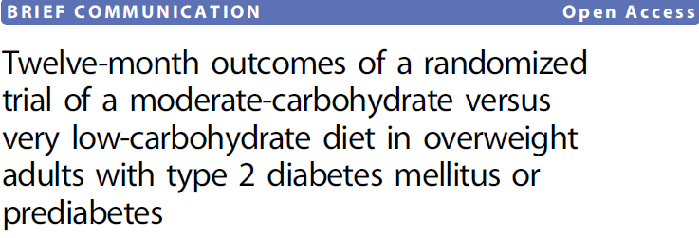
randomized adults (n = 34) with glycated hemoglobin (HbA1c) > 6.0% and elevated body weight (BMI > 25):
a very low-carbohydrate ketogenic (LCK) diet (n = 16)
a moderate-carbohydrate, calorie-restricted, low fat(MCCR) diet (n = 18)
to be physically active, get sufficient sleep, and practice behavioral adherence strategies based on positive affect and mindful eating

Slide 139
Twelve months after baseline, participants in the LCK group evidenced greater reductions in each HbA1c and weight than did participants in the MCCR group
the greater reductions in HbA1c in the LCK group occurred despite greater reductions in glucoselowering medications
At 6 months, we noted an increase in LDL cholesterol in the LCK group compared to the MCCR group. This difference was no longer significant at 12 months

Slide 140
Section 5. Lifestyle Management
There is inadequate research in type 1 diabetes to support one eating plan over another at this time.
A simple and effective approach to glycemia and weight management emphasizing portion control and healthy food choices should be considered for those with type 2 diabetes who are not taking insulin, who have limited health literacy or numeracy, or who are older and prone to hypoglycemia

Slide 141
Section 5. Lifestyle Management
Weight Management
It should be noted, however, that the clinical benefits of weight loss are progressive and more intensive weight loss goals (i.e., 15%) may be appropriate to maximize benefit depending on need, feasibility, and safety
MNT guidance from an RD/RDN with expertise in diabetes and weight management, throughout the course of a structured weight loss plan, is strongly recommended

Slide 142
Section 5. Lifestyle Management
Studies have demonstrated that a variety of eating plans, varying in macronutrient composition, can be used effectively and safely in the short term (1–2 years) to achieve weight loss in people with diabetes
This includes structured low-calorie meal plans that include meal replacements and the Mediterranean eating pattern as well as low-carbohydrate meal plans

Slide 143
Lancet 2018
open-label, cluster-randomised trial at 49 primary care practices in Scotland and England
randomly assigned (1:1)
weight management programme (intervention) or best-practice care by guidelines (control)
aged 20–65 years with type 2 diabetes within the past 6 years, had a body-mass index of 27–45 kg/m2, and were not receiving insulin
The intervention comprised withdrawal of antidiabetic and antihypertensive drugs, total diet replacement (825–853 kcal/day formula diet for 3–5 months), stepped food reintroduction (2–8 weeks), and structured support for long-term weight loss maintenance

Slide 144
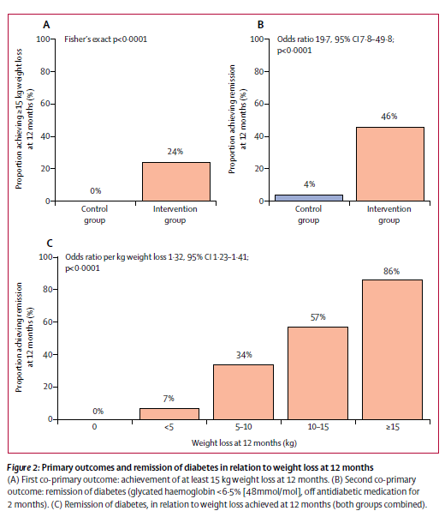
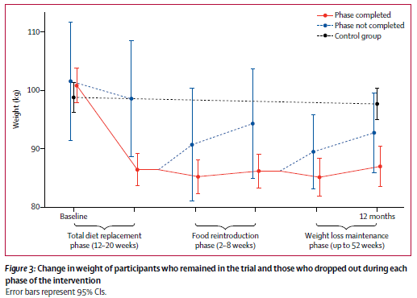
At 12 months, weight loss of 15 kg or more in 24% participants in the intervention group and no participants in the control group
Diabetes remission was achieved in 46% participants in the intervention group and 4% participants in the control group

Slide 145
108 overweight and obese patients with T2D (46 M/62F; age 60 ± 10 years; HbA1c 8.07 ± 1.05%; weight 101.4 ± 21.1 kg and BMI 35.2 ± 7.7 kg/m2)
Group A met with RDN to develop an individualized eating plan. Group B met with RDN and followed a structured meal plan. Group C did similar to group B and received weekly phone support by RDN

Slide 146
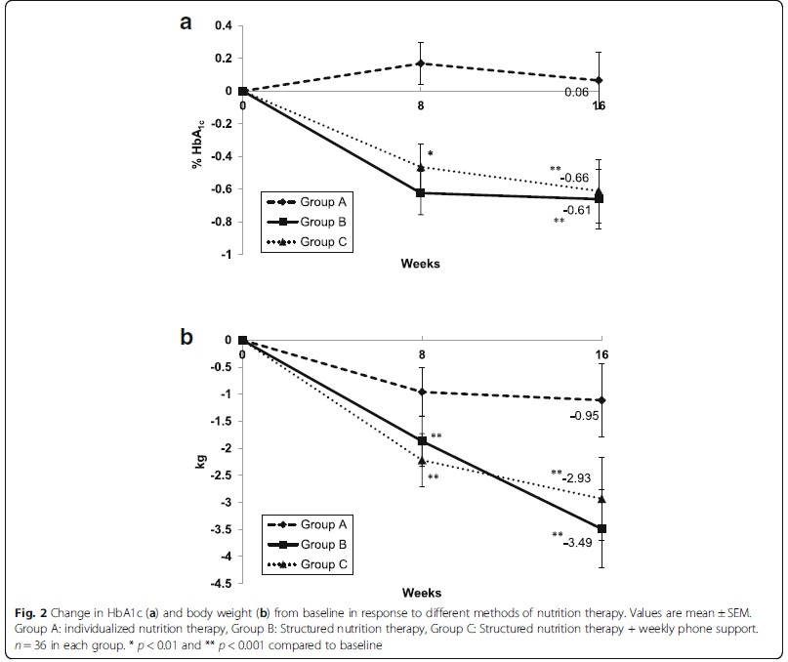
- Total energy intake was significantly lower in all groups compared to baseline with no difference among them - groups B and C significantly reduced their proportion of energy intake from saturated fat compared to group A
Body weight did not change from baseline in group A, but decreased significantly in groups B and C
- An HbA1c reduction of 0.61–0.66%, as seen in the structured NT groups

Slide 147
Section 5. Lifestyle Management
However, no single approach has been proven to be consistently superior , and more data are needed to identify and validate those meal plans that are optimal with respect to long term outcomes as well as patient acceptability
The importance of providing guidance on an individualized meal plan containing nutrient-dense foods, such as vegetables, fruits, legumes, dairy, lean sources of protein (including plant-based sources as well as lean meats, fish, and poultry), nuts, seeds, and whole grains, cannot be overemphasized , as well as guidance on achieving the desired energy deficit

Slide 148
- randomized clinical trial included 609 adults aged 18 to
50 years without diabetes with a body mass index between 28 and 40
from January 29, 2013, through April 14, 2015
randomized to the 12-month HLF(healthy low-fat) or HLC(healthy low-carbohydrate) diet
- In this 12-month weight loss diet study, there was no
significant difference in weight change between a healthy low-fat diet vs a healthy low-carbohydrate diet, and neither genotype pattern nor baseline insulin secretion was
associated with the dietary effects on weight loss

Slide 149
Section 5. Lifestyle Management
Any approach to meal planning should be individualized considering the health status, personal preferences, and ability of the person with diabetes to sustain the recommendations in the plan.

Slide 150
Section 5. Lifestyle Management
Carbohydrates
For people with type 2 diabetes or prediabetes, low-carbohydrate eating plans show potential to improve glycemia and lipid outcomes for up to 1 year
Part of the challenge in interpreting low-carbohydrate research has been due to the wide range of definitions for a low-carbohydrate eating plan

Slide 151
in the period 2004–2014 for guidelines, meta-analyses, and randomized trials assessing the outcomes HbA1c, BMI, weight, LDL cholesterol, quality of life (QoL), and attrition
1376 participants in total [comparing carbohydrate restriction (below 45%) to diet of 45–60% carbohydrate]
Low to moderate carbohydrate diets have greater effect on glycemic control in type 2 diabetes compared with high-carbohydrate diets in the first year of intervention
The greater the carbohydrate restriction, the greater glucose lowering
Apart from improvements in HbA1c over the short term, there is no superiority of lowcarbohydrate diets in terms of glycemic control, weight, or LDL cholesterol.

Slide 152
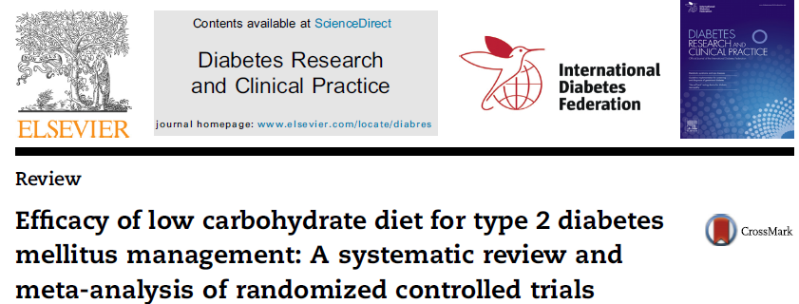
9 studies with 734 patients with diabetes
low carbohydrate diet (less than130 g carbohydrate/day or 26% of daily energy from carbohydrates)
LCD had a significantly effect on HbA1c level
For cardiovascular risk factors, the LCD intervention significantly reduced triglycerides concentration and increased HDL cholesterol
But the LCD was not associated with decreased level of total cholesterol and LDL cholesterol
Subgroup analyses indicated that short term intervention of LCD was effective for weight loss

Slide 153
Section 5. Lifestyle Management
As research studies on low-carbohydrate eating plans generally indicate challenges with long-term sustainability, it is important to reassess and individualize meal plan guidance regularly for those interested in this approach

Slide 154
Section 5. Lifestyle Management
Providers should maintain consistent medical oversight and recognize that certain groups are not appropriate for low-carbohydrate eating plans, including women who are pregnant or lactating, children, and people who have renal disease or disordered eating behavior, and these plans should be used with caution for those taking SGLT2 inhibitors due to potential risk of ketoacidosis
There is inadequate research about dietary patterns for type 1 diabetes to support one eating plan over another at this time

Slide 155
a randomized clinical trial
[n = 136; mean ± SD ; age: 12.8 ±2.6 y; glycated hemoglobin (HbA1c): 8.1% ±1.0% ; 69.1% using an insulin pump]
completed 3-d diet records at baseline and months 3, 6, 9, 12, and 18
HbA1c was obtained every 3 mo; 1,5-anhydroglucitol was obtained every 6 mo
Both overall diet quality and macronutrient distribution were associated with more optimal glycemic control
glycemic control may be improved by increasing intake of high-fiber, low glycemic–index, carbohydrate containing foods

Slide 156
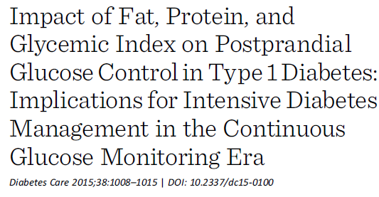
A systematic review of all relevant biomedical databases
All studies examining the effect of fat (n = 7), protein (n = 7), andGI (n = 7) indicated that these dietary factors modify postprandial glycemia
the studies indicated that high-fat/protein meals require more insulin than lower-fat/protein meals with identical carbohydrate content

Slide 158
Lancet Diabetes Endocrinol 2014
randomised controlled trials of interventions longer than 3 months that compared carbohydrate counting with general or alternate dietary advice in adults and children with type 1 diabetes
We identifi ed signifi cant heterogeneity between studies, which was potentially related to differences in study design
Overall there was no signifi cant improvement in HbA1c concentration with carbohydrate counting versus the control or usual care

Slide 159
Section 5. Lifestyle Management
Protein
Therefore, use of carbohydrate sources high in protein (such as milk and nuts) to treat or prevent hypoglycemia should be avoided due to the potential concurrent rise in endogenous insulin
Sodium
Restriction below 1,500 mg, even for those with hypertension, is generally not recommended

Slide 161
Section 5. Lifestyle Management
Micronutrients and Supplements
However, for special populations, including pregnant or lactating women, older adults, vegetarians, and people following very low-calorie or low-carbohydrate diets, a multivitamin may be necessary
Nonnutritive Sweeteners
For those who consume sugar-sweetened beverages regularly, a low-calorie or nonnutritive-sweetened beverage may serve as a short-term replacement strategy, but overall, people are encouraged to decrease both sweetened and nonnutritive-sweetened beverages and use other alternatives, with an emphasis on water intake

Slide 162
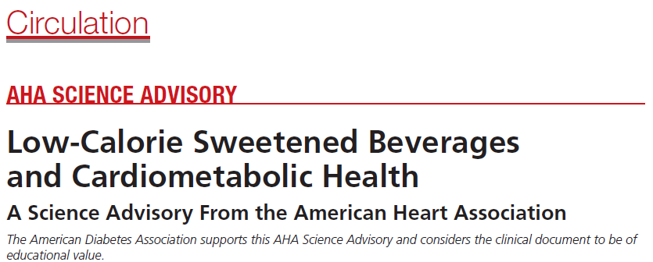
The American Heart Association (AHA) recommends limiting the intake of added sugars no more than
-100 calories (25 g) per day in women 6 teaspoons
(2 tablespoons)
-150 calories (37.5 g) per day in men 9 teaspoons (3 tablespoons)
-Children and adolescents aged 2 to 18 years should limit their intake of added sugars to <100 calories (25 g) per day or <6 teaspoons (2 tablespoons)

Slide 163
used the term nonnutritive sweeteners to refer to LCSs, which included sweeteners that have a higher intensity of sweetness per gram than caloric sweeteners such as sucrose, corn syrups, and fruit juice concentrates
The use of LCS beverages may be an effective strategy to help control energy intake and promote weight loss
Although water is the optimal beverage choice, children with diabetes mellitus who consume a balanced diet and closely monitor their blood glucose may be able to prevent excessive glucose excursions by substituting LCS beverages for sugar-sweetened beverages [SSBs] when needed

Slide 164
For adults who are habitually high consumers of SSBs, LCS beverages may be a useful replacement strategy to reduce intake of SSBs
Thus, the use of other alternatives to SSBs, with a focus on water (plain, carbonated, and unsweetened flavored), should be encouraged

Slide 165
Section 5. Lifestyle Management

Slide 166
Section 5. Lifestyle Management
PHYSICAL ACTIVITY
A recent study suggested that the percentage of people with diabetes who achieved the recommended exercise level per week (150 min) varied by race. Objective measurement by accelerometer showed that 44.2%, 42.6%, and 65.1% of whites, African Americans, and Hispanics, respectively, met the threshold
It is important for diabetes care management teams to understand the difficulty that many patients have reaching recommended treatment targets and to identify individualized approaches to improve goal achievement

Slide 167
Ethnicity & Disease, Autumn 2017
data from the National Health and Nutrition Examination Survey (NHANES) 2003-06
compare the percentage of individuals with diabetes who achieved the recommended levels of physical activity as measured by subjective self-report (500 metabolic equivalents (MET)-minutes/week) and objective accelerometer measurement (150 minutes per week of MVPA) across racial/ ethnic groups
Many individuals with type 2 diabetes mellitus did not meet the recommended physical activity thresholds

Slide 168
Section 5. Lifestyle Management
Moderate to high volumes of aerobic activity are associated with substantially lower cardiovascular and overall mortality risks in both type 1 and type 2 diabetes
A recent prospective observational study of adults with type 1 diabetes suggested that higher amounts of physical activity led to reduced cardiovascular mortality after a mean follow-up time of 11.4 years for patients with and without chronic kidney disease

Slide 169
prospective cohort study and meta-analysis
5859 individuals with diabetes at baseline
total PA was associated with lower risk of CVD and total mortality
Higher levels of PA were associated with lower mortality risk in individuals with diabetes
Even those undertaking moderate amounts of activity were at appreciably lower risk for early death compared with inactive persons
These findings provide empirical evidence supporting the widely shared view that persons with diabetes should engage in regular PA

Slide 170
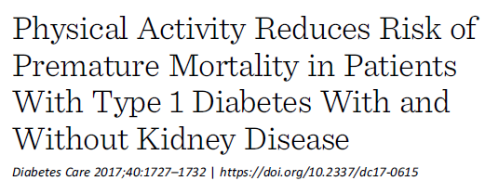
2,639 patients with type 1 diabetes
Multicenter
Mean follow-up time was 11.4 6 ±3.5 years
LTPA)leisure-time physical activity (was assessed by using a validated self-report questionnaire
Exercise is associated with a lower risk of premature all-cause and cardiovascular mortality in patients with type 1 diabetes
This study also demonstrates that physical activity is associated with a lower risk of mortality in patients with type 1 diabetes and CKD

Slide 171
Section 5. Lifestyle Management
A recent study suggested that exercise training in type 1 diabetes may also improve several important markers such as triglyceride level, LDL, waist circumference, and body mass

Slide 172
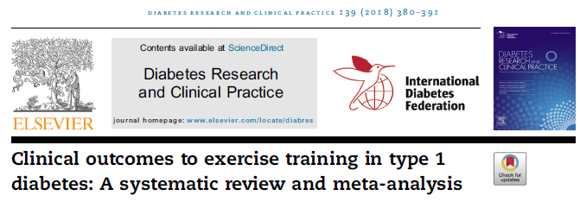
Searches were limited to prospective randomized or controlled trials of exercise training in humans with type 1 diabetes lasting 12 weeks or more

Slide 173
In children our analyses showed improvements in total daily insulin dose, waist circumference, LDL and triglycerides
In adults there were improvements in body mass, BMI, peak VO2, LDL and triglycerides
There were no significant changes in glycosylated haemoglobin (HbA1C%), fasting blood glucose, resting heart rate, resting systolic blood pressure or high density lipoproteins in either group

Slide 174
Section 5. Lifestyle Management
Exercise and Children
Youth with type 1 diabetes who engage in more physical activity may have better health-related quality of life
Frequency and Type of Physical Activity
A wide range of activities, including yoga, tai chi, and other types, can have significant impacts on A1C, flexibility, muscle strength, and balance
Flexibility and balance exercises may be particularly important in older adults with diabetes to maintain range of motion, strength, and balance

Slide 175
Diabetes Care 2017
The TEENs study was an international, cross-sectional study of youth, 8–25 years of age, with T1D
Participants (N= 5,887) in 20 countries
enrolled for 3 predetermined age groups:
8–12, 13–18, and 19–25 years of age
Across all age groups, females reported significantly lower D-HRQOL than did males
The 19–25-year age group reported the lowest D-HRQOL
In all three age groups, the lower the HbA1c, the better the D-HRQOL

Slide 176
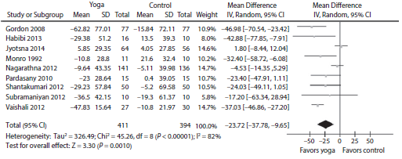
A total of 12 randomized controlled trials with a total of 864 patients type 2 diabetes
yoga significantly decreased FBG, PPBG, HbA1c, TC and LDL-C levels, and increased HDL-C in patients with type 2 diabetes mellitus
the aspects of yoga that benefit patients with type 2 diabetes mellitus remain unknown

Slide 177
Adults with diabetes (ages 50 years and older) should do exercises that maintain/improve balance 2-3 times/week particularly if they have peripheral neuropathy
Yoga and tai chi can be included based on individual preferences to increase flexibility, strength, and balance

Slide 178
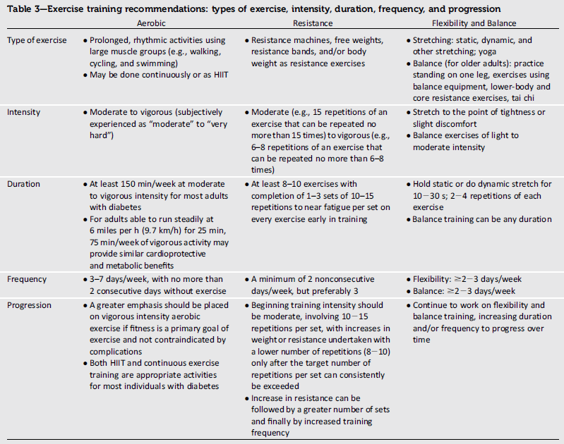

Slide 179
Section 5. Lifestyle Management
SMOKING CESSATION: TOBACCO AND E-CIGARETTES
Recent data show tobacco use is higher among adults with chronic conditions as well as in adolescents and young adults with diabetes
Smokers with diabetes (and people with diabetes exposed to second-hand smoke) have a heightened risk of CVD, premature death, microvascular complications, and worse glycemic control when compared with nonsmokers

Slide 180
-Data were drawn from 9 years (2005–2013)
-Adult (≥18 years) tobacco use included any past 30-day use of cigarettes, cigars, pipes, or smokeless tobacco
-Chronic conditions examined included anxiety, asthma, coronary heart disease, depression, diabetes, hepatitis, HIV, hypertension, lung cancer, stroke, and substance abuse
-Cigarette smoking declined significantly over time among adults with no chronic condition

Slide 182
to examine whether cigarette smoking is more prevalent among diabetics than non-diabetics and whether it differs by age at the time of diagnosis with diabetes from young adulthood (YAH) to adulthood (AH)
used US panel data from the National Longitudinal Study of Adolescent Health (Add Health Study)
12 175 study participants
Early-onset diabetics (age at diagnosis <13 years) were more likely than non-diabetics to report frequent cigarette smoking (smoking on ≥20 days during the previous 30 days) in YAH
On the other hand, late-onset diabetics (age at diagnosis ≥13 years) were more likely than non-diabetics to report heavy cigarette smoking (smoking ≥10 cigarettes per day during the previous 30 days) in AH

Slide 183
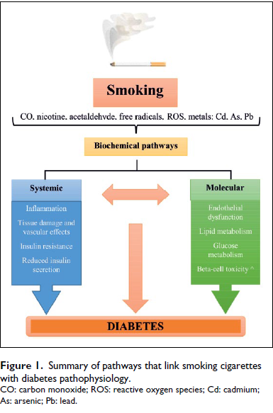
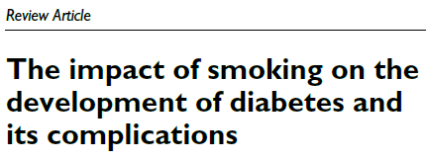
Diabetes & Vascular Disease Research 2017

Slide 185
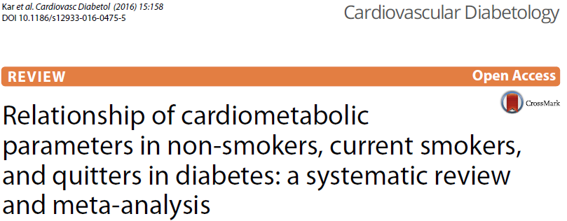
14 observational studies with a total of 98,978 participants’ with either type 1 or type 2 diabetes
Smoking negatively impacts upon the cardiometabolic parameters in people with diabetes
raising cardioprotective HDL cholesterol
the benefit of smoking cessation may not be immediately reflected on the HbA1c
Non-smokers have a statistically significant lower HbA1c and more favourable lipid profile compared to smokers
Smoking cessation does not lead to an increase in HbA1c in long-term and may reduce vascular complications in diabetes by its favourable impact on lipid profile
there was no statistically significant difference in blood pressure between the two groups

Slide 186
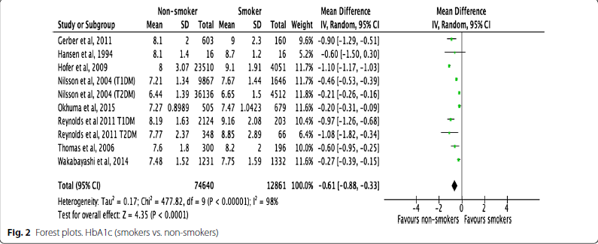

Slide 187
Section 5. Lifestyle Management
Pharmacologic therapy to assist with smoking cessation in people with diabetes has been shown to be effective
In recent years e-cigarettes have gained public awareness and popularity because of perceptions that e-cigarette use is less harmful than regular cigarette smoking

Slide 188
retrospective pooled analysis
Smokers of ≥10 cigarettes per day with diabetes
6,771 participants received varenicline 1 mg b.i.d. Or placebo for 12 weeks
Varenicline tartrate is a selective partial agonist at a4b2 nicotinic acetylcholine receptor subtype that has been shown to significantly increase quit rates
Varenicline was an effective and well-tolerated aid for smoking cessation in individuals with diabetes

Slide 189
Data from three cycles (2012, 2013, and 2014) of the Health Information National Trends Survey were combined
Awareness of e-cigarettes increased from 77.1% in 2012 to 94.3% in 2014
Perception that e-cigarettes were less harmful than regular cigarettes declined from 50.7% in 2012 to 43.1% in 2014
Among smokers, no relationship was observed between e-cigarette
awareness and past-year quit attempts or quit intentions, but those that viewed e-cigarettes as less harmful were less likely to have a past-year quit attempt

Slide 190
Section 5. Lifestyle Management
On the contrary, a recently published pragmatic trial found that use of e-cigarettes for smoking cessation was not more effective than “usual care,” which included access to educational information on the health benefits of smoking cessation, strategies to promote cessation, and access to a free text-messaging service that provided encouragement, advice, and tips to facilitate smoking cessation (183).

Slide 191
183
conducted a randomized, controlled trial that compared five approaches to smoking cessation: usual care and four interventions designed to promote sustained smoking abstinence

Slide 192
Section 6. Glycemic Targets NEW
This section now begins with a discussion of A1C tests
The SMBG and CGM text and recommendations were moved to the new Diabetes Technology section
To emphasize that the risks and benefits of glycemic targets can change as diabetes progresses and patients age
a recommendation was added to reevaluate glycemic targets over time
The section was modified to align with the living Standards updates made in April 2018 regarding the consensus definition of hypoglycemia

Slide 193
Section 6. Glycemic Targets
A1C
assays are available that do not demonstrate a statistically significant difference in individuals with hemoglobin variants. Other assays have statistically significant interference, but the difference is not clinically significant

Slide 194
Section 6. Glycemic Targets
Glucose Assessment
For many people with diabetes, glucose monitoring is key for the achievement of glycemic targets. Major clinical trials of insulin-treated patients have included SMBG as part of multifactorial interventions to demonstrate the benefit of intensive glycemic control on diabetes complications (16)
SMBG is thus an integral component of effective therapy of patients taking insulin. In recent years, CGM has emerged as a complementary method for the assessment of glucose levels. Glucose monitoring allows patients to evaluate their individual response to therapy and assess whether glycemic targets are being safely achieved
Integrating results into diabetes management can be a useful tool for guiding medical nutrition therapy and physical activity, preventing hypoglycemia, and adjusting medications (particularly prandial insulin doses). The patient’s specific needs and goals should dictate SMBG frequency and timing or the consideration of CGM use

Slide 195
Section 6. Glycemic Targets
A1C and Microvascular Complications
ACCORD, ADVANCE, and VADT; Findings from these studies suggest caution is needed in treating diabetes aggressively to near-normal A1C goals in people with long-standing type 2 diabetes with or at significant risk of CVD
Select patients, especially those with little comorbidity and long life expectancy, may benefit from adopting more intensive glycemic targets (e.g., A1C target ,6.5%) if they can achieve it safely without hypoglycemia or significant therapeutic burden

Slide 196
Section 6. Glycemic Targets
Cardiovascular Disease and Type 2 Diabetes
Severe hypoglycemia is a potent marker of high absolute risk of cardiovascular events and mortality (38). Providers should be vigilant in preventing hypoglycemia and should not aggressively attempt to achieve near-normal A1C levels in patients in whom such targets cannot be safely and reasonably achieved
Approaches to Glycemic Treatment,” addition of specific sodium–glucose cotransporter 2 inhibitors (SGLT2i) or glucagon-like peptide 1 receptor agonists(GLP-1 RA) to improve cardiovascular outcomes in patients with established CVD is indicated with consideration of glycemic goals. If the patient is not at A1C target, continue metformin unless contraindicated and add SGLT2i or GLP-1 RA with proven cardiovascular benefit.

Slide 197
Section 6. Glycemic Targets
If the patient is meeting A1C target, consider one of three strategies (39):
1. If already on dual therapy or multiple glucose-lowering therapies and not on an SGLT2i or GLP-1 RA, consider switching to one of these agents with proven cardiovascular benefit.
2. Reconsider/lower individualized A1C target and introduce SGLT2i or GLP-1 RA.
3. Reassess A1C at 3-month intervals and add SGLT2i or GLP-1 RA if A1C goes above target

Slide 198
Section 6. Glycemic Targets
Setting and Modifying A1C Goals
The factors to consider in individualizing goals are depicted in Fig. 6.1. Figure 6.1 is not designed to be applied rigidly but to be used as a broad construct to guide clinical decision making (40) in both type 1 and type 2 diabetes. More stringent control (such as an A1C of 6.5% or,7%) may be recommended if it can be achieved safely and with acceptable burden of therapy and if life expectancy is sufficient to reap benefits of tight control. Less stringent control (A1C up to 8% [64 mmol/mol]) may be recommended if the life expectancy of the patient is such that the benefits of an intensive goal may not be realized, or if the risks and burdens outweigh the potential benefits. Severe or frequent hypoglycemia is an absolute indication for the modification of treatment regimens, including setting higher glycemic goals

Slide 199
Section 6. Glycemic Targets
Diabetes is a chronic disease that progresses over decades. Thus, a goal that might be appropriate for an individual early in the course of the disease may change over time. Newly diagnosed patients and/or those without comorbidities that limit life expectancy may benefit from intensive control proven to prevent microvascular complications. Both DCCT/EDIC and UKPDS demonstrated metabolic memory, or a legacy effect, in which a finite period of intensive control yielded benefits that extended for decades after that control ended.

Slide 200
Section 6. Glycemic Targets
Thus, a finite period of intensive control to near-normal A1C may yield enduring benefits even if control is subsequently deintensified as patient characteristics change. Over time, comorbidities may emerge, decreasing life expectancy and the potential to reap benefits from intensive control. Also, with longer duration of disease, diabetes may become more difficult to control, with increasing risks and burdens of therapy. Thus, A1C targets should be reevaluated over time to balance the risks and benefits as patient factors change.

Slide 201
Section 6. Glycemic Targets
HYPOGLYCEMIA
Level 1 hypoglycemia is defined as a measurable glucose concentration ,70 mg/dL (3.9 mmol/L) but $54 mg/Dl (3.0 mmol/L). A blood glucose concentration of 70 mg/dL (3.9 mmol/L) has been recognized as a threshold for neuroendocrine responses to falling glucose in people without diabetes. Because many people with diabetes demonstrate impaired counterregulatory responses to hypoglycemia and/or experience hypoglycemia unawareness, a measured glucose level ,70 mg/dL (3.9 mmol/L) is considered clinically important, independent of the severity of acute hypoglycemic symptoms. Level 2 hypoglycemia (defined as a blood glucose concentration ,54 mg/dL [3.0 mmol/L]) is the threshold at which neuroglycopenic symptoms begin to occur and requires immediate action to resolve the hypoglycemic event. Lastly, level 3 hypoglycemia is defined as a severe event characterized by altered mental and/or physical functioning that requires assistance from another person for recovery.

Slide 202
Section 6. Glycemic Targets
Studies of rates of level 3 hypoglycemia that rely on claims data for hospitalization, emergency department visits, and ambulance use substantially underestimate rates of level 3 hypoglycemia (45), yet find high burden of hypoglycemia in adults over 60 years of age in the community (46). African Americans are at substantially increased risk of level 3 hypoglycemia (46,47). In addition to age and race, other important risk factors found in a community-based epidemiologic cohort of older black and white adults with type 2 diabetes include insulin use, poor or moderate versus good glycemic control, albuminuria, and poor cognitive function (46). Hypoglycemia may be inconvenient or frightening to patients with diabetes.

Slide 203
Section 6. Glycemic Targets

