Slide 1
Hyperparathyroidism in a ESRD case
Dr.zahedi

Slide 2
What is the Type of hyperparathyroidism in this case?
What is the management of this case?

Slide 3
Type of hyperparathyroidism
PHPT
Coexistence Vitamin D deﬁciency and PHPT
Secondary hyperparathyroidism
Tertiary hyperparathyroidism

Slide 4
A 43-year-old secretary of Indian origin presented in October 2001 with a several month history of right groin discomfort following participation in the London marathon. An X-ray of the pelvis showed a Looser’s zone affecting the neck of the right femur
A bone mineral density (BMD) assessment using Lunar DXA suggested osteopaenia of the lumbarspine (T-2.1) and osteoporosis of the femoral neck (T-2.74)
A diagnosis of vitamin D deficiency with osteomalacia and secondary hyperparathyroidism was made and daily treatment with 500mg of calcium and 400IU (10mg) of cholecalciferol commenced.

Slide 5
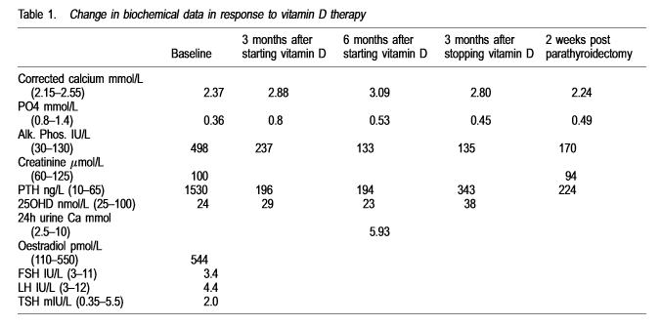

Slide 6
Ultrasound and sestamibi imaging of the neck was suggestive of a right inferior parathyroid adenoma. A surgical neck exploration was carried out in January 2003 and an enlarged right parathyroid gland was removed
As vitamin D deficiency and PHPT are relatively common ,it is not surprising that these conditions may co-exist
A study by Kantorovitch et al. involving 229 patients referred for evaluation of low BMD showed a prevalence of 2.2% for co-existing vitamin D deficiency and PHPT in their population.

Slide 8
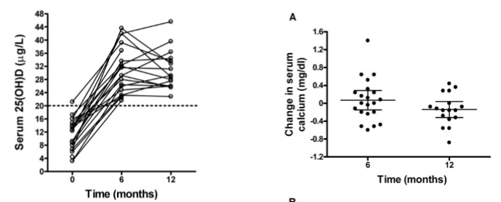
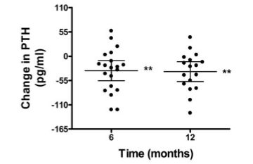

Slide 9
Vitamin D levels should be measured in the evaluation of primary hyperparathyroidism. Vitamin D deficiency (a 25-hydroxyvitamin D level of less than 20 ng per milliliter) can cause secondary hyperparathyroidism, and repletion of vitamin D deficiency can help to reduce parathyroid hormone levels
In most studies, increasing serum 25-hydroxyvitamin D stores to at least 37.5 ng /ml is sufficient for parathyroid hormone suppression and prevention of secondary hyperparathyroidism in persons with normal renal function (although some studies have suggested increasing stores to 50 ng /ml)

Slide 10
Secondary Hyperparathyroidism
In CKD, secondary hyperparathyroidism is common and varies based on estimated glomerular filtration rate (eGFR). In milder forms of CKD, elevations in parathyroid hormone levels occur in about 10% of patients, while being seen in 90% of individuals with severe CKD who are approaching the need for dialysis therapy
Because virtually all patients with CKD have hyperparathyroidism to some degree, there is not a unique clinical presentation that is a hallmark of secondary hyperparathyroidism
Radiographic evaluation is limited to assessments of the bone disease. Obtain radiographs of sites of bone pain. Hand radiographs may show characteristic subperiosteal erosions. Imaging of the parathyroid glands is not indicated unless primary hyperparathyroidism is suggested.

Slide 12
Managment

Slide 13
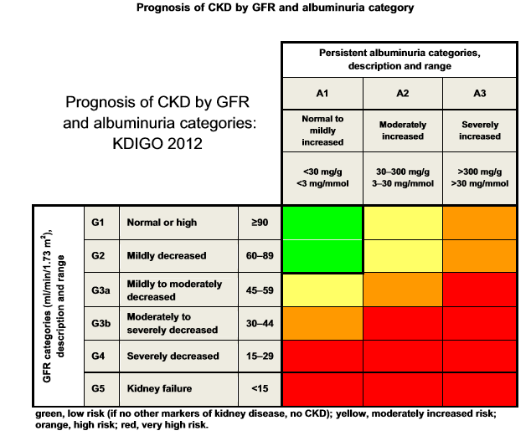

Slide 14
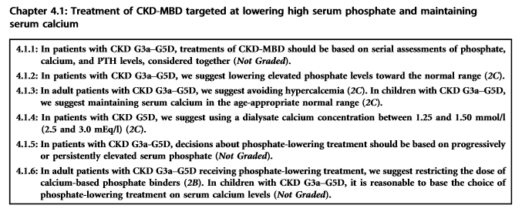

Slide 17
For medical management of HPT, recommendations are primarily that treatments depend on levels of calcium, phosphate and iPTH taken together, but the evidence is generally level 2 or not graded. The only strong evidence is for stopping vitamin D and analogues in the context of hypercalcaemia.

Slide 18
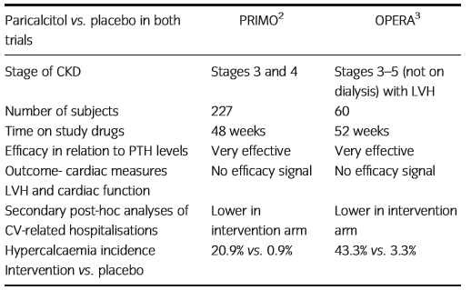
The report by the CKD-MBD KDIGO guidelines group suggested that following the PRIMO and OPERA studies, guidelines relating to the use of calcitriol or its analogues required review. Both of these studies showed signiﬁcantly increased risk of hypercalcaemia in the active arm, without efﬁcacy in relation to left ventricular hypertrophy (LVH) or cardiac function

Slide 19
The role of calcimimetics versus parathyroidectomy
The EVOLVE trial results sparked heated discussion regarding the place of calcimimetic therapy in HPT management. This study examined the efﬁcacy of cinacalcet versus placebo in reducing the time to a composite cardiovascular (CV)endpoint (death, myocardial infarction, hospitalisation for unstable angina, heart failure or a peripheral vascular event)
The primary composite endpoint showed no statistically signiﬁcant signal for efﬁcacy; hazard ratio (HR) 0.93 (95% CI 0.85–1.02; P = 0.11), although secondary analyses including those adjusted for actual treatment received and age showed more favourable results and revealed major problems in the study design and execution

Slide 20
In Australia, the failure of this study to meet its primary efﬁcacy endpoint has resulted in the withdrawal of cinacalcet from the Pharmaceutical Beneﬁts Scheme (PBS)
Current KDIGO guidelines suggest parathyroidectomy for patients with CKD stages 3–5D who fail to respond to medical/pharmacological therapy (2B). There are data on biochemical outcomes, and PTH levels, serum calcium, phosphate and alkaline phosphatase are reduced for up to 5 years post-surgery in most patients
An additional layer of complexity is the relative lack of information on the merits of partial versus complete (+/ partial re-implantation) parathyroidectomy.

Slide 21
Parathyroidectomy is not a trivial procedure in dialysis patients and is associated with signiﬁcant morbidity and mortality
Some studies have shown very signiﬁcant risks and costs: Ishani et al. reported mortality of 2%, and other complications included almost 30% requiring intensive care admission, increased hospitalisations, a 20 fold increase in healthcare visits and nearly double the number of myocardial infarcts
In another study, the healthcare costs associated with repeated reviews of patients after parathyroidectomy outweighed the costs of calcimimetics

Slide 22
Although the ADVANCE trial showed no improvement in the overall rate of coronary artery calciﬁcation in patients treated with cinacalcet compared with controls, patients treated with cinacalcet had signiﬁcantly lower aortic valve calcium volume scores , suggesting that PTH reduction, the consequent metabolic changes or a reduction in vitamin D dosing might be helpful in reducing valvular calciﬁcation
A study comparing cinacalcet with parathyroidectomy that examines efﬁcacy,safety and cost effectiveness over many years is needed, yet practically the chances of obtaining funding for an adequately powered study are low.

Slide 23
In the end-stage renal disease patients who underwent parathyroidectomy (947 patients, 5.08-year follow-up), the incidence density rate of peripheral arterial disease was 12.26 per 1000 person-years, compared with 24.09 per 1000 person-years in those who did not undergo the surgery (3746 patients, 4.52-year follow-up)
Mortality has been shown to be reduced in dialysis patients who undergo parathyroidectomy for severe secondary hyperparathyroidism

Slide 24
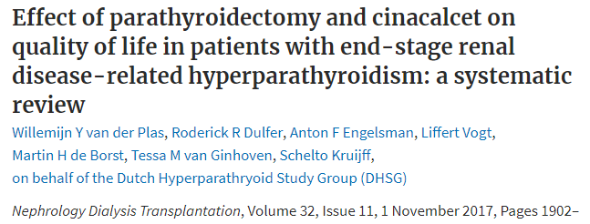
In a meta-analysis of patients with secondary hyperparathyroidism treated with cinacalcet or parathyroidectomy, quality of life was seen to improve after surgical treatment but not with medical therapy
However, available studies into quality of life in such cases are observational, and randomized, comparative data are not available

Slide 25
Surgical technique
The general surgical technique in secondary hyperparathyroidism involves complete parathyroid exploration, as described previously for primary hyperparathyroidism
All four glands must be exposed, and biopsies are taken if needed to ensure correct identification
In most cases, diffuse hyperplasia is encountered, although the size of the glands can be significantly heterogeneous.

Slide 26
subtotal parathyroidectomy (sPTX) was compared with total parathyroidectomy and autotransplantation of fresh tissue (PTX + AT) in 40 patients with severe secondary hyperparathyroidism (HPT)
the investigators found that four of 17 subjects treated with subtotal parathyroidectomy developed recurrent hypercalcemia, with two requiring reexploration
None of the subjects treated with total parathyroidectomy developed recurrent hypercalcemia

Slide 27
Parathyroid autotransplantation
about 100 mg of parathyroid tissue is cut into approximately 12-20 pieces, each of which measures about 1 X 1 mm. These are inserted into pockets in the forearm musculature; each piece is marked with a polypropylene suture on the fascia for localization later, if necessary. We also use clips to facilitate localization with ultrasonography. Parathyroid tissue may also be cryopreserved in case the primary autotransplant fails.

