Slide 1
Diabetic Foot Evaluation
Hengameh Abdi
Endocrine Research Center
Research Institute for Endocrine sciences
Shahid Beheshti University of Medical Sciences
19 October 2017
27 Mehr 1396

Slide 2
Outlines
Background
Pathophysiology and risk factors of diabetic foot ulcer
Comprehensive foot assessment
  History
  Physical examinations
  Risk categorization
Conclusions

Slide 3
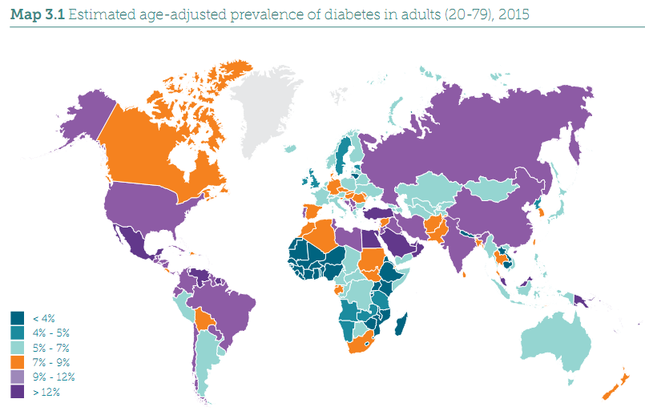
Estimated age-adjusted prevalence of diabetes in 20-79 year-old adults, 2015

Slide 4
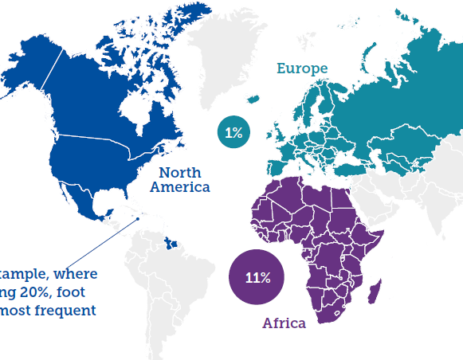
Prevalence of active foot ulceration
Global prevalence: 6.3% (95% CI: 5.4-7.3%)
Zhang P, et al. Ann Med 2017;49:106-16.

Slide 5
Incidence of diabetic foot ulceration
  Annual incidence: 2.0% (in developed countries).
  Lifetime incidence: 19-34%.
Armstrong DG, et al. N Engl J Med 2017;376:2367-75.
Ibrahim A, et al. IDF Clinical Practice Recommendations on the Diabetic Foot 2017.

Slide 6
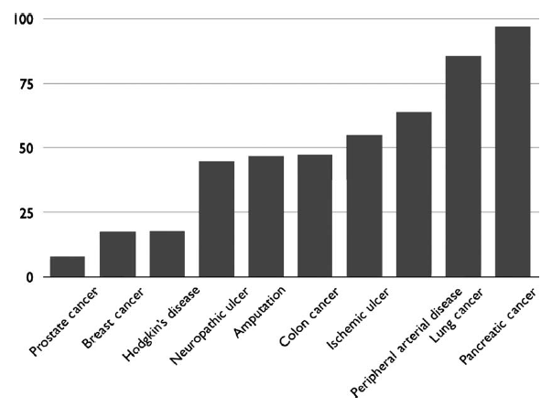
Five-year mortality rate:
Are diabetes-related wounds and amputations worse than cancer?
Armstrong DG, et al. Int Wound J 2007 Dec 1;4(4):286-7.

Slide 7
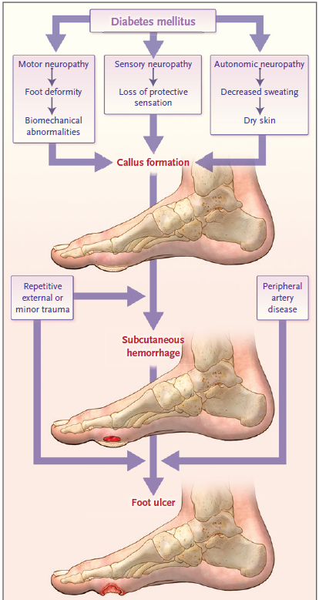
Common Pathway of Diabetic Foot Ulcer Occurrence and Recurrence.
Armstrong DG, et al. N Engl J Med 2017;376:2367-75.

Slide 8
Risk factors for foot ulcers
  Previous amputation
  Past foot ulcer history
  Peripheral neuropathy
  Foot deformity
  Preulcerative callus or corn
  Peripheral vascular disease
  Visual impairment
  Diabetic nephropathy (especially patients on dialysis)
  Poor glycemic control
  Cigarette smoking
Boulton AJM, et al. Diabetes care 2008;31(8):1679-85.
ADA Standards of Medical Care in Diabetes 2017.

Slide 9
The most common triad of causes interacting and ultimately resulting in ulceration
Deformity 63%
Trauma 77%
Reiber GE, et al. Diabetes Care 1999;22:157-162.

Slide 10


Slide 11

Comprehensive Foot Assessment

Slide 12
Essential features of history
Vascular symptoms
  claudication
  rest pain
  nonhealing ulcer
Other diabetes complications
    renal (dialysis, transplant)
    retinal (visual impairment)
  Past history
    ulceration
    amputation
    Charcot joint
    vascular surgery
    angioplasty
    cigarette smoking
  Neuropathic symptoms
    positive (e.g., burning or shooting pain,
    electrical or sharp sensations, etc.)
    negative (e.g., numbness, feet feel dead)

Slide 13
Key components of the diabetic foot exam
  Inspection
  Neurological assessment
  Vascular assessment

Slide 14

Inspection
  Dermatologic
    skin status: color, thickness, dryness, cracking
    sweating
    infection: check between toes for fungal infection
    ulceration
    calluses/blistering: hemorrhage into callus?
  Musculoskeletal
    deformity, e.g., claw toes, prominent metatarsal heads, Charcot joint
    muscle wasting (guttering between metatarsals)

Slide 15
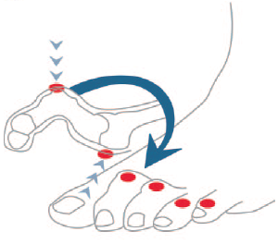
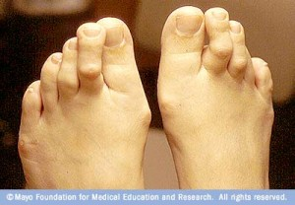

Claw toe deformity and overlapping toes

Slide 16
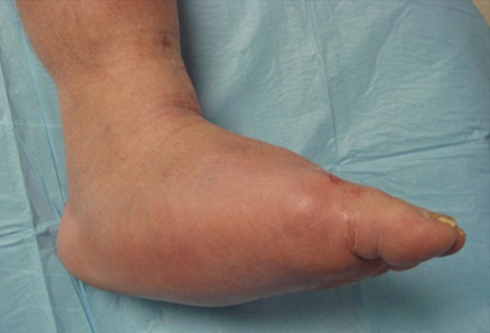
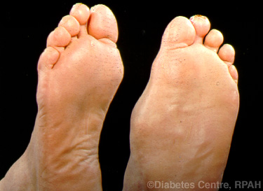
Charcot arthropathy
(diabetic neuropathic osteoarthropathy)

Slide 17
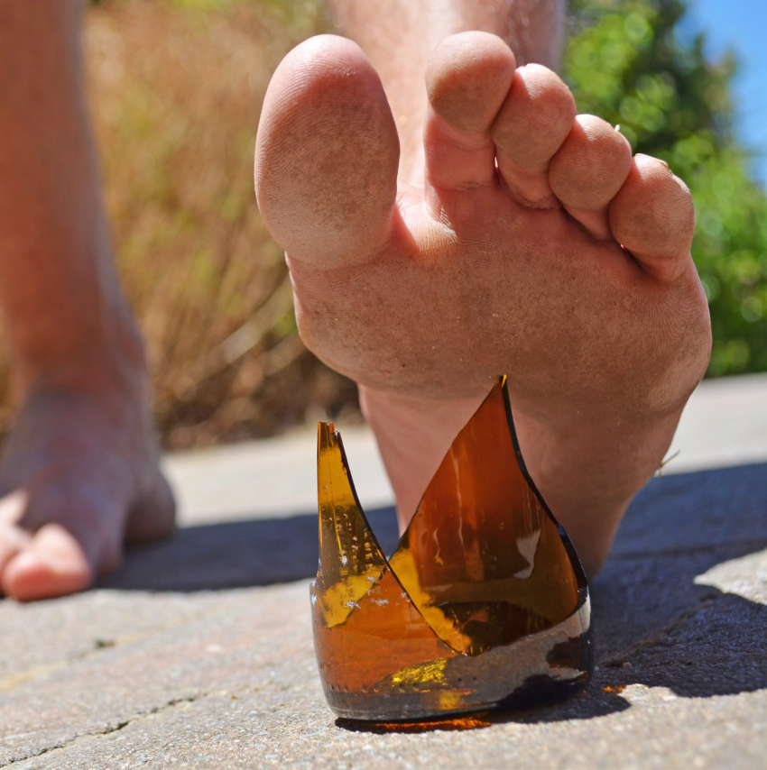
Key components of the diabetic foot exam
  Inspection
  Neurological assessment
  Vascular assessment

Slide 18
Evaluation for Loss of Protective Sensation
(LOPS)
  The 10-g monofilament test + at least 1 of the following assessments:
  Vibration
  Pinprick
  Temperature sensation
  Ankle reflexes
  Vibration perception threshold (VPT)
  ≥ 1 abnormal tests would suggest LOPS, while at least 2 normal tests (and no abnormal test) would rule out LOPS.

Slide 19
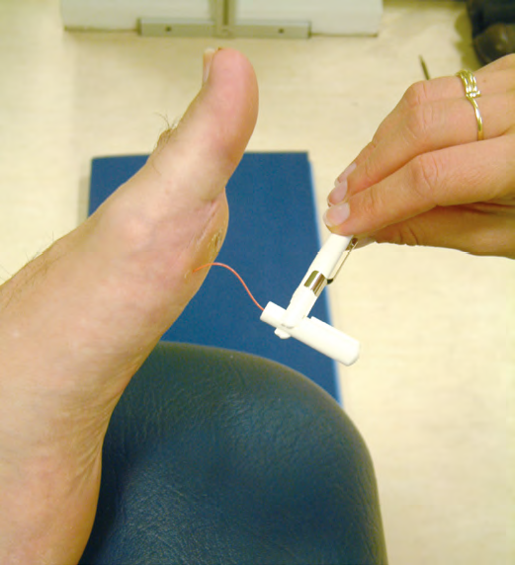
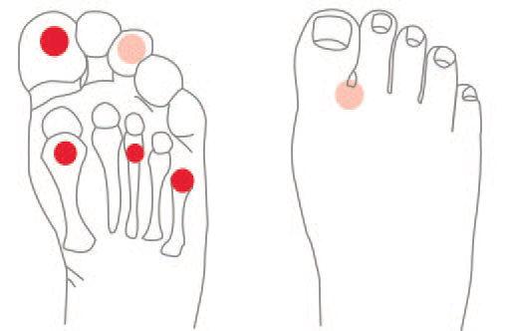
Touch-pressure sensation
  Hold the 10-g monofilament for 1-2 seconds on the plantar surfaces of the 1st, 3rd and 5th metatarsal heads and the plantar surface of the hallux.
  The diagosis of neuropathy is determined if the patient does not feel 1 out of 4 areas tested.
Notes:
Patients should close their eyes while being tested. The sensation of pressure using the buckling 10-g monofilament should first be demonstrated to the patient on a proximal site (e.g., upper arm). Areas of callus should always be avoided when testing for pressure perception.

Slide 20
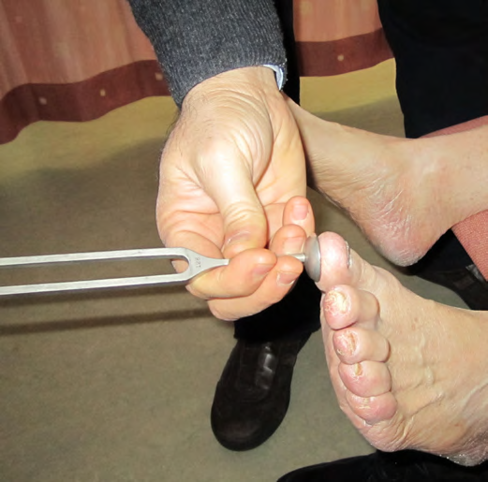
Vibration sensation
  Place a 128-Hz tuning fork on the tip of the big toe.
Notes:
Show the patient on a bony prominence on their hand first.
Ask the patients to close their eyes.
If they cannot feel vibration on the hallux continue checking bony prominences moving proximally until the patient feels the vibration.

Slide 21
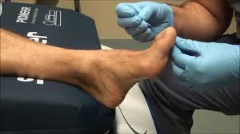
Pinprick (pain sensation)
  A disposable pin should be applied just proximal to the toenail on the dorsal surface of the hallux, with just enough pressure to deform the skin.
  Inability to perceive pinprick over either hallux would be regarded as an abnormal test result.

Slide 22
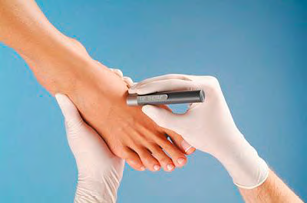
Temperature sensation
  Test temperature sensation with Tip-Therm or test tubes, one with cold water (5-10°C) and one with warm water (35 to 45°C). Put on the dorsum of the patient’s foot directly on the skin and ask the patient what they feel. Grade the temperature sensation testing as normal, weak or loss of temperature sensation.

Slide 23
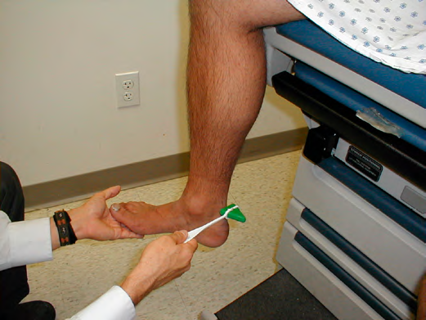
Ankle reflexes
  Check the patient’s ankle reflex and patellar reflex on the Achilles tendon or ligamentum patellae with a percussion hammer.
Notes:
This may be weak in the elderly so it is not a specific test.

Slide 24

Vibration perception threshold (VPT)
  Measure VPT using electromechanical instruments such as the Biothesiometer or Vibrameter.
  Cumulative risk of neuropathic ulceration based on VPT value:
    > 25 V in at least one foot: high risk
    16-24: intermediate risk
    < 15 V: low risk (normal).
Notes:
VPT is widely used in the U.S.; however, identification of the patient with LOPS can easily be carried out without this or other expensive equipment.

Slide 25
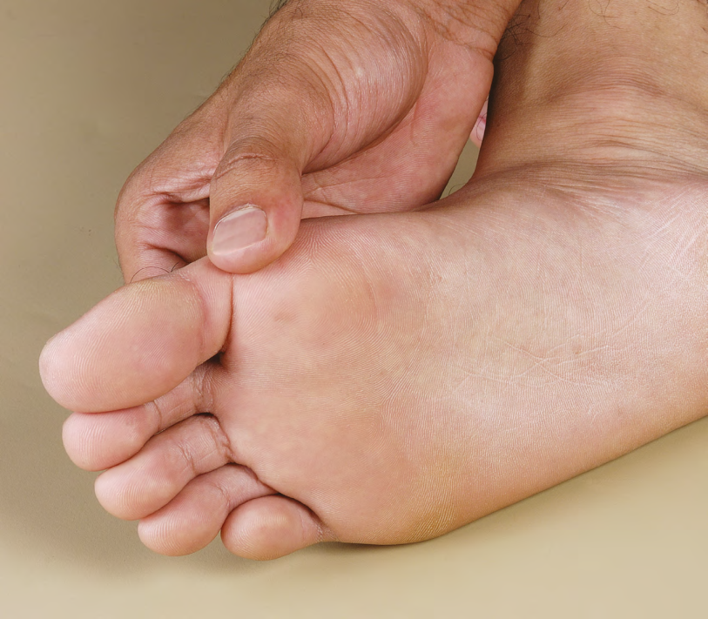
Key components of the diabetic foot exam
  Inspection
  Neurological assessment
  Vascular assessment

Slide 26
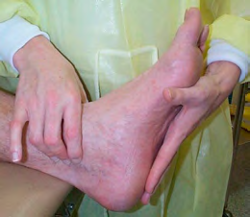
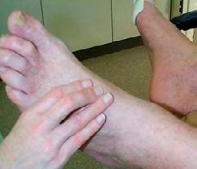
  Palpation of the posterior tibial and dorsalis pedis pulses
    ADA: “present” or “absent”.
    IDF: strong arterial pulse (0, non-ischemic), palpable but slightly diminished (1, mild ischemia), thready and scarcely palpable (2, moderate ischemia) and non-palpable pulses (3, severe ischemia).
ADA: American Diabetes Association
IDF: International Diabetes Federation

Slide 27
  Ankle brachial index (ABI) testing
  Indications:
    Diabetic patients with signs or symptoms of vascular disease.
    (claudication, rest pain, nonhealing ulcer)
    Absent pulses on screening foot examination.
    People with diabetes aged > 50.
    People with diabetes with peripheral arterial disease (PAD) risk factors (such as cardiovascular and cerebrovascular disease, dyslipidemia, hypertension, cigarette smoking, or duration of diabetes of > 5 years).
ADA consensus statement. Diabetes care 2003;26(12): 3333-3341.
Boulton AJM, et al. Diabetes care 2008;31(8):1679-85.
Ibrahim A, et al. IDF Clinical Practice Recommendations on the Diabetic Foot 2017.

Slide 28
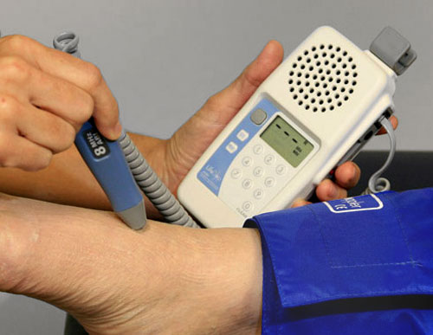

$$ABI=\frac{ankle systolic pressure}{higher brachial systolic pressure}$$
  ABI: (sensitivity, 95%; specificity, 99%)
    > 0.9-1.3: normal
    0.7-0.9: mild PAD (< 0.8: claudication)
    0.4-0.69: moderate PAD
    < 0.4: severe PAD
    (rest pain and tissue necrosis)
    > 1.3: incompressible artery
If ABI > 1.30, toe brachial index (TBI) may be measured. In addition to ABI and TBI, a lower extremity arterial color Doppler ultrasound examination should be carried out in order to further confirm diagnosis of PAD.
This is because ABI in the lower limb arteries of people with diabetes can be falsely elevated or high (> 1.3) even though blood supply to the limb has been reduced.

Slide 29
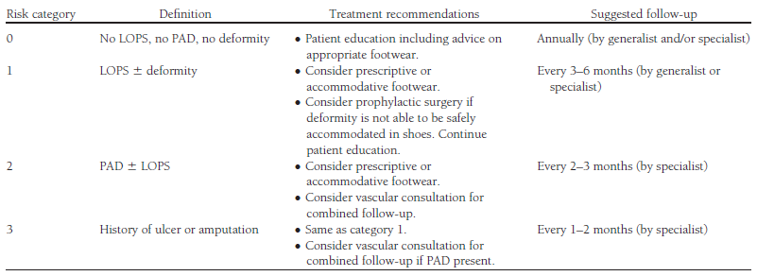
Risk classification based on the comprehensive foot examination
Boulton AJM, et al. Diabetes care 2008;31(8):1679-85.

Slide 30
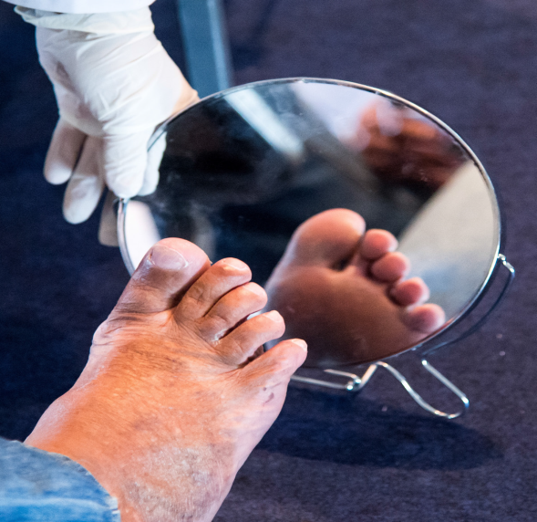
2017 ADA recommendations for diabetic foot care
  Perform a comprehensive foot evaluation at least annually to identify risk factors for ulcers and amputations. B
  All patients with diabetes should have their feet inspected at every visit. C
  Obtain a prior history of ulceration, amputation, Charcot foot, angioplasty or vascular surgery, cigarette smoking, retinopathy, and renal disease and assess current symptoms of neuropathy (pain, burning, numbness) and vascular disease (leg fatigue, claudication). B
ADA: American Diabetes Association

Slide 31
2017 ADA recommendations for diabetic foot care (cont.)
  The examination should include inspection of the skin, assessment of foot deformities, neurological assessment (10-g monofilament testing with at least one other assessment: pinprick, temperature, vibration, or ankle reflexes), and vascular assessment including pulses in the legs and feet. B
  Patients who are ≥ 50 years and any patients with symptoms of claudication or decreased and/or absent pedal pulses should be referred for further vascular assessment as appropriate. C
  A multidisciplinary approach is recommended for individuals with foot ulcers and high-risk feet (e.g., dialysis patients and those with Charcot foot, prior ulcers, or amputation). B

Slide 32
2017 ADA recommendations for diabetic foot care (cont.)
  Refer patients who smoke or who have histories of prior lower extremity complications, loss of protective sensation, structural abnormalities, or peripheral arterial disease to foot care specialists for ongoing preventive care and lifelong surveillance. C
  Provide general preventive foot self-care education to all patients with diabetes. B
  The use of specialized therapeutic footwear is recommended for high-risk patients with diabetes including those with severe neuropathy, foot deformities, or history of amputation. B

Slide 33
Conclusions

Slide 34
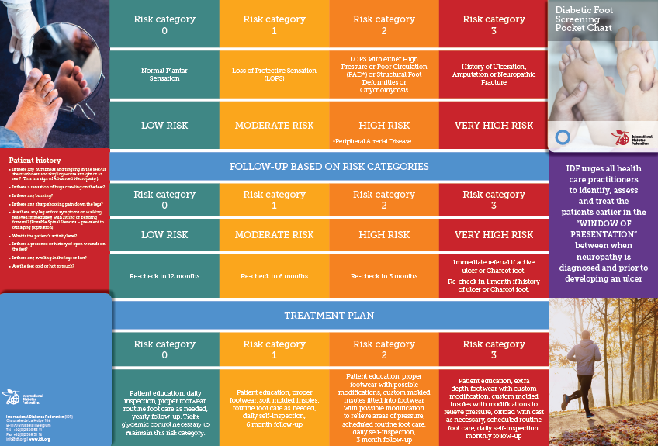
Diabetes Foot Screening Pocket Chart, IDF

Slide 35

Diabetes Foot Screening Pocket Chart, IDF

Slide 36
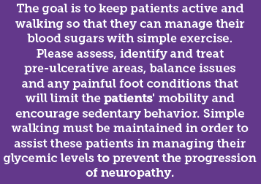


Slide 37

Thanks for your patience

Slide 38
  Most images used in this presentation has been selected from
  IDF website.

