Slide 1


Slide 2
Common causes for secondary osteoporosis
Endocrine diseases
Diabetes mellitus
GH deficiency (rare)
Acromegaly (rare)
Hypercortisolism
Hyperparathyroidism
Hyperthyroidism
Premature menopause
Male hypogonadism
Hematologic diseases
Myeloma
MGUS
Lymphoma/leukemia
Systemic mastocytosis (rare)
Disseminated carcinoma
Chemotherapy
Connective tissue diseases
Osteogenesis imperfecta
Marfan's syndrome (rare)
Ehlers–Danlos syndrome (rare)
Pseudoxanthoma elasticum (rare)
Gastrointestinal disorders
Gastrectomy
Celiac disease
Inflammatory bowel disease
Liver cirrhosis
Chronic biliary tract obstruction
Chronic therapy with PPI
Rheumatological diseases
Rheumatoid arthritis
Ankylosing spondylitis
Systemic lupus erythematosus
Other
Anorexia nervosa
Hofbauer LC, Hamann C, Ebeling PR. Approach to the patient with secondary osteoporosis. Eur J Endocrinol. 2010;162(6):1009–1020.

Slide 3
Hypercortisolism
Diabetes mellitus
Male hypogonadism
Celiac disease
Liver cirrhosis / chronic liver disease

Slide 4
Drugs known to cause osteoporosis and/or fragility fractures
Drug class | Examples
Glucocorticoids | Prednisolone
Calcineurin inhibitors | Cyclosporine A
Chemotherapeutic drugs | Methotrexate, ifosfamide
Tyrosine kinase inhibitors | Imatinib
Thiazolidinediones | Rosiglitazone, pioglitazone
GnRH agonists | Goserelin, buserelin, flutamide
Aromatase inhibitors | Anastrozole, letrozole, exemestane
Progesterone | Depot-medroxyprogesterone acetate
Proton pump inhibitor | Omeprazole and pantoprazole
Unfractionated heparins
Lipase inhibitors | Orlistat
Thyroid hormone | L-thyroxine
Anticonvulsants | Valproic acid
Antidepressants | Selective serotonin re-uptake inhibitors
Anti-retroviral drugs | Tenofovir
Hofbauer LC, Hamann C, Ebeling PR. Approach to the patient with secondary osteoporosis. Eur J Endocrinol. 2010;162(6):1009–1020.

Slide 5

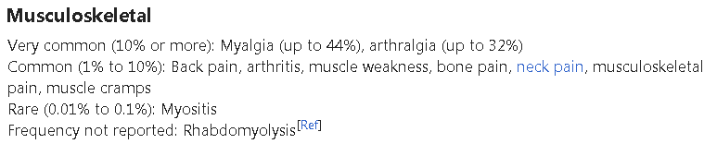

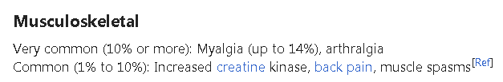
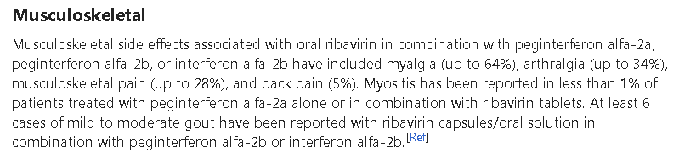
Drugs
    Peginterferon alfa 2a
    Ribavirin
    Daclatasvir (NS5A protein Blocking)
    Sofosbuvir (NS5B protein Blocking)

Slide 6
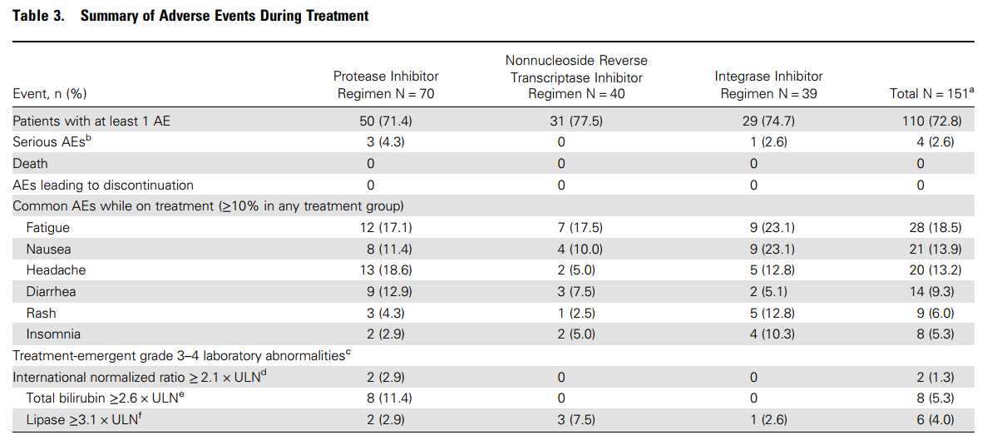
Clinical Infectious Diseases® 2016
12 Weeks of Daclatasvir in Combination With Sofosbuvir for HIV-HCV Coinfection (ALLY-2 Study): Efficacy and Safety by HIV Combination Antiretroviral Regimens
Anne F. Luetkemeyer, Cheryl McDonald,Moti Ramgopal,Stephanie Noviello,Rafia Bhore,and Peter Ackerman

Slide 7
Skeletal Fragility in Endogenous Hypercortisolism
Fragility fractures may be the first clinical manifestation of Cushing’s syndrome *
Fractures involve more frequently the vertebrae and may occur in 30– 50% of the patients with endogenous hypercortisolism, in close relationship with the severity and/or duration of disease **
In >50% of the cases, spine fractures occur without specific clinical symptoms and the radiological and morphometric approach has emerged as the method of choice for evaluating the true prevalence and incidence of these fractures in clinical practice ***
The prevalence of fractures and osteoporosis has been reported to be 15–50 and 38–50 % respectively and may be a presenting feature of CD.
The prevalence of vertebral and rib fractures is significantly higher in men compared to women.
* Vestergaard P, Lindholm J, Jorgensen JO, Hagen C, Hoeck HC, Laurberg P, Rejnmark L, Brixen K, Kristensen L, Feldt-Rasmussen U, Mosekilde L: Increased risk of osteoporotic fractures in patients with Cushing’s syndrome. Eur J Endocrinol 2002; 146: 51– 56.
** Trementino L, Appolloni G, Ceccoli L, Marcelli G, Concettoni C, Boscaro M, Arnaldi G: Bone complications in patients with Cushing’s syndrome: looking for clinical, biochemical, and genetic determinants. Osteoporos Int 2014; 25: 913–921.
*** Angeli A, Guglielmi G, Dovio A, Capelli G, de Feo D, Giannini S, Giorgino R,Moro L, Giustina A: High prevalence of asymptomatic vertebral fractures in post-menopausal women receiving chronic glucocorticoid therapy: a cross-sectional outpatient study. Bone 2006; 39: 253–259.

Slide 8
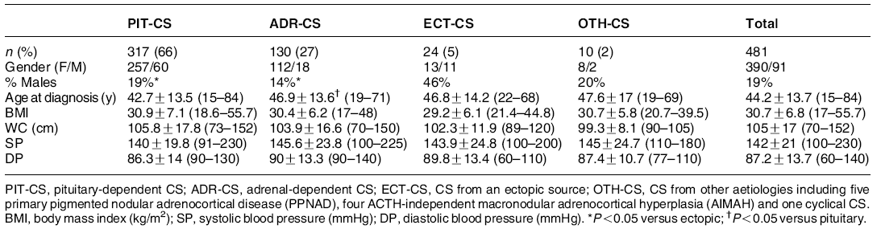
European Journal of Endocrinology (2011)
The European Registry on Cushing’s syndrome: 2-year experience. Baseline demographic and clinical characteristics
Elena Valassi, Alicia Santos, Maria Yaneva, Miklo´s To´th, Christian J Strasburger, Philippe Chanson
Baseline data on 481 CS patients (390 females, 91 males) collected from 36 centers in 23 countries, including new patients from 2008 and retrospective cases since 2000.
General characteristics of the overall population of patients with Cushing’s syndrome and of each aetiologic group

Slide 9

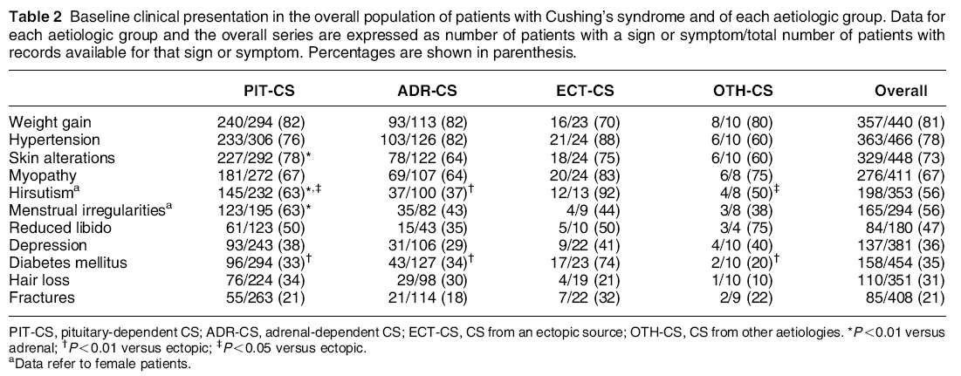

Slide 10
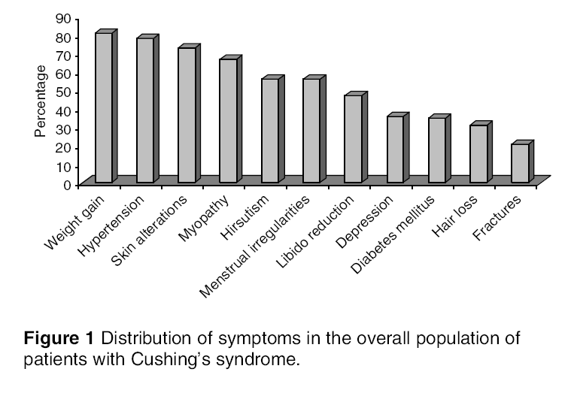
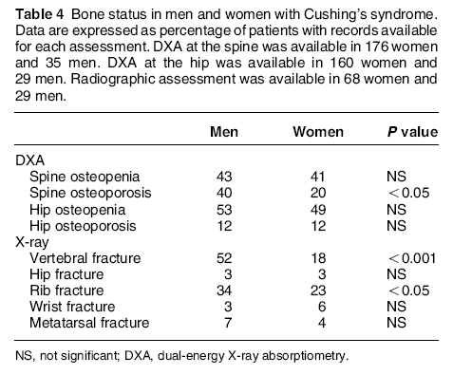
Prevalence of spine osteoporosis was higher in men than women (P<0.05), and males had more vertebral and rib fractures than females (52 vs 18% for vertebrae; and 34 vs 23% for ribs;).

Slide 11
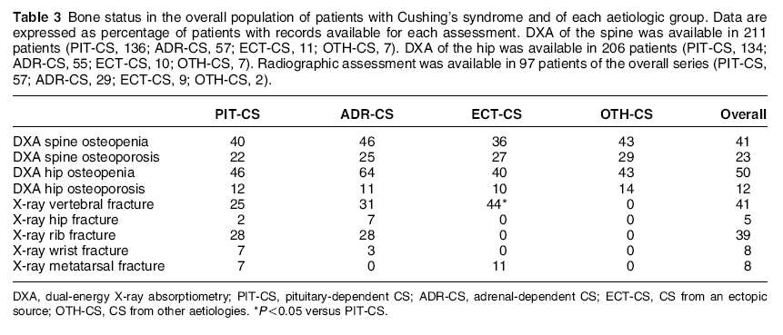

Slide 12
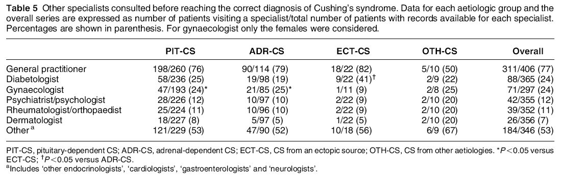

Slide 13
Osteoporos Int. 2013
Bone complications in patients with Cushing’s syndrome:
looking for clinical, biochemical, and genetic determinants
L. Trementino & G. Appolloni & L. Ceccoli & G. Marcelli
● 52 patients with active CS [2007 – 2012] (38 Cushing’s disease and 14 with cortisol-secreting adrenal adenoma) were
genotyped for GR polymorphisms (BclI, N363S, ER22/ 23EK, and A3669G).
● Assessed for : Clinical, hormonal, biochemical markers of bone turnover, BMD and both vertebral and peripheral Fx.

Slide 14
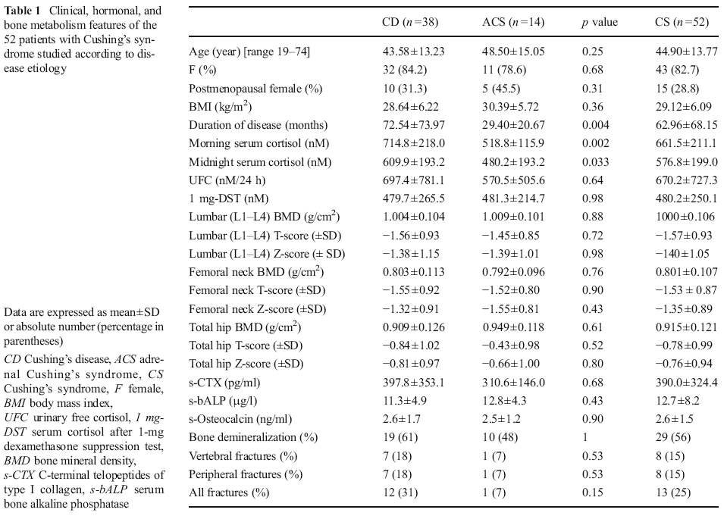

Slide 15
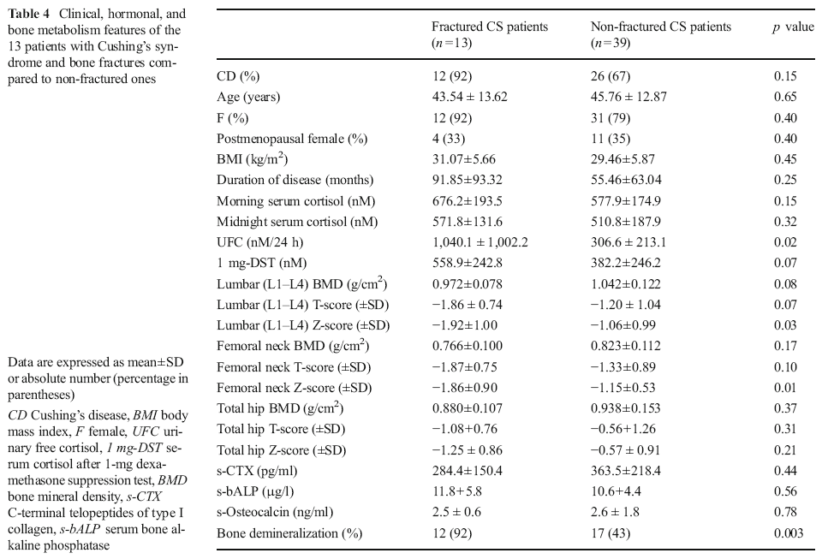

Slide 16
Conclusion
For the first time we investigate the role of both clinical and genetic determinants in the occurrence of bone complications in patients with overt CS.
While GR gene variants, as well as gender and disease etiology, seem not to play a role, the degree and duration of hypercortisolism seem to be the major determinants of bone loss and fractures in this group of patients.

Slide 17
Arch Osteoporos (2015)
The risk factors for fractures and trabecular bone-score value in patients with endogenous Cushing’s syndrome
Zhanna E. Belaya1 & Didier Hans2 & Liudmila Y. Rozhinskaya1 & Natalia V. Dragunova1
patients with CS (n=182) were interviewed in relation to low-traumatic fractures and underwent lateral X-ray imaging from T4 to L5.
BMD and TBS measurements were performed .
Urinary free cortisol was measured by immunochemiluminescence assay (reference range, 60–413 nmol/24 h).

Slide 18
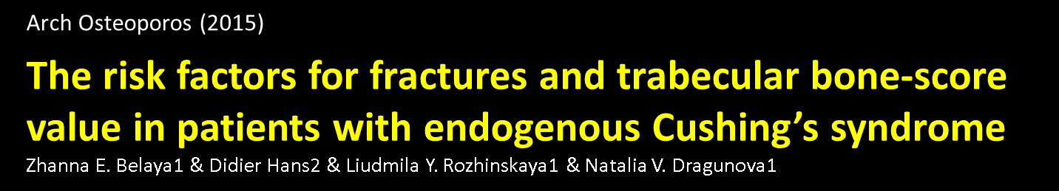
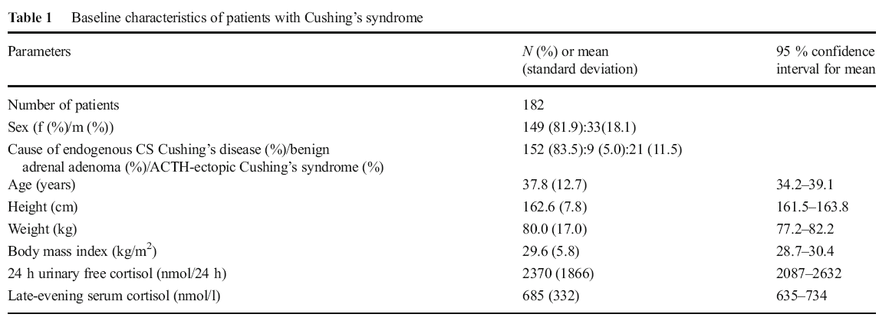

Slide 19
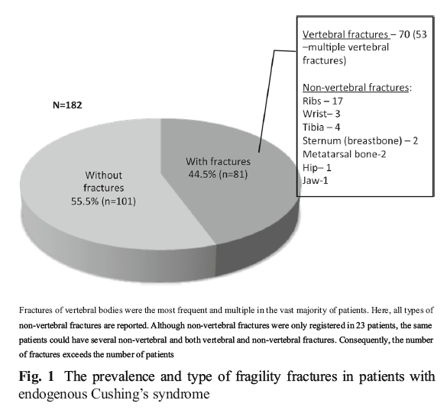

Slide 20
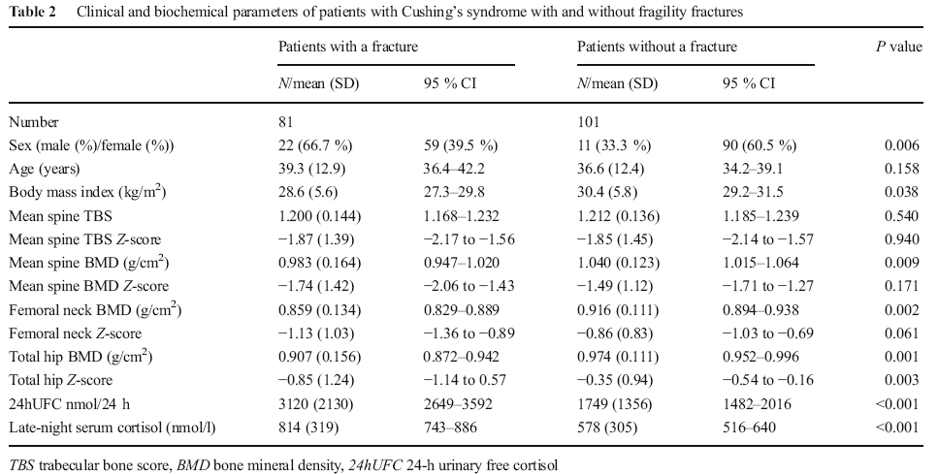

Slide 21
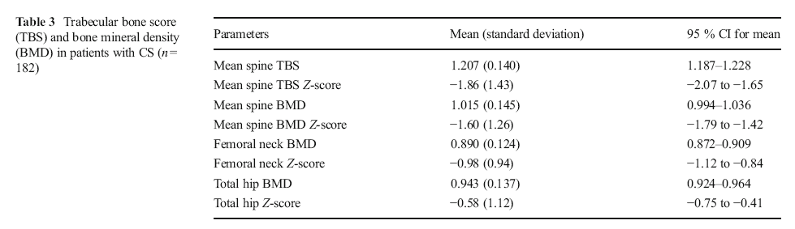
At the time of clinical presentation, CS patients generally appear to have a low TBS value, decreased levels of bone formation markers, and yet just a minimal decrease in BMD.
Neither TBS nor BMD was predictive for fractures.

Slide 22
Conclusions
Young patients with CS have a low TBS. However, the only predictor of low traumatic fracture is the severity
of the disease itself, indicated by high 24hUFC levels.
Consequently, patients with 24hUFC value higher than 1500 nmol/24 h should be considered candidates for
antiosteporotic treatment in the event of hypercorticism not being able to be urgently resolved.

Slide 23
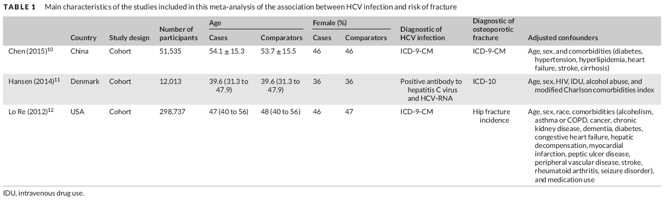
J Evid Based Med. 2018 Jan 11
Hepatitis C virus infection and risk of osteoporotic fracture:
A systematic review and meta-analysis
Karn Wijarnpreecha, Charat Thongprayoon, Panadeekarn Panjawatanan,Patompong Ungprasert
Three studies with 362,285 participants

Slide 24

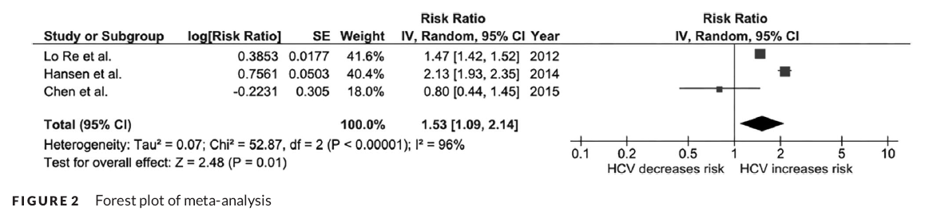
Results : a significantly increased risk of osteoporotic fracture among HCV infected patients compared with subjects without HCV infection with approximately 53% excess risk.
Suggestion : Routine screening for osteoporosis using BMD scan for HCV-infected patients for early treatment .
(cost-effectiveness ?)
Another meta-analysis : OR of 1.65 (95% CI: 0.98–2.77)

Slide 25
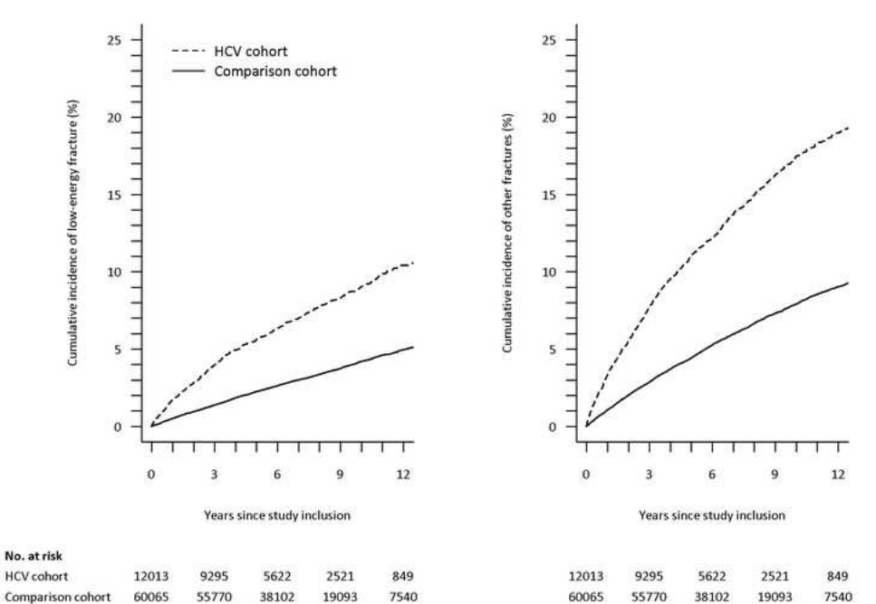
Fracture risk in hepatitis C virus infected persons: results from the DANVIR cohort study
Ann-Brit Eg Hansen, Lars Haukali Omland, Henrik Krarup
Low-energy fracture
Other fracture

Slide 26
increase in receptor–activator ratio of
nuclear factor kappa ligand and osteoprotegerin
increased bone resorption and loss of bone mass
Chronic liver disease
Hyperbilirubinemia
( Bilirubin → inhibit osteoblast proliferation )
Chronic liver disease
impaired bone production
significantly lower level of IGF-1 and
IGF binding protein 3 (IGFBP-3)
osteoporotic fracture
↓ osteoblast differentiation and proliferation
Chronic liver disease from HCV infection

Slide 27
J Bone Miner Res. 2012
Bone quality, as measured by trabecular bone score in patients with adrenal incidentalomas with and without subclinical hypercortisolism
Cristina Eller-Vainicher, Valentina Morelli, Fabio Massimo Ulivieri, Serena Palmie
Prospective observational study in “Fondazione IRCCS Cà Granda,” Milan, Italy.
From January 2010 to December 2011, 102 white patients (63 postmenopausal females, and 39 males) & 70 control
SH+ : Presence of at least two of the following three alterations
(1) 24-hour urinary free cortisol (UFC) levels >70 µg/24 h (193 nmol/L)
(2) serum cortisol levels after 1-mg DST >3.0 µg/dL (83 nmol/L);
(3) adrenocorticotropic hormone (ACTH) levels <10 pg/mL (2.2 pmol/L)

Slide 28
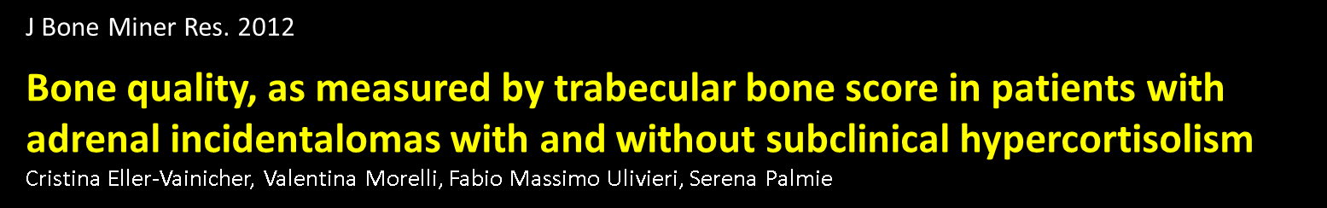
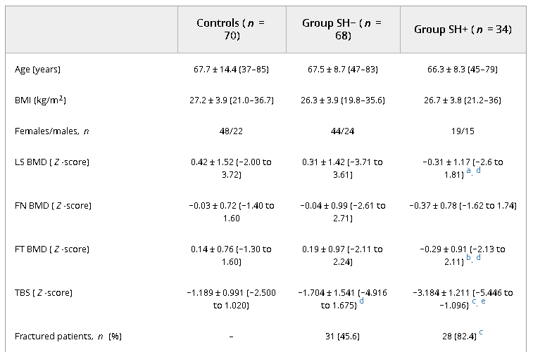
Clinical Characteristics of Patients With Adrenal Incidentalomas With and Without SH

Slide 29
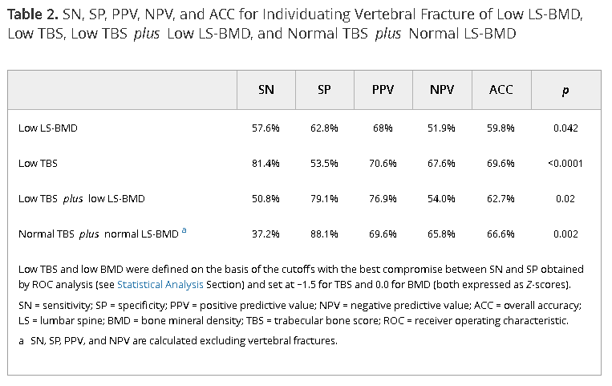

Slide 30
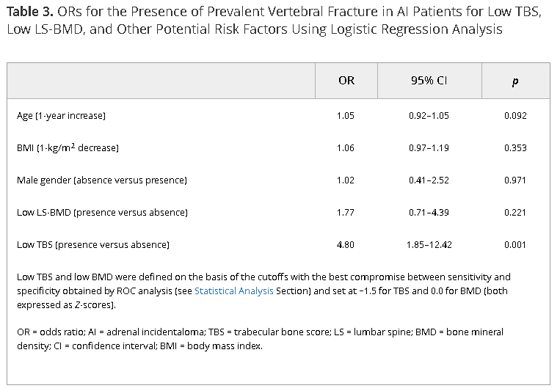

Slide 31
Conclusion
SH affects bone microarchitecture, as evaluated with TBS, and the degree of the damage is associated with the degree of cortisol excess and the number and severity of vertebral fractures.
TBS seems more accurate than BMD for identifying patients at risk for vertebral fractures.
Based on the current analysis, the assessment of TBS could be even of higher interest in conditions of overt glucocorticoid excess.

Slide 32
Pituitary (2012)
Spontaneous recovery of bone mass after cure of endogenous hypercortisolism
Maria Elena Randazzo • Erika Grossrubatscher • Paolo Dalino Ciaramella • Angelo Vanzulli • Paola Loli
Evaluation of the recovery of bone mass within 2 years after remission of hypercortisolism and in long term follow up
20 patients (6M, 14F, 3 post-menopausal, 15–64 years old)
    15 with Cushing’s disease
    2 with ectopic ACTH syndrome
    3 with ACTH independent CS
5 patients were treated with bisphosphonates
BMD : before and 7–33 months after treatment of hypercortisolism

Slide 33

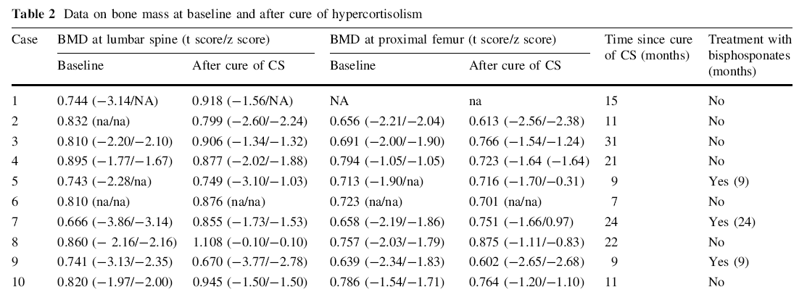

Slide 34
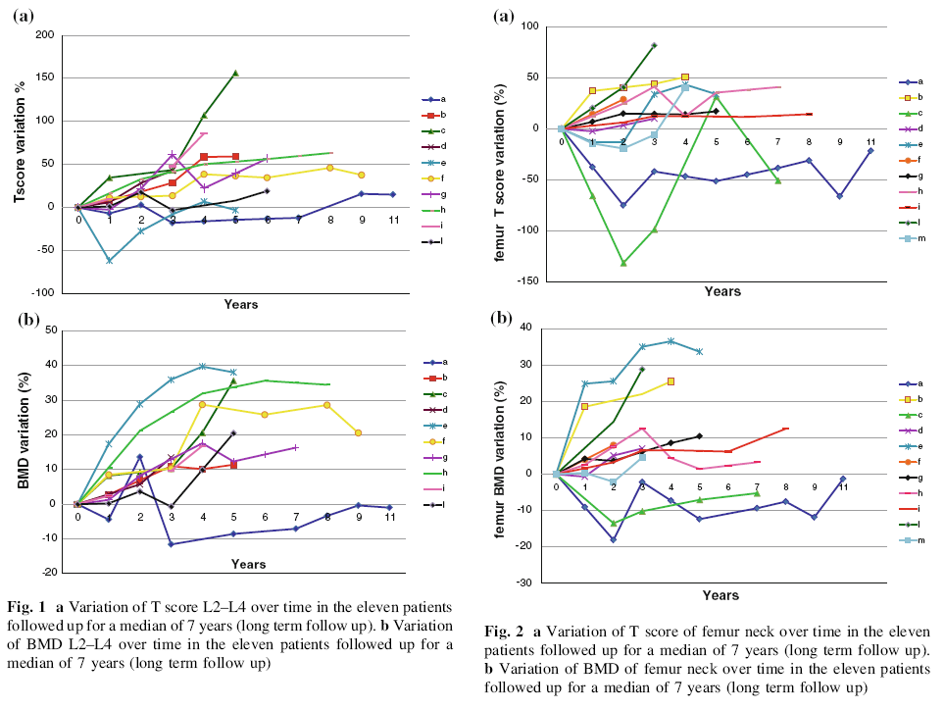

Slide 35
Results
In long term (median 7 years ) a further improvement in bone density was observed in 100% of patients at spine and in 9/11 at femur, although 8/11 patients still had femoral and/or vertebral T score in the range of osteopenia/osteoporosis.
Our data show that osteoporosis due to Cushing’s syndrome is reversible and is a slow and progressive event
occurring over several years. These findings are in line with the limited number of previous studies evaluating bone
recovery after cure of Cushing’s syndrome.

Slide 36
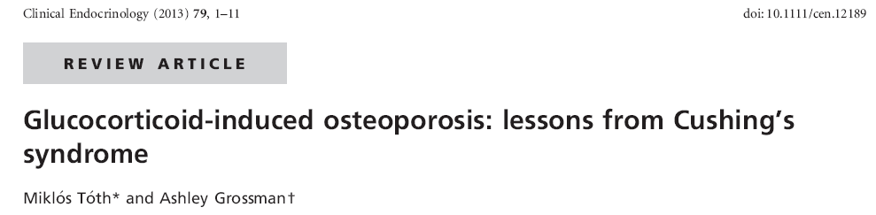
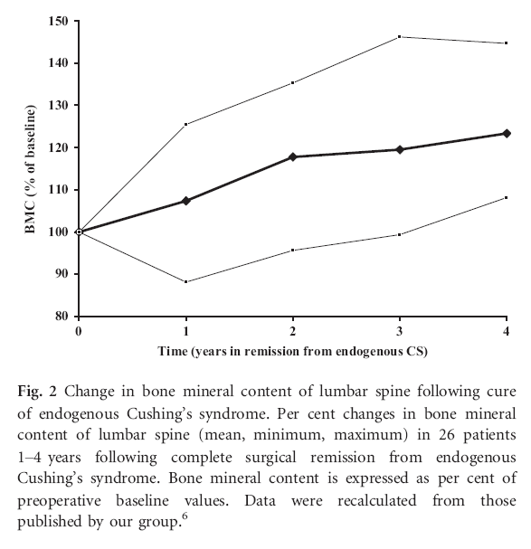
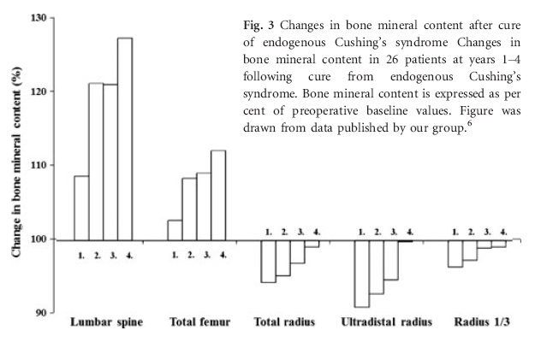

Slide 37
Clin Invest Med. 2017
Head-to-head comparisons of bisphosphonates and teriparatide
in osteoporosis: a meta-analysis
Liu CL, Lee HC, Chen CC, Cho DY.
1,967 patients from eight randomized controlled trials were analyzed;
outcomes included BMD of the femoral neck, total hip and lumbar spine, vertebral and nonvertebral fractures and any adverse event.

Slide 38
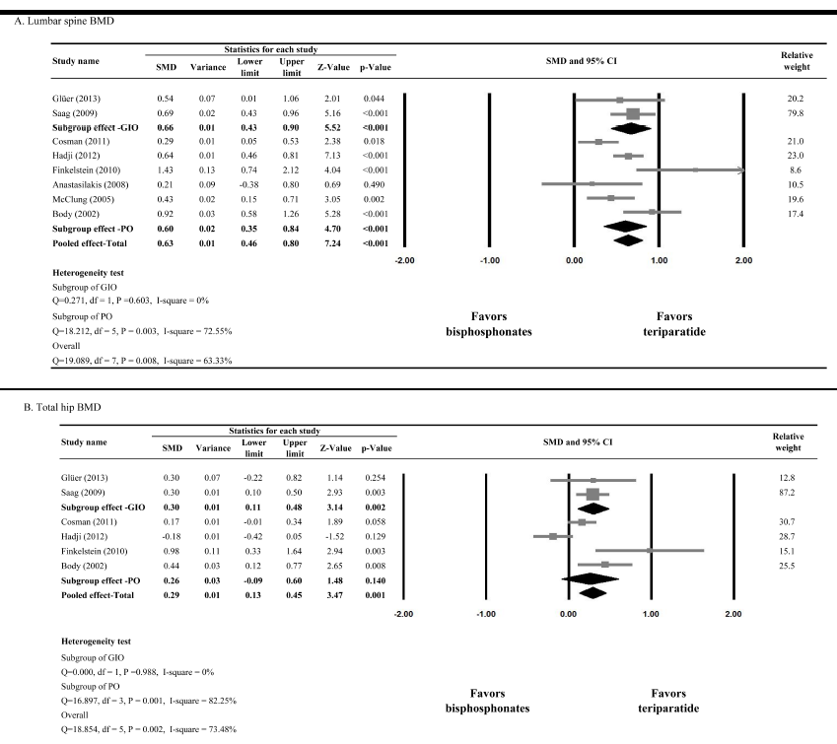

Slide 39
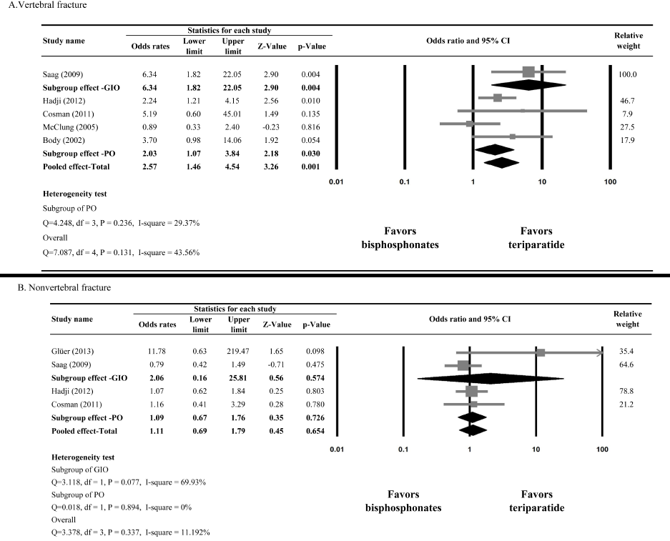

Slide 40
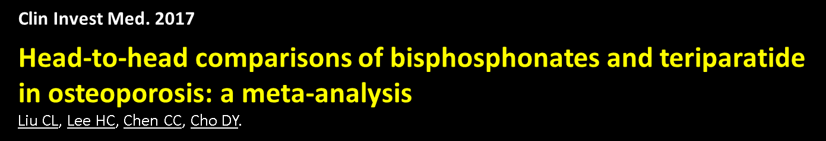
Conclusion
Teriparatide significantly increased the BMD of lumbar spine, total hip and femoral neck, particularly in GIO-induced osteoporosis.
Teriparatide did not lower the risk of nonvertebral fractures when compared with bisphosphonates.

Slide 41
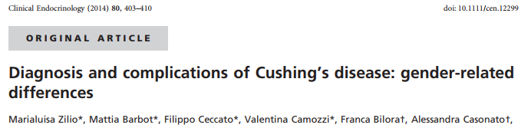
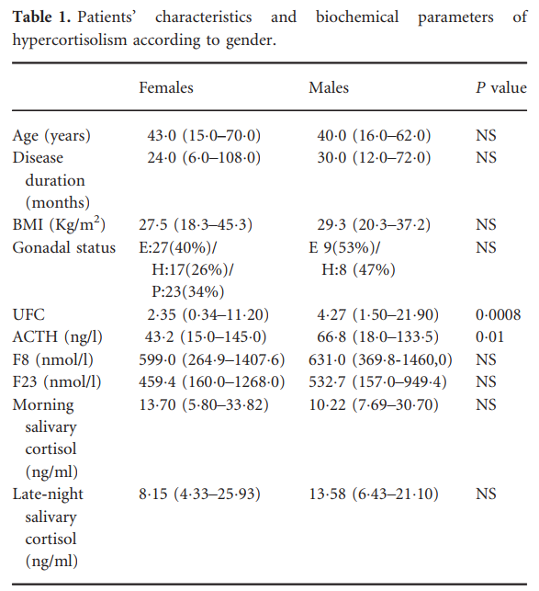
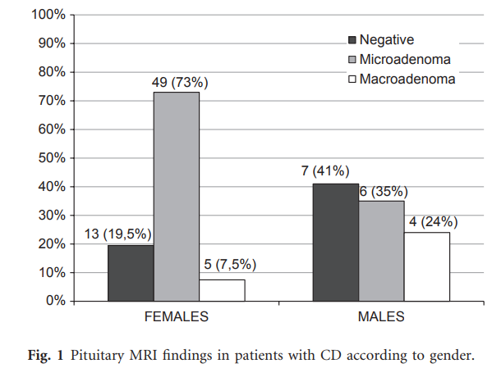
84 adult patients with CD, 67 females and 17 males 2002 -2010

Slide 42
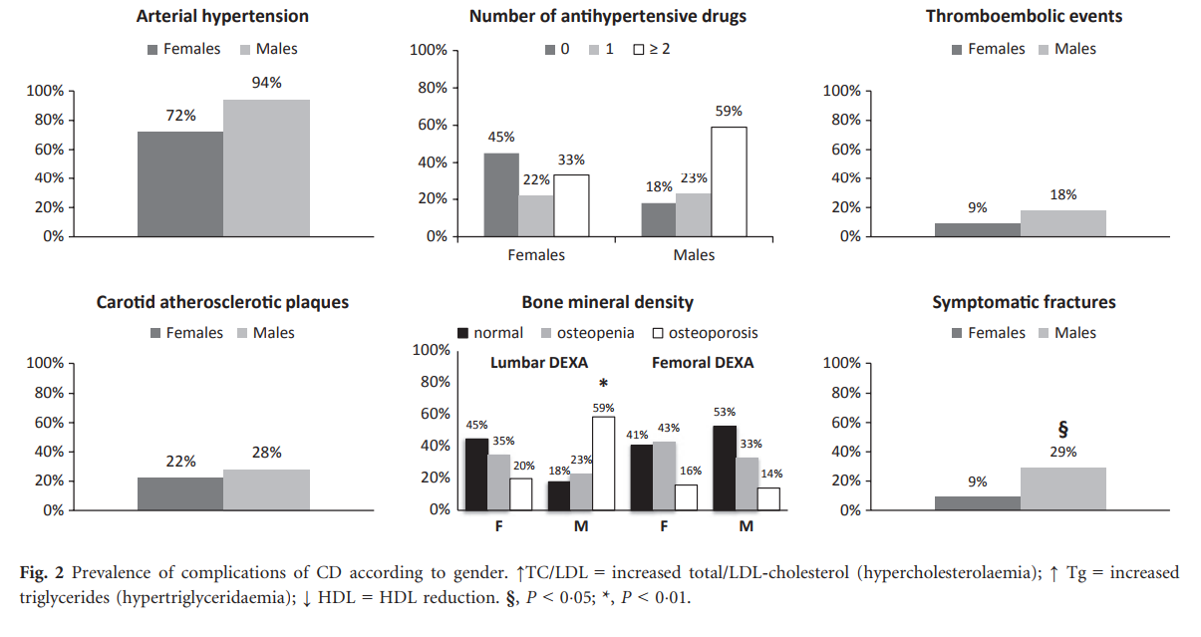

Slide 43
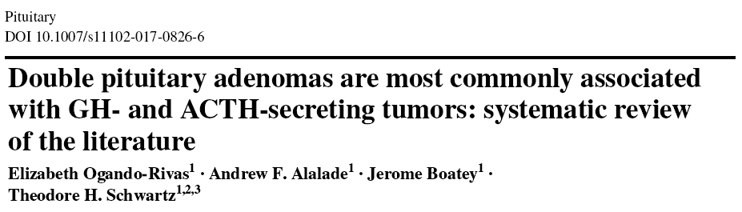
We reviewed papers from 1975 to 2016 and found 17 studywith two pituitary adenomas and 1 with three pituitary
adenomas.
Immunohistochemical staining showed that the most common double pituitary adenomas were growth hormone (GH)- followed by adrenocorticotropic (ACTH)-secreting.

Slide 44
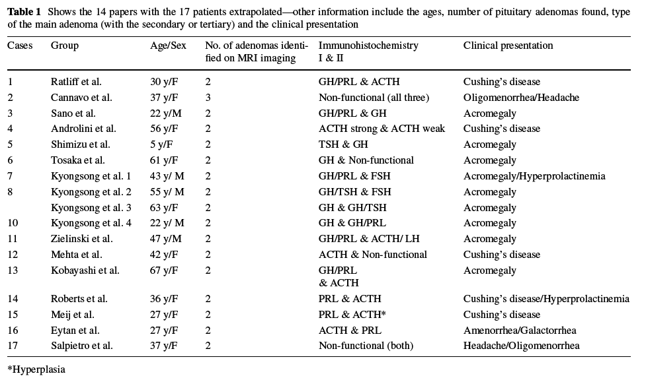

Slide 45
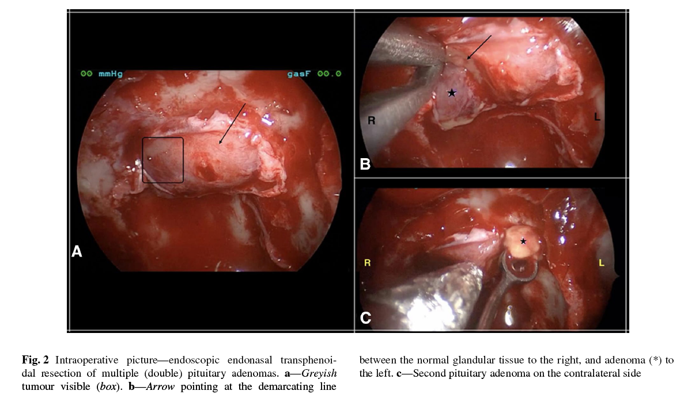

Slide 46
Conclusion
Double pituitary adenomas are rare but most commonly found with GH- or ACTH-producing tumors.
Clinicians should have heightened sensitivity in patients with acromegaly or Cushing’s Disease.

Slide 47
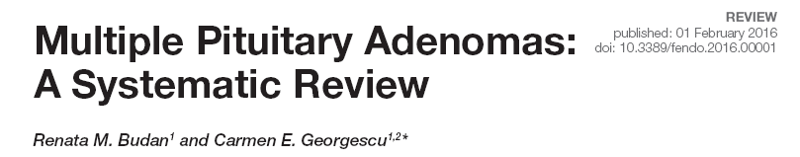
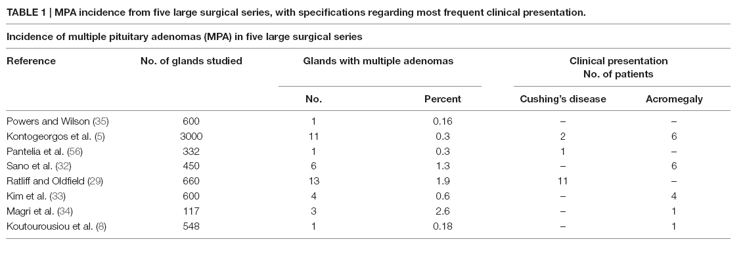
Autopsy Reports
Since the first report on multiple pituitary tumors by Kraus in 1914, estimates provided by autopsy studies on the prevalence of incidentally detected MPA varied widely, ranging from 0.01 to 9% of the examined pituitary glands
Furthermore, cases with double, triple, and even 10 multiple tumors within one pituitary gland were recognized .

Slide 48
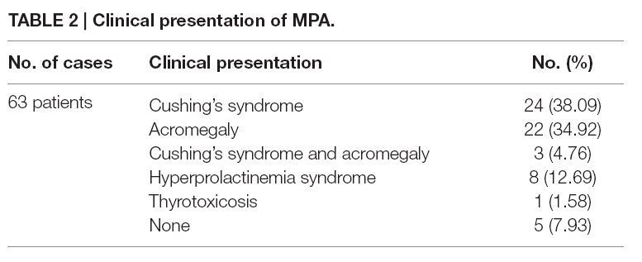
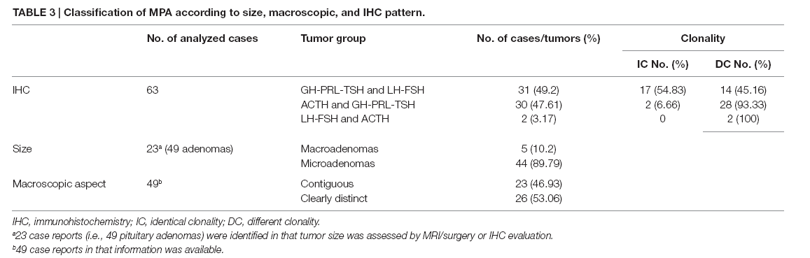

Slide 49
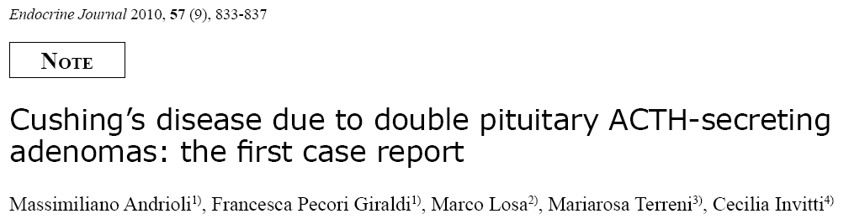
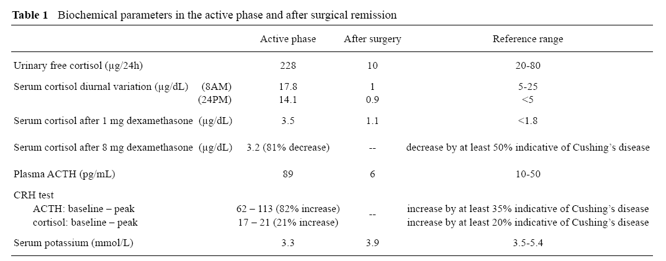
A 56 year-old woman with signs and symptoms of hypercortisolism

Slide 50
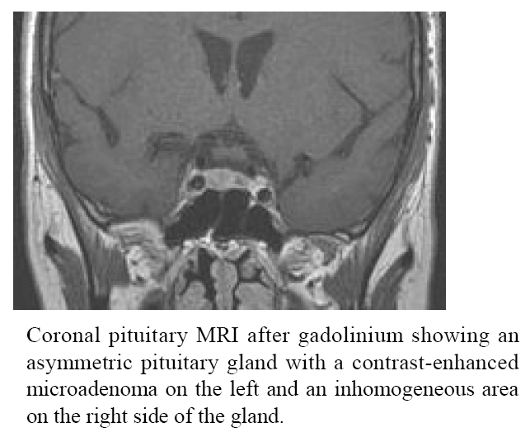
a 2-mm microadenoma close to the neurohypophysis and a 9-mm microadenoma in the right side of the pituitary
Conclusion : double pituitary ACTH-secreting adenomas may occur in patients with Cushing’s disease.
If pituitary imaging is suspicious for multiple lesions then surgical exploration has to be thorough in order to avoid surgical failures.

Slide 51
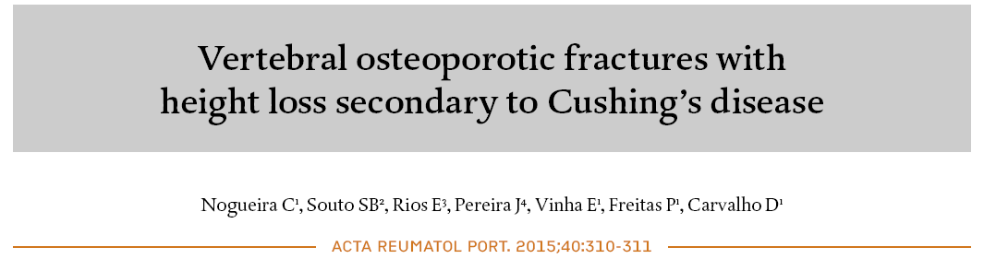
A 37-year-old man with osteoporosis complicated with vertebral and rib fractures and loss of 6 cm in height within the previous year.
He also had hypertension, dyslipidemia, and secondary infertility.
Physical examination revealed a moon face, central obesity, proximal muscle weakness, easy bruising, and kyphosis.

Slide 52
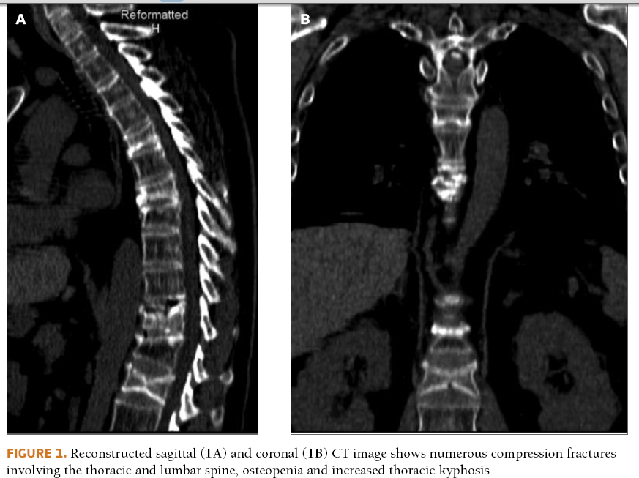

Slide 53
Laboratory
(ACTH) dependent hypercortisolism
24-hour urinary free cortisol: 687.3μg/day (36–137);
cortisol after a 1-mg overnight dexamethasone suppression test: 39.5μg/dL (<1.8);
ACTH:118pg/mL (< 53)].
Total testosterone was low [1.93mg/mL (2.8-8.0)].
Since pituitary magnetic resonance imaging showed no adenoma, he was submitted to bilateral inferior petrosal sinus sampling, which favored Cushing’s disease (CD).
Dual energy X-ray absorptiometry (DXA) revealed osteoporosis of the
lumbar spine (T-score -3.8, Z-score -3.8)
left femur (T-score -3.6, Z-score -2.7).
After cryopreservation of gametes, the patient was submit ted to transsphenoidal surgery and histological findings confirmed the diagnosis.
DXA performed five months after surgery showed osteoporosis of the lumbar spine (T-score -3.4, Z-score -3.6) and osteopenia of the left femur (T-score -2.0, Z-score -1.9). He is still under treatment with alendronate and cholecalciferol.

Slide 54
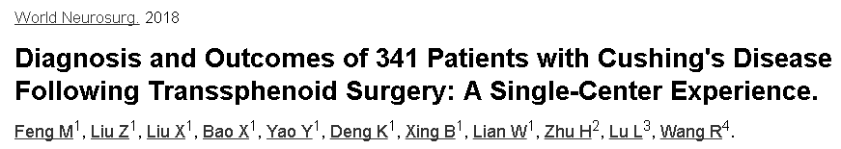
Diagnosis and Outcomes of 341 patients with Cushing's disease following transsphenoid surgery

Slide 55
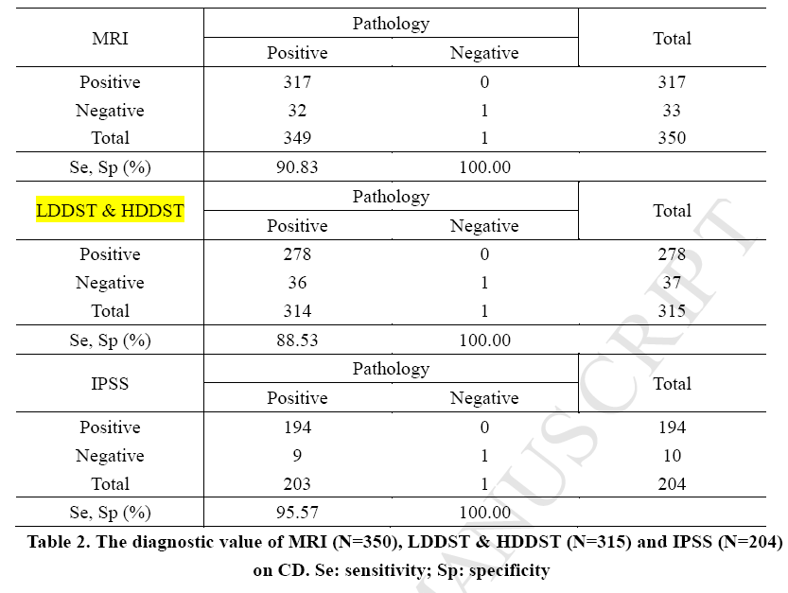

Slide 56



Slide 57
Clin Endocrinol (Oxf). 2018
Tumour lateralization in Cushing's disease by inferior petrosal sinus sampling with desmopressin.
Feng M1, Liu Z1, Liu X1, Zhang X2, Bao X1, Yao Y1,
91 patients with Cushing's syndrome who had either negative findings on MRI or non suppressed HDDST retrospectively analyzed .
HRCT and octreotide receptor imaging of whole body were also negative to rule out ectopic ACTH syndrome.
All patients went through IPSS with desmopressin. Afterwards, transsphenoidal pituitary surgery, light microscope pathology and immunohistological staining for ACTH were performed in all patients.

Slide 58

Tumor lateralization
The concordance rate was 72.5%. ( IPSS and surgery)

Slide 59



Slide 60
Results
90 of 91 patients were confirmed with CD, and of whom 89 had positive IPSS findings.
The sensitivity was 98.9%.
The one patient who was negative for CD also had negative IPSS findings.
The specificity was 100%.
Patients in the concordant group had a higher frequency of right lateralization by surgery.
Conclusions
IPSS with desmopressin is a sensitive approach in the diagnosis of CD and has moderate accuracy in tumor lateralization, making it an alternative choice to IPSS with CRH.

Slide 61


Slide 62


Slide 63
Summary
IPSS
TSS & Pre operative warnings
Medical therapy
Post surgery follow up : TBS / Medical therapy
Bisphosphonate/Teriparatide / Vit. D and Calcium
CVD risk factors modification
Testosterone (?)

