Slide 2
مطالعات کوهورت بیماری های غیرواگیر تلاش برای شناسایی و پیشگیری مهمترین بیماری های قرن دکتر فريدون عزيزي پژوهشکده علوم غدد درون ریز و متابولیسم دانشگاه علوم پزشکی شهید بهتشی

Slide 3
Lifestyle diseases
Lifestyle diseases (diseases of longevity or diseases of civilization) - increase in frequency as countries become more industrialized and people live longer.
These include type 2 diabetes, heart disease, metabolic syndrome, obesity, atherosclerosis, chronic renal failure, osteoporosis, stroke, depression.
Also includes Alzheimer's disease, asthma, COPD, and cirrhosis

Slide 4
Lifestyle diseases
They are caused by an inappropriate relationship of people with their environment
Onset is insidious, they take years to develop, and once encountered are difficult cure
Potentially can be prevented by changes in diet, environment, and lifestyle

Slide 5
منشا بیماری ها از زندگی داخل رحمی (1)
ریشه بیماری های غیرواگیر در زندگی داخل رحمی و رشد اولیه است. افزایش این بیماریها در کودکی و نوجوانی نیز دیده می شود. اهمیت رشد اولیه در بیماریهای غیرواگیر را با فرضیه Development plasticity توجیه می کنند. این پدیده زمانی اهمیت دارد که سلول ها تمایز پیدا می کنند که بیشتر در زمان بارداری است ولی در مواردی مانند کودکی، بلوغ و منوپوز نیز اتفاق می افتد این تغییرات سبب افزایش خطر بیماریها در سنین بالاتر از زندگی می شود.

Slide 6
منشا بیماری ها از زندگی داخل رحمی (2)
فاکتورهایی که در ابتدای زندگی بر پاسخ های فرد به محیط خود تاثیر می گذارند و او را به بیماری در زندگی آینده حساس می کنند Developmental origins of health & disease (DoHad) نامیده می شوند که از پروسه Developmental plasticity، که رشد وتوسعه فنوتیپ را مشخص می کند، به وجود می آیند. ماحصل شواهد اپیدمیولوژی و بالینی از مطالعات انسانی عبارتند از:
فرزندان زنانی که در زمان بارداری در قحطی بسر میبردند، درصد بالایی از خطر ابتلا به بیماری های متابولیک و قلبی عروقی دارند که در طول عمر ادامه می یابد.
سطح متیلاسیون برخی ژنها در موقع تولد با بروز چاقی کودکان ارتباط قوی دارد.
چاقی و دیابت در زمان بارداری عوامل خطر برای بروز بیماری های متابولیک در فرزندان است.
برخی عوامل خطر بیماریهای مزمن از نسلی به نسل دیگر انتقال می یابد (شواهد محدود)

Slide 7
Developmental Origins of Health and Disease (DOHaD)
Chronic disease outcomes have their roots in fetal and early childhood development
The world faces a crisis of increasing chronic diseases → reduction of health and welfare and increased financial burden of NCDs
This includes obesity, type 2 DM, insulin resistance, dyslipidemia, CVD and atherosclerotic disease
They are seen at a younger age as chronic disorders in childhood and adolescents
Serves as a framework to assess the effect of early nutrition and growth on long-term health

Slide 8
Effects of a sedentary lifestyle

Slide 9
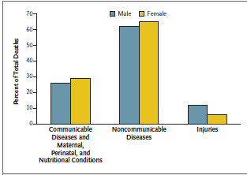
Global Deaths According to Cause and Sex, 2008
Hunter DJ. N Engl J Med 2013; 369: 1336

Slide 10
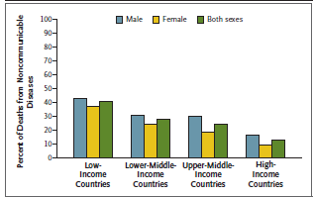
Proportion of Deaths from Noncommunicable Diseases among Persons Younger than 60 Years of Age, According to Income Group of Countries
Hunter DJ. N Engl J Med 2013; 369: 1336

Slide 11
WHO 2012 World Health Statistics
(CVD) accounts for the majority of death from NCDs, causing 17 million deaths in 2008, or nearly half of all reported cases, and it is expected that by 2030, CVD death will reach 28 million. Cancer (21%), respiratory disease (12 %), and diabetes (3.5%)
Curr Hypertens Rep (2012) 14:475–477.

Slide 12
WHO 2012 World Health Statistics
the probability of dying from an NCD during prime working years of 30 to 70 years of age is nearly two-fold higher (48 % vs. 26 %) in low-income and middle-income countries compared to wealthier nations. In addition, 80 % of all NCD deaths overall occurred in the lowest income nations. The problem for these nations,
therefore, is huge.
Curr Hypertens Rep (2012) 14:475–477.

Slide 13
In contrast to hypertension, which showed overall worldwide improvement, the WHO Report notes concerning observations on metabolic syndrome and diabetes, which has been well correlated with obesity.
According to the WHO report, obesity rose from 5 % to 10 % in men worldwide, and from 8 % to 14 % in women. As reported elsewhere, during this same time frame, worldwide diabetes prevalence rose from 8.3 % and 7.5 % in men and women, respectively, in 1980, to 9.8 % and 9.2 % in 2008.
Curr Hypertens Rep (2012) 14:475–477.

Slide 14
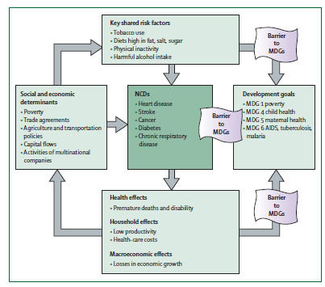
Associations between poverty, non-communicable diseases (NCDs), and development goals MDG=Millennium Development Goal
Curr Hypertens Rep. 2012; 14(6):475-7.

Slide 15
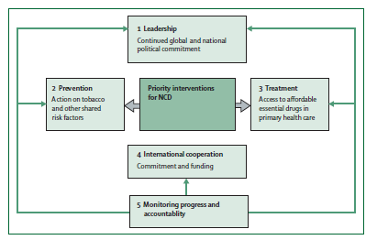
Five priority actions by countries and international agencies for the non-communicable disease (NCD) crisis
Curr Hypertens Rep. 2012; 14(6):475-7.

Slide 16
Prevention of NCD
Focus on behavioural change as the core component of all clinical programmes for the prevention and management of chronic disease.
Establish actual centres to design, implement, study and improve preventive programmes for chronic disease.
Use human-centred design in the creation of prevention programmes with an inclination to action, rapid prototyping and multiple iterations.
Extend the knowledge and skills of Sports and Exercise Medicine professionals to build new programmes for the prevention and treatment of chronic disease.
Mobilise resources and leverage networks to scale and distribute programmes of prevention.
Br J Spoorts Med. 2013; 47(16):1003-11.

Slide 17
Most of the interventions advocated by WHO are nothing to do with doctors and health systems. Most of what needs to be done to counter NCDs lies outside the health systems.
We have strong evidence that we can prevent prediabetes and prehypertension progressing to the full blown conditions by helping people change their lifestyles and lose weight. Again, this is nothing to do with doctors and drugs. The programmers are unaffordable if they use doctors rather than community health workers.
BMJ .2011; 343

Slide 18
During the last decades, the incidence of NCDs increased worldwide and Population Based Cohort Studies designed to determine the risk factors of these diseases especially CVDs

Slide 19
Prospective Studies of Cardiometabolic Disease and Risk Factors
Framingham Heart Study in US (1948)
Puerto Rico Heart Health program (1965)
Bogalusa Heart Study in US (1972)
Honolulu Heart Program among Japanese Americas (1980)
MONICA (multinational Monitoring of trends and determinants in Cardiovascular isease) in 21 countries (1980)
ARIC (Atherosclerosis Risk in Communities Study) in four US communities (1987)
CHS (Cardiovascular Health Study) in US (1989)
SHS (Strong Heart Study) in America Indians (1989)
Rotterdam Study in the Netherlands (1990)
AusDiab (Austrailian Diabetes, Obesity and Lifestyle Study) (1999)
TLGS (Tehran Lipid and Glucose Study) in Iran (1999)

Slide 20
TC, BMI and SBP trends in Iran between 1980 and 2008
TC
BMI
SBP
Male
Female
Farzadfar et al. Lancet 2011, Finucane et al. Lancet 2011, Danaei et al. Lancet 2011

Slide 21
سال شروع | برنامه هاي پيشگيري از بيماريهاي غير واگير در جمهوري اسلامي ايران
1375 | شبكه ملي پيشگيري و مراقبت بيماري ديابت
1377 | برنامه آينده‌نگر بررسي قند و ليپيدهاي خون در يك جامعه تهراني (مرحله اول TLGS)
1379 | پيشگيري از بيماري‌هاي عروقي قلب: قزوين، ابهر
1379 | پروژه قلب سالم اصفهان
1380 | ايجاد تغيير در شيوه زندگي به منظور پيشگيري و كاهش عوامل خطرساز و پيامدهاي بيماري‌هاي غيرواگير (مرحله دوم TLGS)
1381 | پيشگيري از بيماري‌هاي غيرواگير در سه استان فارس، يزد و زنجان (مرتبط با TLGS)
1381 | پروژه قلب سالم خليج فارس
1382 | پيشگيري از چاقي کودکان در اصفهان
1383 | بررسي كشوري عوامل خطر بيماريهاي غير واگير
1384 | (TLGS)مرحله سوم مطالعه قندو ليپيد تهران
1387 | (TLGS)مرحله چهارم مطالعه قند و ليپيد تهران

Slide 22
Global response to non-communicable disease
The authors are principal investigators and other researchers in a network of centers of excellence in low and middle income countries conducting research into non-communicable disease. These authors comprise Maria Terease Cerqueria (Mexico), Alejandro Cravioto (Bangladesh), Nancy Dianis (US), Hassen Ghannem (Runisia)….. BMJ. 2011 Jun 30;342:d3823

