Slide 1
Liver and Pancreas Transplantation
Dr. Rabbani
Assistant Professor
Shahid Beheshti University of Medical Science
January 2020

Slide 2
Liver Transplant

Slide 3
Organ Allocation System
MELD score
INR, Bill, Creat
Between 6-40
Score above 15 is a valid indication for transplant

Slide 4
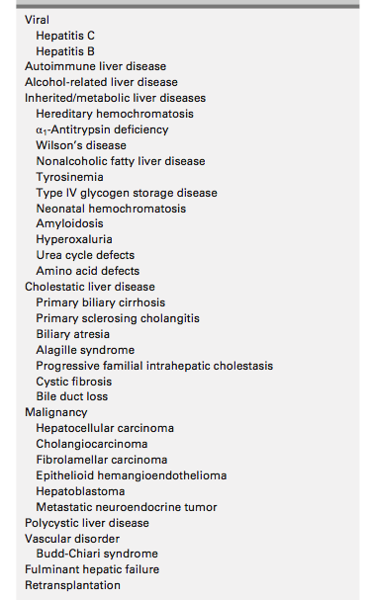
Indications

Slide 5
MELD Exceptions
HCC
CCA
Amyloidosis
Hepatopulmonary Syndrome
Recurrent Cholangitis
Hepatic Encephalopahy
Portopulmunary HTN
Intractable Pruritis
Budd-Chiari syndrome
Cystic Fibrosis
Polycystic liver Disease
Primary Hyperoxaluria
Small for size syndrome

Slide 6
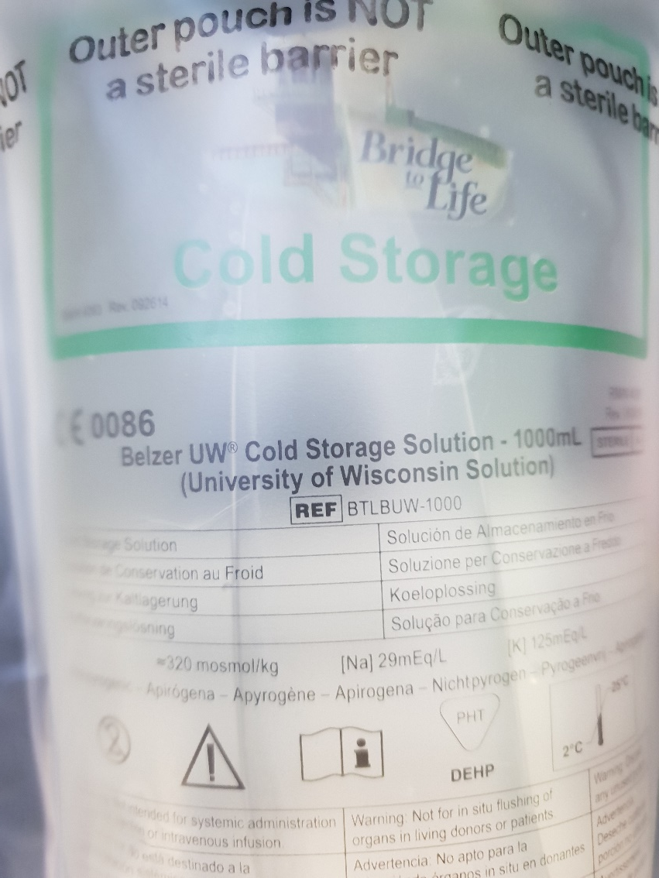

Slide 7
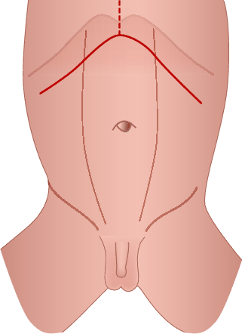

Slide 8
Reperfusion Syndrome
Cold Ischemic Time
Warm Ischemic Time

Slide 9
POD order
Imp: OLTx
Position: Semisitting
Diet: NPO
Please:
1. CVS as ITU routin
2. Chart I/O q 1h
3. Chart NGT, JP Drain, CVP q 6h ( keep CVP 8-10 cmH2O)
4. CXR ( in case of intubation)
5. Serum N/S 1000 cc / IV / TDS
Add 40 meq KCL 20% / L if K<4 meq/ L
6. Amp Ampicillin – Sulbactam 1.5 gr/ IV / TID
or
Amp Meropenem 1gr /IV/ QID ( for high risk patients)
7. Amp Pantaprazole 40 mg / IV / BID
8. Amp Methylprednisolone 1000 mg /IV/ daily * 3 days
or
Vial Thymoglobolin 1.5 mg / kg / day ( up to 5 mg /kg) (In case of renal dysfunction)
decrease to 0.75 mg / kg if PLT< 50,000
HOLD if PLT < 25,000
9. Amp Midazolam mg / IV/ infusion
10. Amp Fentanil mg /IV/ infusion
11. Amp vit C / IV / Daily
12. Amp vit B complex / IV / daily
13. Amp Heparin 18 unit / kg / h ( As ordered if INR < 2.5)
14. Cap Fluconazole 100 mg / PO / BID (adjuast for RF)
15. Tab Co-Trimoxazole 1 tab / PO / Daily
16. Vial HBIG 2000 u/ IV / daily for 6 days (HBV)
17. Tab Tenofovir 300mg/PO/Daily(HBV and HBc+donors) if GFR>50 ml/min
300mg/PO/q48h if 30<GFR<49 ml/min
300mg/PO/q72-96h if 10<GFR<29 ml/min
18. If SBP> 140mmhg or SBP>90 mmhg treat pain with narctics
treat overload with IV Lasix if CVP>12
Tab Metoporolol /PO/BID if PR> 70 /min
Amp Hydralazine / IV/ if PR< 70/min
Tab Amlidopine 5 mg /PO/ BID if DBP> 90 mmhg
Amp Labetalol or TNG if SBP >180 mmhg

Slide 10
19.TabCellcept500mg/PO/BID(starting the second day with max dose of 3gr)
Adjust the dose baesd on WBC count:
WBC <1500 withhold Cellcept and give GCSF once
1500<WBC<2500 : give one dose of GCSF
2500<WBC<3500: decrease the cellcept by 500 mg
20. Tab Prednisolone 20 mg / PO / daily after the third dose of MP
21. Tab Prograf 1 mg / PO / BID strating the second day and increasing daily
Through level of 10-15 for Autoimmune disease
Through level of 8-12 for other indication
Through level of 3-5 for CNI minimization renal sparing protocols
For 1.8< creat< 2 decrease the dose by 1 mg and recheck serum level
For 2< creat<2.5 decrease the dose by 2 mg and recheck serum level
For creat>2.5 withhold mediction
22. Tab Cyclosporine 5-15 mg/kg/day for patients with convulsion
Through level 100-200 ng/ml
23. Amp Ganciclovir 5mg/kg/q12h If GFR>70 ml/min (For CMV disease)
2.5mg/kg/q12h If 50<GFR<69 ml/min
2.5mg/kg/q24h If 25<GFR<49 ml/min
1.25mg/kg/q24h If 10<GFR<24 ml/min
1.25mg/kg 3 times a week after hemodialysis if GFR<10 ml/min
24. Tab Valganciclovir 900 mg every 12h if GFR>60 (For CMV infection)
450 mg every 12h if 40<GFR>59
450 mg once daily if 25<GFR>39
450 mg every 2 days if 10<GFR>24
200 mg every 3 times a week after hemodialysis if GFR<10

Slide 11
Antimicrobial prophylaxis Transplant protocol
Bacterial
Ampicillin-sulbactam, 3 gr IV, starting before transplantation surgery and continuing q6h until 48 hr after surgery is completed; if the patient has penicillin allergy manifested by rash, use ceftizoxime, 2 gr IV q12h, plus vancomycin, 1 gr IV q 12h, starting before surgery and continuing until 24 hr after surgery; if the patient has penicillin allergy manifested by anaphylaxis, use gentamycin, 1.5 mg/kg IV q8h, plus vancomycin, 1 gr IV q 12h, starting before surgery and continuing until 24 hr after surgery.
Consider Meropenem 1 gr IV q6h, plus Vancomycin 1 gr q12h for high risk individuals starting before operation and continuing for 7 days. Recipients high risk for bacterial infection are: intubated, renal failure or need for renal replacement therapy, ICU stay before transplant, primary graft non-function or dysfunction, positive donor culture, adjust by renal function.
Fungal
Fluconazole, 400 mg orally every day until day 30 after transplantation for all recipients, adjust by renal function.
Pneumocyctis Jiroveci
Trimethoprim-Sulfamethoxazole (160 and 800 mg, respectively) orally daily until 1 year after transplantation; continue beyond 1 year in patients requiring additional immunosuppression for rejection; if the patient has sulfa allergy, dapsone 100 mg orally every day or atovaquone 750 mg orally BID.

Slide 12
Immunosuppressive Transplant Protocol
Induction:
Methylprednisolone, 1 gr IV starting in operating room at anhepatic phase for 3 consecutive days for all recipients without special considerations.
Thymoglobulin 1.5 mg/kg/day up to 6 mg/kg for special considerations. Autoimmune hepatitis, HCV cirrhosis recipients, Fulminant hepatic failure, encephalopathy grade III or IV, renal failure, severe neurologic symptoms such as convulsion are indications to use thymoglobulin as induction therapy.
Half the dosage of thymoglobulin to 0.75 mg/kg/day if PLT count decreases below 50,000 /mL, Hold thymoglobulin if PLT count drops below 25,000 /mL.
Maintenance:
All recipients are on triple immunosuppressive as maintenance therapy.
Start Tacrolimus (Prograf) 0.02-0.03 mg/kg PO twice daily and increase dosage to achieve a blood through level of 8-12 ngr/mL initially and decrease to 7 ngr/mL 6 weeks post transplant. Through level should decease to 5-7 ngr/mL by 6 month and 3-5 ngr/mL at the end of first year.
For autoimmune disorders such as AIH, PSC and PBC start tacrolimus 0.02-0.03 mg/kg PO twice daily and increase the dosage to achieve blood through level of 12-15 ngr/mL initially and decrease to 10 ngr/mL 6 weeks post transplant. Through level should decease to 8-10 ngr/mL by 6 month and 5-8 ngr/mL at the end of first year.
Cellcept 500 mg PO BID to maximum dose of 3 gr daily is started. Be cautious about cytopenia as a serious side effect of anti-metabolites. In case of GI symptoms either decrease or divide the dosage throughout the day. Myfortic is an enteric-coated form of this drug prescribed 360 mg PO twice a day with maximum dose of 2,160 mg/ day with less GI symptoms. Decrease drug to 1 gr/ day after 1 year post transplant.
Prednisolone is given 20 mg/ day to all recipients and tapered throughout the first year. Except for autoimmune disorders such as AIH, PSC and PBC which continue 5 mg prednisolone life long.

Slide 13
HBV Prophylaxis Transplant Protocol
Recipient is HBs Ag +: Administer 10,000 units of HBIg IV intraoperatively. Continue with 2000 units of HBIg IV for 6 days starting on postoperative day 1. Then give 2000 units IV every 2 week until discharged home to maintain therapeutic titer level. After discharge administer 1500 units of HBIg IM monthly to maintain therapeutic anti-HBs Ab titer level above 100 International unit/ L until 1 year.
Place all patients on Tenofovir (TDF). Discontinue HBIg for low risk recipients after 1 year and place them on two antiviral oral agents including one nucleoside and one nucleotide. Eligible patients as low risk for HBV recurrence are: Undetectable HBV DNA levels at time of transplantation, HBeAg negative, fulminant hepatitis B, HDV coinfection. High risk patients for recurrence are: recipients with detectable HBV DNA level at the time of transplantation, HBeAg positive, Presence of drug resistant HBV, HIV coinfection, high risk for HCC recurrence, poor compliance to antiviral therapy. Continue HBIg with anti-HBsAb level above 100 international unit/L and Tenofovir for indefinite time.
Adjustment of adult dosage of Tenofovir in accordance with creatinine clearance
≥ 50 (mL/min) 300 mg PO daily 30-49 (mL/min) 300 mg PO q48h 10-29 (mL/min) 300 mg PO q72-96h
Anti-HBc + donor:
HBs Ag+ recipient: HBIg + Oral antiviral agent
Anti-HBc+ and Anti-HBs+ recipient: No treatment
Anti-HBc+ and Anti-HBs- recipient: Oral antiviral agent
Anti-HBc- and Anti-HBs+ recipient: Oral antiviral agent
Anti-HBc- and or Anti-HBs- recipient: Oral antiviral agent

Slide 14
Liver Tx Commission

Slide 15
First Liver Tx Symposium at SBUMS

Slide 16
Pancreas Transplant

Slide 17
History
1966 , University of Minnesota
William Kelly and lilihe
40,000 till 2016

Slide 18
Modalities
Simultaneous Pancreas and kidney transplant
Pancreas after kidney transplant
Pancreas alone transplant

Slide 19
Survival
1 year 96%
5 years over 83%

Slide 20
Indication

Slide 21
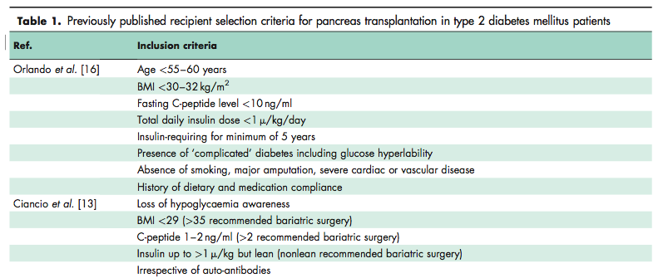

Slide 23
Thank You

