Slide 1

Case Report

Slide 2
ID:
خانم فريباهاشمي ،26 ساله ،مجرد، ليسانس اقتصاد ،اهل و ساكن قم
‍C.C:پر مويي
بيمارخانم 26ساله با سابقه بروز هيرسوتيسم، هيپرتريكوز وهيپومنوره از فروردين ماه ومتعاقبا امنوروvoice deepenedازخرداد ماه كه در مراجعه به متخصص زنان در بررسي ها
TSH :0.5 ,T4 :5.53 ,Hb :13. 6
سونوگرافي رحم وضمايم نرمال داشته است وتحت درمان با سيپروترون استات وسيپروترون كمپاند قرار گرفته است كه كاهش خفيف علايم را بدنبال داشته است و central obesityو weight gainنيز به علايم بيمار اضافه شده است و منجر بمراجعه بيمار به فوق تخصص غدد در ابان ماه شده است ودر اين زمان در بررسي ها
Testosterone:3.69ng/ml DHEAS: 23.6 33 μg/dl (80-340)
17(OH)Progestron: 5.25ng/ml
ODST cortisol: 34.2 33 μg/dl
ACTH < 1.6 pg/ml
LH< 0.25
FSH < 0.2
PRL: 351miu/ml(132-498)
TSH: 0.9 , T4 : 9.18
LFT NL , FBS:94 , Chol:267 (LDL:152, HDL:63)
Ca:10.1, P: 3.2 ,25(OH)VitD< 4 ,Na:143 , K:4.9, Hb:17.9
با اين ازمايشات بيمار به اين مركز ارجاع ميشود .
Notes:
اكن قز

Slide 3
H.M.P:
HLP (-)، DM(-)، HTN (-)، IHD (-)
PDH:سيپروترون استات و سيپروترون كمپاند از خرداد ماه تا ابانماه

Slide 4
H.H:
مصرف دخانيات (-)، substance use (-)
F.H:
فرزند هفتم يك خانواده با هفت فرزند
سابقه مشكل مشابه وبدخيمي هاي ديگر درخانواده بيمار وجود ندارد.

Slide 5
S.O.R:
عمومي:
افزايش وزن 8 كيلو گرم در ماههاي اخيروجود داشته است .تب و تعريق شبانه نداشته است.
پوست:
هيرسوتيسم و هيپرتريكوز واسترياي ارغواني (در ناحيه فوقاني-داخلي رانها) وجود داشته است.نازك شدن پوست وeasy bruising نداشته است.
سر و گردن:
ريزش مو وجود نداشته است. هيرسوتيسم و اكنه و ادم پره اربيتال و rounded face وجود داشته است.
Breast:
كاهش سايز breasts داشته است.
سيستم تنفسي:
سرفه، خلط و هموپتيزي و تنگي نفس وجود ندارد.
Notes:
ست

Slide 6
S.O.R:
گوارش:
درد شكم وفلانك واحساس fullness در شكم ندارد.
ادراري:
پلي اوري و ناكچوري و پلي ديپسي ندارد.
تناسلي:
سن منارك چهارده سالگي و تا فروردين بصورت منظم رخ داده است واز ان زمان دچار هيپومنوره و سپس امنوره شده است.
عضلاني اسكلتي:
ضعف عضلاني خفيف وجود دارد. ازback pain شاكيست.

Slide 7
Ph/Ex:
علائم حياتي:
BP: 140/90
PR: 80/min
RR: 17/min
T: 36.5 ◦C
BW: Kg 65
Height:160 Cm
BMI:25.39
پوست:
هيپرتريكوز ،هيرسوتيسم با Score: 20 واكنه مشهود بود. skin atrophy وجود نداشت.
سر و گردن:
لنفادنوپاتي وجود نداشت. تيروتئد سايز و قوام طبيعي دارد.
چشم:
ادم پره اربيتال وrounded face مشهود بود.پلتوريك نبود.

Slide 8
قفسه سينه:
buffalo-humpو supraclavicular fat pad رويت شد.
ريه:
سمع و دق طبيعي بود.
قلب:
سمع: S1 و S2 طبيعي بود و سوفلي سمع نشد.
شكم:
ظاهر و سمع طبيعي، توده اي در سمت چپ شكم ملموس بود.استرياي ارغواني در ناحيه شكم و پشت رويت نشد.
دور كمر:93 سانتي متر
عضلاني اسكلتي:
تندرنس ودرد استخواني وجود نداشت.ضعف واتروفي عضلاني وجود نداشت.
ژنيتاليا:
كليتورومگالي وجود نداشت.استرياي ارغواني در قسمت فوقاني و مديال رانها مشاهده بود.

Slide 9
 | Basal | Basal | HDDST
cortisol | 33 μg/dl |  | 30.4
ACTH | 2.2pg/ml
24h urine free cortisol | 1330meg/24h | 1812 | 1424
24h urine cr | 922mg/24h | 972 | 960

Slide 10
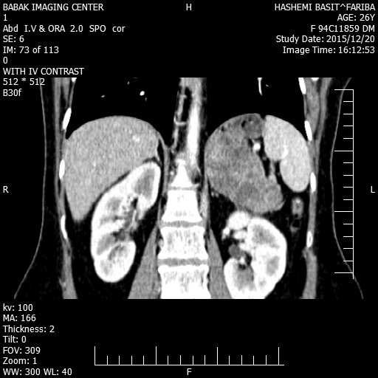

Slide 11
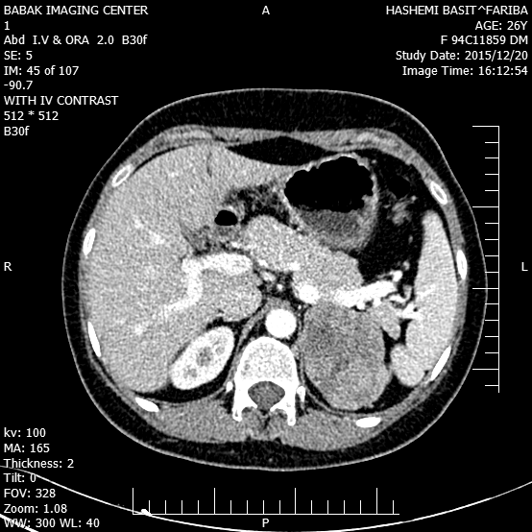

Slide 12
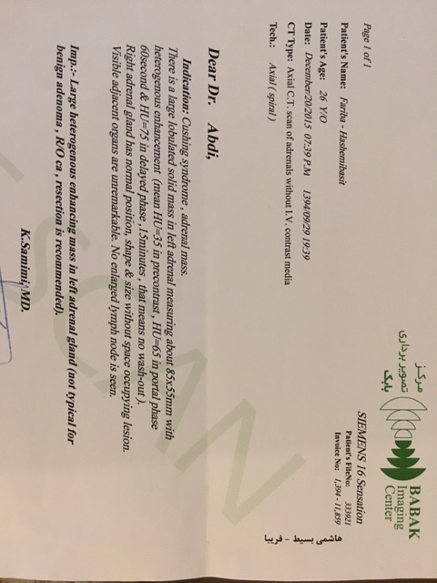

Slide 13
Problem list hypertrichosis hirsutism FGS: 20 , acne depended voice cessation of menstruation rounded face weight gain , central obecity supraclavicular & dorsocervical fat pad purple striae elevated cortisol & testosterone suppressed ACTH
85x55 mm mass in adrenal

Slide 14
What thypes of masses are found in the adrenal gland?

Slide 15
The adrenal gland has 2 parts.
The outer part, called the cortex, is where most tumors develop. The function of the cortex is to make certain hormones for the body. These hormones all have a similar chemical structure and are called steroids. They include Cortisol , Aldosterone , Adrenal androgens.
The inner part of the adrenal gland, called the medulla, is really an extension of the nervous system. Nervous system hormones such as norepinephrine and epinephrine are made in the medulla. Tumors and cancers that start in the adrenal medulla include pheochromocytomas (which are most often benign) and neuroblastomas.

Slide 16
Adrenocortical Mass
Benign or Malignant ?

Slide 17
Adrenal tumors are very common, affecting 3%to 10%of the human population.
They are categorized as either benign (adenoma) or malignant (carcinoma).
ADRENOCORTICAL ADENOMAS The majority of adrenocortical tumors are benign, nonfunctioning adenomas that are discered incidentally on abdominal imaging studies (adrenal incidentalomas).
Others are benign, hormone­secreting adenomas that cause:
Cushing's syndrome:Approximately 10 percent of cases of overt Cushing's syndrome are due to adrenaladenomas. primary aldosteronism: The classic presenting signs of primary aldosteronism are hypertensionand hypokalemia, but potassium levels are frequently normal in modern­day series of aldosteronomas.
Androgen and estrogen­secreting tumors: Androgen­secreting adrenal tumors are usually malignant, butbenign tumors have also been described in women. In a report of 21 women with androgen­secreting tumors,malignant tumors were larger at presentation than benign tumors
( 14 versus 9 cm, respectively).

Slide 18
Inaddition, serum testosterone levels were 2.6­fold higher in the women with malignant tumor. Benign cortisol­secreting adenomas can also produce small amounts of androgens, but the serum androgen levels are usually not elevated.
Estrogen­secreting tumors are rare and are usually malignant . In males it can present as feminization withgynecomastia, decreased libido, testicular atrophy; in women it can present with breast tenderness and dysfunctional uterine bleeding.
Imaging: Most adrenal adenomas are less than 4 cm in diameter.
Adenomas are generally small, homogeneous and well-defined lesions with clear margins.
The lipid­richnature(70%) of cortical adenomas is helpful in distinguishing this benign tumor from ACC.
As an example, CT attenuation of a benign adenoma as expressed in Hounsfield units (HU) is usually <10on an unenhanced scan which suggests that the likelihood that it is a benign adenoma is nearly 100 percent.

Slide 19
ADRENOCORTICAL CARCINOMA
Adrenocortical carcinomas (ACCs) are rare; the incidence is approximately one to two per million population per year .
Although ACC can develop at any age, there is a bimodal age distribution, with disease peaks before the age offive and in the fourth to fifth decade of life . In general, the level of aggressiveness and pace of diseaseprogression are more rapid in adults than in children.
Women develop ACCs more often than men (F:M 1.5 to 2.5:1).
Most patients(40–60%) present steroid hormone excess (glucocorticoids,
mineralocorticoids, androgens) or abdominal mass eﬀects (30%),
but 15–20% of patients with ACC are initially diagnosed
incidentally .

Slide 20
Adults with hormone­secreting ACCs usually present withCushing's syndrome alone (45 percent), or a mixed Cushing's and virilization syndrome, with overproduction of both glucocorticoids and androgens (25 percent) so the combination of hypercortisolism and androgen excess in an adrenal tumor raises the suspicion of ACC signiﬁcantly.
Fewer than 10 percent present with virilization alone, but the presence of virilization in a patient with an adrenal neoplasm suggests a ACC rather than an adenoma.
Aldosterone-producing ACC is also rare, probably comprising <2% of patients with ACC . The clinical symptoms associated with glucocorticoid excess, such as weight gain, weakness, and insomnia,usually develop very rapidly (over three to six months).

Slide 21
clinical signs of androgen excess in ACC usually develop rapidly (often<12 months).
Patients who have coexisting hypersecretion ofadrenal androgens may not experience the typical catabolic effects of glucocorticoid excess.
Imaging:Most ACCs are greater than 4 cm in diameter when discovered .
ACC is a inhomogeneous mass with heterogeneous enhancement, Central necrosis, Calcification ( 20-30%), irregular borders, invasion of surrounding structures or lymph node enlargement.
Pre­contrast HU >20 and <50 percent contrast washout at 10 minutes is more suspicious for malignancy.

Slide 22
In our patient the combination of hypercortisolism and androgen excess symptoms associated with glucocorticoid excess develop rapidly symptoms associated with androgen excess are sudden in onset and develop rapidly testosterone level three times the upper-normal range (> 2 ng/ml )
Size of tumor (8.5 Cm) heterogenous enhancing mass mean HU :35 in precontrast in early and delayed phase no wash out
Adrenocortical carcinoma

Slide 23
What labs or other study do you need?

Slide 24
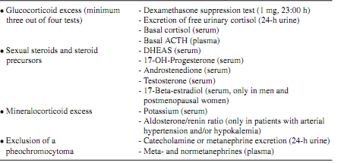
Recommendations of the ACC Working Group of the European Network for the Study of Adrenal Tumors (ENSAT)

Slide 25
Imaging
 | CT or MRI of abdomen and CT thorax Bone scintigraphy (when suspecting skeletal metastases) FDG-PET (optional)
Staging during follow-up
 | CT or MRI of abdomen and CT thorax every 2 - 3 months (depending on treatment)
Recommendations of the ACC Working Group of the European Network for the Study of Adrenal Tumors (ENSAT)

Slide 26
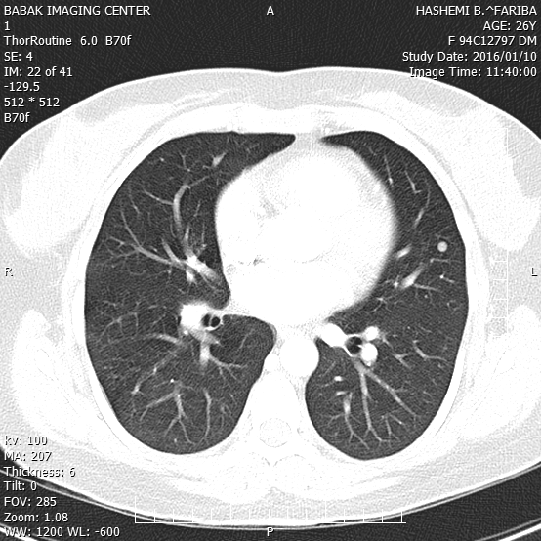
Our patient : lung CT Scan
Lung Nodule

Slide 27
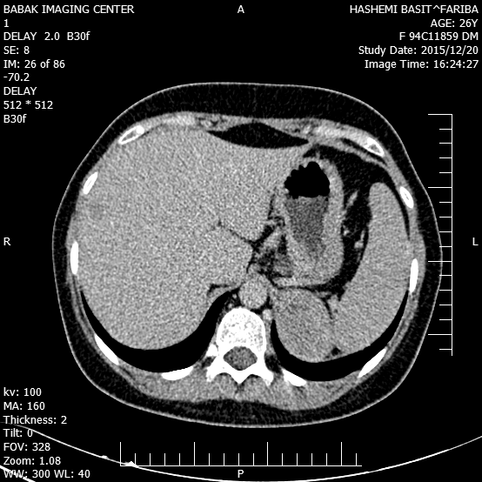
Our patient : Abdomen CT Scan
Low density liver nodule

Slide 28
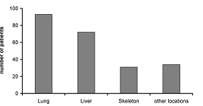
Localization of distant metastases in 160 patients with metastatic ACC. Data from the German ACC Registry (October 2009)

Slide 29
What is the staging system for adrenocortical carcinom?

Slide 30
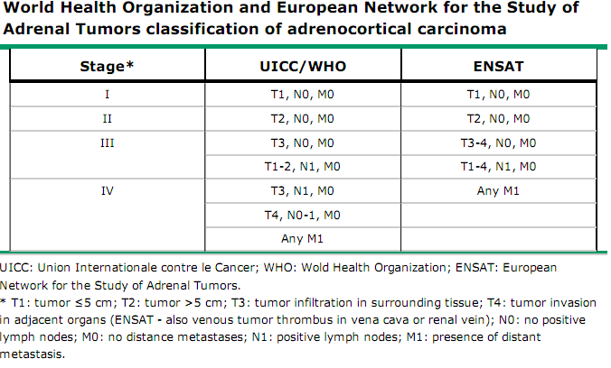

Slide 31
What is the stage of tumor in our patient ?
T2 , N0 , M1 (stage IV )

Slide 32
Prognosis?

Slide 33
Three major criteria are mandatory in order to deﬁne the disease free survival for the localized ACC (stage I, II, and some III) and the overall survival for stage IV ACC:
(1) staging
Five-year stage-dependent survival is 66–82% for stage I, 58–64% for stage II, 24–50% for stage III, and 0–17% for stage IV
(2) resection status “R” surgery is the single most important intervention and the complete resection (R0) correlates with a better prognosis.
Incomplete microscopic resection (R1), an incomplete macroscopic resection (R2) or unknown resection (Rx) are associated with the worst overall survival.
(3) Grading proliferation index, as Ki67% and mitotic count help to assess the ACC prognosis.

Slide 34
Treatment

Slide 35
Complete surgical resection is the only potentially curative treatment for adrenocortical carcinoma (ACC) .
Metastatic ACC
In metastatic disease, diﬀerent parameters had to be considered: the tumoral volume, the number of metastatic organs, the progression slopes. Debulking surgery is only of beneﬁt in patients with a tumoral mass respectable, a limited number of tumoral organs (≤2), with a slight progression and in case of severe hormone excess that cannot be controlled otherwise.
For patients withadvanced functioning tumors, debulking may help to control hormone hypersecretion and increase the efficacy of further therapies . Overall, however, patients with unresectable disease have a poor prognosis, particularly with high­grade disease, often surviving only three to nine months, and they are oftenbetter palliated with medical management.
In general, those with widespread distant metastatic disease in multiple organs or those with multiple metastatic deposits in one organ system unable to be completely resected should not undergo adrenalectomy.

Slide 36
What are the surgical option for adrenalectomy ?

Slide 37
Laparoscopic versus open resection
We suggest open rather than laparoscopic adrenalectomy for patients with ACC. Laparoscopic surgery has largely replaced the open technique for management of benign adrenal pathology, and laparoscopic removal of even large adrenal tumors can be performed safely by experienced surgeons.
However, the role of laparoscopic resection for ACCs is controversial, and open surgery remains the standard approach. Several retrospective studies have shown more frequent or earlier recurences and a shorter disease­free survival when this technique is used for management of ACC . This is not a universal finding,however, and others have shown comparable outcomes from laparoscopic and open adrenalectomy, particularly for tumors up to 10 cm in size in specialized centers. Nonetheless, this is not a widely accepted approach and we and others suggest open rather than laparoscopic resection for known or highly suspected ACC,regardless of size

Slide 38
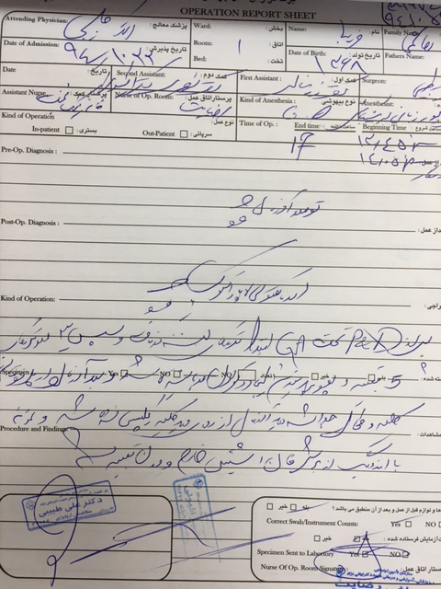

Slide 39
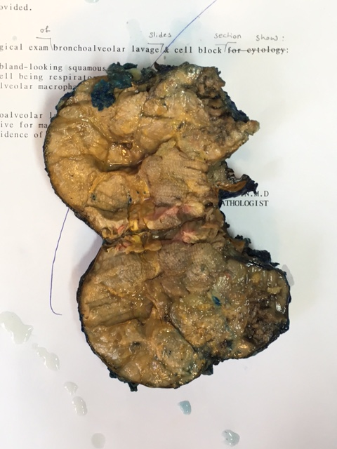
Adrenal mass
M : 9.5 x 8 x 4 cm weight :155 gr

Slide 40
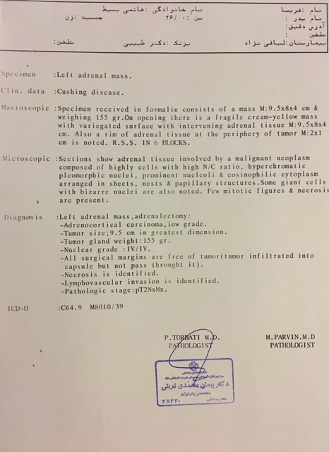

Slide 41
Medical therapy
Mitotane remains the only drug approved by the U.S food and drug Administration (FDA) and European Medicine Executive Agency (EMEA) for treatment of “metastatic ACC.
Recently, the First International Randomized trial in Locally Advanced and metastatic Adrenocortical Carcinoma treatment (FIRM-ACT) trial included 304 patients with metastatic ACC and compared the association of mitotane with etoposide- cisplatin-doxorubicine (M-EDP) with mitotane-streptozotocin(M-Sz) as a ﬁrst-line or second-line treatment.
For patients failing M-EDP, it has been proposed, as second line chemotherapy, the combination of gemcitabine and capecitabine.

Slide 42
Loco-regional Approaches
In case of metastatic ACC or ACC recurrence local treatment modalities, such as radiofrequency ablation (RFA) or transarterial chemoembolization (TACE) are recommended.
Radiotherapy
In order to reduce the risk of local recurrence, external radiation therapy of the tumor bed can be an option. In the literature, three retrospective studies with a little number of patients tempt to solve the questions: two of them showed a beneﬁt in preventing local recurrence, but none of them demonstrates an advantage in term of overall survival . Currently, an adjuvant therapy is recommended only in case of a particularly high risk for local recurrence .

Slide 43
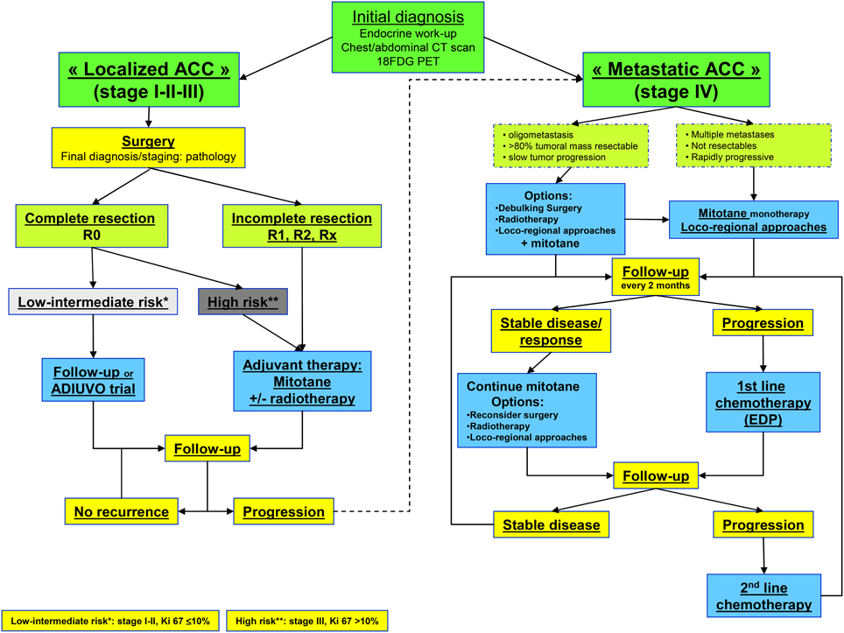

Slide 44
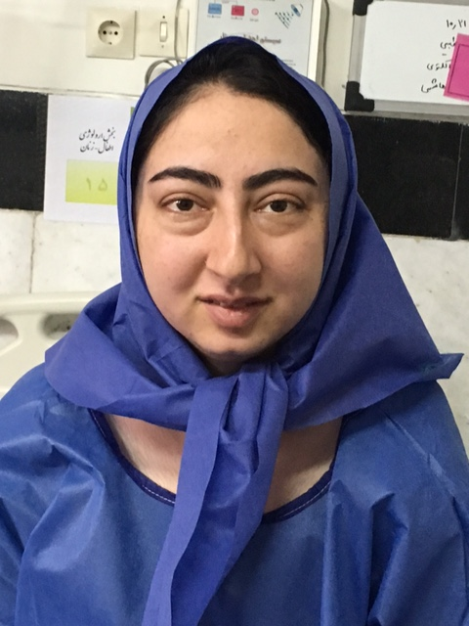
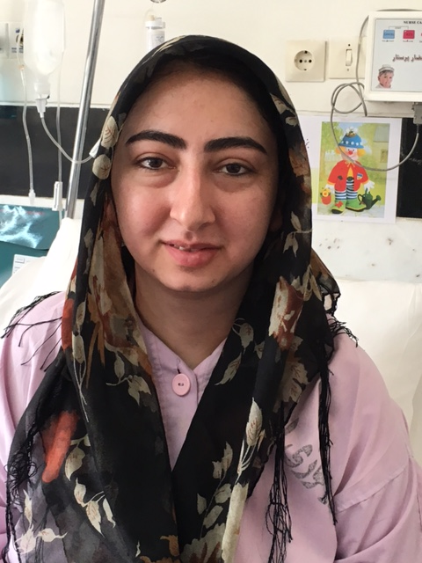
بيمار دو روز پس از جراحي
بيمار ساعاتي قبل از جراحي

Slide 45
Thank you

