Slide 1
IN THE NAME OF GOD
Maryam amirahmadi.MD
Research Institute for Endocrine Sciences
Shahid Beheshti University of Medical Science
11 DECEMBER 2023

Slide 2
Unusual causes of hyperthyrotropinemia and differential diagnosis of primary hypothyroidism: a revised diagnostic flow-chart.
Irene Campi1, Marco Dell’Acqua2, Elisa Stellaria Grassi2, Maria Cristina Vigone3, Luca Persani1,2
1 Department of Endocrine and Metabolic Diseases, IRCCS Istituto Auxologico Italiano, Milan, Italy.
2 Department of Medical Biotechnology and Translational Medicine, University of Milan, Milan, Italy
3 Department of Paediatrics, IRCCS San Raffaele Hospital, Milan, Italy

Slide 3
AGENDA:
. We describe infrequent conditions of TSH elevation in order to raise awareness of these alternative causes of hyperthyrotropinemia.
. We then propose a flow-chart for the differential diagnosis of PH to reduce the risk of misdiagnosis (Figure 1).

Slide 4
Primary hypothyroidism
. very common endocrine disease with up to 10-15% of the general population
cause of hyperthyrotropinemia:
. Iodine deficiency
. Hashimoto’s thyroiditis
. congenital hypothyroidism
. previous surgery/ablative treatments
. Neck radiotherapy
. hypothyroid phase of subacute or silent thyroiditis
. drugs affecting thyroid function ( iodine-rich drugs, cytokines, tyrosine kinases inhibitors, immune checkpoint inhibitors)

Slide 5
TSH
. The assessment of serum TSH levels is also deemed to be the most robust and accurate biomarker during the management of replacement therapy in patients with a previous diagnosis of primary hypothyroidism.

Slide 6
1. Assay interferences
. Analytical interferences in thyroid function tests (TFTs) can result in diagnostic delays, unnecessary testing and inappropriate treatments.
. A recent review of 150 patients with interferences in TFTs shows that in more than 50% of cases, the assay artefact had a harmful impact resulting in mismanagement or adverse events.
. In clinical practice, laboratory artefacts are rare (<1% of the samples) (Table 1).
. Nonetheless, considering a prevalence of hypothyroidism in the population between 2 and 17% (20 to 170 cases every 1000 assay) and a prevalence of analytical errors of 0.4% (4 cases every 1000 assays), the probability of falsely raised TSH canbe estimated as 2.3 to 16.7%, depending on the quoted prevalence of hypothyroidism.

Slide 7
.
The largest prospective study in the UK found a 0.4% incidence of antibodies interfering with TSH assay, meaning ~50.000 tests every year in the whole Country
The most common sources of interference in the TSH assays are endogenous antibodies
Interfering antibodies are of different isotype (IgG, IgM, or IgA) with a heterogeneous specificity and affinity to various molecular targets (Table 1)
Assay interferences

Slide 8
Assay interferences
1) Human anti-animal antibody (HAAA)
anti-mouse antibodies (HAMAs)
response to an animal antibody injected for diagnostic or therapeutic purposes or during
professional/ social exposure.
2) Rheumatoid factors (RF)
in patients with rheumatoid arthritis and in 5-10% of the general population.
(IgM and less frequently of the IgA and IgG isotype).

Slide 9
Assay interferences
3) Endogenous antibodies
. can bind to the primary or secondary antibodies, the conjugate, the enzyme,
the detection system or unidentified components of the kit.
. Some of these interfering antibodies react with mice, rabbit and goat immunoglobulins used in commercial immunoassay. Differently from
HAAA, these antibodies are produced without a past exposure to exogenous antigens and have a low and broad specificity reacting with two or more different species.

Slide 10
Assay interferences
4) Monoclonal paraproteins:
. monoclonal gammopathies
. Lymphomas
. Myeloma
. Transiently after infections

Slide 11
Assay interferences
5) Autoantibodies against the analyte
. called “macro-TSH” that is a large (>150
. complexed with anti-TSH autoantibodies
. bioinactive macromolecule that cannot be easily filtered by the kidney and accumulates in the serum
. 0.5-1.6% of increased TSH levels
. TSH fail to normalize during levothyroxine replacement
. mimic congenital hypothyroidism
. In a recent paper of Hattori et al, macro-TSH was found in 0.43% of neonates and all these babies were born from mothers with macro-TSH as well
. highly increased TSH and normal free thyroxine

Slide 12
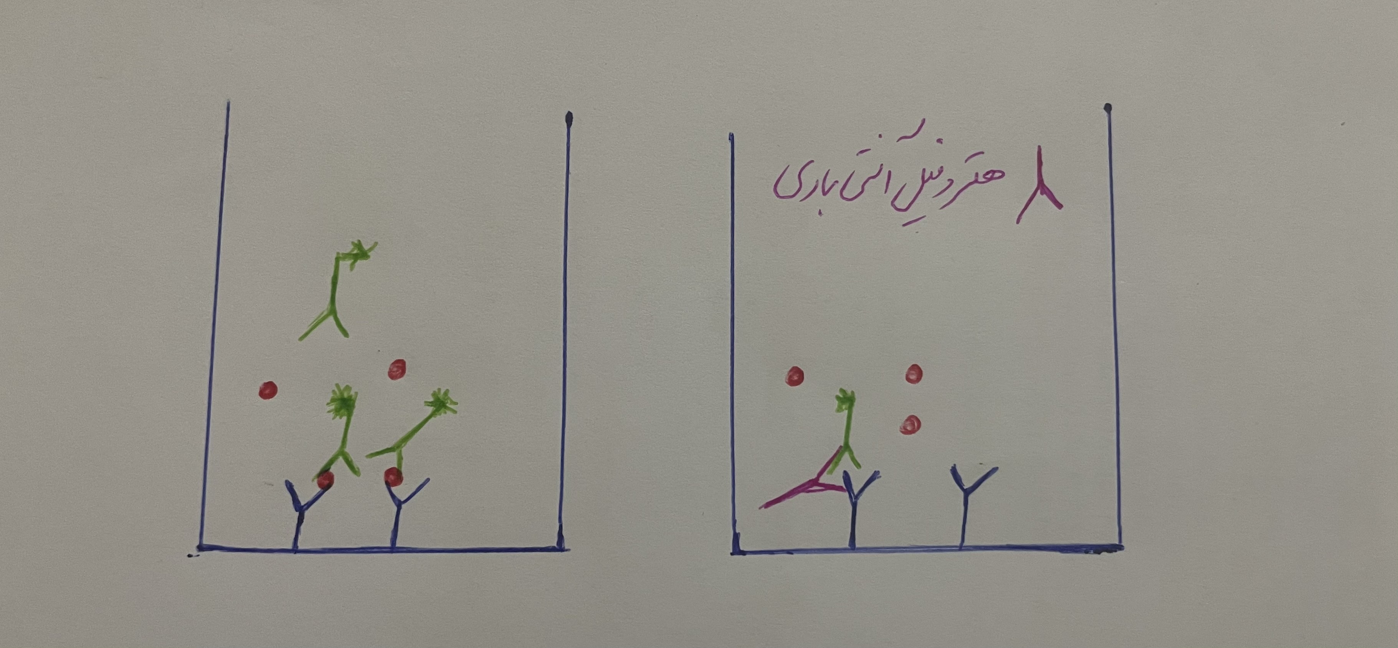

Slide 13
Assay interferences
1) alternative immunoassay
. first and easier step
2) Doubling dilution tests
3heterophile blocking tubes (HBTs)
. simple and useful test,
. although 20%-30% of false negative have been observed.
4) Precipitation with polyethylene glycol (PEG):
. serum samples are incubated at 1:1 ratio with a solution 12.5% of PEG 6000 to deplete Igs and the TSH is measured on the supernatant.
. used for all interferences involving antibodies (HAMA, macro-TSH and paraproteins)

Slide 14
Assay interferences
5) gel filtration chromatography or size exclusion chromatography (SEC)
. differentiate macro-TSH from HAMAs (26).

Slide 15
Table 1. Main causes of assay interferences and their possible effects on thyroid function test
Interference | TSH | fT4 | fT3 | Thyroid autoantibodiesª | Other | Prevalence
Heterophile antibodies | ↑ or ↓ | ↑ or ↓ | ↑ or ↓ | Potentially affected | Possible interference in many other immunoassays | 0.05–6%
Macro TSH | ↑ | – | – | – | – | 0.6–6%
Biotin^{b} | N or ↓ | ↑ | ↑ | TRAb ↑ TPO-Ab↑ Tg-Ab↑ | Competitive assay: ↑ Sandwich assay: ↓ | Unknown
Anti-streptavidin antibodies^{b} | N or ↓ | ↑ | ↑ | TRAb ↑ TPO-Ab↑ Tg-Ab↑ | Competitive assay: ↑ Sandwich assay: ↓ | Unknown, probably 1–2% (23)
Anti-ruthenium antibodies | ↑ or ↓ | ↑ or ↓ | ↑ or ↓ | Potentially affected | Interference with assays using ruthenium labels | Few cases described
Thyroid hormone autoantibodies | – | ↑ | ↑ | – | – | 1.8%
RF and paraproteins | ↑ or ↓ | ↑ | ↑ |  | Possible interference in many other immunoassays | 5–10%

Slide 16
2. Critical illnesses
  changes in TFTs
. hypothalamic/pituitary (impaired secretion of TSH)
. possible peripheral events (changes in the activity of peripheral deiodinase, decreased thyroid hormone binding by serum transport proteins, altered expression of T3 membrane transporters and increased levels of cortisol)
. TSH may be reduced during illnesses and mildly raised during the recovery phase, rarely above 10 mU/L .

Slide 17
Critical illnesses
. TFTs about four weeks after discharge from Hospital.
. reverse triiodothyronine (rT3) may direct the differential diagnosis between NTIs and primary hypothyroidism.
. Type 1 (D1) and type 3 deiodinases (D3) convert thyroxine (T4) to rT3 by inner ring deiodination.
. D1 is positively regulated by T3,
. D3 by T3 and Hypoxia-inducible factor 1α (HIF-1α).
. rT3 is increased in NTIs.

Slide 18
3. Acute amiodarone administration
.iodine-rich antiarrhythmic causing thyroid dysfunctions in nearly 30% of patients taking this drug.
. daily maintenance dose of 200 mg supply about 6 mg of free iodine per day (about 40-
fold higher than the recommended daily dose).
. euthyroid patients, during the initial phase of amiodarone treatment, a progressive and rise of fT4 and rT3 associated with increased TSH levels rarely greater than 20 mU/L, can be observed, while fT3 decreases due to a partial block of deiodinase activity.

Slide 19
4. Resistance to TSH
.a genetic disease
an impaired transmission of the TSH stimulatory signal into the thyroid cells.
. The clinical phenotype is highly variable ranging from a complete resistance, characterized
by congenital hypothyroidism with thyroid hypoplasia, to a partial resistance with variable
hyperthyrotropinemia but without the clinical features of hypothyroidism.

Slide 20
Resistance to TSH
. monoallelic or biallelic mutations in TSHR gene , type 1a and 1c pseudohypoparathyroidism caused by loss-of-function variants in the GNAS1 gene
. The main feature of pseudohypoparathyroidism is the unresponsiveness to parathyroid hormone, associated
with resistance to multiple other hormones (TSH, gonadotropins, calcitonin and growth hormone-releasing hormone).
. These patients have usually a mild TSH resistance, but may exhibit reduced thyroid hormones in the neonatal period.

Slide 21
Complete TSH resistance
. These patients are affected with a severe hypothyroidism associated with a thyroid hypoplasia, detected by newborn screening, and usually characterized by absent thyroid visualization at scintigraphy but detectable circulating thyroglobulin.
. This disorder is included in the differential diagnosis with other causes of thyroid dysgenesis, a condition occurring

Slide 22
Moderate TSH resistance
biallelic
heterozygous
high TSH levels, free thyroid hormones in the normal range
thyroid gland of normal or slightly reduced volume
mild resistance
heterozygous
biochemical features like primary subclinical hypothyroidism, with a slightly
increased TSH and normal free thyroid hormones
normal thyroid at neck ultrasound and are clinically euthyroid

Slide 23
Table 2
Classification of TSH resistance based on the degree of TSHR refractoriness to TSH stimulation.
Degree of resistance | Loss-of-function variants | Inheritance | TSH levels | Free T4 levels
Complete | Biallelic | Autosomal recessive | ↑↑↑ | Low
Moderate | Biallelic | Autosomal recessive | ↑↑ | Normal
Mild | Monoallelic | Autosomal dominant | ↑ | Normal

Slide 24
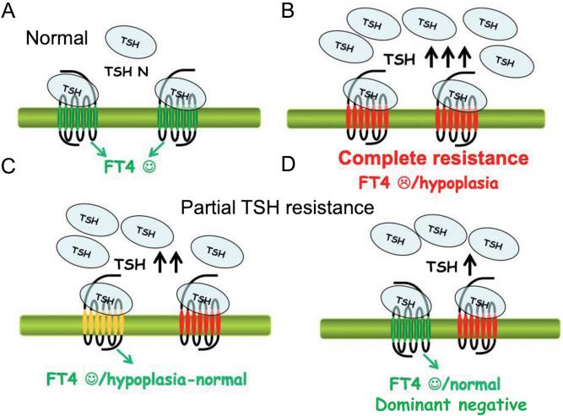
Figure 2 TSH resistance: different degree of sensitivity to TSH actions

Slide 25
5. Refractoriness to levothyroxine replacement therapy
.In a minority of hypothyroid patients, serum TSH levels remain persistently high, in spite of the administration of L-T4 exceeding the weight-based theoretical doses.
. Such patients need a comprehensive assessment for factors affecting L-T4 availability

Slide 26
5.1 Common causes of poor responsiveness to treatment
. poor compliance with therapy, or the intake of drugs/foods interfering with L-T4 absorption.
. at least one comorbidity potentially affecting L-T4 absorption and
. more than a half, were taking L-T4 with proton pump inhibitors, supplements containing calcium or iron or foods rich in fibres or soy
. the nephrotic syndrome as the kidney is involved in the metabolism and elimination of thyroid
hormones.
. Proteinuria is associated with urinary loss of albumin, thyroxine binding globulin and transthyretin with an increased requirement for L-T4

Slide 27
Common causes of poor responsiveness to treatment
. gastric and intestinal diseases
. The absorption of LT4 in the jejunum and ileum,
. patients with gastric diseases, liquid formulations of L-T4
. The work-up for the syndromes of malabsorption include a blood count, general biochemistry, C-reactive
protein and the assessment of vitamin B12 and D, folate, and iron status. prothrombin time can be
prolonged due to vitamin K insufficiency; hypoproteinemia, hypoalbuminemia and low serum levels of
triglycerides and cholesterol are suggestive of protein and fat malabsorption, respectively; in severe cases
electrolyte imbalances can be found, such as hypokalemia, hypocalcemia, hypomagnesemia, and metabolic
acidosis.

Slide 28
5.2 Pseudo-malabsorption
. Rarely, when all the investigations for malabsorption are negative and the defects seems selective for L-T4,
factitious disorders or pseudo-malabsorption should be considered.
In this case the L-T4 absorption test is required to direct the differential diagnosis.
. There is not a standardized protocol for this test
. In our Institution, we usually administer 1 mg of levothyroxine and we measure TSH and fT4 every 60 minutes
up to 6 hours, to assess the maximal T4 absorption and two and seven days later.
. Subsequent weight- based doses are then given once or twice a week, up to normalization of TFTs to demonstrate not-adherence with treatment.

Slide 29
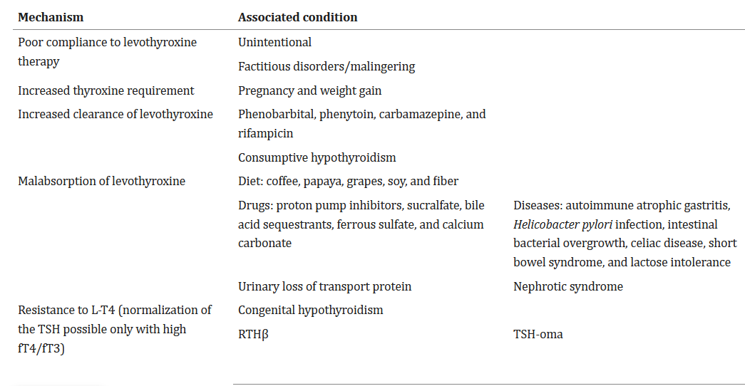
Table 3. Possible causes of refractory hypothyroidism

Slide 30
5.3 Resistance to exogenous thyroxine (RETH)
. In this study of eighteen subjects, the normalization of TSH levels occurred only with supraphysiological levels of fT4 (>20 pmol/L) associated with symptoms of thyrotoxicosis (such as nervousness, tachycardia, diarrhea,or insomnia) .
. resistance to thyroid hormone beta (RTHβ)
. negative THRB gene, decreased T3/T4 ratio, D2 functional deficiency.

Slide 31
Resistance to exogenous thyroxine
. mild hyperthyrotropinemia may be acceptable to avoid iatrogenic thyrotoxicosis.
. propose combined replacement therapy with T4 + T3.
. Some of the patients reported by Lacámara were affected with congenital hypothyroidism (CH) and indeed earlier studies found that in 10-40% of neonates and children with CH the TSH fails to normalize despite an adequate LT4 treatment .
. In addition, a still unexplained degree of resistance to levothyroxine (LT4) persists also later in life, as adult CH patients maintain euthyroidism with higher L-T4 doses compared to postsurgical acquired hypothyroidism

Slide 32
5.4 Central hyperthyroidism
. Both patients affected with RTH-β and TSH-secreting pituitary adenomas on L-T4 may not normalize the TSH, in spite of high fT4 levels.
. The diagnosis (clinical and biochemical features, MRI of hypothalamus-pituitary region and dynamic tests, such as TRH test, T3 suppression test and long acting somatostatin analogue (SSA-LAR) test)
. These latter two tests, have the highest sensitivity and specificity, in case of associated primary hypothyroidism, with TSHoma not responding to T3 and responding SSA-LAR, while an opposite response is found in RTH-β .
. familial dysalbuminemic hyperthyroxinemia (FDH) due to variants with higher affinity for T4 and associated hypothyroidism often display spuriously high fT4 levels in spite of clinical and biochemical euthyroidism .

Slide 33
5.5 Consumptive hypothyroidism
. Paraneoplastic syndrome caused by tumors overexpressing D3,
. D3 catalyzes the deiodination of the inner ring of thyroxine (T4) to rT3 and triiodothyronine (T3) to 3,3'-diiodothyronine (T2), both of which are biologically Inactive.
. overt hypothyroidism with increased requirement for L-T4 in order to restore normal TSH.
. Large and giant hepatic hemangiomas/endotheliomas
. cutaneous and parotid hemangiomas
. fibrosarcoma
. non-vascular tumors such as gastrointestinal stromal tumor (GIST)
. malignant fibrous tumors

Slide 34
Consumptive hypothyroidism
. control of tumor growth,
. Patients with consumptive hypothyroidism require very high doses of L-T4 and/or liothyronine to normalize serum thyroid hormone levels .
. Propranolol: reduce mass proliferation
systemic corticosteroids,
antiangiogenic drugs, such as
interferon alpha, cyclophosphamide, vincristine, or actinomycin D, radiotherapy, selective embolization, and surgery.

Slide 35
CONCLUSIONS AND FUTURE PERSPECTIVES
Primary Hypothyroidism is a frequent disease worldwide and clinical consequences of untreated patients include cardiovascular morbidity, increased mortality and poor quality of life .
An accurate anamnesis, an in-depth clinical assessment of the patients, exclusion of assay interferences, genetic tests or LT4 absorption tests may become useful to avoid misdiagnosis and treatment errors

Slide 36
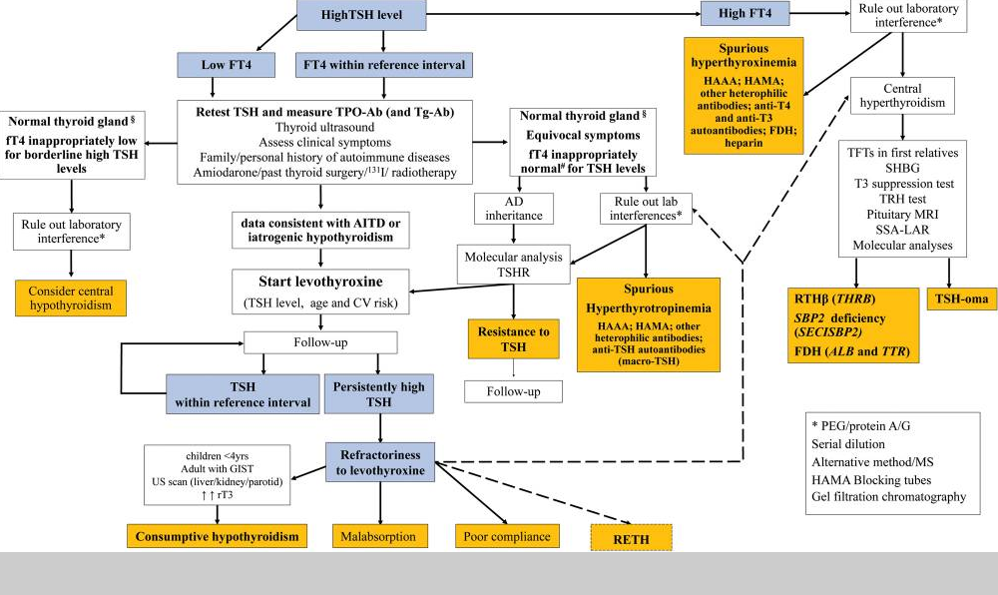
Figure 1 Revised diagnostic flow-chart of high TSH levels

Slide 37
Thanks for your attention

