Slide 1
In the Name of
God

Slide 2
Management of Dyslipidemia
Navid Saadat, MD Associate Professor of Endocrinology Shahid Beheshti University of Medical Sciences

Slide 3
Rationale for Treatment
Benefit of LDL-C reduction in CVD events
Reduction of TG and increases in HDL-C may also be beneficial
Treatment of severe hypertriglyceridemia is indicated to reduce the risk of pancreatitis
Optimal management of risk factors reduces the risk of CVD
INTERHEART study (5 continents, 52 countries, 262 centers)
Optimization of 9 risk factors (90% reduction in the risk of AMI)
Cigarette smoking
Dyslipidemia
Hypertension
Diabetes mellitus
Abdominal obesity
Lack of physical activity
Low daily fruit and vegetable consumption
Alcohol overconsumption
Psychosocial index

Slide 4
Evidence for Beneﬁts
Significant effects of pharmacological (primarily statin) therapy on CVD outcomes
Primary prevention
Secondary prevention
1 mmol/L (∼40 mg/dl) reduction in LDL-C
10% reduction in all-cause mortality
20% reduction in CVD mortality
No evidence of any threshold within the cholesterol range
No ”J point” or dangerous lower threshold for LDL levels
LDL-C at which CVD event rate approaches zero is ∼60 mg/dl in primary prevention studies and ∼30 mg/dl in secondary prevention studies
Statin therapy is associated with a slightly increased risk of diabetes
Elderly
Intensive therapy
Rosuvastatin
CVD event rate reduction with statins outweighed the risk of incident diabetes even for patients at highest risk for diabetes
Clinical decision-making should not be changed for patients in whom statin therapy is recommended

Slide 5
Interventions
Medical Nutrition Therapy (MNT)
Increased physical activity
Weight loss (5-10%)
↓LDL-C=15%
↓TG=20%
↑HDL-C=10%
Smoking cessation
↑HDL-C
Reduction of
Saturated fat < 7%
Cholesterol <200-300 mg/d
Trans fats < 1%
Increment in
Omega-3 fatty acids
Soluble fibers
Phytosterols
Soy protein
Glycemic control
↓TG

Slide 6
Pharmacotherapeutic Options
Agents targeting endogenous cholesterol
Statins
Fibrates
Nicotinic acid
Agents targeting exogenous cholesterol
Cholesterol absorption inhibitor
Bile acid-binding agents
Emerging therapeutic candidates
CETP Inhibitors
Apo B-100 antisense oligonucleotide
Apo A1 mimetic
PCSK9 inhibitors
MTP inhibitor
Squalene synthase Inhibitor

Slide 7
Lipid-lowering Drugs
Statins
Lovastatin
Fluvastatin
Pravastatin
Simvastatin
Atorvastatin
Rosuvastatin
Pitavastatin
Fibrates
Gemfibrozil
Fenofibrate
Bezafibrate
Bile acid-binding agents
Cholestyramine
Colestipol
Colesevelam
Cholesterol absorption inhibitor
Ezetimibe
Nicotinic acid
Omega-3 oils

Slide 8
Diets and Dietary Supplements
Mediterranean diet
Improvement of dyslipidemia and CVD events
DASH diet
Improvement of dyslipidemia and CVD events
Garlic
No significant effect on LDL-C
Olive oil
Virgin (high in polyphenols)
Refined (low in polyphenols)
Virgin olive oil : ↓HDL-C and ↓LDL-C
Nuts
Walnut, almond and pistachio
Improvement of dyslipidemia and CVD events
Green Tea
Improvement of all-cause and CVD mortality

Slide 9
Dietary Supplements
Phytosterols
Sitosterol
Campesterol
Stigmasterol
Occur naturally in vegetable oils
2 g/d
↓TC and LDL-C = 7–10%
Little or no effect on HDL-C and TG
Possible decrease in carotenoid and fat-soluble vitamins
No data in CVD prevention
Soy protein
↓LDL-C = 3–5%

Slide 10
Dietary Fibers
Non-starch polysaccharides that are resistant to digestion
Classification
Soluble
Barley
Oat
Psyllium
Soybean
Apple
Rip banana
Broccoli
Almond
Insoluble
Wheat
Legumes
Cauliflower
Unripe bananas
3 g/d = 5 mg/dl ↓TC and ↓LDL-C

Slide 11
Statins
First-line therapy in dyslipidemias
Efficacy (dose dependent)
↓LDL-C : 30-60% (atorvastatin, rosuvastatin)
↑HDL-C : 5-10% (rosuvastatin, simvastatin)
↓TG : 10-30 (atorvastatin, rosuvastatin, simvastatin)
Doubling the dose of any statin will achieve a further 6% LDL-C lowering
Benefit to statin therapy is observed in all subjects at risk for CVD
Low cholesterol is associated with increased mortality in patients ≥ 80 years

Slide 12
Statins
No adverse outcomes have been reported in subjects with chronic transaminase elevations due to
Hepatitis B or C
NAFLD
Liver failure directly attributable to statins is rare or nonexistent
Fewer drug interactions with pravastatin, fluvastatin, rosuvastatin, and pitavastatin
Chronic liver disease
Pravastatin (low dose)
Chronic kidney disease
Atorvastatin and fluvastatin
Majority of cholesterol synthesis occurs at night
Administration at bedtime (simvastatin)

Slide 13
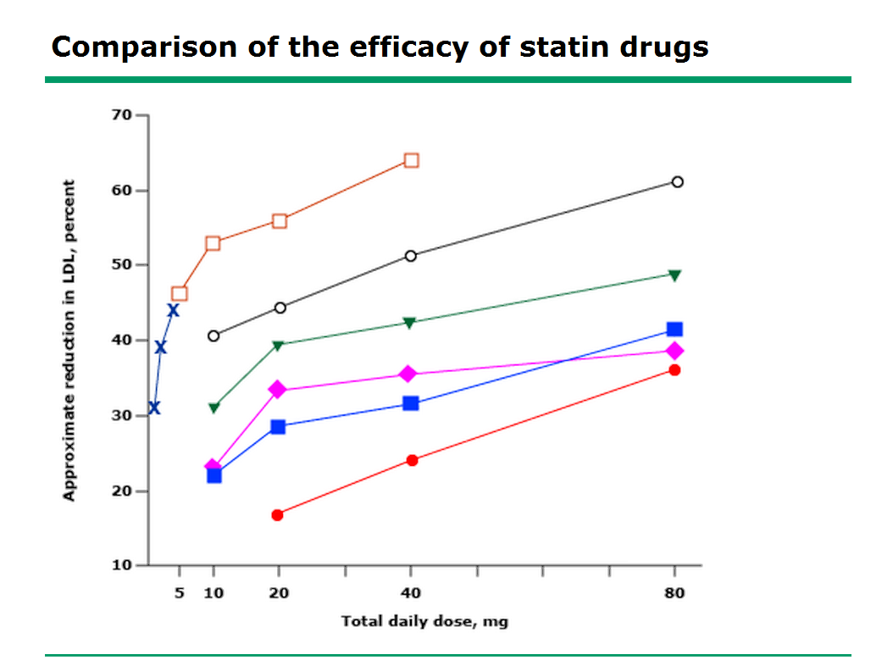
Rosuvastatin
Atorvastatin
Pitavastatin
Simvastatin
Lovastatin
Pravastatin
Fluvastatin

Slide 14
Cholesterol Absorption Inhibitor
Ezetimibe
Binds to Niemann-Pick C1like (NPC1L1) transporter of the small intestine and liver
Blocking the absorption of dietary and biliary cholesterol and phytosterols
Without affecting fat-soluble vitamins absorption
Ezetimibe can be used as second-line therapy
Monotherapy = ↓LDL-C ∼15-20%
Combination therapy + statins = adds an ↓LDL-C∼15-20%
Combination therapy + fenofibrate in mixed dyslipidemia
Gemfibrozil and fenofibrate can increase ezetimibe levels
Recommended dose =10 mg/d
No dosage adjustment in hepatic and renal impairment
Side effects
Diarrhea
Myalgia
Ezetimibe monotherapy does not cause significant increases in hepatic aminotransferases
No convincing evidence that it improves clinical outcomes

Slide 15
Ezetimibe Efficacy Dose–Response Study
Mean % change in LDL-C
Placebo
0.25 mg
1 mg
5 mg
10 mg
-9.9%
-12.6%
-16.4%
-18.7%

Slide 16
Bile Acid Binding Agents
Cholestyramine, Colestipol and Colesevelam
Bind to bile acids in the intestine
Blocking reabsorption
Reducing the enterohepatic recirculation
Increasing LDL-R expression
Liver increases its synthesis of cholesterol
Partially attenuates their efficacy
Increase hepatic VLDL production and TG levels can be elevated
High incidence of GI side effects (Colesevelam is exception)
Decreased absorption of drugs / fat soluble vitamins (Colesevelam is exception)
Colesevelam
↓LDL-C ∼20%
↑HDL-C ∼3%
↑TG ∼5-10%
Alternative in statin-intolerant patients
Adjunct therapy in patients not meeting LDL-C goals on statin monotherapy
↓LDL-C ∼10-20%
Limited evidence for improvements in clinical outcomes

Slide 17
Nicotinic Acid (Niacin)
Acts on G Protein-coupled Receptor ”GPR109A&B” on adipocytes
Inhibits the hepatocyte microsomal diacylglycerol acyltransferase-2 (DGAT2)
Key enzyme that catalyzes the transformation of diacylglycerol to TG
The most potent agent for raising HDL
Stimulating Apo A1 production in the liver
Anti-inflammatory properties
↓ CRP
↑ Adiponectin
↓ Lipoprotein-associated phospholipase A2
↓ Pro-atherogenic chemokines
At doses 1500–3000 mg/d
↓LDL-C =15–25%
↓TG = 20–50%
↑HDL-C = 20–35%
↓Lp(a) = 30%
The most common side effect of niacin is flushing
Stimulates PGD2 receptor 1 in the skin
Laropiprant selective PGD2 receptor 1 antagonist

Slide 18
Nicotinic Acid (Niacin)
Unlike statins, nicotinic acid hepatotoxicity can progress to fulminant hepatitis
Relationship between nicotinic acid and hepatotoxicity is not clearly dose-related and regular monitoring of transaminase levels is recommended
Nicotinic acid does not cause myopathy or rhabdomyolysis, nor does increase the risk for these problems when used in combination with a statin
Safety profile of niacin + statin combination therapy comparable to that of either drug alone
Nicotinic acid has been used safely in combinations with bile acid-binding agents or fibrates
Contraindicated in patients with active peptic ulcer disease
5% increase in FBS and 0.3% in HbA1c
10% increase in uric acid
No clear direct evidence that raising HDL-C really results in CVD prevention

Slide 19
Fibrates
Activator of PPAR-α
Induction of LPL
Repression of ApoC-III
Clofibrate (associated with cholangiocarcinoma and GI malignancies)
Gemfibrozil
Fenofibrate
Bezafibrate
↓TG = 35–50% and ↑HDL-C = 5–20%
Reduction of diabetic retinopathy, progression of microalbuminuria and risk of limb amputations
Bezafibrate reduced the severity of intermittent claudication
Bezafibrate decreases blood glucose level, HbA1C, insulin resistance and reduces the incidence of T2DM (↑adiponectin)
Interaction with statins
Gemfibrozil (statin levels 2-6X)
Fenofibrate (no effect)
Fluvastatin and pravastatin may be preferable

Slide 20
Fibrates
Adverse effects
GI upsets
Myopathy (CKD)
↑Liver enzymes
Cholelithiasis
↑Homocysteine
Fenofibrate and bezafibrate (not gemfibrozil)
Monotherapy with fibrates confer 5X increased risk of myopathy vs. statin monotherapy
More common with gemfibrozil than with fenofibrate
Unlike statins, which have demonstrated clinical efficacy across a broad range of LDL-C, fibrates have primarily shown reductions in CVD events in subsets of patients with high TG ( >200 mg/dl ) or low HDL-C ( <40 mg/dl ) or high LDL/HDL cholesterol ratio ( >5.0 )
All fibrates raise creatinine in a reversible manner (especially fenofibrate)
FIELD study =12%
No change in GFR
Increased creatinine production from muscle
Role of fibrates in prevention of CVD remains controversial
No effect on all-cause mortality or CVD mortality
There are no data to address whether the addition of fibrates to statins will confer further benefit

Slide 21
Omega-3 Fatty Acids
Plant origin
C18 : 3 α-Linolenic acid (ALA) = Canola, Flaxseed
Marine origin
C20 : 5 Eicosapentaenoic acid (EPA) = Salmon, Shrimp, Sardine, Tuna
C22 : 6 Docosahexaenoic acid (DHA) = Salmon, Shrimp, Sardine, Tuna
↓VLDL production , ↓TG ∼30-50% , ↑HDL-C ∼5%
∼2-4 g/d of EPA + DHA are necessary to reduce TG by 20–50%
Lowered blood pressure, reduced arrhythmia, coagulability and improved endothelial function
Significant reduction in total mortality, sudden death and CVD deaths (20%) with low dose (1g/day)
Efficacy appears to be related to non-lipid effects
Addition statin was found to cause a further ∼20% reduction in CVD events
In patients with severely elevated TG levels at high risk of pancreatitis the addition of a short course (2–4 weeks) of omega-3 can be helpful in rapidly lowering TG levels

Slide 22
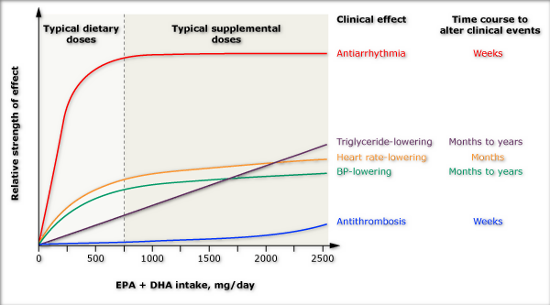
Dose responses and time courses for altering clinical events of physiologic effects of omega-3

Slide 23
Hypertriglyceridemia
Hypertriglyceridemia should be addressed with dietary and lifestyle changes
Severe hypertriglyceridemia ( >1,000 mg/dl) may warrant immediate pharmacological therapy to reduce the risk of acute pancreatitis
Reduction of dietary fat
Reduction of simple carbohydrate intake (fructose)
Increased intake of protein
Drug treatment
Fibrate as a first-line agent
Moderate to severe TG levels
Fibrates
Niacin
Omega-3 fatty acids
Pioglitazone
Orlistat ( postprandial hypertriglyceridemia )

Slide 24
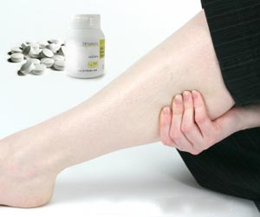
Statin-associated Myopathy

Slide 25
Statin-associated Myopathy
Definition / Clinical spectrum
Myalgia (2-11%)
muscle ache or weakness without increased serum CPK levels
Myositis (0.5%)
muscle symptoms with elevated CPK levels
Rhabdomyolysis (0.1%)
muscle symptoms with marked CPK elevations (>10 times) plus an elevated serum creatinine
Asymptomatically increased CPK
Myopathy risk is not directly proportional to cholesterol-lowering efficacy
Mostly dose related
Incidence
Highest for atorvastatin, simvastatin and rosuvastatin
Lowest for fluvastatin
Clinical features
Fatigue, pain, tenderness, weakness, nocturnal cramping, and brown urine
Symptoms tend to be proximal, generalized, and worse with exercise

Slide 26
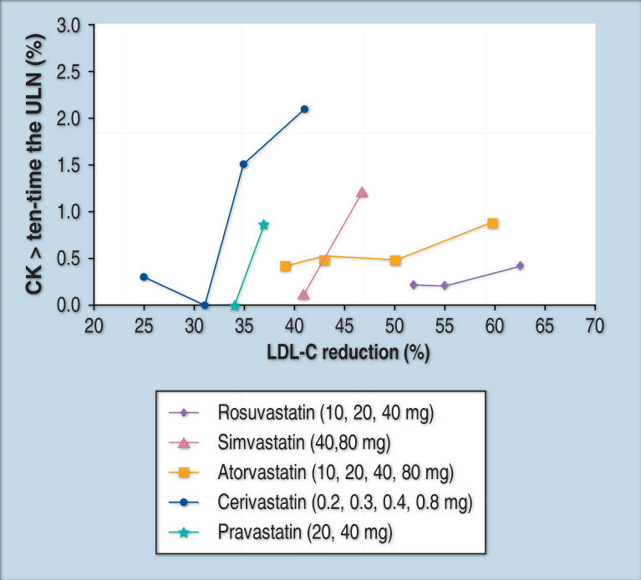
Cerivastatin
Simvastatin
Pravastatin
Atorvastatin
Rosuvastatin
Incidence of myopathy and relationship to statin
dosing and percentage LDL-C reduction

Slide 27
Statin-associated Myopathy
The time to onset of myopathy can be quite variable
Mean duration before onset of symptoms ∼ 6 months
Range : 1 week to 4 years
Mean duration after stopping therapy ∼ 2 months
Range : 1 week to 4 months
Risk of aminotransferase elevation with statin
∼4 cases per 1000 patients
Routine monitoring of LFT is not necessary
It is useful to obtain a baseline LFT
Routine monitoring of CPK is not recommended
It is useful to obtain a baseline CPK
Checking a TSH level prior to statin therapy

Slide 28
Is Measuring Baseline CPK Necessary Before Starting Statin Therapy?
CPK is not very sensitive as a marker of muscle injury
Normal CPK concentration does not necessarily rule out ongoing muscle damage
Slightly raised concentrations of CPK are common in the general population
Idiopathic hyperCPKemia
Absence of clinical or histological evidence of neuromuscular disease
Found in all ethnic groups
More common in men than in women
Elevated CPK levels can be associated with strenuous muscle exercise
Physical activity, especially when unaccustomed, and concurrent medical conditions, such as hypothyroidism, may also increase CPK
Measure baseline CPK only in high risk groups

Slide 29
Mechanism of Statin Myopathy
Induction of Atrogin-1
Activation of Ubiquitin Proteasome Pathway (UPP) system
Degradation of skeletal muscle proteins
Reduced intramuscular Coenzyme Q10 (Ubiquinone)
Mitochondrial respiratory dysfunction
Impaired energy production
Isoprenoid Depletion
Reduction in isoprenylated, farnesylation and geranylgeranylation GTP-binding proteins Rho, Ras, and Rac
Induction of apoptosis
Increase the uptake of plant sterols and increased muscle sitosterol levels
Inhibition of
Cellular growth
DNA synthesis
Induction of apoptosis

Slide 30
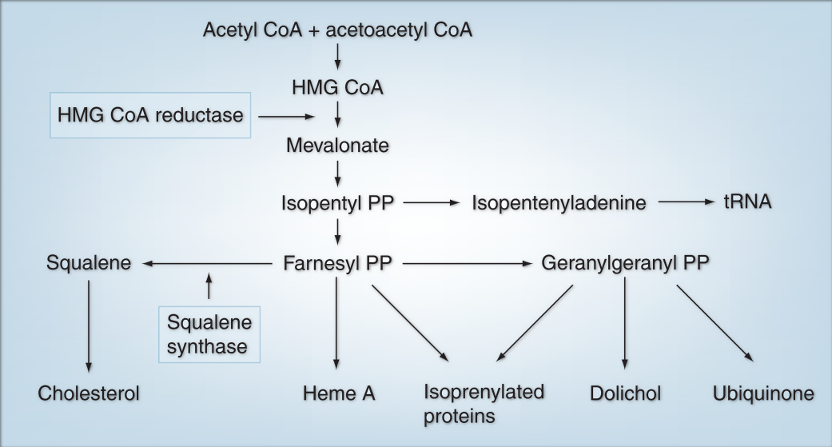
Pathways of Mevalonate Metabolism

Slide 31
Risk Factors
Dose
Advanced age (>80 years old)
Female sex
Electrolyte disturbances
Low BMI
Hypothyroidism
Diabetes mellitus
Diminished hepatic and renal function
Drug interactions ( inhibitors or substrates of the cytochrome P450 )
Fibrates (particularly gemfibrozil)
Fenofibrate preferred to combine with statin
Nicotinic acid
Calcium channel blockers (diltiazem/verapamil)
Amiodarone
Thiazolidinediones
Warfarin
Heavy exercise
Excess alcohol
Drug abuse (cocaine, amphetamines, heroin)
Intercurrent infections
Major surgery or trauma
Diet (grapefruit and pomegranate juice)

Slide 32
Is the Risk of Myopathy Equal for All Statins?
Lipophilic compounds are more likely to penetrate into muscle tissue
Enhancing the potential for myotoxic effects
Lipophilic
Lovastatin
Simvastatin (most lipophilic)
Atorvastatin
Fluvastatin (exception)
Hydrophilic
Pravastatin
Rosuvastatin

Slide 33
When is Muscle Biopsy Necessary?
Muscle biopsy is not routinely needed
Indications
Atypical cases
Persistent muscular problems
Persistent ↑CPK after statins have been withdrawn
Muscle pathology is non-specific
Pathologic changes occur even in patients who do not have symptoms

Slide 34
Management
If intolerable muscle symptoms develop
Discontinue statin regardless of CPK levels
Rechallenge only after patient becomes asymptomatic
If muscle symptoms are tolerable and CPK <10X
Statin may be continued and muscle symptoms can be used as guide to stop continue treatment
If muscle symptoms are tolerable and CPK >10X
Discontinue statin therapy and weigh risk and benefits
If CPK elevation is associated with elevated creatinine
Discontinue therapy

Slide 35
Management
Increasing dosing interval (70% success rate)
Every other day
Twice weekly
Once weekly
Use of an agent with a longer half-life
Atorvastatin
Rosuvastatin
Use of an alternative statin
Fluvastatin
May not produce the desired effects on HDL-C
Ezetimibe
Coenzyme Q10 supplementation
Vitamin D supplementation
Red yeast rice (RYR) therapy

Slide 36
Coenzyme Q10 Supplementation
Coenzyme Q10 (“Co-Q10") is created through mevalonate and is thought to be decreased during statin therapy
Coenzyme Q10 supplementation may be effective in reducing myalgia
50% mean reduction in pain scores
Coenzyme Q10 was well tolerated
Additional costs

Slide 37
Pathways of Mevalonate Metabolism

Slide 38
Vitamin D Supplementation
Low 25OHD (≤ 20ng/ml) are associated with myalgia
Vitamin D deficiency may contribute to statin-induced myalgia
Vitamin D supplementation may lower serum concentrations of atorvastatin while acting synergistically with the drug to decrease TC and LDL-C
Vitamin D supplementation if
25OHD levels are low
Myalgia symptoms are minor
CPK is not elevated
50,000 IU of cholecalciferol weekly for 8-12 weeks

Slide 39
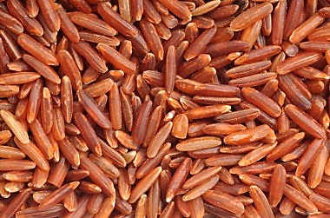
Red Yeast Rice (RYR)
RYR contains several bioactive compounds, including “Monacolin K” (lovastatin)
Problems with recommending RYR as a statin substitute
Lack of standardization
Concentrations of “Monacolin K” vary significantly
May have harmful levels of nephrotoxins (Citrinin)
RYR should be used only as a last resort when statins can absolutely not be tolerated

Slide 40
Drug Resistant Hypercholesterolemia
Definition
LDL-C >250 mg/dl without CVD
LDL-C >200 mg/dl with CVD
Management
LDL apheresis
Partial ileal bypass surgery
Liver transplantation
Familial hypercholesterolemia (homozygous)
Portocaval shunt

Slide 41
LDL Apheresis
Potential candidates
CAD + LDL-C >200 mg/dl after standard therapy
Without CAD + LDL-C >300 mg/dl after standard therapy
1st degree relative with premature CAD + ↓HDL-C /↑Lp(a)
Familial hypercholesterolemia (homozygous)
LDL-C decrement
Acute = 50-76%
Chronic = 30-40%
No study has demonstrated significantly improved survival with LDL apheresis

Slide 42
New and Emerging Therapeutic Candidates
Cholesteryl Ester Transfer Protein (CETP) Inhibitors
Anacetrapib
Evacetrapib
Apo B-100 antisense oligonucleotide
Mipomersen
Apo A1 mimetic
4F
5A
Proprotein Convertase Subtilisin/Kexin type 9 (PCSK9) inhibitors
Annexin A2 (endogenous inhibitor)
Secreted by liver and binds to LDR-R
Preventing LDL-R from recycling to the cell surface and promotes degradation
Controlled by Sterol REgulatory Binding Proteins (SREBPs)
Reduction of LDL-C and Lp(a)
Statins, fenofibrate and ezetimibe upregulate PCSK9 through SREBP, restricting the dose related effectiveness of drugs
Microsomal Triglyceride Transfer Protein (MTP) inhibitor
Lomitapide
Squalene synthase Inhibitor
Lapaquistat

Slide 43
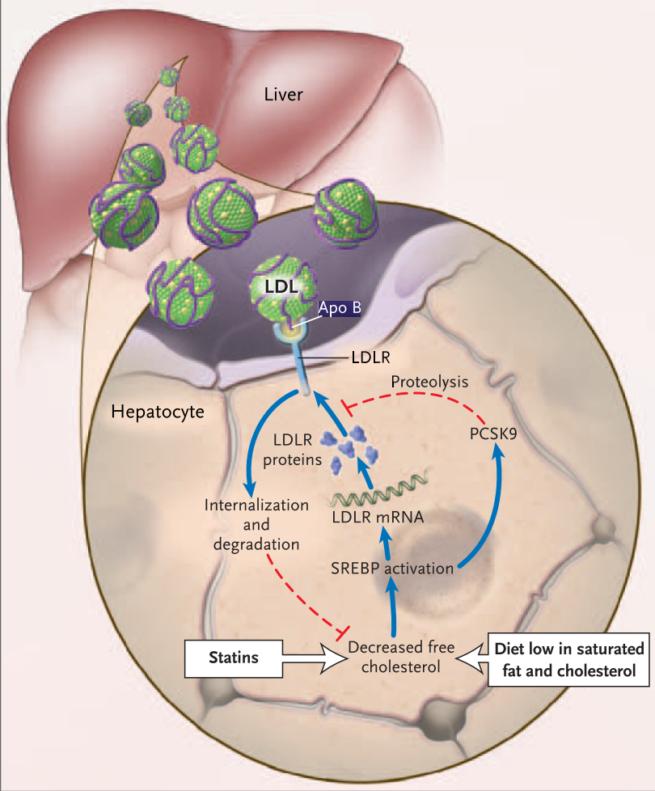
Role of PCSK9 in LDL-R Degradation

Slide 44
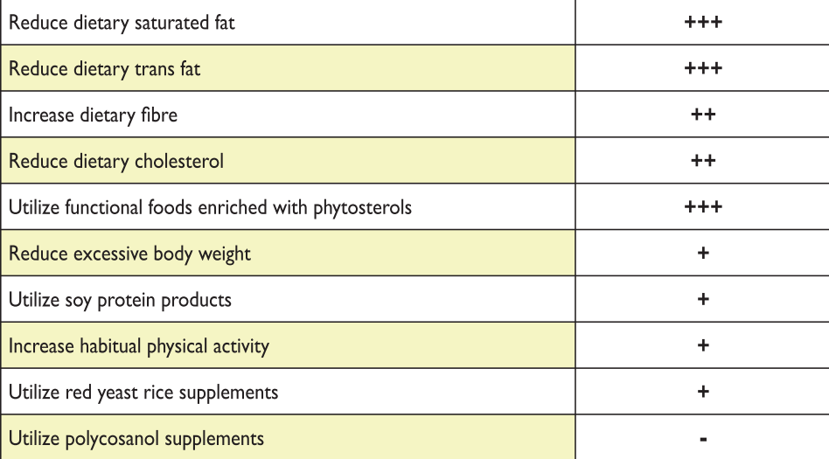
Lifestyle Interventions (TC/LDL-C Reduction)

Slide 45
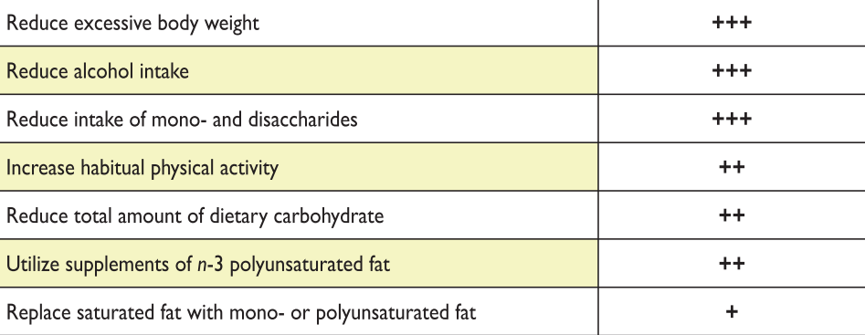
Lifestyle Interventions (TG Reduction)

Slide 46
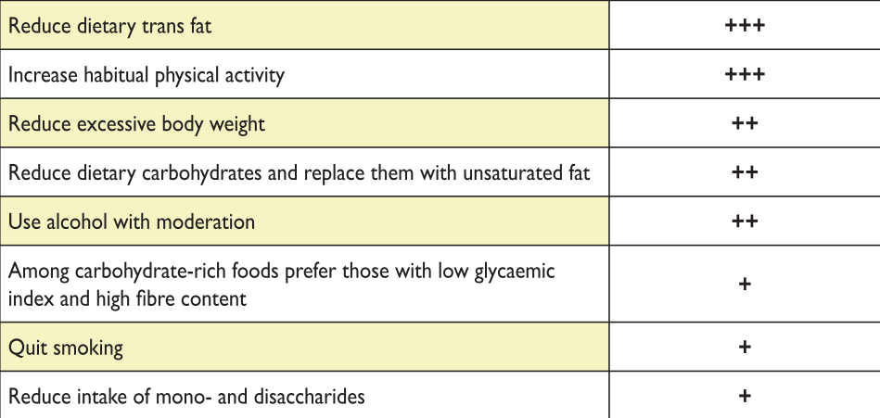
Lifestyle Interventions (HDL-C Elevation)

Slide 47
Treatment of Hypercholesterolemia
High LDL-C
Lifestyle Changes
Drug Therapy
Statins
Notes:
Treatment of hyperlipidemia
Statins have been and remain the drugs of first choice for lowering LDL-C. They lower LDL-C more effectively than other currently available agents, and they reduce CHD risk. Because of their LDL-C–lowering efficacy, they are able to achieve LDL-C treatment goals in the majority of patients, regardless of their risk category. In fact, the more potent the LDL-C–lowering efficacy of the statin, the greater the percentage of patients who will achieve their LDL-C goal. Statins are also remarkably safe as will be described below. About 5–10% of patients will not be able to tolerate a statin and so the only alternative agents for lowering LDL-C are a bile acid resin and niacin. These drugs are not as effective in lowering LDL-C and cause bothersome side effects which make patient compliance a problem. However, they are effective in reducing CHD risk and in the majority of patients can be successfully taken.
Reference:
Expert Panel on Detection, Evaluation, and Treatment of High Blood Cholesterol in Adults. Executive summary of the third report of the National Cholesterol Education Program (NCEP) Expert Panel on Detection, Evaluation, and Treatment of High Blood Cholesterol in Adults (Adult Treatment Panel III). JAMA 2001;285:2486-2497.

Slide 48
Treatment of Mixed Dyslipidemia
High LDL-C and TG
Lifestyle Changes
Drug Therapy
STEP
1
Statins
Increase statin dose
Add fibrate, niacin or omega-3
STEP
2
Notes:
Treatment of mixed hyperlipidemia
The management of the patient with mixed hyperlipidemia starts with TLC and progresses to LDL-C reduction to the LDL-C goal. If patients require additional treatment to achieve their secondary treatment goal defined by non-HDL-C, several approaches can be chosen. Statin therapy (or other LDL-C–lowering regimens) may be intensified, or triglyceride-lowering drugs may be added to the regimen.
Reference:
Expert Panel on Detection, Evaluation, and Treatment of High Blood Cholesterol in Adults. Executive summary of the third report of the National Cholesterol Education Program (NCEP) Expert Panel on Detection, Evaluation, and Treatment of High Blood Cholesterol in Adults (Adult Treatment Panel III). JAMA 2001;285:2486-2497.

Slide 49
Dyslipidemia | Drugs
Cholesterol | Statins Niacin Bile acid sequestrants
Cholesterol + Triglyceride | Statins Fenofibrate Niacin
Triglyceride | Fibrates Niacin Omega-3
Lp(a) | Niacin Bezafibrate ERT PCSK9 inhibitors

Slide 50
Summary
Treatment recommendations and goals
Reduction of saturated fat, trans fats, and cholesterol intake
Increment of ω-3 fatty acids, soluble fibers and phytosterols
Weight loss (if indicated)
Increased physical activity
Diabetic patients
Statin + life-style therapy
LDL-C < 100 mg/dl
LDL-C < 70 mg/dl (overt CVD)
Reduction in LDL-C of 30-40% from baseline
TG <150 mg/dl
HDL-C > 40 mg/dl in men and > 50 mg/dl in women
Combination therapy has been shown not to provide additional CVD benefit above statin therapy alone and is not generally recommended

Slide 51
Thank you for your attention

