Slide 2
Medical Therapy in Acromegaly
Hengameh Abdi, MD, Endocrinologist
Endocrine Research Center
Research Institute for Endocrine Sciences
Shahid Beheshti University of Medical Sciences
30 April 2015

Slide 3
Agenda
Three forms of medical therapy:
Receptor-based, directed at the pituitary adenoma including Somatostatin Receptor Ligands (SRLs) and Dopamine agonists
Directed at decreasing/blocking GH effects in the periphery including growth hormone receptor antagonist

Slide 4
Somatostatin Receptor Ligands (SRLs)

Slide 5
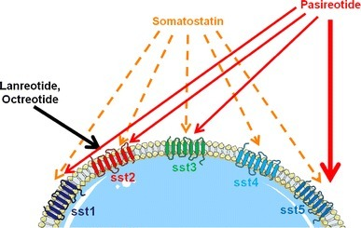
adapted from Petersenn S, Endocrine Updates, 2011 with kind permission from Springer Science+Business Media B.V.)

Slide 6
Different formulations of SRLs
SRL | Dosage and Mode of Administration | Availability in Iran
Octreotide | 50-500 µg sc q8h | Yes
Octreotide LAR (Sandostatin LAR) | 10-30 mg im q4wk | Yes (Vial 20 mg, 30 mg) with insurance coverage
Lanreotide | 30 mg im q1-2 wk | No
Lanreotide autogel (Somatuline depot) | 60-120 mg sc q4wk | No

Slide 7
JCEM 2005; 90: 4465-73

Slide 8
Comparison of the characteristics of the studies of secondary therapy with SRLs
 | Octreotide LAR | Lanreotide SR
Number & Design | 11 open-label prospective studies & 1 blinded RCT | 19 open-label prospective studies
Biochemical criteria for efficacy | Normalization of IGF-I in 10 studies Mean GH <2.5 g/liter in all studies GH <1 g/liter post-OGTT in one study | Normalization of IGF-I in 18 studies Mean GH <2.5 g/liter in 12 studies Mean GH <5g/liter in 2 studies Mean GH <3.75 in 2 studies 50% GH suppression in 1 study
Dosage | ~ 50%: 20 mg q 4 wk | ~ 75%: 30 mg q 1-3 wk
Duration | 15.5 months (6-36) | 15.5 months (3-36)

Slide 9
Characteristics of the studies of primary therapy with SRLs:
17 open-label prospective studies:
sc octreotide (266 subjects)
octreotide LAR (15 subjects)
lanreotide SR (25 subjects)
both octreotide LAR and lanreotide SR (20 subjects)
Criteria for efficacy:
normalized IGF-I in 17 studies
mean GH <2.5–5g/liter in all studies
post-OGTT GH <1 g/liter in 4 studies
Mean study duration:14.3 months (3–24 months)

Slide 10
Biochemical efficacy of secondary SRL therapy and primary SC Octreotide therapy
Too few studies were available with which to directly compare the different drug preparations when used as primary therapy.

Slide 11
Biochemical response prediction:
Overall, pretherapy GH level was a negative predictor of meeting biochemical criteria for control with SRL therapy (B= -0.00472; P=0.05):
Octreotide LAR (B= -0.00121; P=0.83)
Lanreotide SR (B= -0.0105; P=0.0145)
Primary octreotide (B= -0.00341; P=0.18)
Baseline IGF-I was not a significant predictor of efficacy.
Preselection was a positive predictor of IGF-I normalization rate (B= 0.1213; P=0.04), which was greater among preselected than unselected subjects (B= 0.1472;P=0.0475).

Slide 12
Tumor shrinkage on SRL therapy
Notes:
The overall rate of tumor increase was 1.4% (95% CI, 0.1 and 2.8).

Slide 13
Concluding remarks:
The efficacy of octreotide LAR is greater than lanreotide SR among subjects unselected for prior somatostatin analog responsiveness.
Biochemical efficacy is similar, but tumor shrinkage is greater when these drugs are given as primary vs. secondary therapy.

Slide 14
Objective: Evaluation of primary pharmacological treatment in acromegaly
Design: Open prospective study
Patients: 67 consecutive patients (36 women; age, 54.9 ±14.2 yr; 72% bearing macroadenoma)
Intervention: Individually tailored octreotide LAR
F/U: 48 months (range, 6-108)
Main Outcome Measures: Safe GH (<2.5 μg/liter), normal age-matched IGF-I levels, and tumor shrinkage
JCEM 2006; 91: 1397-1403

Slide 15
Of the 67 patients entering the protocol, 34 stayed on OCLAR (32 with normal and two with only mildly elevated GH and IGF-I levels).
The other 33 patients elected to switch to alternative forms of therapy (surgery, lanreotide, or addition of cabergoline) within 6–84 months of OCLAR even though in 23 of them either GH or IGF-I concentrations became normal.

Slide 16
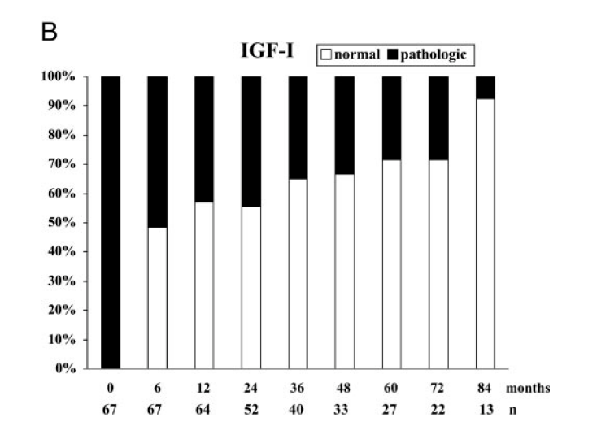

Slide 17
Results:
Safe GH levels: 68.7%
Normal age-matched IGF-I values: 70.1%
Hormonal endpoints were achieved regardless of basal levels.
GH/IGF-I decreased mostly within 6–12 months.
No difference in the achievement of hormonal endpoints was observed between patients bearing macro- and microadenoma.

Slide 18
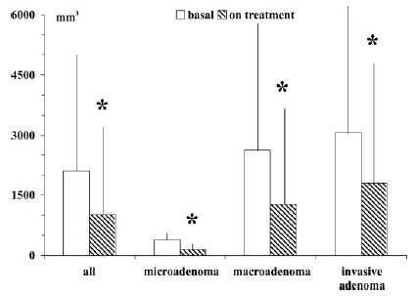
Tumor shrank in 82.1% of patients by 62±31% (range, 0–100%)
* P<0.05
Notes:
The achievement of both hormonal and volumetric endpoints was obtained in 44.8% of patients.
The higher the basal GH values and the greater the GH/IGF-I changes on treatment, the greater the tumor shrinkage.

Slide 19
Concluding remarks:
The efficacy on GH/IGF-I levels in unselected patients and the outstanding volumetric control indicate that treatment with OCLAR may be the first therapeutic approach to all acromegalic patients not amenable to surgical cure.
Tumor shrinkage might also encourage the evaluation of primary OCLAR adoption in patients with initial visual field defects.

Slide 20
41 eligible studies with 1685 patients
Octreotide LAR: 748 patients, sc octreotide: 937 patients
Limitations: Most trials were open-label and had no control group.
PLoS ONE 2012; 7(5): e36411

Slide 21
Results:
Tumor shrinkage:
Overall: 53% [95% CI: 45%-61%]
OCLAR: 66% [95% CI: 57%-74%]
Weighted mean percentage reduction in tumor size:
Overall: 37.4% [95% CI: 22.4%-52.4%]
OCLAR: 50.6% [95% CI: 42.7%-58.4%]

Slide 22
Determinants of tumor shrinkage: (Univariate analysis)
Type of tumor measurement (volume vs linear)
OR: 2.73; 95% CI:1.73–4.31
Type of SRL (OCLAR vs sc octreotide)
OR: 3.18; 95% CI:1.95–5.20
Treatment duration (> 1 year vs < 1 year)
OR: 1.90; 95% CI: 1.02–3.55)
Pretherapy (Tx-naïve vs second-line therapy)
A positive relationship between tumor shrinkage and the achievement of ‘‘safe’’ GH levels
A positive correlation between tumor shrinkage and the attainment of normal IGF-I level

Slide 23
Concluding remark:
Octreotide LAR induces clinically relevant tumor shrinkage in more than half of patients with acromegaly.

Slide 24
Study population: 438 consecutive patients (1966-2009)
Follow-up: 11.6 ± 7.9 yr
Twenty patients (4.5%) died.
Age- and sex-adjusted SMR was 0.70 (95% CI 0.43–1.08).
Bogazzi F. European Journal of Endocrinology 2013; 169: 367-76

Slide 25
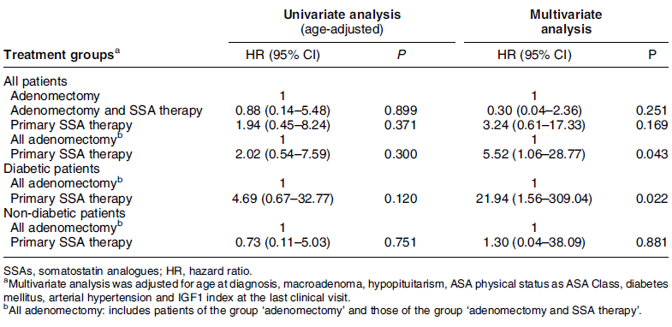
Effects of therapies for acromegaly on mortality

Slide 26
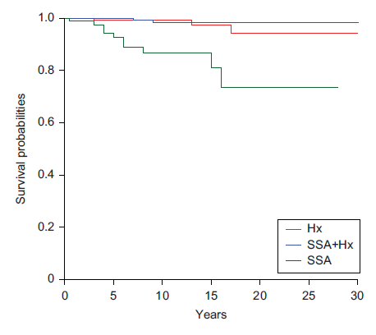
Notes:
Radiotherapy was associated with an increased risk of mortality, which occurred in patients with the more locally advanced disease.

Slide 27
Concluding remarks:
The effect of SRL therapy alone or that following pituitary adenomectomy was comparable to that of curative neurosurgery on survival in non-diabetic patients; on the contrary, SRL therapy as the primary therapy may be less effective than adenomectomy in reducing mortality rate in diabetic patients.

Slide 28
Safety of SRLs:
SRLs are well tolerated in most patients and treatment discontinuations due to adverse events are generally related to transient gastrointestinal (GI) disturbances.
The most commonly reported adverse events are injection-site discomfort and erythema, GI disturbances (such as diarrhea, abdominal pain, nausea and vomiting), biliary sludge or gallstones, and abnormal glucose metabolism.
Most adverse events are transient and of mild-to-moderate intensity.
A recent meta-analysis of 31 studies in patients treated with SRLs showed a statistically significant decrease in fasting plasma insulin, but without any significant change in fasting plasma glucose.
Fleseriu M. Pituitary 2011; 14:184–193
Mazziotti G, et al. JCEM 2009; 94:1500–1508

Slide 29
Dopamine Agonists

Slide 30
Objective: To obtain a more accurate picture of the efficacy of cabergoline in acromegaly, both alone and in combination with somatostatin analogs.
15 studies (11 prospective; None were randomized or placebo-controlled)
Individual data analysis (n=227)
JCEM 2011; 96: 1327-35

Slide 31
Results: (9 studies of cabergoline alone)
Mean (SD) duration of treatment: 10.8 (8.2) months
Cabergoline dose: 0.3-7 mg/wk
Normal IGF-I levels: 51/149 (34%)
Mean GH<2.5 ng/ml: 72/149 (48%)
In multivariate analysis, the decline in IGF-I was related to:
The baseline IGF-I concentration (β=1.16; P<0.001)
Treatment duration (β=0.28; P<0.001)
Baseline prolactin concentration (β=-0.18; P=0.01)
With a trend toward a relation with the cabergoline dose (β=0.38; P=0.07)

Slide 32
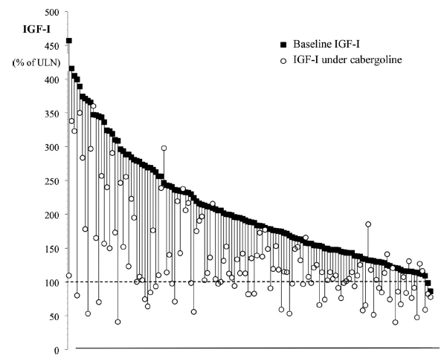
Individual IGF-I levels, expressed as a percentage of the age-adjusted ULN range before (black squares) and after treatment with cabergoline (open circles) in patients with acromegaly with acromegaly.

Slide 33
Results: (5 studies of cabergoline added to ongoing SRL therapy)
Mean (SD) duration of combined treatment: 6.6 (4.1) months
Cabergoline dose: 1-7 mg/wk
Normal IGF-I levels: 40/77 (52%)
In multivariate analysis, the decline in IGF-I was related to the baseline IGF-I concentration (β=0.74; P<0.001).

Slide 34
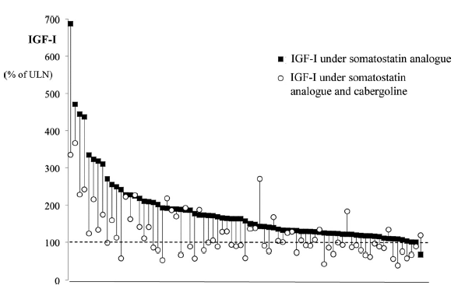
Individual IGF-I levels, expressed as a percentage of the age-adjusted ULN range during treatment with somatostatin analogs alone (black squares) and after cabergoline adjunction (open circles) in patients with acromegaly.

Slide 35
Effect of cabergoline on tumor volume: (only 5 studies)
Tumor volume decreased in 17 of 49 patients.
Tumor shrinkage was associated with:
higher baseline prolactin concentration
higher baseline IGF-I concentration
previous treatment

Slide 36
Concluding remarks:
Cabergoline single-agent therapy normalizes IGF-I levels in one third of patients with acromegaly.
When the IGF-I is below 150% of ULN, the patient has a 50% chance of achieving a normal level on cabergoline.
When a somatostatin analog fails to control acromegaly, cabergoline adjunction normalizes IGF-I in about 50% of cases. This effect may occur even in patients with normoprolactinemia.

Slide 37
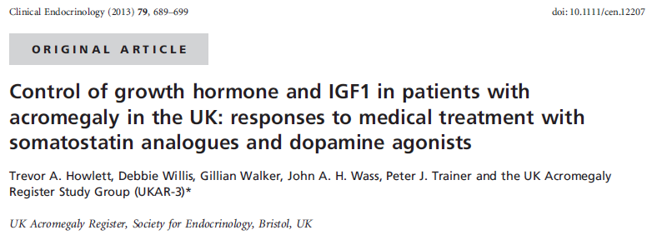
2572 patients from data covering >30 yr

Slide 38
Results:
Somatostatin analogues were used in 40.6% and dopamine agonists (DA) in 41.4%.
Control on medical treatment was better after prior surgery and/or radiotherapy.
On long-term SRL, GH was controlled in 75%, IGF1 in 69% and both in 55%.
On long-term DA, GH control was similar but IGF1 worse (77%/55%/45%).
Increasing precourse GH levels were associated with a decreasing proportion who achieved control, despite greater suppression from baseline.

Slide 39
Concluding remarks:
In UK, safe GH levels are still only achieved in 75% on long-term medical treatment, with GH and IGF1 both normalized in no more than 55% on SRL and 36% on cabergoline.
It remains unclear whether the control of GH, but not IGF1, observed in many patients is sufficient to restore long-term morbidity and mortality to normal.

Slide 40
GH Receptor Antagonist (Pegvisomant)

Slide 41
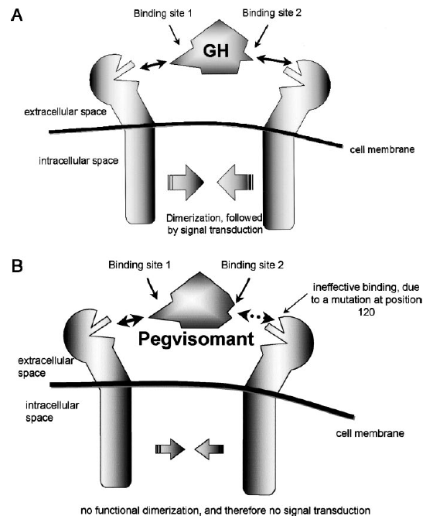

Slide 42
There was no association between the duration of pegvisomant treatment and change in tumor volume. For all patients who had at least 12 months between their baseline and final scan, the results were similar with a mean change of –0·067 cm3 (p=0·064).

Slide 43
ACROSTUDY: A global ongoing noninterventional surveillance study
1288 subjects from 12 countries (51% male, mean age of 42.1 yr)
Mean duration of pegvisomant therapy: 3.7 yr
JCEM 2012; 97: 1589-97

Slide 44
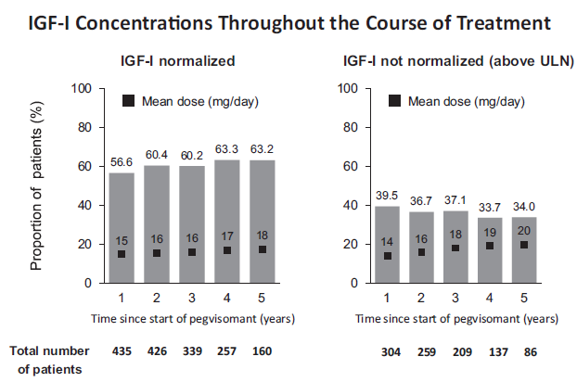
Notes:
The proportion of patients with normal IGF-I levels remained stable over time.

Slide 45
Safety events:
Pegvisomant-related adverse events: 9.6% (124 subjects)
Pegvisomant-related serious adverse events: 2% (26 subjects)
No deaths were attributed to pegvisomant.
The incidence of increase in pituitary tumor size in the subset with confirmed MRI increases on central reading represented 3.2% of the overall cohort with at least two available MRI (n=936).

Slide 46
Concluding remarks:
Data entered and evaluated in ACROSTUDY indicate that pegvisomant is an effective and safe medical treatment in patients with acromegaly. The reported low incidence of pituitary tumor size increase, liver enzyme elevations, and lipodystrophy at the injection site are reassuring.

Slide 47
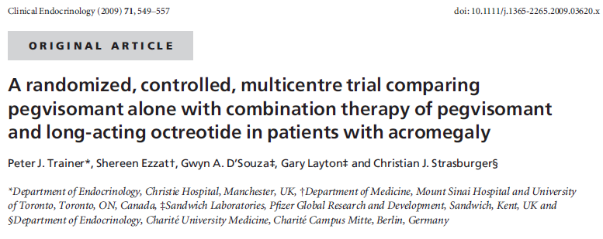
An open-label, multicentre, randomized, 40-week outpatient study
The primary end-point: adverse events
The secondary end-point: biochemical IGF-I-based efficacy

Slide 48
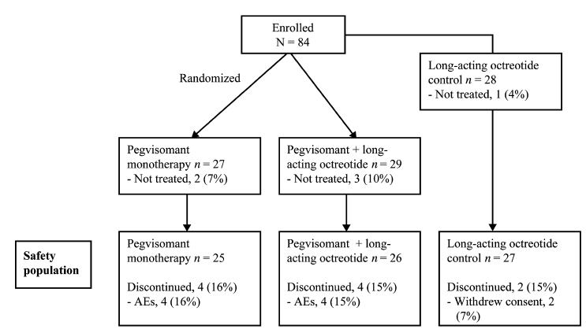

Slide 49
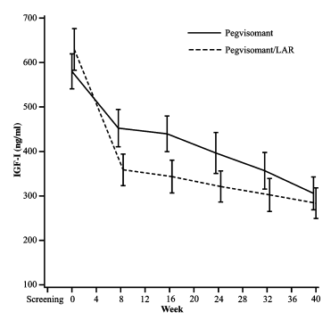
IGF-I concentrations initially declined faster with combination therapy; however,
by week 40, there was no difference in IGF-I levels between the two groups.

Slide 50
Safety events:
Pegvisomant monotherapy and P-LAR were well tolerated and there were no differences in the number of AEs.
Patients receiving P-LAR tended to be more likely to have clinically significant increases (>3×ULN) in hepatic transaminase levels, especially those receiving high-dose LAR.

Slide 51
Concluding remarks:
In patients suboptimally controlled on LAR, pegvisomant and P-LAR were equally well tolerated and effective in normalizing IGF-I, and overall clinical improvement was observed with both regimens.
Pegvisomant monotherapy and adjunctive therapy are equally viable options for the treatment of LAR-resistant acromegaly.

Slide 52
Evolving formulations of SRLs:
Pasireotide
Subcutaneous octreotide hydrogel implant
Oral octreotide (Octreolin)
Octreotide FluidCrystal® injection depot

Slide 53
adapted from Petersenn S, Endocrine Updates, 2011 with kind permission from Springer Science+Business Media B.V.)

Slide 54
Design: A prospective, randomized, double-blind study at 84 sites in 27 countries.
Patients: 358 patients with medically naive acromegaly. Patients either had previous pituitary surgery but no medical treatment or were de novo with a visible pituitary adenoma on magnetic resonance imaging.
Intervention: Pasireotide LAR 40 mg/28 days (n=176) or octreotide LAR 20 mg/28 days (n=182) for 12 months.
Main outcome measure: The proportion of patients in each treatment arm with biochemical control (GH< 2.5 g/L and normal IGF-1) at month 12.
JCEM 2014; 99: 791-99

Slide 55
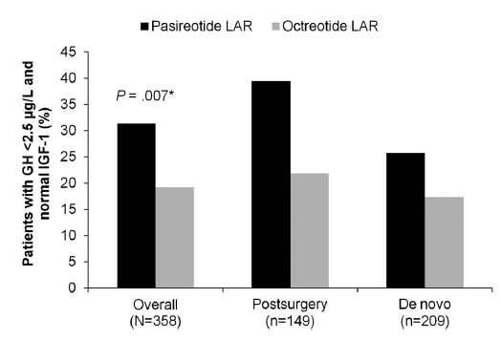
Hyperglycemia-related adverse events
were more common with pasireotide LAR (57.3% vs 21.7%).
Notes:
Biochemical control was achieved by significantly more pasireotide LAR patients than octreotide LAR patients (31.3% vs 19.2%; P .007; 35.8% vs 20.9% when including patients with IGF-1 below the lower normal limit).

Slide 56
Concluding remark:
Pasireotide LAR demonstrated superior efficacy over octreotide LAR and is a viable new treatment option for acromegaly.

Slide 57
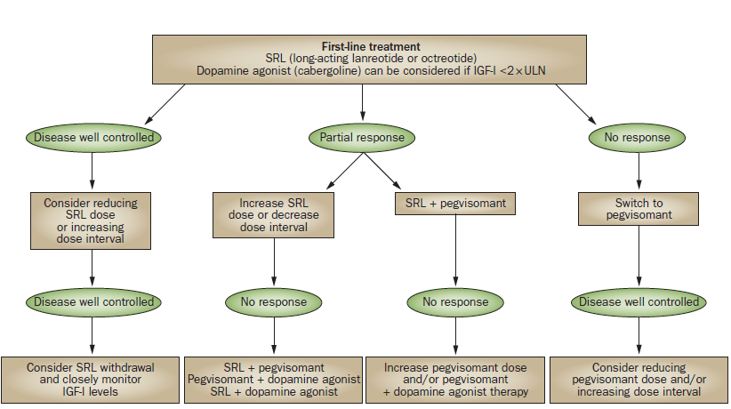
Adapted from Giustina A et al. Nat Rev Endocrinol 2014;10:243–248

Slide 58
Thanks for your patience!

